Slide 1
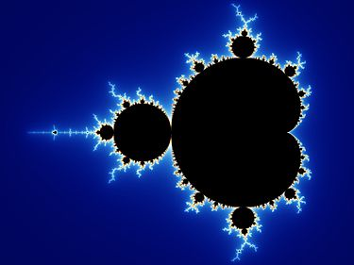

Slide 2
Mandelbrot Set

Slide 3
Self - Similarity

Slide 4
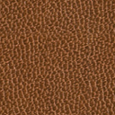
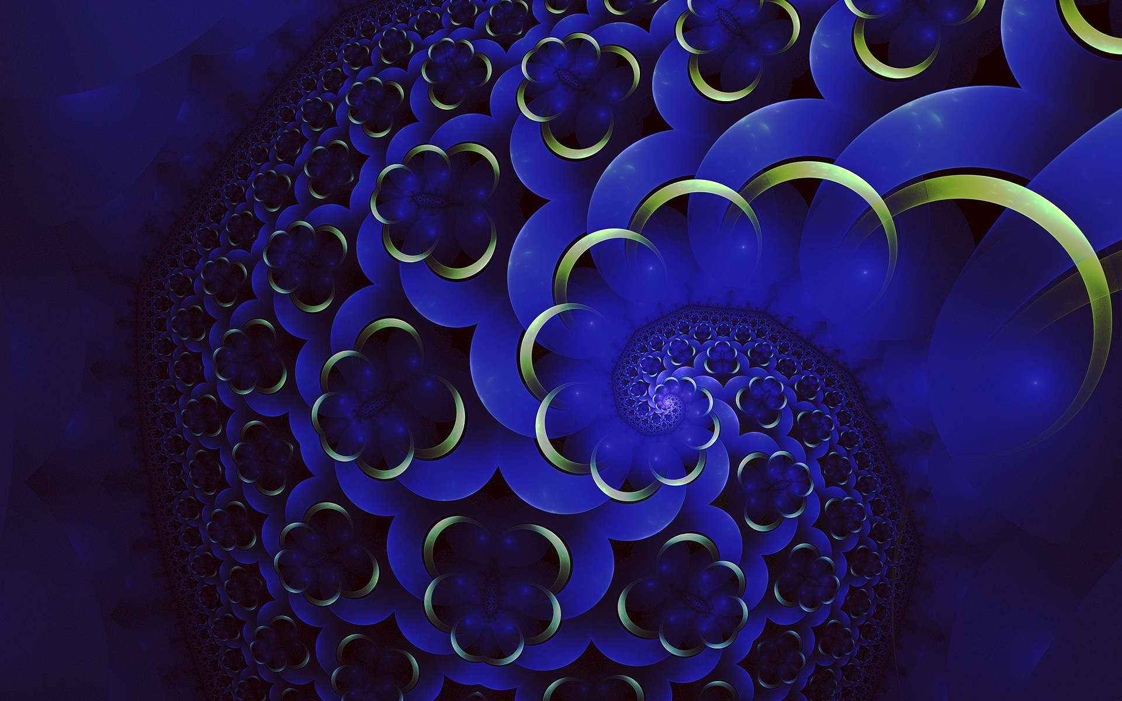
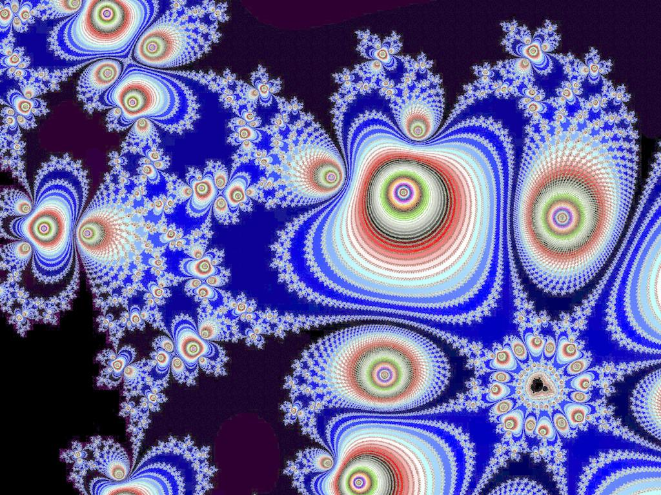
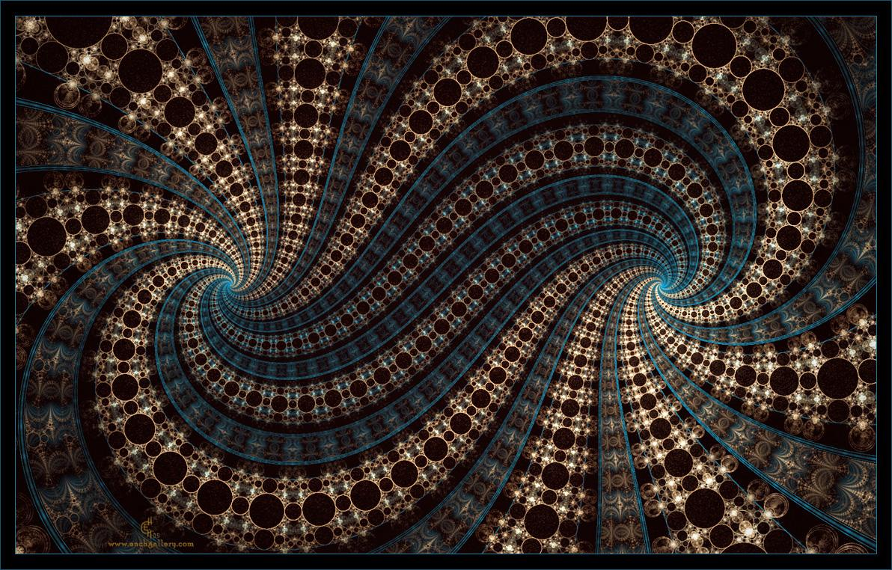
Fractal
vessel，river， branch

Slide 5
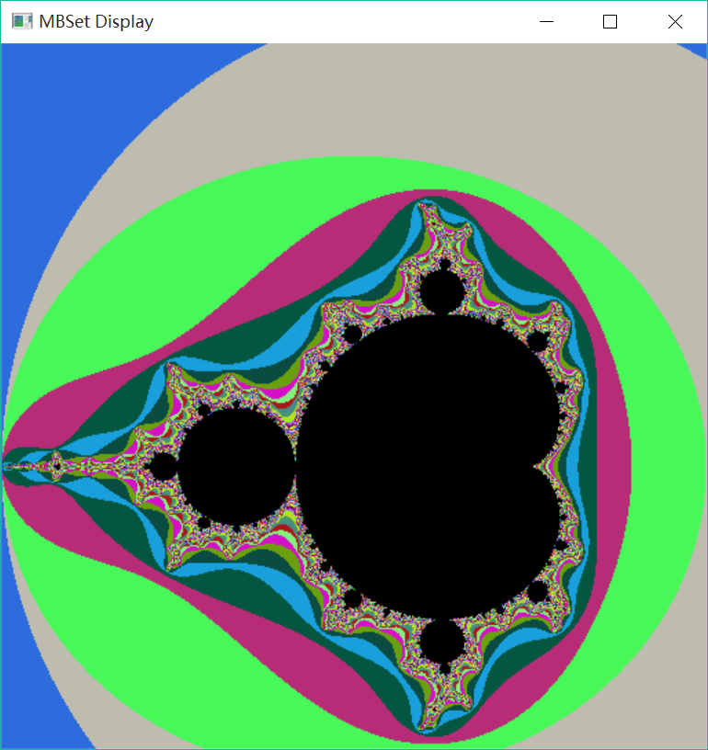
Functions of my program
1. Compute and display the graph of MB in defferent colors by using OpenGL
2. Amplify every detial for infinite times theoretically
3. Use muti-thread technology to finish every amplification with in 2 seconds based on pntium 4 cores

Slide 6
Some key steps of my program
Division of the screen
Distribution of the colors
Conversion of the coordinates(including amplication)
Muti-thread control

Slide 7
1. Division
int DivideEvenly(int numTask, int numCPU, int rank, bool ending) {
// 1st: Complete number of tasks to be divided
// 2nd: Exact number of CPUs
// 3rd: The rank of a CPU in range [0, numCPU - 1]
// 4th: false for starting index, true for ending index
double avgTask = (double)numTask / numCPU;
double previousTask = avgTask * rank; // Number of preceding CPUs equals rank
double pendingTask = avgTask * (rank + 1);
int firstRank = (int)previousTask;
int lastRank = (int)pendingTask - 1;
if(!ending) return firstRank;
// Return the index of first corresponding element [0, numTask - 1]
else return lastRank;

Slide 8
Distribution of the colors
Every color has 6 dimension: 2 for position, 1 for iteration, 3 for RGB
define two arrays color[][][]&colormatch[][]
glPointSize(4);
for(int j = 0; j < screenSize; j++)
{
for(int k = 0; k < screenSize; k++)
{
glColor3f(colors[j][k][0],
colors[j][k][1], colors[j][k][2]);
glVertex2i(k, j);}
int main(int argc, char** argv)
{
srand(time(0));
use random function for evaluation
compute all coefficients of the 6 dimensions
distribute the colors based on the coefficients of the 6 dimensions

Slide 9
512
Conversion of the coordinates
(including amplication)
O 1
1.8
max
Computing codes
-2
O3
1
double real = lowerReal + (upperReal - lowerReal) * k / (screenSize - 1);
double imag = lowerImag + (upperImag - lowerImag) * j / (screenSize - 1);
min
Amplifying codes
O2
512
-1.2
double lowerReal_new = lowerReal + (upperReal - lowerReal) * minX / (screenSize - 1);
double upperReal_new = lowerReal + (upperReal - lowerReal) * maxX / (screenSize - 1);
double lowerImag_new = lowerImag + (upperImag - lowerImag) * minY / (screenSize - 1);
double upperImag_new = lowerImag + (upperImag - lowerImag) * maxY / (screenSize - 1);
O1: The orgin for computer
O2: The orgin for conversion
O3: The orgin for compex plane

Slide 10
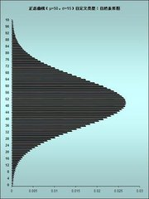
Muti-thread control
void callThreads() {
pthread_mutex_init(&updateMutex, 0);
pthread_mutex_init(&computationDoneMutex, 0);
pthread_mutex_init(&coutMutex, 0);
pthread_cond_init(&allDoneCondition, 0);
pthread_mutex_lock(&computationDoneMutex);
pthread_mutex_lock(&coutMutex);
activeThreads = totalThreads;
for(int i = 0; i < totalThreads; i++) {
pthread_t t;
pthread_create(&t, 0, ThreadCompute, (void*)i);
}
cout << "Multi-thread Computing..." << endl;
//unlock coutMutex
pthread_mutex_unlock(&coutMutex);
//unlock computationDone and wait for the signal from allDoneCondition
pthread_cond_wait(&allDoneCondition, &computationDoneMutex);
cout << "All threads finished computing!" << endl << endl;
Most of the time is used on read data, instead of computing, so if you can assign tasks more efficiently, it will costs less time.

Slide 11

NOW LET'S HAVE A TRY !

