Slide 1

Project-6 Sales Forecasting Across Multiple Retail Stores
Intern name :- Himanshu Manmode hmanmode321@gmail.com
Submission Date: 25TH JUNE , 2025
Notes:
To use this title animation slide with a new image simply 1) move the top semi-transparent shape to the side, 2) delete placeholder image, 3) click on the picture icon to add a new picture, 4) Move semi-transparent shape back to original position, 5) Update text on slide.

Slide 2
PROJECT OVERVIEW
Client: Rossmann Pharmaceuticals
Organization: NextHikes IT Solutions
Business Goal
Forecast sales across multiple retail stores up to six weeks in advance, assisting managers and the finance team in effective decision-making using predictive analytics.
Key Drivers for Sales Forecasting:
Promotions & competitive landscape
Holidays (state & school)

Slide 3
Dataset Summary
Fields- Sales, Customers, Store info, Dates, Promotions etc
Primary Dataset Fields
- Sales: Target variable (daily turnover)
- Customers, Promo, Promo2: Promotional impact features
- StateHoliday, SchoolHoliday: Holiday impact features
- StoreType, Assortment: Store-level categorical data
- CompetitionDistance: Distance to nearest competitor
Data And Features

Slide 4
Feature Engineering
Holiday flags (before/after)
Encoded categorical features
Extracted: Weekday, Weekend, Month segment
Competition duration & Promo intervals
Lag features, rolling means

Slide 5
#
Task 1 - Exploration of customer purchasing behavior
Exploratory Data Analysis
Stores close to competitors might need aggressive marketing or better pricing to attract customers.
one Promo Interval dominates, it suggests a preferred promotional strategy among stores.
most stores have low sales, strategies like discounts or marketing might be needed.
few stores have very high sales, investigate what makes them successful—location, promotions, or product mix.

Slide 6
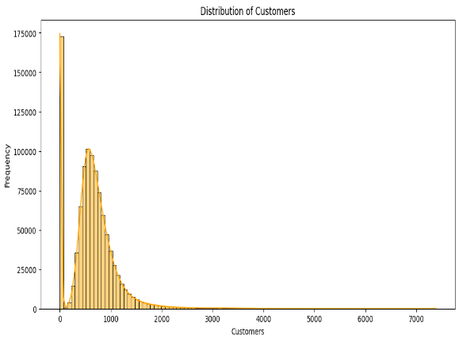
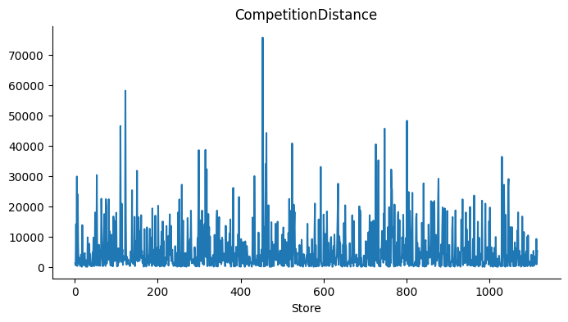
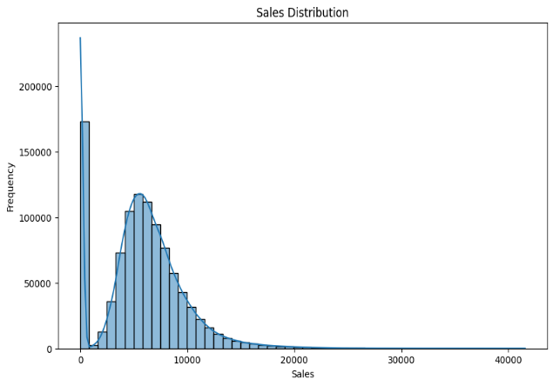
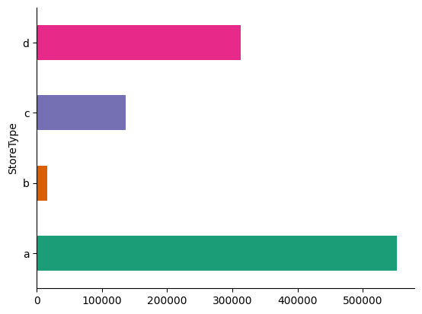
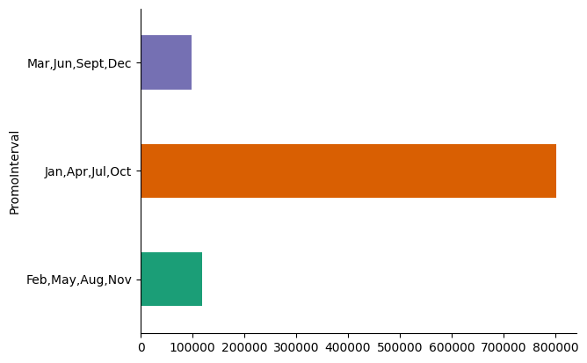
Key EDA Charts

Slide 7
Task 2 - ML Modeling Approach
Used RandomForestRegressor with sklearn pipeline
Chose RMSE as loss function
Hyperparameter tuning with GridSearchCV
Evaluated R², MAE, RMSE R^2 Score: 0.95
Serialized model with timestamp

Slide 8
Feature Importance & Interpretation
Top Influencers:
Promo
Competition Distance
Day of Week
Customer Count
Store Type
Estimated confidence intervals via bootstrapping

Slide 9
Task 2.6 - Deep Learning with LSTM
1
2
3
4
5
Built 2-layer LSTM in TensorFlow
Normalized data (-1, 1)
Created supervised data via sliding window
Sales forecasted per store
Handled stationarity & lag-based features
Reference : The basics you can find anywhere 5 Steps To Successful Storytelling Published on April 5, 2014 Featured in: Marketing & Advertising

Slide 10
Task 2.7 - MLflow Integration
Tracked experiment metrics (RMSE, parameters)
Versioned models
Used MLflow's UI for monitoring
Enabled reproducibility of results
Notes:
Tip:
When using complex image as full-bleed background add a transparency (70%-90%) fill layer to give contrast to text.

Slide 11
Task 3 - Web App Deployment
Tech Stack: Streamlit
Input: StoreID, Date, Promo flags, CSV upload
Output: Predicted Sales & Customers
Download as CSV
Visualize results in plots

Slide 12
Hosting and Delivery
Deployed on Heroku
GitHub repo with all code/notebooks
Dashboard available to Finance Team
Screenshots submitted for
MLflow
-Web App UI

Slide 13
TAKEAWAY
Learning Outcomes
End-to-End ML Workflow
Data Cleaning & Feature Engineering
LSTM Time-Series Modeling
Model Tracking & Deployment
Dashboard Design for Business Users
Notes:
Combine an image and multiple key statements with a strong grid.

Slide 14
THANK YOU

