Slide 1

Project-5 User Analytics In The Telecommunication Industry
Intern name :- Himanshu Manmode hmanmode321@gmail.com
Submission Date: April 24, 2025

Slide 2
Agenda
- User Overview
- Engagement Analysis
- Experience Analysis
- Satisfaction Analysis
- Final Recommendation

Slide 3
User Overview – Top Used Handsets
1.Huawei B528S- 23A
Recommendation: Apple -Target marketing based on top-used handsets. upgrade campaign , Brand loyalty Promotions etc ,Huawei -competitive Pricing- Huawei models sell well due to affordability.
3.Apple iphone 6
2. Apple iphone 6S

Slide 4
Top 3 Handset Manufacturers
1. Samsung
2. Apple
3. Huawei
Top 5 handsets per manufacturer were analyzed.

Slide 5
Application Usage Metrics
Aggregated per user:
- xDR sessions
- Session duration
- Download/Upload volume
Used for behavioral analysis.

Slide 6
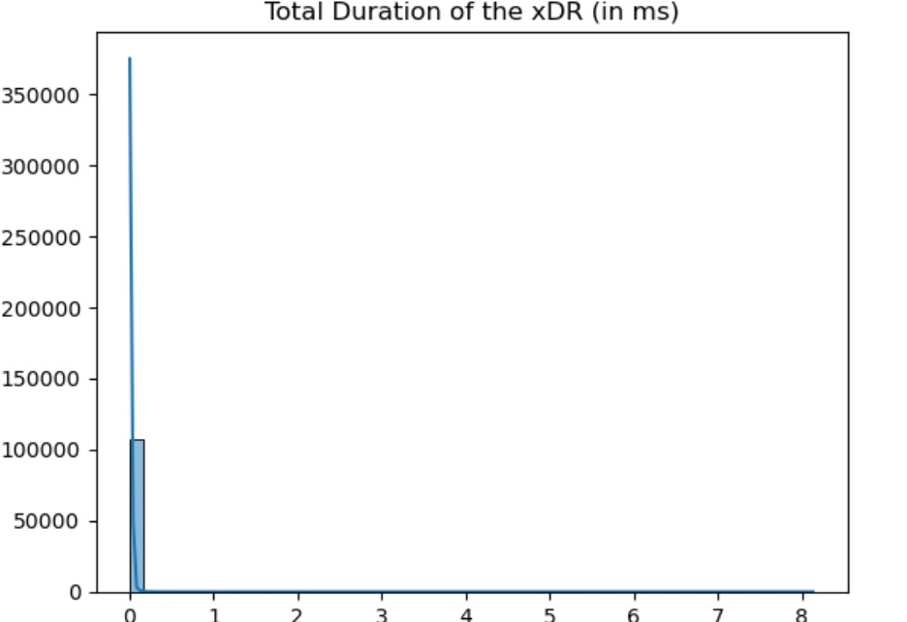
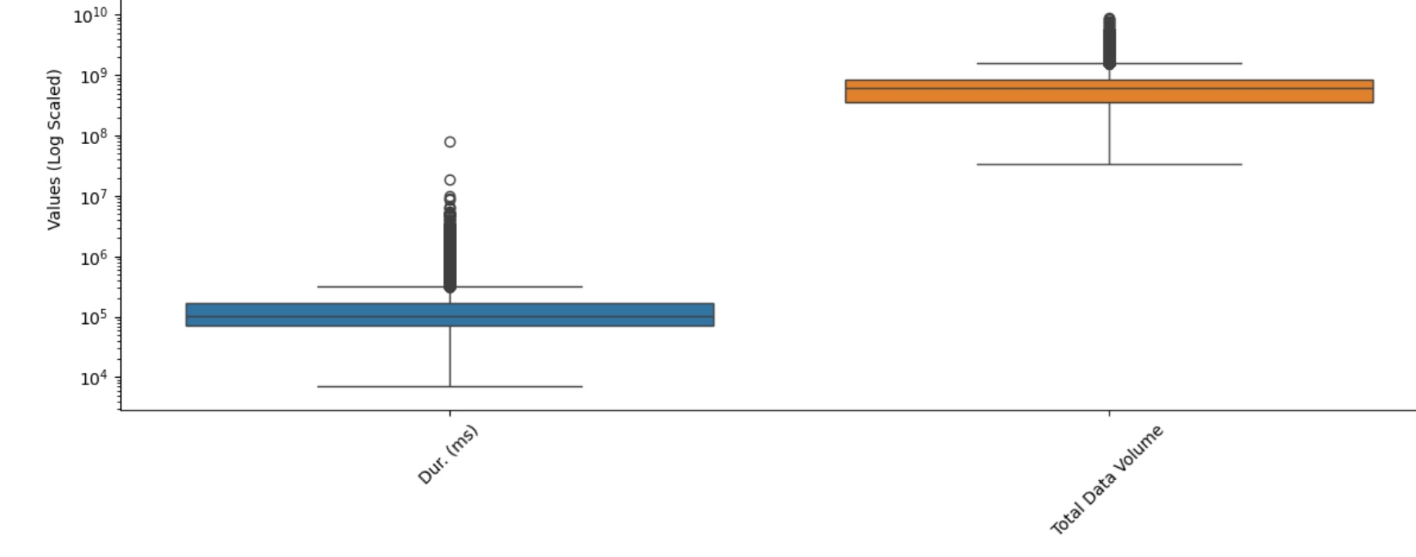
EDA Summary
Non-Graphical & Graphical EDA conducted.
Missing values treated with mean.
Outliers visualized and handled.

Slide 7

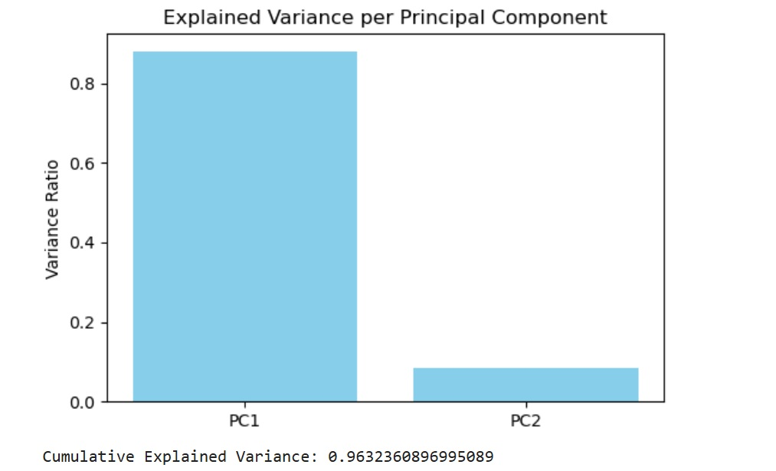
Principal Component Analysis
#Key Observations
#PC1 > PC2
#PC1 explains the majority of the variance. #PC2 explains a smaller portion #PC2 captures the next most significant pattern, but its contribution is less impactful than PC1.

Slide 8
User Engagement - Metrics
Tracked:
- Session frequency
- Session duration
- Total traffic
Top 10 users listed.

Slide 9
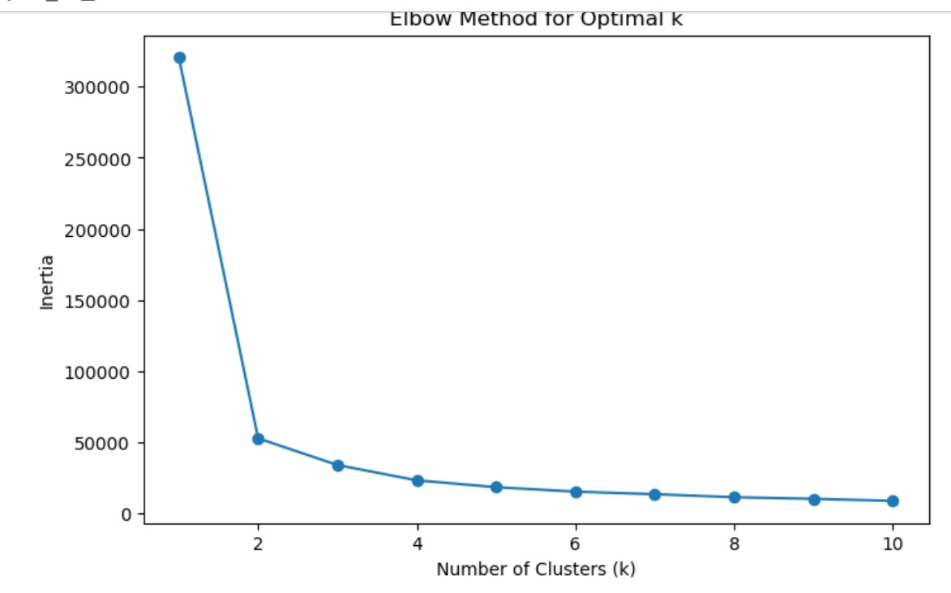
K-Means Engagement Clustering K=3
3 clusters identified using k=3.
Normalized engagement scores used.
Elbow method used for k optimization.
#Optimal k = 3 (based on elbow point)
means 3 clusters are a good fit for segmenting your users based on engagement.
#Cluster 0: Low engagement #Cluster 1: Medium engagement #Cluster 2: High engagement

Slide 10

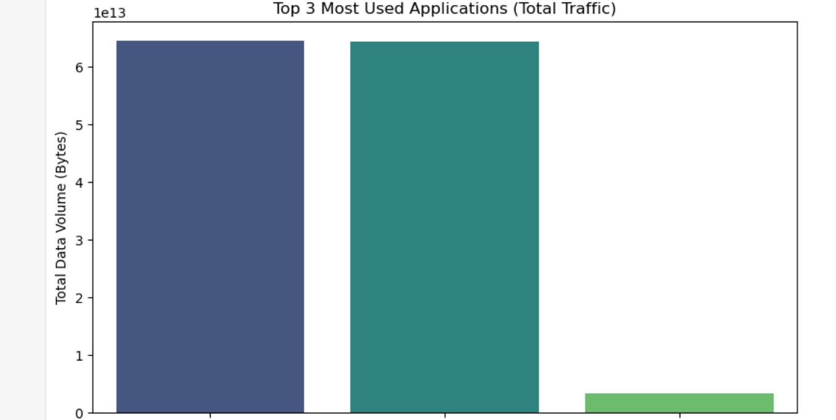
Most Used Applications
Top 3 apps:
1. Gaming
2. Other
3.Youtube
Highly engaged users identified per app.

Slide 11

User Experience Metrics
- TCP retransmission
- RTT
- Average Throughput
- Handset Type
Top, bottom, most frequent values computed.

Slide 12

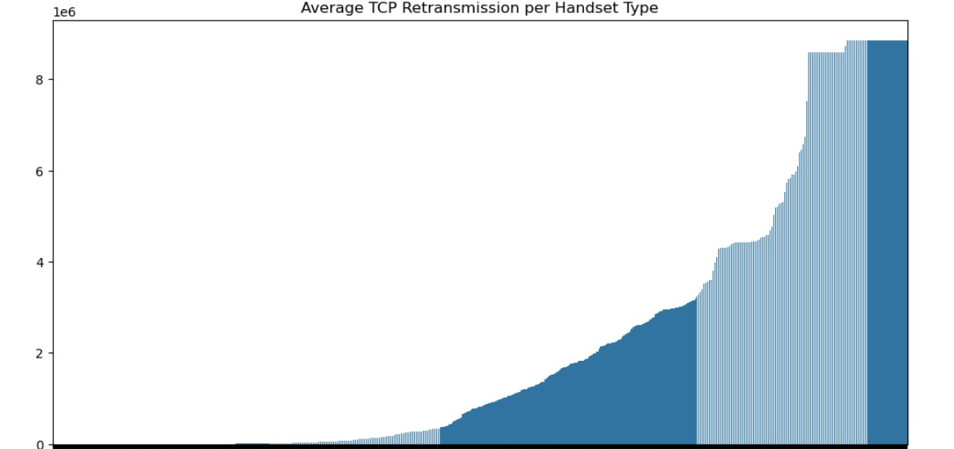
Experience By Handset Type
TCP & Throughput metrics evaluated by device type.
Some devices showed poor performance.

Slide 13
Experience Clustering
K-Means (k=3) performed on experience metrics.
Clusters labeled based on performance.
Cluster 0: High RTT, High Retransmission, Low Throughput → Poor experience
Cluster 1: Moderate RTT and Retransmission, Moderate Throughput → Average experience
Cluster 2: Low RTT, Low Retransmission, High Throughput → Best experience

Slide 14

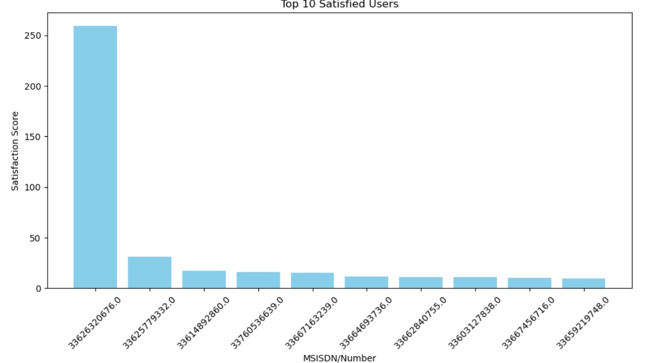
Satisfaction Analysis
Assigning a satisfaction score
If a user is in the "Good Experience" cluster → Satisfied (1)
#If a user is in the "Poor Experience" cluster → Not Satisfied (0)
#Middle users (Average) → Can be assigned based on a threshold
Engagement & Experience scores used.
Euclidean distance from least engaged/experienced cluster.
Top 10 Satisfied Users

Slide 15

Satisfaction Prediction Model
Linear REGRESSION AND RANDOM FOREST MODEL BUILT FOR PREDICTION .
Good R² score OF 0.99 achieved.

Slide 16

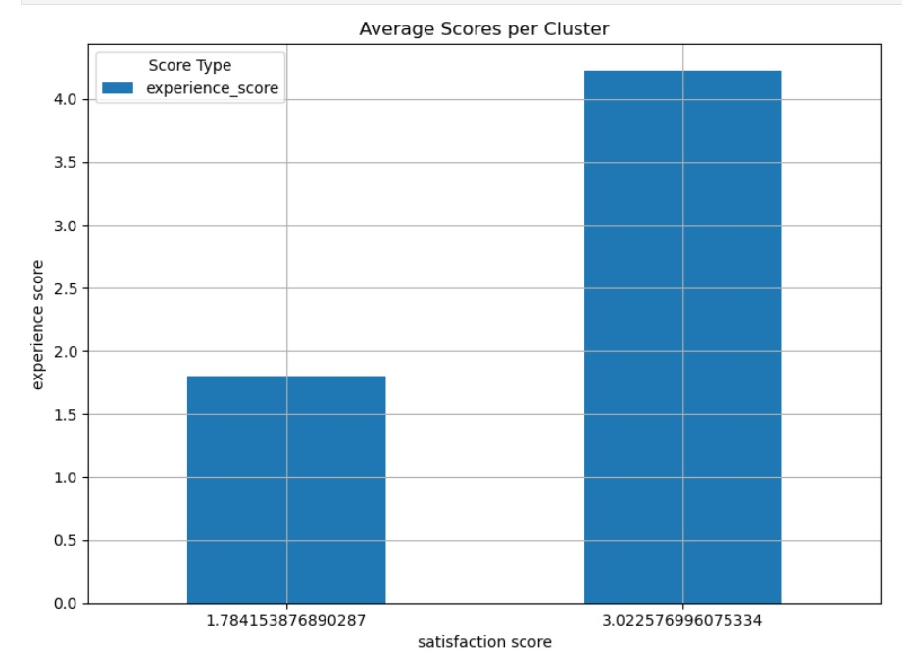
Satisfaction Clustering
Users grouped in 2 clusters based on satisfaction.
Average score per cluster calculated.

Slide 17

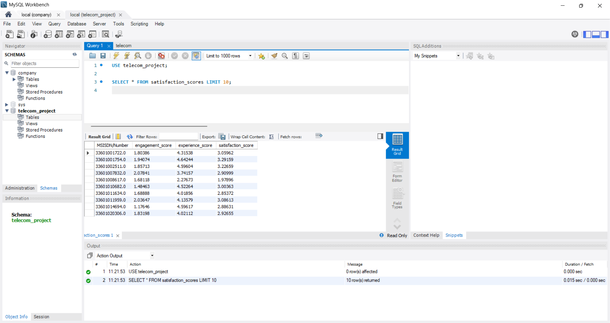
Mysql Export
Satisfaction scores exported to MySQL database.
Screenshot of SELECT query output shared.

Slide 18

Limitations
-One month data only
- Missing real-time traffic
- No pricing or customer service info
- Device model variance

Slide 19

Recommendation
TellCo has potential.
Strong user base, but experience varies by handset.
Buy decision with focus on device optimization.

Slide 20
Thank You
GitHub Link
hmanmode321/NexthikesITsolutionsProject5
PREPARED FOR NEXTHIKES IT SOLUTIONS

