Slide 1

NLP Project for Disaster Tweet Classification
NEXTHIKES- IT -SOLUTIONS PROJECT-7
Intern name :- Himanshu Manmode hmanmode321@gmail.com
Submission Date: 30TH JULY , 2025

Slide 2

Agenda
Twitter is a vital source of real-time information
Distinguishing real disaster alerts is challenging
Build an ML model to classify tweets as disaster-related or not
Develop a classification model
Aim for high accuracy and precision
Ensure model robustness
Build a scalable solution

Slide 3

Dataset Overview
10,000 hand-classified tweets
Columns: id, text, keyword, location, target
Target: 1 = disaster, 0 = non-disaster

Slide 4

Data Exploration
Checked missing values
Visualized class distribution
Analyzed top keywords like fire, earthquake
Checked missing values
Class distribution is balanced similar counts of disaster and non-disaster tweets.

Slide 5
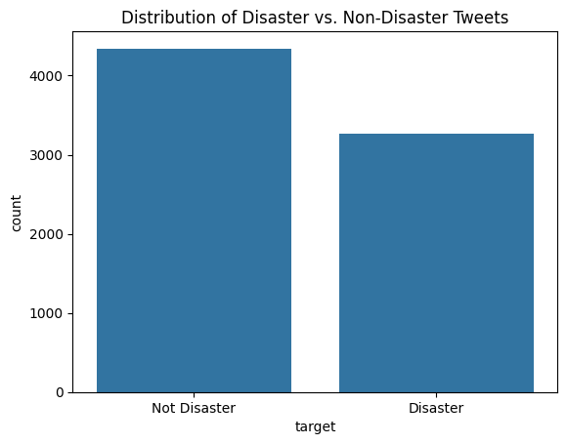
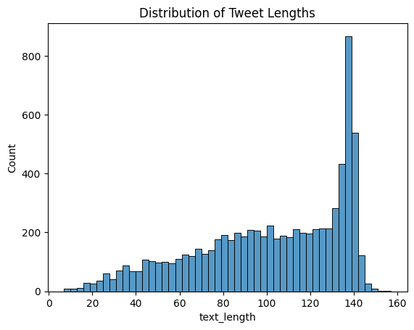
KEY EDA PLOTS

Slide 6
Feature Engineering
TF-IDF vectorizer
Tweet length, keyword presence
Word2Vec embeddings
Experiment with additional features like tweet length, presence of hashtags, or user mentions

Slide 7
Model Selection
Logistic Regression
Random Forest
Naive Bayes
LSTM

Slide 8
Model Training & Tuning
Cross-validation
Grid search for hyperparameters
Selected best model
Choose a classification models suitable for text classification, such as logistic regression, random forests, or neural networks.
Trained each model using the training data and evaluate their performance using cross-validation techniques.
Optimize hyperparameters of the selected models using techniques like grid search or random search.

Slide 9
Model Evaluation and Validation
Evaluation Metrics
Linear Regression
Random Forest
LSTM
Accuracy
Precision
Recall
F1-Score
Confusion Matrix
ROC Curve
AUC
.
Accuracy -84.3
Precision-84.8
Recall-72
F1-Score-0.77
Confusion Matrix
ROC Curve
AUC
Accuracy -81.9
Precision-81.5
Recall-69.3
F1-Score-0.74
Confusion Matrix
ROC Curve
AUC
Accuracy -0.50
Precision-0.58
Recall-0.63
F1-Score-0.60
Confusion Matrix
ROC Curve
AUC

Slide 10
Model Deployment
Serialized model using pickle
Streamlit-based web app
Integrated for predictions
Hosted on Streamlit

Slide 11
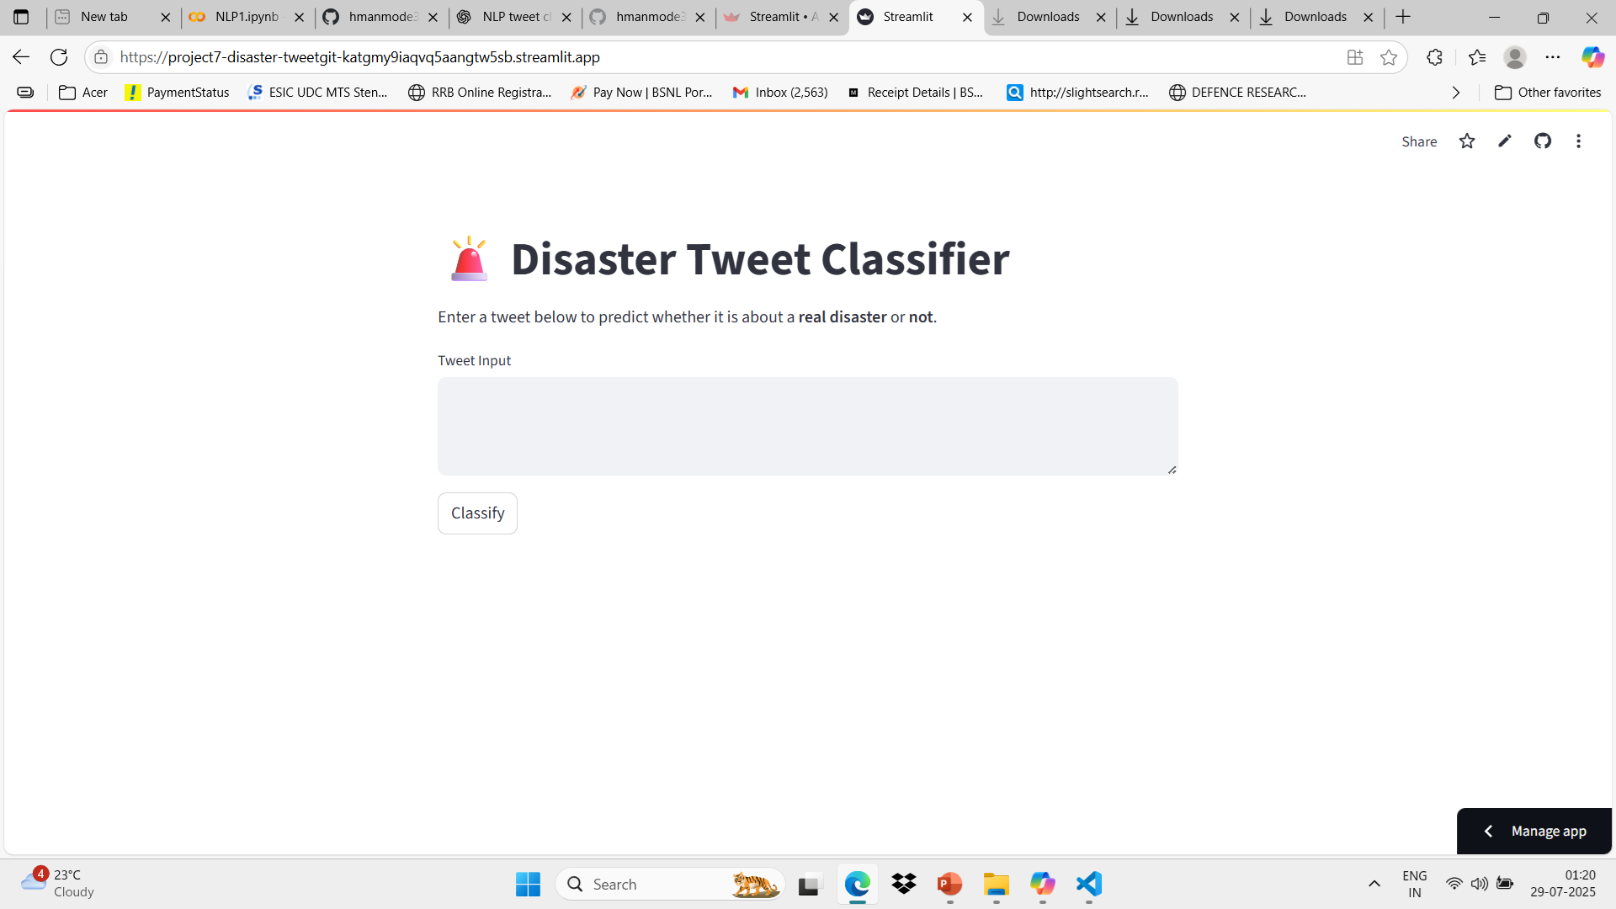
Web App Interface
User-friendly UI
Tweet input box
Real-time result
Screenshot of app

Slide 12

Challenges Faced
Data Quality & Noise
Tweets are noisy, unstructured, and full of abbreviations, slang, emojis, and misspellings.
Differentiating sarcasm or humor from real disasters was hard.
Text Preprocessing Complexity
Balancing between removing noise and retaining important context (e.g., hashtags or mentions that may carry meaning).
Model Selection & Overfitting
Simpler models like Naive Bayes were fast but lacked nuance.
Complex models (LSTM, BERT) risked overfitting and were computationally expensive.
Imbalanced Classes
Slight imbalance in disaster vs. non-disaster tweets affected model performance and required careful metric evaluation.
Deployment Issues
Converting NLP pipelines into production-ready Flask apps.
.

Slide 13






Summary
Robust tweet classification model
High performance
Deployed application
Improve with real-time streaming
Model helps automate tweet classification
Can be extended to other languages or disaster

Slide 14

References and Future Work
.
BERT for better context
Real-time tweet scraping
Multilingual support
Monitoring dashboard
Kaggle Dataset
Scikit-learn Docs
Flask Docs
Streamlit Docs

Slide 15

"NLP helps machines understand us and, more importantly, helps us understand ourselves."
THANK YOU

