Slide 1
PROJECT-8 Job Market Analysis and Recommendation System
Intern Name – Himanshu Manmode
For Next-Hikes IT Solutions
Project Submission Date 05.09.2025

Slide 2

Objective
The primary objective of this project is to analyze job market trends and build a recommendation system for job seekers based on real-time data.
01
The System Will Help In Identifying-
High-demand Job Roles
Salary Trends.
02
Emerging Job Categories
Personalized Job Recommendations.
03

Slide 3
Situational Overview
The Job Market Is Dynamic And Influenced By Technological Advancements, Economic Shifts, And Cultural Trends.
This Project Harnesses Data Analytics To
Understand Job Market Dynamics
Provide Actionable Insights
Deliver Predictions And Recommendations For Job Seekers And Recruiters

Slide 4
Project Tasks Overview
1. Correlation between job title keywords & salaries
2. Identify emerging job categories
3. Predict high-demand job roles
4. Compare hourly rates across countries
5. Build job recommendation engine
6. Track job market dynamics
7. Investigate remote work trends
8. Predict future job market trends

Slide 5
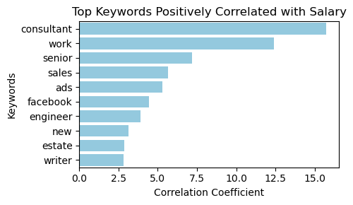
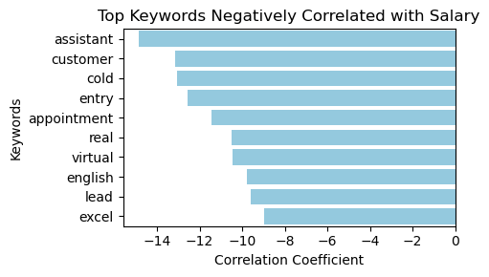
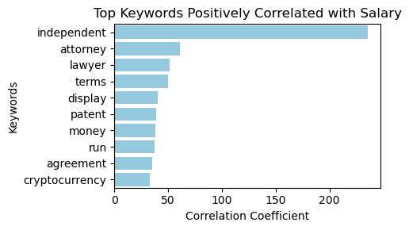
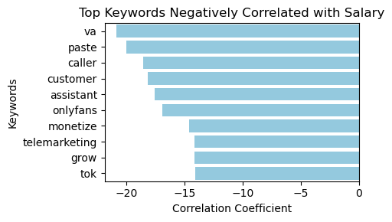
Task 1: Correlation between Job Title Keywords & Salaries
#The plot highlights keywords most positively correlated with higher salaries
#Jobs containing these terms—often technical skills or senior roles—tend to offer better compensation#

Slide 6
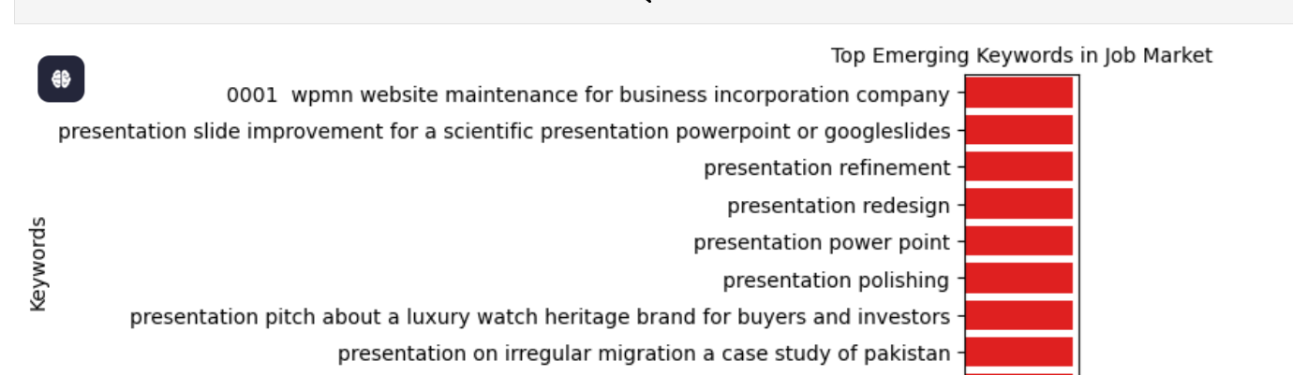
Task 2- Identify Emerging Job Categories
>
Objective: Analyze posting frequency to find emerging categories.
Deliverables: Growth analysis report with categories list.

Slide 7
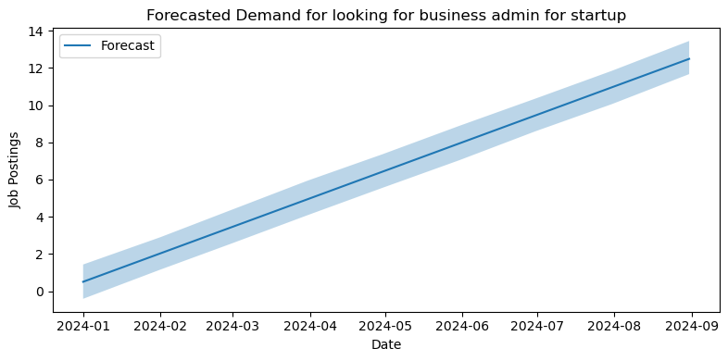
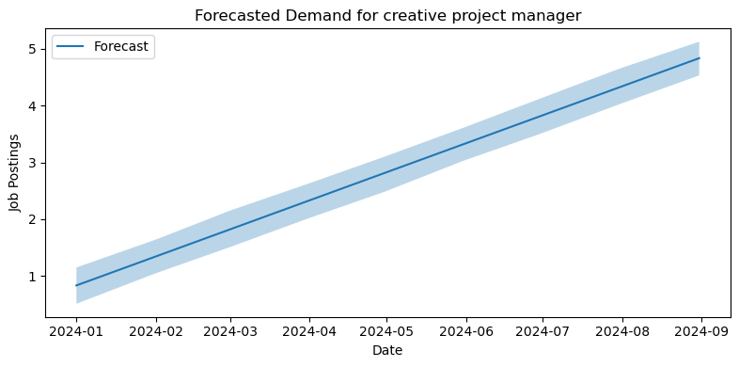
Task 3- Predict High-Demand Job Roles
Objective: Forecast job roles based on posting patterns.
Deliverables- Different High demand jobs plotted and analyzed

Slide 8
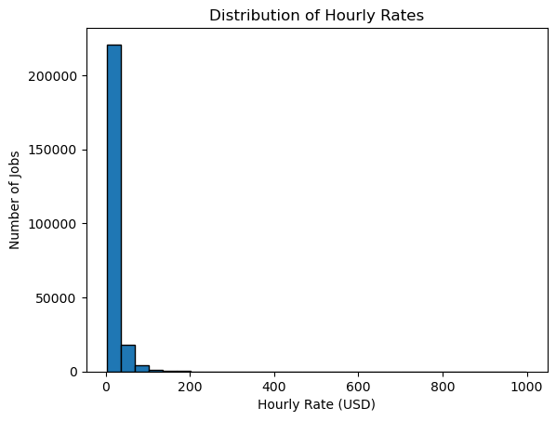
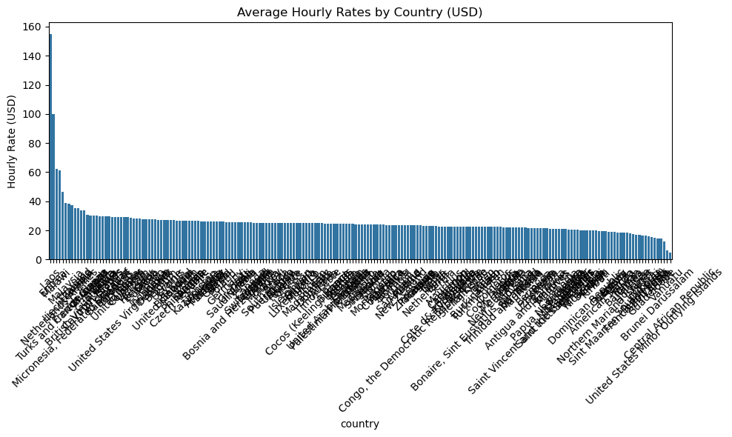
Task 4- Compare Hourly Rates Across Countries
Compare hourly rates across countries.
Average Hourly Rates calculated and plotted

Slide 9
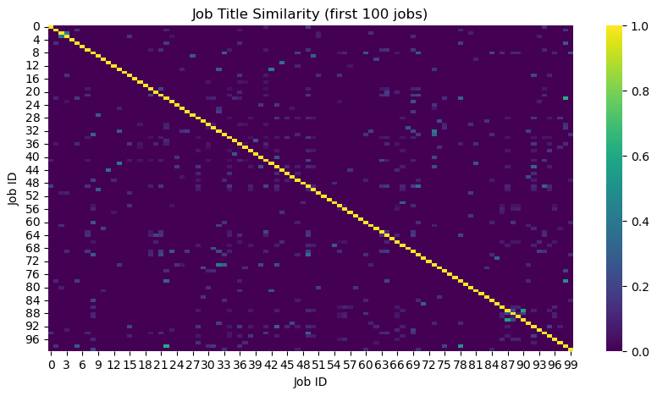
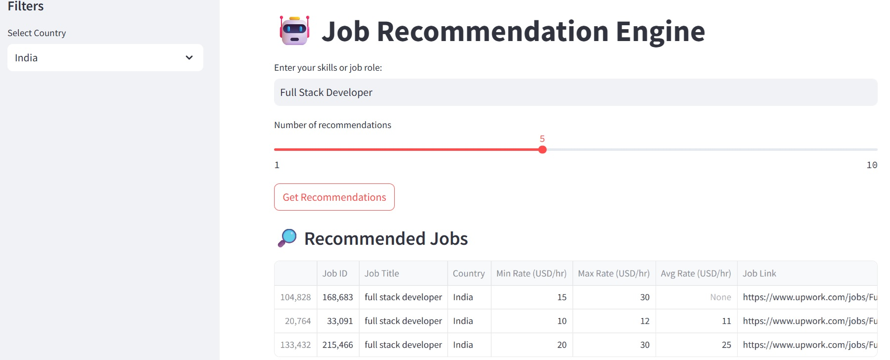
Task 5-Job Recommendation Engine
# job recommendation Engine Created and tested in python script
# Job recommendation API and Streamlit Dashboard For recommendation is In VS code
# Also Deployment Done on streamlit

Slide 10
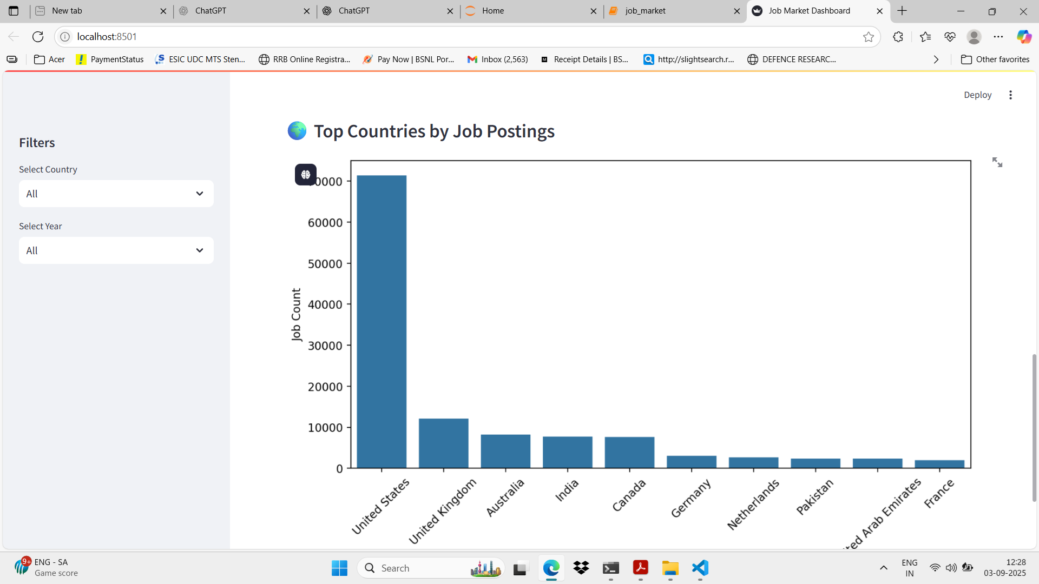
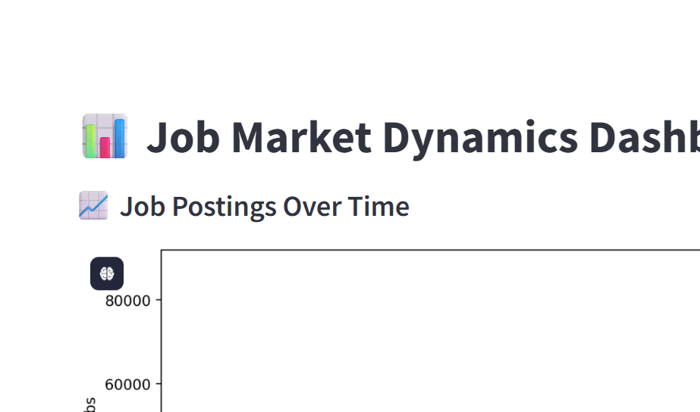
Task 6- Track changes in job market dynamics over months .
A dashboard that updates monthly with new trends is done in VS Code

Slide 11
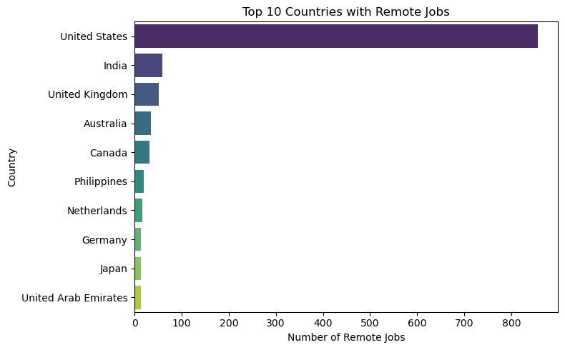
Task 7- Investigate trends in the remote work landscape
# US has the most number of remote jobs followed by UK and india
# countries like spain , sigapore and vietnam has the lowest remote jobs .

Slide 12
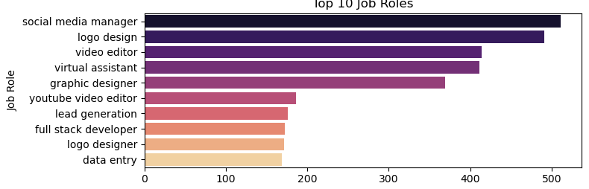
Task 8- Predict future job market trends
# model has been trained as Future Trends are predicted using Prophet .
# Future Job Trend Forecasted using Dataset #

Slide 13
SUMMARY INSIGHTS
REMOTE WORK TRENDS
FUTURE JOB PREDICTIONS
Analysis of remote job postings over time shows the growth and adoption of remote work.
An overall increasing trend in remote job postings suggesting growing adoption of flexible and remote work arrangements.
Occasional spikes or dips, which may correspond to seasonal hiring patterns, economic factors,
trend demonstrates that remote work is becoming a standard part of the job market
Top Countries for Remote Jobs
Countries with the most remote opportunities dominate the global remote work landscape.
Some regions have significantly fewer postings, indicating unequal adoption of remote work.
Analysis of the top 10 job roles shows which positions are most in demand
total job postings for the next 12 months
Forecast indicates steady growth in overall job postings, reflecting a robust job market

Slide 14
Conclusion
This project provides a multi-faceted view of the job market through-
Data analysis & predictive modeling.
Personalized job recommendations.
Streamlit App Deployment
Deliverables- Reports, models, dashboards, and a user-friendly web app.

Slide 15

THANK YOU
“The future belongs to those who can interpret data today and act wisely tomorrow.”

