Slide 1

PROJECT -9 LLM Project Building a News Research Tool
Leveraging LangChain, OpenAI, and NewsAPI
Intern Name :- HIMANSHU Manmode
PROJECT SUBMISSION DATE 05.10.205

Slide 2





Introduction
Create a tool that helps equity research analysts summarize news articles.
Key Technologies:
LangChain (orchestration)
OpenAI API (summarization)
NewsAPI (news data)
Streamlit (web app interface)

Slide 3
OBJECTIVES
Build an AI-powered news research assistant
Automate news summarization for financial analysts
-Provide real-time, relevant insights from global news sources
Simplify analyst workflow with an interactive web app

Slide 4

Project Workflow
Workflow-
Environment Setup → API Integration → LangChain Configuration → News Summarization → Streamlit App

Slide 5
Task 1.1: Install required libraries pip install langchain openai streamlit newsapi-python Task 1.2: Obtain API Keys - API → from OpenAI Website - NewsAPI key → from NewsAPI Website -Used Groq Api Key .
Phase 1 – Environment Setup

Slide 6
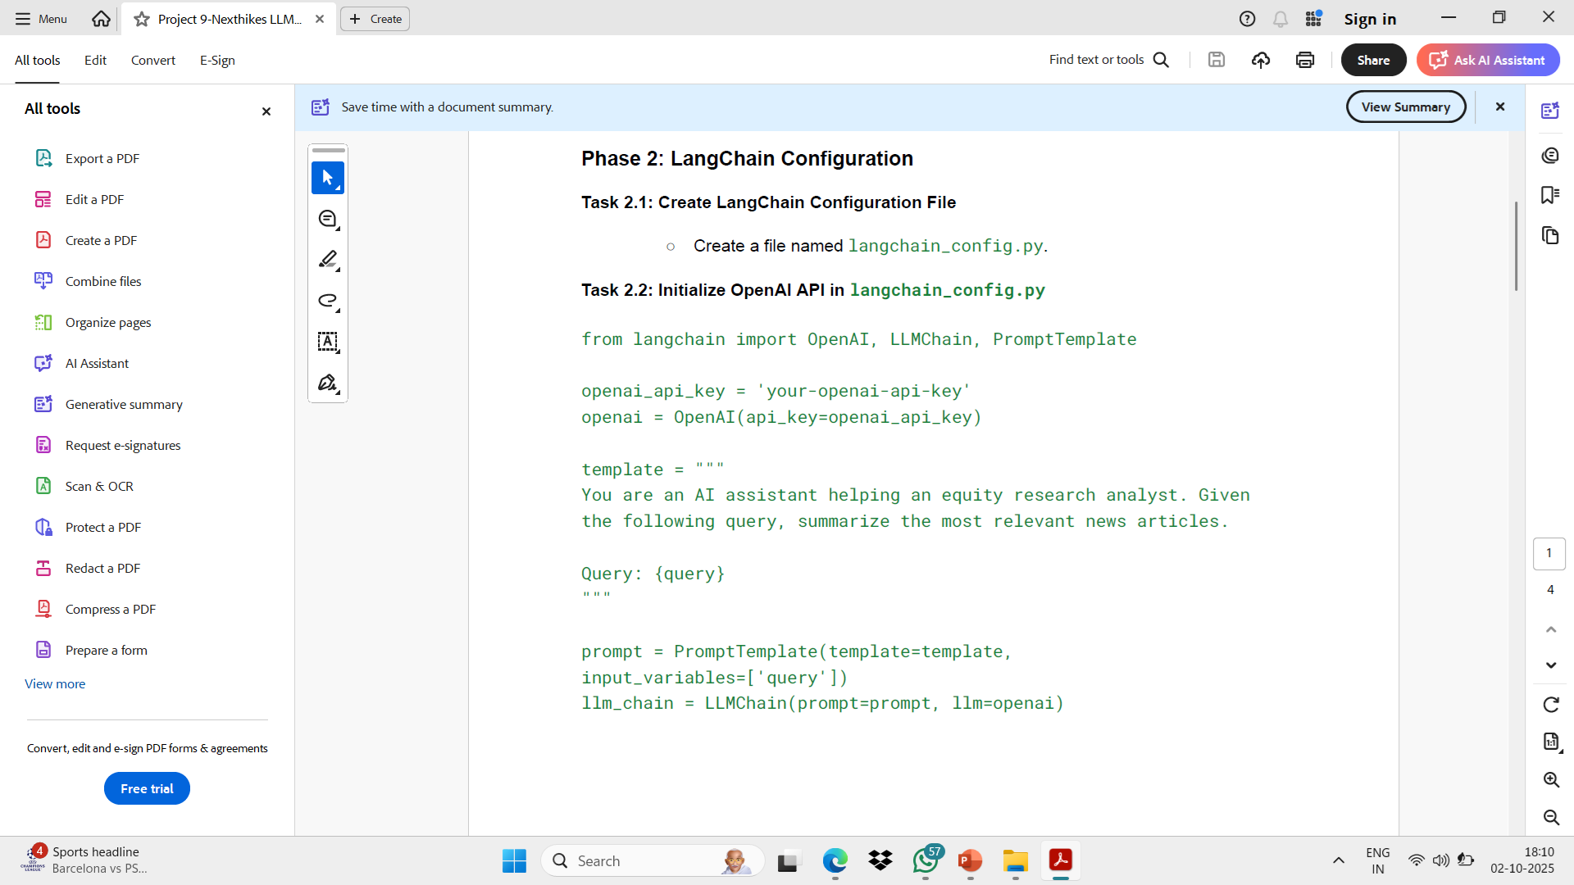
Task 2.1: Create langchain_config.py Task 2.2: Initialize OpenAI API from langchain import OpenAI, LLMChain, PromptTemplate openai_api_key = 'your-openai-api-key' groq_api_key = "your-groq-api-key"
Phase 2 – LangChain Configuration

Slide 7
Key Features
- AI-powered news summarization
- Real-time news fetching using NewsAPI
- Easy-to-use Streamlit dashboard
-Customizable query prompts for financial insight

Slide 8
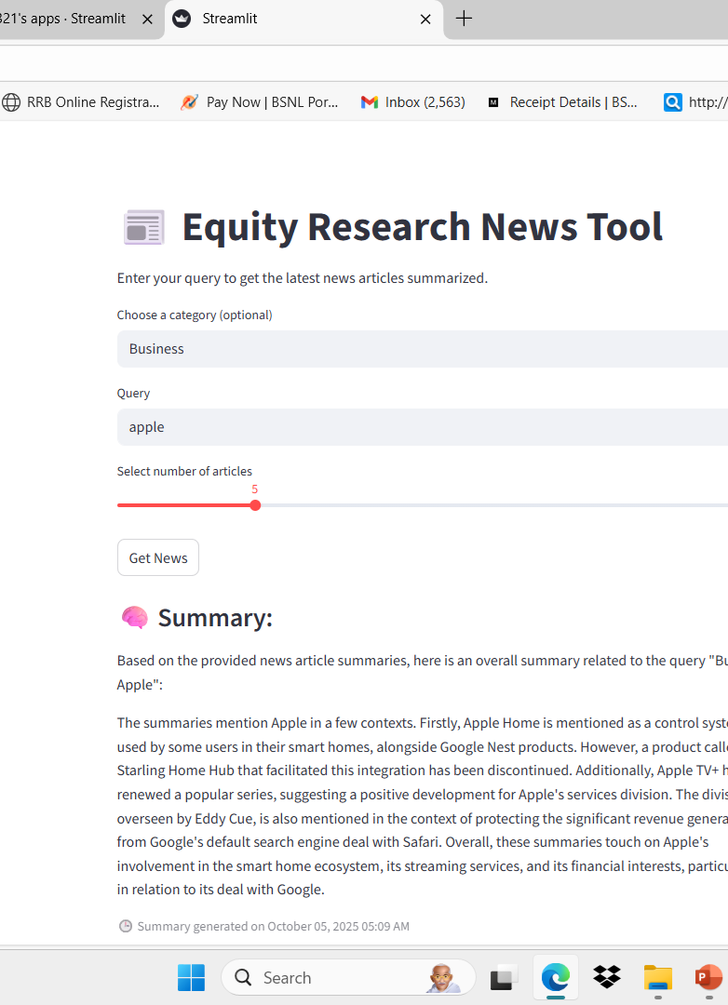
Expected Output
- Input: 'Latest news on Apple Inc.'
- Output: Concise AI-generated summaries of top news articles
- Streamlit app displays results interactively

Slide 9
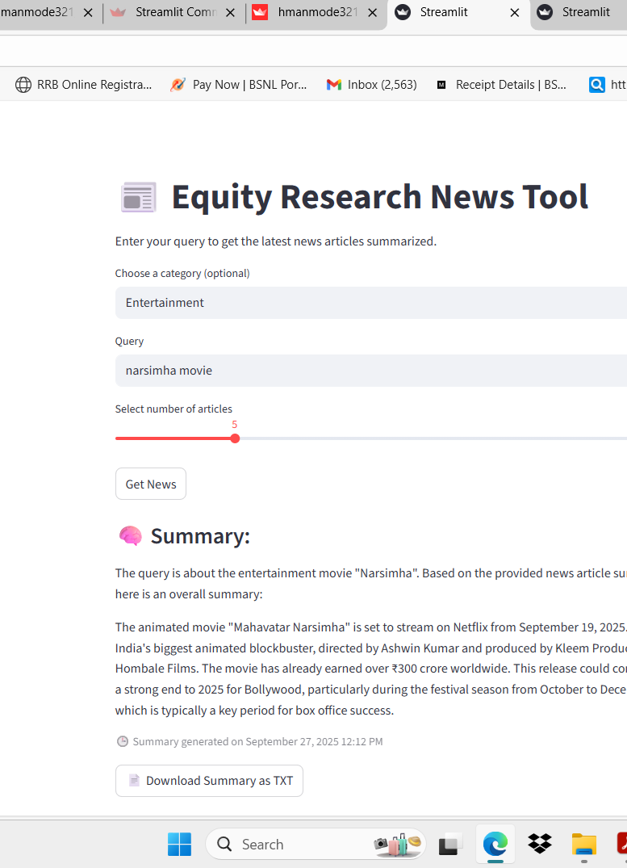
Learning Outcomes
- Hands-on with LangChain framework
- Integration of LLMs + APIs
- Building and deploying Streamlit apps
- Understanding AI-assisted financial research

Slide 10
- Built a working LLM-powered research tool - Demonstrated integration of OpenAILangChain + NewsAPI - Potential extension: Add sentiment analysis, trend detection, and visualization
Conclusion

Slide 11
References
- LangChain Documentation
- OpenAI API Docs
- NewsAPI Docs
- Streamlit Documentation

Slide 12
THANK YOU
“LLMs are not just programs—they are collaborators in knowledge, reasoning, and communication.”

