Slide 1
Core (CR) Vmin Example Analysis
Dataset: WW25 merged CSV (NVLHM66A0H30N00S623)
Domain example: Core (CR) -> Cdie (U5)
X-axis: UPM_0107...U1.U5 S2T = UPM/9154
Filter: T0 only (DevRevStep_SORT_U1.U5 = 8PY6CVT)
Linear fit generated per CR frequency/core column
Normalized VF summary uses Vmin at U5 S2T target 0.87

Slide 2
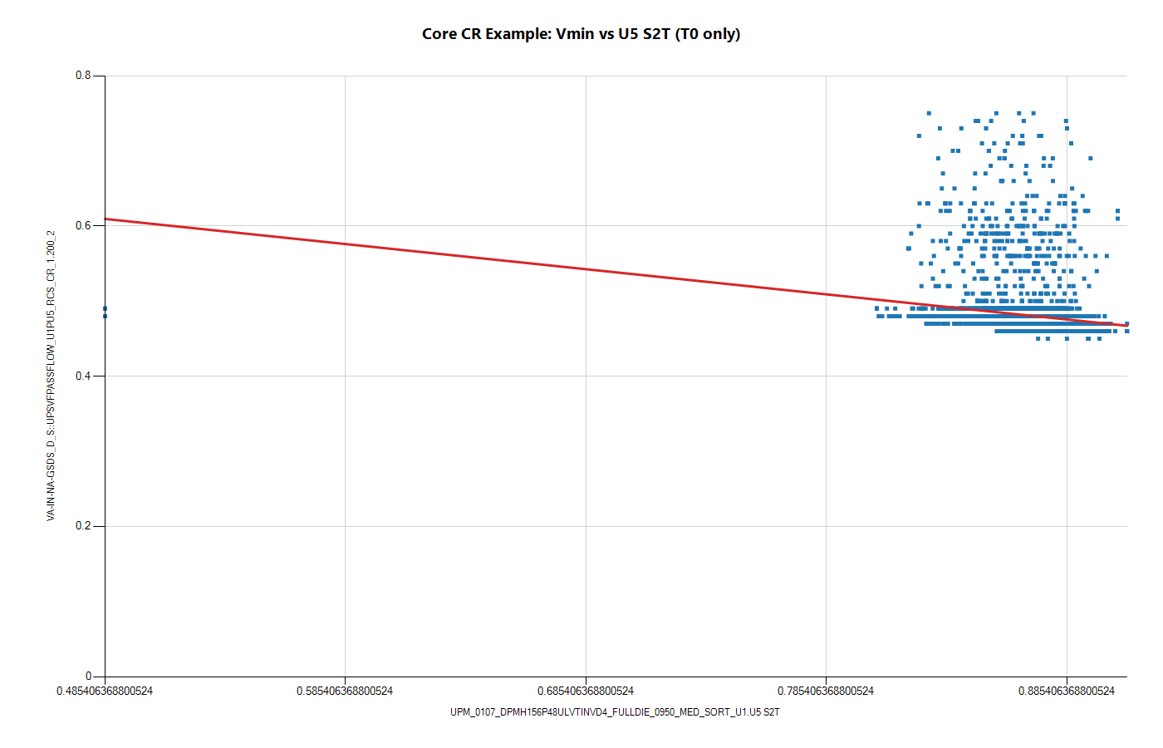
Example: CR_1.200_2 Vmin vs U5 S2T with Linear Fit

Slide 3
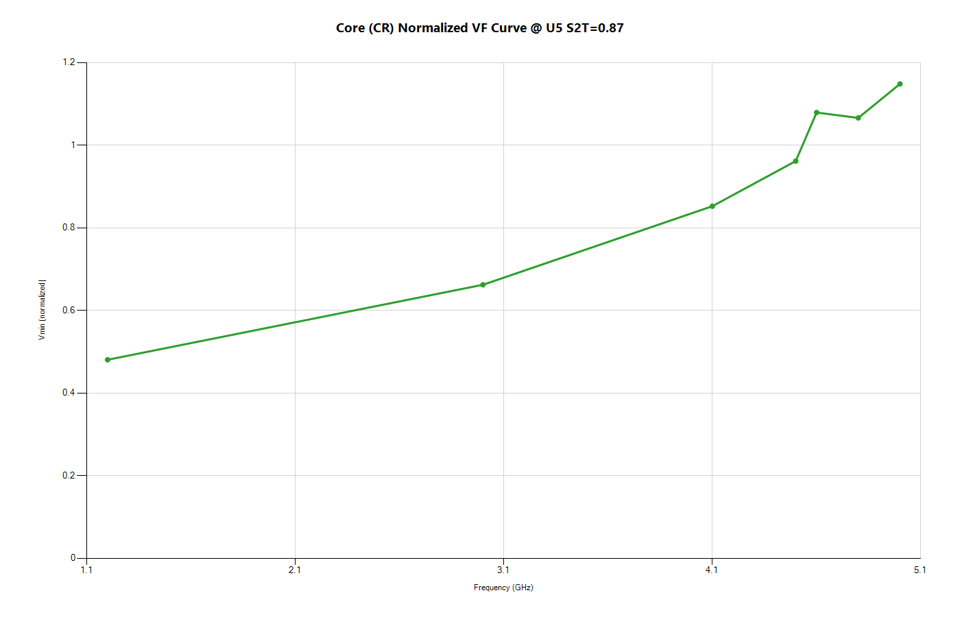
Core (CR) Normalized VF Curve @ U5 S2T=0.87

Slide 4
Core (CR) Summary Table (Domain, Freq, Vmin)
Domain | Freq (GHz) | Vmin
CR | 1.2 | 0.48
CR | 3 | 0.662
CR | 4.1 | 0.852
CR | 4.5 | 0.961
CR | 4.6 | 1.079
CR | 4.8 | 1.066
CR | 5 | 1.148

