Slide 1
Vmin Starting-Point Analysis (All Domains)
Input: R:\Products\NVL\NVL-H\Weekly Runs\Vmin_NVLHM66A0H30N00S623_WW25_2026_merged.csv
Outlier rules:
Vmin: 0 <= Vmin < 2
UPM: median +/- 3*sigma (full population)
Vmin excluded: 800 UPM excluded: 2505 Accepted: 571810
UPM bounds:
TPI_UPM::UPM_X_SCREEN_K_START_X_X_X_X_FEM_CALC_UPM_FEM_ULVT_FULLDIE_PDK0P9_0950MV_SORT_U1.U2: [13f, 13f]
TPI_UPM::UPM_X_SCREEN_K_START_X_X_X_X_FEM_CALC_UPM_FEM_ULVT_FULLDIE_PDK0P9_0950MV_SORT_U1.U4: [13f, 13f]
UPM_0107_DPMH156P48ULVTINVD4_FULLDIE_0950_MED_SORT_U1.U5: [75713f, 84353f]
Vmin columns: 80 | Summary rows: 63

Slide 2
Top Fits by R2 (N>=100)
Domain | Freq | Core | R2 | N | Vmin@Target
GTVPG | 2.9 | 1 | 0.69 | 8822 | 0.876
GT | 2.9 | 1 | 0.69 | 8822 | 0.876
CR | 4.5 | 1 | 0.68 | 8823 | 0.96
SADPU | 2.5 | 1 | 0.676 | 8793 | 0.897
SAQ | 3.4 | 1 | 0.676 | 8793 | 0.897
SAME | 1.45 | 1 | 0.676 | 8793 | 0.897
SAC | 2.7 | 1 | 0.676 | 8793 | 0.897
SAN | 1.65 | 1 | 0.676 | 8793 | 0.897
SAVPU | 1.429 | 1 | 0.676 | 8793 | 0.897
AT | 3.6 | 1 | 0.67 | 8756 | 0.859
AT | 3.6 | 2 | 0.638 | 8733 | 0.86
CR | 4.1 | 1 | 0.626 | 8823 | 0.852

Slide 3
Normalized VF Summary Table
Die | Domain | Freq (GHz) | Vmin
CDIE | AT | 1.2 | 0.473
CDIE | AT | 2.8 | 0.701
CDIE | AT | 3.2 | 0.774
CDIE | AT | 3.6 | 0.859
CDIE | AT | 3.7 | 0.884
CDIE | AT | 3.9 | 0.992
CDIE | AT | 4.2 | 1.07
CDIE | CCF | 1.2 | 0.468
CDIE | CCF | 3 | 0.668
CDIE | CCF | 3.4 | 0.741
CDIE | CCF | 4 | 0.862
CDIE | CCF | 4.3 | 0.972
CDIE | CCF | 4.8 | 1.122
CDIE | CCF | 5 | 1.171
CDIE | CR | 1.2 | 0.481
CDIE | CR | 3 | 0.663
CDIE | CR | 4.1 | 0.854
CDIE | CR | 4.5 | 0.963
CDIE | CR | 4.8 | 1.066
CDIE | CR | 5 | 1.157
GTDIE | GT | 1.2 | 0.595

Slide 4
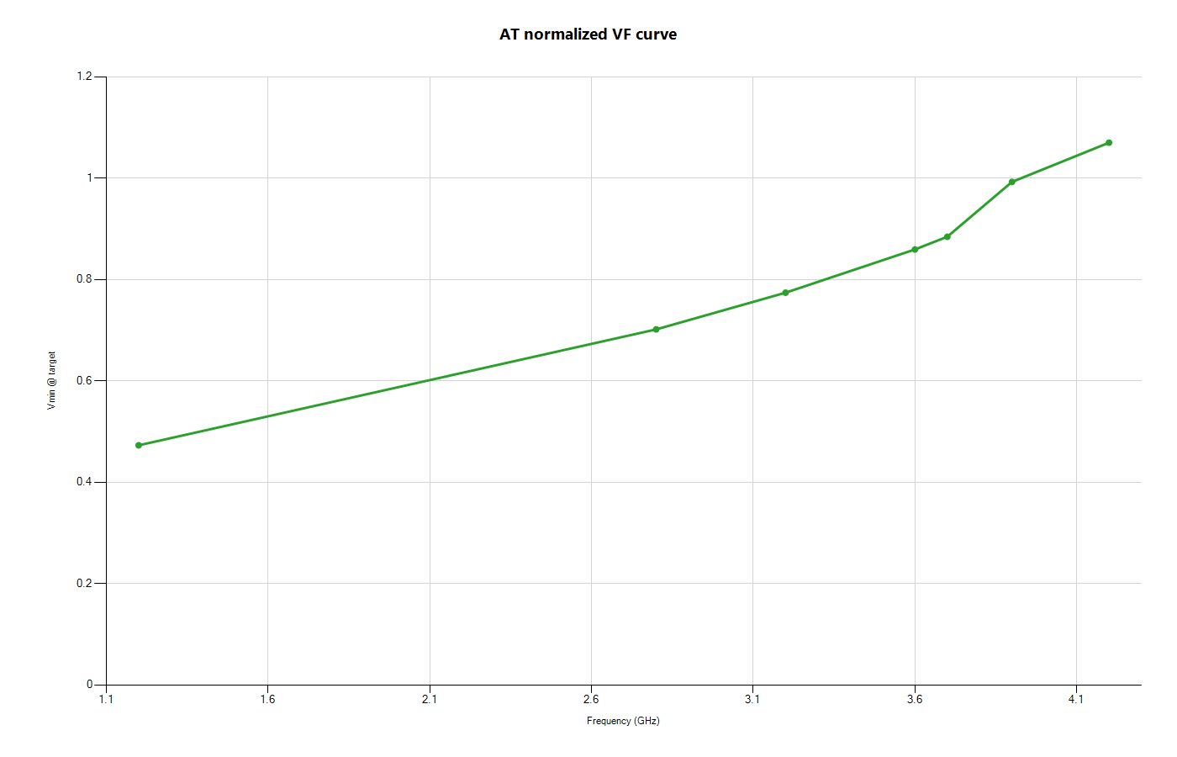
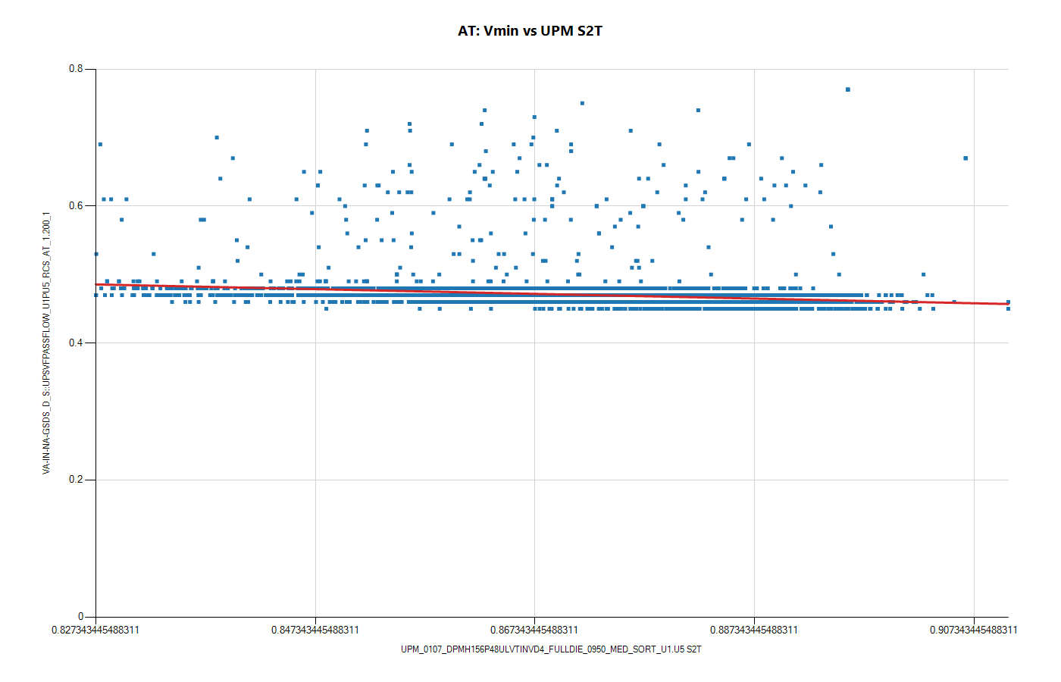
Domain AT: VF and Vmin-vs-UPM

Slide 5
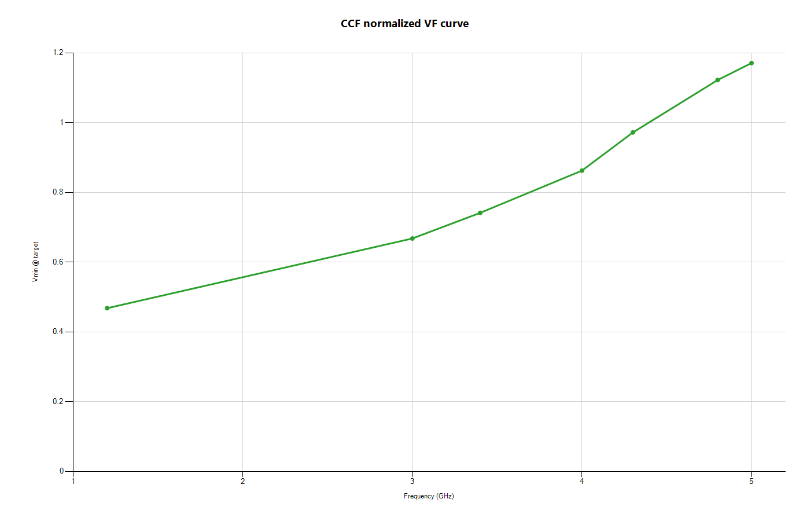
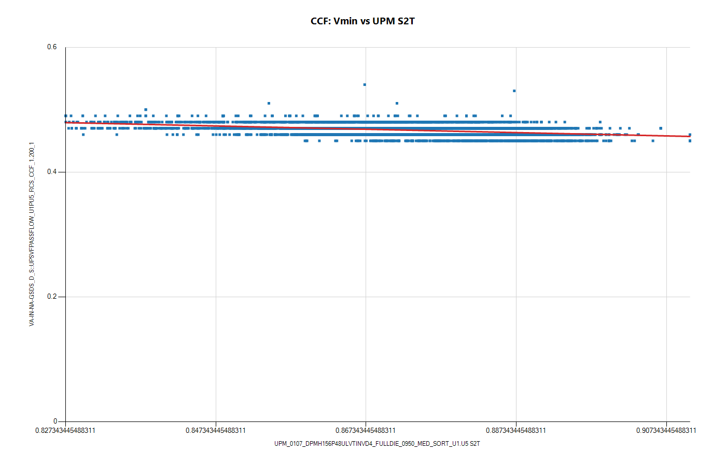
Domain CCF: VF and Vmin-vs-UPM

Slide 6
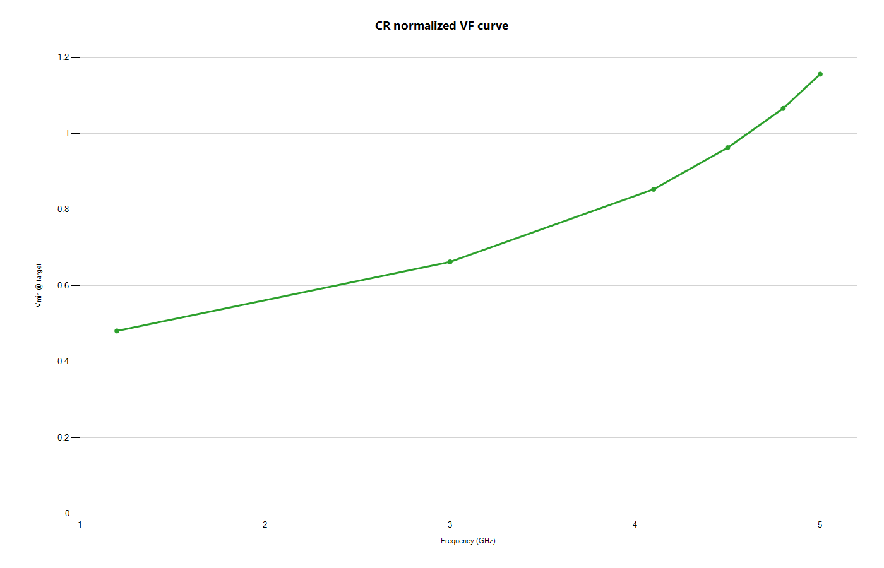
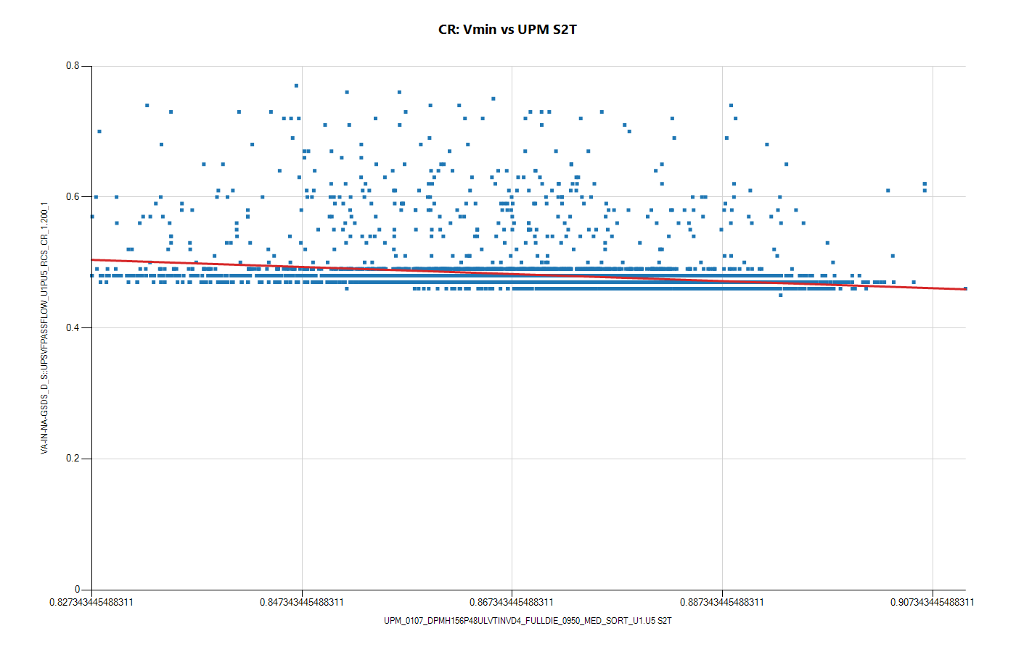
Domain CR: VF and Vmin-vs-UPM

Slide 7
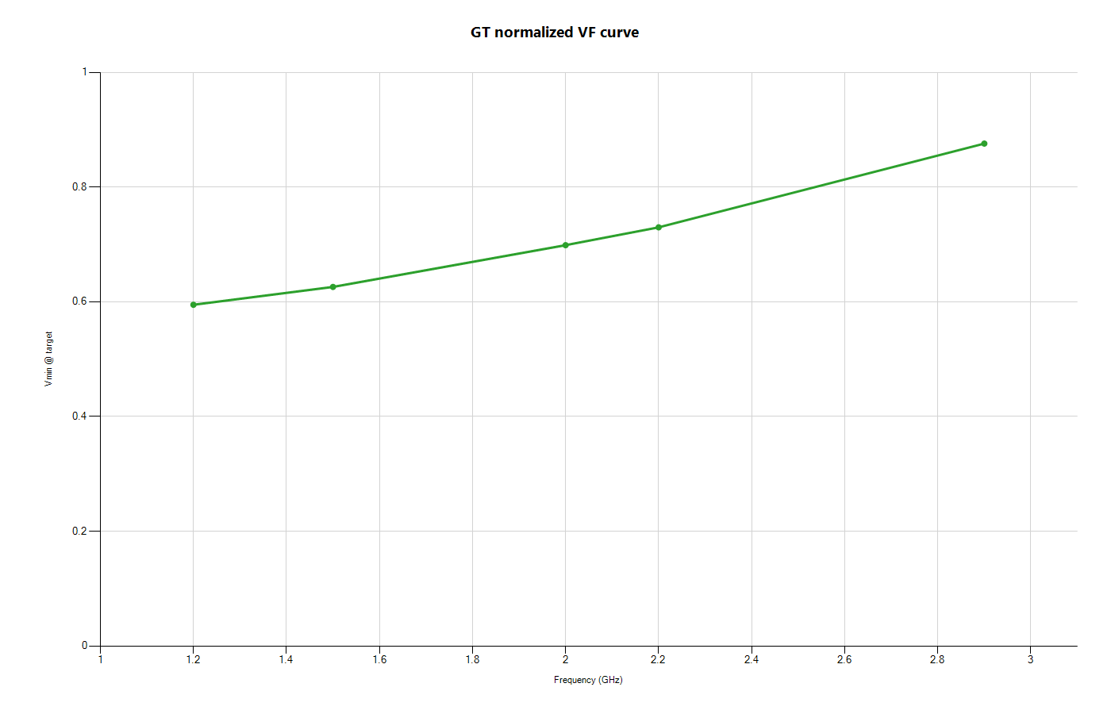
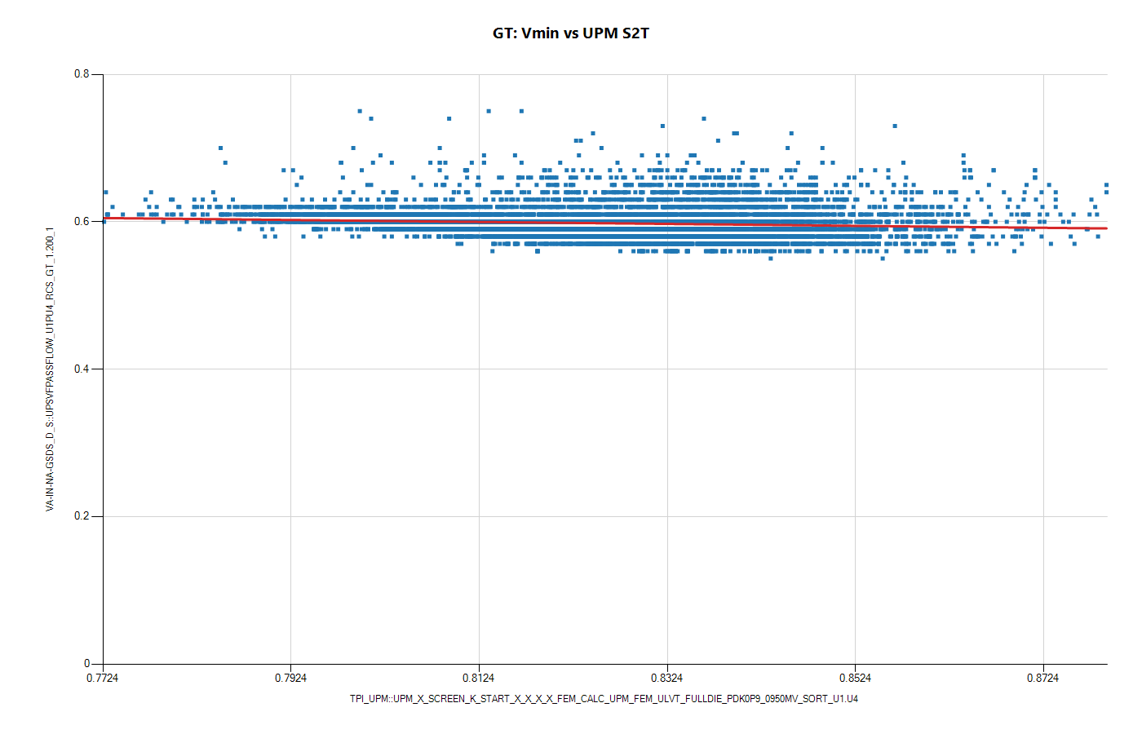
Domain GT: VF and Vmin-vs-UPM

Slide 8

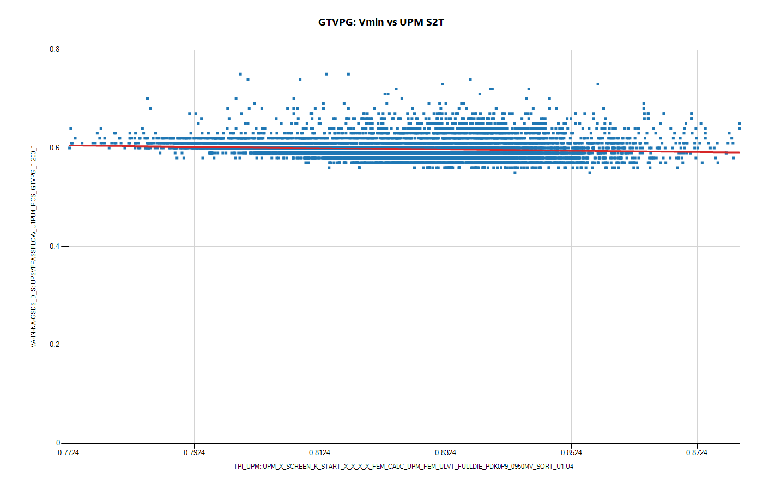
Domain GTVPG: VF and Vmin-vs-UPM

Slide 9
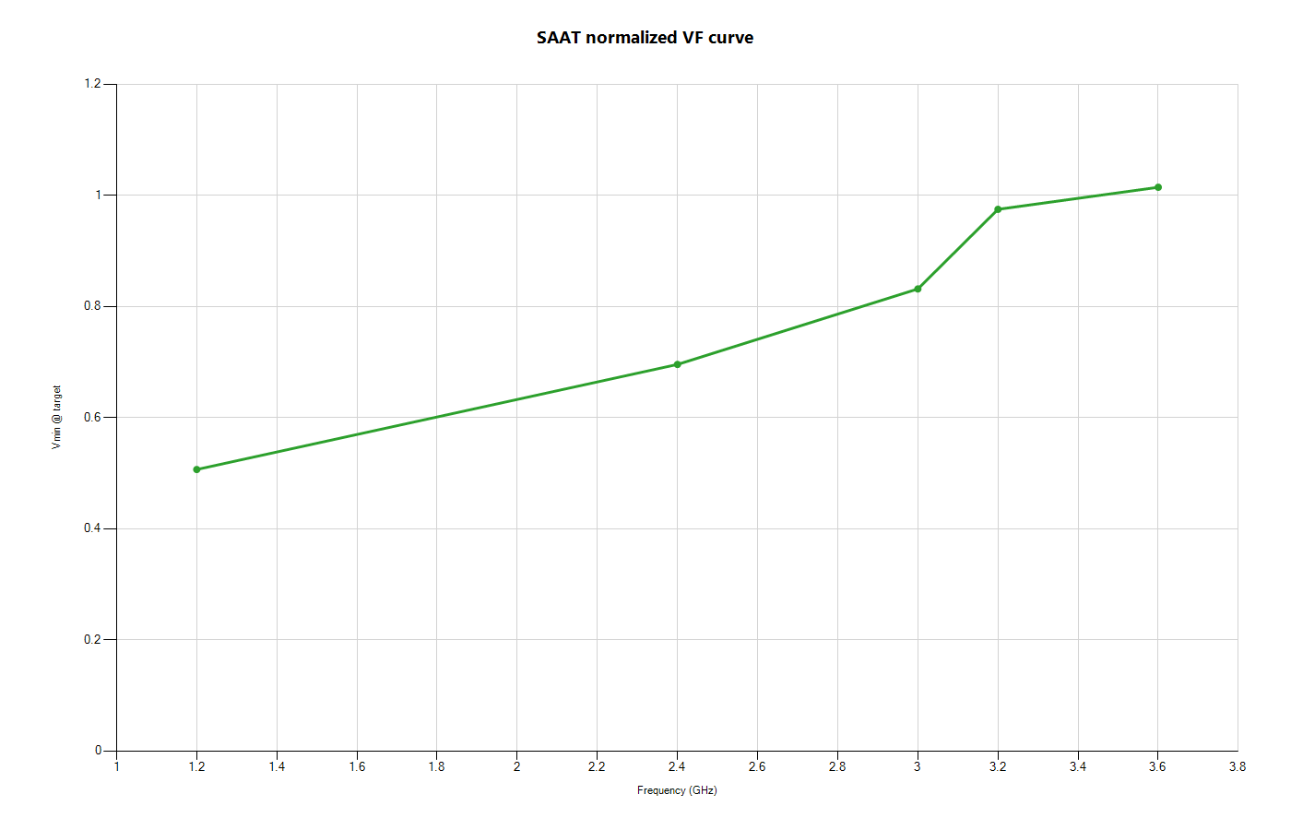
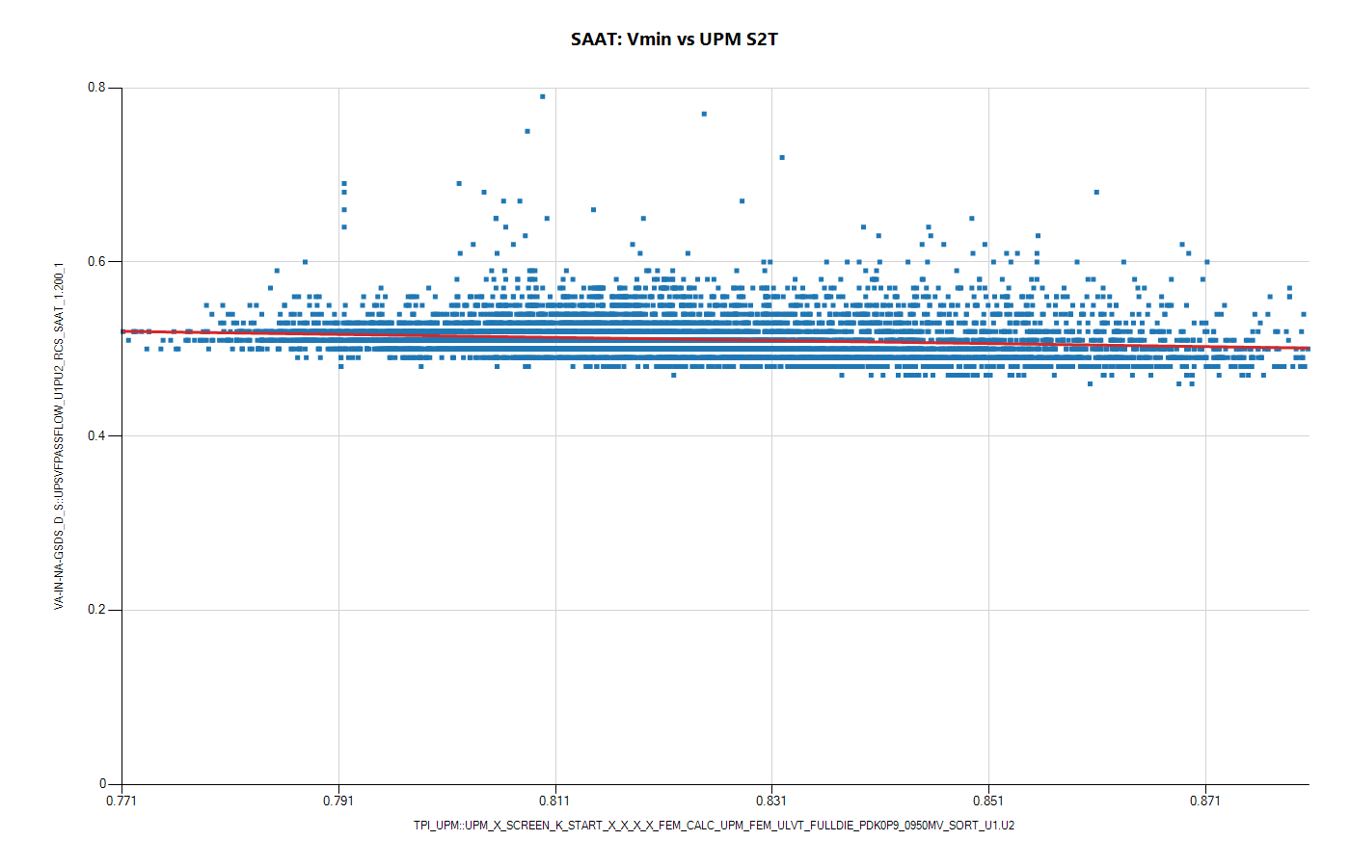
Domain SAAT: VF and Vmin-vs-UPM

Slide 10
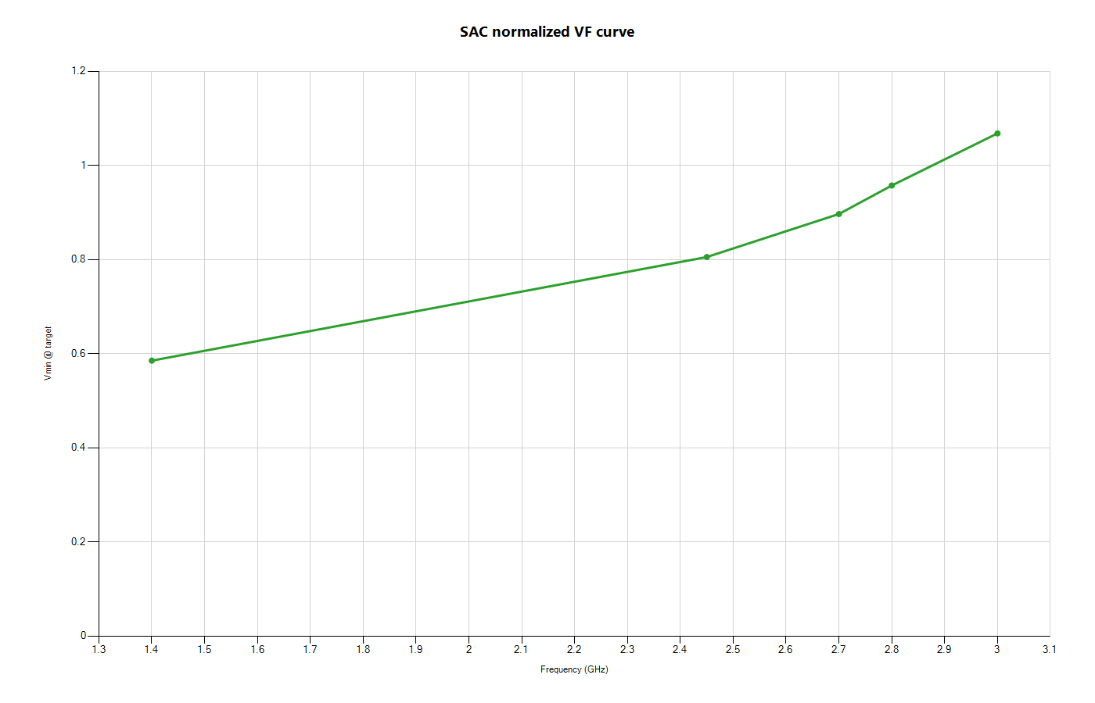
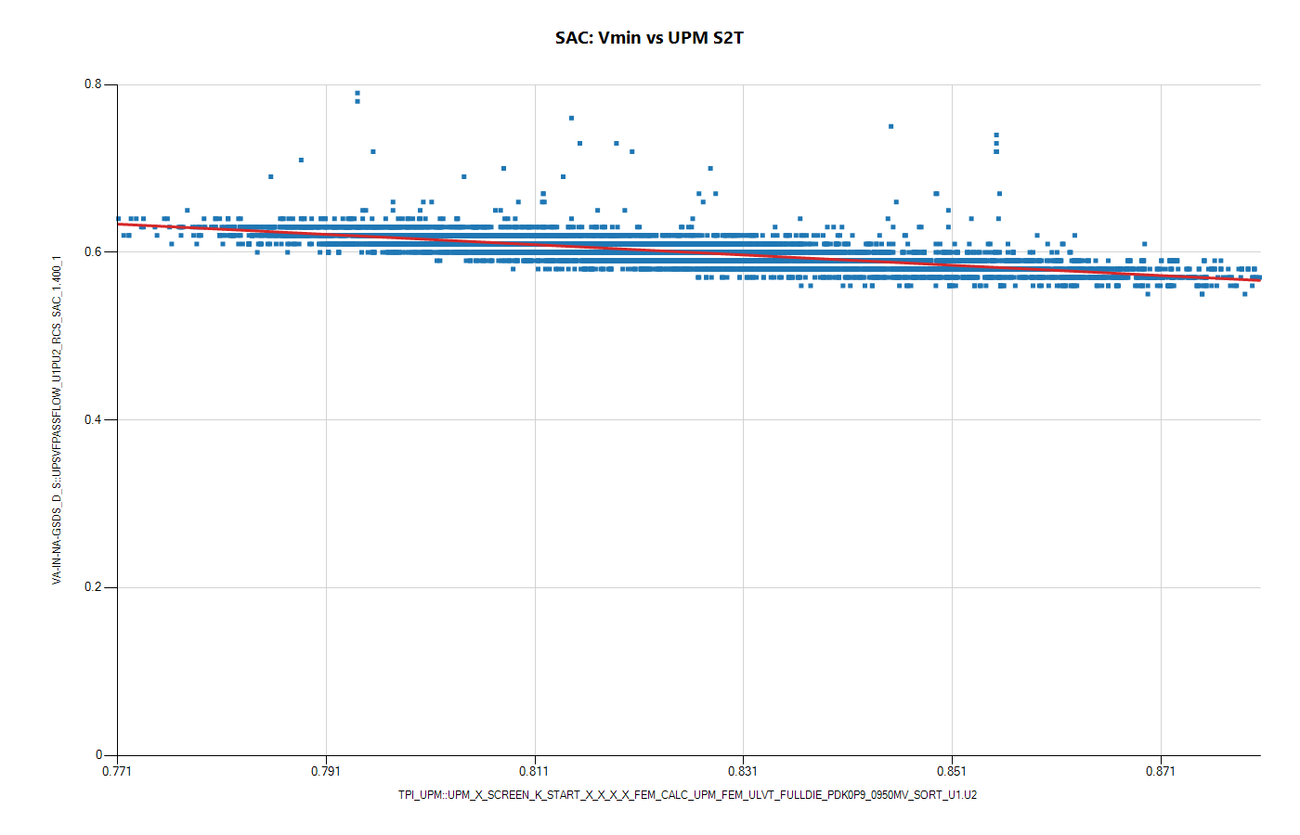
Domain SAC: VF and Vmin-vs-UPM

Slide 11
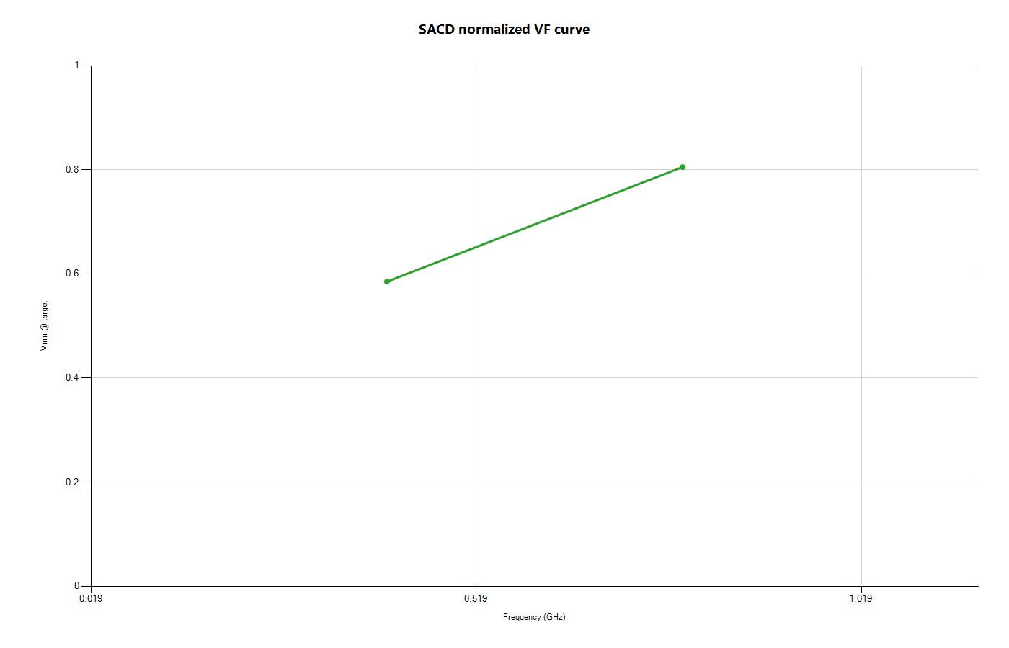
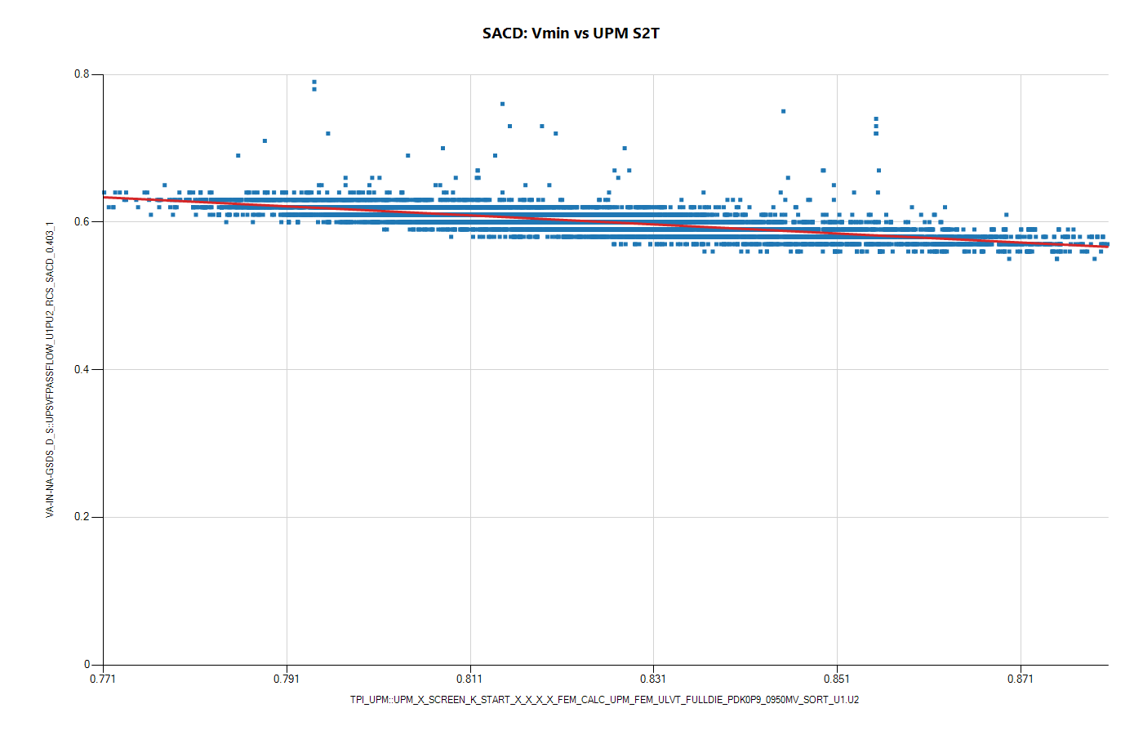
Domain SACD: VF and Vmin-vs-UPM

Slide 12
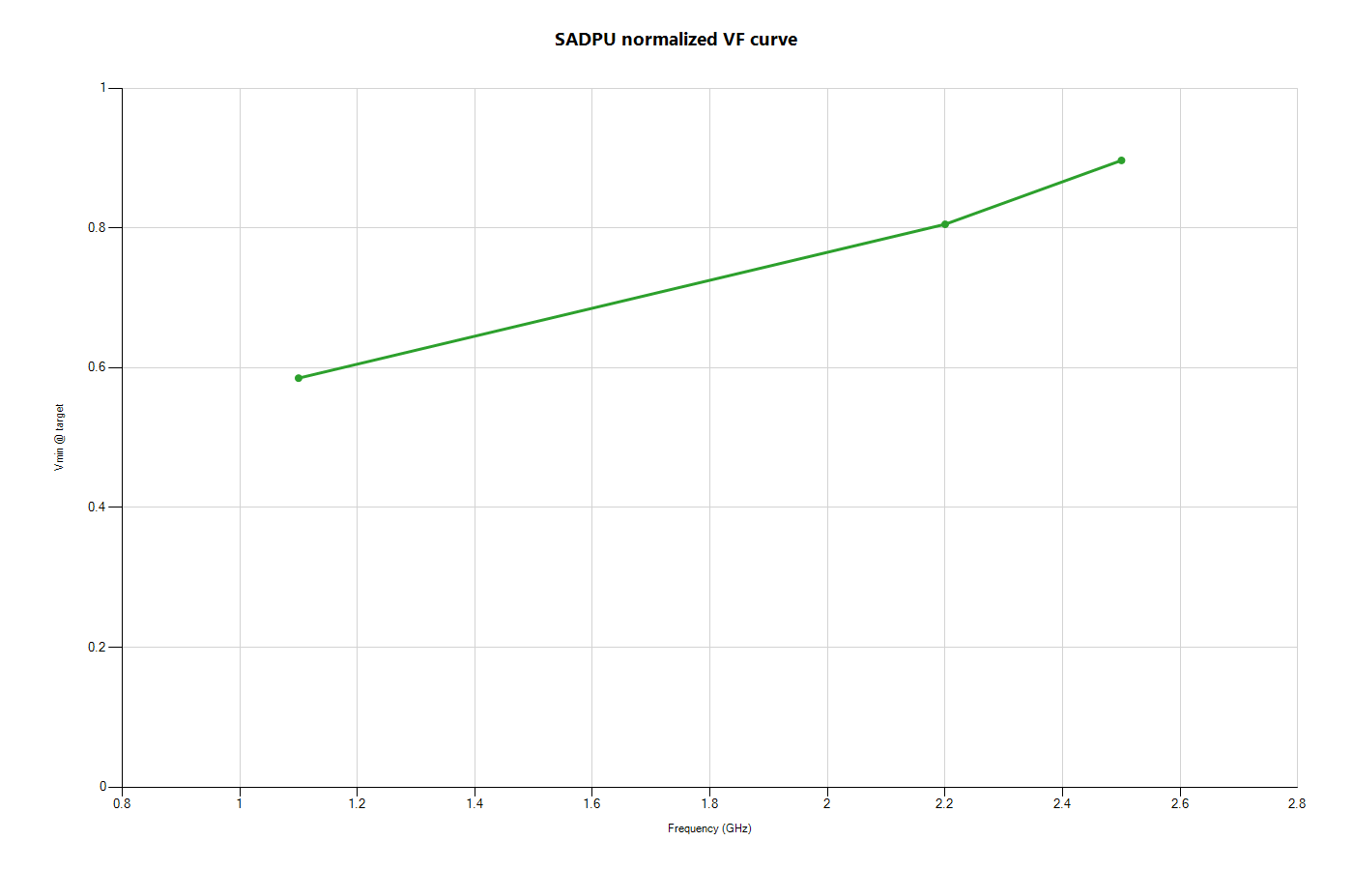

Domain SADPU: VF and Vmin-vs-UPM

Slide 13
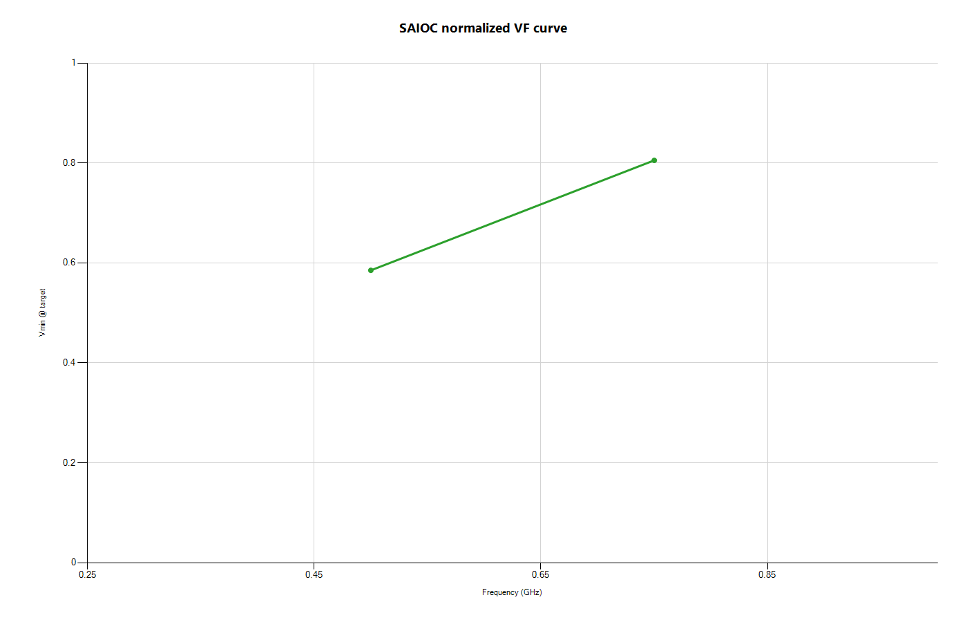

Domain SAIOC: VF and Vmin-vs-UPM

Slide 14


Domain SAME: VF and Vmin-vs-UPM

Slide 15
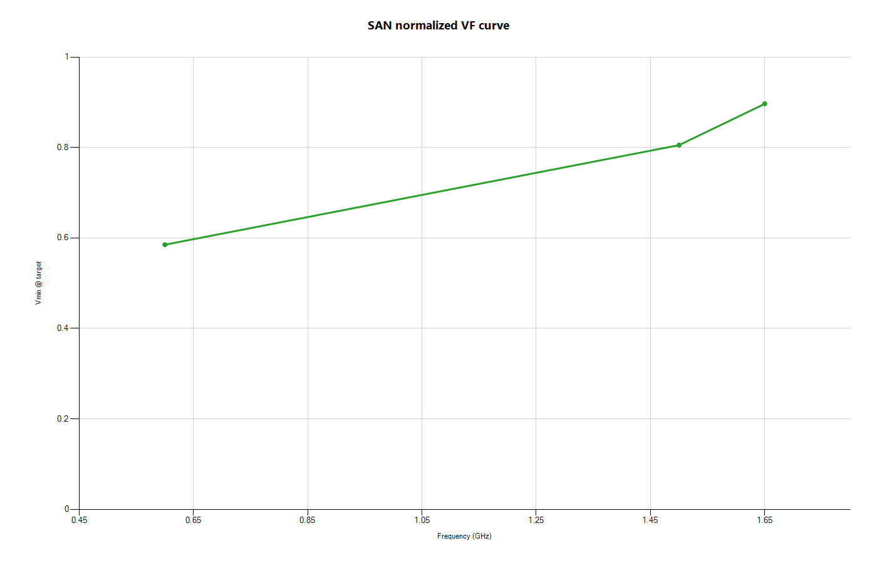
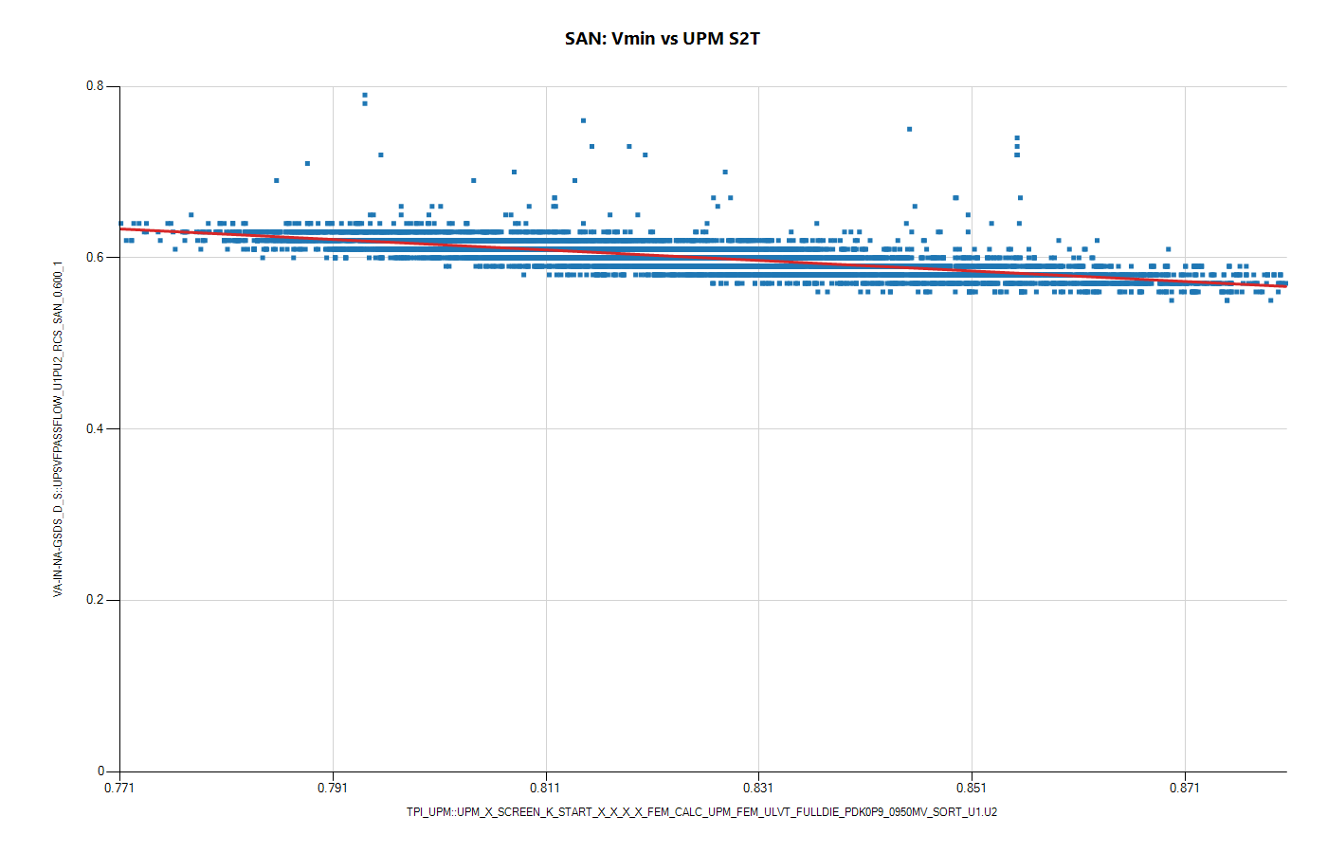
Domain SAN: VF and Vmin-vs-UPM

Slide 16


Domain SAPS: VF and Vmin-vs-UPM

Slide 17
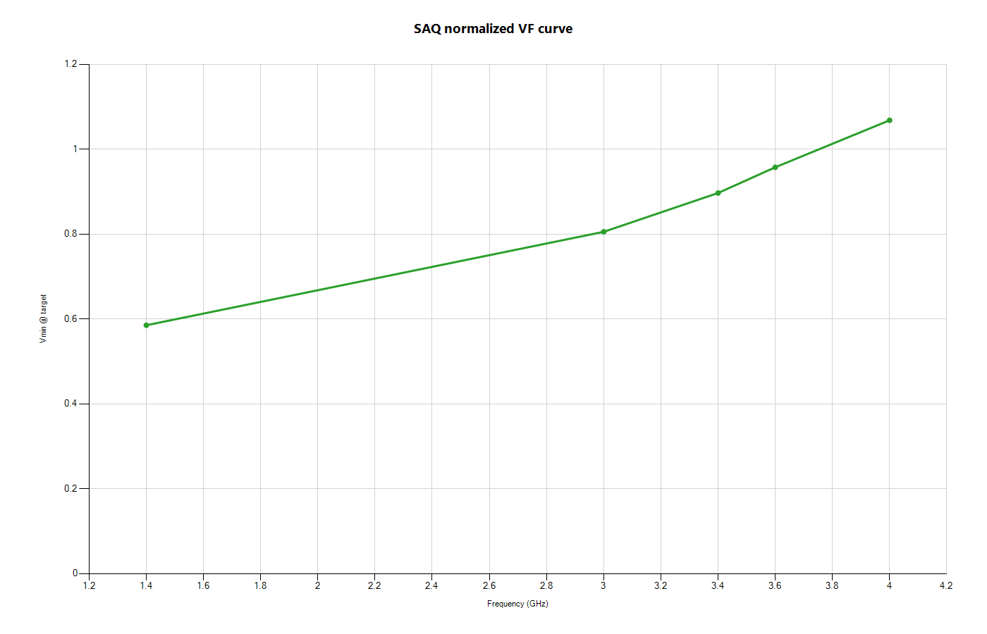
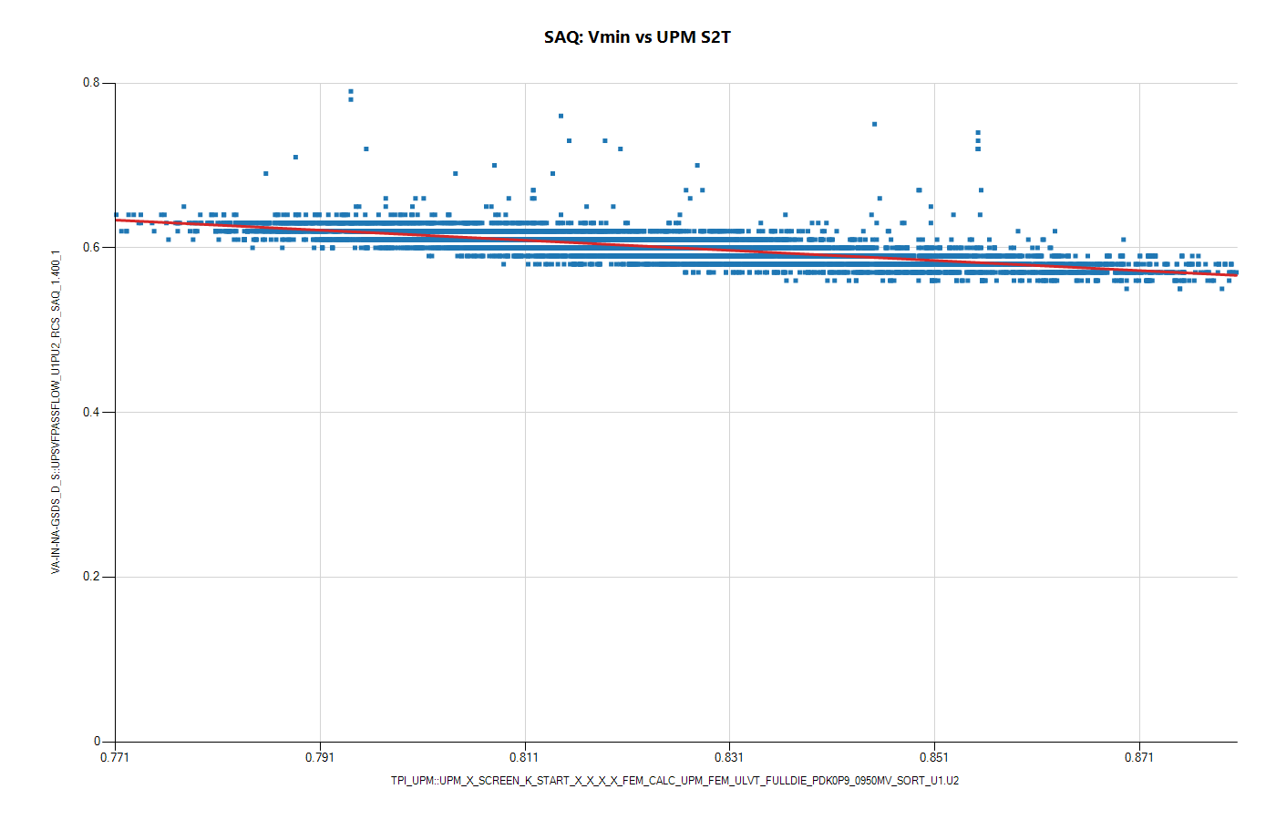
Domain SAQ: VF and Vmin-vs-UPM

Slide 18
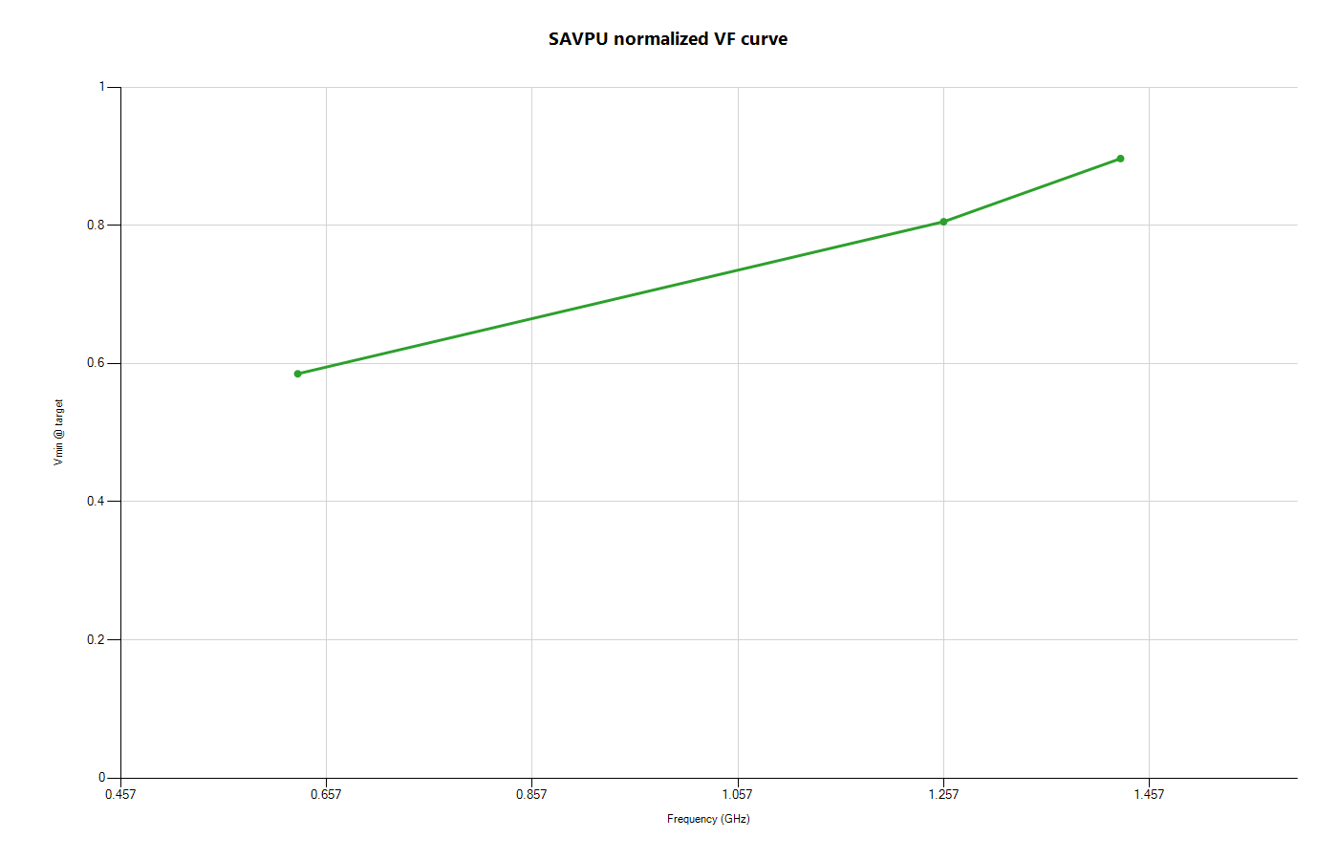

Domain SAVPU: VF and Vmin-vs-UPM

