Slide 1
Vmin Starting-Point Analysis (All Domains)
Input: R:\Products\NVL\NVL-H\Weekly Runs\Vmin_NVLHM66A0H30N00S623_WW25_2026_merged.csv
Rules applied:
1) Cdie/U5 uses UPM_0107...U1.U5 / 9154 and target 0.87 with T0 step 8PY6CVT
2) GT die/U4 uses TPI_UPM...U1.U4 and target 0.85 with A-step 8PQ8CVAA
3) Hub die/U2 uses TPI_UPM...U1.U2 and target 0.85 with A-step 8PF9CVA
Mapped UPSVF Vmin columns: 80
Domain-frequency summary rows: 63

Slide 2
Top Fits by R2 (N>=100)
Domain | Freq | Core | R2 | N | Vmin@Target
GT | 2.9 | 1 | 0.707 | 8882 | 0.876
GTVPG | 2.9 | 1 | 0.707 | 8882 | 0.876
SAME | 1.45 | 1 | 0.679 | 8807 | 0.897
SAN | 1.65 | 1 | 0.679 | 8807 | 0.897
SAC | 2.7 | 1 | 0.679 | 8807 | 0.897
SADPU | 2.5 | 1 | 0.679 | 8807 | 0.897
SAQ | 3.4 | 1 | 0.679 | 8807 | 0.897
SAVPU | 1.429 | 1 | 0.679 | 8807 | 0.897
SADPU | 2.2 | 1 | 0.621 | 8807 | 0.805
SAN | 1.5 | 1 | 0.621 | 8807 | 0.805
SAQ | 3 | 1 | 0.621 | 8807 | 0.805
SAVPU | 1.257 | 1 | 0.621 | 8807 | 0.805

Slide 3
Normalized VF Summary Table (Domain/Freq/Vmin)
Die | Domain | Freq (GHz) | Vmin
CDIE | AT | 1.2 | 0.374
CDIE | AT | 2.8 | 0.6
CDIE | AT | 3.2 | 0.672
CDIE | AT | 3.6 | 0.756
CDIE | AT | 3.7 | -4.516
CDIE | AT | 3.9 | 0.979
CDIE | AT | 4.2 | 1.066
CDIE | CCF | 1.2 | 0.468
CDIE | CCF | 3 | 0.667
CDIE | CCF | 3.4 | 0.74
CDIE | CCF | 4 | 0.861
CDIE | CCF | 4.3 | 0.97
CDIE | CCF | 4.8 | 1.119
CDIE | CCF | 5 | 1.171
CDIE | CR | 1.2 | 0.48
CDIE | CR | 3 | 0.662
CDIE | CR | 4.1 | 0.852
CDIE | CR | 4.5 | 0.961
CDIE | CR | 4.8 | 1.066
CDIE | CR | 5 | 1.148
GTDIE | GT | 1.2 | 0.596

Slide 4
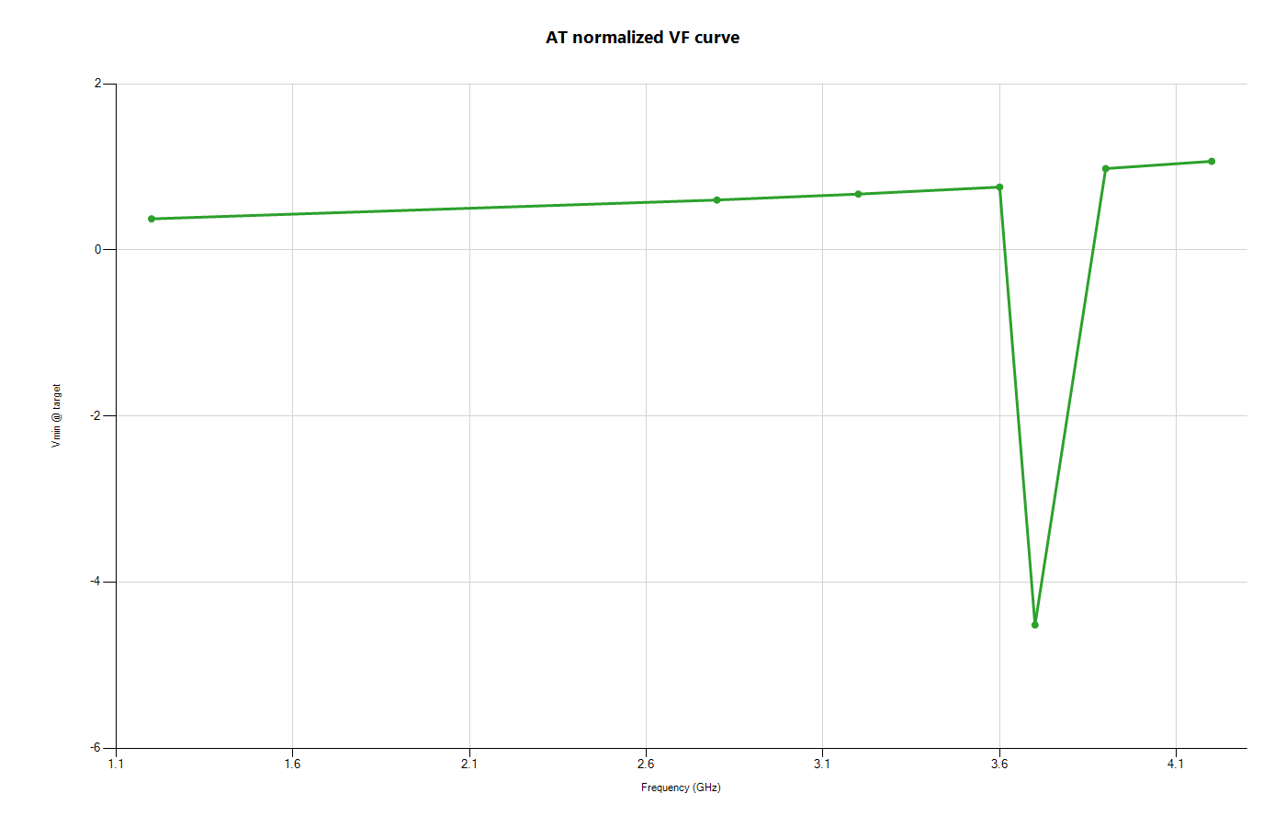
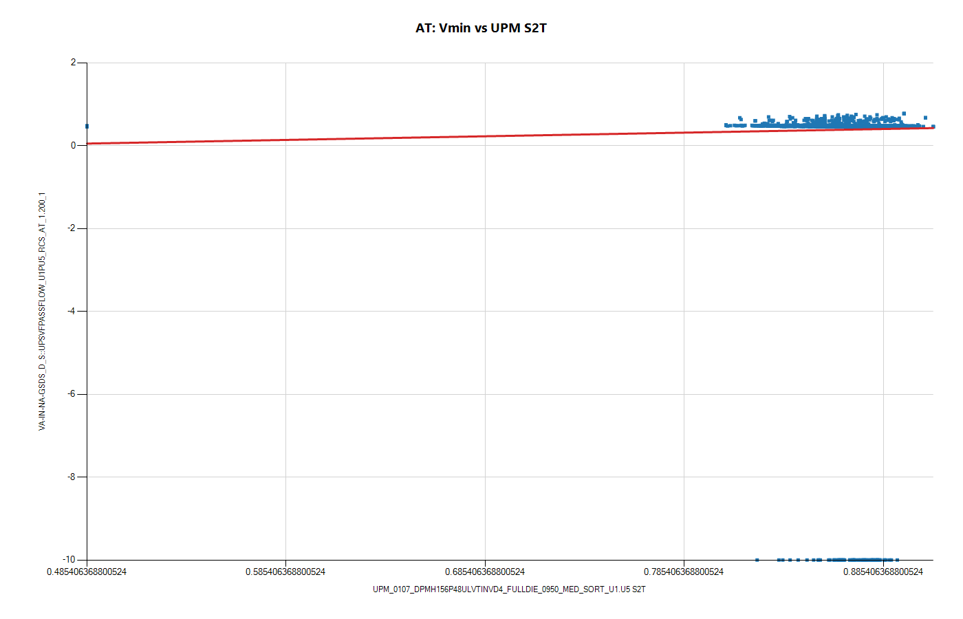
Domain AT: VF and Vmin-vs-UPM

Slide 5
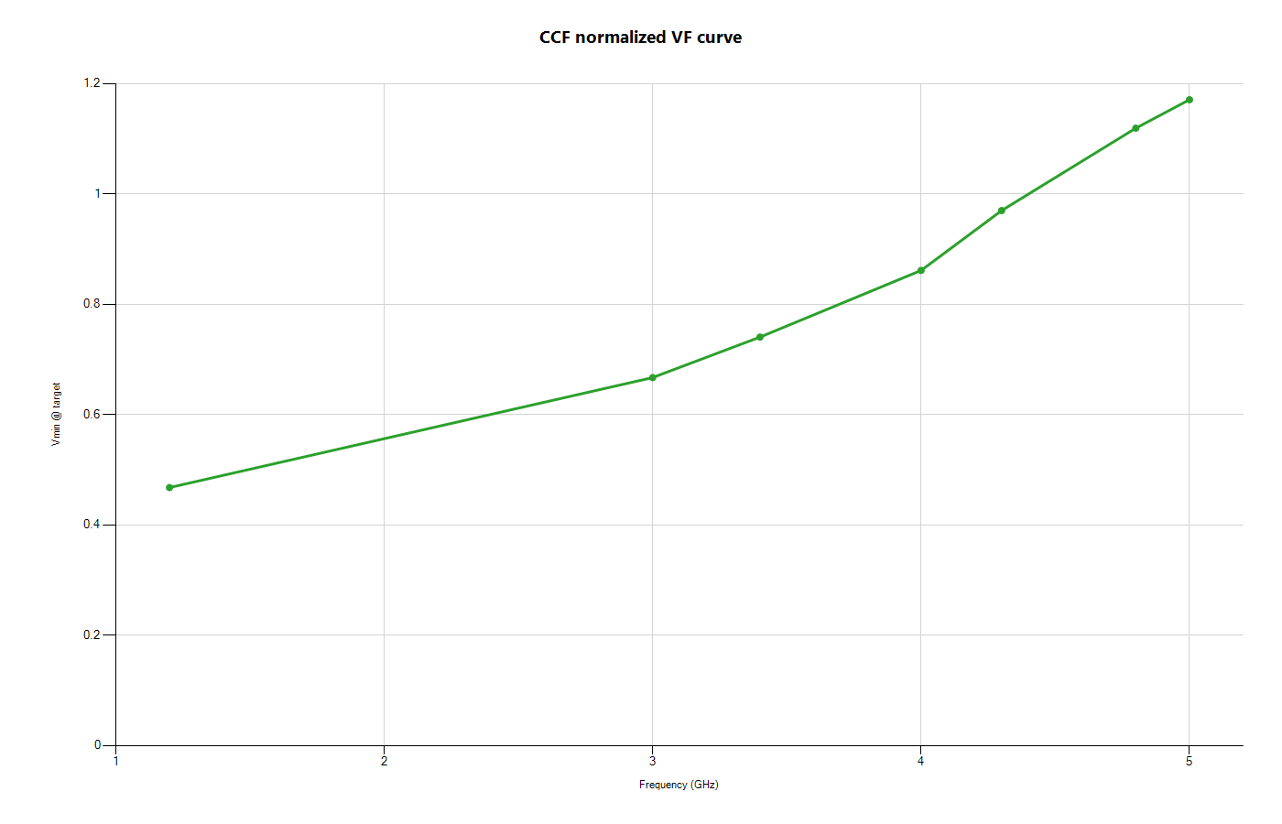
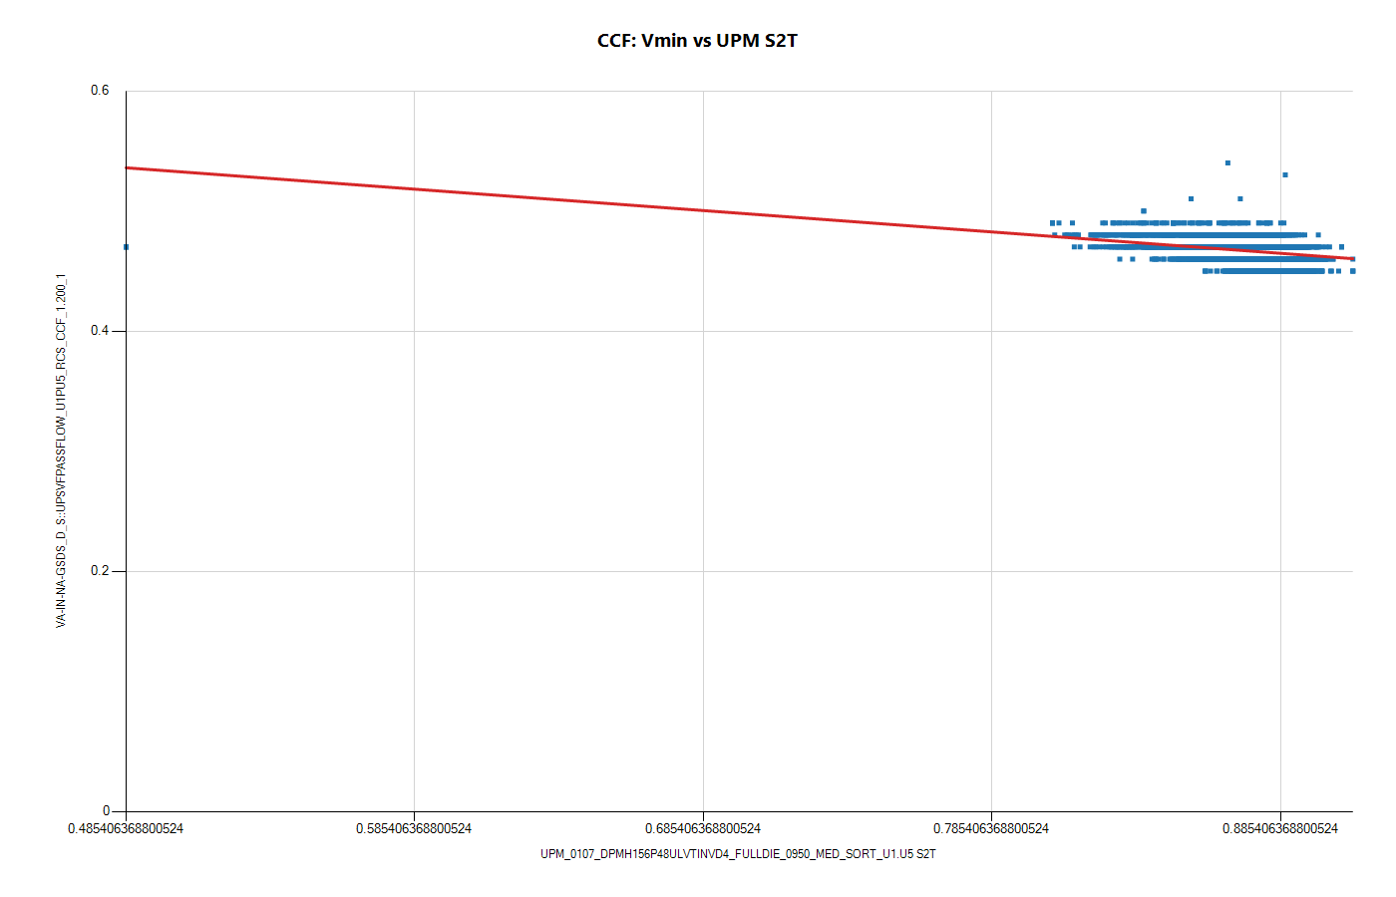
Domain CCF: VF and Vmin-vs-UPM

Slide 6
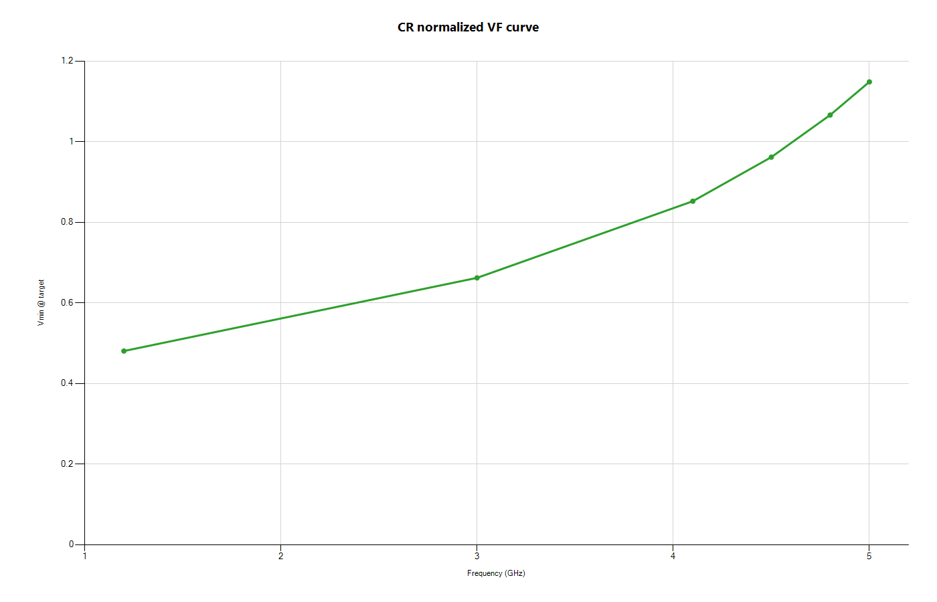
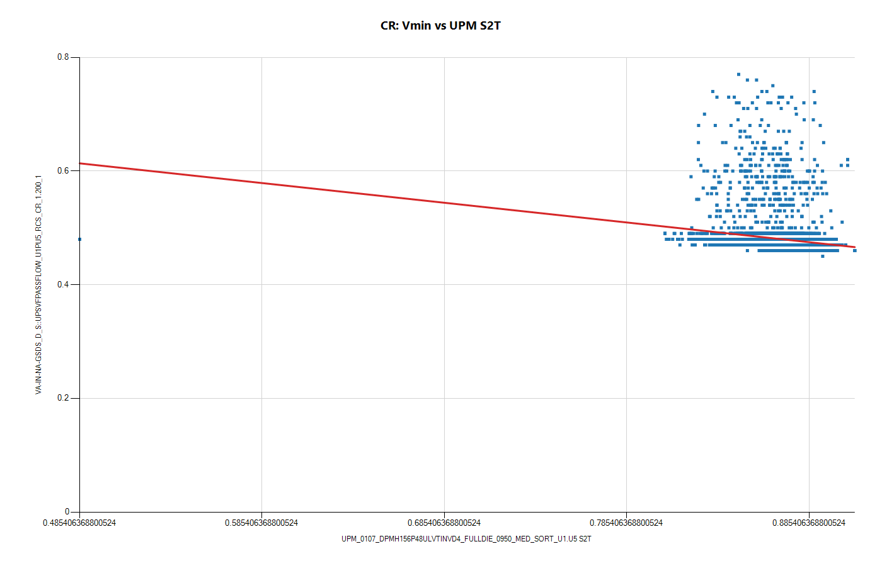
Domain CR: VF and Vmin-vs-UPM

Slide 7
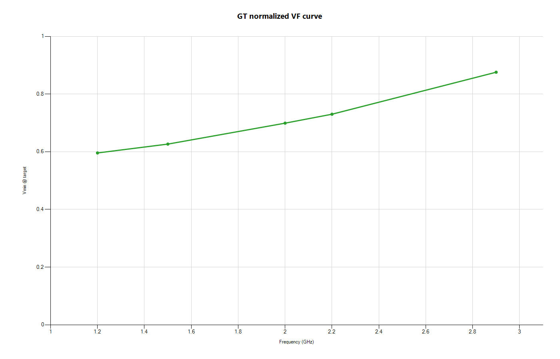
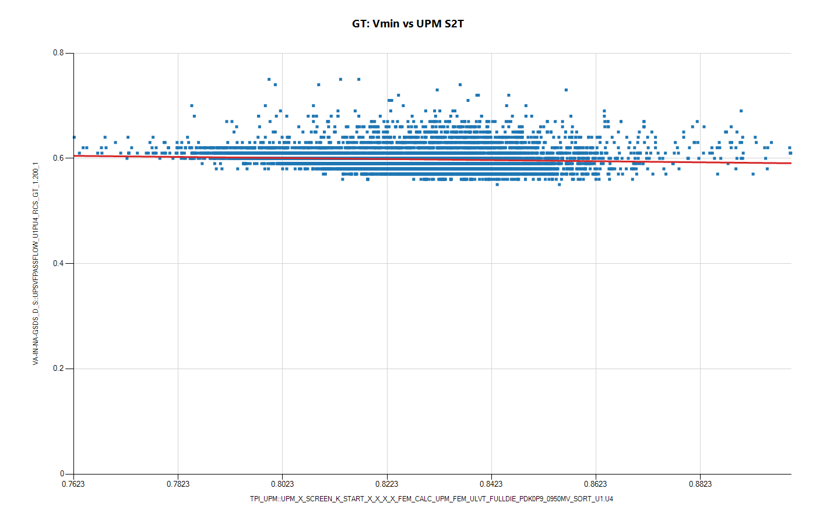
Domain GT: VF and Vmin-vs-UPM

Slide 8

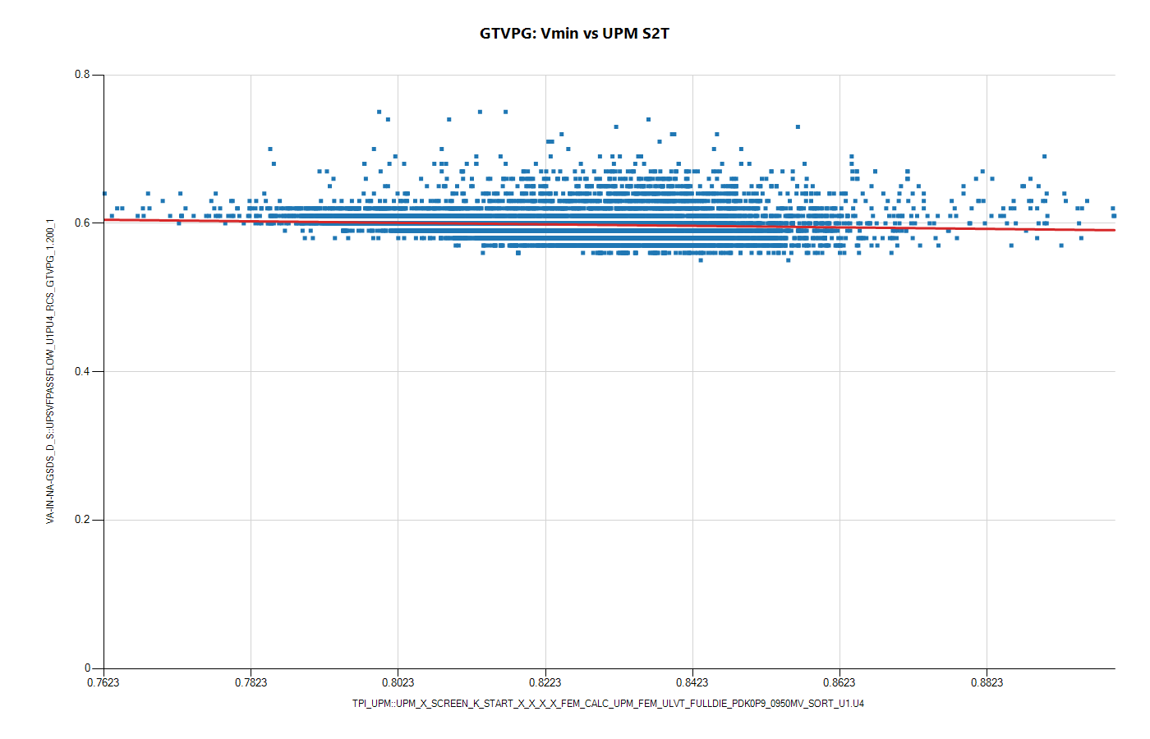
Domain GTVPG: VF and Vmin-vs-UPM

Slide 9
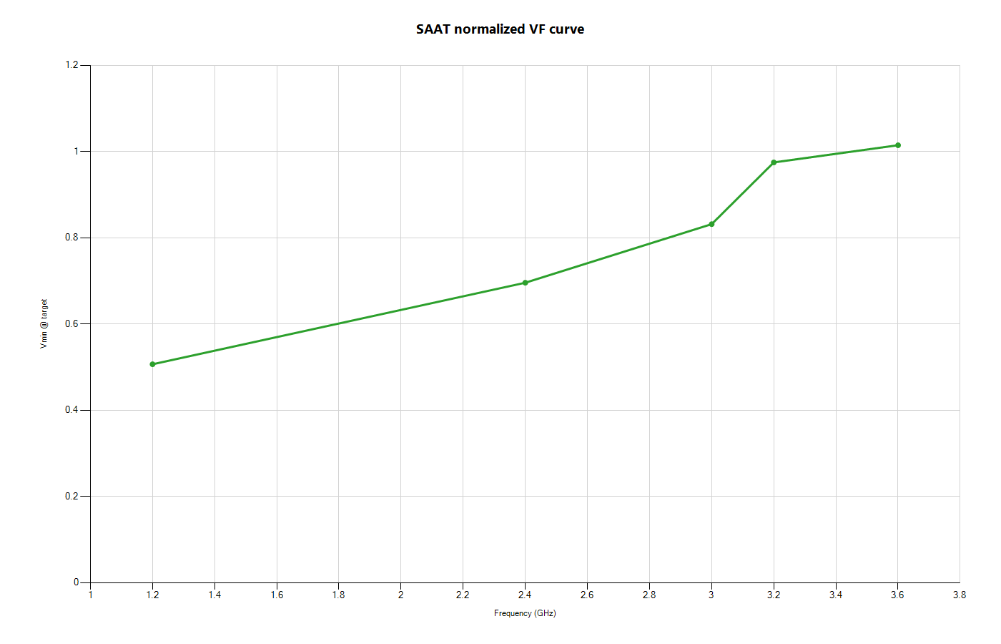
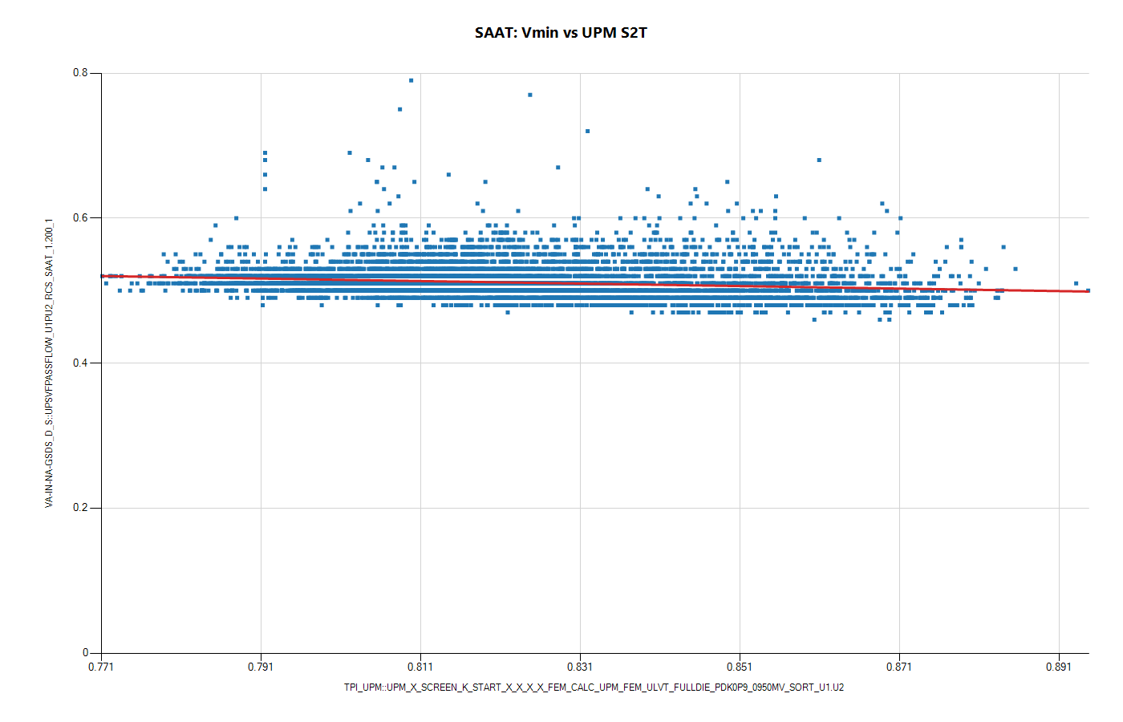
Domain SAAT: VF and Vmin-vs-UPM

Slide 10
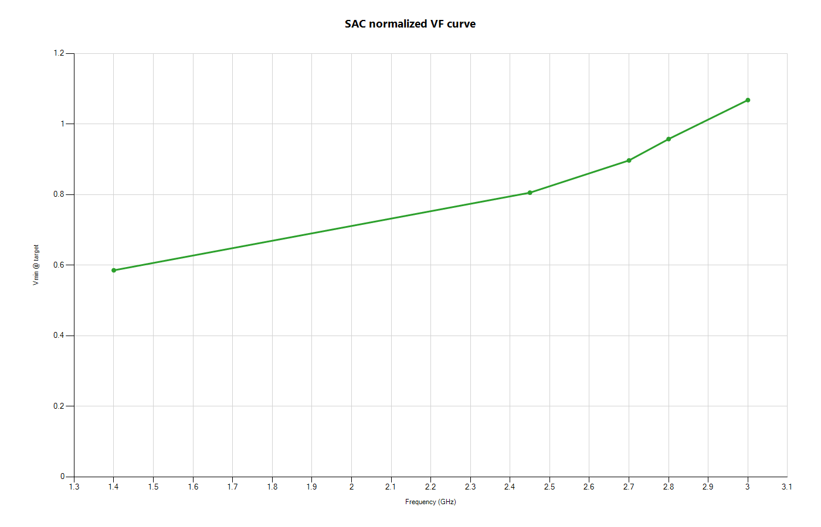
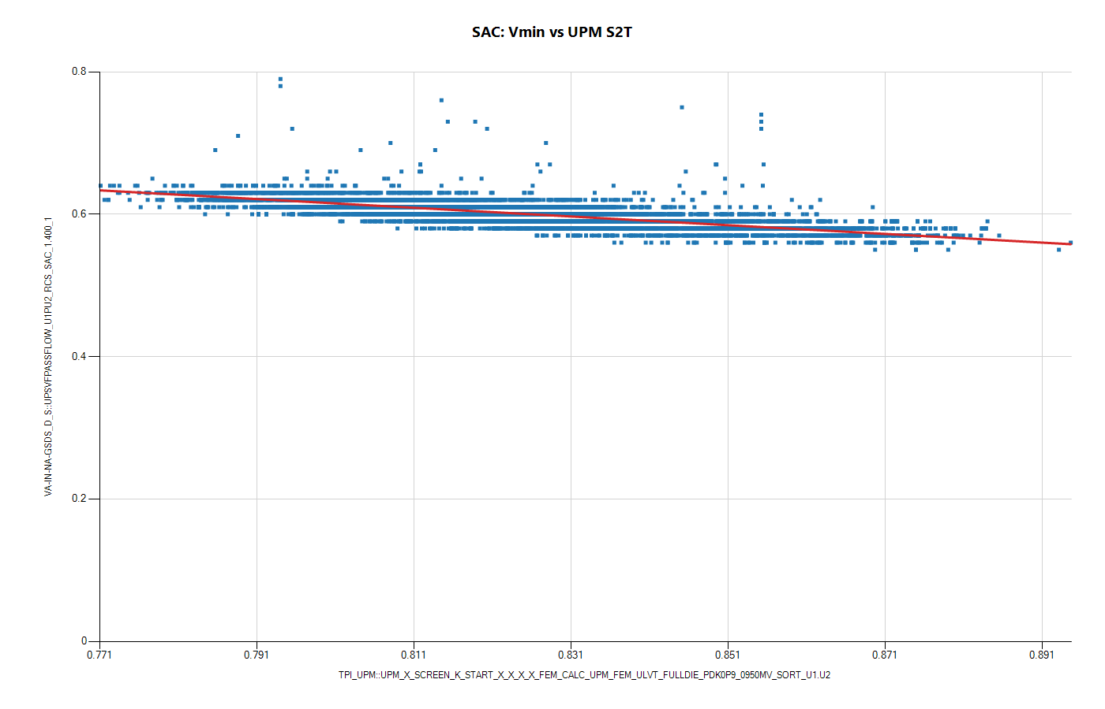
Domain SAC: VF and Vmin-vs-UPM

Slide 11
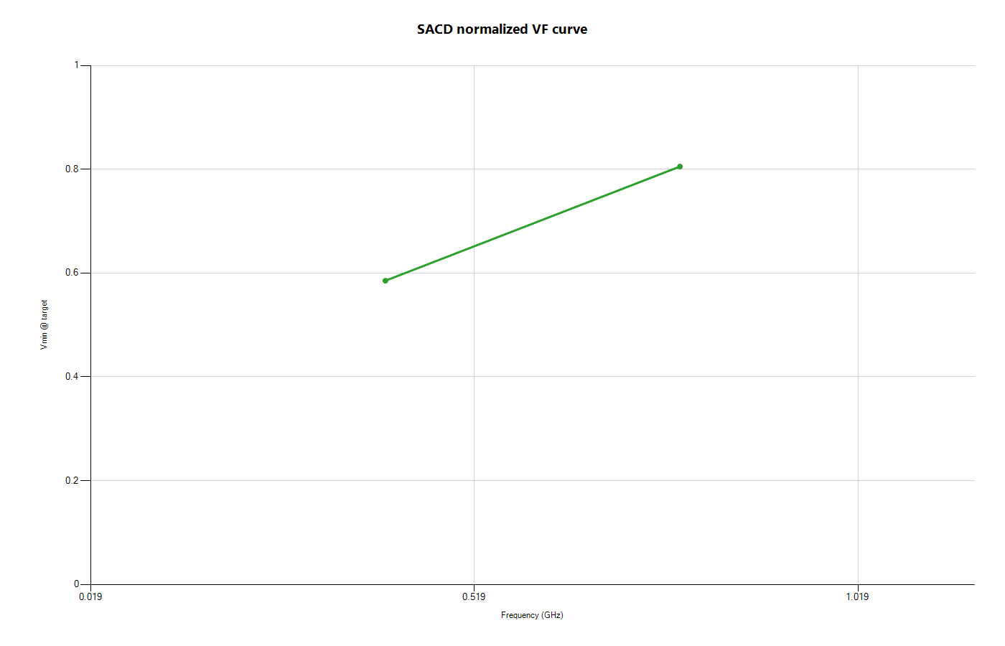

Domain SACD: VF and Vmin-vs-UPM

Slide 12
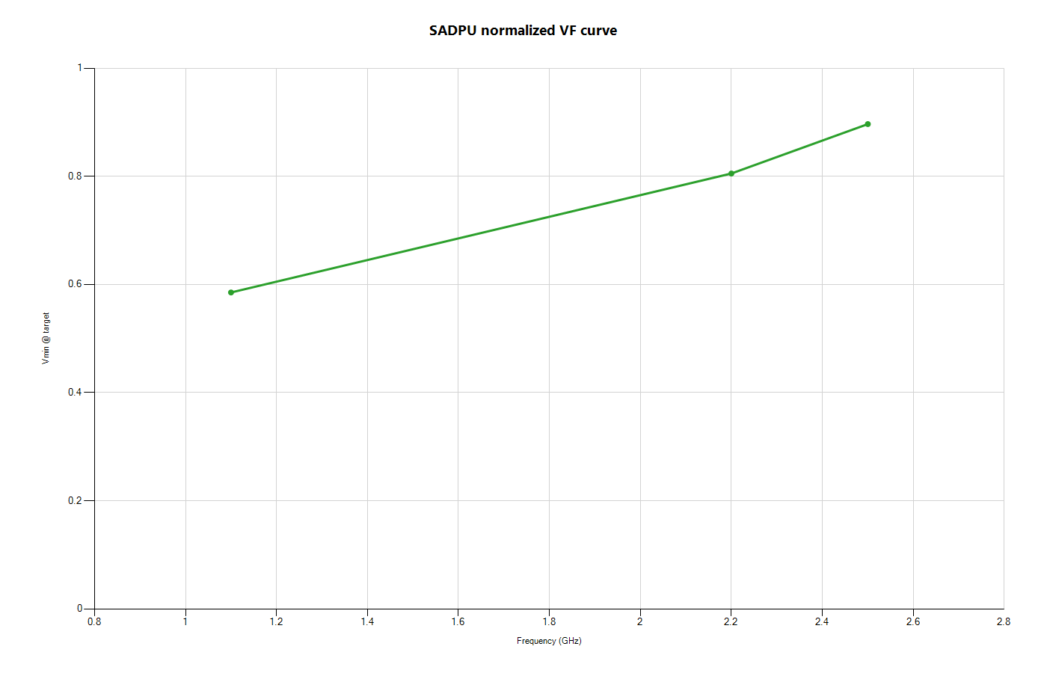
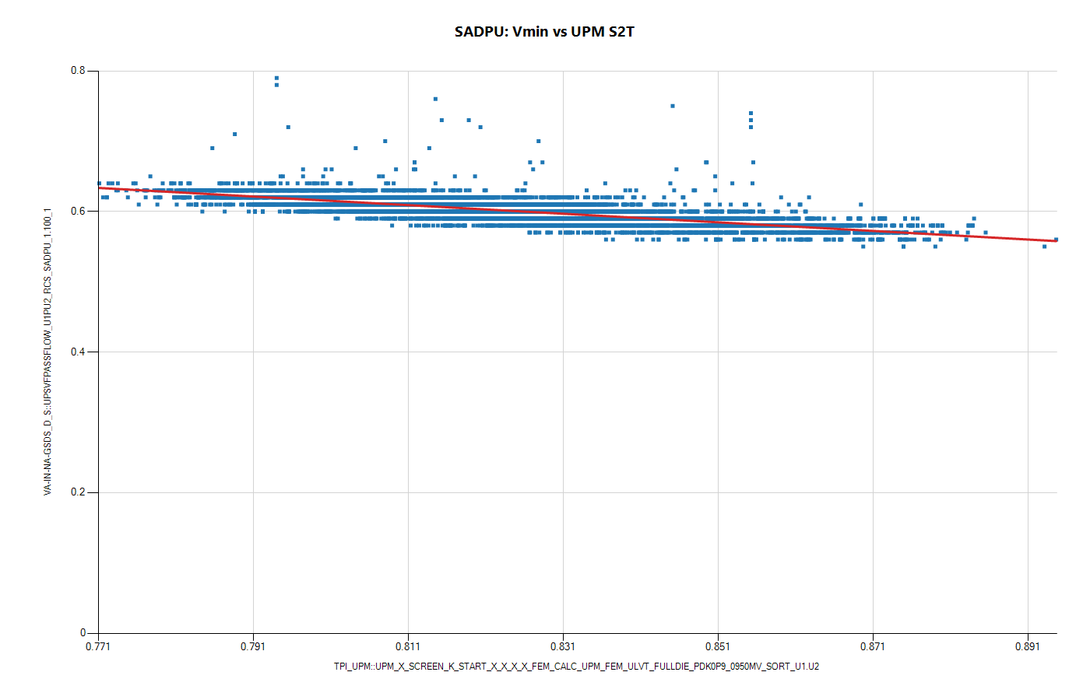
Domain SADPU: VF and Vmin-vs-UPM

Slide 13
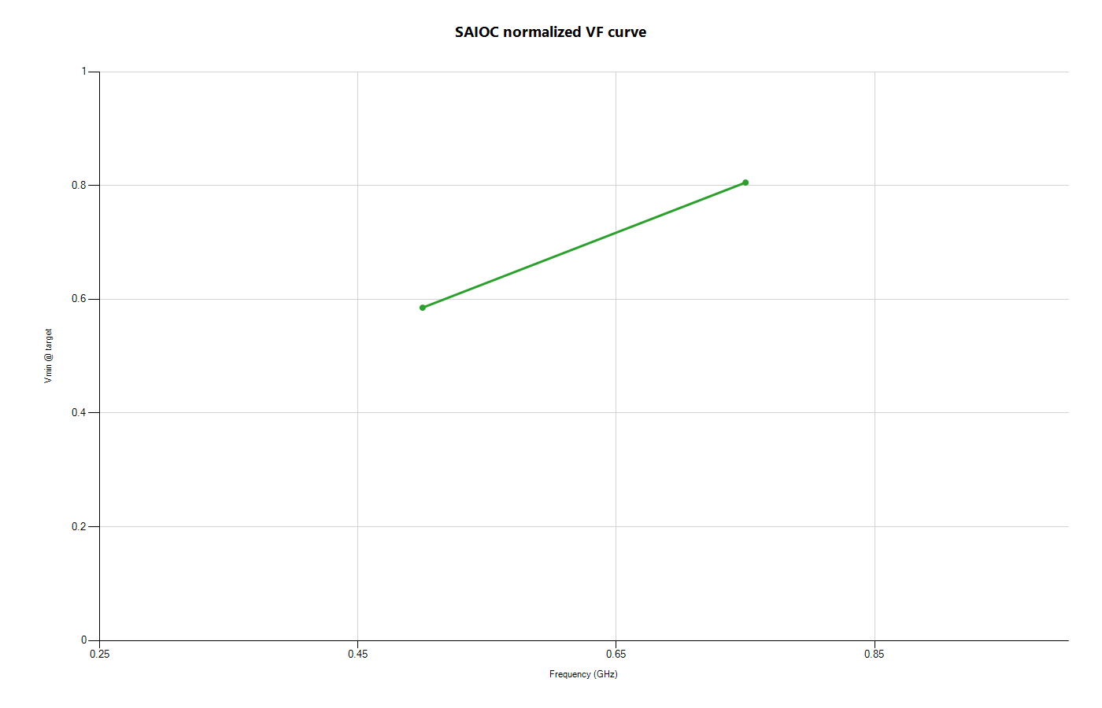

Domain SAIOC: VF and Vmin-vs-UPM

Slide 14


Domain SAME: VF and Vmin-vs-UPM

Slide 15
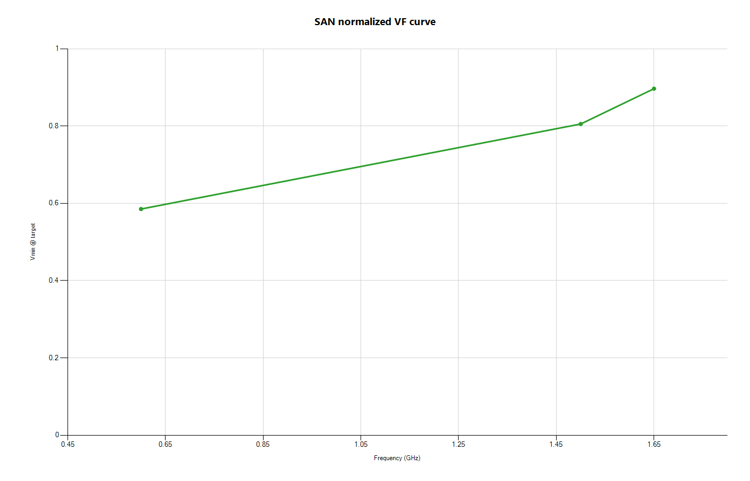

Domain SAN: VF and Vmin-vs-UPM

Slide 16


Domain SAPS: VF and Vmin-vs-UPM

Slide 17
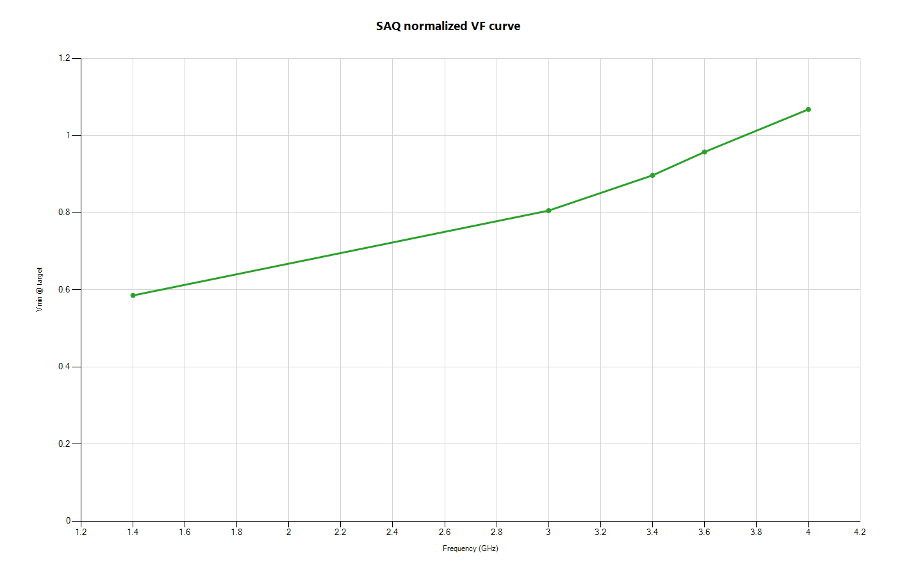

Domain SAQ: VF and Vmin-vs-UPM

Slide 18
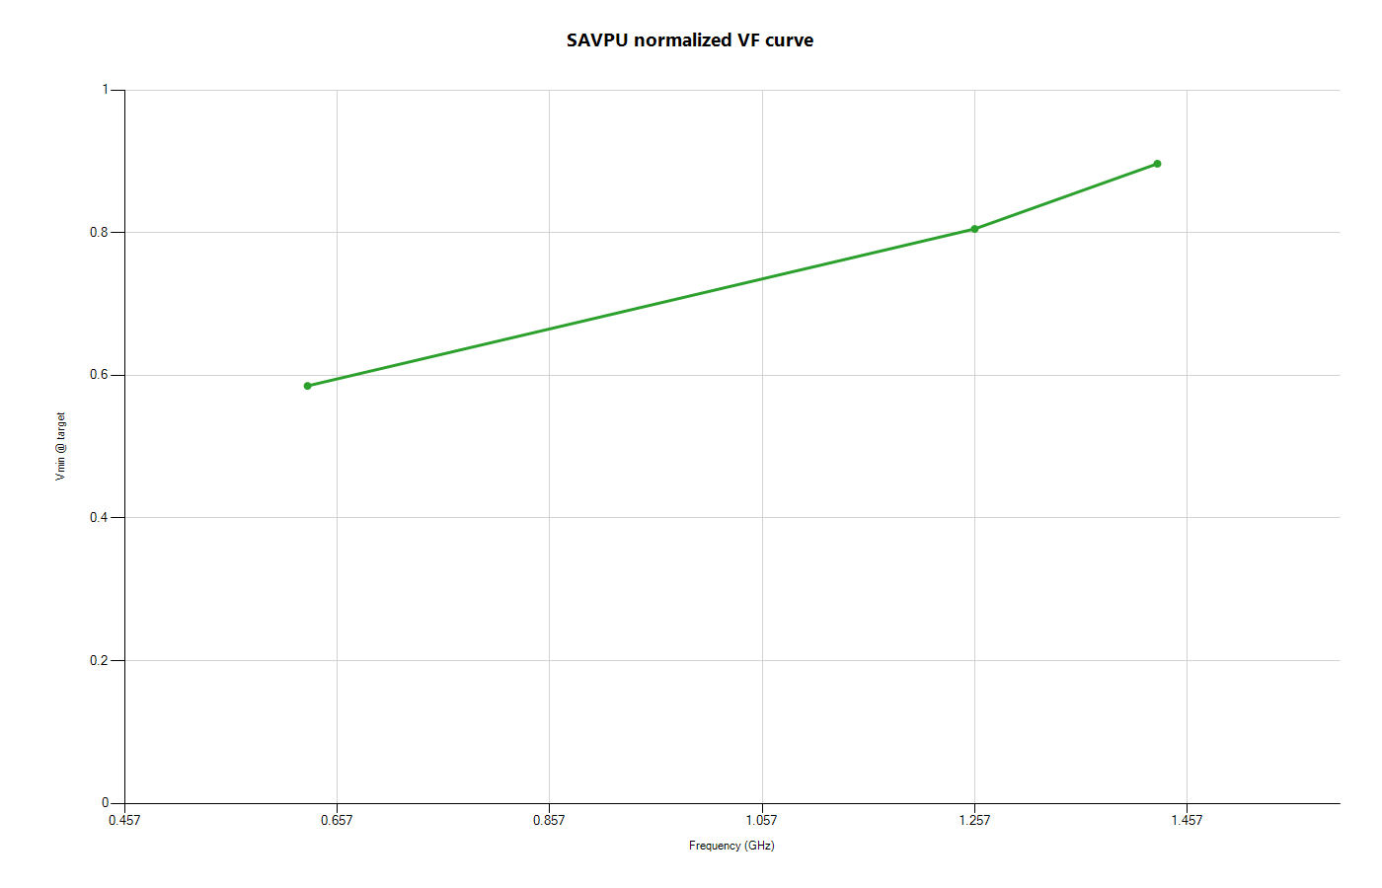

Domain SAVPU: VF and Vmin-vs-UPM

