Slide 1
Hiring Process Analytics
Traininty
Harsh Shrivastava

Slide 2
Agenda
Project Info
Description
Approach
Tech Stack Used
Insights
Summary

Slide 3
Project Info
Description
The aim is to analyze the hiring trends for a MNC. As a Data Analyst at Google, the task is to extract meaningful insights and provide report to the hiring department for better Hiring process.
Approach
The project follows a systematic approach to Exploratory Data Analysis (EDA), including understanding the data columns and their content, checking for missing data, clubbing columns with multiple categories for comprehensive analysis, identifying and handling outliers, and creating a data summary. Using statistical knowledge and Excel formulas.
Tech-Stack Used
Windows 11
Excel
VBA
Statistical Knowlegde

Slide 4
InSIGHTS
Task 1: Determine the gender distribution of hires. How many males and females have been hired by the company?
Total of 7169 Candidates interviewed and only 4697 got the job in different departments.
2563 are Male
1856 are Female

Slide 5
InSIGHTS
Task 2: What is the average salary offered by this company? Use Excel functions to calculate this.
Many departments had their minimum and maximum salaries and Operations Department Offered the Highest Salary.
The company provided the average salary of ~50,000

Slide 6
InSIGHTS
Task 3: Create class intervals for the salaries in the company. This will help you understand the salary distribution
Company offered minimum of $100 and maximum to an whopping $400,000.
Maximum number of Salary Offered laid in the range of $40k - $80K

Slide 7
InSIGHTS
Task 4: To show the proportion of people working in different departments.
9 departments had hiring in the year of 2014 in the 2nd Quarter, offering 4000+ job applications.
HR Department hired the lowest number of candidates - 70
&
Operations Department on the other hand, hired the highest number of candidates - 1843

Slide 8
InSIGHTS
Task 4: Represent the different position tiers within the company.
15 positions and c9 have the highest number of hiring and 4 positions such as n9, n6, m7, n10 hired 1 each in their departments.

Slide 9
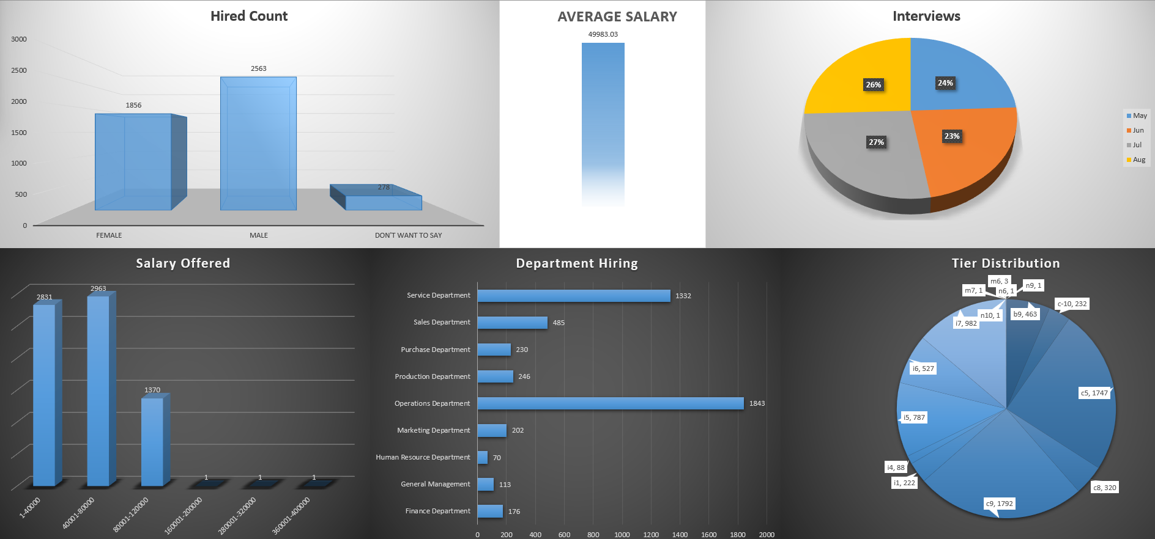
Summary
We have provided insights and analyzed the data that will help the company to conduct and see more carefully into their hiring.

