Slide 1


robot04 Mapping Experiments: 20 October 2026
BCIT Centre of Welding Technologies and Metallurgy Research
x
Motion and Power Electronics Control (MPEC) Lab
18 autonomous exploration runs · Hector SLAM, Nav2 and frontier exploration on a Raspberry Pi 5 · robot04 (MentorPi T1)
By:
Marthens HAKIZIMANA
Amir TAGHAVIPOUR
Notes:
Results of one day of autonomous mapping tests with robot04: what ran, how each run ended, the maps that were saved and what to fix next.

Slide 2
The Day at a Glance
20 October 2026, 09:32 – 12:57
18
153 m
32.5 min
8
autonomous runs
driven by the robot
explorer time
maps saved on the PC
1
Bounded area: works
7 of 9 enclosure runs finished and drove home; the last 6 runs had no failed goal
2
Large open area: not yet
82 % of goals aborted by Nav2 in the morning; no run got back to its start
3
Two side findings
battery check trips on voltage dips; new app timer matches the explorer within 12 s
No code changed during the day: the runs differ in where they ran and how they ended.
2
Motion and Power Electronics Control (MPEC) Lab
BCIT Centre for Welding Technologies and Metallurgy Research
Notes:
Eighteen runs in about three and a half hours, 153 metres driven. The main result: in a bounded area the whole loop works, mapping until no frontier is left and returning home. In the large open area it does not yet.

Slide 3
Setup and What Was Measured
Same software and parameters in every run
On the robot (Raspberry Pi 5)
On the PC (robot04 mapper app)
Hector SLAM, 0.05 m cells, MS200 lidar 10 Hz
Nav2: NavFn + Regulated Pure Pursuit, 0.10 m/s
Frontier explorer: radius 0.15 m, min frontier 0.30 m, replan 3 s, no-progress 30 s, battery ≥ 7.0 V
Watches map, path, Nav2 plan and frontiers
Starts the stack over ssh; Explore / Pause / Home
Saves pgm + yaml + json; new mapping timer saved with the map
Measure | Source | Definition
duration | explorer log | Explore pressed → done or operator stop
distance | explorer log | sum of SLAM pose steps
mapped area | map | known cells (free + occupied) × 0.05² m², also beyond walls
goals | explorer log | reached / frontier seen on the way / failed (Nav2 aborted, timeout)
Data: 18 explorer logs, 17 robot maps, 8 PC maps, all in experiments/2026-10-20/data.
3
Motion and Power Electronics Control (MPEC) Lab
BCIT Centre for Welding Technologies and Metallurgy Research
Notes:
Everything ran on the Pi; the PC only watched and saved maps. The explorer logs every goal and samples the pose, mapped area and battery every few seconds, which is where all the numbers in this deck come from.

Slide 4
Five Sessions Through the Day
How each group of runs ended
A
B
C
D
E
09:32
10:09
10:53
11:49
12:38
Large open area
One long run
Battery low
Small enclosure
Enclosure, repeat
4 runs
0 back home
65 / 79 goals failed
26 m driven
1 runs
0 back home
2 / 16 goals failed
59 m driven
4 runs
0 back home
0 / 5 goals failed
0 m driven
5 runs
4 back home
10 / 34 goals failed
29 m driven
4 runs
3 back home
0 / 31 goals failed
39 m driven
Failures fell from 82 % (A) to 29 % (D) to 0 % (E) as the area became smaller and closed.
4
Motion and Power Electronics Control (MPEC) Lab
BCIT Centre for Welding Technologies and Metallurgy Research
Notes:
Session A was a large open area; B one long run there; C four runs that stopped at once on the battery rule; D and E a small walled enclosure, where the explorer finished on its own.

Slide 5
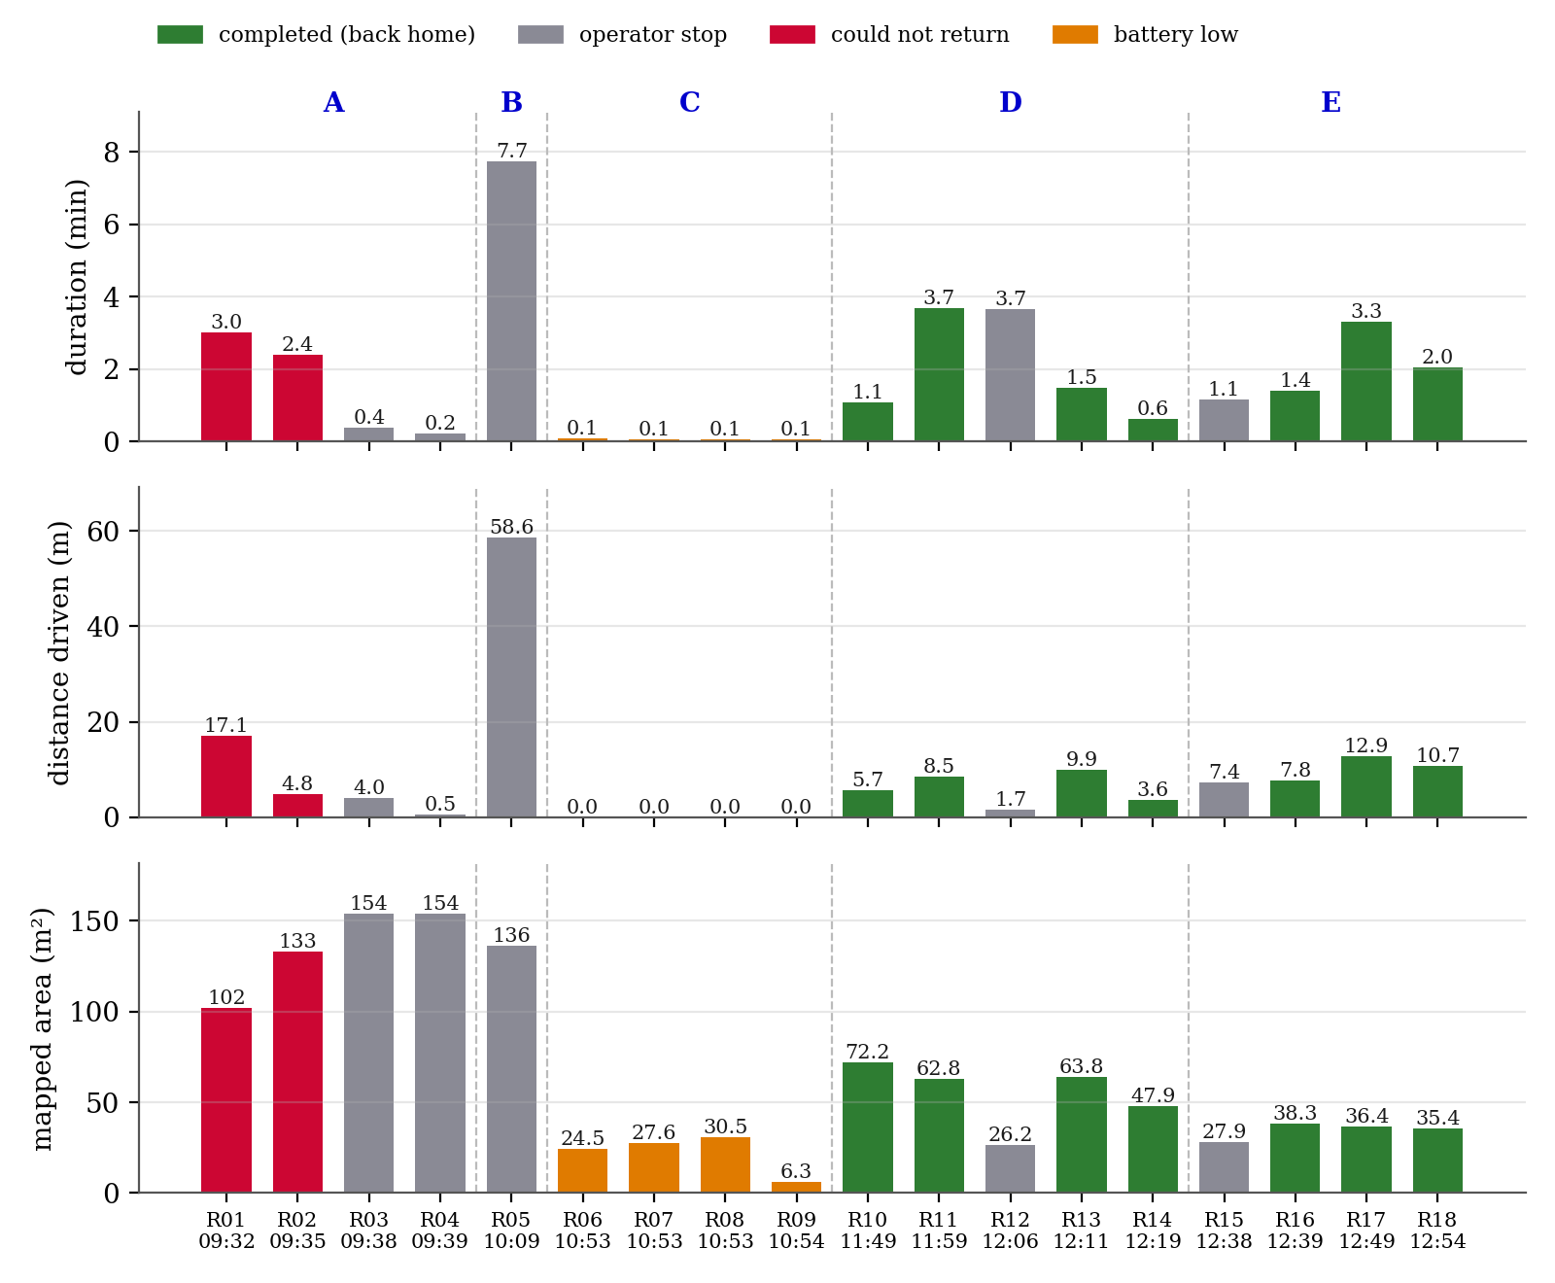
Every Run
Duration, distance and mapped area, coloured by outcome
Longest
R05: 7.7 min, 58.6 m, 136 m²
Completed
7 runs, 0.6–3.7 min
Cumulative
A and C kept one SLAM map across runs, so their area adds up
Green = explored to the last frontier and drove home without help.
5
Motion and Power Electronics Control (MPEC) Lab
BCIT Centre for Welding Technologies and Metallurgy Research
Notes:
One bar per run. Red: could not drive back. Grey: stopped by the operator. Orange: battery low. Green: done.

Slide 6
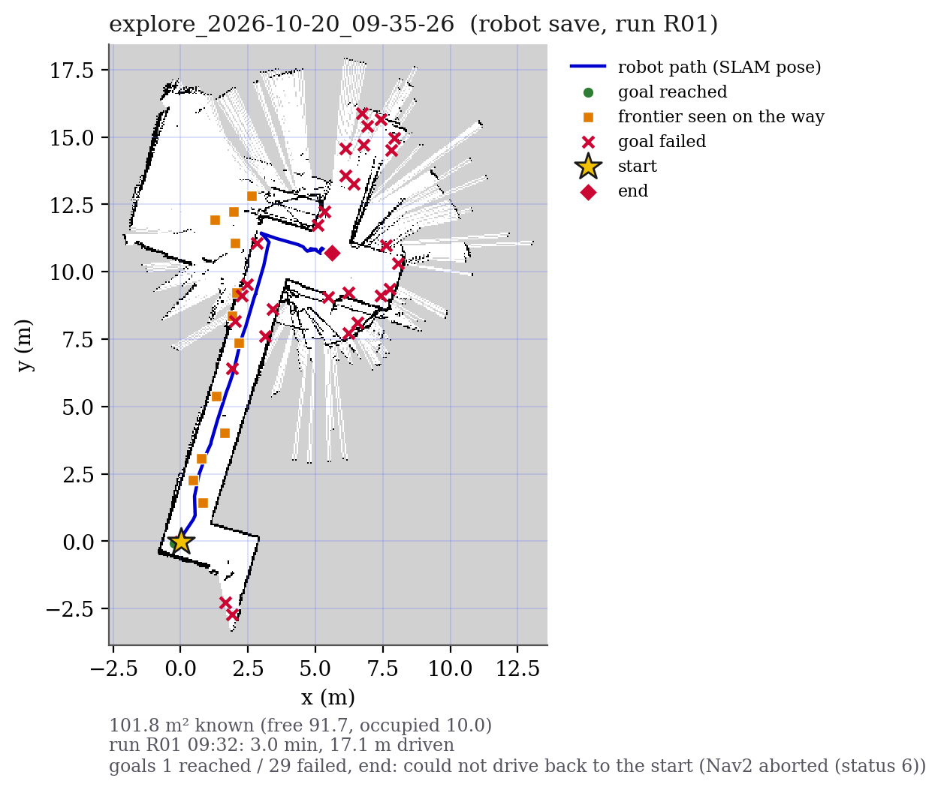
Session A: Large Open Area
Nav2 aborted 62 of 74 goals in R01 and R02
29 / 41
33 / 33
R01 goals failed / sent
R02 goals failed / sent
Failed goals (×) sit at the far edge of the map and behind walls
Neither run could drive back to its start
Frontier search 80–150 ms per goal here (20–70 ms in the enclosure)
Open question: why Nav2 aborts. Check the 0.45 m wall clearance in narrow passages and goals inside the inflated costmap.
The explorer kept choosing goals Nav2 could not plan to: 41 goals in 3 min in R01.
6
Motion and Power Electronics Control (MPEC) Lab
BCIT Centre for Welding Technologies and Metallurgy Research
Notes:
The robot's own save from R01. Blue is the path, red crosses the goals Nav2 aborted. The cause is not known yet; the next test is to log the abort reason and the costmap at each failed goal.

Slide 7
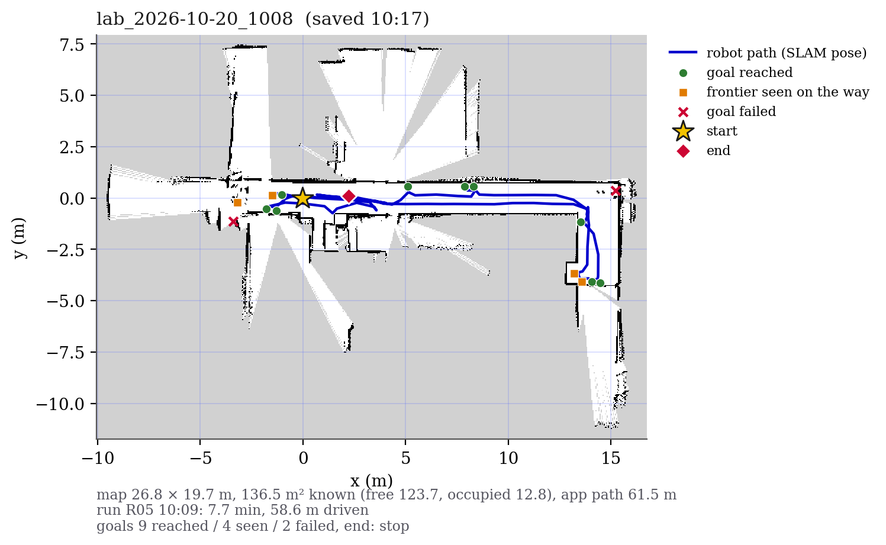
Session B: The Longest Run
R05, 10:09, saved as lab_2026-10-20_1008
7.7 min
58.6 m
explored
driven
136 m²
9 / 2
mapped
goals reached / failed
A corridor about 15 m long and the branch at its far end; stopped by the operator before it finished
In the same area as session A, one run reached 9 goals and drove 59 m.
7
Motion and Power Electronics Control (MPEC) Lab
BCIT Centre for Welding Technologies and Metallurgy Research
Notes:
The longest run of the day: nearly 8 minutes and 59 metres, 136 square metres mapped. Only 2 of 16 goals failed. The operator stopped it before the end.

Slide 8
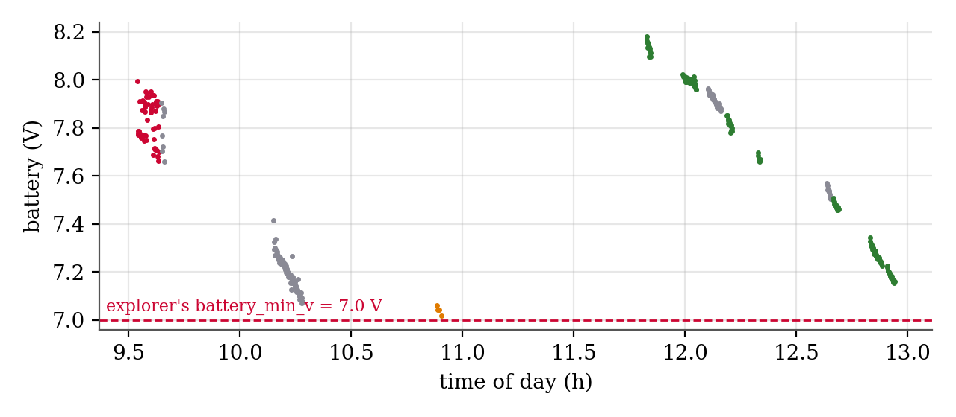
Session C: The Battery Rule Fired at Once
Four runs at 10:53, each ended within 4 s
Run | Battery | Ran
R06 | 7.06 V | 4 s
R07 | 7.04 V | 4 s
R08 | 7.04 V | 4 s
R09 | 7.02 V | 4 s
Fix: filter the voltage (e.g. a 5 s mean) before comparing it with 7.0 V, and log the minimum voltage.
Explorer limit: battery_min_v = 7.0 V
Logged samples 7.02–7.06 V, but the check uses the instantaneous voltage, which dips when the motors start
R05 had ended at 7.07 V; by 11:49 the battery read 8.18 V
A safety rule on a raw voltage stops the robot at the first load step.
8
Motion and Power Electronics Control (MPEC) Lab
BCIT Centre for Welding Technologies and Metallurgy Research
Notes:
Each of these runs cancelled its first goal with 'battery low' and went home. The voltage in the log was just above the limit; the dip when the tracks start pushed the instantaneous value below it.

Slide 9
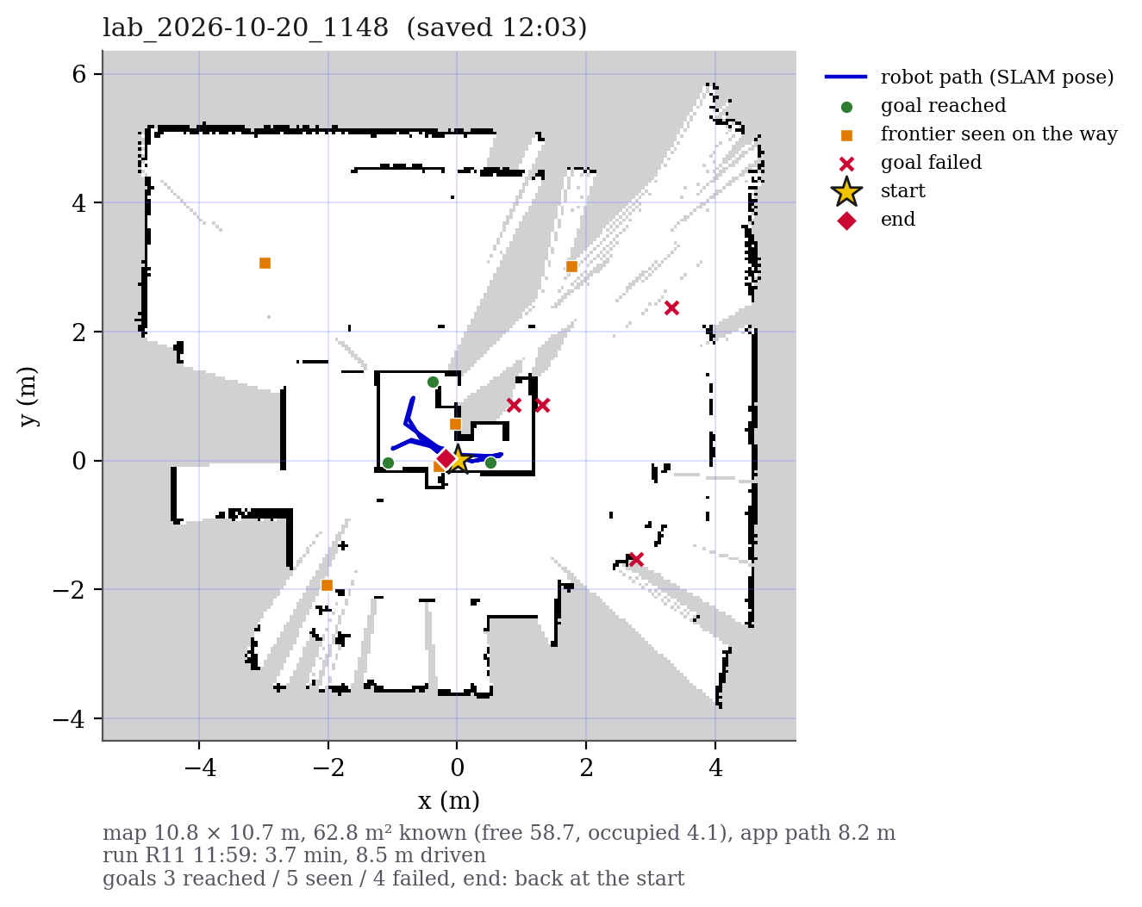
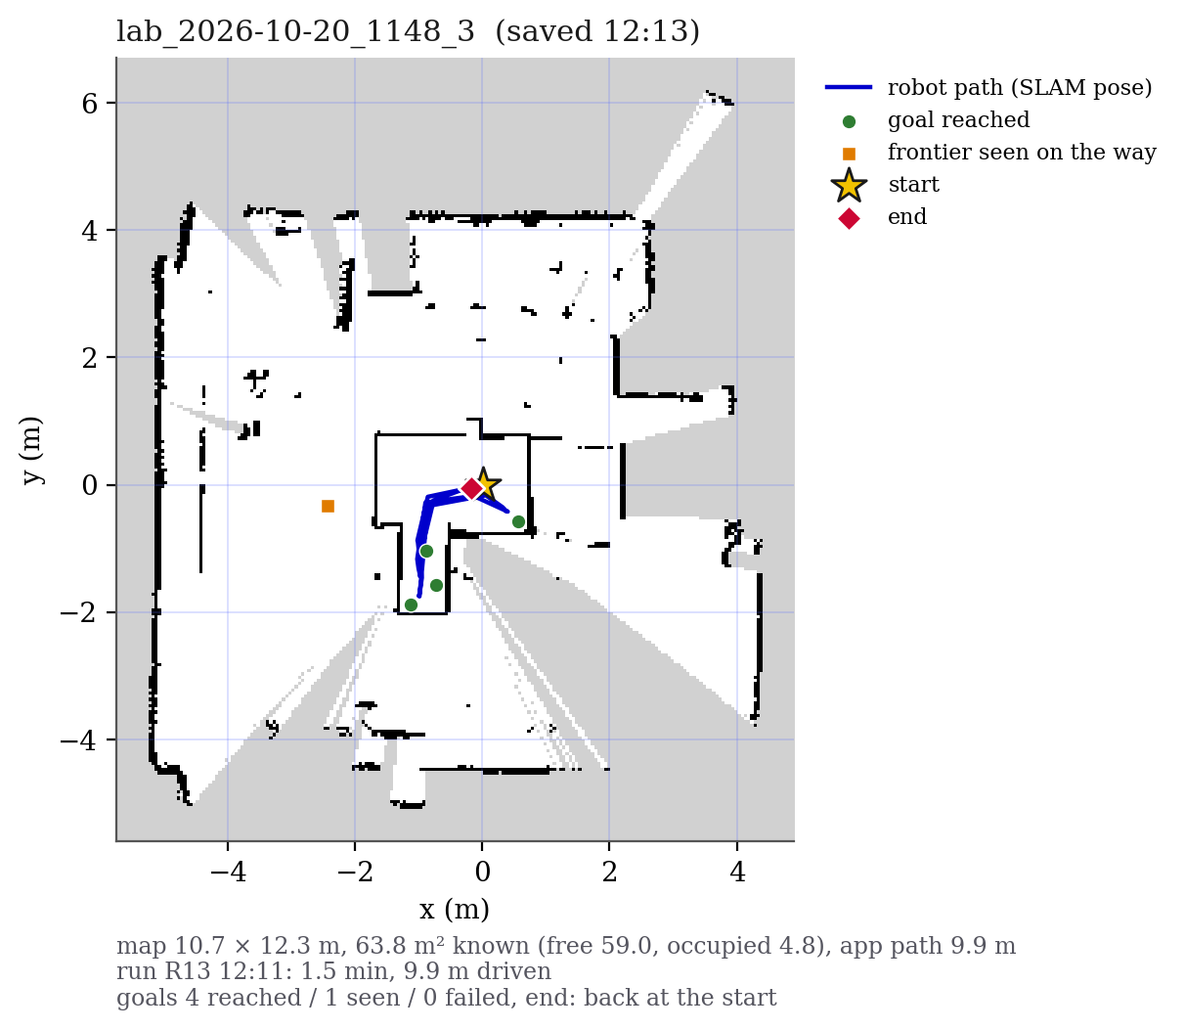
Session D: A Small Enclosure
11:49 – 12:21, four of five runs finished on their own
R11 (left): R11 11:59: 3.7 min, 8.5 m, 3 reached / 4 failed; failed goals outside the walls. R13 (right): R13 12:11: 1.5 min, 9.9 m, 4 reached / 0 failed.
The lidar sees out of the enclosure; goals placed out there cannot be reached and fail.
9
Motion and Power Electronics Control (MPEC) Lab
BCIT Centre for Welding Technologies and Metallurgy Research
Notes:
The robot drove only inside the walled enclosure about 2.5 m across; the lidar saw out into the room, so the map is larger than the area the robot could drive. 10 of 34 goals failed, all outside or against the walls.

Slide 10
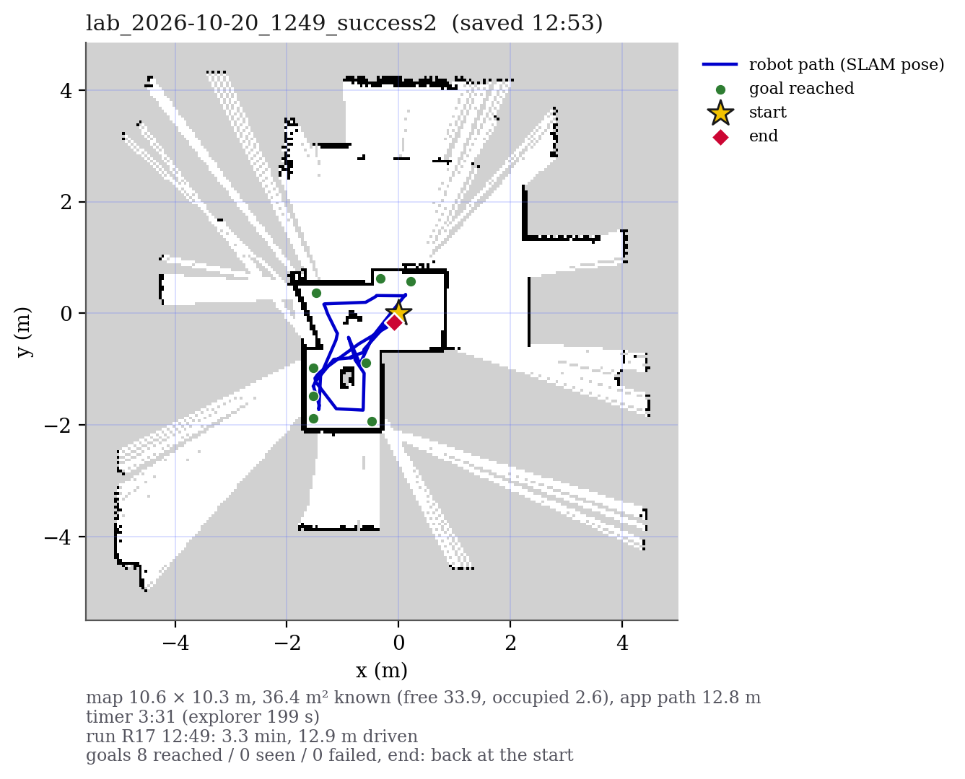
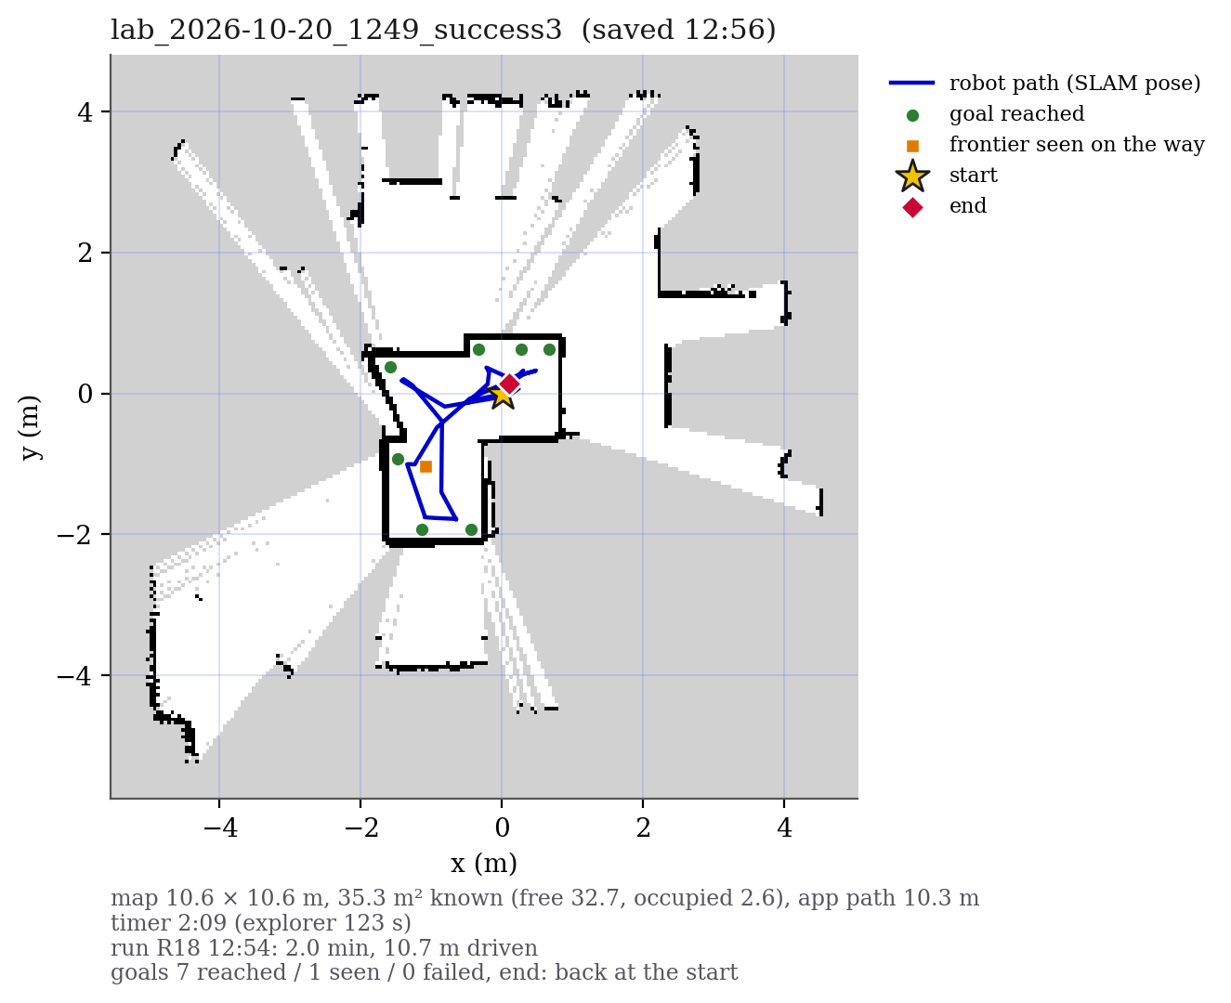
Session E: Repeat Runs, No Failed Goals
12:38 – 12:57, 31 goals sent, none failed
Completed runs R16–R18: 1.4–3.3 min, 7.8–12.9 m driven, mean 0.08 m/s (cruise 0.10), 5–14 s to drive home after the last frontier.
R17 (left) reached all 8 of its goals; R18 (right) 7, and saw 1 more on the way.
10
Motion and Power Electronics Control (MPEC) Lab
BCIT Centre for Welding Technologies and Metallurgy Research
Notes:
The last session: three of four runs finished, R15 was stopped by the operator. No goal failed. These two maps were also the first saved with the app's new timer.

Slide 11
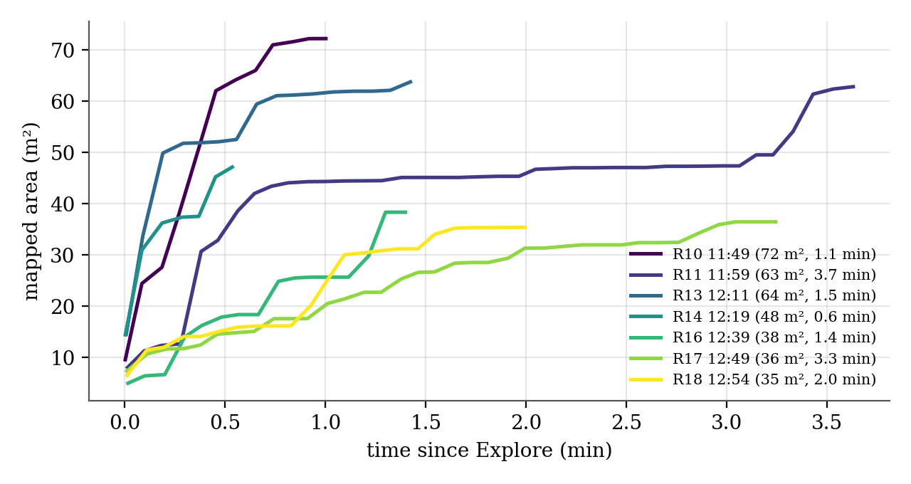
How Long Mapping Takes
Mapped area against time, and the new app timer
Map | App timer | Explorer
R17 | 211 s | 199 s
R18 | 130 s | 123 s
Timer runs while SLAM poses arrive and is saved in the map's json.
Reads 6–12 s longer: it also counts SLAM before Explore and the time until the map is saved.
Steep start: each goal opens a new view for a 360° lidar
Then corners one at a time: R11 sat at 45–47 m² for more than 2 min
Completed runs: 0.6–3.7 min
Use the explorer time to compare runs; the app timer records the whole session.
11
Motion and Power Electronics Control (MPEC) Lab
BCIT Centre for Welding Technologies and Metallurgy Research
Notes:
Each completed run maps quickly at first and then slowly. The timer added to the app today agrees with the explorer's clock; the difference is the time before Explore and before saving.

Slide 12
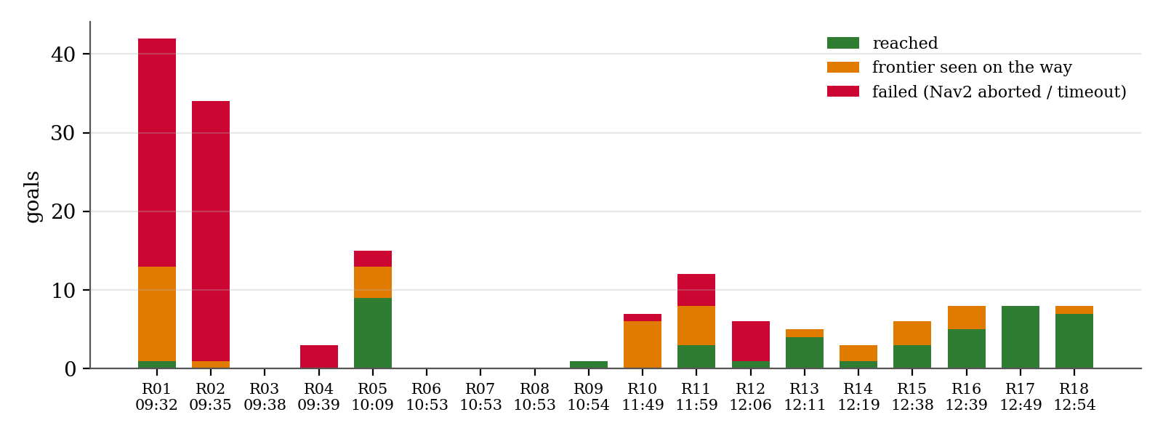
Where the Goals Went
Goal outcomes per run
Session | A | B | C | D | E
failed / sent | 65 / 79 | 2 / 16 | 0 / 5 | 10 / 34 | 0 / 31
Orange: frontiers the lidar cleared before the robot got there, so the explorer moved on.
12
Motion and Power Electronics Control (MPEC) Lab
BCIT Centre for Welding Technologies and Metallurgy Research
Notes:
Green goals were reached, orange disappeared on the way, red failed. The failures are almost all in the morning's open area.

Slide 13
The Saved Maps
~/Desktop/robot04_maps, lab_2026-10-20_*
Map | Run | Extent (m) | Known m² | Occupied m² | Path (m) | Timer
1008 | R05 | 26.8 × 19.7 | 136.5 | 12.8 | 61.5 | –
1148 | R11 | 10.8 × 10.7 | 62.8 | 4.1 | 8.2 | –
1148_2 | R12 | 10.2 × 10.6 | 26.2 | 1.5 | 1.7 | –
1148_3 | R13 | 10.7 × 12.3 | 63.8 | 4.8 | 9.9 | –
1148_4 | R14 | 9.8 × 10.9 | 47.8 | 3.4 | 3.5 | –
1237_success | R16 | 10.6 × 11.2 | 38.3 | 2.4 | 7.7 | –
1249_success2 | R17 | 10.6 × 10.3 | 36.4 | 2.6 | 12.8 | 211 s
1249_success3 | R18 | 10.6 × 10.6 | 35.3 | 2.6 | 10.3 | 130 s
Every map is also plotted with metric axes, path and goals in figures/maps.
13
Motion and Power Electronics Control (MPEC) Lab
BCIT Centre for Welding Technologies and Metallurgy Research
Notes:
Eight maps saved from the PC app. All are map_server pgm and yaml, so Nav2 can load them.

Slide 14
Findings and Next Steps
What to change before the next session
1
Works in a bounded area: 7 of 9 enclosure runs finished and drove home; last 6 runs: 0 failed goals
2
Open areas: Nav2 aborts: log the abort reason and costmap per failed goal; try a smaller inflation
3
Unreachable frontiers: drop frontiers with no path in the global costmap before sending them
4
Battery rule: filter the voltage before the 7.0 V check; log the minimum
5
Timing: explorer time per run; app timer saved with every map from now on
Next session: the same enclosure test, then the open area with Nav2 abort logging.
14
Motion and Power Electronics Control (MPEC) Lab
BCIT Centre for Welding Technologies and Metallurgy Research
Notes:
Five points: the loop works when the area is closed; the open area needs the Nav2 failures understood; unreachable frontiers should be filtered; the battery check needs filtering; and every map now carries its time.

