Slide 1


A Low-Cost Robot that Maps a Home on Its Own
BCIT Centre of Welding Technologies and Metallurgy Research
x
Motion and Power Electronics Control (MPEC) Lab
Hector SLAM, Nav2 and frontier exploration on a Raspberry Pi 5 · robot04 (MentorPi T1), October 2026
By:
Marthens HAKIZIMANA
Amir TAGHAVIPOUR
Notes:
~20 s. This is about turning a small educational robot into one that maps a home by itself: it decides where to go, avoids obstacles, and comes back with a map. Everything runs on a Raspberry Pi 5; my laptop only watches.

Slide 2
Why Let the Robot Drive Itself?
Motivation & goal
1
A map comes first
Localisation, path planning and inspection all start from a map of the space
2
Driving is the slow part
With a lidar the mapping is solved; steering slowly through every room is not
3
Low-cost hardware
Can a low-cost tracked robot with an entry-level lidar do it, with everything on board?
Goal: press Explore, walk away, come back to a finished map of the house.
2
Motion and Power Electronics Control (MPEC) Lab
BCIT Centre for Welding Technologies and Metallurgy Research
Notes:
~40 s. Mapping with a 2D lidar is a solved problem; what costs time is the operator driving slowly through every room. Frontier exploration automates that. The question was whether a cheap robot can do it with all the computation on board.

Slide 3
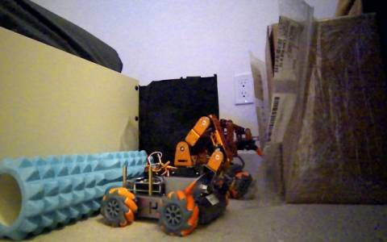
robot04: What We Started With
Hiwonder MentorPi T1, rebuilt on ROS 2 Jazzy
Computer
Raspberry Pi 5, 8 GB · Ubuntu 24.04 · ROS 2 Jazzy
Drive
2 tracks, JGB37-520 motors, STM32 speed loop · 0.15 m/s top
Lidar
Oradar MS200 · 360° · 10 Hz · own ROS 2 driver
Camera
Deptrum Aurora 930 RGB-D · watched from the PC
Operator
Laptop, ROS 2 Humble, same Wi-Fi · Cyclone DDS
What the robot sees: its RGB camera, 10 fps on the PC
Written for this work: lidar driver (47-byte packets, CRC-8, 450 rays), velocity adapter, frontier explorer, Nav2 configuration, the PC mapper app, and a lidar-only calibration test.
Standard ROS 2 parts where they exist; small, testable glue where they don't.
3
Motion and Power Electronics Control (MPEC) Lab
BCIT Centre for Welding Technologies and Metallurgy Research
Notes:
~40 s. The robot: Pi 5, tracks, a 360 degree lidar and a depth camera. There was no ROS 2 driver for the lidar, so I wrote one. The rest is standard ROS 2: Hector SLAM and Nav2, plus glue I wrote.

Slide 4
Which SLAM, Which Navigation, Which Exploration?
Related work and the choices made
Component | Options considered | Chosen | Why
2D SLAM | GMapping (RBPF), Cartographer, SLAM Toolbox, Hector | Hector SLAM | needs no odometry (tracks skid); ≈ 3 % of a Pi core
Navigation | Nav2: DWB, MPPI, Regulated Pure Pursuit | Nav2 + RPP | slow diff-drive robot, few parameters, built-in collision check
Planner | NavFn, Smac 2D/Hybrid, Theta* | NavFn (A*) | cheap, allow_unknown for goals at the map's edge
Exploration | explore_lite, RRT exploration, information gain | own greedy frontier | every decision logged; blacklist + return home; Jazzy native
Placement | SLAM on PC, robot as sensor vs. all on robot | all on robot | Wi-Fi drop must not break the control loop
Kohlbrecher 2011 (Hector) · Grisetti 2007 (GMapping) · Hess 2016 (Cartographer) · Macenski 2020/2023 (Nav2, RPP) · Yamauchi 1997 (frontiers) · Umari 2017 (RRT exploration)
Mature parts for SLAM and navigation; the explorer is the only planning logic written here.
4
Motion and Power Electronics Control (MPEC) Lab
BCIT Centre for Welding Technologies and Metallurgy Research
Notes:
~45 s. For SLAM I chose Hector because it needs no odometry, and the tracks skid. For navigation Nav2 with Regulated Pure Pursuit, which suits a slow differential robot. The explorer is my own greedy frontier explorer, because I wanted every decision logged and a clean return home.

Slide 5
Every Loop on the Robot, the PC Only Watches
System architecture: nodes, rates and where they run
Drivers
SLAM
Navigation
Explorer
robot-fleet-node.service
robot-explore.service
robot-explore.service
robot-explore.service
ms200_node /scan 10 Hz
robot_node odom 20 Hz,
cmd_vel, 0.25 m stop
camera_bridge JPEG 10 Hz
hector_mapping
/map 1 Hz, 5 cm, 1024²
TF map → robot04/odom
planner 1 Hz (NavFn)
controller 8 Hz (RPP)
local costmap 10 Hz
BT navigator, smoother 20 Hz
search every 3 s
NavigateToPose action
/explore/state 1 Hz
JSONL run log
Raspberry Pi 5 · ROS 2 Jazzy · Cyclone DDS · domain 17 · ≈ 1.5 of 4 cores
Operator PC: Humble, Wi-Fi
subscribes /map, /plan, /slam_out_pose, JPEG, /explore/state · publishes /explore/control and teleop cmd_vel · starts the stack with ssh systemctl --user
Rule: a Wi-Fi drop costs the view, never the control loop
Hector on the PC worked for teleop mapping (≈ 20 KB/s, +6 ms); for autonomy it moved on board.
5
Motion and Power Electronics Control (MPEC) Lab
BCIT Centre for Welding Technologies and Metallurgy Research
Notes:
~60 s. Two systemd services on the Pi: drivers at boot, and the exploration stack on demand, which the PC starts over ssh. Every control loop runs on the Pi. The laptop subscribes to the map, plan, camera and explorer state, and only publishes start, pause and home.

Slide 6
A Lidar Driver and a Frame Tree
ms200_node (written for this work) and the TF chain
Bytes | Field (MS200, LD06 layout)
0–1 | header 0x54 0x2C
2–3 | rotation speed, °/s
4–5 | start angle, 0.01°
6–41 | 12 × (range mm u16, intensity u8)
42–43 | end angle, 0.01°
44–45 | time stamp, ms
46 | CRC-8, polynomial 0x4D
TF tree
map
hector_mapping, at scan time
robot04/odom
robot_node, encoders, 20 Hz
robot04/base_footprint
230 400 baud · angle of point k interpolated start → end
revolution ends when the angle wraps → 450 rays (0.8°), nearest return per ray, invalid = inf
device angles clockwise → negated (ROS: counter-clockwise) · drop < 0.10 m (own frame)
static: z = 0.12 m
robot04/laser
udev: /dev/lidar matched by USB ID and port (voice module is a CH340 too)
Lidar yaw checked against the camera: 0° is the front, angles counter-clockwise.
6
Motion and Power Electronics Control (MPEC) Lab
BCIT Centre for Welding Technologies and Metallurgy Research
Notes:
~45 s. No ROS 2 Jazzy driver existed, so I parsed the 47-byte packets myself, checked the CRC, and binned each revolution into 450 rays. The TF chain: Hector publishes map to odom, the motor node odom to base, and the laser is a static frame 12 cm up.

Slide 7
Hector SLAM: Scan Matching Without Odometry
Kohlbrecher et al. 2011, ROS 2 port, running on the Pi
ξ* = argmin_ξ Σᵢ [ 1 − M( Sᵢ(ξ) ) ]²
ξ = (x, y, ψ) robot pose · Sᵢ(ξ) = scan end point i in the map · M = occupancy, bilinearly interpolated
Δξ = H⁻¹ Σᵢ [ ∇M(Sᵢ(ξ)) ∂Sᵢ/∂ξ ]ᵀ [ 1 − M(Sᵢ(ξ)) ], H = Σᵢ [∇M ∂Sᵢ/∂ξ]ᵀ[∇M ∂Sᵢ/∂ξ]
Gauss–Newton step; coarse map level first, then fine (2 levels) to avoid local minima
Map | Updates | Scan window | Occupancy update | Frames | Cost on the Pi
5 cm, 1024² (51 m), 2 levels | every 0.2 m / 0.06 rad | 0.12–8 m | free 0.4 · occupied 0.9 | map → robot04/odom | ≈ 3 % of a core
No loop closure: Hector's map is only as good as each match. It holds at ≤ 0.6 rad/s turning; it fails if the robot's motion is not what the controller believes (slide 15).
Odometry-free SLAM suits tracks: the map is the only reference the pose needs.
7
Motion and Power Electronics Control (MPEC) Lab
BCIT Centre for Welding Technologies and Metallurgy Research
Notes:
~60 s. Hector finds the pose that puts every scan point on an occupied cell, by Gauss-Newton on a bilinearly interpolated map, coarse to fine. No odometry is used, which is why it suits a tracked robot. It has no loop closure, so a bad match stays in the map.

Slide 8
Nav2 on a Raspberry Pi: The Configuration
config/nav2.yaml (servers started directly, no bringup)
Server | Plugin / key parameters
planner_server | NavFn, A*, allow_unknown, tolerance 0.3 m
controller_server | RPP, 8 Hz, 0.10 m/s, lookahead 0.25–0.6 m
goal checker | 0.20 m, any heading
progress checker | 0.10 m in 20 s
local costmap | odom frame, 3 × 3 m rolling, 10 Hz, inflation 0.40
global costmap | map frame, static (/map) + scan, inflation 0.45
behavior_server | spin, backup, wait
velocity_smoother | 20 Hz, ≤ 0.12 m/s, ≤ 0.8 rad/s, open loop
bt_navigator | navigate_to_pose w/ replanning + recovery
Regulated Pure Pursuit
κ = 2 y_L / L²
ω = v κ
L: lookahead distance, y_L: lateral offset of the carrot
v reduced on tight curves (r < 0.5 m) and near obstacles (costmap cost)
rotate in place first when heading error > 0.6 rad, at 0.6 rad/s
collision check of the arc up to the carrot, 1.5 s ahead
robot = circle r = 0.15 m
TF tolerance 1.0 s: Hector stamps map → odom with the scan time, 0.1–0.2 s old.
8
Motion and Power Electronics Control (MPEC) Lab
BCIT Centre for Welding Technologies and Metallurgy Research
Notes:
~60 s. The servers I start, with their key parameters. Pure pursuit steers toward a carrot on the path: curvature two y over L squared. It slows down on tight curves and near obstacles and rotates in place for big heading errors. The transform tolerance had to go to one second because Hector's TF is stamped with the scan time.

Slide 9
Obstacle Avoidance in Three Layers
Each layer works even if the one above fails
Layer 1 Global planner (1 Hz)
NavFn on Hector's map + live scan; inflation 0.45 m keeps paths off walls; replans around new obstacles
Operator override
Any drive key, button, Space or STOP sends pause first
pause → explorer cancels the Nav2 goal, adapter is muted
teleop cmd_vel then owns the motors
Explore resumes from the same map
One run: zero interventions
Layer 2 Local controller (8 Hz)
3 × 3 m costmap from the latest scan (raytrace clears, marks to 3.5 m); RPP stops if its arc collides within 1.5 s
Layer 3 Motor node (20 Hz)
independent of Nav2: refuses or stops motion toward anything closer than 0.25 m in ±25° of travel; stops 0.5 s after the last command
Blind spots: one plane at 12 cm. Stairs, cables, chair-leg crossbars and table tops are invisible to all three layers.
The last layer does not trust the first two.
9
Motion and Power Electronics Control (MPEC) Lab
BCIT Centre for Welding Technologies and Metallurgy Research
Notes:
~45 s. Three layers: planner, controller, and the motor node, which checks the lidar itself and stops below 25 cm whatever Nav2 asks. The operator can always take over: any key pauses the explorer first.

Slide 10
From m/s to Track Commands
cmd_vel_adapter and the kinematic calibration
f = v / v_max t = ω b / (2 v_max)
ℓ = f − t r = f + t
v_max = 0.153 m/s · b = 0.105 m (effective) · |ℓ|, |r| ≥ 0.12 if ≠ 0
Command | Measured | Model
fwd 0.15, 2 s | 0.017 m/s | 0.023 (ramp)
fwd 0.30, 2 s | 0.047 m/s | 0.046 m/s
fwd 0.60, 2 s | 0.091 m/s | 0.092 m/s
turn 0.10 | 0.05 rad/s | deadband
turn 0.25, 1.5 s | 43° (scan) | 47° (encoders)
turn 0.40, 1.5 s | 82° (scan) | 85° (encoders)
robot_node takes fractions −1…1 of max speed, not m/s
tracks do not move below ≈ 0.1 of max: each non-zero track raised to 0.12
both scaled down together if one saturates: curvature kept
muted until Explore, and on pause/stop
Linear: encoders; rotation: lidar scan alignment. Scan / encoder yaw = 0.954 → b = 0.10 / 0.954 = 0.105 m, far below the 0.17 m between track centres: tracks skid when turning in place.
A two-line adapter, but every constant in it was measured on the floor.
10
Motion and Power Electronics Control (MPEC) Lab
BCIT Centre for Welding Technologies and Metallurgy Research
Notes:
~45 s. Nav2 speaks metres per second; the motor node speaks fractions. The adapter converts, compensates the deadband, and keeps the curvature when one track saturates. Speeds measured on carpet match the model.

Slide 11
Where to Go Next: The Frontier Search
explorer.py + frontiers.py, every 3 s on the Pi
1
Classify: free p ≤ 25, occupied p ≥ 65, unknown −1; crop to the known area
Search on the Pi
mean / max | 50 / 58 ms
candidates per search | 11.1
map cells searched | known area + 20 cells
2
Clearance c = EDT(¬occupied) · res; traversable = free ∧ c ≥ 0.15 m
3
Dijkstra (8-connected) from the robot's cell → geodesic distance d
4
Frontier = free cell with an unknown 4-neighbour; 8-connected clusters ≥ 0.30 m
Why the cap on L:
the ragged edge of a long scan merged into one 38.9 m "frontier"; uncapped, its bonus outweighed every distance and the robot chased it.
5
Goal of a cluster: reachable cell within 0.35 m, nearest its centroid
6
Score = d − 0.5 · min(L, 1.5 m); lowest wins
Nearest-frontier greedy (Yamauchi 1997) with a capped size bonus.
11
Motion and Power Electronics Control (MPEC) Lab
BCIT Centre for Welding Technologies and Metallurgy Research
Notes:
~60 s. The search: classify cells, distance transform for clearance, Dijkstra for the real path distance, frontier clusters, a goal on the reachable side of each, then the score. The size bonus is capped: on the first run one 39 metre ragged edge dominated everything.

Slide 12
Goals, Failures and Going Home
The explorer's state machine
idle
exploring
returning
done
paused
Explore
no frontier ×3
start reached
from any, by the operator
A goal ends when … | Then | In the run
Nav2 reports success | blacklist goal + its frontier (pockets under furniture never clear) | 24
its frontier is seen on the way (no frontier within 0.6 m of it) | cancel, take the next | 5
Nav2 aborts, or < 0.15 m / 0.5 rad progress in 30 s | blacklist (0.4 m radius) | 0
timeout 40 s + 2.5 · d / 0.05 m/s | blacklist | 1
battery < 7.0 V or 45 min | return home | –
Every event and a 5 s sample (area, frontiers, battery) → ~/explore_logs/<time>.jsonl; the results slides are computed from it.
Without blacklisting reached goals, the robot re-sent one goal 39 times in two minutes.
12
Motion and Power Electronics Control (MPEC) Lab
BCIT Centre for Welding Technologies and Metallurgy Research
Notes:
~45 s. Goals end four ways. Reached goals are blacklisted too, because a frontier that is still there when you stand next to it is a pocket the lidar can't see into. When three searches find nothing, the robot drives home and saves the map. Everything is logged.

Slide 13
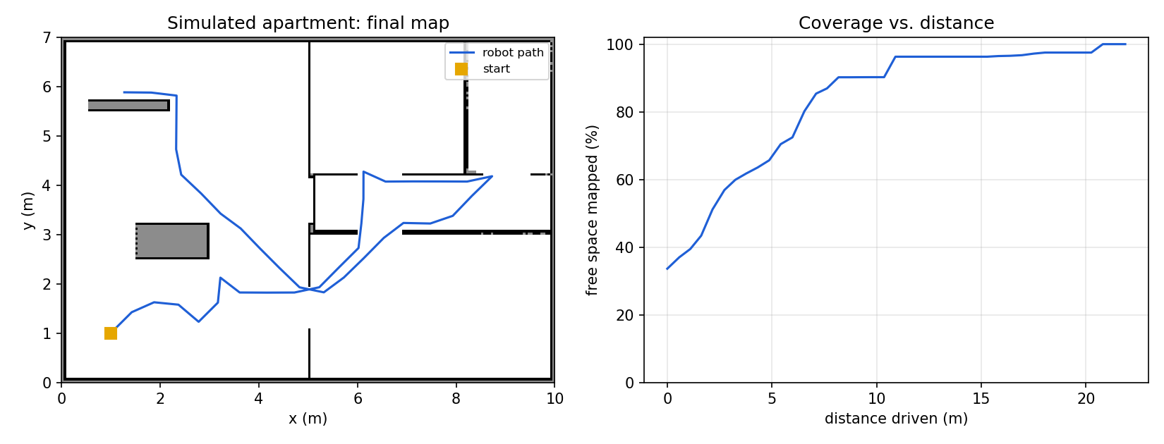
Checking the Explorer Before the Robot
tools/sim_explore.py: synthetic apartment, ray-cast lidar
100 %
21.9 m
40
36 ms
of 64 m² free space mapped
driven
frontier goals
per search (laptop)
No SLAM error, no controller: tests goal choice and termination only.
13
Motion and Power Electronics Control (MPEC) Lab
BCIT Centre for Welding Technologies and Metallurgy Research
Notes:
~30 s. Before the robot, the explorer ran on a synthetic 10 by 7 metre apartment with a ray-cast lidar. It mapped all free space in 22 metres. This checks the goal choice and the stopping rule, not SLAM or control.

Slide 14
Distributing the Load: Measured, Not Assumed
CPU on the Pi 5 while exploring · network · middleware
Process (Pi 5) | % of a core
aurora930 camera driver | 26
explorer (Python) | 21
robot_node (Python) | 17
camera_bridge (JPEG) | 9
bt_navigator | 9
planner_server | 7
controller_server | 6
ms200_node | 5
behaviour, smoother, lifecycle | 11
hector_mapping | 3
total (of 400), 52 °C, no throttle | ≈ 150
Placement
Scan over Wi-Fi: ≈ 2 KB × 10 Hz = 20 KB/s, +6 ms latency
Control loop on board: a drop > 0.5 s would otherwise stop the robot (cmd_vel timeout)
Movable to the PC if needed: explorer + global planner (not time-critical)
Middleware
PC Cyclone, robot Fast DDS → camera frames lost after driver restart (shared memory), explorer state garbled on the PC
Fix: Cyclone on both (service drop-in rmw.conf)
Humble ↔ Jazzy NavigateToPose differ: action stays on the Pi
The Pi has headroom: the 0.1 m/s tracks, not the CPU, set the pace.
14
Motion and Power Electronics Control (MPEC) Lab
BCIT Centre for Welding Technologies and Metallurgy Research
Notes:
~45 s. I measured before moving anything: about one and a half cores of four. The camera is the biggest load. Mixing DDS vendors caused two unrelated bugs; using Cyclone everywhere fixed both.

Slide 15
The Bug the Wheels Could Not See
Inverted motor signs, found with the lidar only
Commanded left turn, 20 s: encoder odometry +383°, Hector −678°. Mirrored lidar, or a robot turning the wrong way?
k* = argmin_k median_i | A_i − B_{i+k} |
Δψ = 0.8° · k*
A, B: range vectors (450 rays) before/after; valid rays only
Command (1.5 s) | Scan | Encoders
before: turn +0.25 | −51.2° | +28.5°
before: turn −0.25 | +44.8° | −28.8°
after: turn +0.25 | +43.2° | +46.8°
after: turn −0.25 | −47.2° | −50.3°
after: turn +0.40 | +81.6° | +85.3°
after: turn −0.40 | −86.4° | −88.5°
Diagnosis: both motor signs inverted since set-up: "forward" drove toward the rear (range ahead grew 0.37 m), "left" turned right. The odometry used the same signs, so it always agreed with the command. Fix: left_sign −1, right_sign +1, track width 0.105 m; confirmed by camera frames.
Check motion with a sensor that does not share the motors' conventions.
15
Motion and Power Electronics Control (MPEC) Lab
BCIT Centre for Welding Technologies and Metallurgy Research
Notes:
~60 s. The key finding. The wheels and SLAM disagreed in sign. Aligning two scans by circular shift gives the true rotation without trusting either; the lidar's angle convention had been checked with the camera. Both motor signs were inverted, and the odometry, using the same signs, could never notice.

Slide 16
Bring-Up: Seven Faults Before a Clean Map
Symptom, cause and fix, in the order they were found
Symptom | Cause | Fix
camera black after a driver restart | Fast DDS shared memory: old subscriber never rematched | Cyclone DDS on the robot
explorer "waiting for Nav2" | relative action name in /robot04 namespace | /navigate_to_pose
explorer crashed on first failure | keyword clash in the event logger | rename + guarded callbacks + respawn
goals aborted: "unable to transform" | Hector TF stamped with scan time (0.1–0.2 s old) | transform tolerance 1.0 s
controller at 5–6 Hz | local costmap 5 Hz < controller 8 Hz | local costmap 10 Hz
walls drawn twice, map smeared | both motor signs inverted, track width 0.17 | signs −1/+1, b = 0.105 m
one goal sent 39 times | reached frontier that never clears | blacklist reached goals
None of the seven was in an algorithm; all were at an interface.
16
Motion and Power Electronics Control (MPEC) Lab
BCIT Centre for Welding Technologies and Metallurgy Research
Notes:
~45 s. Seven faults, in order. Middleware, namespaces, a logger bug, timestamps, rates, motor signs and frontier pockets. None was in Hector, Nav2 or the frontier idea; all were at the joins.

Slide 17
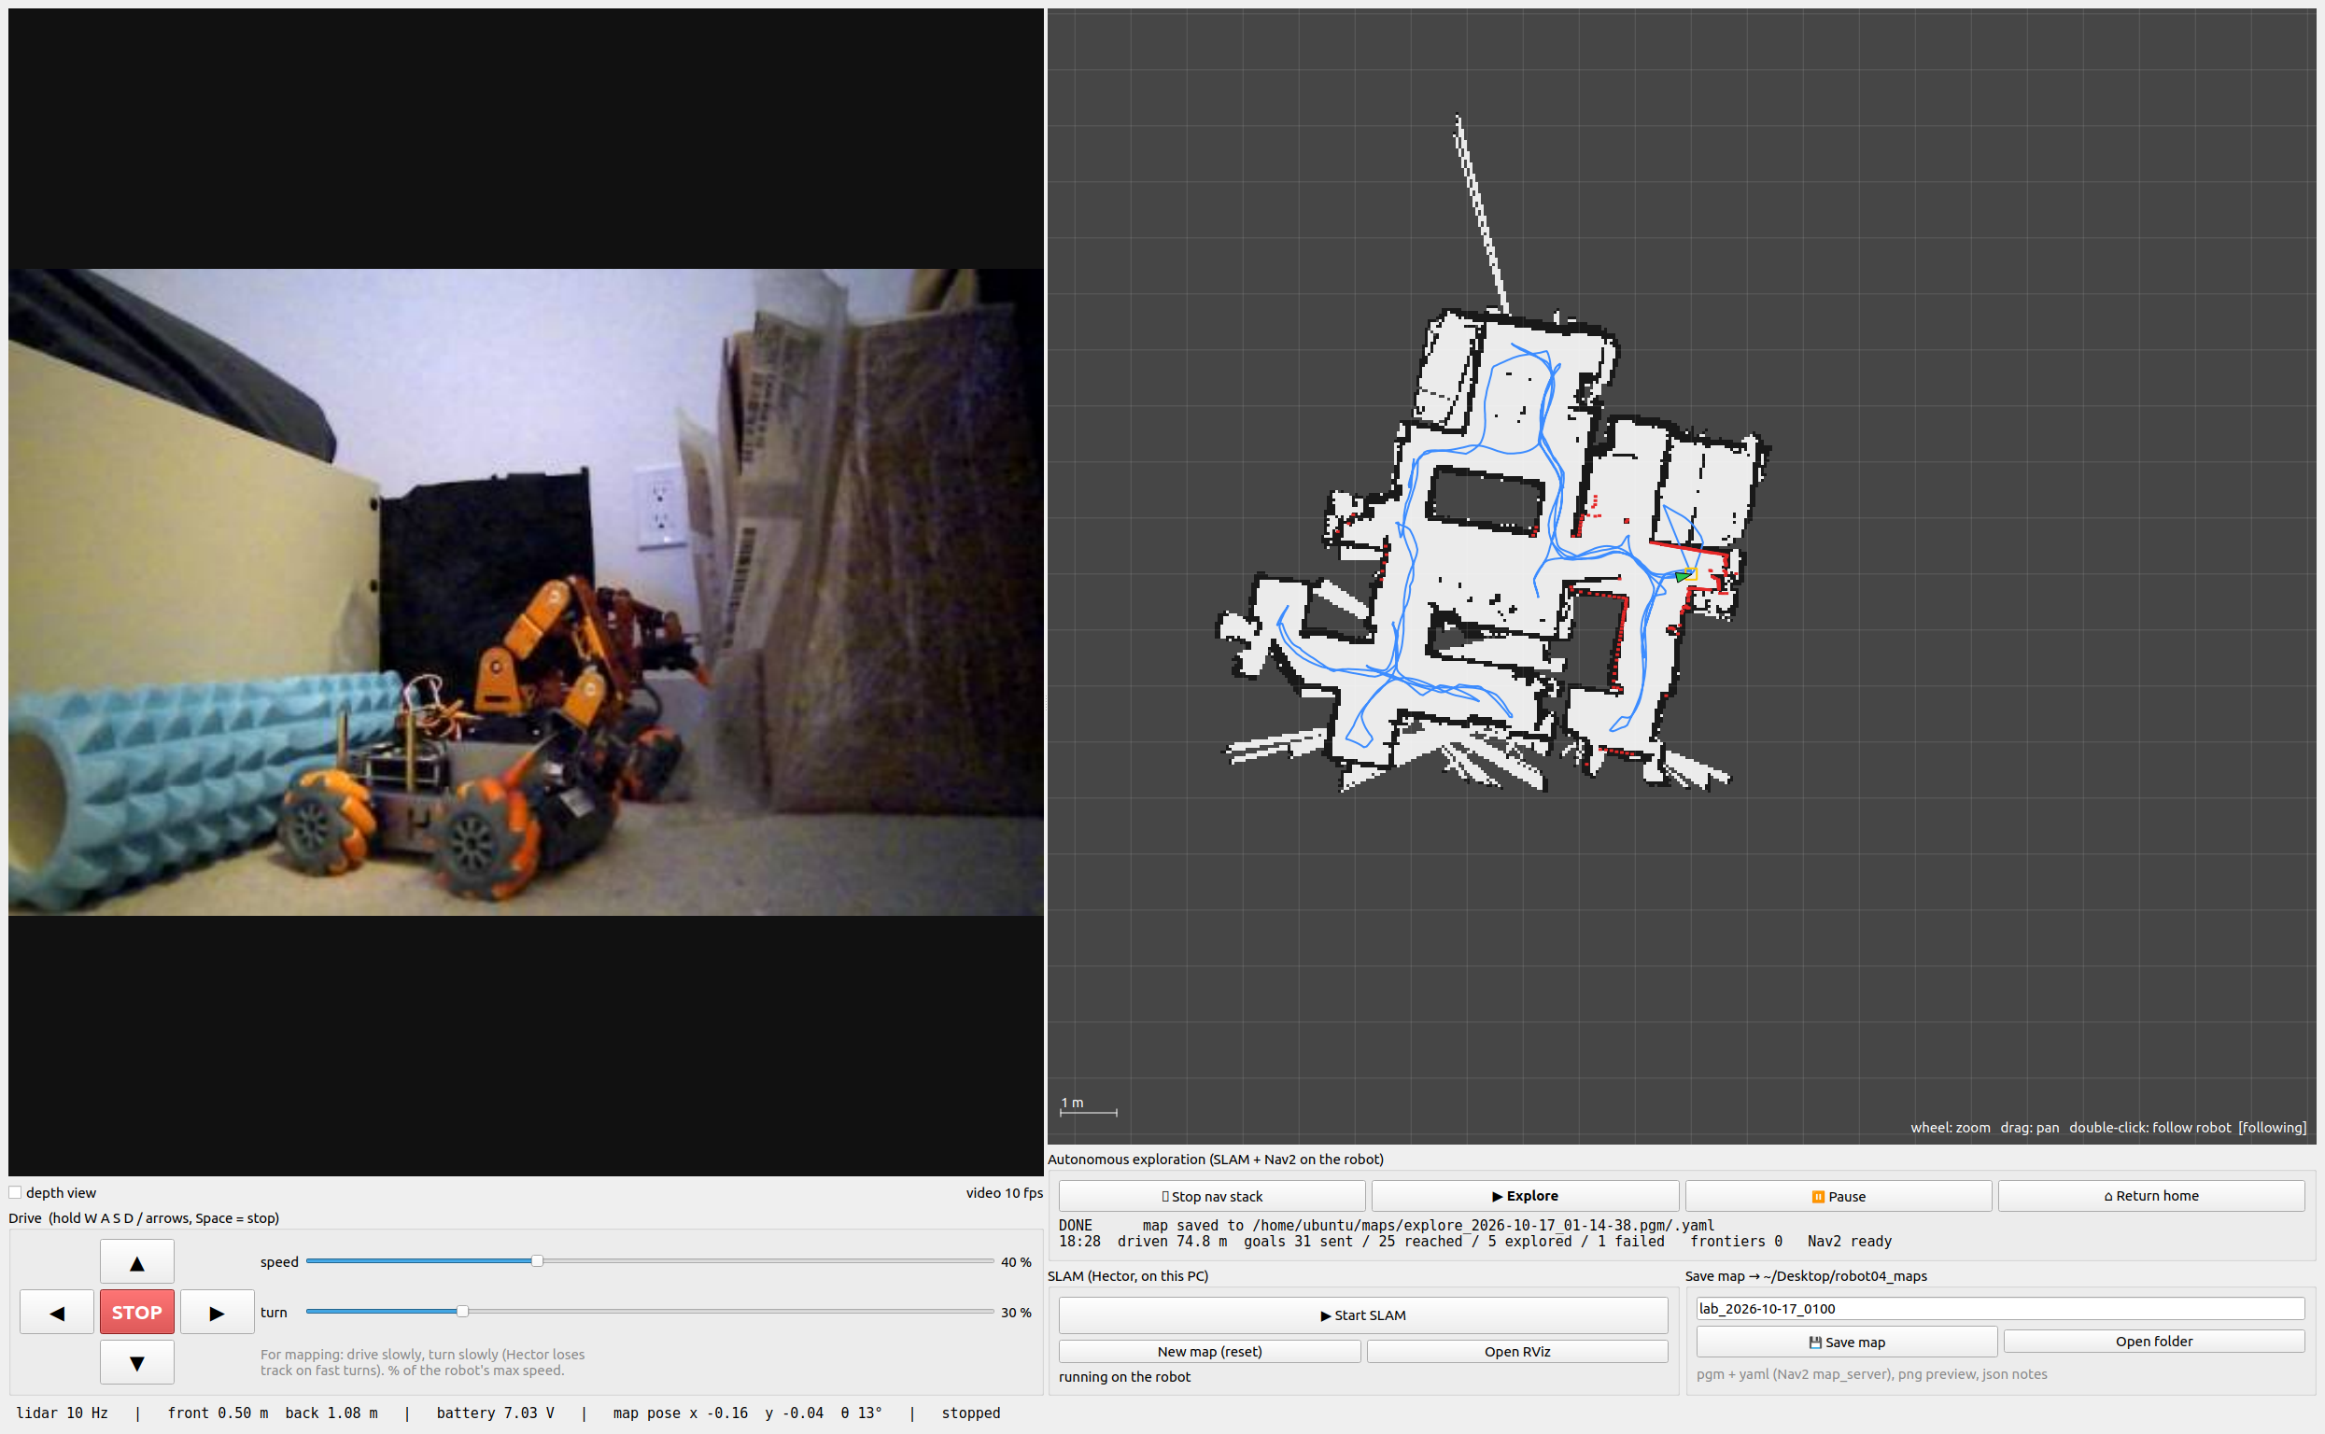
Watching and Steering from the PC
robot04 mapper (PyQt5, ROS 2 Humble)
Left: camera (10 fps JPEG) and hold-to-drive teleop. Right: live map, SLAM path (blue), Nav2 plan (green), goal (magenta), frontiers (cyan), start (yellow); Explore / Pause / Return home; save as map_server pgm + yaml.
The app never commands the robot while it explores, unless the operator takes over.
17
Motion and Power Electronics Control (MPEC) Lab
BCIT Centre for Welding Technologies and Metallurgy Research
Notes:
~30 s. The operator app at the end of the run: camera on the left, the map and the robot's path on the right, the explorer's state below. It starts the stack over ssh and can pause, take over or send the robot home.

Slide 18
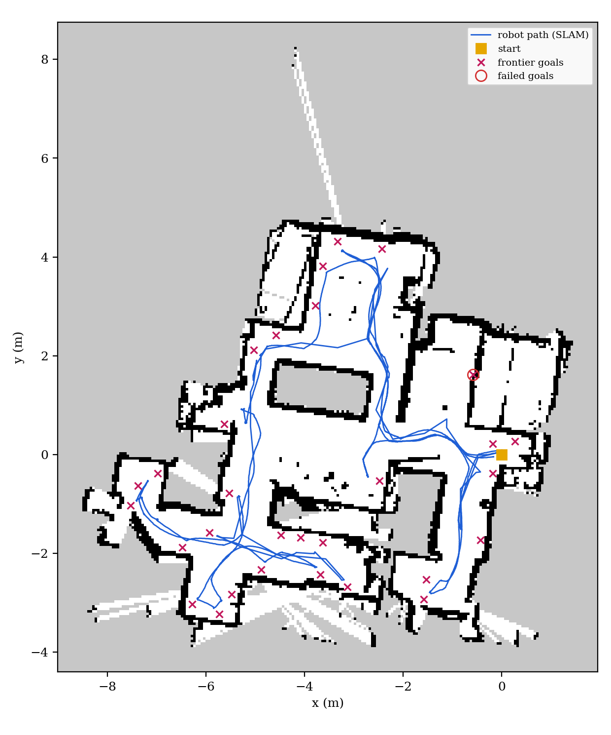
The Result: The Home, Mapped Unattended
One autonomous run, robot04 on its own
47 m²
12.6 min
mapped
unattended
74 m
29 / 30
driven
goals done / sent; 1 failed
No frontier left after 11.6 min: drove back, stopped 0.2 m from the start, saved the map. Zero operator interventions.
Pressed Explore once; the robot chose all 30 goals itself and came home.
18
Motion and Power Electronics Control (MPEC) Lab
BCIT Centre for Welding Technologies and Metallurgy Research
Notes:
~60 s. One unattended run in an apartment: 47 square metres in twelve and a half minutes, 74 metres driven, 30 goals chosen by the robot, one failed, behind a wall. When nothing was left it drove home and saved the map. The streak at the top is free space seen through a narrow gap; too narrow to count as a frontier.

Slide 19
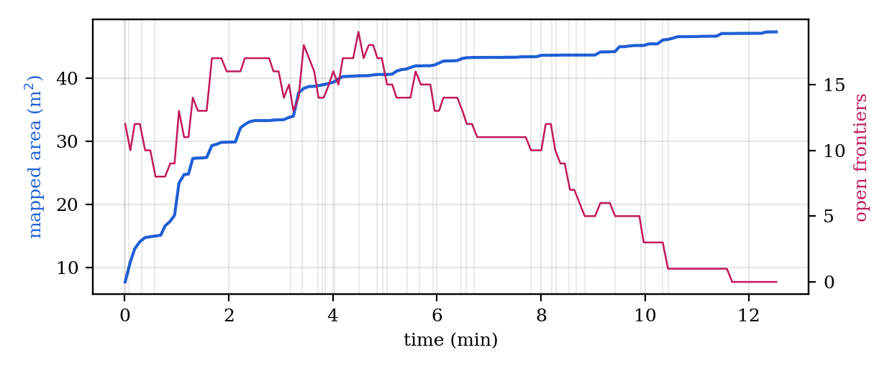
The Run in Numbers
From the explorer's log and the saved map
Metric | Value
duration | 12.6 min
mapped (known cells) | 47.3 m²
free / occupied | 37.5 / 9.8 m²
map extent | 10.9 × 13.2 m
path (SLAM, 5 cm steps) | 74.0 m
mean speed | 0.098 m/s
mapping rate | 3.8 m²/min
goals sent / failed | 30 / 1
search mean / max | 50 / 58 ms
battery | 7.40 → 7.08 V
interventions | 0
Area: fast for 2 min (each goal opens a room to a 360° lidar), then corners one at a time
Open frontiers peak ≈ 4.5 min, zero at 11.6 min → drive home
Mean speed ≈ cruise 0.10 m/s: time spent driving, not recovering
1 failure: goal behind a wall, reachable only through unknown space; dropped at its 156 s timeout
Greedy exploration's usual shape: quick coverage, then a long tail of corners.
19
Motion and Power Electronics Control (MPEC) Lab
BCIT Centre for Welding Technologies and Metallurgy Research
Notes:
~45 s. Area grows fastest in the first two minutes, when each goal opens a new room, then creeps up as corners are visited one by one. Frontiers peak around four minutes and reach zero at eleven and a half. The Pi used about one and a half cores.

Slide 20
What Bringing It Up Taught Us
Lessons & limitations
Conventions: Odometry agreed with wrong motor signs; only the lidar disagreed
Rates: Controller faster than its costmap → it waits; looked like CPU load
Time stamps: SLAM pose carries the scan time: raise TF tolerance
Namespaces: Explorer looked for /robot04/navigate_to_pose; Nav2 was at /
Pockets: Reached frontiers that never clear (under furniture) → blacklist
Middleware: Same DDS on every machine fixed two unrelated faults
Limits: a 2D lidar at 12 cm cannot see stairs, cables or table tops; Hector has no loop closure. Next: depth-camera cliff and 3D obstacle check, information-gain frontiers.
The algorithms worked as published; the time went into the interfaces.
20
Motion and Power Electronics Control (MPEC) Lab
BCIT Centre for Welding Technologies and Metallurgy Research
Notes:
~45 s. None of the problems were in the algorithms. They were in conventions, rates, timestamps, names and middleware. Limits: the lidar sees one plane, so stairs and cables are invisible to it.

Slide 21
What to Remember
Summary
A low-cost robot maps a home by itself with standard ROS 2 parts, provided each part is configured for the next and the motion is checked against the lidar.
1
On board
2
Safe by layers
3
Reproducible
SLAM, Nav2 and the explorer on a Pi 5; the PC only watches
planner, controller, and a motor node that refuses to hit things
code, configuration, run logs and this analysis on GitHub
Thank you! Questions?
github.com/hmarthens1/rpi5-robot-board · ros2/mentorpi_nav · pc/robot04-mapper
21
Motion and Power Electronics Control (MPEC) Lab
BCIT Centre for Welding Technologies and Metallurgy Research
Notes:
~30 s. Three things: everything runs on the robot, obstacle avoidance is layered down to the motor node, and it is all on GitHub with the run logs. Thank you.

