Slide 1

Chapter 7:
Sampling Distributions
^{Discovering Statistics}
^{2nd Edition Daniel T. Larose}
Lecture PowerPoint Slides
Notes:
Basic Practice of Statistics - 3rd Edition
Chapter 5

Slide 2

Chapter 7 Overview
7.1 Introduction to Sampling Distributions
7.2 Central Limit Theorem for Means
7.3 Central Limit Theorem for Proportions

Slide 3
The Big Picture
Where we are coming from and where we are headed…
In Chapters 1–4, we learned ways to describe data sets using numbers, tables, and graphs. In Chapters 5–6 we learned the tools of probability and probability distributions that allow us to quantify uncertainty.
In Chapter 7, we will discover that seemingly random statistics have predictable behaviors. The special type of distribution we use to describe these behaviors is called the sampling distribution. We will also learn about the most important result in statistical inference, the Central Limit Theorem.
The sampling distributions we learn in this chapter form the basis for the statistical inference we will perform in the rest of the book.

Slide 4
7.1: Introduction to Sampling Distributions
Objectives:
Explain the sampling distribution of the sample mean.
Describe the sampling distribution of the sample mean when the population is normal.
Find probabilities and percentiles for the sample mean when the population is normal.

Slide 5

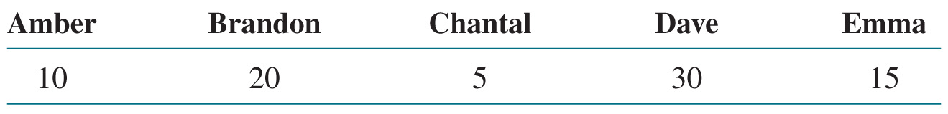
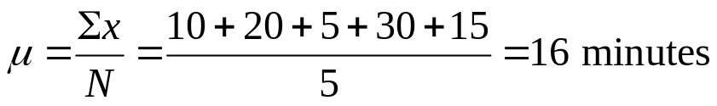
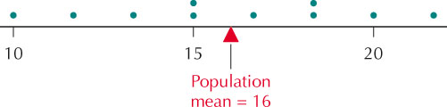
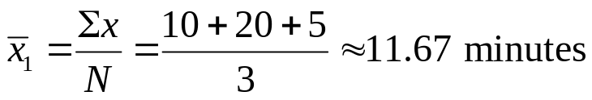
Sampling Distribution of the Sample Mean
In this chapter, we will develop methods that will allow us to quantify the behavior of statistics like the sample mean.
The sampling distribution of the sample mean for a given sample size n consists of the collection of the means of all possible samples of size n from the population.
Example 7.1
If we calculate the mean time for every possible sample of three individuals, we get the sampling distribution below.

Slide 6


Sampling Distribution of the Sample Mean
When working with sampling distributions, it is important to know the mean and standard deviation.
The mean of the sampling distribution of the sample mean is the value of the population mean µ. That is, .
The standard deviation of the sampling distribution of the sample mean is called the standard error of the mean. It is equal to
, where σ is the population standard deviation.
Note, because the denominator of the standard error formula is √n, the larger the sample size, the tighter the resulting sampling distribution. Larger sample sizes lead to smaller variability, which results in more precise estimation.

Slide 7
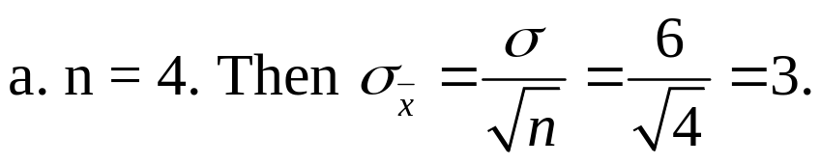
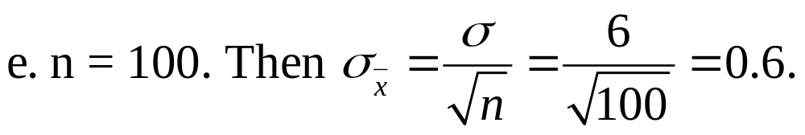

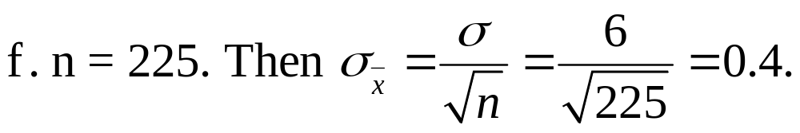
Example
According to CanEquity Mortgage company, the mean age of mortgage applicants in the City of Toronto is 37 years old. Assume that the standard deviation is 6 years. Find the mean and standard deviation for the sampling distribution of the sample mean for the following sample sizes:
(a) 4, (b) 100, (c) 225
(a)
(b)
(c)

Slide 8
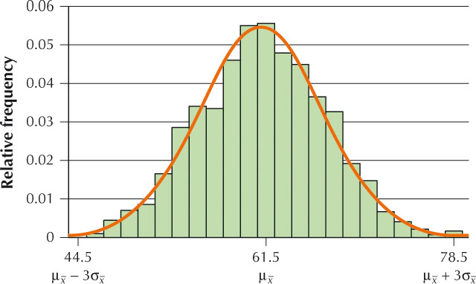
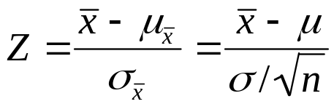
Sampling Distribution of the Sample Mean for a Normal Population
Two important facts should be noted about sample means that are collected from a normal population.
For a normal population, the sampling distribution of the sample mean is distributed as normal (µ, σ/√n), where µ is the population mean and σ is the population standard deviation.
When the sampling distribution of the sample mean is normal, we may standardize to produce the standard normal random variable:

Slide 9
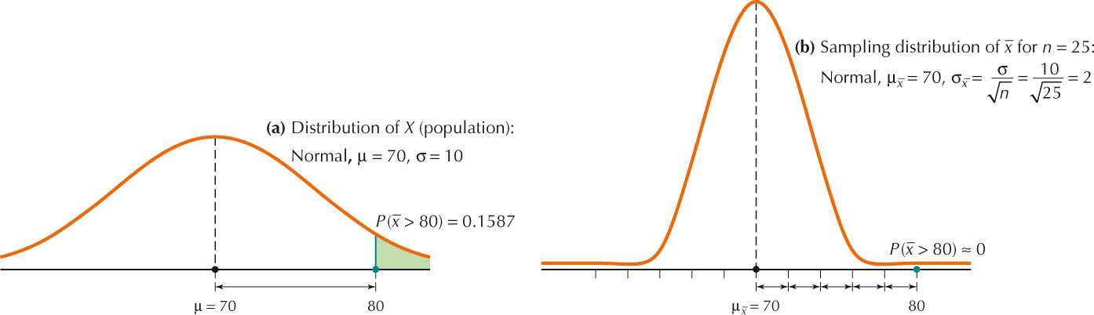
Probabilities and Percentiles Using a Sampling Distribution
Since we know the sampling distribution of the sample mean is normal when the population is normally distributed, we can use the techniques of Section 6.5 to answer questions about the means of samples taken from normal populations.
Example
Suppose the quiz scores for a certain instructor are normal (70, 10).
Find the probability that a randomly chosen student’s score will be above 80.
Find the probability that a sample of 25 quiz scores will have a mean score greater than 80.

Slide 10
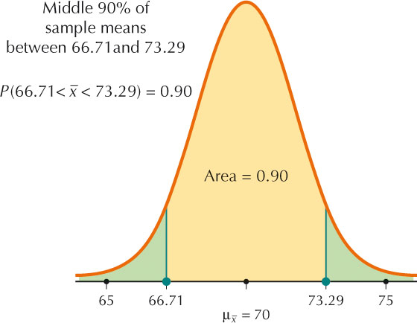
Probabilities and Percentiles Using a Sampling Distribution
Example
Suppose the quiz scores for a certain instructor are normal (70, 10).
What two symmetric values contain the middle 90% of all sample means between them? Assume a class size of 25.
The middle 90% will fall between the 5th percentile and the 95th percentile. These percentiles correspond to Z = –1.645 and Z = 1.645.
70 – 1.645(2) = 66.71
70 + 1.645(2) = 73.29

Slide 11
7.2: Central Limit Theorem for Means
Objectives:
Use normal probability plots to assess normality.
Describe the sampling distribution of sample means for skewed and symmetric populations as the sample size increases.
Apply the Central Limit Theorem for Means to solve probability questions about the sample mean.

Slide 12
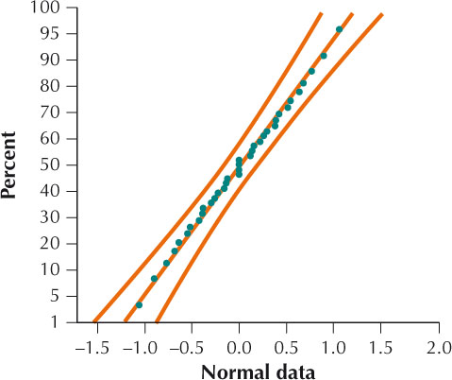
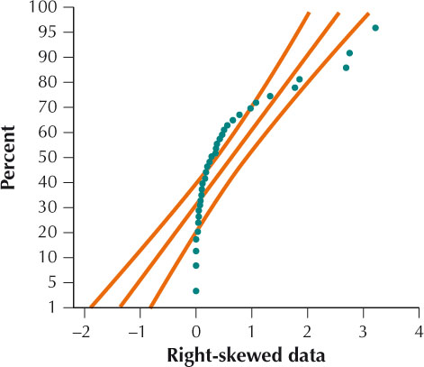
Normal Probability Plots
Much of our analysis requires that the sample data come from a population that is normally distributed. We can use histograms, dotplots, and stem-and-leaf displays to assess normality. But a more precise tool is the normal probability plot of the estimated cumulative normal probabilities against the corresponding data values.
If the points in the normal probability plot either cluster around a straight line or nearly all fall within the curved bounds, then it is likely that the data set is normal. Systematic deviations off the straight line are evidence against the claim that the data set is normal.

Slide 13
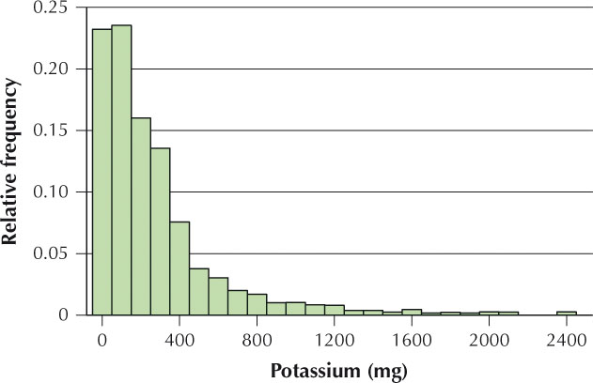
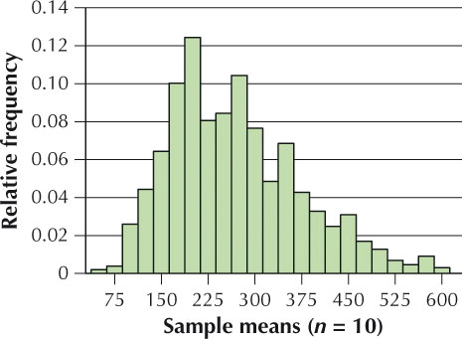
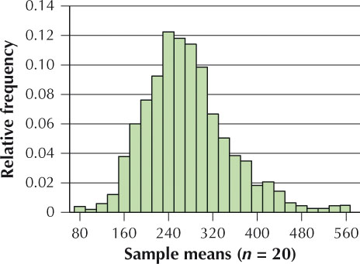
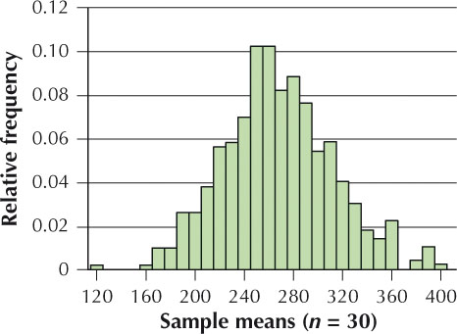
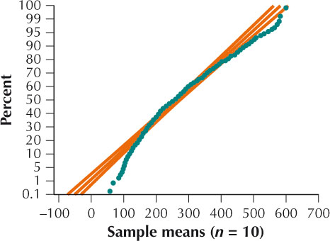
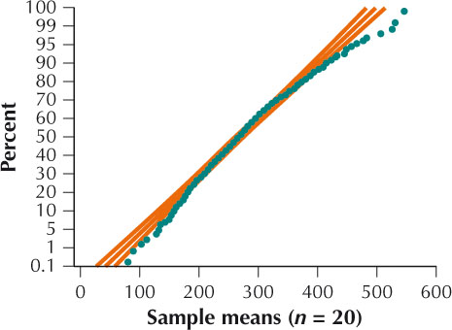
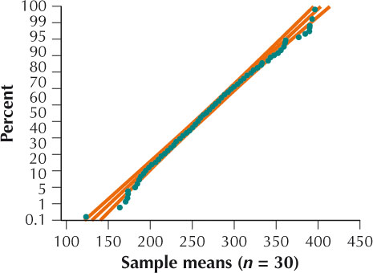
Sampling Distribution of x-bar for Skewed Populations
The sampling distribution of sample means for a normal population is also normal. What if the population is not normal?

Slide 14
Central Limit Theorem for Means
Regardless of the population, the sampling distribution of the sample mean becomes approximately normal as the sample size gets larger.
Central Limit Theorem for Means
Given a population with mean µ and standard deviation σ, the sampling distribution of the sample mean becomes approximately normal (µ, σ/√n) as the sample size gets larger, regardless of the shape of the population.
Rule of Thumb: We consider n ≥ 30 as large enough to apply the Central Limit Theorem for Means for any population.

Slide 15
Central Limit Theorem for Means
If the Population is Normal
The sampling distribution of sample means is normal.
If the Population is Non-Normal or Unknown
and the Sample Size is At Least 30
The sampling distribution of the sample mean is approximately normal.
If the Population is Non-Normal or Unknown
and the Sample Size is Less Than 30
We have insufficient information to conclude that the sampling distribution of the sample mean is either normal or approximately normal.

Slide 16
7.3: Central Limit Theorem for Proportions
Objectives:
Explain the sampling distribution of the sample proportion.
Apply the Central Limit Theorem for Proportions to solve probability questions about the sample proportion.

Slide 17
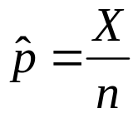
Sampling Distribution of the Sample Proportion
The sample mean is not the only statistic that can have a sampling distribution. Every statistic has a sampling distribution. One of the most important is the sampling distribution of the sample proportion.
Suppose each individual in a population either has or does not have a particular characteristic. If we take a sample of size n from the population, the sample proportion (read “p-hat) is:
where X represents the number of individuals in the sample that have the particular characteristic.
The sampling distribution of the sample proportion for a given sample size n consists of the collection of the sample proportions of all possible samples of size n from the population.

Slide 18

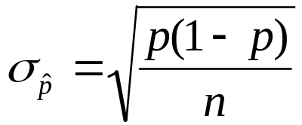
Sampling Distribution of the Sample Proportion
The mean of the sampling distribution of the sample proportion is the value of the population proportion p. This may be denoted as
The standard deviation of the sampling distribution of the sample proportion is called the standard error of the proportion and is found by
where p is the population proportion and n is the sample size.
The sampling distribution of the sample proportion may be considered approximately normal only if both np ≥ 5 and n(1 – p) ≥ 5.
The minimum sample size required to produce approximate normality is the larger of either n₁ = 5/p or n₂ = 5/(1 – p).

Slide 19
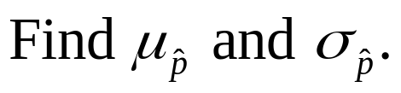
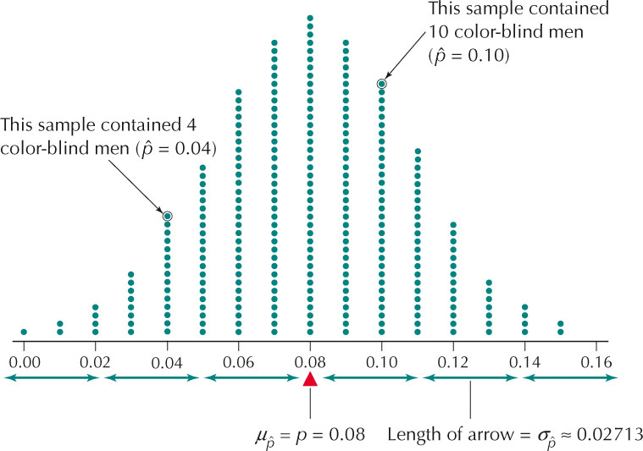
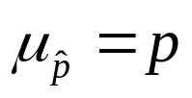
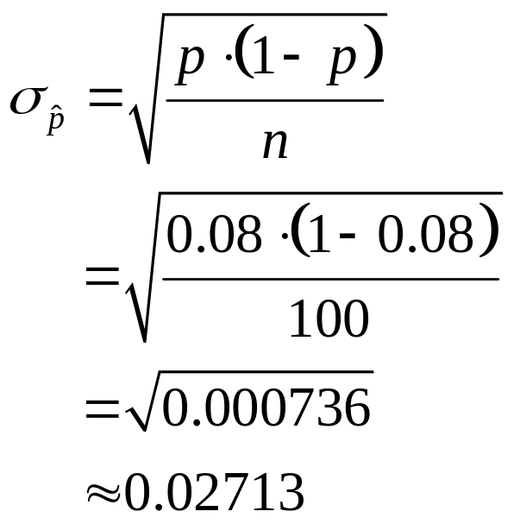
Sampling Distribution of the Sample Proportion
The National Institutes of Health reported that color blindness linked to the X chromosome afflicts 8% of men. Suppose we take a random sample of 100 men and let p denote the proportion of men in the population who have color blindness linked to the X chromosome.

Slide 20
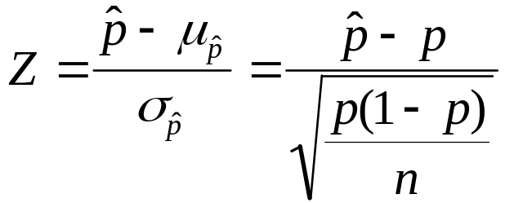
Applying the Central Limit Theorem for Proportions
Central Limit Theorem for Proportions
The sampling distribution of the sample proportion follows an approximately normal distribution with mean p and standard deviation
when both np ≥ 5 and n(1 – p) ≥ 5.
When the sampling distribution of the sample proportion is approximately normal, we can standardize to produce the standard normal Z:

Slide 21
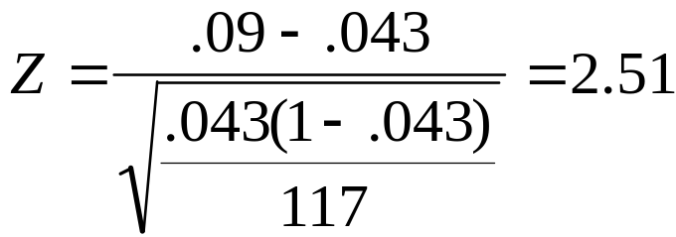
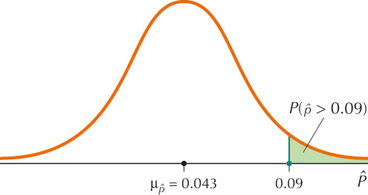
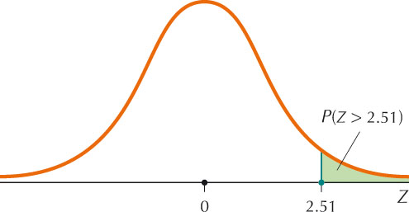
Example
The Texas Workforce Commission reported that the state unemployment rate in March 2007 was 4.3%. Let p = 0.043 represent the population proportion of unemployed workers in Texas.
Find the probability that a sample of 117 Texas workers will have a proportion unemployed greater than 9%.
Since 117(0.043) > 5 and 117(0.957) > 5,
we can apply the Central Limit Theorem
for Proportions.
P(Z > 2.51) = 1 – 0.9940 = 0.0060

Slide 22
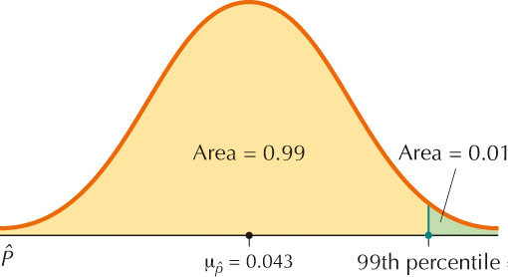
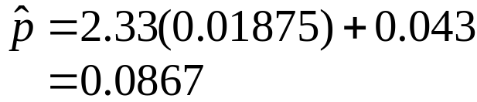
Example
The Texas Workforce Commission reported that the state unemployment rate in March 2007 was 4.3%. Let p = 0.043 represent the population proportion of unemployed workers in Texas.
Find the 99th percentile of sample proportions for n = 117.
The Z-value associated with 0.9901 is 2.33.

Slide 23
Chapter 7 Overview
7.1 Introduction to Sampling Distributions
7.2 Central Limit Theorem for Means
7.3 Central Limit Theorem for Proportions

