Slide 1

Chapter 8:
Confidence Intervals
^{Discovering Statistics}
^{2nd Edition Daniel T. Larose}
Lecture PowerPoint Slides
Notes:
Basic Practice of Statistics - 3rd Edition
Chapter 5

Slide 2
Chapter 8 Overview
8.1 Z Interval for the Population Mean
8.2 t Interval for the Population Mean
8.3 Z Interval for the Population Proportion
8.4 Confidence Intervals for the Population Variance and Standard Deviation

Slide 3
The Big Picture
Where we are coming from and where we are headed…
We stand on the threshold of the two most important statistical inference methods: confidence intervals and hypothesis testing. Everything that we have studied thus far has been in preparation for this moment.
Here in Chapter 8, we learn about confidence interval estimation, where we can infer with a certain level of confidence that our target parameter lies within a particular interval.
Every chapter from here to the end of the book will uncover a new and different topic in statistical inference. In Chapter 9, “Hypothesis Testing,” we will learn about the most prevalent method of statistical inference.

Slide 4
8.1: Z Interval for the Population Mean
Objectives:
Calculate a point estimate of the population mean.
Calculate and interpret a Z interval for the population mean, when the population is normal, and when the sample size is large.
Find ways to reduce the margin of error.
Calculate the sample size needed to estimate the population mean.

Slide 5
Calculate a Point Estimate
Recall that characteristics of the sample are called statistics, while characteristics of the population are called parameters. Statistical inference consists of methods for estimating and drawing conclusions about parameters, based on the corresponding statistic.
Point estimation is the process of estimating unknown population parameters by known statistics. The value of each sample statistic used as an estimate is called a point estimate.
Since a sample is only a small subset of a population, generalizing from a sample to the population carries the risk that the point estimate may not be very accurate. Confidence intervals help provide a means to construct an interval, based on the statistic, that is likely to contain the parameter.

Slide 6
Z Interval for the Population Mean
Although we cannot measure how confident we are of a statistic as a point estimate of a parameter, we can use the statistic to find an interval that is likely to contain the parameter.
A confidence interval is an estimate of a parameter consisting of an interval of numbers based on a point estimate, together with a confidence level specifying the probability that the interval contains the parameter.
Confidence intervals are often reported in the format:
(lower bound, upper bound)

Slide 7
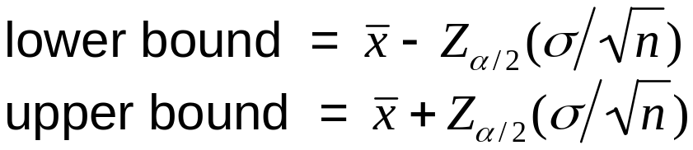

Z Interval for the Population Mean
Z Interval for the Population Mean µ
The Z interval for µ may be constructed only when either of the following two conditions are met:
  The population is normally distributed and σ is known.
  The sample size is large (n ≥ 30), and the value of σ is known.
When a random sample of size n is taken from a population,
a (100 – α)% confidence interval is given by:
The Z interval can also be written as
α | Confidence Level | α/2 | Z_{α/2}
0.10 | 90% | 0.05 | 1.645
0.05 | 95% | 0.025 | 1.96
0.01 | 99% | 0.005 | 2.576

Slide 8
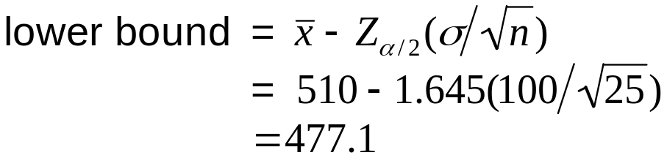
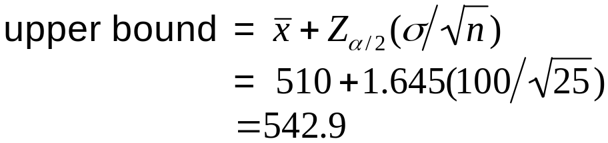
Example
The College Board reports that the scores on the 2010 SAT mathematics test were normally distributed. A sample of 25 scores had a mean of 510. Assume the population standard deviation is 100. Construct a 90% confidence interval for the population mean score on the 2010 SAT math test.
We are 90% confident that the population mean SAT score on the 2010 mathematics SAT test lies between 477.1 and 542.9.

Slide 9
Margin of Error
Confidence intervals for the population mean µ take the form:
point estimate ± margin of error E
The margin of error E is a measure of the precision of the confidence interval estimate. For the Z interval, the margin of error takes the form E = Z_{α/2}(σ/√n).
In our example, E = Z_{α/2}(σ/√n) = 32.9. Therefore, the confidence interval has the form:
510 ± 32.9
We would like our confidence interval estimates to be as precise as possible. Therefore, we would like the margin of error to be as small as possible. There are two strategies to decrease E:
  Decrease the confidence level
  Increase the sample size

Slide 10
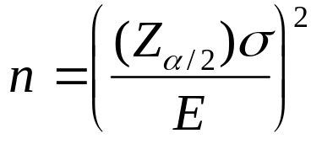
Sample Size for Estimating µ
A natural question when constructing a confidence interval is “How large a sample size do I need to get a tight confidence interval with a high confidence level?”
Sample Size for Estimating the Population Mean
The sample size for a Z interval that estimates µ to within a margin of error E with confidence (100 – α)% is given by:
Whenever this formula yields a sample size with a decimal, always round up to the next whole number.

Slide 11
8.2: t Interval for the Population Mean
Objectives:
Describe characteristics of the t distribution
Calculate and interpret a t interval for the population mean.

Slide 12
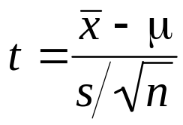
Introducing the t Distribution
In Section 8.1 we constructed confidence intervals for the population mean assuming the population standard deviation was known. In many real-world problems, we do not know the value of σ, and thus cannot use the Z interval to estimate µ. In these cases we can use s to estimate σ and use a different distribution, the t distribution.
t Distribution
For a normal population, the distribution of
follows a t distribution, with n – 1 degrees of freedom.

Slide 13
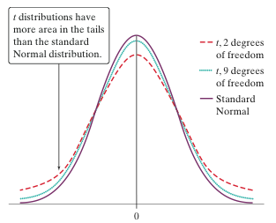
Characteristics of the t Distribution
Centered at zero. The mean of t is 0, just as with Z.
Symmetric about its mean 0, just as with Z.
As df decreases, the t curve gets flatter, and the area under the t curve decreases in the center and increases in the tails.
  That is, the t curve has heavier tails than the Z curve.
As df increases toward infinity, the t curve approaches the Z curve.

Slide 14
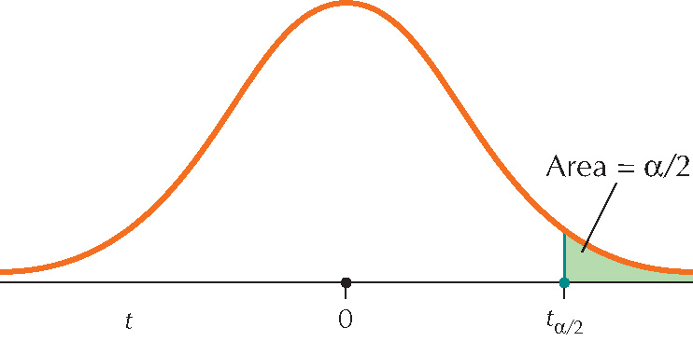
Finding t_{α/2}
Step 1: Go across the row marked “Confidence level” in the t table until you find the column with the desired confidence level at the top. The t_{α/2} value is in this column somewhere.
Step 2: Go down the column until you see the correct number of degrees of freedom on the left. The number in that row and column is the desired value of t_{α/2}.
t_{α/2} has area α/2 to the right of it.

Slide 15
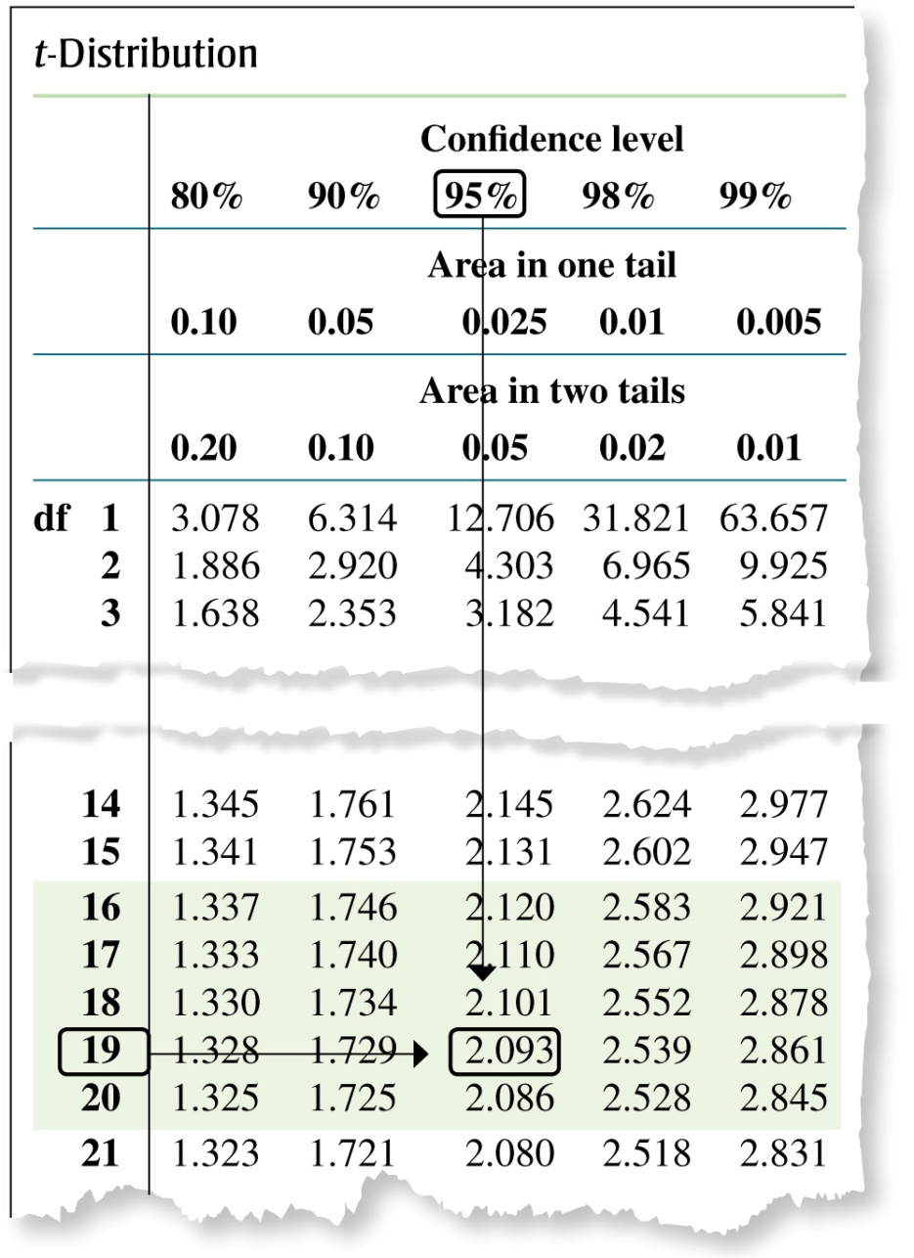
Example
Find the value of t_{α/2} that will produce a 95% confidence interval for μ if the sample size is n = 20.
Step 1
Go across the row labeled “Confidence level” in the t table until we see the 95% confidence level.
Step 2
df = n – 1 = 20 – 1 = 19
Go down the column until you see 19 on the left.
The number in that row is t_{α/2} = 2.093.

Slide 16
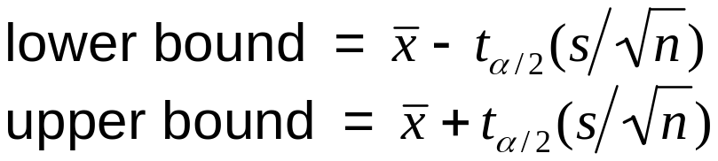

t Interval for the Population Mean
t Interval for µ
The t interval for µ may be constructed when either of the following two conditions are met:
  The population is normally distributed.
  The sample size is large (n ≥ 30).
When a random sample of size n is taken from a population,
a (100 – α)% confidence interval is given by:
The t interval can also be written as:
For the t interval, the margin of error takes the form E = t_{α/2}(s/√n). The interval can be interpreted as “We can estimate µ to within E units with (1 – α)% confidence.”

Slide 17
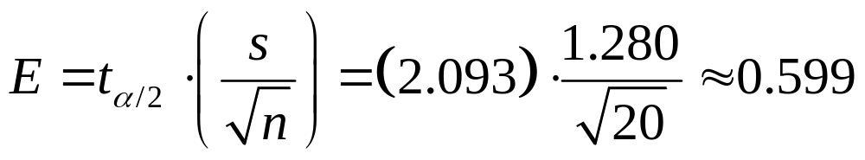
Example
Use the statistics observed in Example 8.10.
a. Find the margin of error for the 95% confidence interval for mean foot lengths.
b. Interpret the margin of error.
Solution
a. n = 20 and s = 1.280.
For a confidence level of 95%, t_{α/2} = 2.093.
The margin of error of fourth-grade foot length is:
b. We can estimate the population mean of fourth-grade foot lengths to within 0.599 centimeters with 95% confidence.

Slide 18
8.3: Z Interval for the Population Proportion
Objectives:
Calculate the point estimate of the population proportion.
Construct and interpret a Z interval for the population proportion.
Compute and interpret the margin of error for the Z interval for p.
Determine the sample size needed to estimate the population proportion.

Slide 19
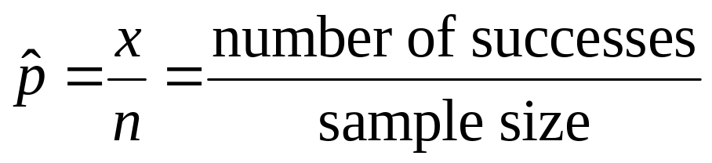
Calculate a Point Estimate
Recall that characteristics of the sample are called statistics, while characteristics of the population are called parameters. We have dealt with interval estimates of µ, but we may also be interested in the interval estimate for the population proportion of successes, p.
is a point estimate of the population proportion p.

Slide 20
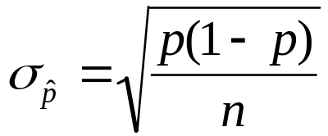
Z Interval for the Population Proportion p
Recall the Central Limit Theorem for Proportions
Central Limit Theorem for Proportions
The sampling distribution of the sample proportion follows an approximately normal distribution with mean p and standard deviation
when both np ≥ 5 and n(1 – p) ≥ 5.
We can use the CLT for Proportions to construct confidence intervals for the population proportion p.

Slide 21
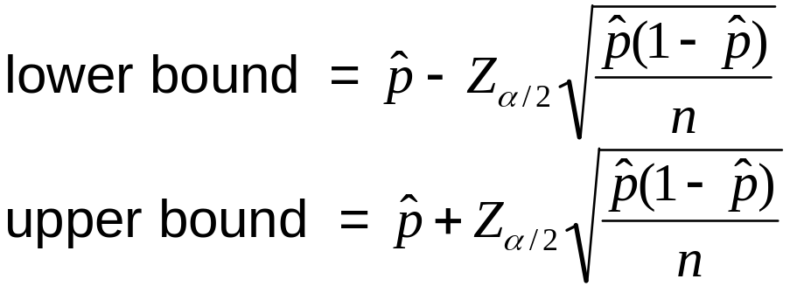
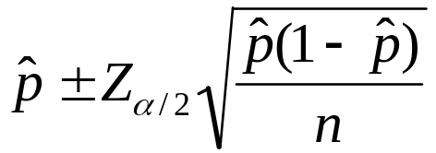
Z Interval for p
Z Interval for the Population Proportion p
The Z interval for p may be constructed only when both of the following two conditions are met: n(p-hat) ≥ 5 and n(1 – p-hat) ≥ 5.
When a random sample of size n is taken from a population,
a (100 – α)% confidence interval is given by:
The Z interval can also be written as:
α | Confidence Level | α/2 | Z_{α/2}
0.10 | 90% | 0.05 | 1.645
0.05 | 95% | 0.025 | 1.96
0.01 | 99% | 0.005 | 2.576

Slide 22
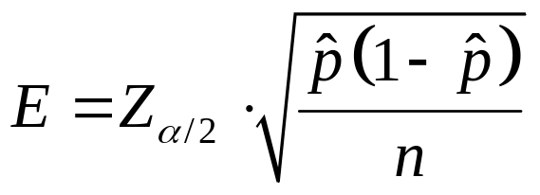
Margin of Error
Confidence intervals for the population proportion p take the form:
point estimate ± margin of error E
The margin of error E is a measure of the precision of the confidence interval estimate. For the Z interval, the margin of error takes the form:
The margin of error E for a (1– α)% Z interval for p can be interpreted as follows:
“We can estimate p to within E with (1 – α)100% confidence.”

Slide 23
Example
There is hardly a day that goes by without some new poll coming out. Especially during election campaigns, polls influence the choice of candidates and the direction of their policies. In October 2004, the Gallup organization polled 1012 American adults, asking them, “Do you think there should or should not be a law that would ban the possession of handguns, except by the police and other authorized
persons?” Of the 1012 randomly chosen respondents, 638 said that there should NOT be such a law.
a. Check that the conditions for the Z interval for p have been met.
b. Find and interpret the margin of error E.
c. Construct and interpret a 95% confidence interval for the population proportion of all American adults who think there should not be such a law.

Slide 24
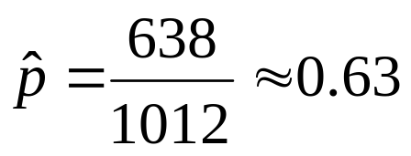
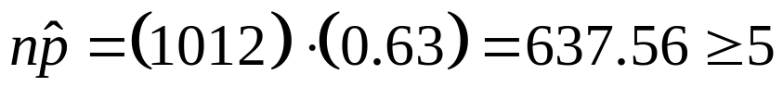
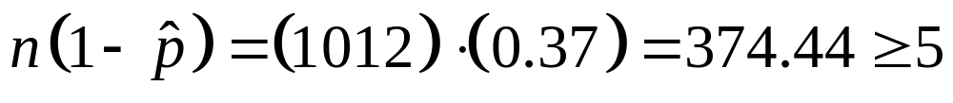
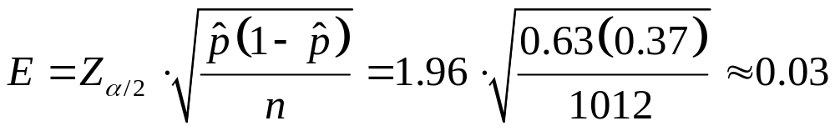
Solution
Sample size is n = 1012
Observed proportion is:
The confidence level of 95% implies that our Z_{α/2} equals 1.96.

Slide 25
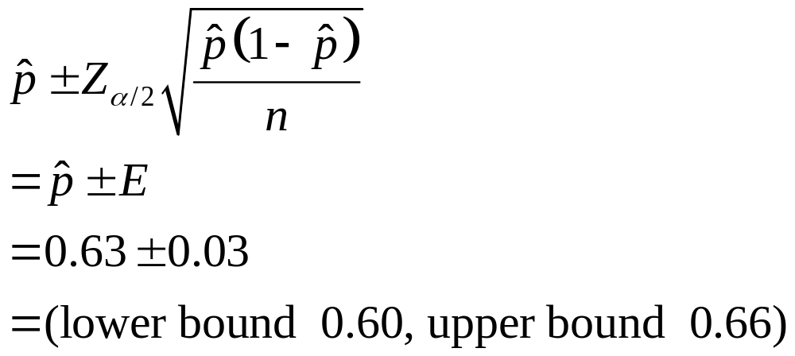
Solution
Thus, we are 95% confident that the population proportion of all American adults who think that there should not be such a law lies between 60% and 66%.

Slide 26
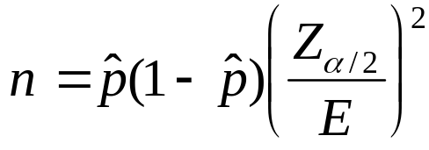
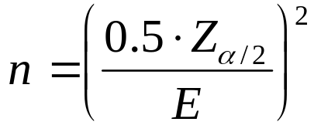
Sample Size for Estimating p
A natural question when constructing a confidence interval is “How large a sample size do I need to get a tight confidence interval with a high confidence level?”
Sample Size for Estimating the Population Proportion
The sample size for a Z interval that estimates p to within a margin of error E with confidence 100(1 – α)% is given by:
Whenever this formula yields a sample size with a decimal, always round up to the next whole number.
When p-hat is unknown, use

Slide 27
8.4: Confidence Intervals for the Population Variance and Standard Deviation
Objectives:
Describe the properties of the χ² (chi-square) distribution, and find critical values.
Construct and interpret confidence intervals for the population variance and standard deviation.

Slide 28
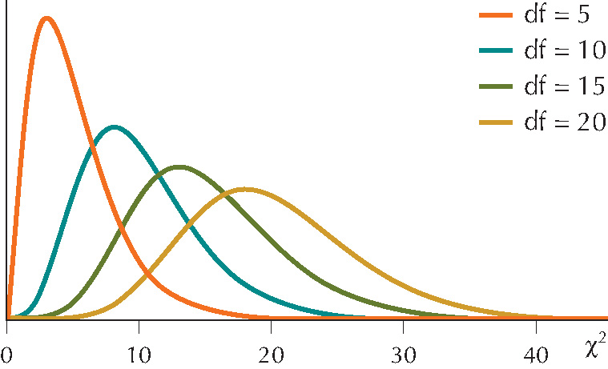
Properties of the χ² Distribution
The χ² distribution (pronounced ky-square) was discovered in 1875. The χ² random variable is continuous with the following properties:
Properties of the χ² Distribution
The total area under the curve equals 1.
The value of χ² is never negative, so the χ² starts at 0 and extends indefinitely to the right.
The χ² curve is right-skewed.
There is a different curve for each df, n – 1. As df increases, the curve begins to look more symmetric.

Slide 29
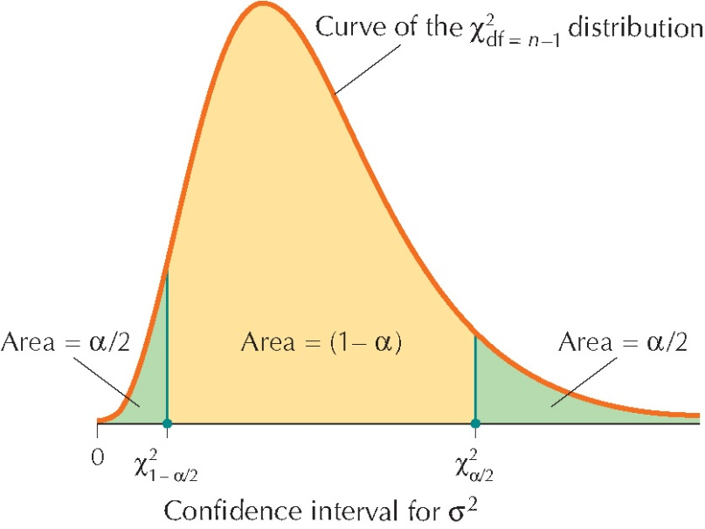
χ² Critical Values
To construct confidence intervals, we need to find the critical values of a χ² distribution for a given confidence level.
For a confidence interval for σ² with a
confidence level 100(1 – α)% we can find two critical values:
χ²_{1 -α/2} = the value with area 1 – α/2 to the right of it.
χ²_{α/2} = the value with area α/2 to the right of it.

Slide 30
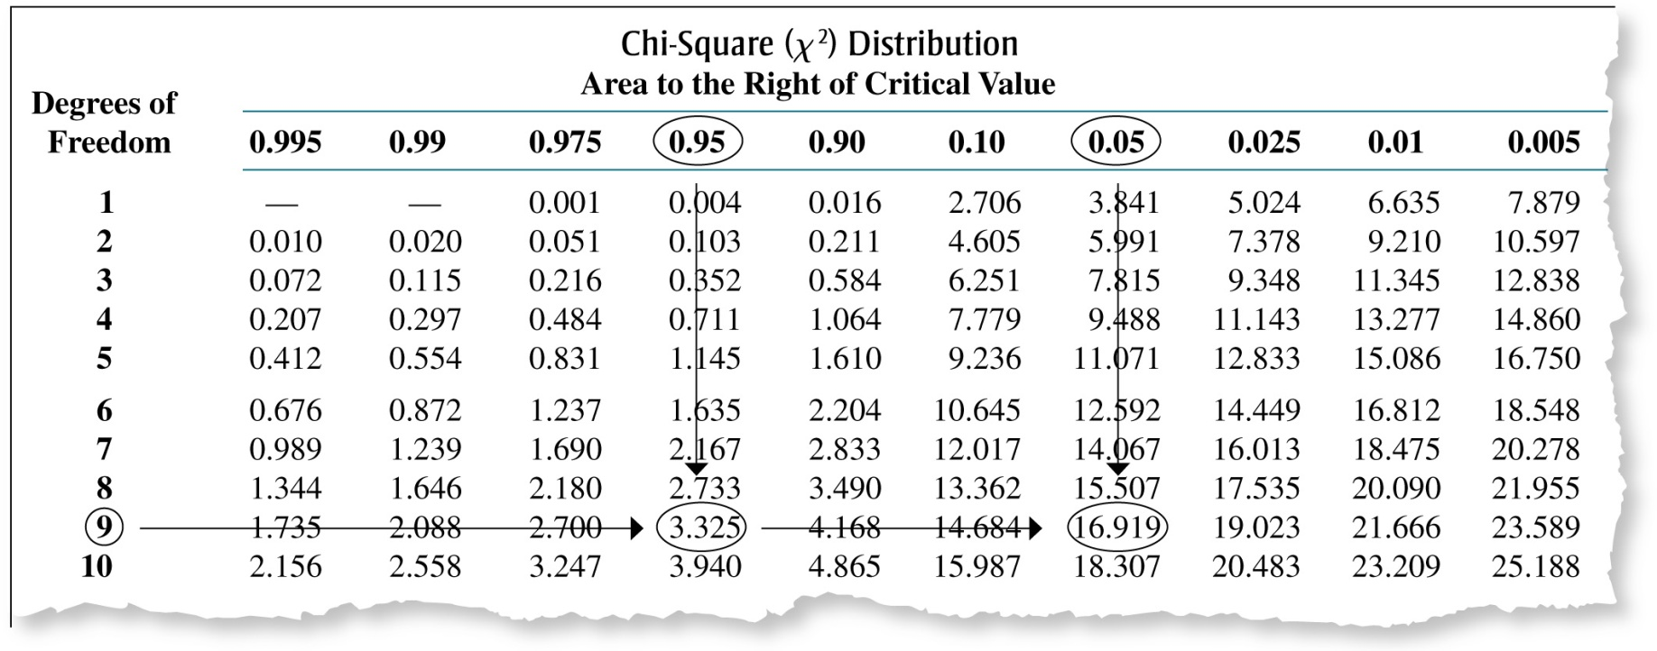
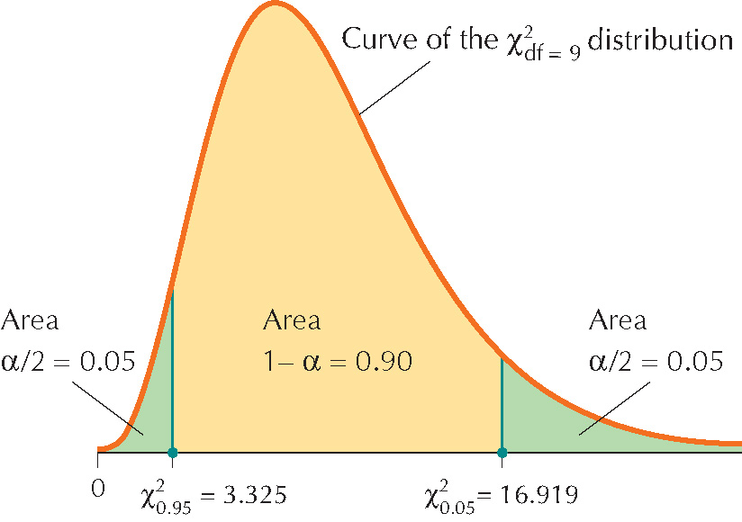
χ² Critical Values
Find χ²_{0.95} and χ²_{0.05} using the χ² table and n = 10.

Slide 31
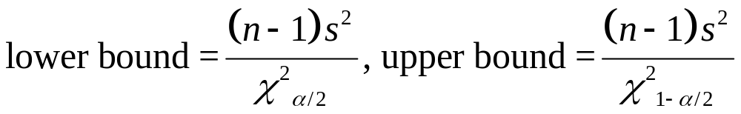
Confidence Interval for the Population Variance σ²
Take a sample of size n from a normal population with mean μ and standard deviation σ.
A 100(1 – α)% confidence interval for the population variance σ² is given by:
Where s² represents the sample variance and χ²_{1-α/2} and χ²_{α/2} are the critical values for a χ² distribution with n – 1 degrees of freedom.

Slide 32
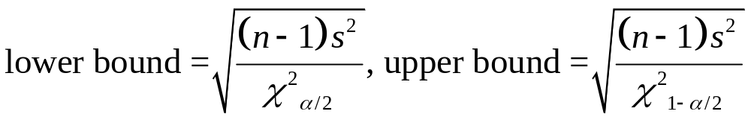
Confidence Interval for the Population Standard Deviation σ
A 100(1 – α)% confidence interval for the population standard deviation σ is then given by:

Slide 33
Chapter 8 Overview
8.1 Z Interval for the Population Mean
8.2 t Interval for the Population Mean
8.3 Z Interval for the Population Proportion
8.4 Confidence Intervals for the Population Variance and Standard Deviation

