Slide 1
Bioinformatic tools for the identification of gene pathways and biological processes

Slide 2
Filtering for rare variants

Slide 3
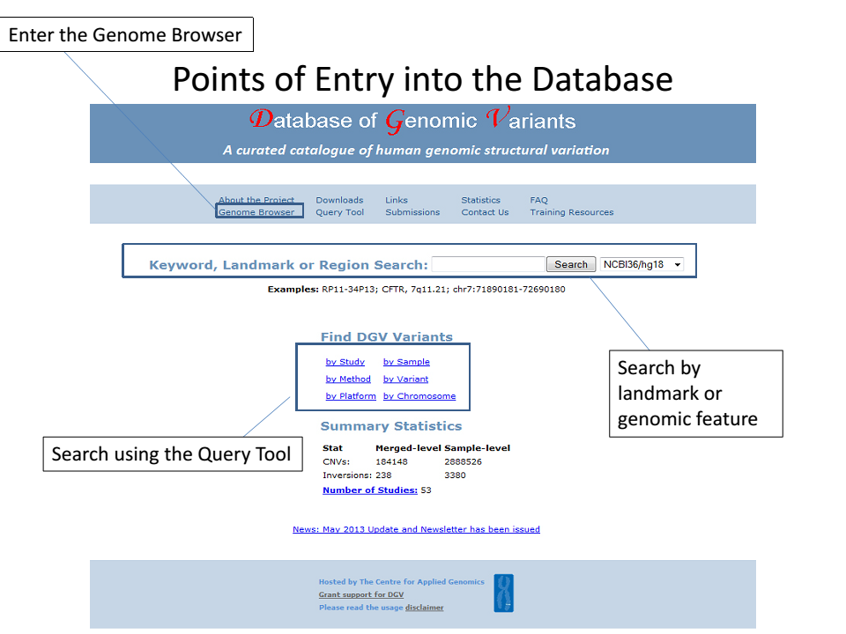

Slide 4
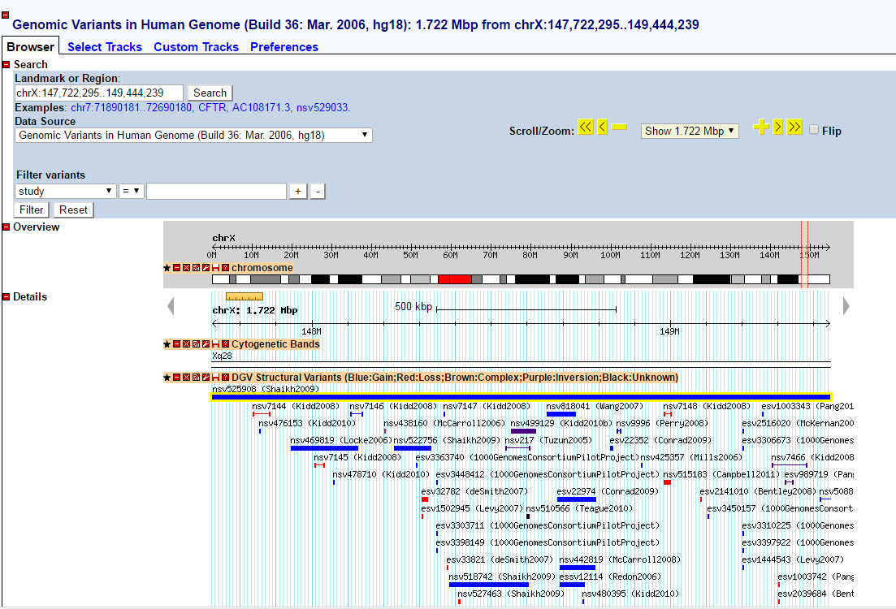
DGV output

Slide 5
Knowing the genes…..
Large scale studies result into potential disease candidate genes or differentially expressed genes
Possible information for the resulted genes:
Interacting partner (Protein-Protein Interaction Network)
Gene Ontology
Biological process
Molecular function
Cellular location
Pathways
Phenotype

Slide 6
Online resources
String Server
Enrichr
DAVID (ID conversion)
Ontologizer
Cytoscape (ClueGO, BiNGO)
R (TopGO, Gostats, GOProfile)
G:Profiler
etc

Slide 7
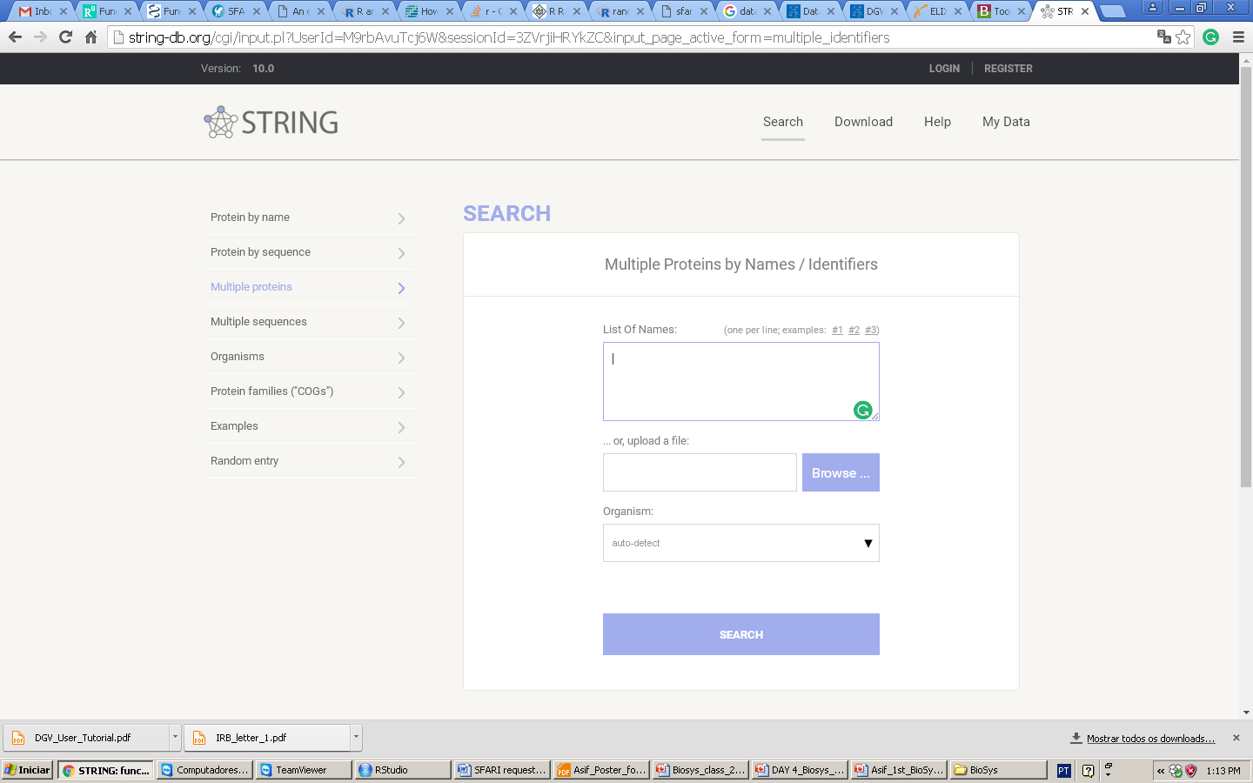
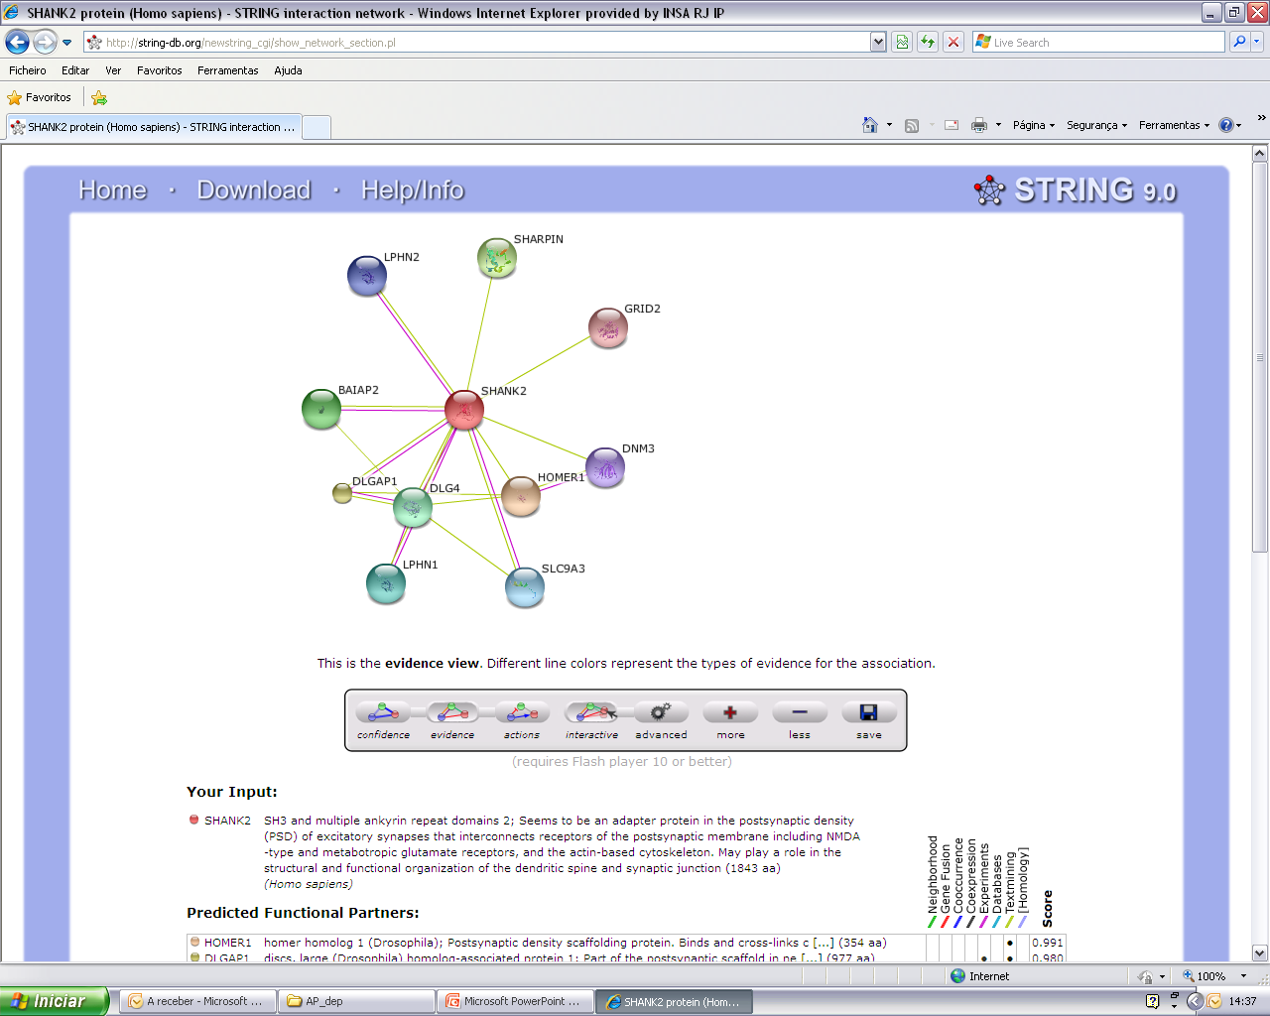
Predicted functional partners
Step1: Search by name or protein sequence
Step2: Select Organism

Slide 8
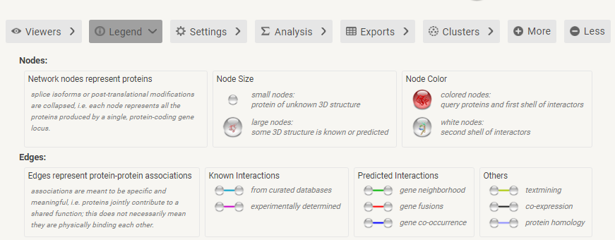
STRING: Interaction type

Slide 9
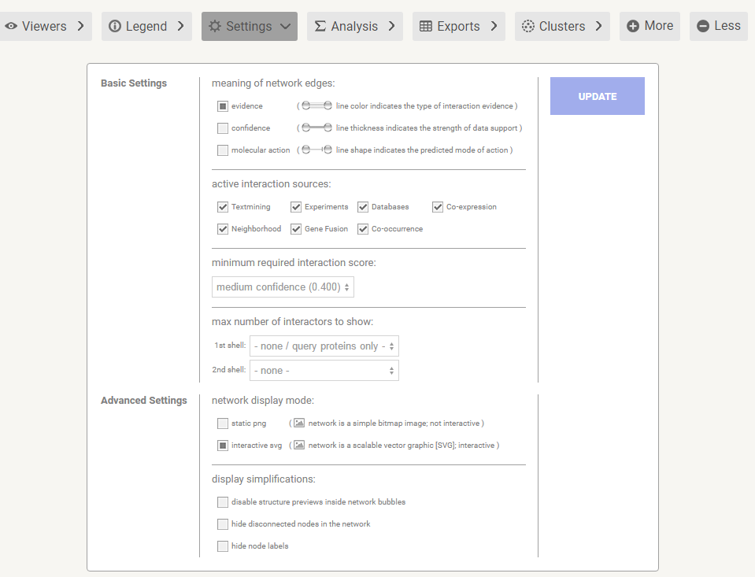
STRING: Filter for high confidence interactions

Slide 10
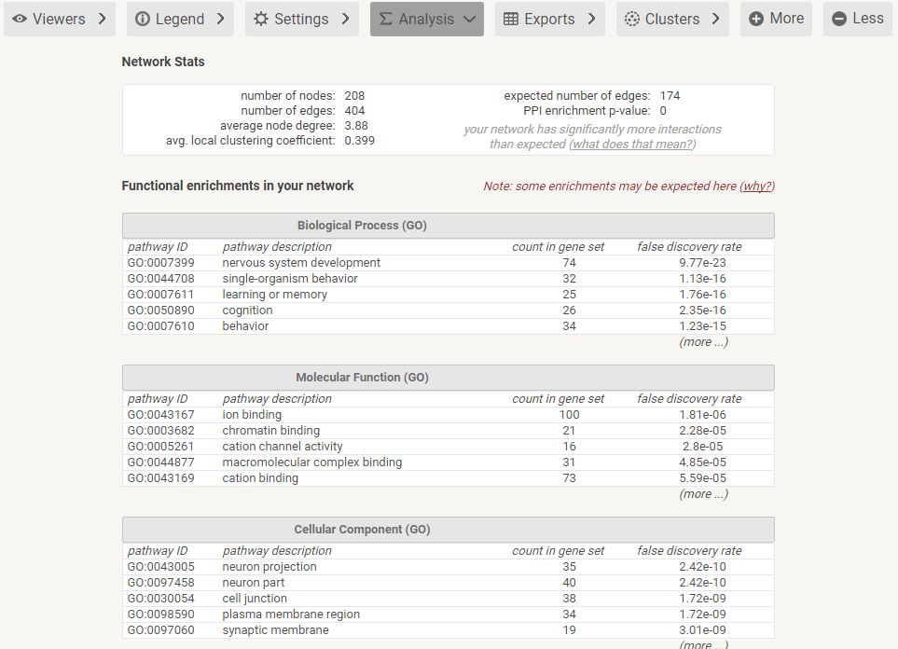
Functional enrichment

Slide 11
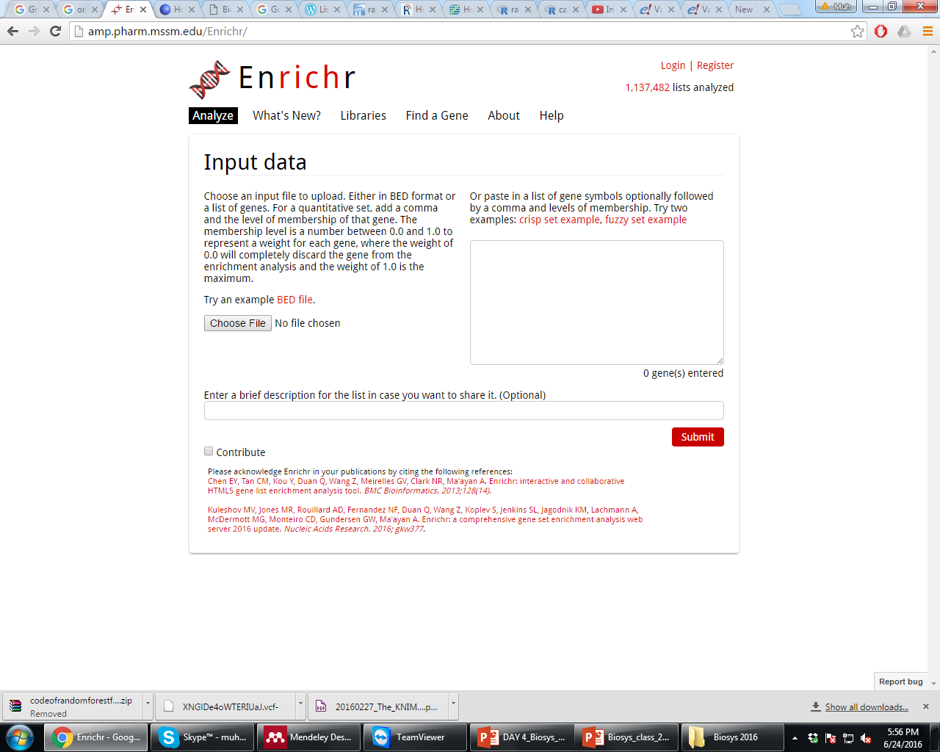
Pathways from multiple databases
Gene Ontologies
Human Phenotype Ontologies
Statistically Rigid
Input genes list

Slide 12
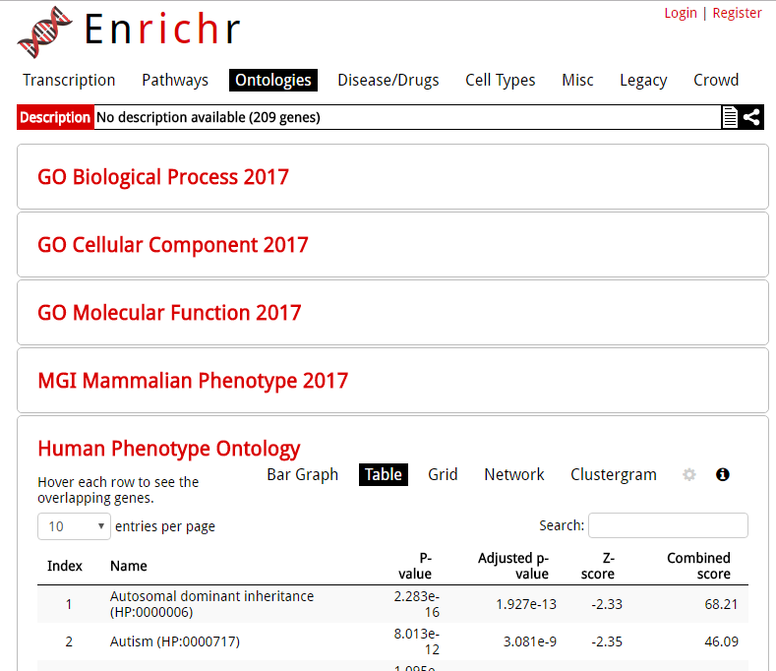
GO enrichment analysis

Slide 13
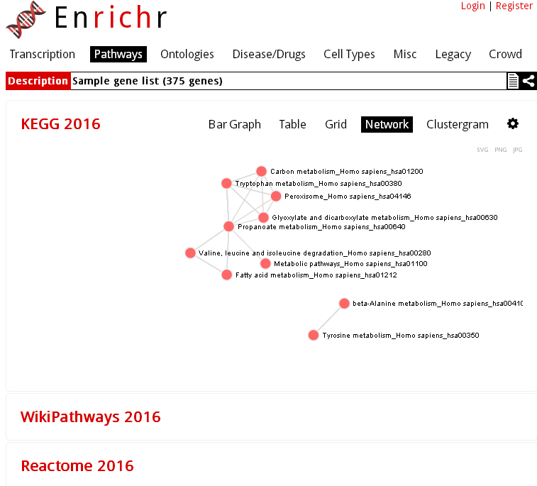
Pathway enrichment analysis

Slide 14
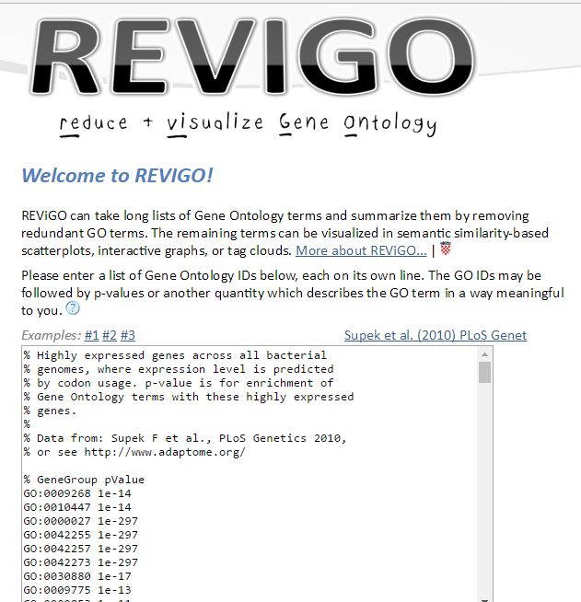
Summarising enrichment results

Slide 15
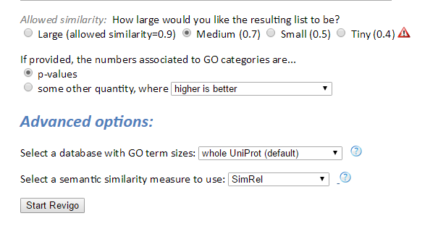
Summarising enrichment results

