Slide 1
“Brushing” Glue Robots
Vertical Rod Robot
Feed Area
Buffer Area
Build Area
“Buffer Advance” direction
Horizontal Rod Robot
“Dabbing” Glue Robots
25mm arc length at center of curve.
18mm radius to center
Curves are driven in “x” direction (same as pixel to the left A) and picked up by running lower pixel B in “y” direction
A
B

Slide 2
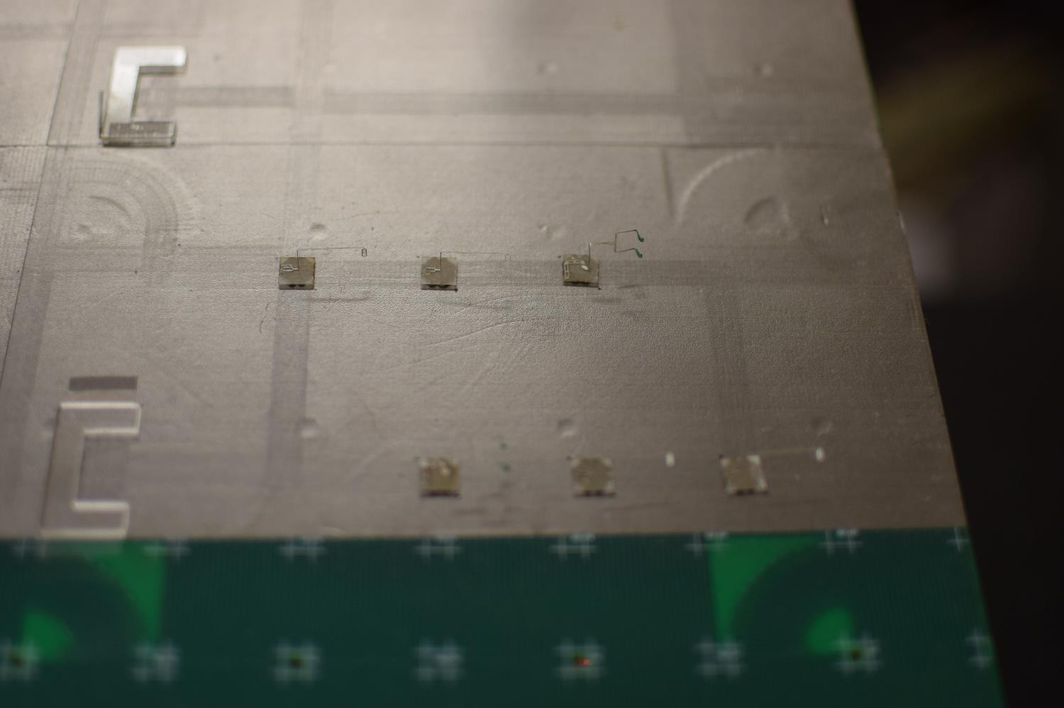

Slide 3
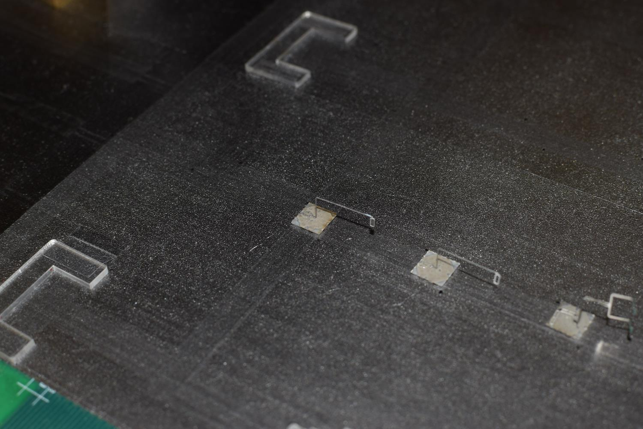
Brushing Robots

Slide 4
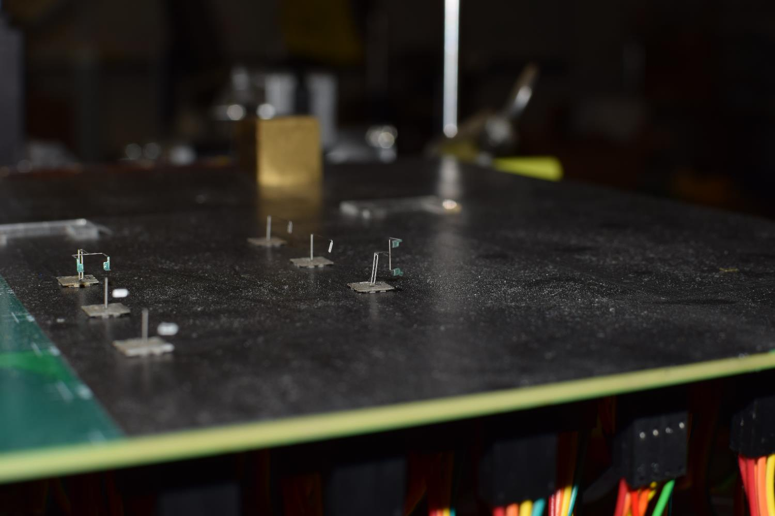
Vertical Rod Robot

Slide 5
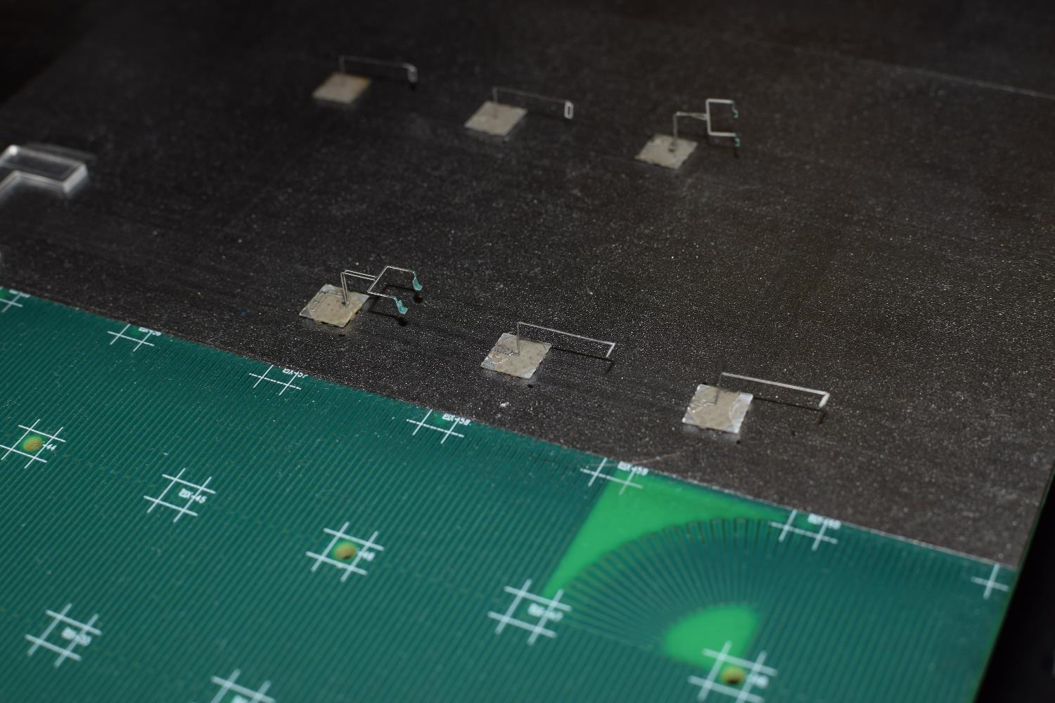
Horizontal Rod Robot
Dabbing Robots

Slide 6
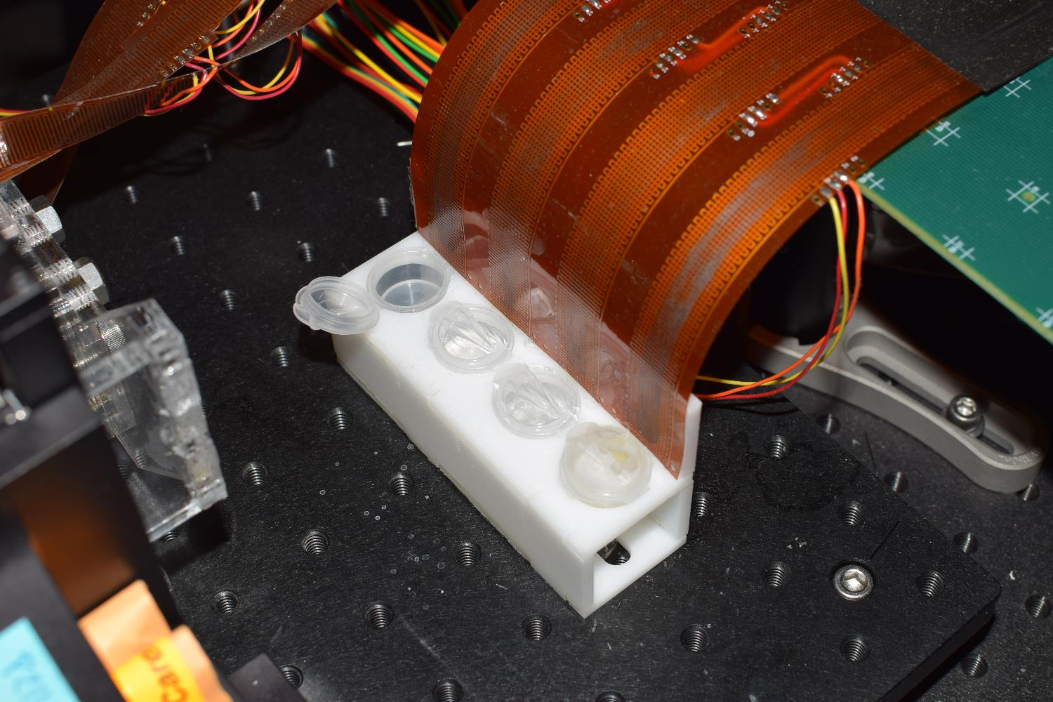
Water, glue, solvent wells.

Slide 7
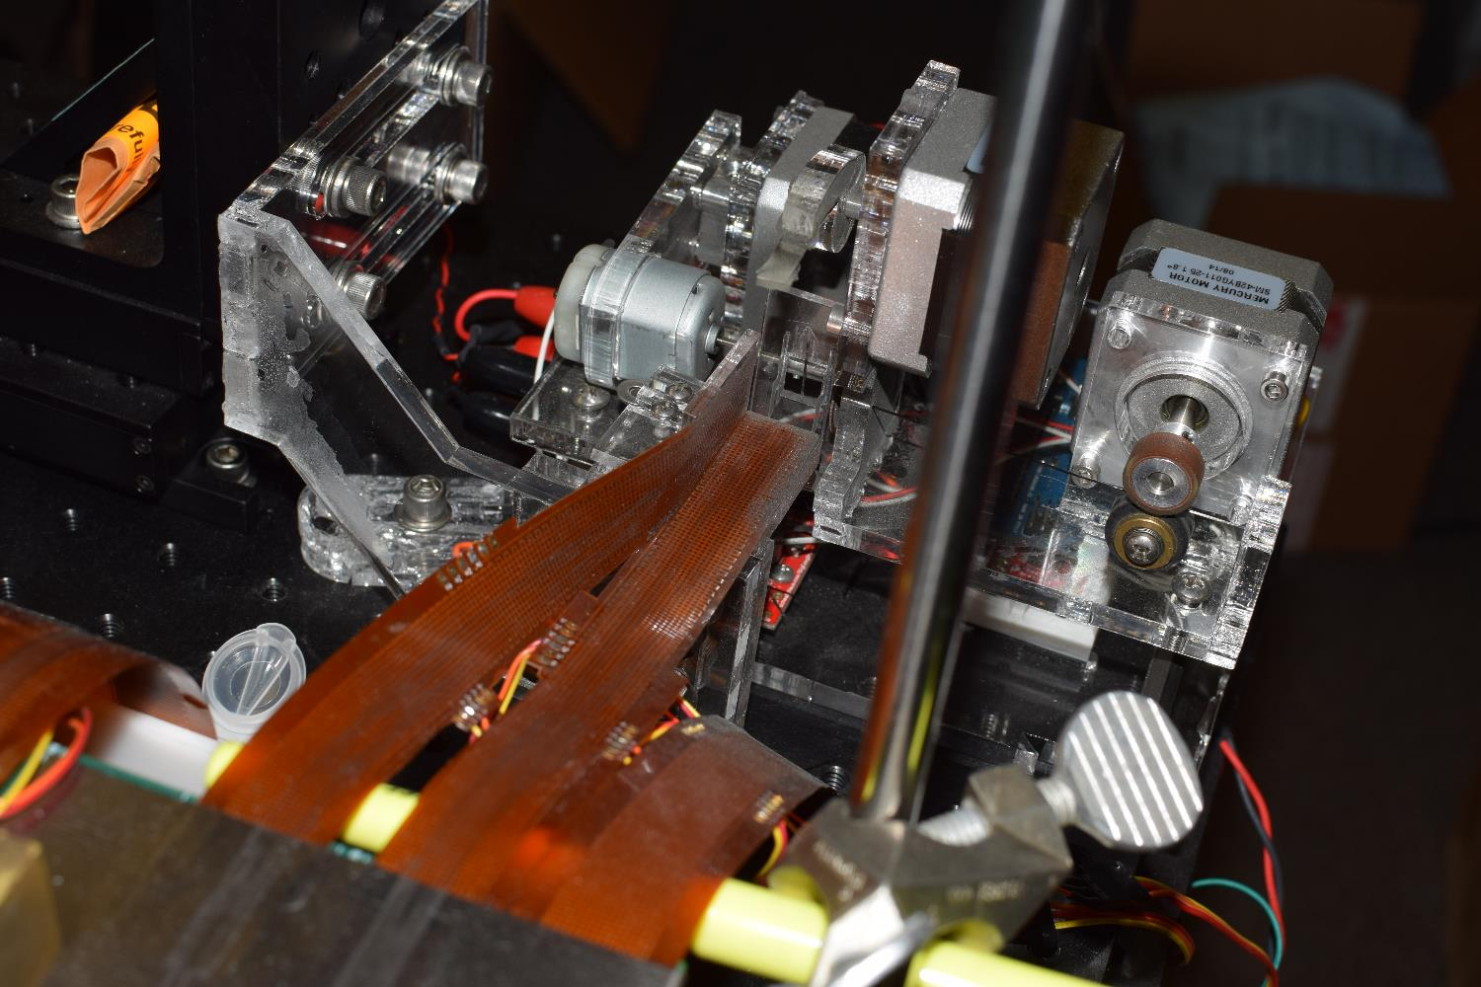
Rod Feeder

Slide 8
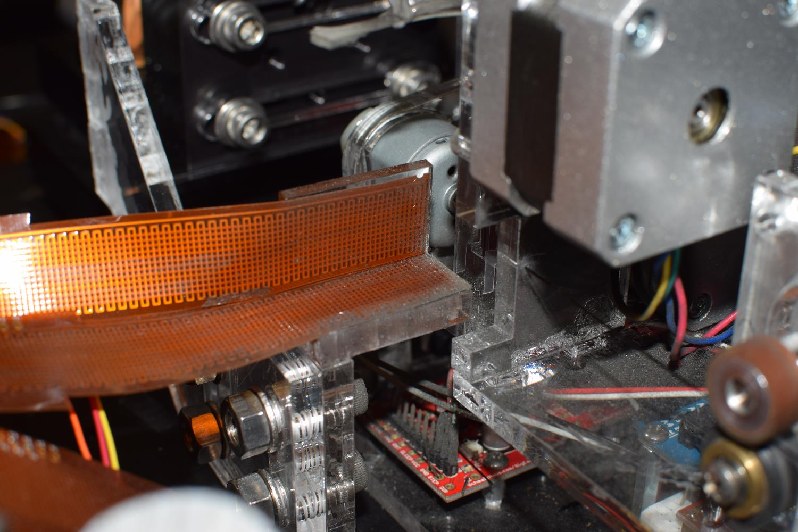

Slide 9
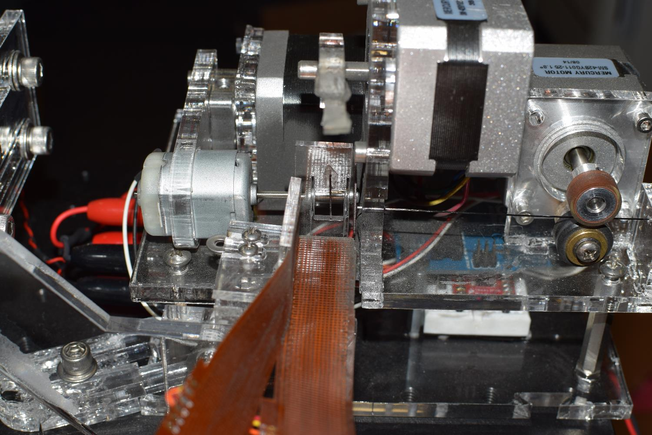

Slide 10
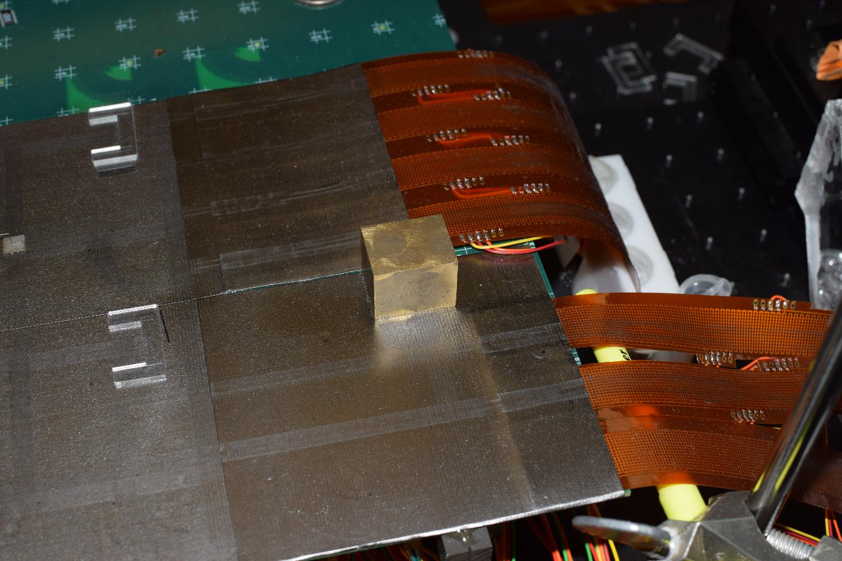
16mm x 28mm outer rectangular envelope
10mm x 16mm cutout
This corner is at coordinates (120, 0)
25mm x 20mm footprint
This corner is at coordinates (24, 96)
This corner is at coordinates (120, 96)

