Slide 1



Software engineering (Undergraduate)
Chapter 1 introduction to software engineering
Course Name software engineering
CSC 3114
(Undergraduate)
DR. M. Mahmudul hasan
Assistant Professor, CS, AIUB
Web: http://cs.aiub.edu/profile/m.hasan
WordPress: https://wordpress.com/view/mhasansuman.wordpress.com

Slide 2
Why system fails?
Chapter 1: Introduction to Software Engineering
Dr. M. Mahmudul Hasan
S.2
MMH
The system fails to meet the business requirements for which it was developed. The system is either abandoned or expensive adaptive maintenance is undertaken.
Errors appear in the developed system causing unexpected problems. Patches have to be applied at extra cost.
There are performance shortcomings in the system, which make it inadequate for the users’ needs. Again, it is either abandoned or amended incurring extra costs.
Users reject the implemented system, lack of involvement in its development or lack of commitment to it.
Systems are initially accepted but over time become un-maintainable and so pass into disuse.

Slide 3
what is Software engineering?
Chapter 1: Introduction to Software Engineering
Dr. M. Mahmudul Hasan
MMH
S.3
Technologies that make it easier, faster, and less expensive to build high-quality computer programs
A discipline aiming to the production of fault-free software, delivered on time and within budget, that satisfies the users’ needs
An engineering: set of activities in software production
The philosophy and paradigm of established engineering disciplines to solve what are termed software crisis

Slide 4
Scope of software Engineering
Chapter 1: Introduction to Software Engineering
Dr. M. Mahmudul Hasan
S.4
MMH
The aim of Software Engineering is to solve Software Crisis:
Late
Over budget
Low quality with lots of faults
Software crisis is still present over 35 years later!

Slide 5
Software characteristics
Chapter 1: Introduction to Software Engineering
Dr. M. Mahmudul Hasan
S.5
MMH
A logical (intangible) rather than a physical system element
Being developed or engineered, but not being manufactured
Software cost concentrating in engineering, not in materials
Software does not “wearing out” but “deteriorating”(not destroyed after lifetime like hardware, but backdated by aging that needs to update)
Software is a ‘differentiator’ (different sub-systems, e.g., cashier’s workstation in a supermarket)
Without “spare parts” in software maintenance (no extra useless features in software)
Most software continuing to be custom built (based on the requirements)

Slide 6
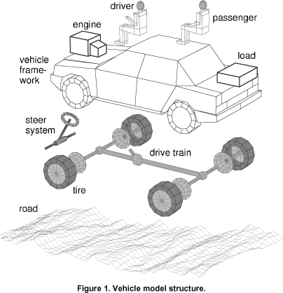
Sub-system vs module
Chapter 1: Introduction to Software Engineering
Dr. M. Mahmudul Hasan
S.6
MMH
Sub-System
Is a system in its own right whose operation does not depend on the services provided by other sub-systems
Are composed of modules
Have defined interfaces which are used for communication with other sub-systems
Module
Is a system component that provides one or more services to other modules
It is not normally considered to be an independent system

Slide 7
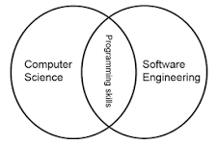
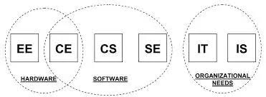
Goal: Computer science vs. Software engineering
Chapter 1: Introduction to Software Engineering
Dr. M. Mahmudul Hasan
S.7
MMH
CS: to investigate a variety of ways to produce S/W, some good and some bad
SE: to be interested in only those techniques that make sound economic sense (Project Mgt – time, budget, etc.)

Slide 8
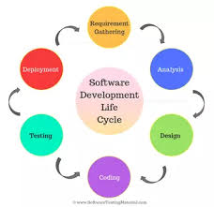
Software development life cycle (SDLC)
Chapter 1: Introduction to Software Engineering
Dr. M. Mahmudul Hasan
S.8
MMH
A structured set of activities required to develop a software system. The way we produce software, including:
Requirements Analysis/Specification
Designing/Modeling
Coding /Development
Testing/QA/Verification & Validation
Implementation/Integration/Deployment/Delivery
Operation/Maintenance
Documentation

Slide 9
SDLC: Case -1
Chapter 1: Introduction to Software Engineering
Dr. M. Mahmudul Hasan
S.9
MMH
You and your development team have been appointed to work on a database for a major bank. For obvious reasons, your client is very concerned with security. You and your team come up with many security features that could be implemented into the product. In what phase of a software life cycle process would this task occur?
(A) Specification
(B) Design and Implementation
(C) Verification and Validation

Slide 10
SDLC: Case -1
Chapter 1: Introduction to Software Engineering
Dr. M. Mahmudul Hasan
S.10
MMH
You and your development team have been commissioned to work on a database for a major bank. For obvious reasons, your client is very concerned with security. You and your team come up with many security features that could be implemented into the product. In what phase of a software life cycle process would this task occur?
(A) Specification
(B) Design and Implementation
(C) Verification and Validation

Slide 11
Good & bad software
Chapter 1: Introduction to Software Engineering
Dr. M. Mahmudul Hasan
S.11
MMH
Good software is maintained—bad software is discarded
Different types of maintenance
Corrective maintenance [about 20%]
Modification to fix a problem
Enhancement [about 80%]
Perfective maintenance (modification to improve usability,…) [about 60%]
Adaptive maintenance (modification to keep up-to-date) [about 20%]
Preventive maintenance (modification to avoid any future error) [about 20%]

Slide 12
Faults in software development phases
Chapter 1: Introduction to Software Engineering
Dr. M. Mahmudul Hasan
S.12
MMH
60 to 70 percent of faults are specification and design faults
Data of Kelly, Sherif, and Hops [1992]
1.9 faults per page of specification
0.9 faults per page of design
0.3 faults per page of code
Data of Bhandari et al. [1994]
Faults at end of the design phase of the new version of the product
13% of faults from previous version of product
16% of faults in new specifications
71% of faults in new design

Slide 13
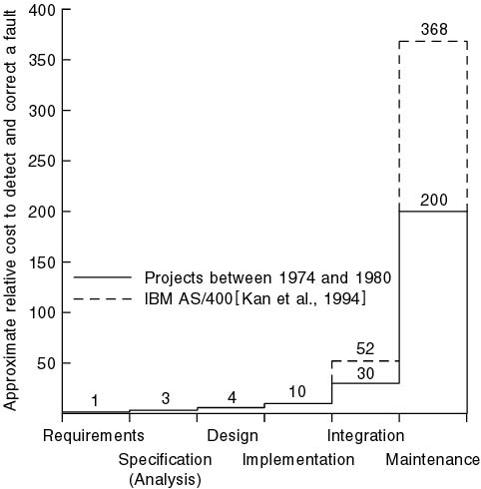
Cost of detection & correction of a fault
Chapter 1: Introduction to Software Engineering
Dr. M. Mahmudul Hasan
S.13
MMH

Slide 14
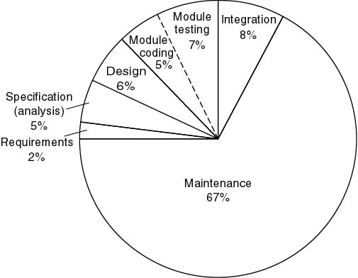
Cost of detection & correction of a fault
Chapter 1: Introduction to Software Engineering
Dr. M. Mahmudul Hasan
S.14
MMH

Slide 15
Cost of change
Chapter 1: Introduction to Software Engineering
Dr. M. Mahmudul Hasan
S.15
MMH

Slide 16
Product bathtub curve model
Chapter 1: Introduction to Software Engineering
Dr. M. Mahmudul Hasan
S.16
MMH
“Infant Mortality” --
due to design or
manufacturing defects
Failure Rate
“deteriorating” --
due to cumulative
affects of environments
Time

Slide 17
Software idealized curve
Chapter 1: Introduction to Software Engineering
Dr. M. Mahmudul Hasan
S.17
MMH
Failure Rate
Idealized Curve
Time

Slide 18
Software actual failure curve
Chapter 1: Introduction to Software Engineering
Dr. M. Mahmudul Hasan
S.18
MMH
Increased failure rates
due to side effects
Failure Rate
Actual Curve
Change
Idealized Curve
Time

Slide 19
Software application
Chapter 1: Introduction to Software Engineering
Dr. M. Mahmudul Hasan
S.19
MMH
System software (control computer H/W such as OS)
Embedded software (e.g., auto pilot, biometric device)
Business software (commercial application for business users, SAP, ERP, DSE)
Engineering and scientific software (e.g., statistical analysis-SPSS, MATLAB)
Personal computer software (e.g., Microsoft Office)
Web-based software (use over internet with browser, e.g., Gmail)
Artificial intelligence software (interact with computer, HCI, game)

Slide 20
Software Myths (management)
Chapter 1: Introduction to Software Engineering
Dr. M. Mahmudul Hasan
S.20
MMH
Myth1: We already have a book that’s full of standards and procedures for building s/w, won’t that provide my people with everything they need to know?
Myth2: My people have state-of-the-art software development tools, after all, we buy them the newest computers.
Myth3: If we get behind schedule, we can add more programmers and catch up.
Myth4: If I decide to outsource the software project to a third party, I can just relax and let that firm build it.

Slide 21
Software Myths (customer)
Chapter 1: Introduction to Software Engineering
Dr. M. Mahmudul Hasan
S.21
MMH
Myth1: A general statement of objectives is sufficient to begin writing programs – we can fill in the details later.
Myth2: Project requirements continually change, but change can be easily accommodated because software is flexible.

Slide 22
Software Myths (practitioner)
Chapter 1: Introduction to Software Engineering
Dr. M. Mahmudul Hasan
S.22
MMH
Myth1: Once we write the program and get it to work, our job is done.
Fact: the sooner you begin writing code, the longer it will take you to get done.
Myth2: Until I get the program “running,” I have no way of assessing its quality.
Myth3: The only deliverable work product for a successful project is the working program.
Myth4: Software engineering will make us create voluminous and unnecessary documentation and will invariable slow us down.

Slide 23
references
Chapter 1: Introduction to Software Engineering
Dr. M. Mahmudul Hasan
S.23
MMH
Pressman, R.S. (2010). Software Engineering: A Practitioner’s Approach.
Kelly, J. C., Sherif, J. S., & Hops, J. (1992). An analysis of defect densities found during software inspections. Journal of Systems and Software, 17(2), 111-117.
Bhandari, I., Halliday, M. J., Chaar, J., Chillarege, R., Jones, K., Atkinson, J. S., & Yonezawa, M. (1994). In-process improvement through defect data interpretation. IBM Systems Journal, 33(1), 182-214.

