Slide 1





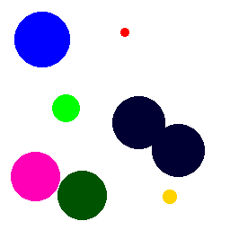
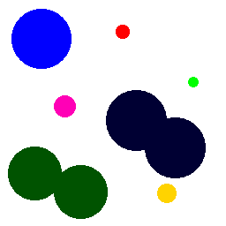
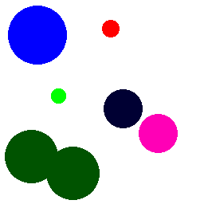
Arrays needed:
Time
Analyze particles ID
Mode in previous
History
Modes-ROI
AssignedID
Also: MAX ID
Swelling
Coalescing
Bursting
Shrinking
Partial track
Oscillating
Noise
T1
T2
T3
T4
1
1
7
1
7
1
7
Target
9
2
3
2
2
2
3
4
3
3
4
5
6
5
6
8
5
8
5
1
1
2
1
2
1
2
Analyze particles
3
2
3
3
5
3
4
4
4
4
5
5
6
5
6
7
6
7
6
Label (AP) |  | Modes |  |  | Assign (same)
1 |  |  |  |  | 1
2 |  |  |  |  | 2
3 |  |  |  |  | 3
4 |  |  |  |  | 4
5 |  |  |  |  | 5
6 |  |  |  |  | 6
 |  |  |  |  | Ok!
Label (AP) | Mode in previous | Modes |  | Assign | Obs
1 | 1 | 1 |  | 1 | Ok
2 | NaN | NaN |  | 7 | Sem passado: atribuir nova
3 | 2 | 2 |  | 2 | Ok
4 | 3 | 3 |  | 3 | Ok
5 | 5 | 5 |  | 5 | Ok
6 | 6 | 6 |  | 6 | Ok
7 | NaN | NaN |  | 8 | Sem passado: atribuir nova
Label (AP) | Mode in previous | Modes |  |  | Assign | Obs
1 | 1 | 1-1 |  |  | 1 | Ok
2 | 7 | NaN-7 |  |  | 7 | Ok, new
3 | NaN | NaN-NaN |  |  | 9 | Sem passado: atribuir nova
4 | 3 | 3-3 |  |  | 3 | Ok
5 | 2 | 2-2 |  |  | 2 | Ok
6 | 5 | 5-5 |  |  | 5 | Ok
7 | 8 | NaN-8 |  |  | 8 | Ok, new
Label (AP) | Mode in previous | Modes | Temp | Modes-ROI | Assign | Obs
1 | 1 | 1-1-1 |  |  | 1 | Ok
2 | 7 | NaN-7-7 |  |  | 7 | ok
3 | 2 | 2-2-2 |  |  | 2 | Ok
4 | 3 | 3-3-3 | 3 | 3-3-3 | 3 | Tie-break
5 | 3 | 3-3-3 | 3 | 4-3-3 | 4 | Tie-break
6 | 5 | 5-5-5 |  |  | 5 | Ok
Max ID: 6
Max ID: 8
Max ID: 9
Max ID: 9
Wrong tie break – assign new

