Slide 1



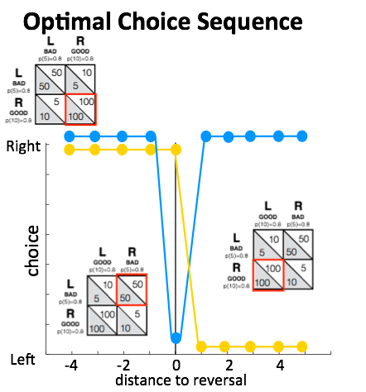
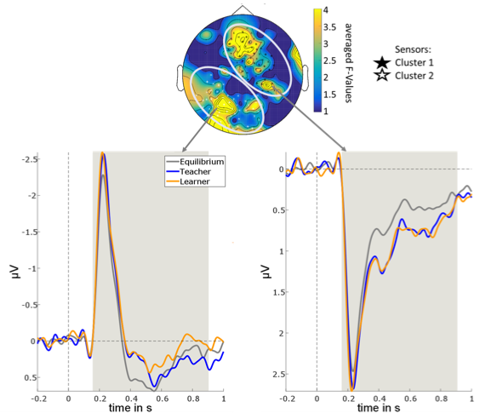
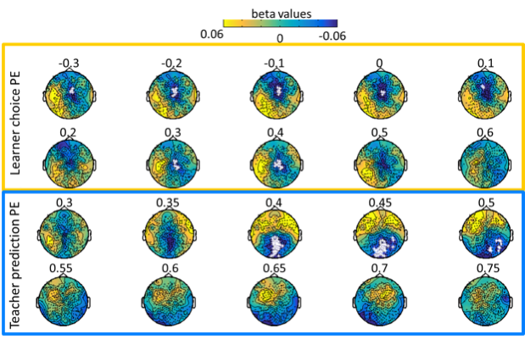
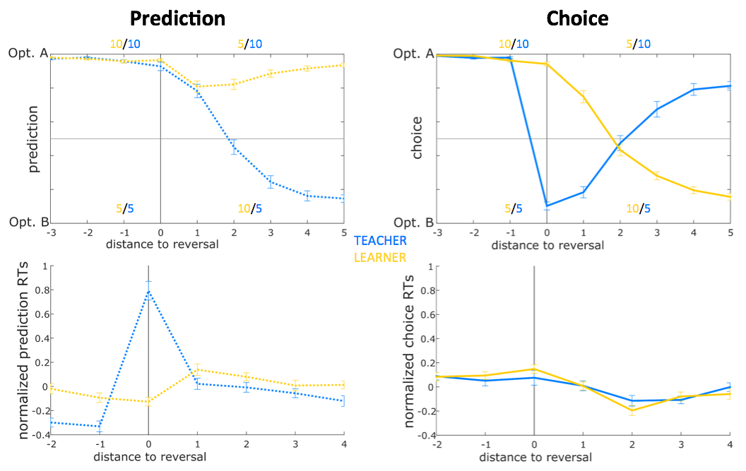
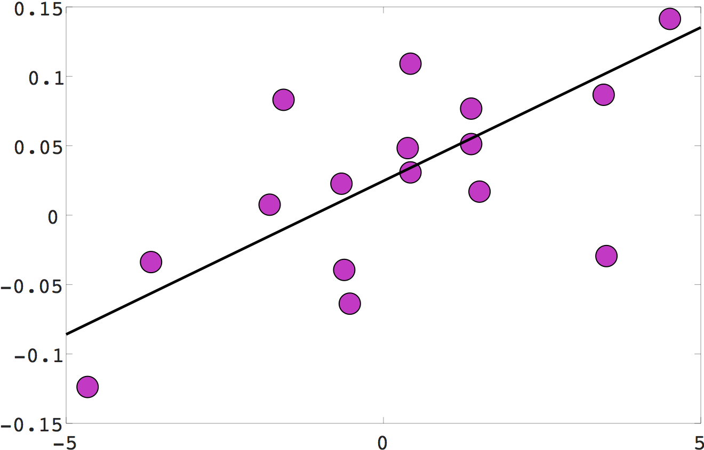
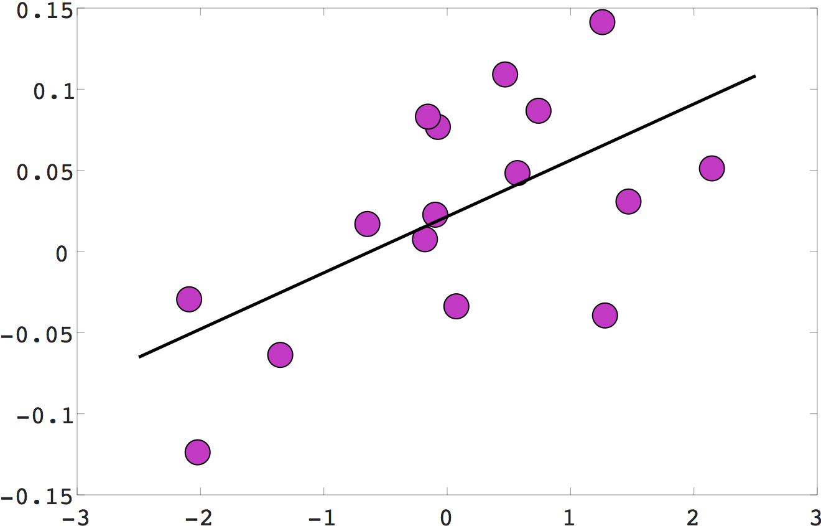
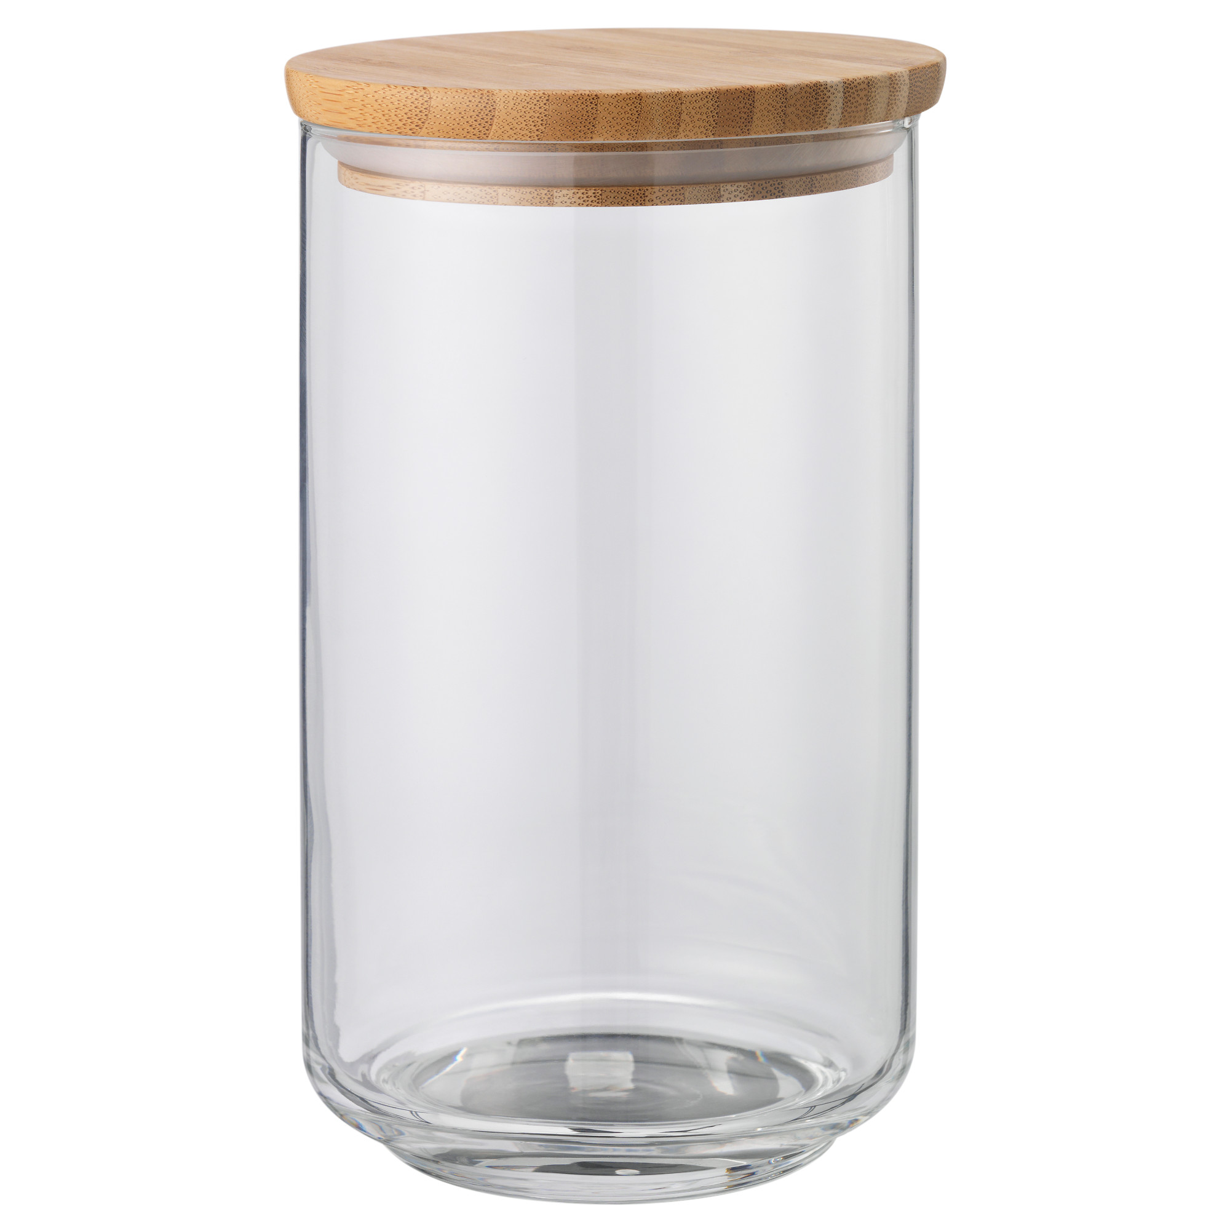
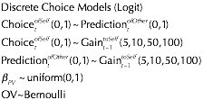
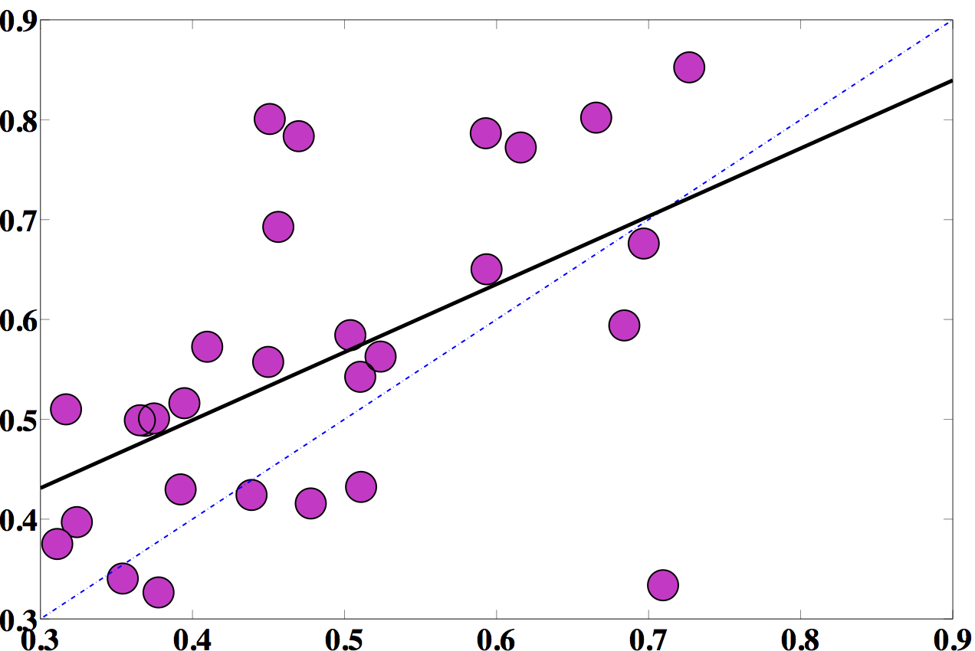
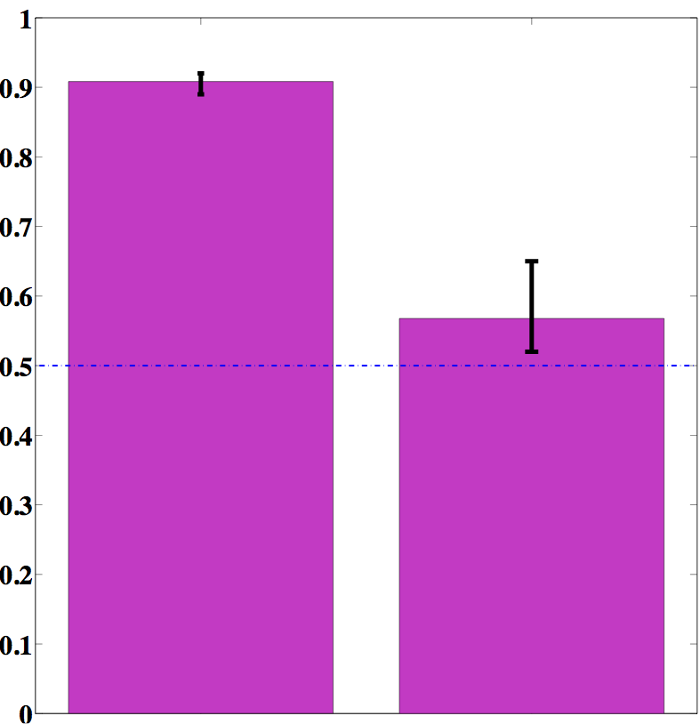
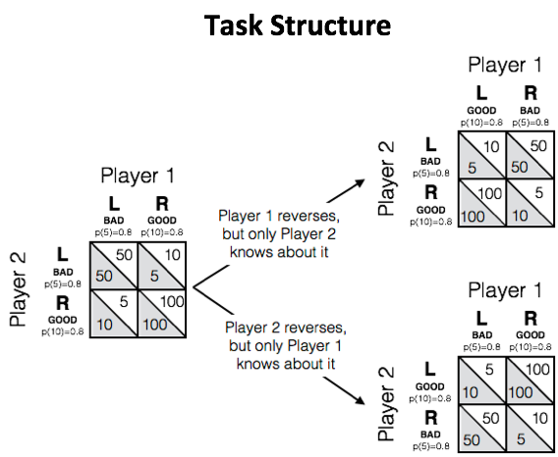
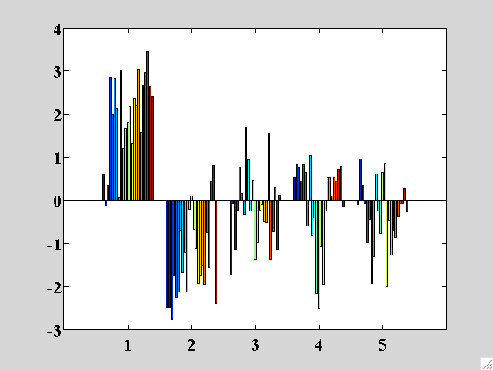
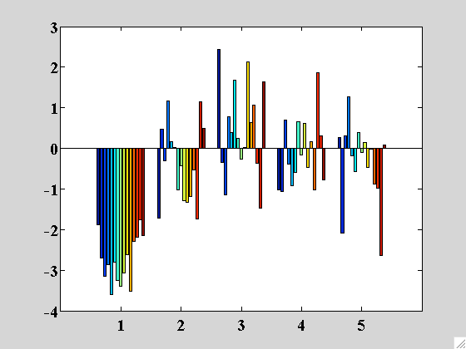
Theory of Mind and Valuation during Cooperation
Michael Spezio^{1,2,3}, Tessa Rusch³, Yuqing Lei^{1,2}, Vanessa Hayes², Jan Glaescher³
CogSci2017, London, England
#155
1. Psychology and 2. Neuroscience, Scripps College, Claremont, CA USA; 3. Institute for Systems Neuroscience, University Medical Center, Eppendorf, Hamburg, Germany
1. Introduction
3. ToM & Predicting Others’ Choices
5. Processing Feedback for Prediction Errors
Theory of Mind (ToM) means affirming, at least pragmatically, the presence of “other minds” (1) then representing others to have particular mental states and representations and not others. (2,3) Cognitive models of others’ cognitive models can be used to make predictions about behavior that influence decisions about and within both cooperative and competitive interaction. Despite the clear interactive role for ToM, almost all current inquiry into ToM takes a spectatorial approach, relying on mere observation followed by evaluation (e.g., the Sally-Anne task, 4). However, there is good evidence that social cognition fundamentally changes in direct interaction with others (5), particularly when interaction outcomes drive valuational outcomes. We developed a novel dyadic, interactive cooperative decision-making task: the Interactive False Belief Teacher-Learner Task (IFBTLT). Each participant’s actions under uncertainty influence the joint reward probabilities of both, favoring cooperation and coordination. Only Teachers have knowledge of the correct action-reward contingencies, while Learners must learn from Teachers for optimal actions. We expected that Teachers would predict Learners’ choices by using ToM, and specifically that they would match the valuational preferences of Learners in order to achieve best results for both.
Focus on Perireversal Trials
Feedback ERPs
Correlation Between FB ERPs & PEs
REVERSAL TRIAL
for
Ppt. 2
Ppt. 1 (T) Knows
Ppt. 2 (L) Doesn’t Know
The Teacher Predicts the Learner
N = 22 Dyads, 44 Ppts.
Learner
Choice PE
Optimal IF
No Uncertainty
Teacher
Learner
Teacher Predicts Learner
Teacher
Prediction PE
6. Cooperativity & Uncertainty Avoidance Influence How Well Teacher & Learner Weights Cohere
Teacher
Learner
Teacher Prediction and Learner Choice weights on shared gains (β100) associated more strongly when Teachers and Learners were closer on Cooperativity (Temperament/Character Inventory) and Uncertainty Avoidance (Intolerance of Uncertainty Scale, Fact. 2).N = 16 dyads, 32 ppts.
2. False Belief Teacher-Learner Task
Cooperativity
Uncertainty Avoidance
LEFT
RIGHT
REVERSAL TRIAL
for
Ppt. 1
Ppt2 (Teach.) Knows
Ppt1 (Learn.) Doesn’t Know
LEFT
RIGHT
4. Teachers Follow Learners’ Weights on Shared Gain
Dyad Residual, β100
Dyad Residual, β100
Ppt. 1
80% Lo
80% Hi
80% Hi
80% Lo
r = 0.63, p = 0.009
[0.19,0.86]
r = 0.60, p = 0.014
[0.15,0.84]
Dyad Residual, TCI Coop
Dyad Residual, IUS
Uncertainty Avoidance
Rew = 5
β100 for Teacher Prediction
7. Conclusions
Ppt. 2
80% Lo
80% Hi
Rew = 10
80% Lo
80% Hi
A novel interactive task elicited theory of mind about a partner’s evaluation of shared gains. Teachers’ predictions about Learners’ choices weighted shared gains similarly to the way that Learners did. Learners showed no such effect. Teachers’ neural processing of feedback tracked with their PE for Predictions, while Learners’ neural processing of feedback followed their PEs for Choice and not Prediction. The more dissimilar Teachers and Learners were on psychometric scales of Cooperativity and Uncertainty Avoidance, the less closely associated were the weights on shared gains. The Interactive False Belief Teacher-Learner Task reveals an aspect of ToM in which people match valuation of feedback in order to predict their partners’ next actions.
Teachers Choose by Valuing Their Predictions of Learner Choice
ρ=0.49, p=0.003
Cooperative Coordination
N = 18 Dyads
36 Ppts.
Ppt. 1 Draw
β100 for Learner Choice
64%
4%
16%
16%
 | Other’s Choices as Learner | Self’s Choices as Learner | Other’s Choices as Teacher | Self’s Choices as Teacher
Self’s Predictions as Teacher | ρ=0.46* [0.17,0.68] | ρ=0.29 [-0.03,0.56] | ρ=0.05 [-0.33,0.42] | ρ=0.74* [0.53,0.87]
Self’s Predictions as Learner | ρ=0.01 [-0.33,0.36] | ρ=0.59* [0.28,0.81] | ρ=0.35 [0,0.65] | ρ=0.19 [-0.16,0.49]
Self’s Choices as Teacher | ρ=0.41* [0.15,0.63] | ρ=0 [-0.34,0.35] | ρ=0.08 [-0.27,0.42]
 | Other’s Choices as Learner | Self’s Choices as Learner | Other’s Choices as Teacher | Self’s Choices as Teacher
Self’s Predictions as Teacher | ρ=0.49* [0.14,0.74] | ρ=0.09 [-0.28,0.44] | ρ=-0.12 [-0.46,0.23] | ρ=0.76* [0.54,0.90]
Self’s Predictions as Learner | ρ=0.41 [0.24,0.48] | ρ=0.15 [-0.19,0.46] | ρ=0 [-0.32,0.32] | ρ=0.30 [-0.05,0.59]
Self’s Choices as Teacher | ρ=0.63* [0.33,0.84] | ρ=0.12 [-0.26,0.43] | ρ=-0.05 [-0.38,0.29]
Acknowledgements. We are grateful for helpful conversations with Martin Hebart, Saurabh Kumar, and Prashant Doshi, and for funding support from the National Science Foundation’s program in Collaborative Research in Computational Neuroscience (CRCNS; grant 1608278); the Bundesministerium fuer Bildung und Forschung (grant 01GQ1603); the Mellon Foundation supporting undergraduate research fellowships; the Self, Motivation, and Virtue Project; the Templeton Religion Trust; and the John Templeton Foundation.
References.
Reid, T. (2002). Essays on the Intellectual Powers of Man (D. R. Brookes Ed.). Edinburgh, Scotland: Edinburgh University Press.
Premack, D., & Woodruff, G. (1978). Does the chimpanzee have a theory of mind? The Behavioral and Brain Sciences, 4, 515-526.
Leslie, A. M. (1987). Pretense and representation: the origins of "theory of mind". Psychological Review, 94(4), 412-426.
Baron-Cohen, S., Leslie, A. M., & Frith, U. (1985). Does the autistic child have a 'theory of mind'? Cognition, 21(1), 37-46. doi:10.1016/0010-0277(85)90022-8
Schilbach, L., Timmermans, B., Reddy, V., Costall, A., Bente, G., Schlicht, T., & Vogeley, K. (2013). Toward a second-person neuroscience. Behavioral and Brain Sciences, 36(04), 393-414. doi:10.1017/S0140525X12000660
Ppt. 2 Draw
Ppt. 1 Gain
100
50
10
5
Teachers
Choose
Learners
Choose
Ppt. 2 Gain
100
50
5
10
Anxiety
Emotional Modulation

