Slide 1
Wilson financial CASE STUDY SOLUTION
GROUP 4

Slide 2
AGENDA
Introduction
Description
Entity-Relationship Diagram
Reports
Assumptions
Summary of Findings
Recommendations

Slide 3
INTRODUCTION
Group 4 consists of Brittany Kyncl, Mark Witt, Riese Bohnak, and Holly McFarland. We are all current students at Bellevue University and enrolled in the CSD 310 – Database Development and Use course.

Slide 4
description
Wilson Financial Case Study

Slide 5
Jake and ned Wilson noticed the need for a business dedicated to financial management and advising in their small town and decided to open Wilson financial. After realizing the growth that has occurred in the past year, they decided to re-evaluate their business approach. They determined that they needed to assess their client list, their assets, and the billing process to ensure that their customers were receiving an optimal service and they were continuing to see a positive return. The billing structure was the main concern to be addressed.

Slide 6
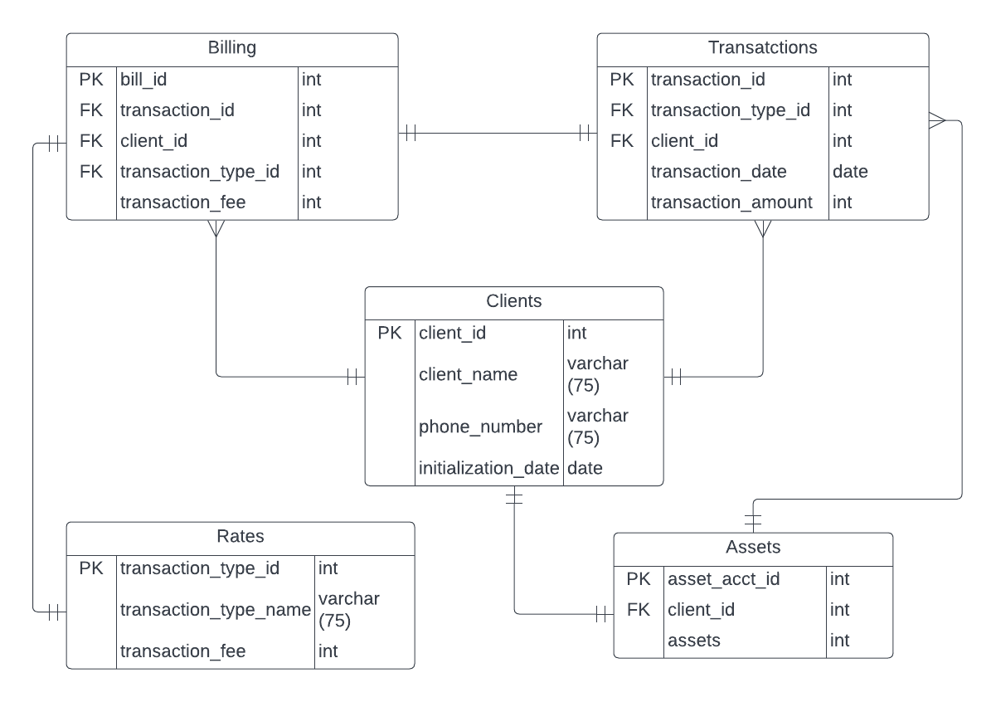
Entity-relationship diagram

Slide 7
reports
1
What is the average amount of assets held within each client account? What is the total amount of transaction fees each client has paid? How does this compare to the amount held in each client’s asset account?
2
How many clients have a high rate of transactions per month? What is the overall amount of transaction activity per month, per year? Is this rate declining or increasing?
3
How many clients have been added within the past six months? What is the rate of client acquisition for every six-month period? Is this rate declining or increasing?
4
What is the total revenue from client transaction fees per month, per year? What is the rate of increase/decrease between these periods? Is it trending down or up?

Slide 8
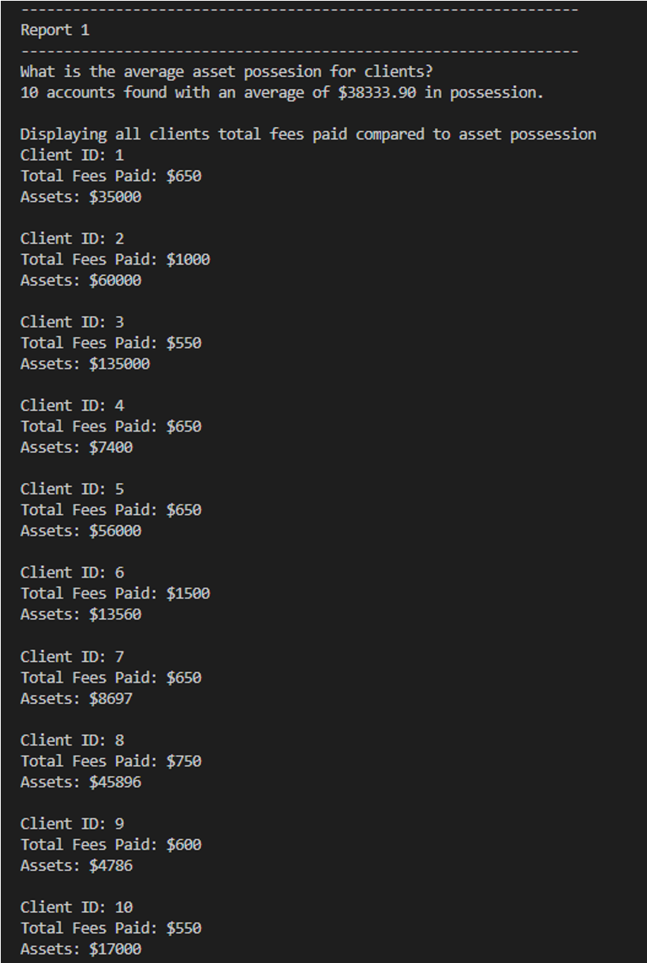
Report 1 This report aims to determine the average amount of assets held within each client account. Then the total amount of transaction fees each client has paid since their account initialization date how this number compares to the amounts held within each client’s asset account.

Slide 9
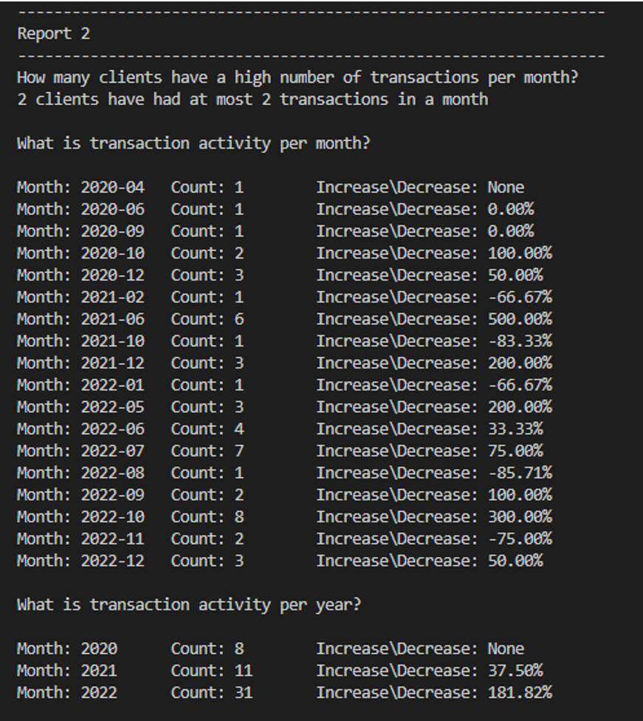
Report 2 This report aims to determine how many clients have a high rate of transactions per month comparatively. to determine the overall amount of transaction activity per month and per year. Based on these findings we can then see if this rate is declining or increasing.

Slide 10
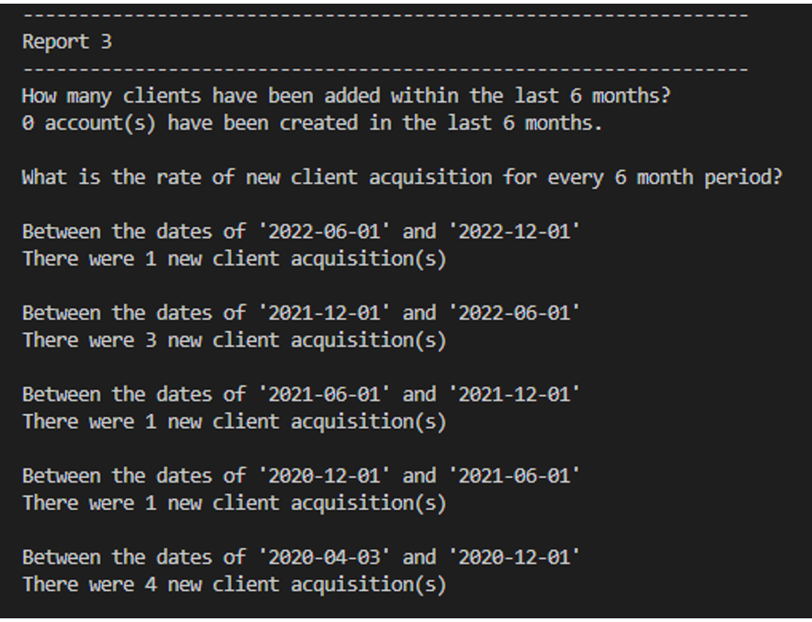
Report 3 This report is to determine how many clients, if any, have been added within the past six months. Then it shows the number of new clients acquired every six months since the first client initialization date. From these findings, we can see an overview of Wilson Financial’s client acquisition rate.

Slide 11
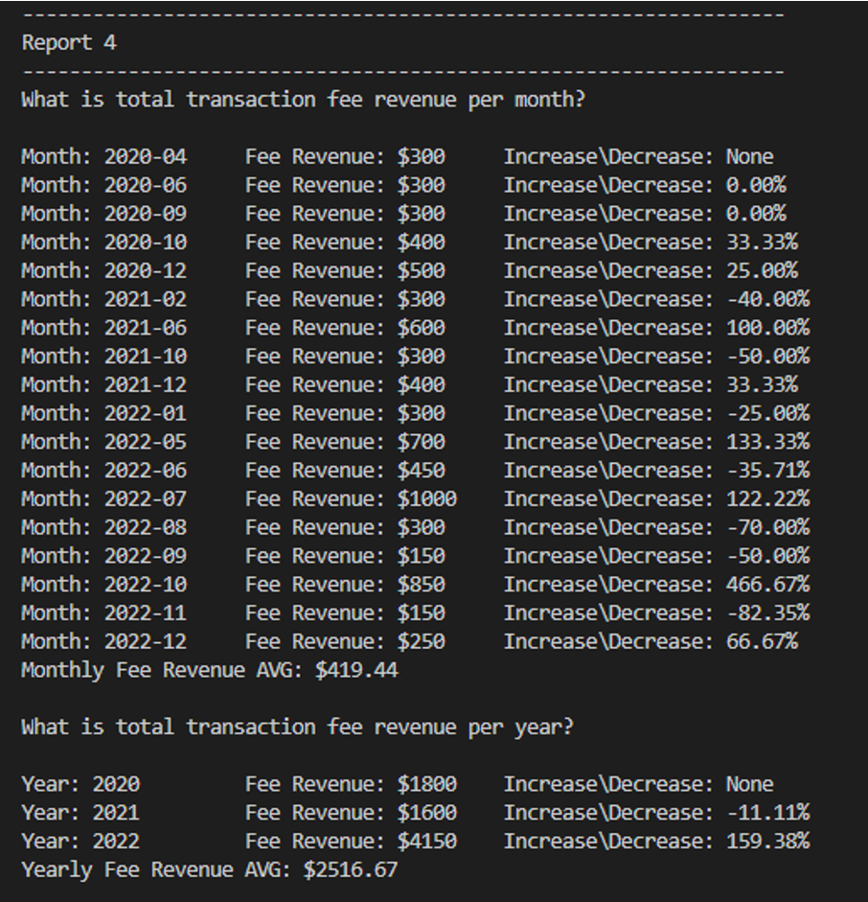
Report 4 The gathered data shows the total revenue from transaction fees per month. Then it shows the same data spread out over a period of years. To the right of the total fee revenue for each period is a percentage rate increase or decrease. to help determine any trends of growth or decline in fee revenue.

Slide 12
Assumptions
Currently has a billing structure to send a bill to each client for each transaction
Client bills are paid through separate account management
Does not already have any sort of incentive programs for customer engagement

Slide 13
Summary of findings
The average asset possession for each client is $38,333.90.
Comparatively the total transaction fees each client has paid is much less than the amounts in each clients’ assets account.
Only 2 clients have had at most 2 transactions in a month showing that the number of clients who have multiple transactions per month could be an area of improvement.
Looking at total transactions for all clients on a month by month and year by basis. Total transactions amount has been steadily increasing since the business opened. The increase is even more apparent when viewed per year period, showing an impressive 181.82% increase in transactions from 2021 to 2022.
Our report found that no new clients have been added within the most recent six -month period.
The number of clients added per every six-month period since the business opened has been decreasing and most notably in the most recent six-month period.
Looking at an overview of revenue generated by transaction fees on a month by month and year by basis since the business has opened. The report shows an average monthly intake of $419.44 from fee revenue and an average yearly intake of $2516.67 from fee revenue.
The rate of increase for fee revenue is steadily increasing at a slow rate but does show a pattern of small decline followed by a larger increase in the next period. These numbers correlate with the findings on total transaction activity and client acquisitions.

Slide 14
recommendations
Transaction fees paid directly from client’s asset accounts
Implement an incentive program
Focus on improving the client acquisition rate

Slide 15
THANK YOU
Brittany Kyncl
Mark Witt
Riese Bohnak
Holly McFarland

