Slide 1
Looking for the Best Location for an Italian Restaurant
Hongmei Zhu

Slide 2
Introduction
Assume our client wants us to help him to decide where is the best location to operate an Italian restaurant in Boston, MA
Candidate locations - There are three locations available for our client to rent in Boston
Analyze the geographic distribution of Boston businesses and venues of the three locations
Audience – Business owners who wants to find the best location to run their business

Slide 3
Criteria of the best location
Criteria
There are no more than two Italian Restaurants within 800 meters.
There is at least one big park within 800 meters.
There is at least one big mall within 800 meters.
Goal - Figure out the best location chosen from the three candidate locations

Slide 4
Data and Sources - 1
Candidate locations
48 Deckard St, Boston, MA 02121
52 Mt Vernon St, Boston, MA 02108
270 W Fifth St, Boston, MA 02127
Boston zip codes - https://bostonopendata-boston.opendata.arcgis.com/datasets/53ea466a189b4f43b3dfb7b38fa7f3b6_1
Massachusetts zip codes and latitudes/longitudes - https://public.opendatasoft.com/explore/dataset/us-zip-code-latitude-and-longitude/table/?q=MA

Slide 5
Data and Sources - 2
Shopping mall data - https://www.bostoncentral.com/shopping.php, and google search results.
Venues of each zip code – Obtained by requesting from Foursquare
Venues of each candidate location – Obtained by requesting from Foursquare

Slide 6
Python libraries used to solve problem
pandas, numpy - data processing and analysis
requests – send url as request to server side
geopy.geocoders – geocoding physical address
Sklearn.cluster – k-means algorithm
folium – Web map creation

Slide 7
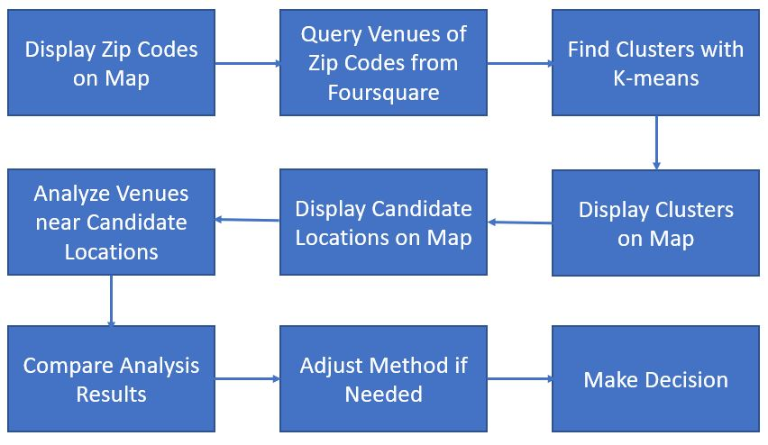
Methodology

Slide 8
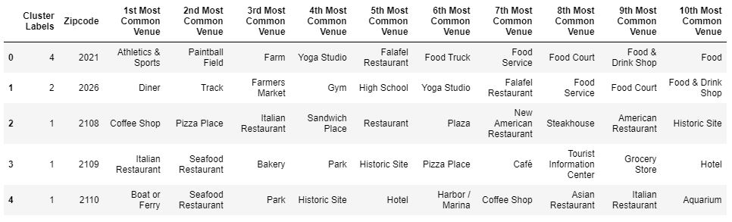
K-means algorithm
Explore businesses in Boston with K-means algorithm. K = 5
Label of each zip code with top 10 most common venues

Slide 9
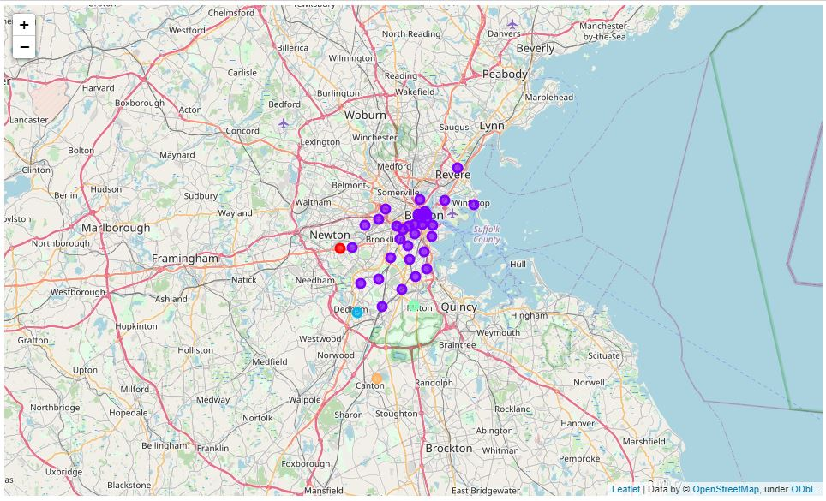
Cluster map of zip codes

Slide 10
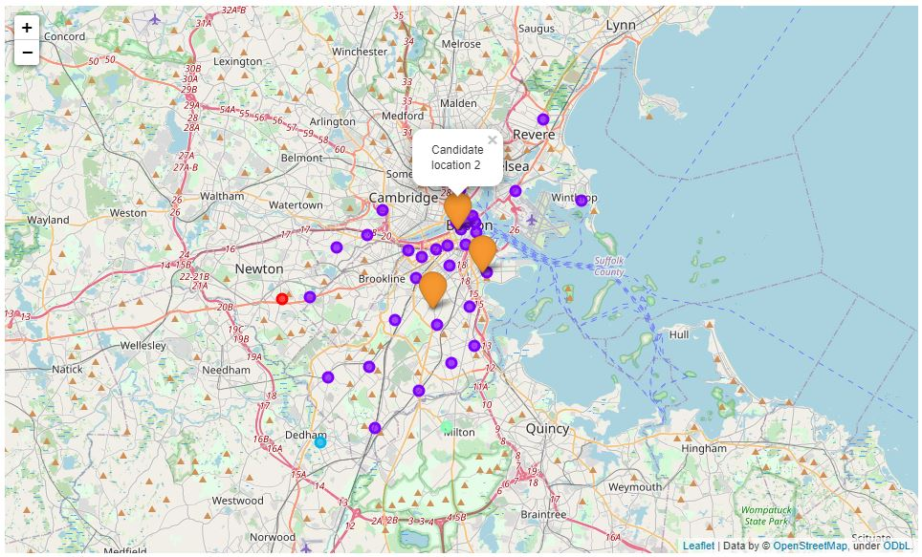
Candidate locations on cluster map

Slide 11
Analysis results
Candidate Location | Analysis Output
1 | There is no Italian Restaurant within 800 meters There is no park within 800 meters 1 shopping mall(s) found within 800 meters
2 | 5 Italian Restaurant(s) found within 800 meters 3 park(s) found within 800 meters There is no shopping mall within 800 meters
3 | 2 Italian Restaurant(s) found within 800 meters 1 park(s) found within 800 meters There is no shopping mall within 800 meters5.
Location 1 and 3 are better than location 2. Need further analysis.

Slide 12
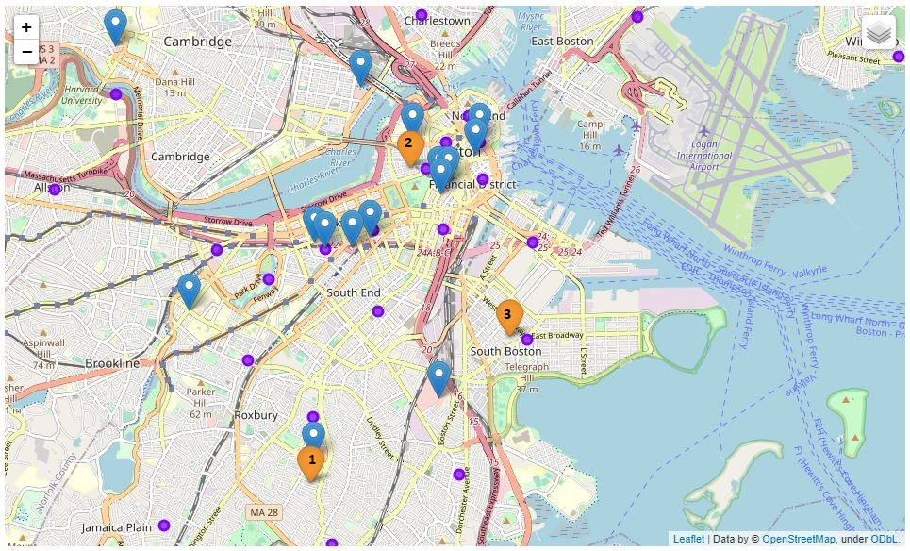
Add shopping malls on map

Slide 13
Conclusion
The Candidate location 1 is considered as the best location

