Slide 1
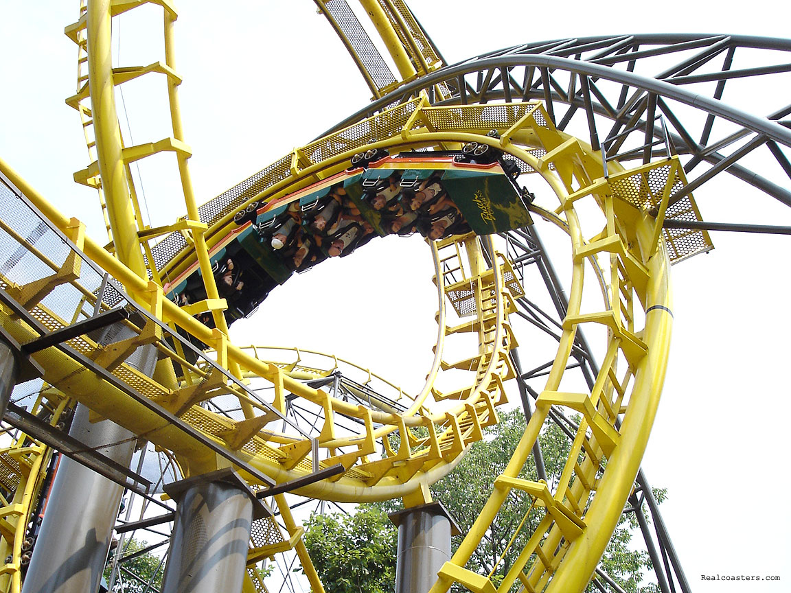

Potential and Kinetic Energy

Slide 2
How is all energy divided?
All Energy
Potential
Energy
Kinetic
Energy
Gravitation
Potential
Energy
Elastic
Potential
Energy
Chemical
Potential
Energy

Slide 3
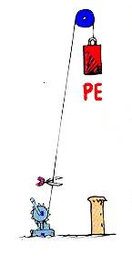

What is Potential Energy?
Energy that is stored and waiting to be used later

Slide 4
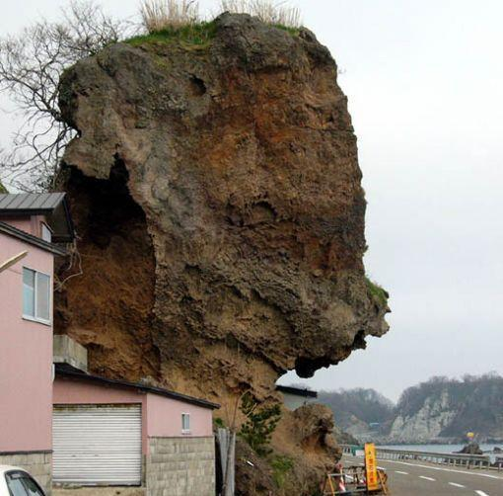
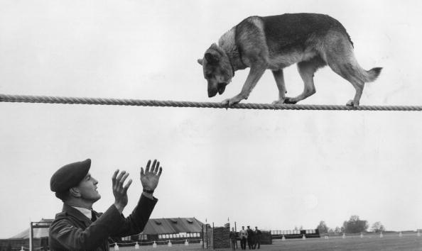
What is Gravitational Potential Energy?
Potential energy due to an object’s position
P.E. = mass x
height x gravity
Don’t look down, Rover!
Good boy!

Slide 5
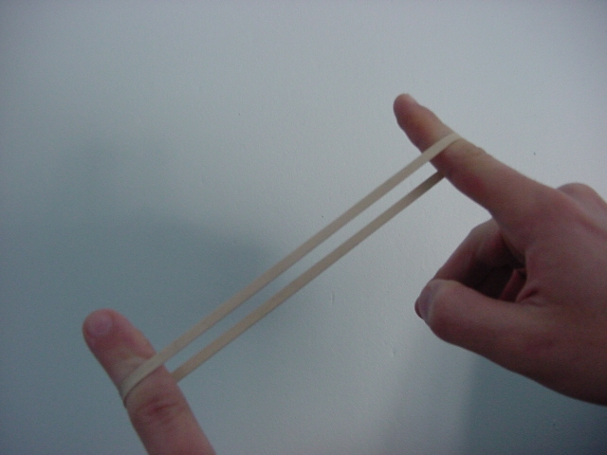

What is Elastic Potential Energy?
Potential energy due compression or expansion of an elastic object.
Notice the ball compressing
and expanding

Slide 6
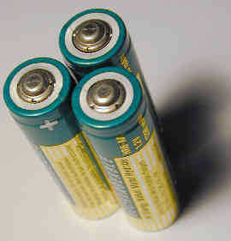
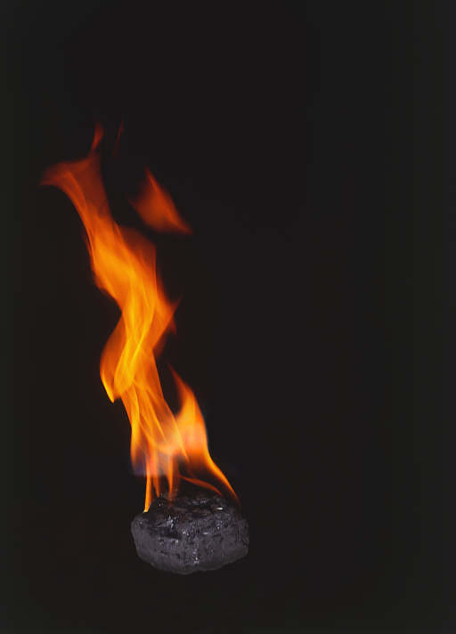

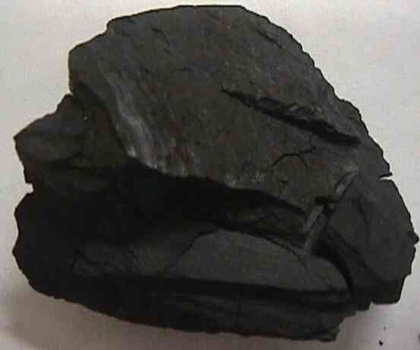
What is Chemical Potential Energy?
Potential energy stored within the chemical bonds of an object

Slide 7
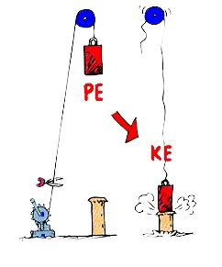

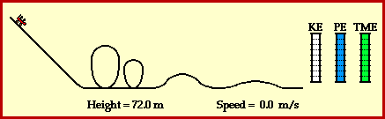
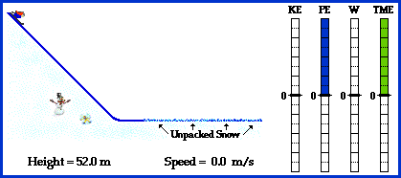
What is Kinetic Energy?
Energy an object has due to its motion
K.E. = .5(mass x speed²)

