Slide 1
Song Genre Classifier
Sam Thurman
Hamza Masood
Flatiron School – Mod 3 Project
March 27, 2020

Slide 2
Agenda
Problem Statement
Dataset Choices
Dataset deep dive
Baseline model
Model Improvements
Live demo!
Future improvements

Slide 3
Problem Statement
Given some basic metadata and spectral analysis of a song, predict its genre
Uses
Ingestion engine for new music at a music streaming service
Archival analysis in academia

Slide 4
Dataset Choices
Starting point: Million Song Dataset published by researchers at Columbia University (>50 features)
Full million song set (350+GB)
10K subset for quick analysis (2 GB)
59.6K songs subset published by researchers working off the original dataset includes:
Basic: Genre, artist, title, duration
Musical features: Loudness, tempo, time signature, key, mode
Timbre (24 features)

Slide 5
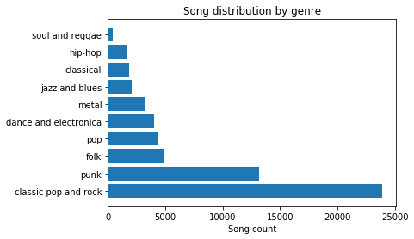
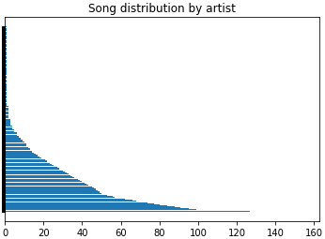
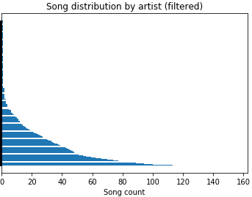
Dataset Deep Dive: 1
Drop ‘title’, ‘Unnamed: 0’
Reset index to ‘track_id’
Remove ‘classic pop and rock’ from ‘genre’ column

Slide 6
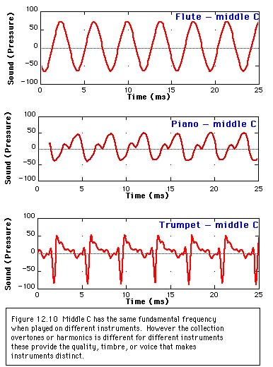
Dataset Deep Dive: 2
A short description of the timbre data:
Averages/variances for 12 channels
Song is split into segments, then each segment is stripped to 12 frequency channels (MFCC algorithm)
The average/variance for each channel is across all the segments
The zero-order coefficient indicates the average power of the input signal, the first-order coefficient represents the distribution spectral energy between low and high frequencies, and so on

Slide 7
Baseline Model Random Forest Classifier
No hyperparameter tuning
All genres
No artist name column
Cross-validation scores:
[0.58791946, 0.56778523, 0.57818792, 0.56308725, 0.57449664]

Slide 8
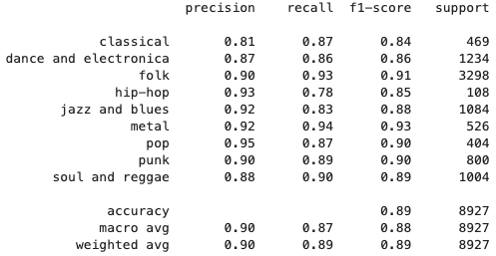
Model Improvements Piped and Pickled
One Hot Encoding ‘artist_name’ (~3.5K columns)
SMOTE
Hyperparameter tuning for RFC (limited features)
Pipeline/pickling
Revised train/test split for live demo model

Slide 9
Live Demo!

Slide 10
Future Improvements
Larger data set
More robust and streamlined approach for stripping the timbres
Exploration of other spectral data to incorporate
Interface to input audio files directly, instead of their features
Track the songs that the model was 'unsure' about using prediction probabilities

