Slide 1

Explainable AI and Deep Reinforcement Learning for Novel Hypersonic Maneuvers
Dr. Ali K. Raz
Assistant Professor
araz@gmu.edu
Dr. Kyle Williams
Principal Technical Staff
kwilli2@sandia.gov
Dr. Kris Ezra
Research Scientist
kris@purdue.edu
Sandia Field Day 2022

Slide 2
Introduction
Motivation, Contribution, Intro to RL

Slide 3
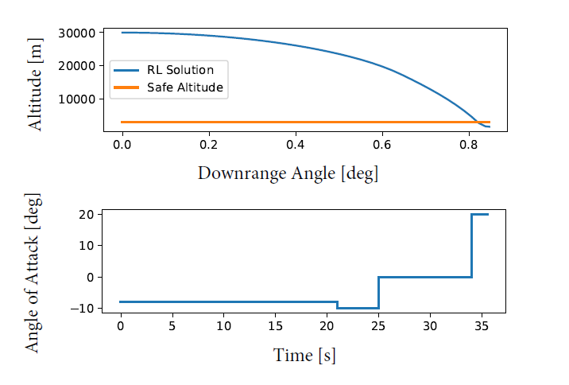
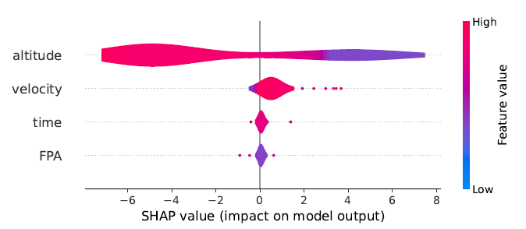
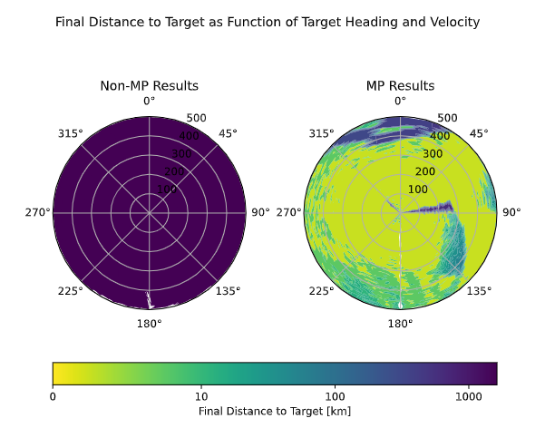
Motivation and Contributions
Motivation:
Hypersonic vehicles in national security missions requires real-time and adaptive trajectory generation during mission execution
Real-time trajectory generation and maneuvers are computationally prohibitive
Artificial Intelligence (AI) techniques, such as, Reinforcement Learning (RL) enables training of an agent to operate in dynamic uncertain environments
Impressive performance outcomes to learn nearly-optimal solutions in a variety of application domains
Limited testing and characterization of performance bounds of RL solutions
(1) RL for A4H
(agent-based models)
(2) RL Test and Evaluation (Explainable AI)
Contributions:
(1) Implement RL in hypersonic scenarios
Proof-of-concept that RL can learn hypersonic dynamics, control, and constraints
Demonstrate RL control of HGVs via AoA commands
(2) Develop a comprehensive Test and Evaluation Framework for RL
Explainable AI for understanding RL decision-making
Robustness Testing of RL solutions in hypersonic scenarios
(3) Apply RL in complex environments for national security missions
Random and Moving targets
Motions Primitives for guiding a vehicle to a moving target
(3) Complex Environments
(moving targets, motion primitives)

Slide 4
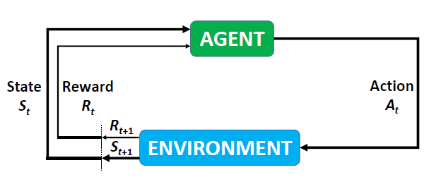
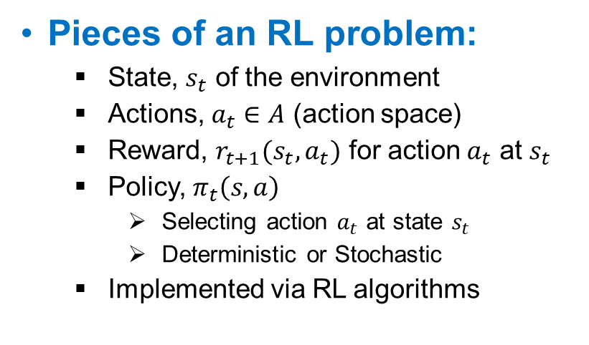
Brief Introduction to Reinforcement Learning
What is RL?
A methodology to allow an agent to learn what actions to take in dynamic and uncertain environments and learn the optimal behavior
RL interacts with the simulation environment to achieve pre-defined goals
Achieving goals is rewarded
Learning occurs from exploration of environment and exploitation of rewards
Pieces of an RL problem:
State, $s_{t}$ of the environment
Actions, $a_{t}∈A$ (action space)
Reward, $r_{t+1}(s_{t},a_{t})$ for action $a_{t}$ at $s_{t}$
Policy, $π_{t}\left(s,a\right)$
Selecting action $a_{t}$ at state $s_{t}$
Deterministic or Stochastic
Implemented via RL algorithms
Reinforcement Learning

Slide 5
Initial Hypersonic RL Study
T&E Framework, Proof-of-Concept mission, problem formulation, comparison with optimal control solution

Slide 6
Published Technical Contributions
The results in this section are packaged and presented in the proceedings of the IEEE Aerospace 2022 and have been submitted in refined form for a journal paper.
Citation:
Raz, A. K., Nolan, S. M., Levin, W. C., Mall, K., Mia, A., Mockus, L., Ezra, K., and Williams, K., “Test and Evaluation of Reinforcement Learning via Robustness Testing and Explainable AI for High-Speed Aerospace Vehicles,” IEEE Aerospace Conference Proceedings, 2022.

Slide 7
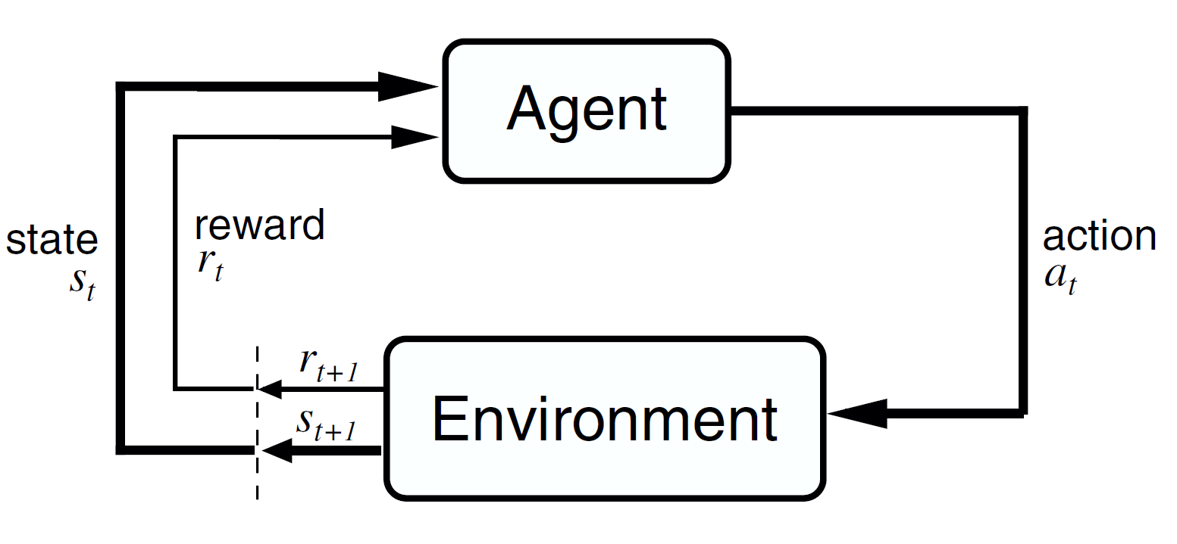
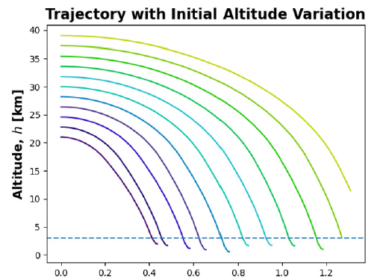
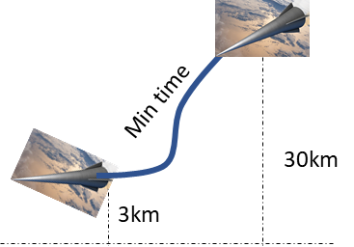
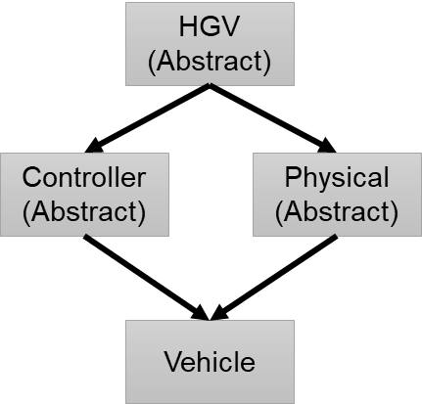
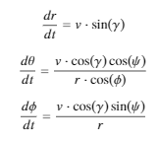
(TC-1) Framework for Implementing RL in HGV Applications
RL Requirements for HGV Applications
A model of the mission, the HGV, and an interface that exposes a reward assessment
A supplied set of actions which correspond to state change of HGV
A method for understanding and validating agent behavior
Systems Engineering Test and Evaluation of RL
(Tool Set: SE/XAI)
Reinforcement Learning
(Tool Set: Python/Keras)
Agent-based Hypersonic Dynamics and Simulation Model
(Tool Set: Discrete Agent Framework – MATLAB/Python)
Test and Evaluation
of RL
RL
Domain Knowledge
Systems Engineering
Matlab/Python Models:
Provides agent-based abstraction of HGV (EQM + vehicle constraints)
Provides agent-based abstraction of target models and assessment of rewards
Provide atmospheric models
Systems Engineering based Test and Evaluation of RL
Robustness Testing of RL
Explainable AI for RL
Validating Optimal Behavior

Slide 8
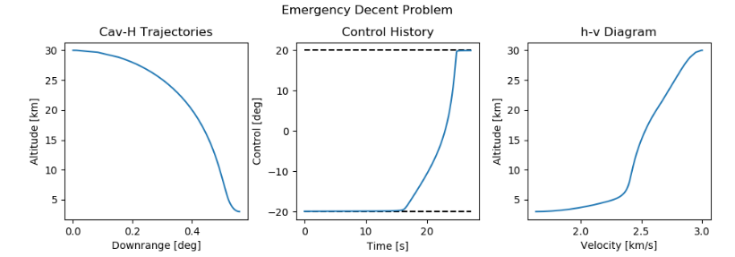
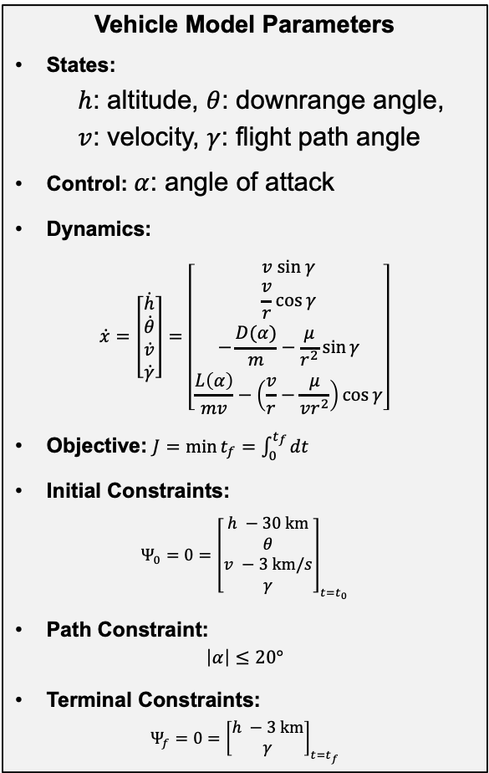
Proof-of-Concept High-Speed Aerospace Mission
Vehicle Model Parameters
States:
$h$: altitude, $θ$: downrange angle,
$v$: velocity, $γ$: flight path angle
Control: $α$: angle of attack
Dynamics:
$$\dot{x}=\left[\begin{matrix}\dot{h} \\ \dot{θ} \\ \dot{v} \\ \dot{γ}\end{matrix}\right]=\left[\begin{matrix}v sin γ \\ \frac{v}{r}\cos{γ} \\ −\frac{D(α)}{m}−\frac{μ}{r^{2}}\sin{γ} \\ \frac{L\left(α\right)}{mv}−\left(\frac{v}{r}−\frac{μ}{vr^{2}}\right)\cos{γ}\end{matrix}\right]$$
Objective: $J=\min{t_{f}}=\int_{0}^{t_{f}}{dt}$
Initial Constraints:
$$Ψ_{0}=0={\left[\begin{matrix}h −30 km \\ θ \\ v −3 km/s \\ γ\end{matrix}\right]}_{t=t_{0}}$$
Path Constraint:
$$\left|α\right|≤20°$$
Terminal Constraints:
$$Ψ_{f}=0={\left[\begin{matrix}h −3 km \\ γ\end{matrix}\right]}_{t=t_{f}}$$
Emergency Descent Problem for Hypersonic Glide Vehicle
The vehicle at 30 km altitude and 3 km/s velocity needs to descend to level flight at a safe altitude of 3 km in minimum time
Constraints must be satisfied
8

Slide 9
Reinforcement Learning Problem Formulation
Reward Function
Designed to train the RL agent an emergency descent problem
Reward structure based on distance to target and FPA
RL Agent
RL trained from SB3 Python package
Proximal Policy Optimization (PPO)
RL training parameters (backup)
Action Space
AoA command
±20º in variable increments of 2º
State
Distance to target
Altitude
Velocity
AoA
FPA
Environment
Emergency descent problem space
Atmosphere, simulation clock, scheduler, etc.
9

Slide 10
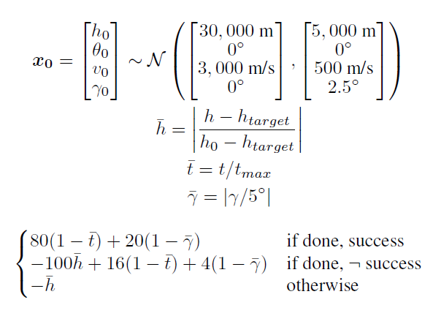
Reinforcement Learning Training Configuration
RL Training Setup
RL Hyperparameters
Hyperparameter | Value
batch_size | 64
n_steps | 512
gamma | 0.9700
learning_rate | 0.0001
ent_coeff | 0.0015
clip_range | 0.1170
n_epochs | 20
gae_lambda | 0.8862
max_grad_norm | 4.6527
vf_coef | 0.6591
net_arch | Medium
activation_fn | tanh
Reward
The Optuna package for Python was used to optimize the hyperparameters governing the PPO training.
Using 64 trials with 200,000 steps was sufficient to produce good hyperparameters for training. After optimizing the hyperparameters, the DNN was trained for 500,000 episodes.
10

Slide 11
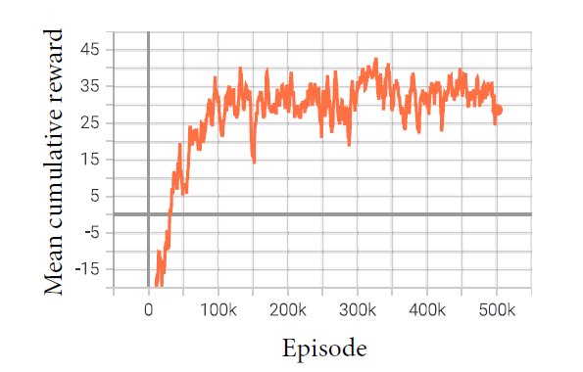
RL Results: Nominal Case (Vehicle Descent From 30 km to 3 km)
RL training
Provides AoA commands to guide the vehicle to a pre-determined safe altitude
Included randomly sampling vehicle initial conditions
Completed after 500k episodes
Sufficient cumulative reward of +30 to train policy
AoA commands issued by the RL agent
11

Slide 12
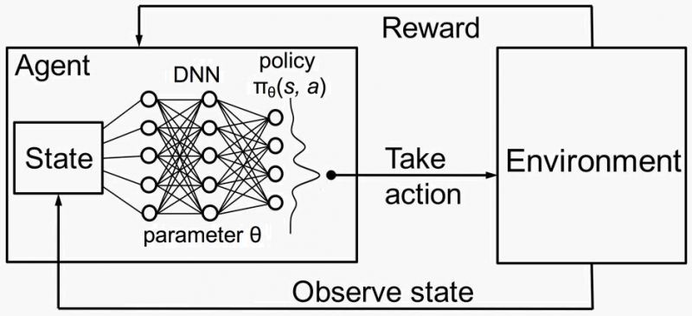
The Need for RL Test and Evaluation (T&E)
Once trained, an RL agent is a Deep Neural Network
Well-established performance outcomes
Limited characterization of performance bounds due to variations and uncertanities
Limited explanation of black-box decision-making logic
Status-Quo of RL Testing:
Strong focus on RL implementation and comparing learning policies in different application domains
Selective demonstration of test cases, mostly based on Monte Carlo simulation and user selected variations
Limited evaluation of acceptable and unacceptable performance regions
Systems Engineering Perspective
Example T&E Questions to Ask
What is the impact of variations in environment, observed states, and action space on the RL performance?
How does the input (i.e., observed state) influence RL decision making?
How does RL respond to modeled (i.e., included in training) and unmodeled uncertanities?
How does the array of RL solutions compare to other accepted solutions?
Notes:
https://medium.com/@vishnuvijayanpv/deep-reinforcement-learning-value-functions-dqn-actor-critic-method-backpropagation-through-83a277d8c38d

Slide 13
(TC-2) Three Part T&E Framework for RL

Slide 14
Robustness Testing of RL Solutions
Purpose: Identify sources of variation in RL problem space and quantify the impact on RL performance
General Sources of Variations in RL
Derived Test Cases for High-Speed Vehicle RL Solution
Source | Nature of Variation | Modeling Approach for Robustness Testing
Environment | Initial Conditions | Latin Hypercube Sampling Monte Carlo Simulations Design of Experiments
Action Space/ State Space | Tolerance and Sensitivity | Expected probability distribution with parameters
State Space | Impulses and Hard Overs | Expected magnitude and time duration
Test Cases | Objective
TC-1 | Individually vary environment Initial Conditions (ICs) (i.e., altitude, velocity, and FPA) to examine RL performance
TC-2 | Quantify performance bounds on ICs variations with Latin Hypercube Sampling
TC-3 | Sensitivity to impulses on the action space
TC-4 | Sensitivity to random variations in the action space
TC-5 | Sensitivity to impulses on the state space
TC-6 | Sensitivity to random variations in the state space

Slide 15
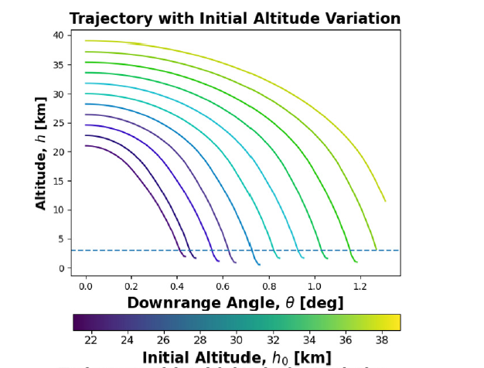
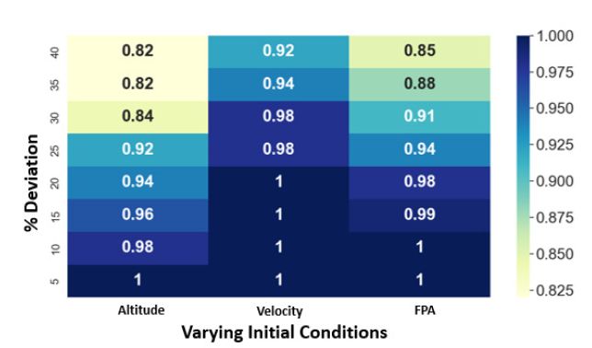
Robustness Testing Results (TC-1 and 2)
TC-1 Modeling Approach:
Train RL agent by randomly sampling ICs with pre-defined range
Results shown for 30% variations
TC-2 Modeling Approach:
Utilize Latin Hypercube Sample to generate IC samples outside training bounds
Results show fractions of successful trajectories per 50 samples
Safe target altitude not reached from higher altitudes
100% success only within 5% of altitude variation
Results for additional test cases in backup

Slide 16
Post-Hoc Analysis Approaches
Post-Hoc Analysis
Visualization
Explanations by Example
Model Simplification
Local Explanations
Text Explanations
Feature Importance
Feature Importance

Slide 17
Feature Importance Based XAI Methods
Post-Hoc Analysis
Feature Importance
Integrated Gradients (IG)
Local Interpretable Model-agnostic Explanations
(LIME)
Skaters
(Beta Phase)
Layer-wise Relevance Propagation
(LRP)
Explain Like I’m 5
(eLI5)
SHapley
Additive exPlanations
(SHAP)
SHapley
Additive exPlanations
(SHAP)

Slide 18
Different Types of Explainers
Explainers Available
Tree Explainer
Computes SHAP values for decision trees-based models
Kernel Explainer
Model agnostic method
Based on LIME and Shapley values
Deep Explainer
Based on DeepLIFT and Shapley values
Explain deep learning models
Support not available for certain RL models
Gradient Explainer
Combines ideas from Integrated Gradients, SHAP, and SmoothGrad into a single equation
Explain deep learning models
Support not available for certain RL models

Slide 19




SHAP Properties
Local Accuracy
The explanation model, g(x’), should match the original model, f(x), when x = h_{x}(x’)
2. Missingness
A minor book-keeping property; a missing feature has a 0 Shapley value
3. Consistency
Let f and f’ be two models. If the marginal contribution of a feature increases or
stays the same, its Shapley value also correspondingly increases or stays the same

Slide 20
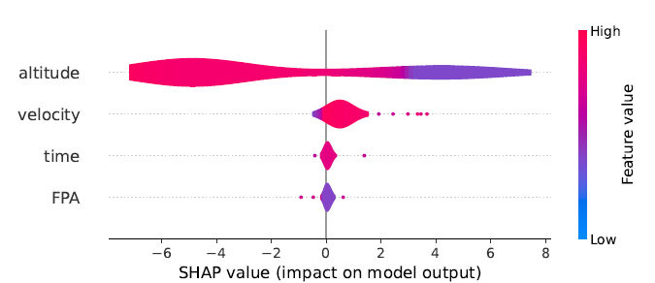
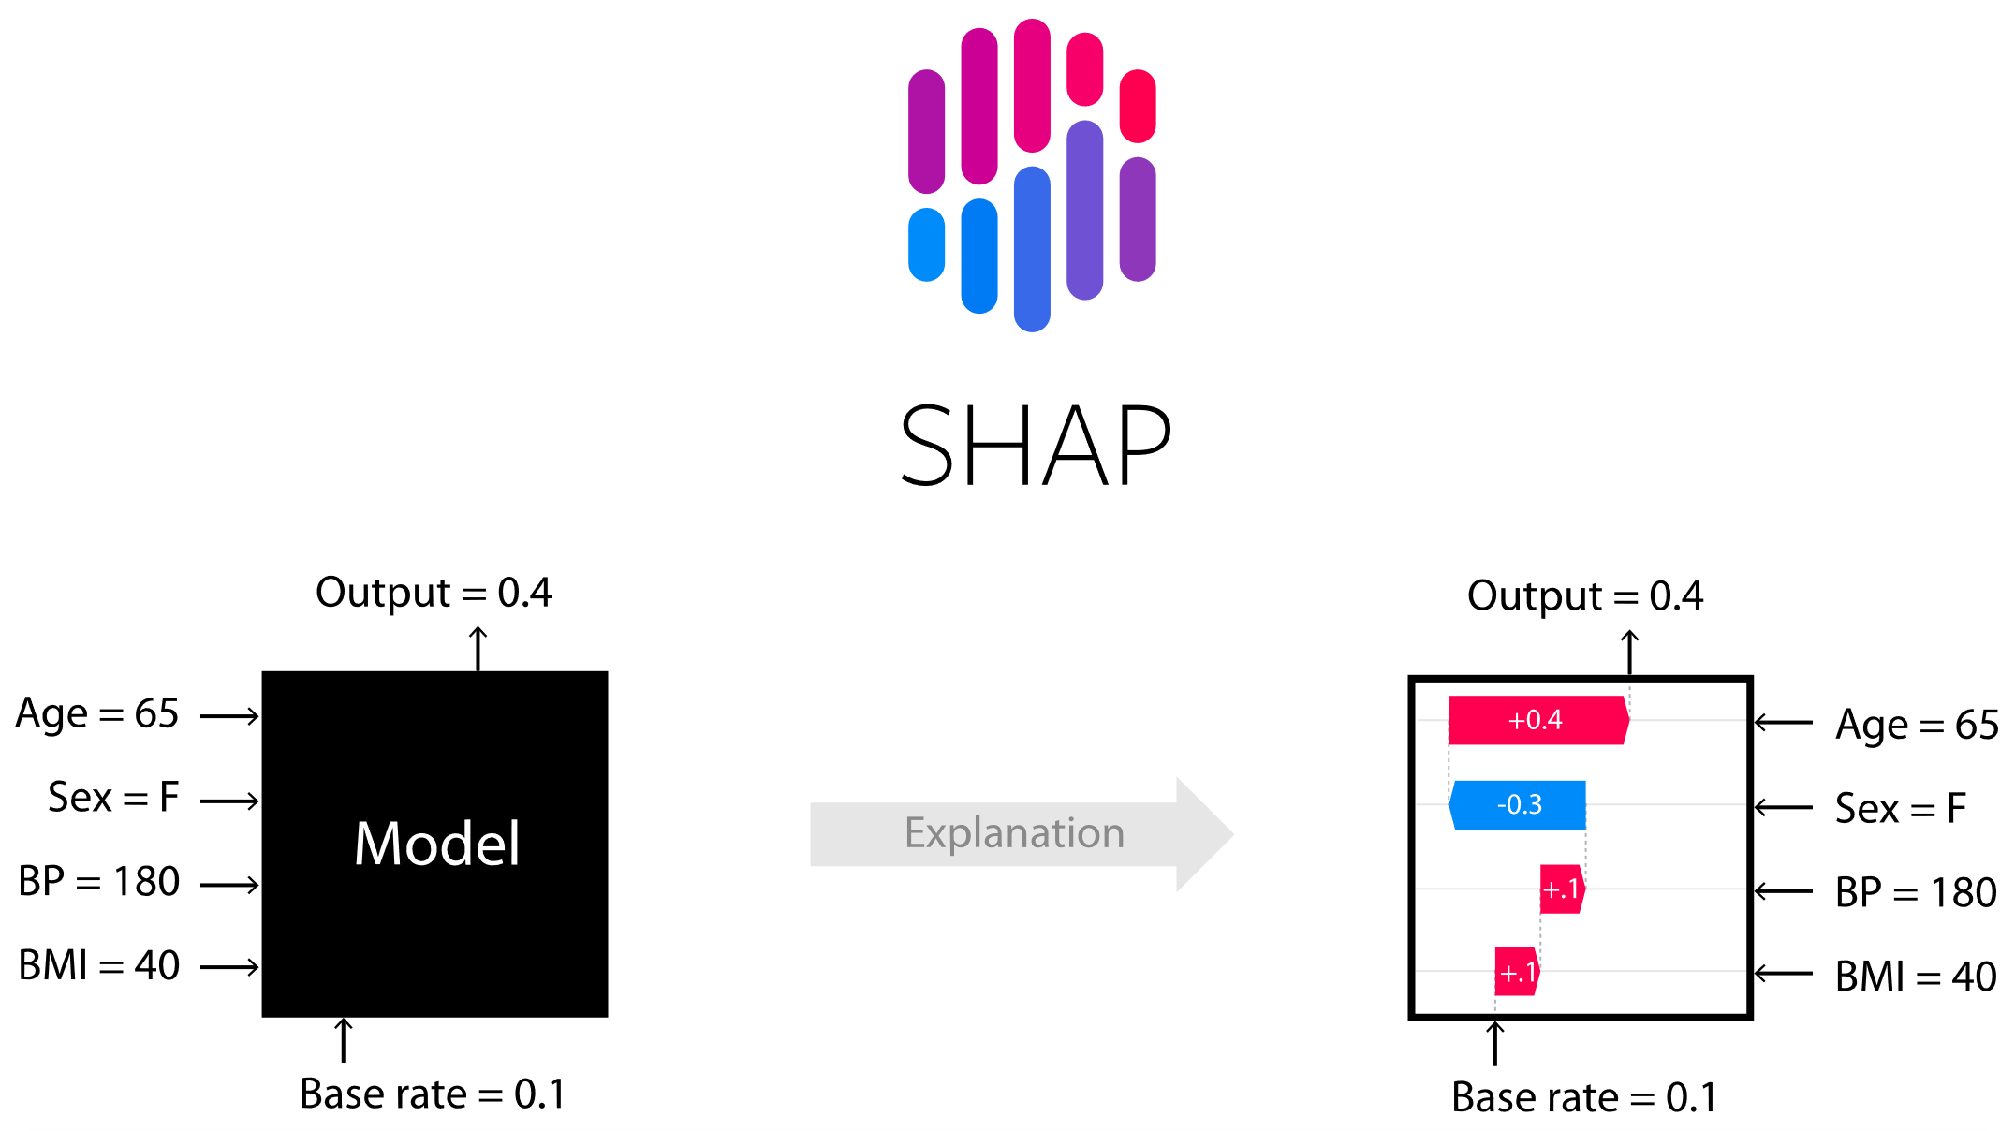
Examination Via Explainable AI (XAI) Techniques
Brief Introduction to Explainable AI
SHAP Applied to RL Problem
Investigates trained Deep Neural Network (DNN) models with analytical techniques to extract decision making attributes
SHapley Additive exPlanations (SHAP)
State of the art for reverse engineering the output of any predictive model
Yields importance of input features for a given prediction
Focuses on coalitions in cooperative game theory
Inputs: Time, Altitude, Velocity, and Flight Path Angle
Output: Angle of Attack (between -20˚ and 20˚)
Number of Trajectories: 1000
Objective: Reach a particular target in a minimum time
1
2
3
1
Higher altitude values oppose a change in AoA whereas lower altitudes support it.
2
Higher velocity values positively influence change in AoA
3
FPA and Time have least impact.
20
Notes:
SHapley Additive exPlanations

Slide 21
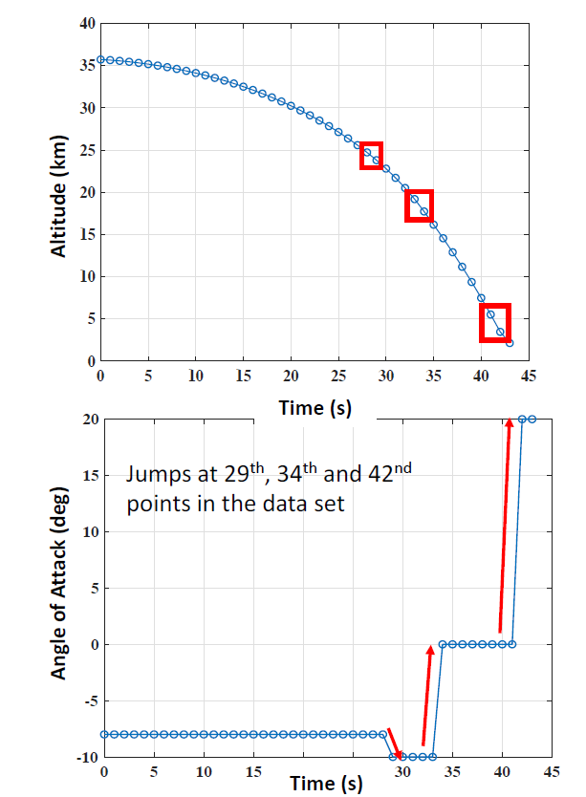
Real Time Analysis With SHAP
Data Point # | AoA (deg) | SHAP Values
 |  | Time | Altitude | Velocity | FPA
29 | -8 | 0.3431 | 1.2848 | 3.6734 | 0.2792
30 | -10 | 0.1581 | 1.8660 | 3.4531 | 0.1032
33 | -10 | 0.1613 | 3.3503 | 1.9171 | 0.1517
34 | 0 | 0.1488 | 3.8376 | 1.4204 | 0.1736
41 | 0 | 0.1330 | 5.2111 | 0.1003 | 0.1362
42 | 20 | 0.1116 | 5.3742 | -0.0201 | 0.1147
Higher SHAP values for altitude and velocity correlate with the changes in AoA
As the vehicle descends to target altitude, higher AoA values are issued to prevent the vehicle from diving further
Currently, investigating further interpretation of SHAP values and mapping SHAP to actual values
Sample feasible vehicle trajectory and control history plots

Slide 22
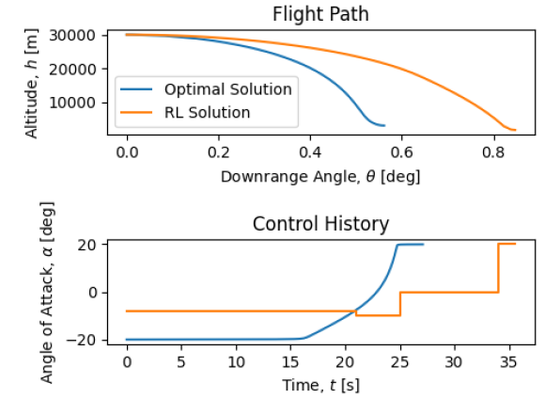
Validation With Optimal Control Solutions
RL Results with PPO algorithm
Training Options:
Varying initial conditions
500K Episodes
Optimal control solved by indirect methods using beluga software
RL agent approximates optimal solution
Potential differences due to:
RL solution is discrete action space
OP solution is continuous action space
Goal is not to exactly reproduce the optimal trajectory

Slide 23
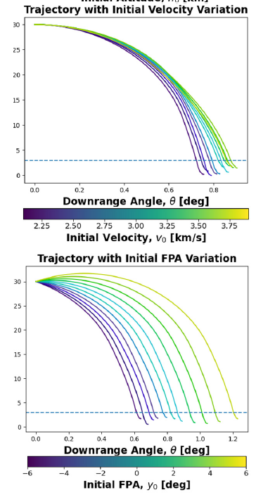
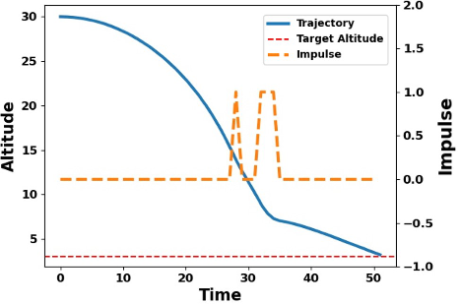
Perturbed Test Case Results
RL unable to recover if an impulse was applied during the 25-30 second window
No impact was found for moderate impulses in 0-20 seconds

Slide 24
Robustness Testing Results (TC-2)
TC-2 Modeling Approach
Introduce random variation in action space, i.e., the AoA command randomly sampled within ±4 ͦ
Nominal Case – Unperturbed
(Success)
TC-3 – Perturbed
(Failure observed after 1000 trials)
RL AoA command at 1Hz control frequency shown by different colors
Robustness Testing characterizes performance bounds on RL
Helps in setting operational requirements for RL and derived requirements for lower-level control systems
Results for additional test cases in backup

Slide 25
Motion Primitives Applied to Hypersonics

Slide 26
Published Technical Contributions
The results in this section are has been accepted to the proceedings of the AIAA SciTech 2023 and plan to be submitted to the AIAA Journal of Aerospace Information Systems.
Citation:
Levin, W. C., Nolan, S. M., Ezra, K., Raz, A. K., Parish, J., and Williams, K., “Motion-Primitive based Deep Reinforcement Learning for High Speed Aerospace Vehicle Missions,” AIAA SciTech Conference Proceedings, 2023.

Slide 27
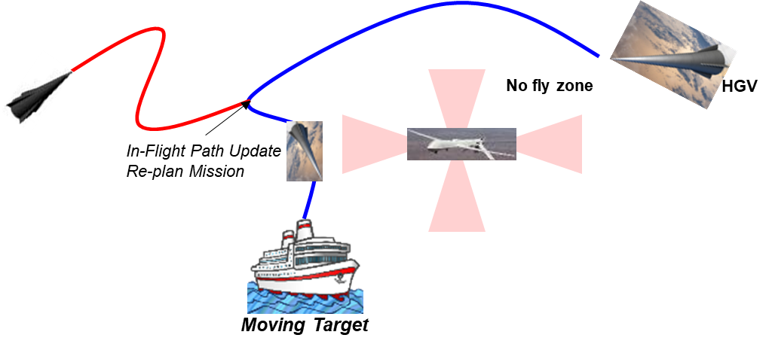
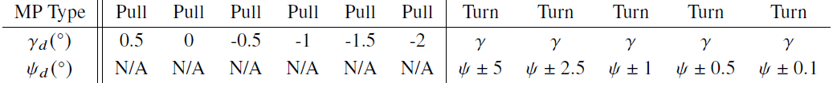
(TC-3) Apply RL in Complex Environments for National Security Missions
Increasing Complexity of Mission and Environment
Target moving at constant speed and constant altitude
Action space defined by only AoA cannot achieve this goal
Expanding RL action space to include a library of motion primitives
Motion primitives (MPs) are segmented movement templates available to a vehicle during flight
MPs either pull to a specified FPA or a turn for a relative heading change
MPs are executed for a specified duration
Full trajectories are constructed by selecting a sequence of MPs

Slide 28
Action Space Definitions
Non-MP Action Space
For comparison, agent trained using an action of discrete control values
Control Options:
Angle of Attack: -20, -17.9, -15.8, …, 15.8, 17.9, 20 deg
Bank: -75, 0, 75 deg
Motion Primitive Action Space
MPs either a pull to a specified FPA or a turn for a relative heading change
The angle of attack and bank angles are determined by a simple closed-loop controller
MP duration decreases from 25 s to 0.5 s as nears target to allow more fine-tuning

Slide 29
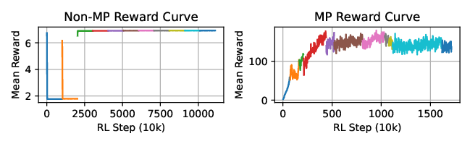
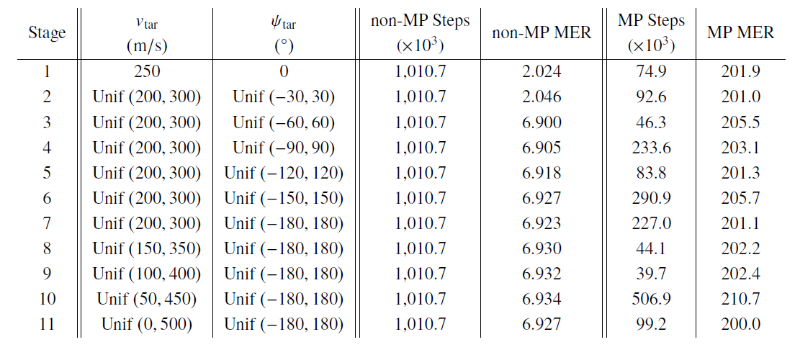
Complex Environment Challenges for RL Training
Designed a curriculum for training RL
Curriculum increases range of target speed and direction as agent trains
Telescopic reward function guides agent toward target during training
Optuna used to train hyperparameters for better training and fairer comparison
Introduced temporal variation in MPs to fine tune target honing
MP duration decreases from 25s to 0.5s as the vehicle nears a target
Results of Curriculum Training with and without MPs
Training in complex environments requires motion primitive based approach with curriculum training

Slide 30
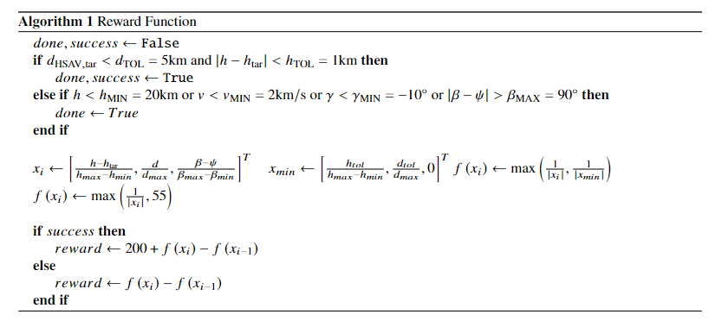
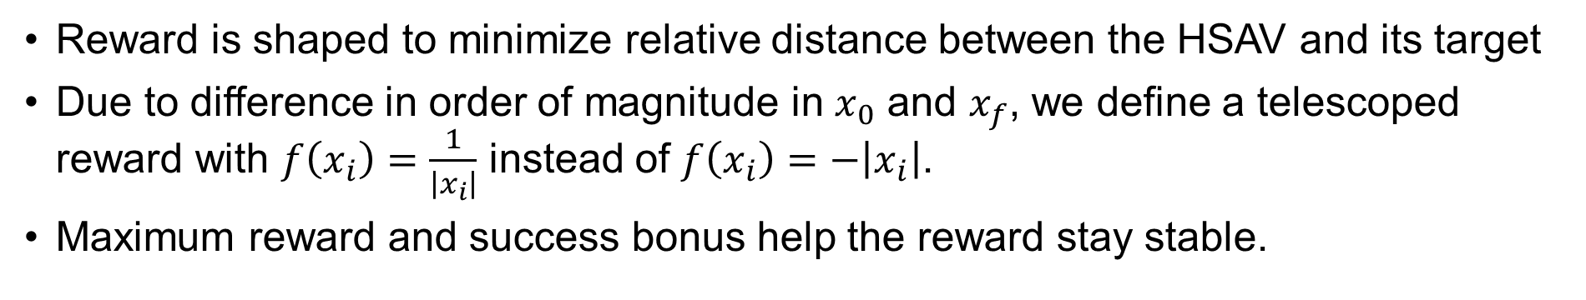
Reward Shaping
Reward is shaped to minimize relative distance between the HSAV and its target
Due to difference in order of magnitude in $x_{0}$ and $x_{f}$, we define a telescoped reward with $f\left(x_{i}\right)=\frac{1}{\left|x_{i}\right|}$ instead of $f\left(x_{i}\right)=−\left|x_{i}\right|$.
Maximum reward and success bonus help the reward stay stable.

Slide 31
Motion Primitive Execution Time
We found that the HSAV flew right past the target and was therefore failing the mission with a constant MP time.
Hence, we introduced a sliding MP time from 25 seconds down to 0.5 seconds based on a rough approximation of time-to-go (i.e. the time until the HSAV intercepts the target)
Time-to-go = distance from HSAV to target / velocity of HSAV
Time-to-go > 25 sec → MP time = 25 sec
25 sec > Time-to-go > 0.5 sec → MP time = Time-to-go
Time-to-go < 0.5 sec → MP time = 0.5 sec

Slide 32
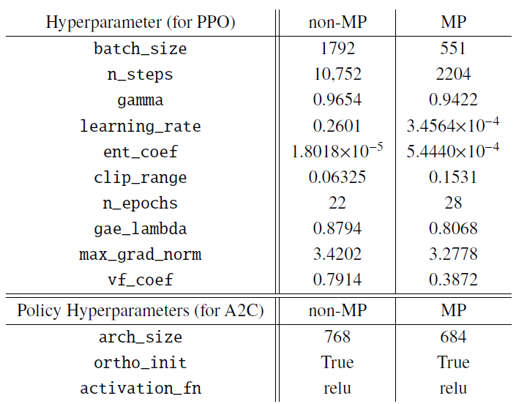
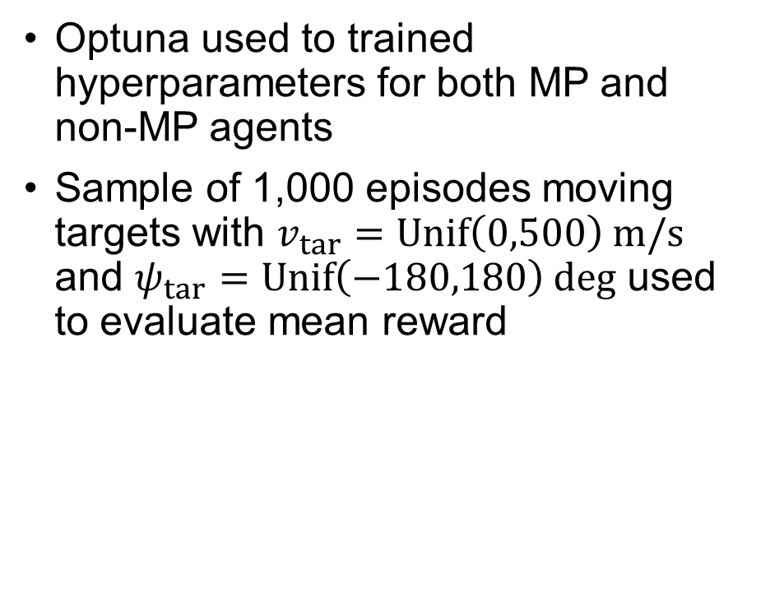
Hyperparameter Values Tuned with Optuna
Optuna used to trained hyperparameters for both MP and non-MP agents
Sample of 1,000 episodes moving targets with $v_{tar}=Unif\left(0,500\right) m/s$ and $ψ_{tar}=Unif\left(−180,180\right) deg$ used to evaluate mean reward

Slide 33
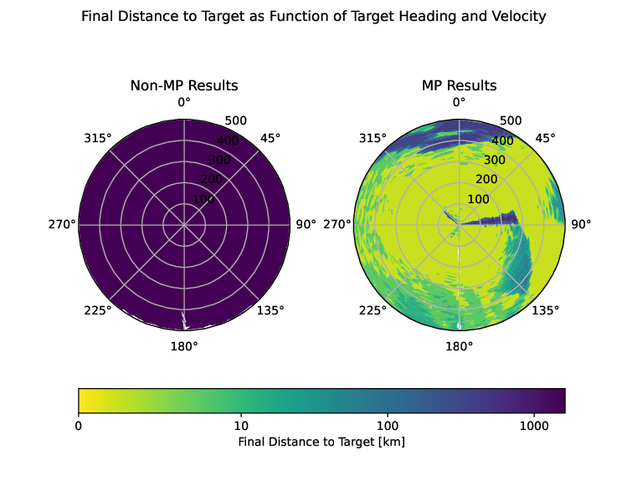
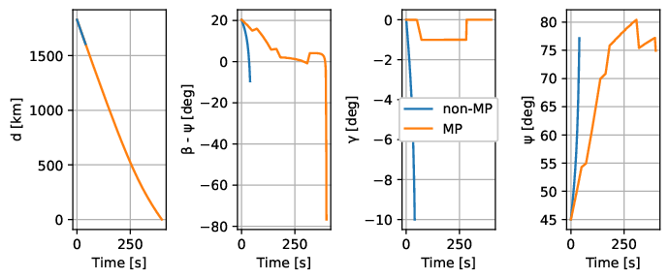
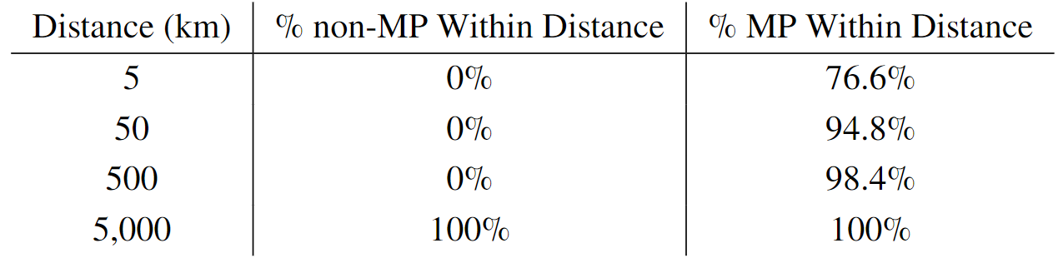
Results for Moving Target and Motion Primitives
Final Distance to Target as Function of Target Heading and Velocity
MP action space significantly out-performed non-MP approach
MP agent was successful in 76.6% of cases
Non-MP agent failed in every case consistently hitting a minimum FPA constraint
Distribution of 10,000 Episodes of Trained Agents within Target Range
Trajectories of agents for $v_{tar}=250\frac{m}{s}, ψ_{tar}=0 deg$
Notes:
v

Slide 34
Conclusions
Summary, Publications, the Team

Slide 35
Summary and Takeaways
Real-time trajectory generation and maneuvers are computationally prohibitive for hypersonic missions but needed for national security missions
Our work extends Reinforcement Learning to hypersonic vehicles for near real-time maneuvers and guidance
Dissemination and Publications:
Raz et. al., “Reinforcement Learning for Aerospace Vehicle Mission Planning Through Predator-Prey Models” Presentation, AIAA Defense Conference 2021, Laurel, MD
Raz et al., “Test and Evaluation of Reinforcement Learning via Robustness Testing and Explainable AI for High-Speed Aerospace Vehicles”, IEEE Aerospace 2022 Conference, Big Sky, MT
Levin et al., “Motion-Primitive based Deep Reinforcement Learning for High-Speed Aerospace Vehicle Missions”, AIAA SciTech 2023 Conference, Great Harbor, MD, (in review)
Raz et al., “Explainable-AI and Robustness based Test and Evaluation for Reinforcement Learning”, IEEE Systems Journal (in work)
(1) Agent-based flexible RL implementation for Hypersonic Missions
(2) Explainable AI and Robustness Testing for understanding RL decision-making
(3) Motions Primitives based RL for complex maneuvers to hit moving targets
35

Slide 36










Sandia-GMU-Purdue Team
TPOC
PI and Co-PI
Technical Staff
Dr. Linas Mockus
Rob Campbell
Dr. Kyle Williams
Dr. Ali Raz
Dr. Kris Ezra
Current Graduate and Undergraduate Students
Sean Nolan
PhD Student
Winston Levin
MS Student
Ahmad Mia
MS Student
Lauren Risany
Ugrad / SNL Intern
Paige La
MS Student

