Slide 1
Introduction to Sforce Web Services API
Sarah T. Whitlock
Program Manager, Technical Education
salesforce.com

Slide 2

Agenda
Characteristics and Features of the Web Service
Supported Operations and Objects
The “Pieces” of the Solution
Demo: Console App to List Competitor Accounts
Resources for Further Study

Slide 3



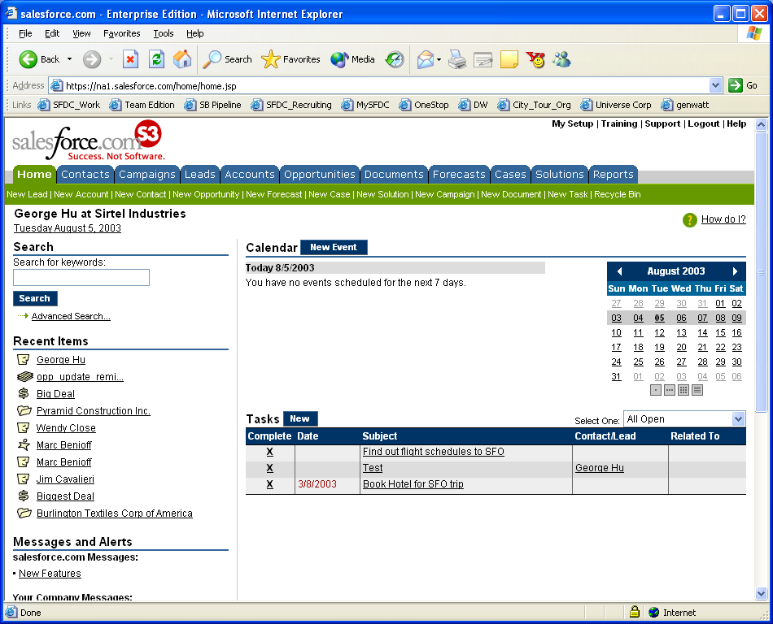






What can you do with Sforce?
Web Service API
Customize
Integrate
Extend
ERP
Portals
Legacy Apps
Accounting
Modify “out-of-the box” functionality to meet specific business requirements
Connect customer and sales data with other enterprise systems and business processes
Add CRM functionality with business specific forms, business processes and devices

Slide 4
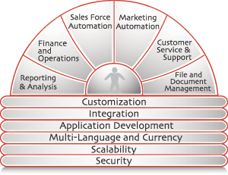

How Does the Web Service Work?
Internet
request (xml)
response (xml)
Client
Service
Request-response model
Client initiates the request
Http(s) POST’s
Conforms to SOAP and WSDL Standards

Slide 5
Features of the Web Service
20 Operations (Methods) Supported
  These are the “verbs” of the Web service
Numerous Entities (Objects) Supported
  These are the “nouns” of the Web service
  All Custom Objects Included
Sforce Object Query Language (SOQL)
  SQL-like query language
Sforce Object Search Language (SOSL)
  Search language for programmatic text searches

Slide 6
Supported Operations
The “Verbs”

Slide 7

Supported Operations
Login/Client Session
  login – logs in to the Sforce single sign-on server and starts a client session
salesforce.com
1. login - https://www.salesforce.com
…
2. sessionId, serverURL on success:
https//na1.salesforce.com
www
na0
na1
3. query, create, update, delete, etc

Slide 8
Supported Operations (cont’d)
Query Data
  query – executes a query against the specified object (SOQL)
  queryMore – retrieves the next batch of objects from a query
SOQL Example: Find the First Name of all Contacts in CA with the Last Name = Smith and whose First Name isn’t Jim
binding.query(“Select FirstName from Contact where LastName = ‘Smith’ and MailingState = ‘CA’ and not FirstName = ‘Jim’”);

Slide 9
Supported Operations (cont’d)
Search and Retrieval
  retrieve - retrieves one or more objects based on the specified object IDs
  search - executes a text search in your org's data (SOSL)
SOSL Example: Search for the name Joe Smith or Joe Smythe in Leads and Contacts and return the Name and Phone Number
Find {“Joe Smith” or “Joe Smythe”} In All Fields
Returning Lead {Name, Phone}, Contact {Name, Phone}

Slide 10
Supported Operations (cont’d)
Modify Data
  create – adds one or more new individual objects to your organization's data
  update – updates one or more existing objects in your organization's data
  delete – deletes one or more individual objects from your organization's data

Slide 11
Supported Operations (cont’d)
Object Metadata
  describeGlobal – retrieves a list of available objects for your organization's data
  describeSObjects / describeSObject – retrieves metadata (field list and object properties) for the specified object type(s)
  describeLayout – retrieves information about the layout (presentation of data to users) of a given object type
  describeTabs – retrieves information about the apps and tabs configured for the user

Slide 12
Supported Operations (cont’d)
Data Replication
  getDeleted - retrieves the IDs of specified individual objects that have been deleted since the specified time
  getUpdated - retrieves the IDs of specified individual objects that have been updated since the specified time
Business Process
  convertLead – converts a Lead into an Account, Contact, and (optionally) an Opportunity

Slide 13
Supported Operations (cont’d)
Utilities
  getServerTimeStamp – retrieves the current system timestamp (GMT) from the Sforce Web service
  getUserInfo – retrieves personal information for the user associated with the current session
  resetPassword – changes a user's password to a server-generated value
  setPassword – sets the specified user's password to the specified value

Slide 14
Supported Entities
The “Nouns”

Slide 15
Supported Entities
Account
AccountContactRole
AccountShare
AccountTeamMember
Approval
Asset
AssignmentRule
Attachment
BusinessProcess
Campaign
CampaignMember
Case
CaseComment
CaseHistory
CaseSolution
CaseStatus
Contact
Contract
ContractContactRole
ContractStatus

Slide 16
Supported Entities (cont’d)
CurrencyType
Document
Event
EventAttendee
Folder
Group
GroupMember
Lead
LeadStatus
MailMergeTemplate
Note
Opportunity
OpportunityCompetitor
OpportunityContactRole
OpportunityHistory
OpportunityLineItem
OpportunityLineItemSchedule
OpportunityShare
OpportunityStage
OpportunityTeamMember

Slide 17
Supported Entities (cont’d)
Partner
PartnerRole
PriceBook (deprecated)
Pricebook2
PricebookEntry
Product (deprecated)
Product2
Profile
RecordType
SelfServiceUser
Scontrol
Solution
SolutionStatus
Task
TaskPriority
TaskStatus
User
UserRole
UserTeamMember
WebLink

Slide 18
What “responses” Do You Get?

Slide 19

Most calls return an array of “Results” objects
login: LoginResult
create, update: SaveResult[]
query: QueryResult[]
delete: DeleteResult[]
Create, Update, and Delete “Results” arrays also return an array of Error objects
Errors can be examined to see why a call failed

Slide 20
How Do We Understand Each Other?

Slide 21
Message Formats and Protocols
Define message format with WSDL
  Web Service Description Language
  Server defined
  What operations and objects are allowed to the client
  XML format
Format messages using SOAP
  Simple Object Access Protocol
  Messages contained in an “envelope”
  XML format
Exchange messages via Http(s)
  Hypertext Transfer Protocol
  Permits access through firewalls
  Secure – encryption with ssl

Slide 22
WSDL

Slide 23
Web Service Definition Language (WSDL)
WSDL is an XML format for describing network services as a set of endpoints operating on messages
WSDL is, basically, the interface that describes the format of messages you send to and receive from the Sforce web service
Salesforce.com supports 2 versions of the WSDL
  Enterprise WSDL
  Partner WSDL

Slide 24
Which WSDL Is Right for Me?
Enterprise WSDL
Strongly typed
Tied to a specific configuration of Salesforce
Changes if custom fields or custom objects are added to your organization's Salesforce configuration
Primarily for Customers
Partner WSDL
Loosely typed
Useful for ANY configuration of Salesforce
Does NOT change if custom fields or custom objects are added to an organization's Salesforce configuration
Primarily for Partners

Slide 25
Generating Proxies from the WSDL
Client environments access the Sforce Web services API through local based objects that serve as proxies for their server-side counterparts
Before using the Sforce Web services API, you must first generate these objects from your organization's WSDL file
Example: use Apache Axis WSDL2Java utility:
java -classpath=pathToJars
org.apache.axis.wsdl.WSDL2Java -a -T 1.2 WsdlFile

Slide 26
SOAP

Slide 27
Simplified SOAP Message
<soapenv: Envelope>
<soapenv: Header>
… some header stuff…
</soapenv: Header>
<soapenv: Body>
<create>
<sObjects>
<Name>Very Important Account</Name>
<AccountNumber>12345</AccountNumber>
</sObjects>
</create>
</soapenv: Body>
</soapenv: Envelope>

Slide 28
How Do I Get Started?
Select a development language
  VB.Net
  C#.Net
  Java
Obtain a SOAP client
  .Net platform
  Apache Axis for Java
Get access to an Enterprise Edition Salesforce account
  Developer Edition is available for learning
Generate the WSDL

Slide 29
End-to-End Development Process

Slide 30
Basic Steps
Generate the WSDL
Import WSDL into your development environment
Generate Proxies from the WSDL
Code your client application
Remember: if you use the Enterprise WSDL, you MUST re-generate the WSDL and associated proxies if custom fields or custom objects are added to your organization's Salesforce configuration

Slide 31
Demo: Simple Console Application to Display Competitor Accounts

Slide 32
Need More Information or Help?

Slide 33
Resources
www.sforce.com
  API Documents
  Community Bulletin Boards
  Sample Code in Java, .Net, PHP, Perl
  Link to Open Source Projects
Salesforce.com Global Professional Services
  Technical Support
  Functional and Technical Consultants
Instructor-led Sforce Training
  Sforce Fundamentals
  Sforce Workshop

Slide 34
Sforce Fundamentals – 1 day
Who
  Business Analysts
  IT and Project Managers
  Developers
  Anyone seeking to learn what Sforce is and does
What
  Learn the elements of Sforce best applied to build a solution
  Use cases – examples of Sforce solving real-world problems
Prerequisites
  Administrator Workshop (or, equivalent knowledge)

Slide 35
Sforce Workshop – 4 days
Who
  Developers
What
  Hands-on programming exercises
  Exposure to Salesforce data model
  Data retrieval with SOQL/SOSL
  Design patterns
    Session Management
    Retrieving Large Data Sets
    Extending Salesforce through Web Applications
  Re-usable code samples
Prerequisites
  Sforce Fundamentals, programming skills

Slide 36
Q&A

