Slide 1
BORG CALENDAR
SOEN 6471 Project Presentation
Instuctor : Dr. Peter Rigby

Slide 2
Project Overview (M1)
Borg is an open source calendar software
Written in Java, self-contained ( using JVM)
It is a supports task tracking, project management, all sorts of appointments, memo and to-do lists.
The whole project has 28K LOC
Model package has 7K LOC
UI package has 20K LOC

Slide 3
Overview (Con'd)
BORG is in 1.7.7 version so it should be rather stable. The very first version was in 2003
The last update was in January 2013. We saw 218 downloads this week and around 30 user reviews -> ( Active project)

Slide 4
Actors and Use Cases (M2)
Main actor: - End-User

Slide 5
M2 (Cont'd)
Main Use cases:
Add Appointment
Select View
Manage Tasks
Manage Projects
Manage Contacts
....

Slide 6
Domain diagram vs. Architectural diagram(m3)

Slide 7
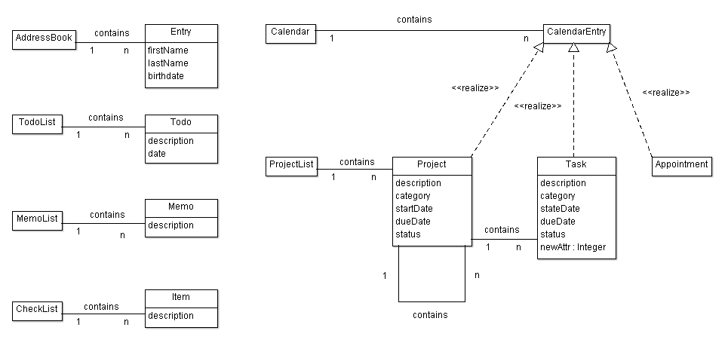
Domain Diagram
VS
Architectural Diagram

Slide 8
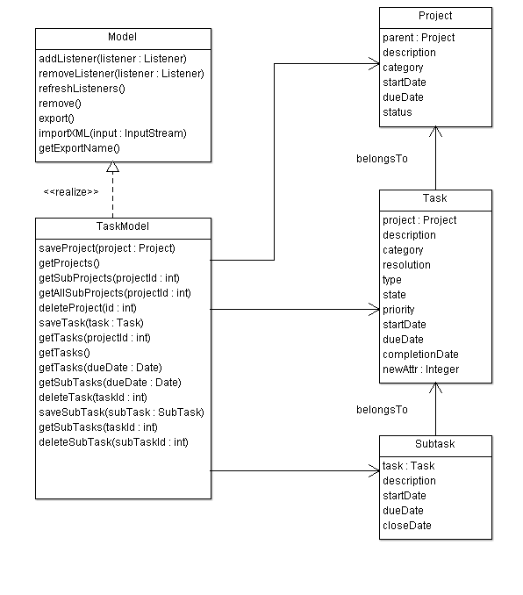

Slide 9
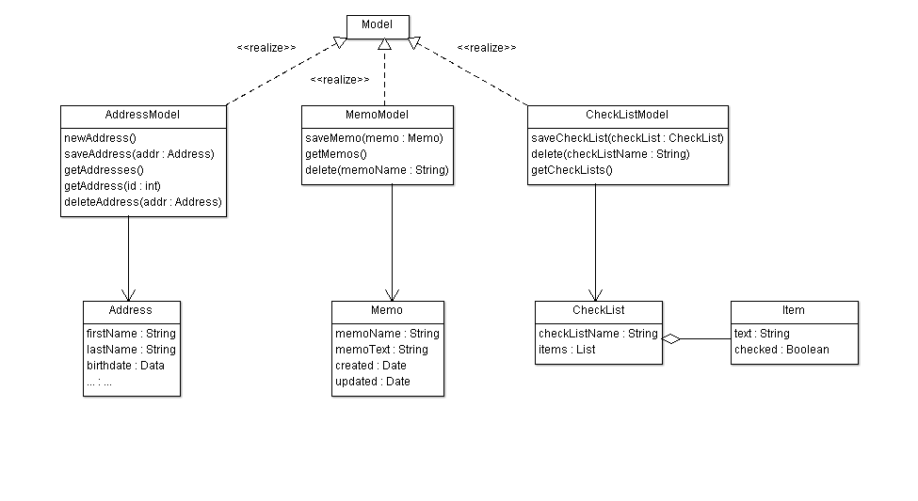

Slide 10
Refactoring (m4)
MVC Pattern
Observer (listener) pattern
Factory Pattern
Composite Pattern
Implement a refactoring

Slide 11
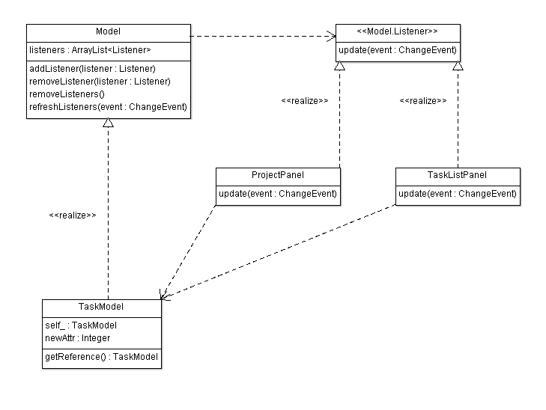
MVC Pattern
MVC Pattern

Slide 12
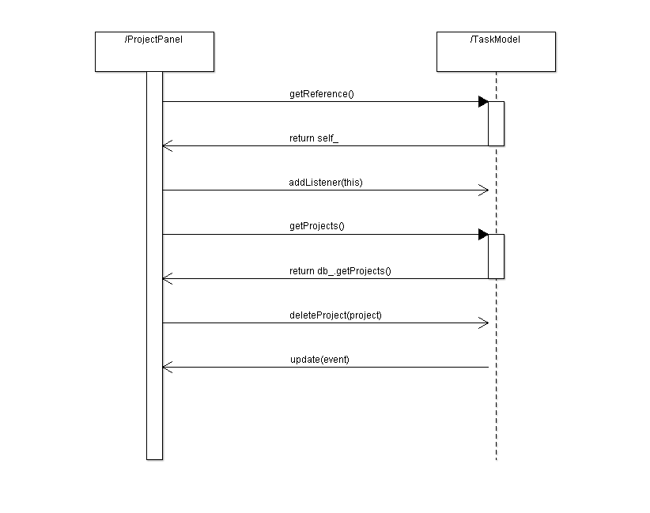
MVC Pattern
MVC Pattern

Slide 13
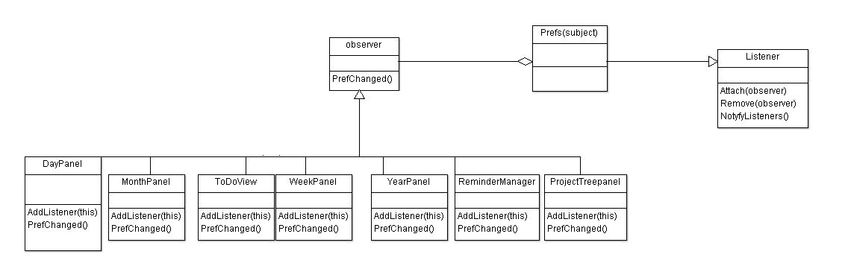
MVC Pattern
Observer (listener) pattern

Slide 14
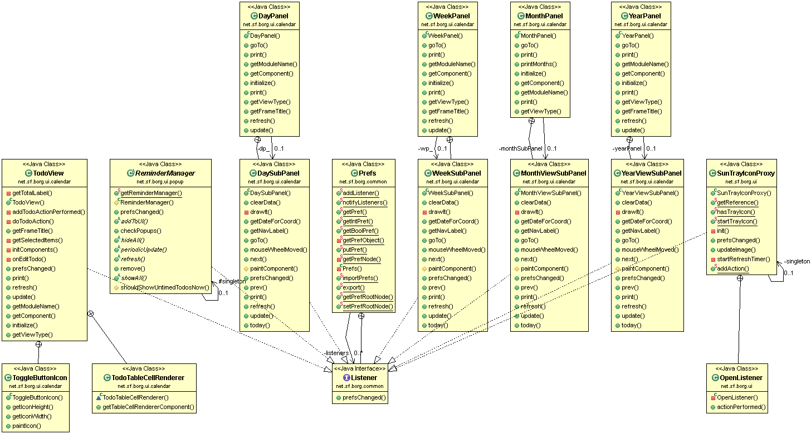
MVC Pattern
Observer (listener) pattern

Slide 15
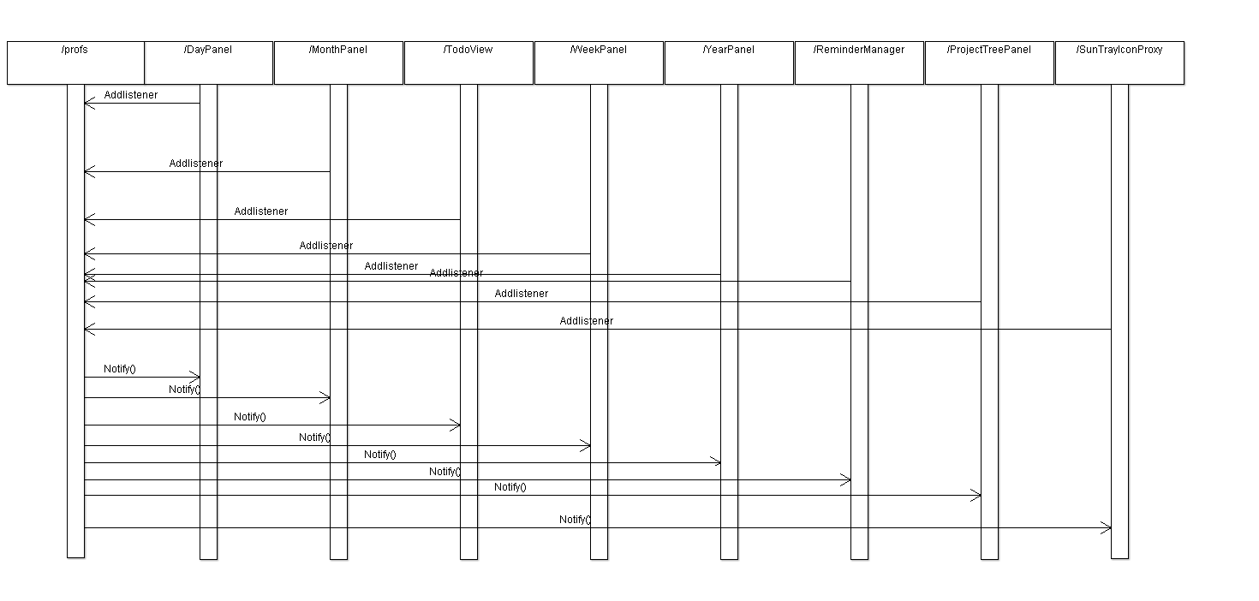
MVC Pattern
Observer (listener) pattern

Slide 16
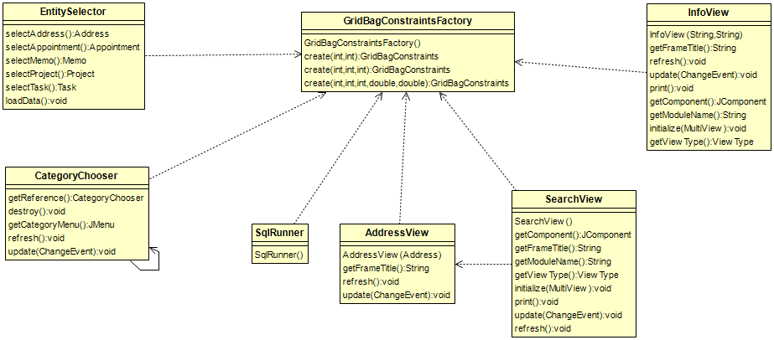
MVC Pattern
Factory Pattern

Slide 17
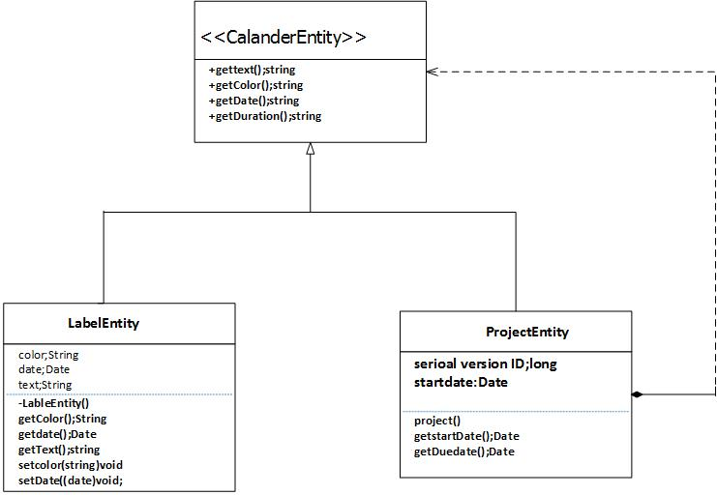
MVC Pattern
Composite Pattern

Slide 18
Implement a refactoring
There are 5 steps to do so:
Step 1: Copy TaskModel.daysBetween() and TaskModel.daysLeft() to DateUtil
Step 2: Replace usages of TaskModel.daysBetween() by DateUtil.daysBetween()
Step 3: Remove TaskModel.daysBetween()
Step 4: Replace usages of TaskModel.daysLeft() by DateUtil.daysLeft()
Step 5: Remove TaskModel.daysLeft()

Slide 19
Patchset 1/5: Copy TaskModel.daysBetween() and TaskModel.daysLeft() to DateUtil
Commit 88cab62dd16b688c814fb2836082e2acf2b4ebd4
diff --git a/Source Code/BORG/borg_src/BORGCalendar/src/net/sf/borg/common/DateUtil.java b/Source Code/BORG/borg_src/BORGCalendar/src/net/sf/borg/common/DateUtil.java
index 0880b2d..8b585c5 100644
--- a/Source Code/BORG/borg_src/BORGCalendar/src/net/sf/borg/common/DateUtil.java
+++ b/Source Code/BORG/borg_src/BORGCalendar/src/net/sf/borg/common/DateUtil.java
@@ -130,5 +130,74 @@ public class DateUtil {
return hoursString + minutesString;
}
+ /**
...

Slide 20
Conclusion
What we learned
Using Git and GitHub
Collaborating in an open source project
Reverse engineering and detection of project Architecture
Reverse engineering tools like Object Aid UML
Collaborate in teamwork

