Slide 1

Walmart Sales Forecasting
Group 10
Akhilesh Sunil Joshi | 669332717
Harsh Mehta | 659163943
Kranti P. Yeole | 655817383

Slide 2
Introduction
Objective
Problem
analyze past sales patterns predict future sales performance
Develop a model to forecast weekly sales considering factors such as:
Seasonality
Holidays
Promotional events
Economic conditions
Importance
Accurate sales forecasting enables efficient inventory management, targeted marketing campaigns, and informed decision-making for sustained business growth
Notes:
Introduction:
Aim to predict future sales across various Walmart stores and departments using historical data.
Utilize predictive analytics and machine learning techniques to enhance sales forecasting accuracy.
Problem Statement:
Develop a model to forecast weekly sales considering factors such as:
Seasonality
Holidays
Promotional events
Economic conditions
Significance:
Accurate sales forecasts help in inventory and staff management, especially during peak shopping seasons.
Improve decision-making processes through better resource allocation and marketing strategies.

Slide 3
Data Overview
Walmart Sales Data (Kaggle): Contains historical sales data, including factors such as store locations, departments, dates, and weekly sales figures.
Store Data: Provides information about Walmart store types and sizes. External Data: Fuel prices, economic conditions, and other relevant factors that may influence sales.
Dataset Preparation: Created test and train datasets, including data for stores, departments, dates, and weekly sales categories.
We have data of 45 walmart stores for 2 years 2010-12. In training data we have 421570 rows and total variables studied 20
Notes:
Source of Data:
The data is sourced from a Kaggle dataset specifically focusing on Walmart's historical sales.
Dataset Components:
Sales data from various departments and stores.
Information on store types and sizes.
Regional economic indicators such as fuel prices.
Promotional data including markdowns and special offers.
Data Preparation:
Created test and train datasets to facilitate model development.
Data cleaning to handle missing values and outliers to ensure data quality and consistency.

Slide 4
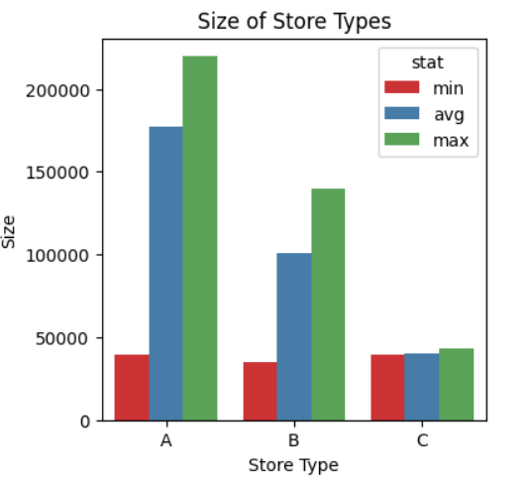
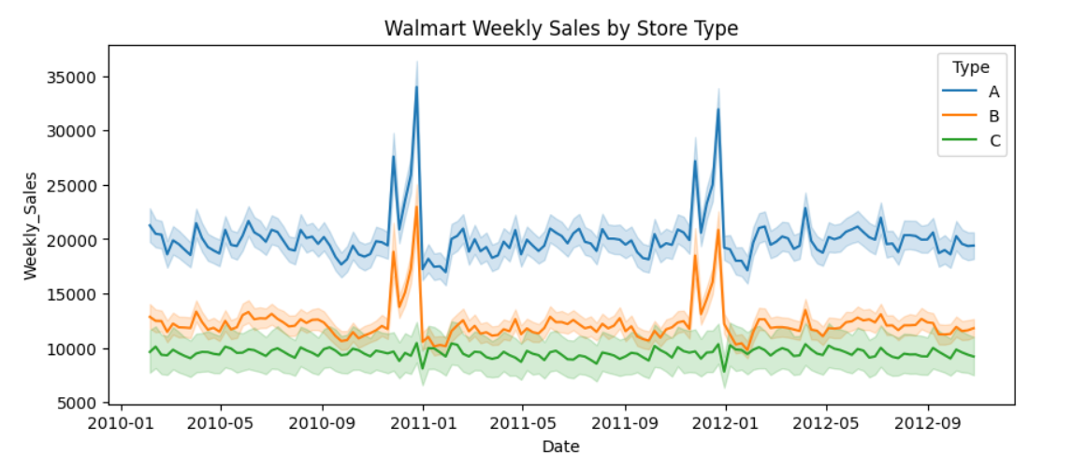
Exploratory Data Analysis
3 Store Types: A,B,C
A has largest size, followed by B, and lastly C.
Store type A produces highest sales.
Store type C produces the least sales.

Slide 5
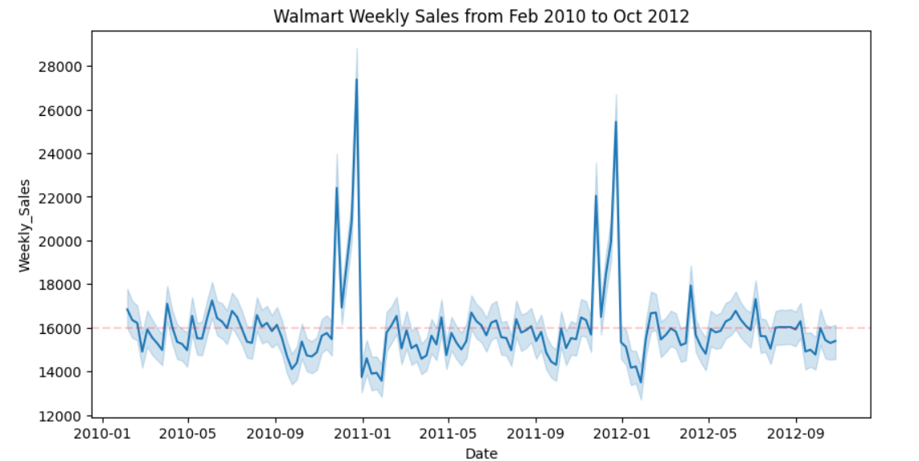
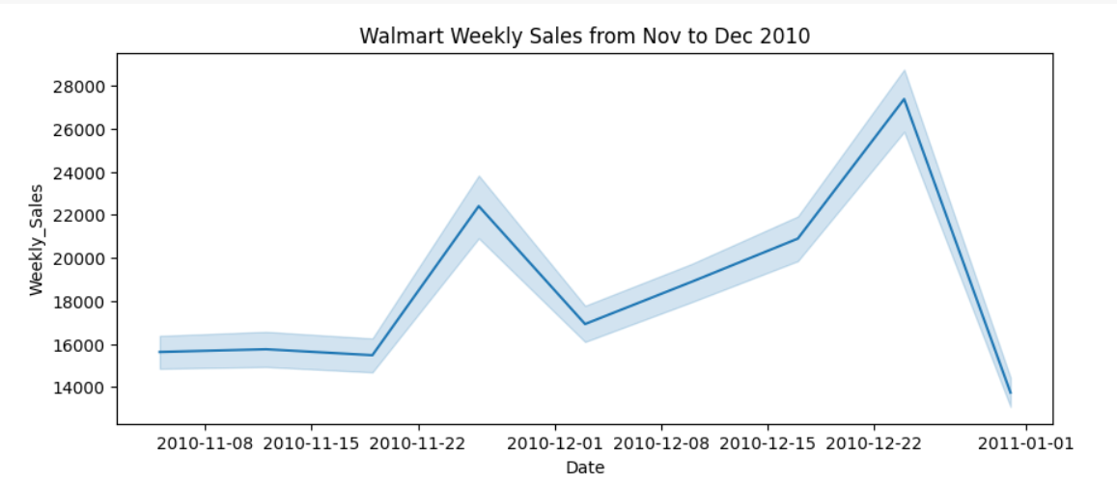
Exploratory Data Analysis
Massive spike during November and December each year.
Slight increase in sales between May and July.
January sales significantly less.
Thanksgiving and Christmas week with the highest sales.

Slide 6
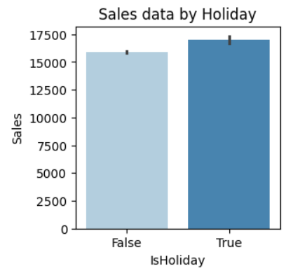
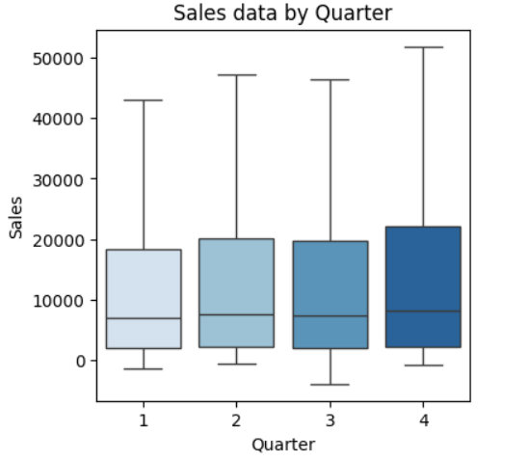
Exploratory Data Analysis
Holidays lead to better sales.
Last quarter has the highest sales due to a greater number of holidays in that quarter.

Slide 7
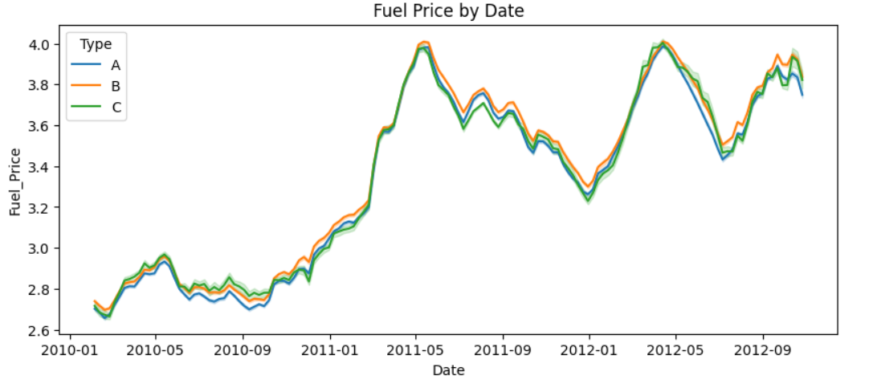
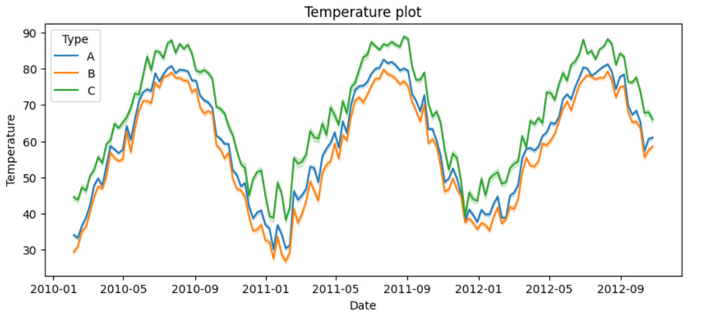
Exploratory Data Analysis
Temperature and Fuel Price Changes do not affect the sales much.
All store types follow the same trend.
Hence, dropped these variables to improve performance of model.

Slide 8
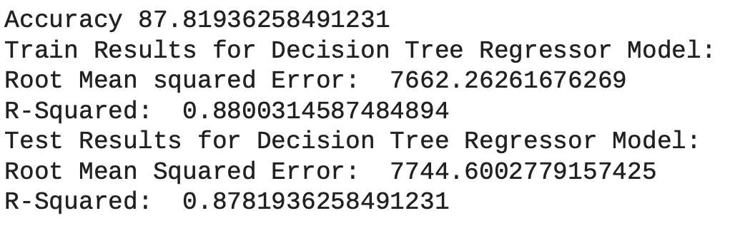
Decision Tree Model
Moderate Accuracy: The accuracy for the Decision Tree model is lower at approximately 87.81%, which suggests less predictive performance
Training Performance: The RMSE of 7662.26 and R-squared of 0.8800 indicate the model fits the training data reasonably well.
Testing Performance: The test RMSE is slightly higher at 7744.60, and the test R-squared is 0.8782, which is slightly less than the training R-squared, suggesting a very slight overfitting or variance in the model’s predictions when generalized to unseen data.

Slide 9
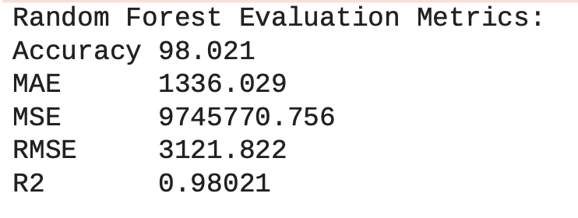
Random Forest Model
High Accuracy: The accuracy is quite high at 98.021%
Root Mean Squared Error (RMSE): The RMSE of 3121.822, which is higher than MAE, also points towards the presence of outliers affecting the model predictions.
R-squared Value: An R-squared of 0.98021 implies the model explains 98.021% of the variance in the target variable, signifying a very good fit.
Notes:
High Accuracy: The accuracy is quite high at 98.021%, which is typically excellent for most predictive modeling tasks.
Mean Absolute Error (MAE): The MAE of 1336.029 indicates that the predictions are, on average, within this range of the actual values, which could be considered good depending on the scale of sales data.
High Mean Squared Error (MSE): The large MSE value of 9745770.756 suggests the presence of outliers or extreme values that the model is sensitive to.
Root Mean Squared Error (RMSE): The RMSE of 3121.822, which is higher than MAE, also points towards the presence of outliers affecting the model predictions.
R-squared Value: An R-squared of 0.98021 implies the model explains 98.021% of the variance in the target variable, signifying a very good fit.

Slide 10
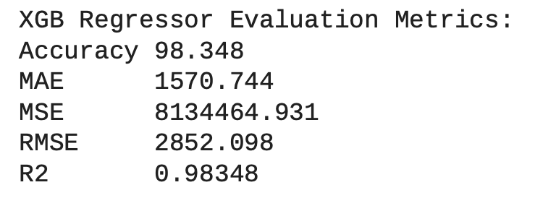
XGBoost Model
Accuracy: At 98.348%, the model is highly accurate in its predictions.
RMSE (Root Mean Squared Error): An RMSE of 2852.098 means that the model’s predictions are, on average, about $2852 from the actual sales numbers.
R2 (R-Squared): With an R^2 of 0.98348, the model explains about 98.348% of the variability in the response variable, indicating a very good fit.

Slide 11
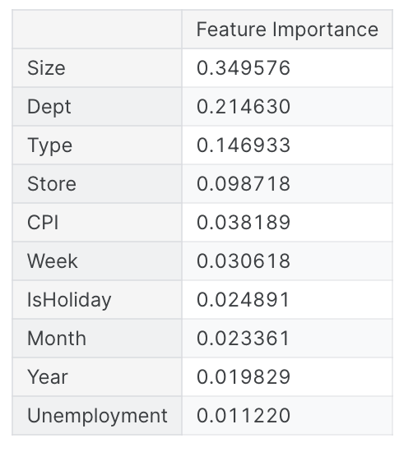
XGB - Feature Importance
Store Size: Primary factor, with 34.96% influence on sales.
Department: Second major contributor at 21.46%.
Store Type: Significant role in sales variance, 14.69% importance.
Location: Notable but lesser impact at 9.87%.
CPI: Moderate economic influence, 3.82%.
Weekly Cycle: Recognizable pattern effect, 3.06%.
Holidays: Slight sales uplift, 2.49% importance.
Seasonality: Minor role at 2.34%.
Yearly Trend: Long-term changes impact at 1.98%.
Unemployment: Least impact on sales, 1.12%.
Notes:
Store Size Dominates: The most substantial predictor with a 34.96% influence, indicating larger stores may see higher sales volumes.
Department Significance: Commands a 21.46% importance, suggesting sales vary significantly across different store departments.
Type of Store Matters: Holds a 14.69% score, which may reflect how sales differ between store formats (e.g., Supercenter vs. Neighborhood Market).
Location Influence: Individual store locations play a smaller but noteworthy role at 9.87%, possibly due to demographic or geographic factors.
Economic Context: Consumer Price Index (CPI) impacts sales with a 3.82% score, possibly reflecting the sensitivity of sales to economic conditions.
Weekly Patterns: Week of the year has a 3.06% importance, highlighting regular weekly sales cycles or effects of specific promotions.
Holiday Impact: Being a holiday week accounts for 2.49% importance, suggesting a modest increase in sales during holiday periods.
Seasonal Trends: Month of the year has a 2.34% score, indicating a minor effect of seasonality on sales.
Year-Over-Year Changes: Year feature with 1.98% importance, reflecting long-term trends or shifts in sales patterns.
Employment Conditions: Unemployment rate is the least influential at 1.12%, suggesting lower impact on sales forecasting in this model

Slide 12
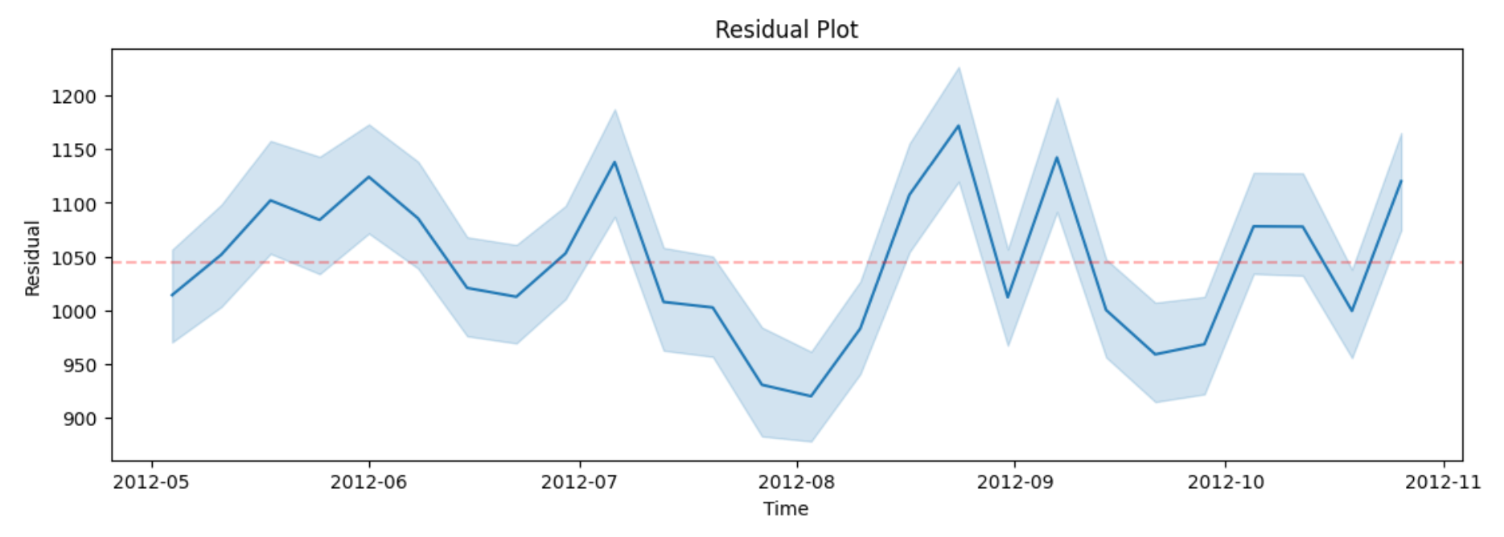
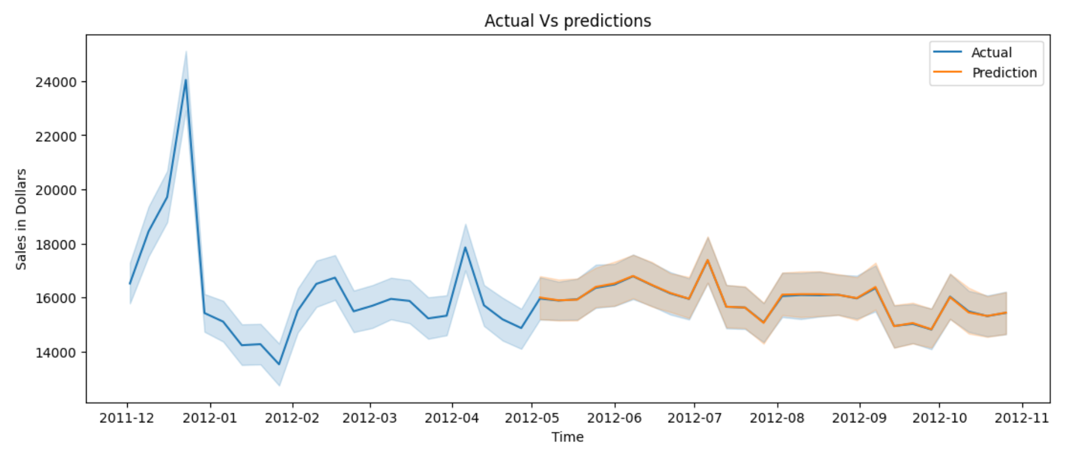
XGB – Residual and Actual vs Predictions Plot
The residuals fluctuate around a consistent band width over time, indicating that the model’s performance is stable across the different time periods.
There’s no clear trend in the residuals, suggesting the model does not systematically underpredict or overpredict in certain periods.
The consistency around the red dashed line (presumably the zero line) suggests the model has no major bias.
The prediction band closely follows the actual sales pattern, signifying the model’s high accuracy in capturing the sales trend.
The width of the prediction intervals suggests some variability in the model’s confidence in its predictions

Slide 13
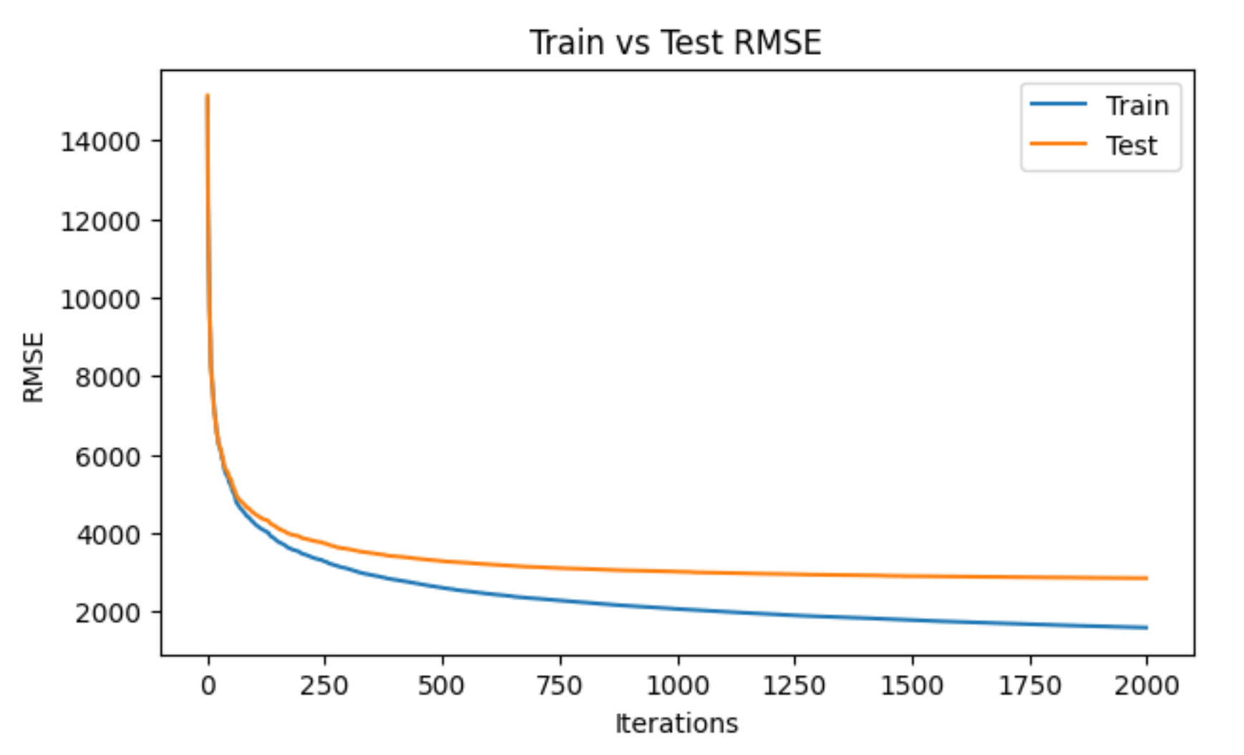
XGB – Train vs Test RMSE
The RMSE for both train and test datasets decreases sharply and stabilizes quickly, indicating the model learns well without needing many iterations.
The close proximity of the train and test lines suggests that the model is not overfitting

Slide 14
Further Improvements
More detailed feature engineering and feature selection will be done.
More data can be found to observe holiday effects on sales and more different holidays can be added like Easter, Halloween and Come Back to School times to analyze sales.
Analysis can be done to find the items which are more and less in demand in Walmart stores to improve sales.

Slide 15
Thank You

