Slide 1
ENGINE CONDITION TREND MONITORING Predicting the failure of aircraft engines
Shreyas S
Machine Learning Intern
Faststream Technologies
Vinay Bansal
Chief Executive Officer
Faststream Technologies
Vinod Agrawal
Chief Technology Officer
Faststream Technologies

Slide 2
OBJECTIVE
To predict the probability of failure of an aircraft engine based on 5 parameters
When a parameter’s value increases beyond a certain value, the probability of failure of that part starts increasing
The collective probability of failure of all the parameters are considered to predict the probability of failure of the Turbine Engine

Slide 3
METHODOLOGY
Data of 1000 engines is collected over 5 years
The five parameters considered are:
Noise from Fan Blade
Exhaust Gas Temperature of the Turbine
Fuel Flow of the Turbine
Low Pressure Fan Speed
High Pressure Rotor Speed
An increase in any of the parameter’s value beyond a certain limit increases the probability of failure of the entire Turbine Engine
The month where the probability reaches one is when the Turbine Engine will reach complete failure

Slide 4
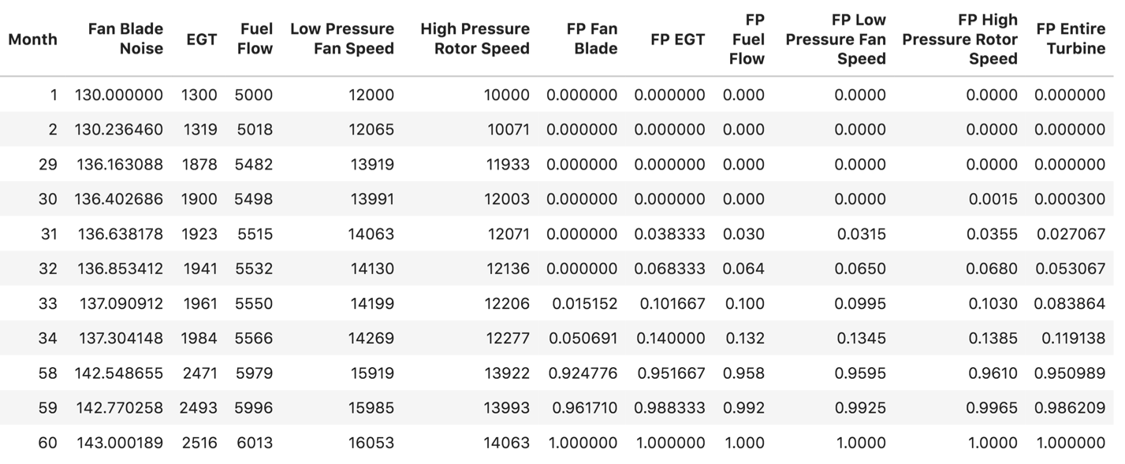
SAMPLE DATA (under normal conditions)

Slide 5
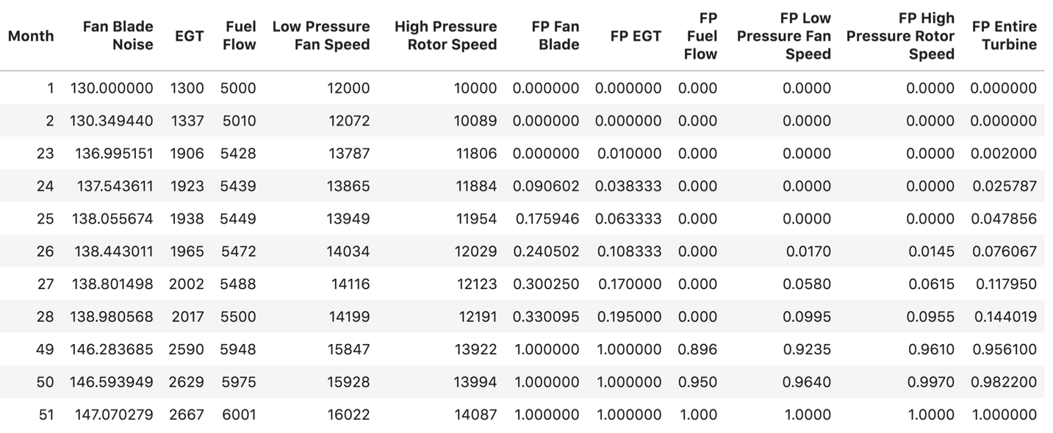
SAMPLE DATA (under abnormal conditions)

Slide 6
IMPLEMENTATION
All the data is generated using python’s numpy library
Data for 1000 engines is generated to train the Machine Learning Model
Data for 10 engines is again generated to test the Machine Learning Model and predict the accuracy
Data generated for Test Set is generated randomly so that probability of failure of each engine is random and also to prove that the Machine Learning Model is working

Slide 7
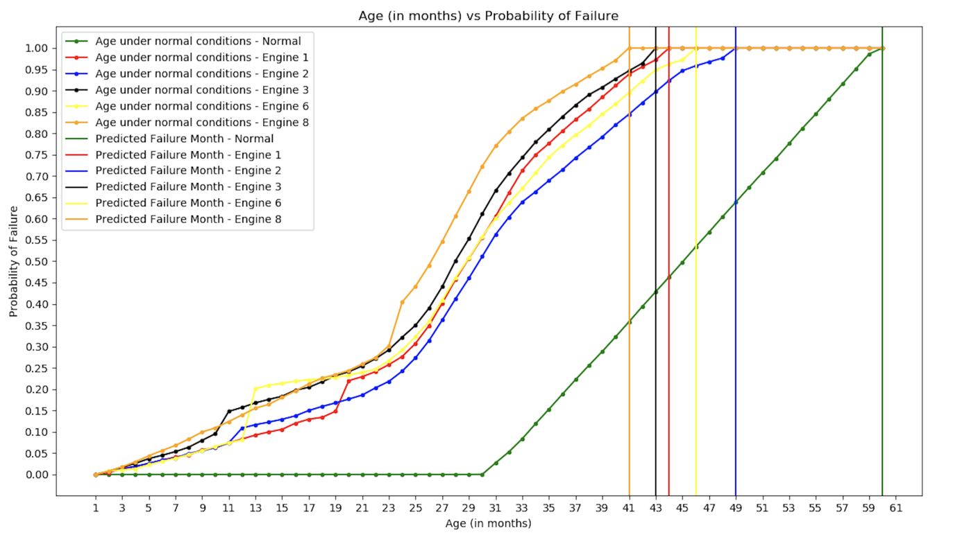
RESULTS

Slide 8
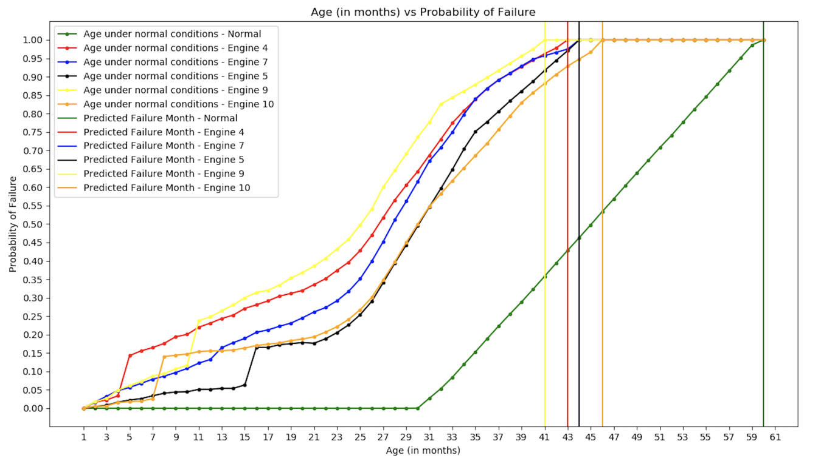
RESULTS

