Slide 1
ENGINE CONDITION TREND MONITORING Predicting the failure of aircraft engines
Shreyas S
Machine Learning Intern
Faststream Technologies
Vinay Bansal
Chief Executive Officer
Faststream Technologies
Vinod Agrawal
Chief Technology Officer
Faststream Technologies

Slide 2
OBJECTIVE
To predict the probability of failure of an aircraft engine based on five parameters using three machine learning algorithms and comparing the performances of each algorithm

Slide 3
BACKGROUND
Aircraft engine failure constitutes multiple reasons such as noise from the fan blade, exhaust gas temperature of turbine, fuel flow of turbine, low pressure fan speed, high pressure rotor speed, mechanical problems in the engine, oil leaks, fuel pump problems etc.
We have considered five components – Fan Blade Noise, Exhaust Gas Temperature of Turbine, Fuel Flow of Turbine, Low Pressure Fan Speed and High Pressure Rotor Speed

Slide 4
ASSUMPTIONS
Data, in the absence of its availability, has been generated based on nominal value and random degradation
The probability of failure of each component starts to increase when it reaches a certain value
The failure of each component constitutes to the total probability of failure of the whole Turbine Engine
The Turbine Engine fails completely when the probability reaches 1

Slide 5
METHODOLOGY
Data of 1000 engines are generated
In the first phase, using the generated data, Multiple Linear Regression algorithm is applied and the model is saved separately
In the second and consecutive phases, Decision Tree and Random Forest algorithms are applied and their models are saved as well
Data for another 10 engines with random degradation is again generated

Slide 6
METHODOLOGY
Multiple Linear Regression’s model is loaded to the new dataset
The probability of failure is then calculated for each of the 10 engines
This process is repeated for Decision Tree and Random Forest algorithms
The accuracy of each algorithm is calculated by computing the R² Score.

Slide 7
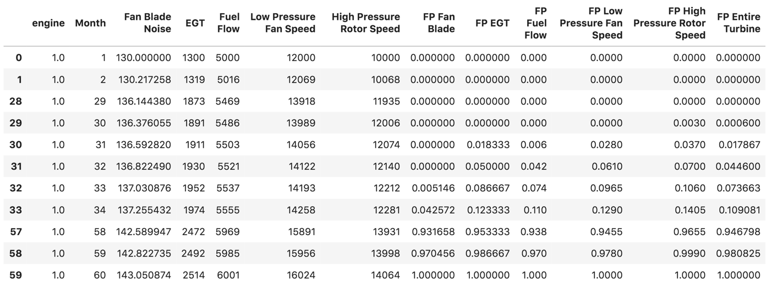
SAMPLE DATA (under normal conditions)

Slide 8
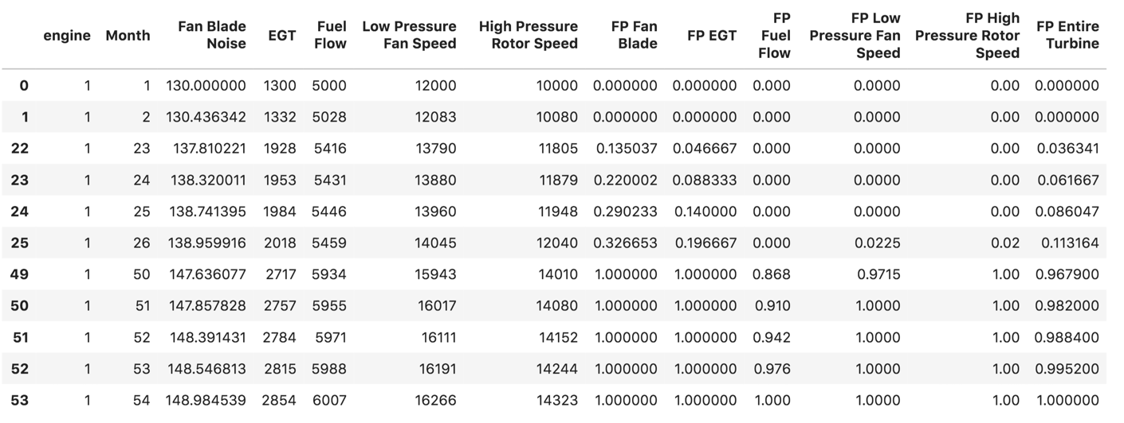
SAMPLE DATA (with random degradation)

Slide 9
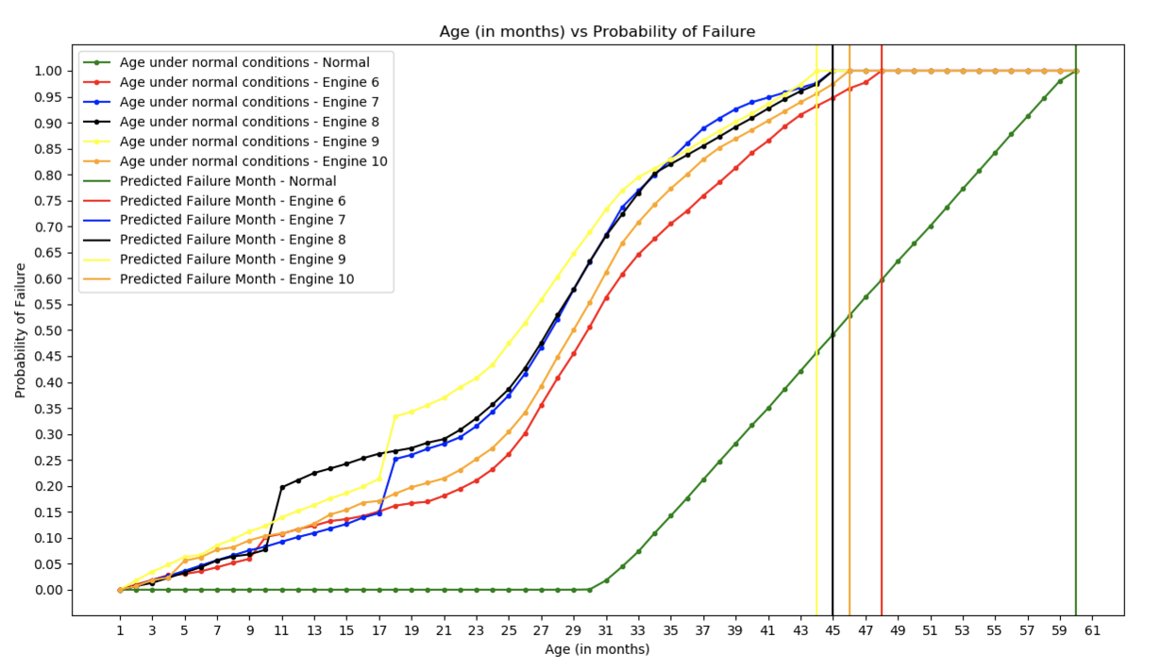
RESULTS (Multiple Linear Regression)

Slide 10
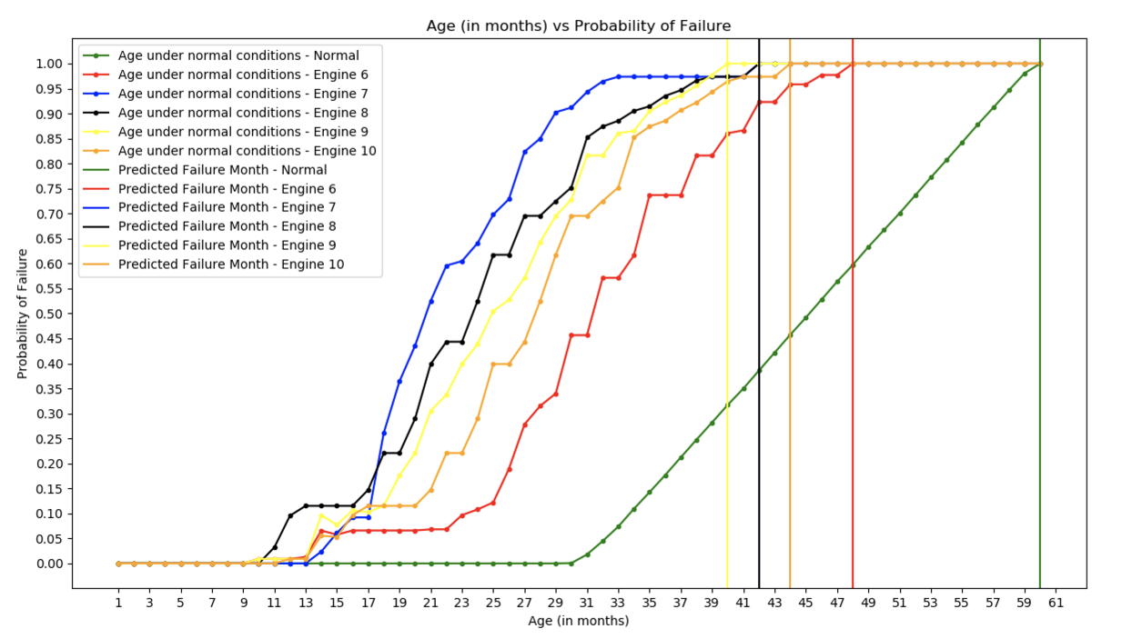
RESULTS (Decision Tree)

Slide 11
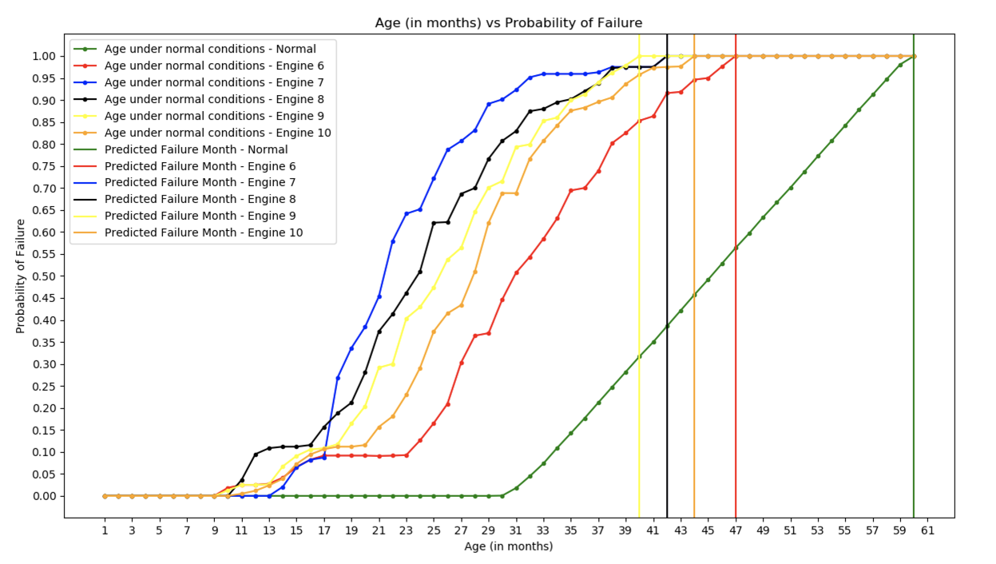
RESULTS (Random Forest)

Slide 12
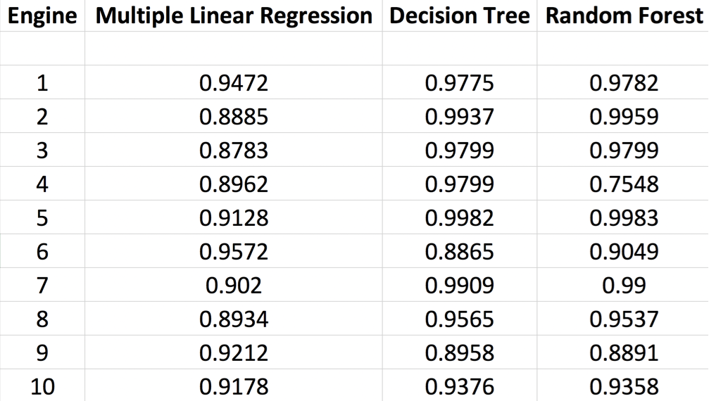
Final Result Comparison (R2 Score)

