Slide 1
ENGINE CONDITION TREND MONITORING Failure prediction of aircraft engines
Shreyas S
Machine Learning Intern
Faststream Technologies
Vinay Bansal
Chief Executive Officer
Faststream Technologies
Vinod Agrawal
Chief Technology Officer
Faststream Technologies

Slide 2
OBJECTIVE
To predict the probability of failure of an aircraft engine using three machine learning algorithms and comparing the performances of each algorithm

Slide 3
BACKGROUND
Aircraft engine failure constitutes multiple reasons some of which are listed below:
Noise from the Fan Blade
Exhaust Gas Temperature of Turbine
Fuel Flow of Turbine
Low Pressure Fan Speed
High Pressure Rotor Speed
Mechanical problems in the engine
Oil Leaks
Fuel Pump problems
We have considered the first five components for this project

Slide 4
ASSUMPTIONS
The failure of each component constitutes to the total probability of failure of the whole Turbine Engine
The Turbine Engine fails completely when the probability gets close to one

Slide 5
METHODOLOGY
In the absence of real data, degradation in a component is generated based on its base value and random distribution
Thousand data sets are generated for training the Machine Learning Algorithms
Another set of data is generated for validating the prediction of the probability of failure of the Turbine
Three different Machine Learning Algorithms are used to predict the probability of failure

Slide 6
METHODOLOGY
Simulation is carried out in three phases totally
In the first phase, Multiple Linear Regression has been used
In the second phase, Decision Tree Regression has been used
In the third and final phase, Random Forest Regression has been used
Results of all these algorithms are compared by computing the R² Score

Slide 7
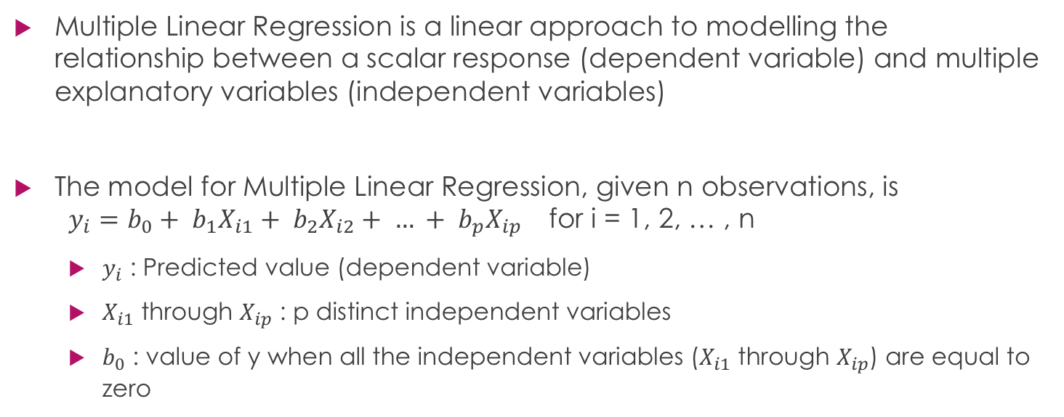
ALGORITHM - MULTIPLE LINEAR REGRESSION
Multiple Linear Regression is a linear approach to modelling the relationship between a scalar response (dependent variable) and multiple explanatory variables (independent variables)
The model for Multiple Linear Regression, given n observations, is $y_{i}=b_{0}+ b_{1}X_{i1}+ b_{2}X_{i2}+ … + b_{p}X_{ip}$ for i = 1, 2, … , n
$y_{i}$ : Predicted value (dependent variable)
$X_{i1}$ through $X_{ip}$ : p distinct independent variables
$b_{0}$ : value of y when all the independent variables ($X_{i1}$ through $X_{ip}$) are equal to zero

Slide 8
ALGORITHM – DECISION TREE
Decision tree builds regression models in the form of a tree structure. It breaks down a dataset into smaller and smaller subsets while at the same time an associated decision tree is incrementally developed. The final result is a tree with decision nodes and leaf nodes.
A decision node has two or more branches, each representing values for the attribute tested.
Leaf node represents a decision on the numerical target. The topmost decision node in a tree which corresponds to the best predictor called root node.

Slide 9
ALGORITHM – RANDOM FOREST
The Random Forest Regression is a type of Machine Learning Algorithm that makes predictions by combining decisions from a sequence of base models. More formally we can write this class of models as:
g(x) = f₀(x) + f₁(x) + f₂(x) + … + f_{n}(x)
where the final model g is the sum of simple base models f_{i}. Here, each base classifier is a simple Decision Tree.

Slide 10
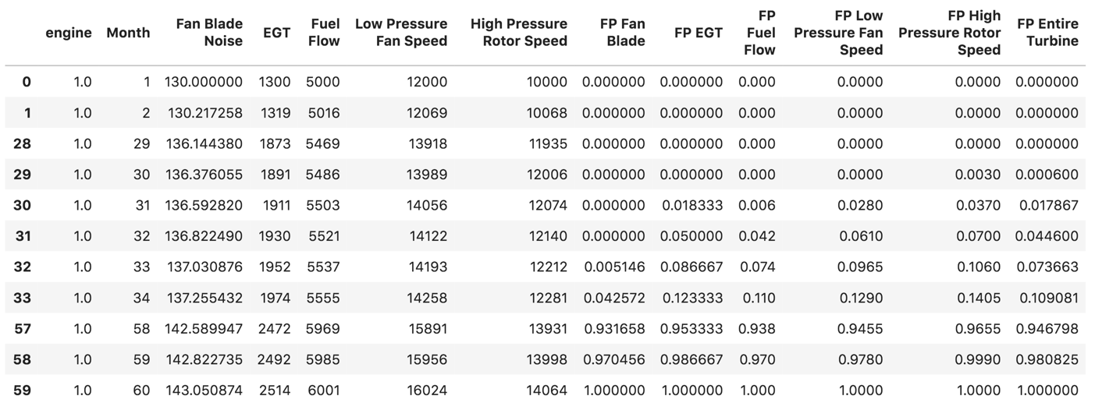
SAMPLE DATA (under normal conditions)

Slide 11
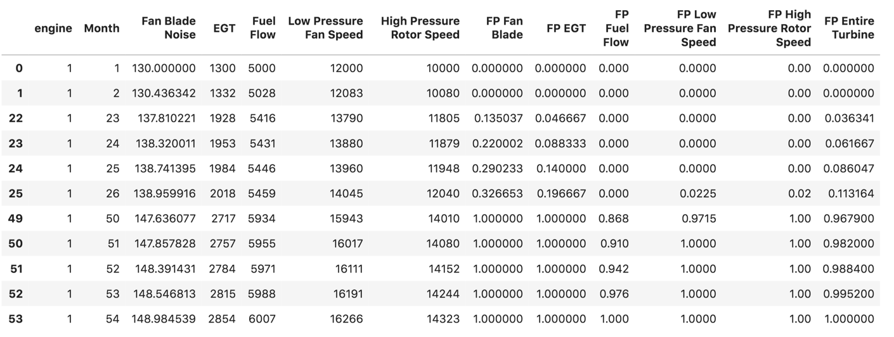
SAMPLE DATA (with random degradation)

Slide 12
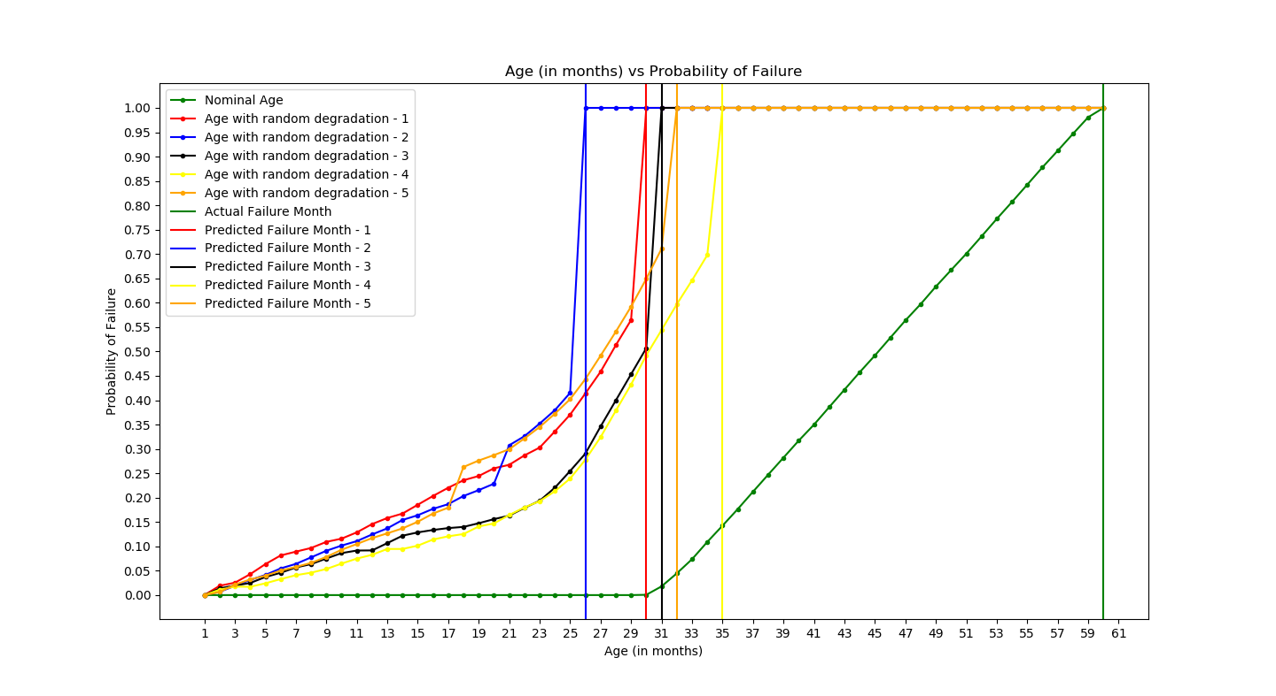
RESULTS (Multiple Linear Regression)

Slide 13
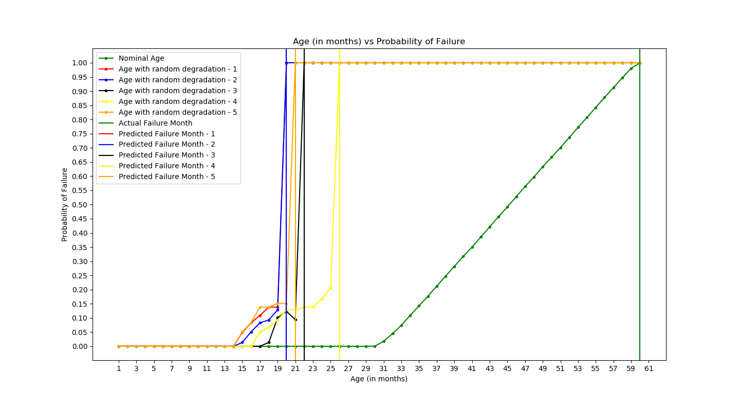
RESULTS (Decision Tree)

Slide 14
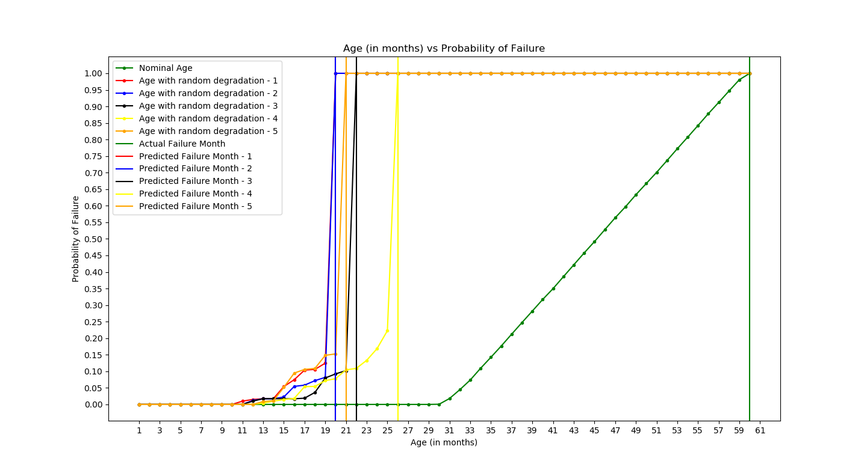
RESULTS (Random Forest)

Slide 15
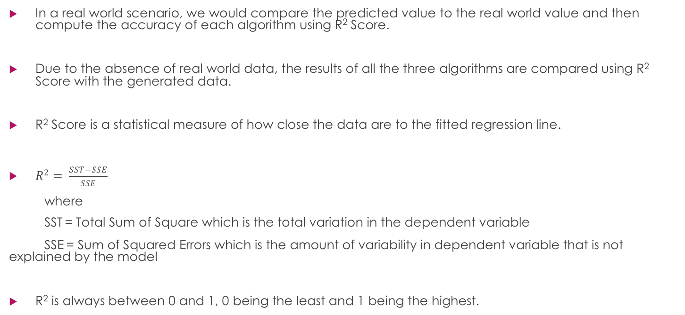
Final Result Comparison
In a real world scenario, we would compare the predicted value to the real world value and then compute the accuracy of each algorithm using R² Score.
Due to the absence of real world data, the results of all the three algorithms are compared using R² Score with the generated data.
R² Score is a statistical measure of how close the data are to the fitted regression line.
$R^{2}= \frac{SST−SSE}{SSE}$
where
SST = Total Sum of Square which is the total variation in the dependent variable
SSE = Sum of Squared Errors which is the amount of variability in dependent variable that is not explained by the model
R² is always between 0 and 1, 0 being the least and 1 being the highest.

Slide 16
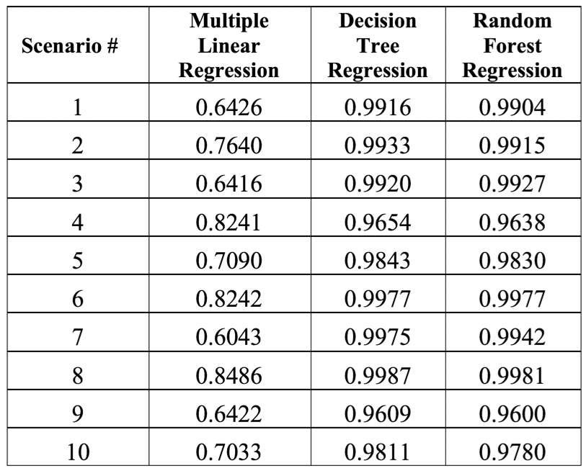
R² Scores of all the Algorithms

Slide 17
CONCLUSION
From the R² Scores table, the results show that the Decision Tree algorithm scores constantly higher than Random Forest and Multiple Linear Regression algorithms.
Random Forest algorithm’s results were very close to Decision Tree’s and is much better than Multiple Linear Regression.
Multiple Linear Regression comes last out of the three.

Slide 18
FUTURE ENHANCEMENTS
All the data used in this project was based on a few assumptions
Further, the same process can be carried out and implemented on real world data from an actual aircraft engine to predict when it might actually fail.

