Slide 1

C2T3:Predicting Customer Credit Limits
Hunter Messer

Slide 2
Introduction
The Credit One data is a table of Taiwan loan customers with associated demographic information, history of monthly past payments, history of monthly bill statements, history of monthly previous payments, and whether the customer has defaulted on their loan
The data is stored in a MySQL database. This was extracted to my local drive, where I will be using the local file for my analysis
Questions posed:
How do you ensure that customers can/will pay their loans?
Can we approve customers with high certainty?

Slide 3
Data Cleaning/Pre-Processing
During the preliminary analysis, I have noticed the following issues with the data:
Two feature headers
Data type of all variables is object
One NULL ID
This was cleaned and fixed during the process

Slide 4
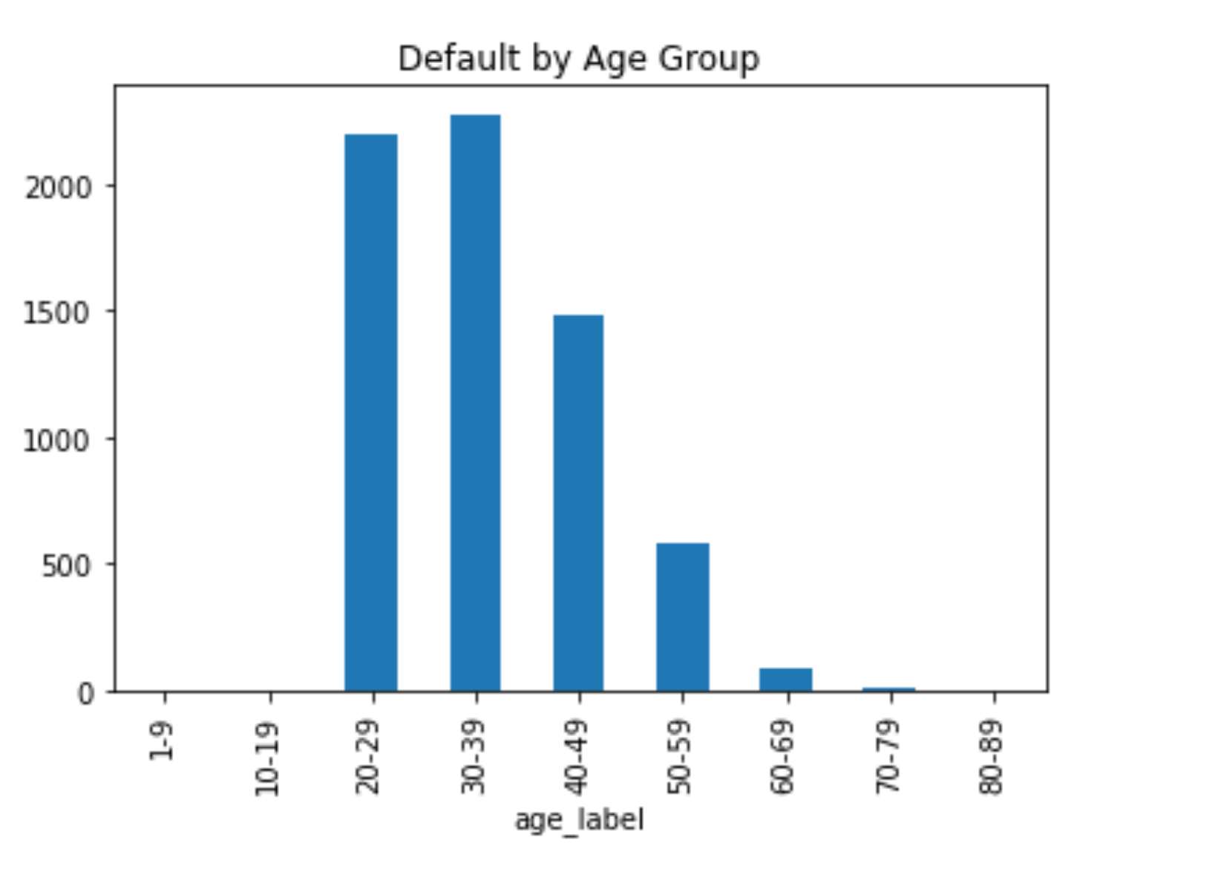
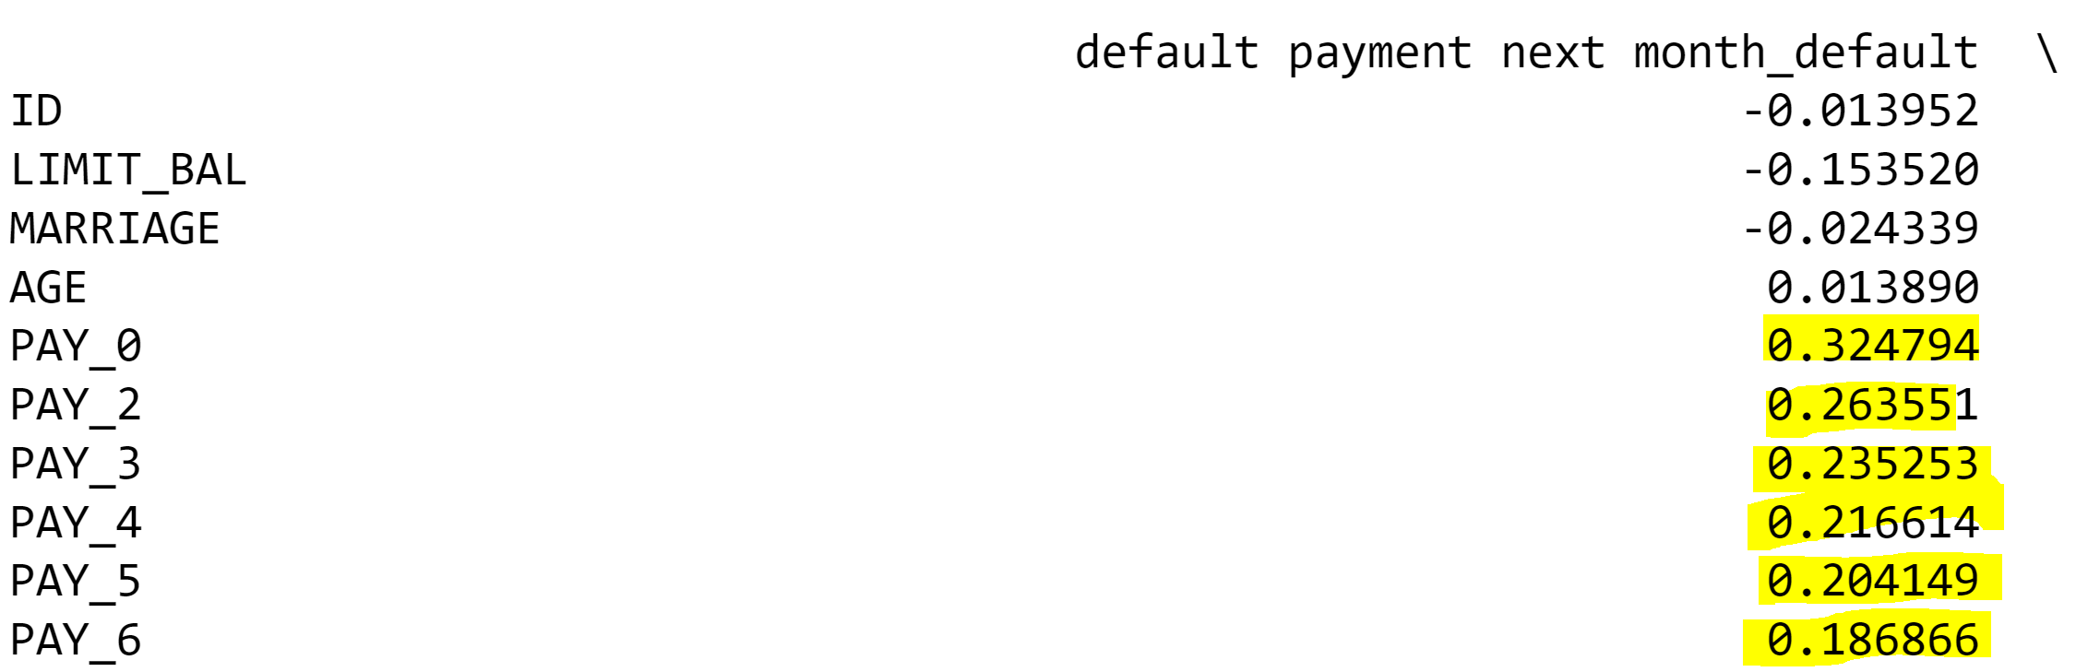
EDA
The following insights were found during the EDA process:
There is a 30% default rate, which seems to be significantly high
Defaulted loans mainly come from the younger customers within the population (Age 20 – 29: 33% of pop., Age 30 – 39: 34% of pop.)
There is a positive correlation between pay month_0 (and subsequent months) and defaulted loans. In other words, customer who default tend to be late on their first payment
Correlation between credit given (Limit_Bal) and defaulted loans

Slide 5
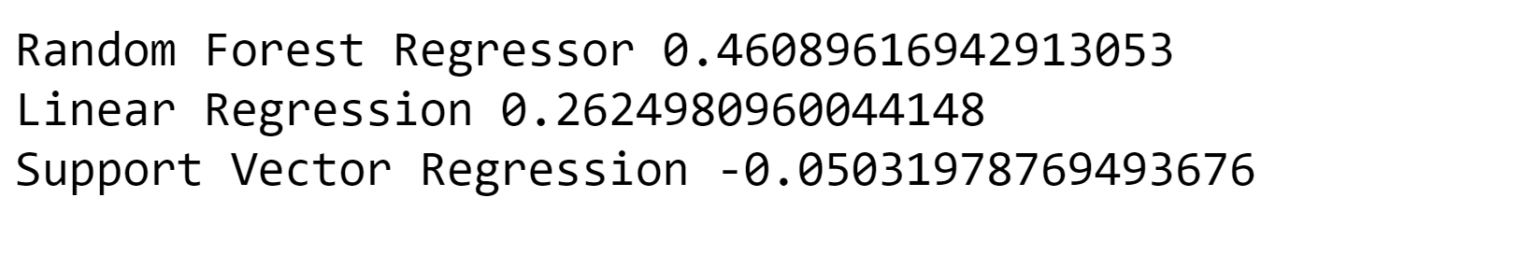
Analysis: Regression
None of the three regressions provided an accurate model that could be used to predict whether customers will pay their loans and/or being able to approve customers with high certainty (based on r^2 and RMSE)
Limit Balance was used as the y-variable for the best model, along with most of the features used as x-variables

Slide 6
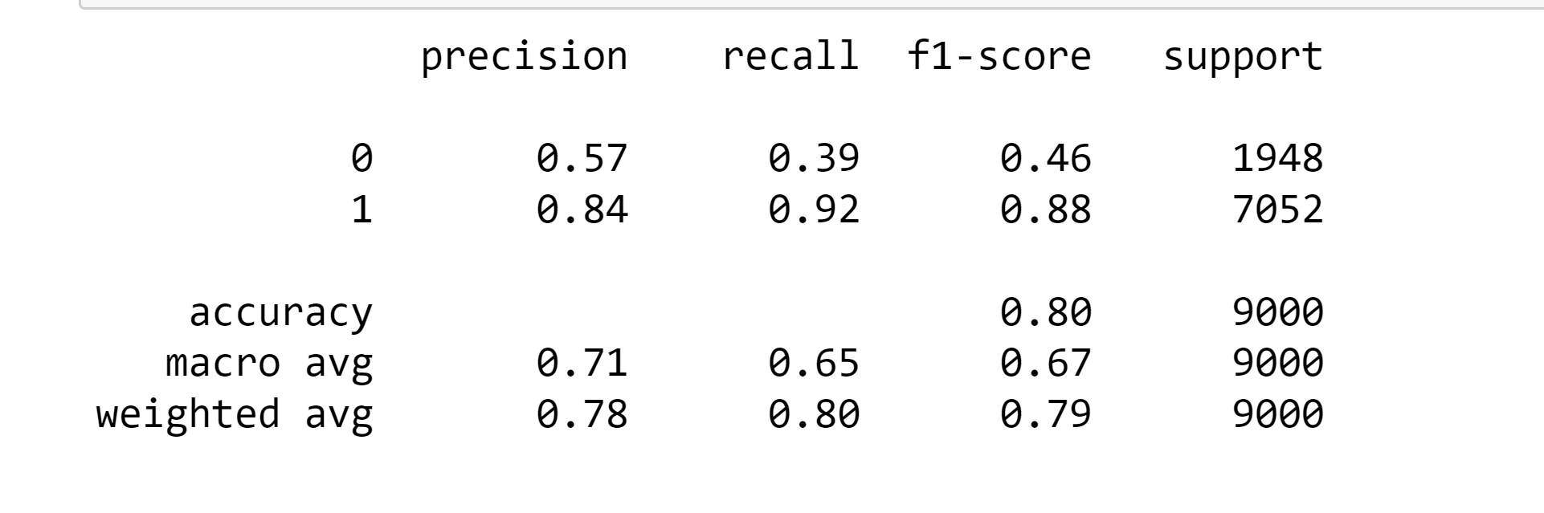
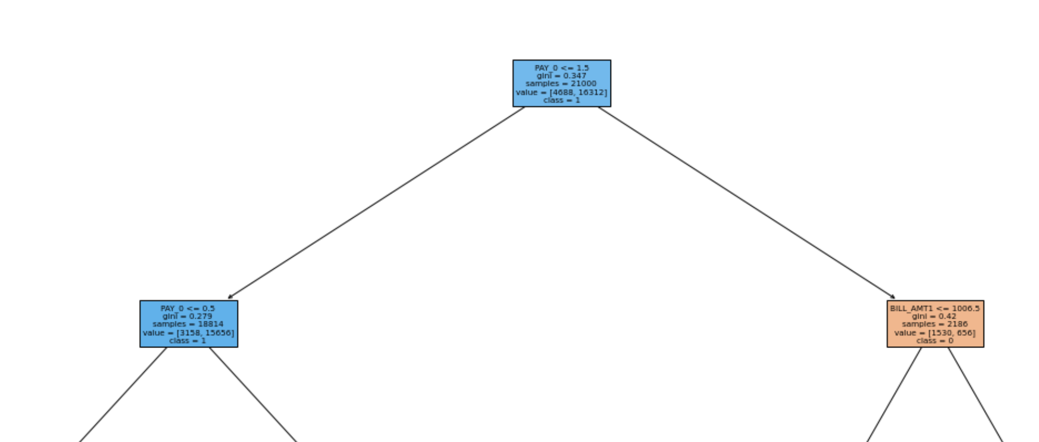
Analysis: Classification
Although Limit Balance could not be used to make an accurate prediction, using the dummy variable “default payment next month_not default” as the y-variable provided an 80% accuracy score
As stated before, those who pay their first bill tend to not default on their loans

Slide 7
Conclusion Recommendations
Recommend more demographic data to possibly create a better output model and provide more insight
More stringent on the amount of loan credit being given to customers
Extend loans to an older population as they tend to default less than younger individuals
Implement some form of monitoring system that tracks customers who miss their first payment

