Slide 1
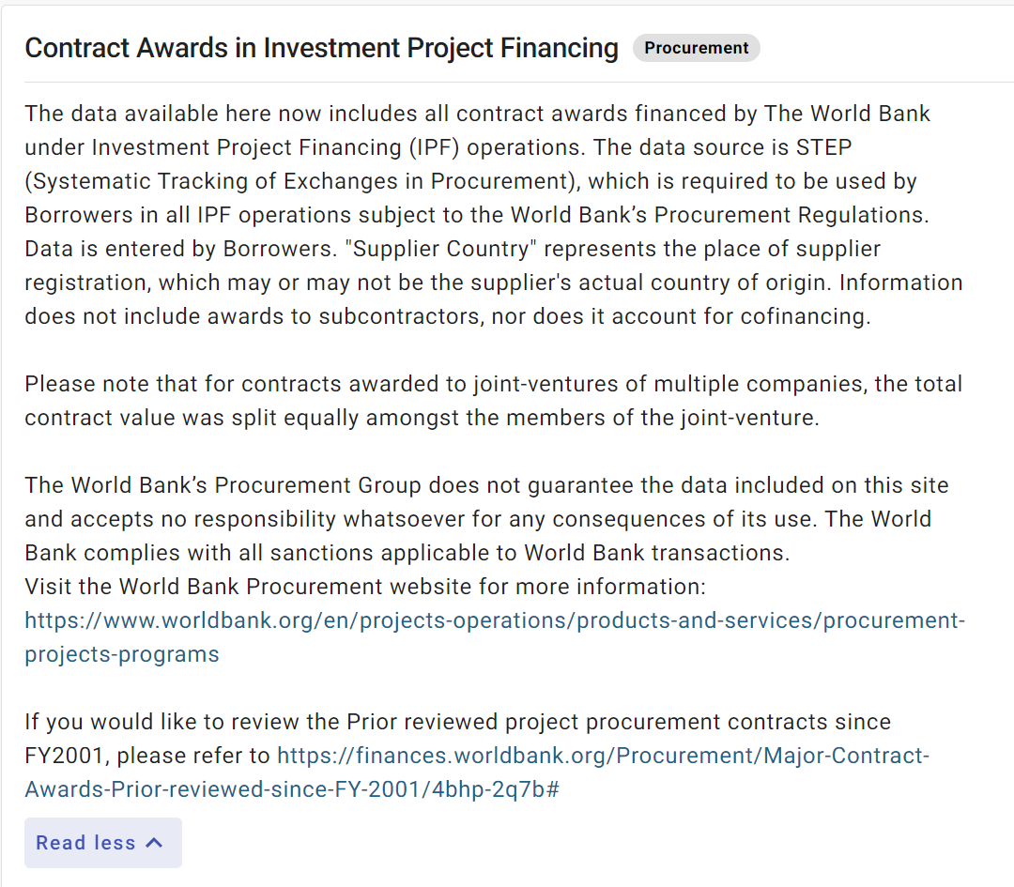

Slide 2


Slide 3
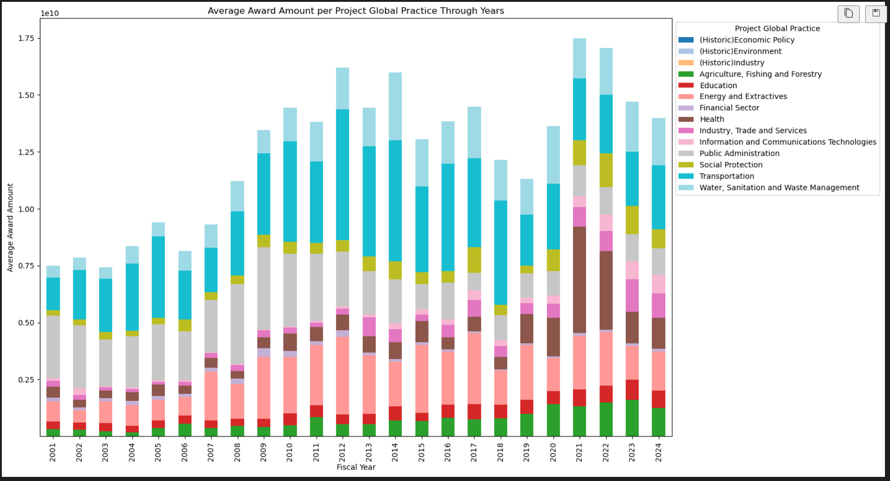

Slide 4
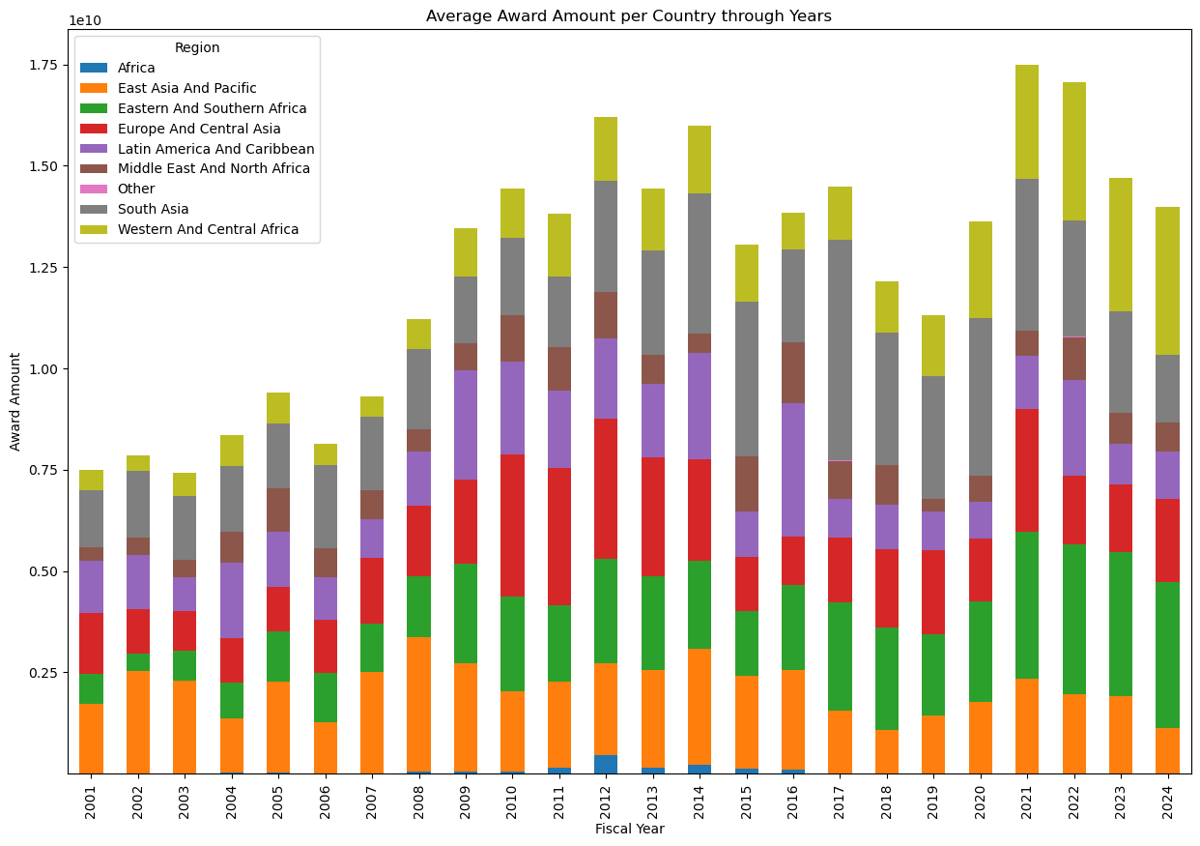

Slide 5


Slide 6
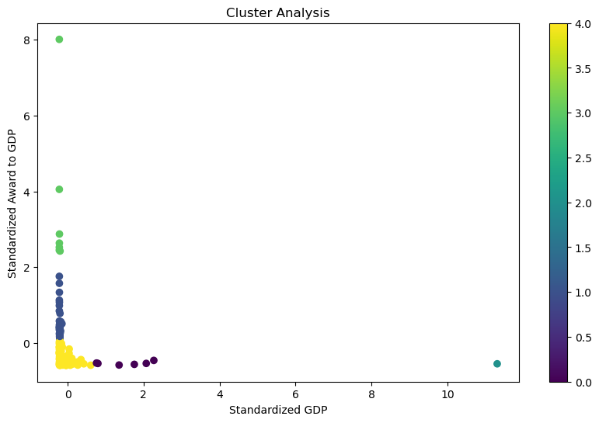

Slide 7
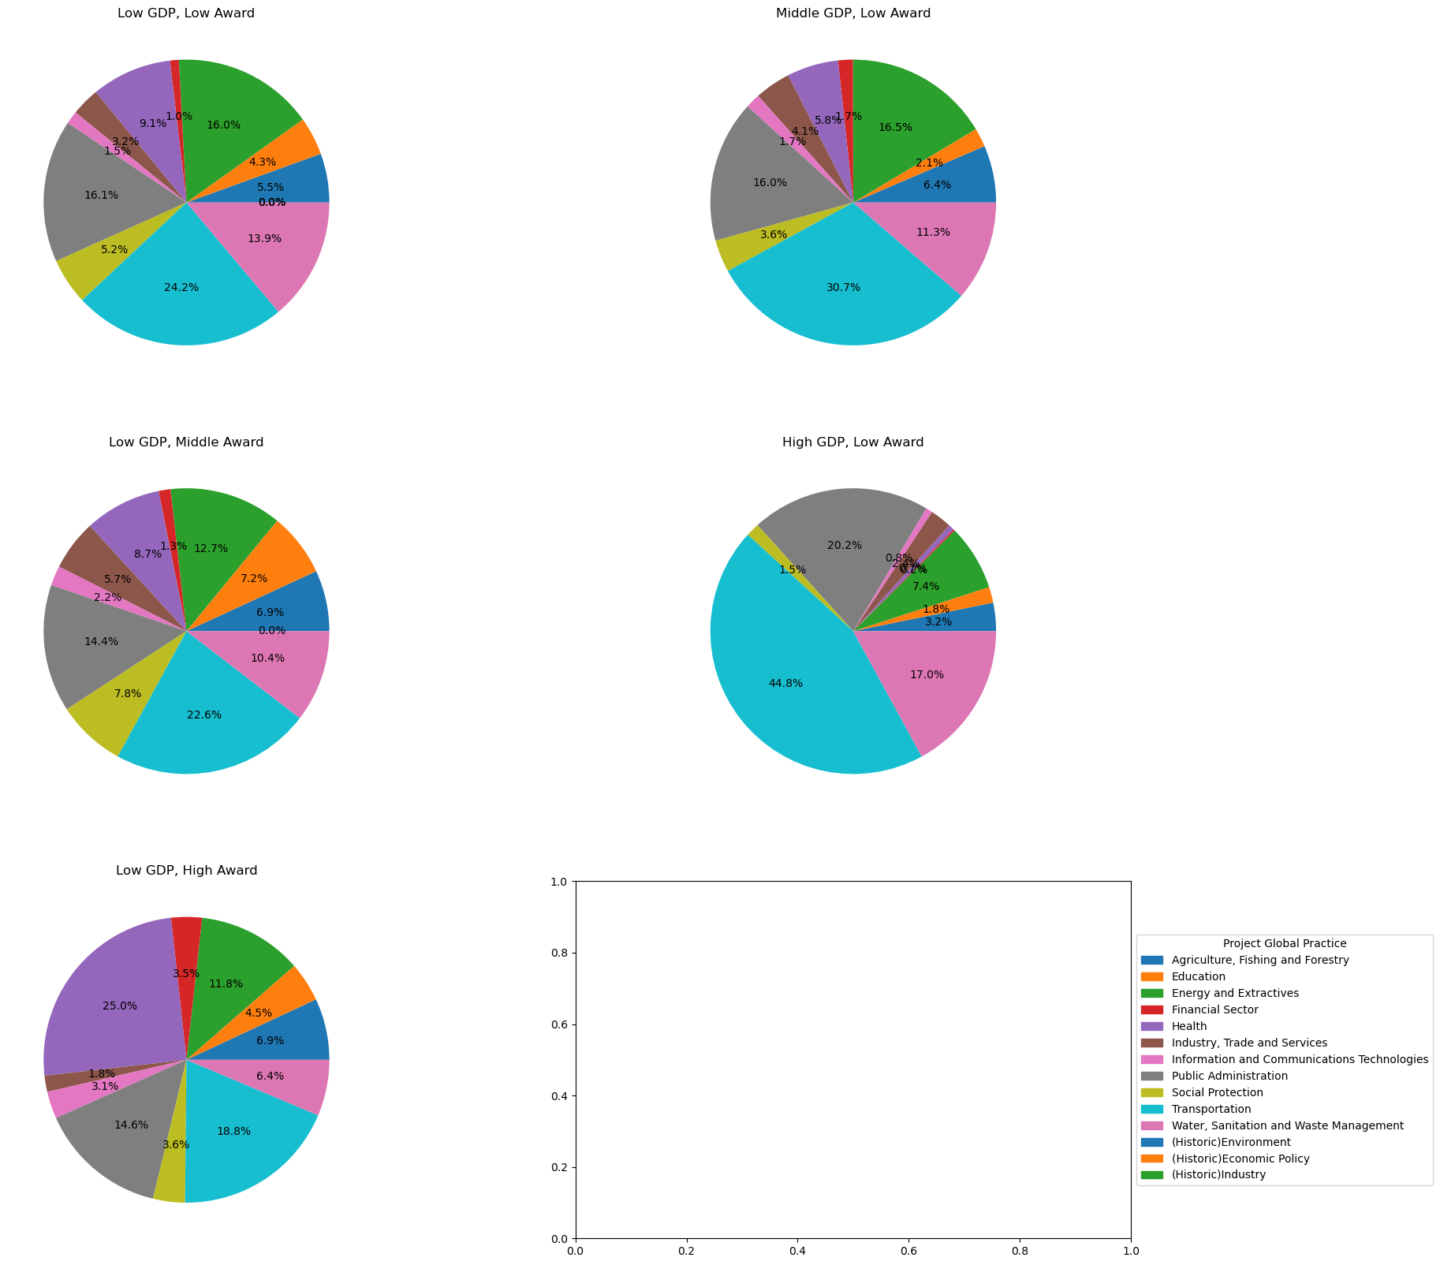

Slide 8
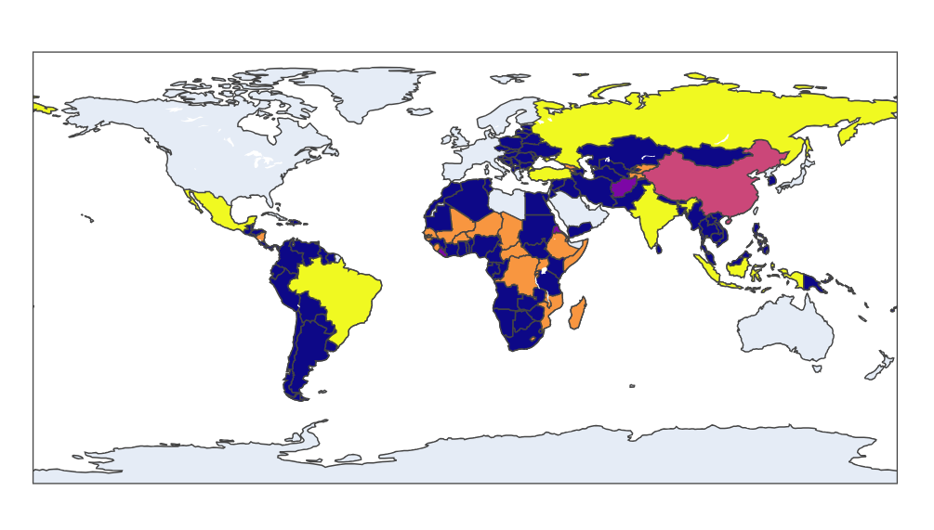

Low GDP & Low Award
Low GDP & High Award
High GDP & Low Award
Low GDP Middle Award
Middle GDP & Low Award

