Slide 1
Used Car Price Predictor
A Python ML Project by Henry Gruen

Slide 2
Full Project
A link to this full project can be found in the google docs portfolio linked in my resume, in the “Just for fun projects” folder

Slide 3
Background
This summer I bought a used car off craigslist and discovered I knew less than I previously thought about the market for cars. I tried using sites like KelleyBlueBook but they consistently gave me estimates significantly below cars’ listing prices that did not help me find a reasonable deal.
After some time searching for a better solution I found a dataset on Kaggle of every used car listing in 2021. I decided the best solution might be making my own model, so I set off to work.

Slide 4
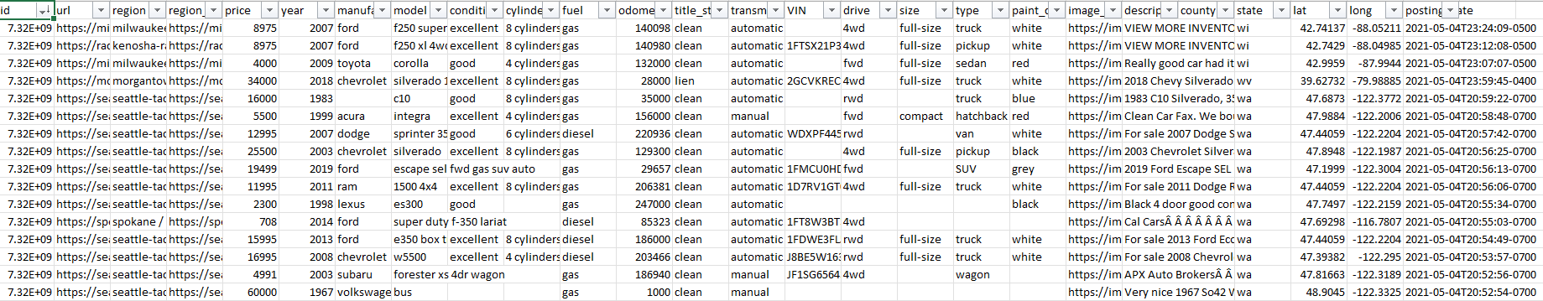
The Data
The data used in this project comes from Kaggle user Austin Reese, who aggregated every Craigslist 'cars & trucks' listing in the United States from 2021. It can be found here: https://www.kaggle.com/datasets/austinreese/craigslist-carstrucks-data

Slide 5
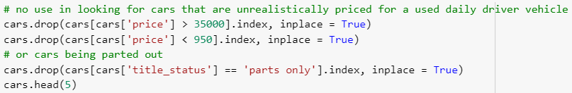
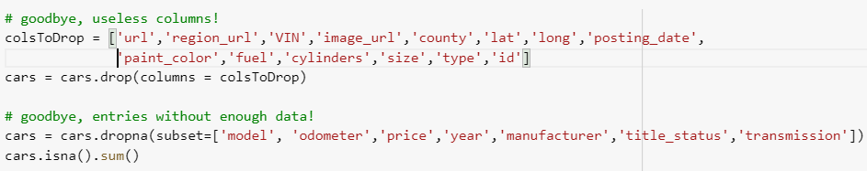
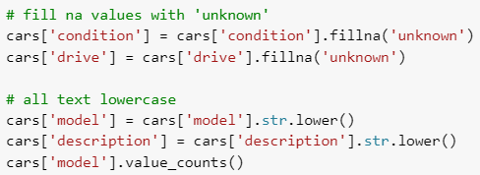
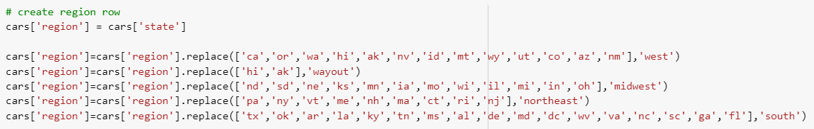

Data Cleaning
Sort out cars unlikely to be candidates for a daily driver
Get rid of columns that are less likely to affect value Account for 100,000+ entries . without known drive/condition
Create column to sort by region instead of stats Find listings with “Camry” in title

Slide 6
Model Selection
For my model I chose to go with a random forest regression. I chose this method because the cleaned Camry’s dataset had a substantial number of listings (over 4,000) and a large variety of outcomes for columns like condition, year, title status and transmission, and the natural variety of sellers not knowing the exact value of their car playing a role. Because of this, I figured finding ‘trees’/cars as close to the chosen listing as possible would give me the best result.
I chose to sort by model name before training the model because there wasn’t enough consistency in names to sort by every model name. Additionally, the sample size for Camrys was large, but many other car models are not as abundant on second hand sites like craigslist as Camrys.

Slide 7


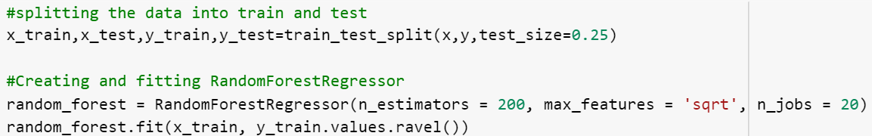
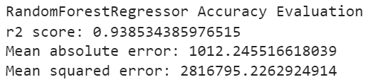
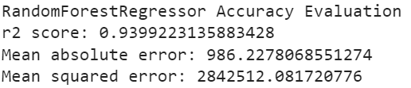
Model Fitting/Testing
Car I bought: 1999 Camry, 220k miles, Midwest region, automatic, ‘good’ condition, clean title, automatic
Price of car I bought: $2700 (listed at $2850)
Price model predicted: $2706

Slide 8
Thank You
Full .ipynb file can be found here

