Slide 1
Spotify App Store Review Analysis
A Python Machine Learning portfolio project by Henry Gruen

Slide 2
Intro and Objectives
One of the most prominent debates in the modern music landscape has little to do with music itself, but rather the streaming platforms music is offered on. Spotify and Apple Music have become the two titans of the industry, and many listeners are loyal fans of one or another. I have been a Spotify user for over 5 years and been very satisfied with the service, but I decided to take a look at app store reviews to get a glimpse of why some users feel differently or agree.
Objectives:
1) Analyze distribution of reviews and most popular reviews
2) Use TF-IDF to find most common words and phrases in reviews with good, ok and poor ratings
3) Use Count Vectorizer and TF-IDF classification to predict review sentiment

Slide 3
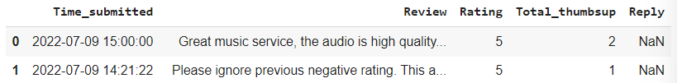
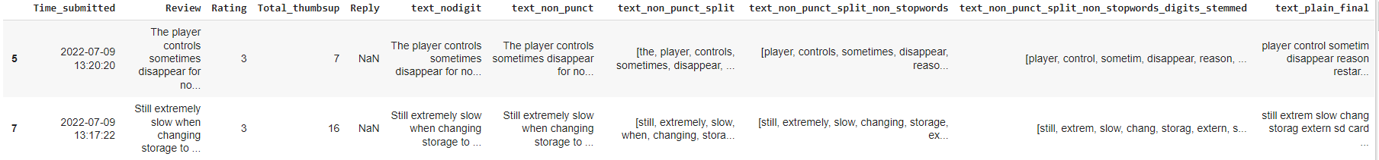
Data Cleaning
Before :
After (changes: punctuation, digits & stop words removed, stemmed, split):

Slide 4
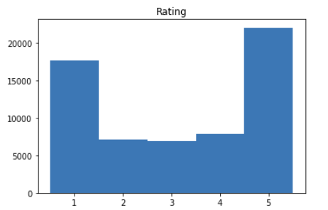
Surface Analysis
Trends seen in popular (high likes) posts:
Pros: Easy to use, Good recommendation algorithm,
good audio quality, good podcast selection
Cons: Network connection & Loading, Too many ads, automatic shuffling, play button not working, current song not displaying, long wait between songs, radio not automatically activating, false ad promises (30 mins uninterrupted), some songs unavailable, glitchy, log in problems

Slide 5
TF-IDF analysis
TF-IDF analyzes the most common phrases, in this case 1-, 2-, and 3-word phrases, among text. I’ve split the reviews into good, poor and worst categories and chosen some of the most informative popular phrases from each category;
Good (4-5): Playlist, Sound quality, Easy use, every song, find song, great select, Use every day, love listen podcast, even without premium, find every song
Poor (2-3): ad, can’t, premium, playlist, many ad, can’t play song, play song want, can’t download song, can’t choose song, can’t listen download
Worst (1): many ad, listen song, can’t open, pay premium, stop play, ad every song, song want listen, stuck load screen, won’t let play, skip per hour, add song playlist

Slide 6

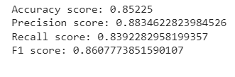
CountVectorizer and TF-IDF classification
Both Count Vectorizer and TF-IDF sentiment analysis can be used to predict the likelihood that text is positive or negative. I assigned ‘positive sentiment’ to 4- and 5-star reviews and ‘negative’ to 1-, 2-, and 3-stars to see if my model could predict the difference. Here are the results:
Count Vectorizer: TF-IDF:

Slide 7
Takeaways
Spotify’s strong suits are music selection, recommendation algorithms, podcast availability and audio quality
Many users are frustrated with the frequency of ads for non premium users
There seems to be a loading screen issue generating many one-star reviews
Users are having trouble downloading songs
Users are frustrated with the number of skips allowed per minute
Users are sometimes unable to play the song they would like to hear
Users are having trouble with the network connection when using the app

