Slide 1
MLB Win Percentage Added
A SQL Data Analysis Project by Henry Gruen

Slide 2
Background
Baseball has long been a sport that piques my interest. Due to its long seasons and the relative individuality of a batter-pitcher matchup, baseball has had the reputation of being a very statistics and analytics influenced sport.
Historically, many popular hitting stats have been measured as averages (Batting Average, On Base Percentage) or counting stats accumulations (Home Runs, Runs Batted In). These stats are certainly valuable, but fail to account for a very important aspect of the game, exactly how much a hitter’s plate appearance helped put his team in a position to win the game.

Slide 3
Win Percentage Added
Win Percentage Added (WPA) is defined as the sum of each of a player’s plate appearances impact on their team’s ability to win the game. For example:
Player x hits a 2 run single with one out in the top of the 8th inning to give their team a 5-4 lead, bringing their team’s winning chances from 48% to 78%, and giving the player 0.3 WPA for their plate appearance
Player y hits a flyout with 2 outs and runners on 1st and 2nd in a 5-4 game bringing their chances of winning from 17% to 0%, giving the player -0.17 WPA for the plate appearence

Slide 4
The Goal
-Aggregate data from multiple sources to create a database of MLB players’ WPA by season
-Allow for players to be sorted by position, age and salary
-Adjust salaries to reflect a portion of total league payroll
-Include traditional stats for comparison

Slide 5
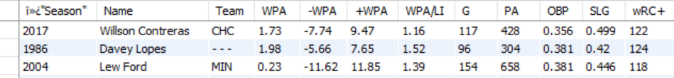



The Data
wpachart.csv, curated and downloaded from fangraphs.com people.csv, from Lahman archives
mlbstats.csv, from seanlahman.com/ (Lahman archives) salaries.csv, from Lahman archives
Appearances.csv, from Lahman archives

Slide 6
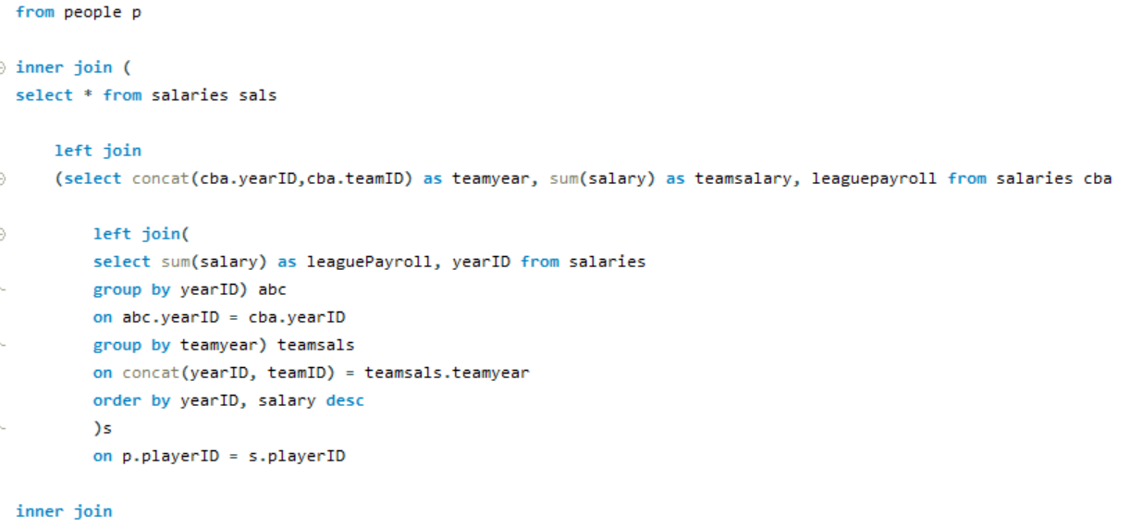
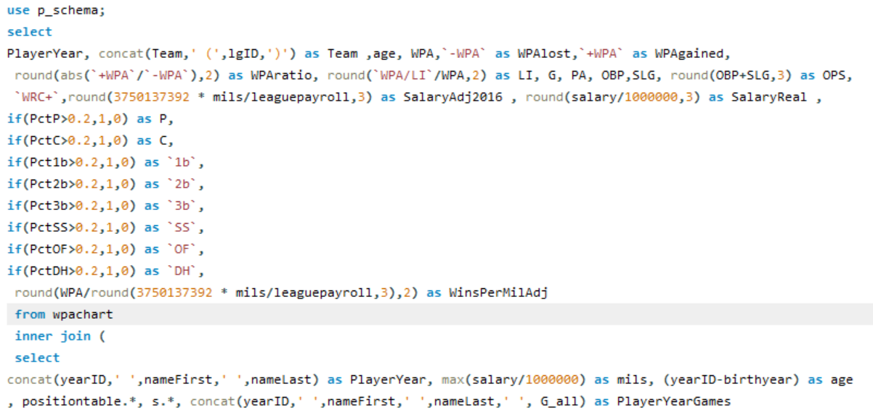
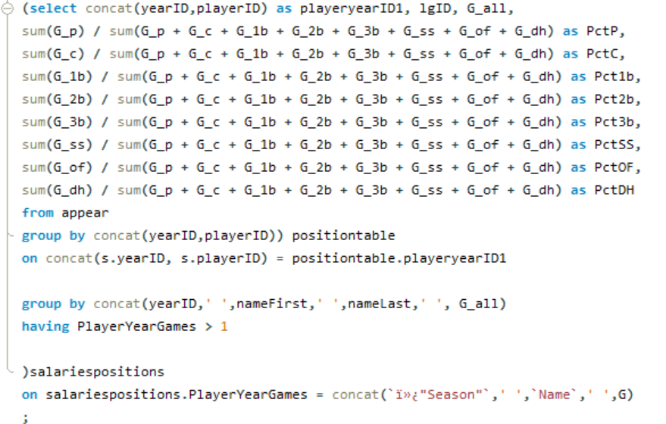
SQL Code
(Cont. on right)

Slide 7
Challenges/Solutions
While the lahman DB had consistent playerID’s, the WPAchart did not, so I had to Join players based on Name, Season and Games played to account for players with the same name (eg. there were 2 Chris Young’s in 2016)
In assessing player positions, I chose the cutoff to be 20% of games played to give the player a binary ‘Yes’ to play a certain position
I was only able to find salary data for 1985-2016, so most recent seasons are not included

Slide 8
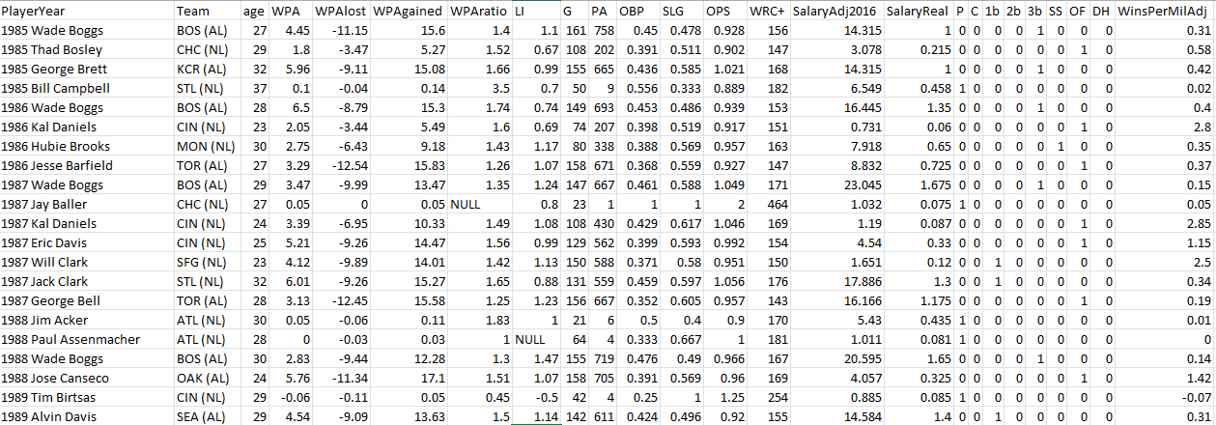
The Result (exported as CSV)

Slide 9
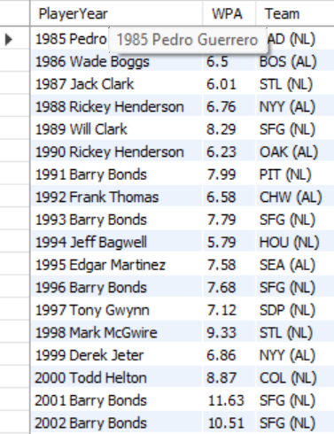
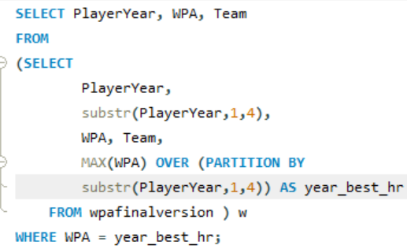
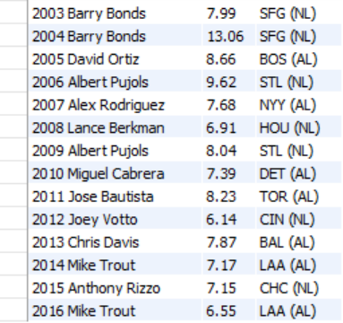
Fun Queries
Who was the WPA leader each season? (result from previous slide is now in table wpafinalversion)

Slide 10
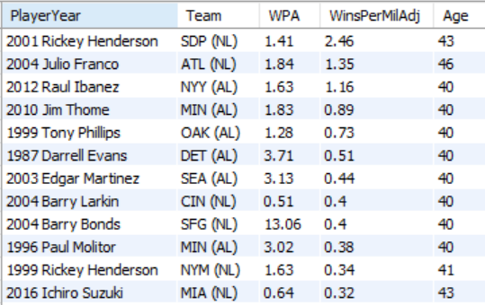
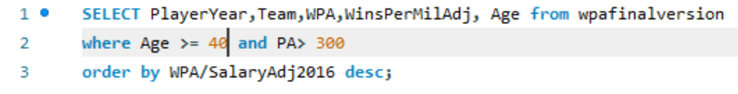
Fun Queries (cont.)
Who were the most effective players (measured by wins per $1m, salaries adjusted as a proportion of league payroll, normalized to 2016), age 40+ with a sample size of 300 plate appearances?

Slide 11
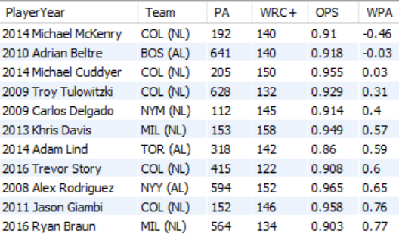
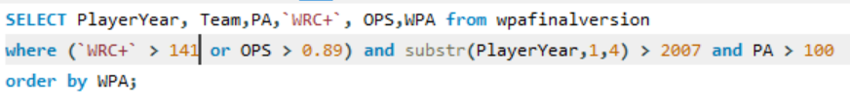
Fun queries (cont.)
Who had the worst WPA of players in the 90th percentile of more popular hitter stats (OPS of over 0.890, WRC+ of over 141) with at least 100 plate appearances since 2008?

Slide 12
So What?
Like every statistic in baseball, WPA is not without its flaws. It ignores defense and devalues a player’s performance in non-crucial situations. It may not be perfect, but it offers teams and fans a refreshingly simple way to assess a player’s value to a team in terms of how much they help put their team in position to achieve their goal of winning games. When paired with a player’s salary, it is perhaps the most digestible way for a team or a fan of a team to understand how rewarding their investment in a player was from a retrospective point of view.

