Slide 1
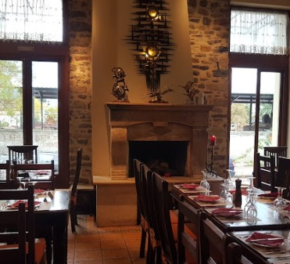

26th of May at 20:00
ΒΕΓΓΕΡΑ RESTAURANT
ΣΑΡΑΝΤΑΠΟΡΟΥ 39-41
ΒΟΛΟΣ
ΤΗΛ 2421023123

Slide 2
26th of May at 20:00
VEGGERA RESTAURANT
Sarantaporou 39.-41,
Volos

