Slide 1
Basic UNIX Workshop
Volos Summer School

Slide 2

What is UNIX ?
UNIX is an operating system family (analogous to DOS and Windows)
First developed in the 1960s
Operating system, (OS)= suite of programs which make the computer work. It is a stable, multi-user, multi-tasking system for servers, desktops and laptops.

Slide 3
Welcome to UNIX
chr=3;ps=80088046; join -j1 <(join -j1 <(cat <(zgrep -m 1 CHROM /nfs/t144_helic/sequencing-data/HA-4x1x-seq/VQSR-filtered/$chr.hardfiltered.vcf.gz) <(tabix /nfs/t144_helic/sequencing-data/HA-4x1x-seq/VQSR-filtered/$chr.hardfiltered.vcf.gz $chr:${ps}-$ps) | ~/transpose-2.0/src/transpose -l 2000x2000 -t -f 200| grep -v NA | awk 'OFS=\"\\t\"{if(NF<2){$(NF+1)=\"NA\"}print}'| sed -f /nfs/t144_helic/sequencing-data/sample_tables/HA.sed | sed -f /nfs/t144_helic/sequencing-data/sample_tables/HA.duplicates.sed |sort -k1,1) <(cat <(zgrep -m 1 CHROM /nfs/t144_helic/sequencing-data/HA-4x1x-seq/imputed-firstpass/$chr.vcf.gz) <(tabix /nfs/t144_helic/sequencing-data/HA-4x1x-seq/imputed-firstpass/$chr.vcf.gz $chr:${ps}-$ps) | ~/transpose-2.0/src/transpose -l 2000x2000 -t -f 200 | grep -v NA | awk 'OFS=\"\\t\"{if(NF<2){$(NF+1)=\"NA\"}print}'| sed -f /nfs/t144_helic/sequencing-data/sample_tables/HA.sed | sed -f /nfs/t144_helic/sequencing-data/sample_tables/HA.duplicates.sed |sort -k1,1)) <(cat <(zgrep -m 1 CHROM /nfs/t144_helic/sequencing-data/HA-4x1x-seq/imputed-secondpass/$chr.vcf.gz) <(tabix /nfs/t144_helic/sequencing-data/HA-4x1x-seq/imputed-secondpass/$chr.vcf.gz $chr:${ps}-$ps) | ~/transpose-2.0/src/transpose -l 2000x2000 -t -f 200 | grep -v NA | sort -k1,1) | sort -k1,1 -r | tr ' ' '\\t' | grep -e '1|' -e '|1' -e '1/' -e '/1' -e CHROM -e POS -e FILTER -e INFO -e FORMAT -e REF -e ALT -e QUAL|less

Slide 4
The UNIX operating system
UNIX itself is not used anymore
Linux (Fedora, Arch, Ubuntu, Red Star Linux) is its successor and Berkeley Software Distribution (BSD).
UNIX-based systems do not rely on a graphical interface
With UNIX, you don’t use the mouse!
Linux often comes with a window-manager and advanced graphical support, but advanced users still use a terminal emulator

Slide 5

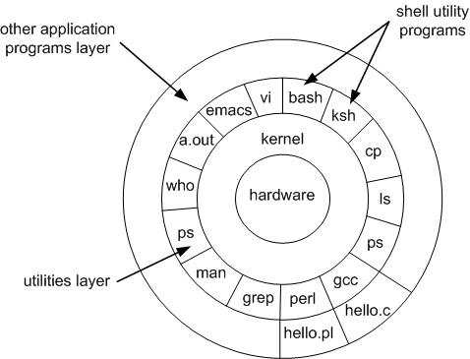
The UNIX operating system
The shell is what you see when you open a command line. It allows the user to interact with the kernel. The shell has only a few basic commands (mostly file management). Other applications can be built to interact with the kernel and can be called in the shell.
The kernel is the core of the OS, the part that interacts with the processor, memory, disk storage, keyboard, mouse, screen etc.… or in one word the hardaware.
Hardware physically executes the operations requested by the kernel.

Slide 6
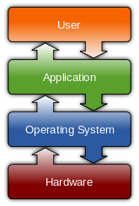
What happens when I type a command?

Slide 7
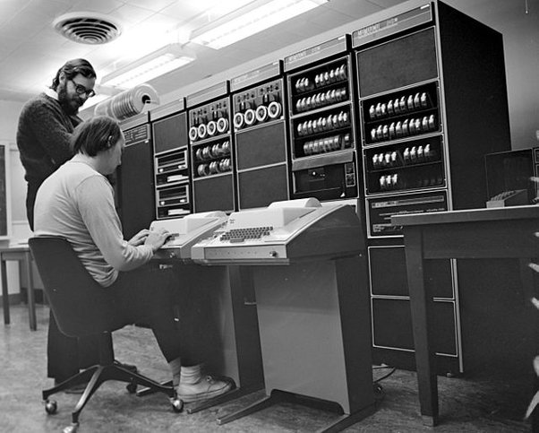
Text-only, you say?
It is now forgotten, but all historical computers ran on text-only interfaces (MS-DOS before Windows, OS/2 before Mac OS).
They are really useful for file and data manipulation.

Slide 8
Text-only, you say?
Every action must be typed on the screen and sent to the system with Enter
You are always in a directory; every command you send will affect the current directory unless stated otherwise
Remember where
you are!

Slide 9
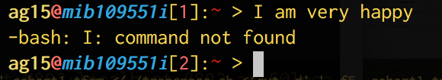
Text-only, you say?
When you send a command, the system will look it up
If it is a system command, it will execute it itself
If not, it will look if it’s a third-party program installed on the computer
If not, it will yell at you.

Slide 10
The command line
user1@host:~$ find –iname “*.txt”
What the computer writes
« the command prompt »
The arguments
« these are my criteria »
The command
« find a file that match certain criteria »

Slide 11
The command prompt
user1@host:~$
Username @ name of the computer : current directory $

Slide 12
The command line
You have to remember all the useful commands (or look them up on the internet)
When you are not sure of the exact name of a command:
- apropos keyword (will give you the commands with keyword in their manual page header)
- apropos copy
You have to remember all the arguments for every command
If you remember the name you can get help about the arguments
Most commands have a “help me” argument
There is a command that tells you how to run other commands:
user1@host:~$ find –-help
user1@host:~$ nano –h
user1@host:~$ man find

Slide 13




Command input
Filename Completion
History +

Slide 14
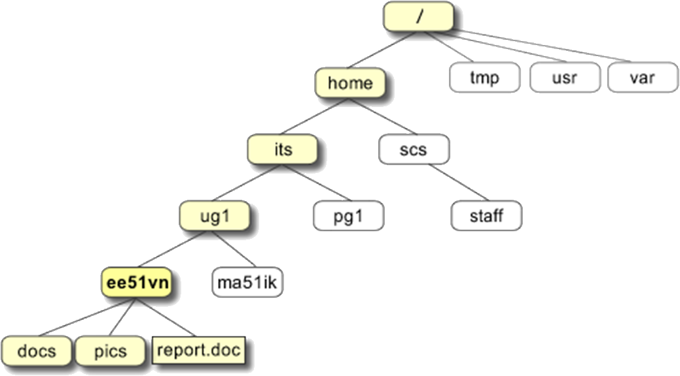
Directory Structure
If you are user “its”, you will land here when opening your session
This directory is your “home” directory, designated by the character “~”

Slide 15
Directory Structure
The full path to the file report.doc is
"/home/its/ug1/ee51vn/report.doc”
The local path is:
“~/ug1/ee51vn/report.doc”
The relative path is:
“ug1/ee51vn/report.doc“
All three directory types are recognised by UNIX systems

Slide 16
Directory Structure
Change the local directory
its@host:~$ cd ug1

Slide 17
Directory Structure
Change the local directory
its@host:~/ug1$

Slide 18
Directory Structure
Change the local directory
its@host:~/ug1$ cd ee51vn/docs

Slide 19
Directory Structure
Change the local directory
its@host:~/ug1/ee51vn/docs$

Slide 20
Directory Structure
Change the local directory
its@host:~/ug1/ee51vn/docs$ cd ~/ug1/ee5v1

Slide 21
Directory Structure
Change the local directory
its@host:~/ug1/ee51vn$

Slide 22
Directory Structure
Change the local directory
its@host:~/ug1/ee51vn$ cd ..

Slide 23
Directory Structure
Change the local directory
its@host:~/ug1$

Slide 24
Directory Structure
Change the local directory
its@host:~/ug1/ee51vn$ cd ../../

Slide 25
Directory Structure
Change the local directory
its@host:~$

Slide 26
Commands
Pathnames
pwd (print working directory)
Pathnames enable you to work out where you are in relation to the whole file-system
Listing files and directories
ls (lists the contents of your current working directory)
ls –a (lists files that are normally hidden)
ls –lrt (lists files in detailed format, sorted by modification time from oldest to newest)
Making Directories
mkdir filename
Changing to a different directory
cd filename
cd .. (The parent directory)

Slide 27
Hands-On!!!
Use the command mkdir to create the file system of the image above inside your home directory.
Use the commands cd, ls and pwd to explore the file system.
Make another directory inside your home directory called backups.

Slide 28
Commands
Command | Meaning
ls | list files and directories
ls -a | list all files and directories
mkdir directory | make a directory named “directory”
cd directory | change to named directory
cd | change to home-directory
cd ~ | change to home-directory
cd .. | change to parent directory
cd . | does nothing: changes to current directory
pwd | display the path of the current directory

Slide 29
Commands
Copying Files
cp file1 file2 (is the command which makes a copy of file1 in the current working directory and calls it file2)
cp /nfs/…/…/…..txt . (take a file stored in an open access area of the file system, and use the cp command to copy it to your directory)
Moving files
mv file1 file2 (moves (or renames) file1 to file2)
mv file1 dir1 (moves file1 to dir1 and you end up with only one file rather than two!)

Slide 30
Commands
Removing files and directories
rm file1 (deletes file1)
rmdir dir1(deletes dir1)
Displaying the contents of a file on the screen
clear (clear screen)
cat file1 (concatenate, display the contents of a file on the screen)
less file1 (writes the contents of a file onto the screen a page at a time)
head file1 (writes the first ten lines of a file to the screen)
tail file1 (writes the last ten lines of a file to the screen)

Slide 31
Commands
Searching the contents of a file
less file
/pie to search for “pie”
grep ‘keyword’ file
wc (word count)
“wc –l” counts the number of lines

Slide 32
Commands
Creating a file
pico "or" nano <filename> (ctrl x (to exit), answer Y if you want to save the changes and enter)
cat>filename (ctrl d to save and exit)

Slide 33
Hands-On!!!
Create a .txt file.
Create a backup of your .txt file by copying it to a file called science.bak.
Delete science.bak.
Rename your .txt file to VSS.txt.
Create a directory called tempstuff, then remove it.
Place a copy of /home/volos/sigritiko.txt to your directory.
Display the contents of sigritiko.txt on the screen and find ‘1:6531589’.

Slide 34
Commands
Command | Meaning
cp file1 file2 | copy file1 and call it file2
mv file1 file2 | move or rename file1 to file2
rm file | remove a file
rmdir directory | remove a directory
cat file | display a file
less file | display a file a page at a time
head file | display the first few lines of a file
tail file | display the last few lines of a file
grep 'keyword' file | search a file for keywords
wc file | count number of lines/words/characters in file

Slide 35
Commands
The * wildcard
ls list* (This will list all files in the current directory starting with list....)
ls *list (….list)
The ? wildcard
ls ?ouse
The character ? will match exactly one character. So ?ouse will match files like house and mouse, but not grouse.

Slide 36
Commands
Command | Meaning
* | match any number of characters
? | match one character
man command | read the online manual page for a command
whatis command | brief description of a command
apropos keyword | match commands with keyword in their man pages

Slide 37
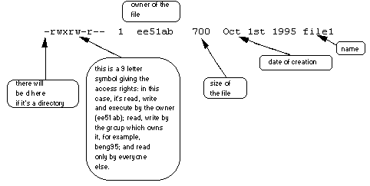
Commands
ls –l
The 9 remaining symbols indicate the permissions, or access rights, and are taken as three groups of 3.

Slide 38
Compressing files
gzip filename.txt
This will compress the file and place it in a file called filename.txt.gz
To expand the file, use the gunzip command.
gunzip filename.txt.gz

Slide 39
Hands-On!!!
Make five copies of VSS.txt
How many files in your pwd include "VSS" in their filename?
Compress and expand one of your files in the directory.

