Slide 1




Human Genetics of Complex Traits Workshop
Current tools and best practices for performing genome-wide scans
Konstantinos Hatzikotoulas
Notes:
Hello everyone. I am Konstantinos Hatzikotoulas, and I am a Senior Staff Scientist in Institute of Translational Genomics at Helmholtz Zentrum München and I am also affiliated with Technical University of Munich. Today I am going to present you current tools and best practices for carrying out a genome-wide scan.

Slide 2
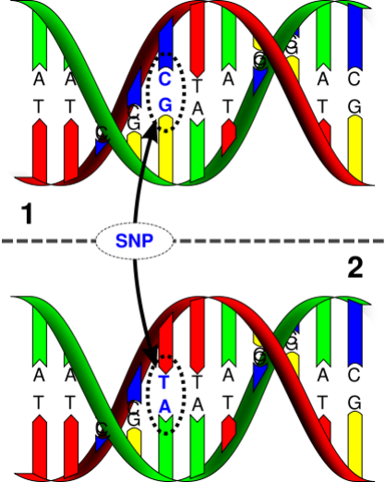

Before we start …
A Single Nucleotide Polymorphism (SNP) is a single base pair at which more than one nucleotide is observed.
The Minor Allele Frequency (MAF) is the relative frequency in a relevant population of the minor (2nd most common) allele.
For biallelic SNPs, if the MAF of T allele is q then the frequency of the C allele is p=1-q.
Notes:
In human beings, 99.9% of all bases in the genome—from individual to individual—are the same. The remaining 0.1% make a person unique. One type of this variation is the SNP. A SNP is a germline substitution of a single nucleotide at a specific position in the genome. The word polymorphism consists of two Greek words. Poly which means many and morphism which means faces, so already we have an indication that something is different in the population. Indeed, most of the people will have the upper DNA molecule in our figure but some might have the lower one. We see that there is a difference at a single base-pair location (a C/T polymorphism). They occur almost once in every ~600 nucleotides on average, which means there are roughly 4 to 5 million SNPs in a person's genome. Most of them are harmless but some of them are responsible for diseases, either directly affecting the change of the protein in a coding region or indirectly in the non coding region by regulating the coding elements. When we observe 2 different distinct nucleotides is Biallelic/, three Triallelic and four Quatra-allelic. If we have INDELS and Copy number variation then we call them multi allelic or polyallelic SNPs. A typical measure of this variation in a population is the frequency and specifically we usually use the term MAF which is the 2nd most common allele. The alleles frequency necessarily sum to unity, so 100%. In our example. for biallelic SNPs, if the MAF of T allele is q then the frequency of the C allele is p=1-q. People often talk of common and rare SNPs, although the distinction is not well deﬁned, and likely depends on sample size: the most common division is common as MAF >0.05, low frequency between 5% and 1%, and rare lower than 1%. One more thing that we need to know about the alleles and their terminology, is that one is called ‘the reference allele’ which sometimes is also referred to as the “wildtype” or major or ancestral allele, while the other ‘the non-reference’ is referred to as the alternative or “mutant” allele. Usually, the reference allele is the most common one, but this is not universally true, as you saw in Clara’s presentation, and the most common allele in one population may not be most common in another. Care must be taken when combining datasets to ensure that the reference alleles are the same. https://www.lubio.ch/blog/genotyping-terms

Slide 3
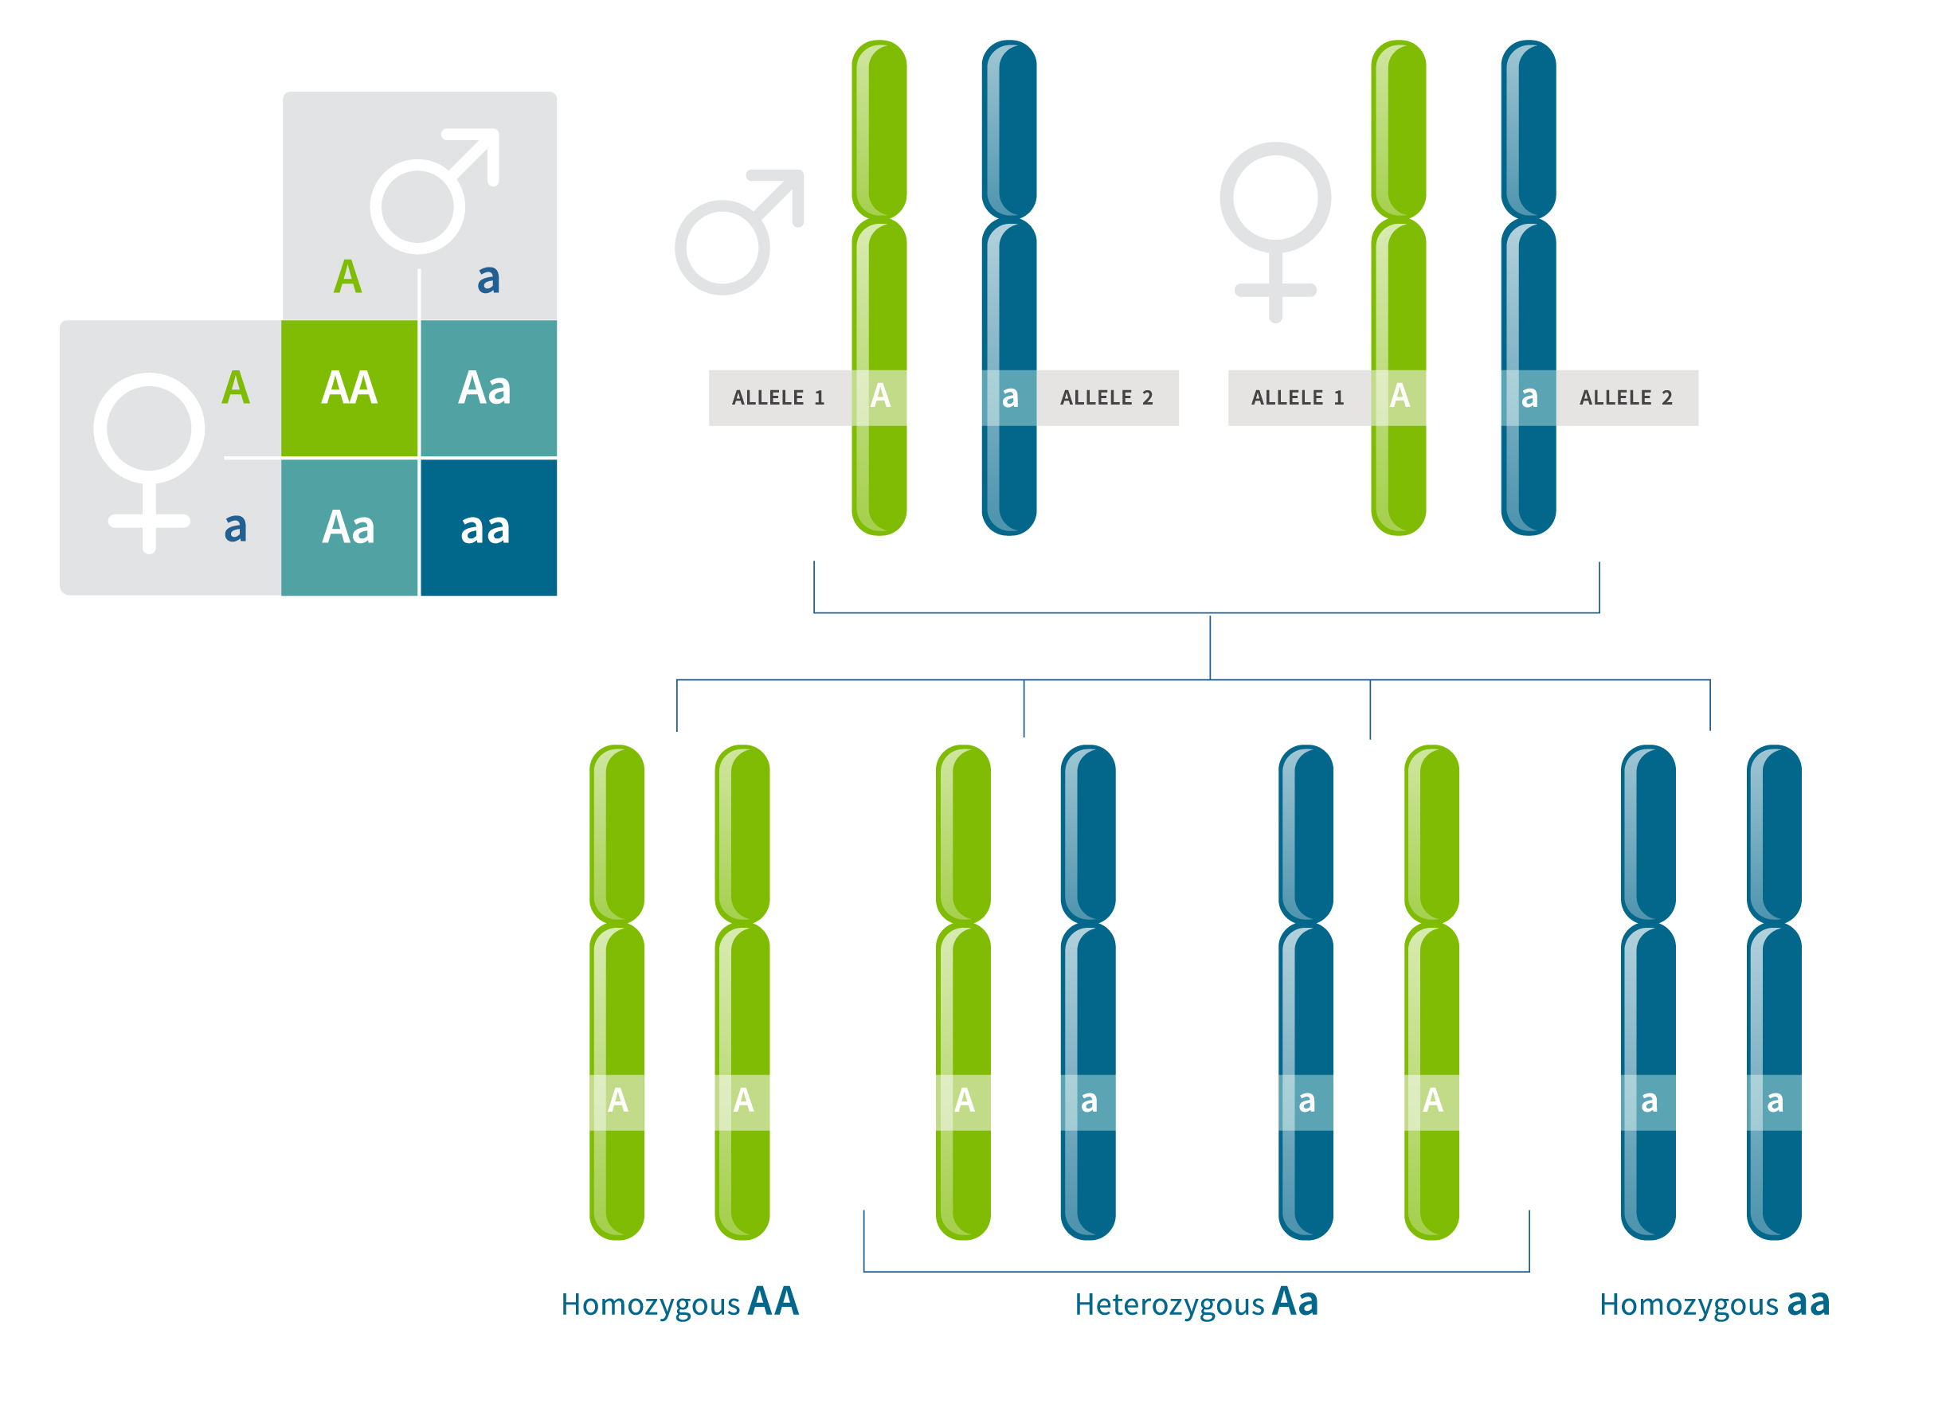
Before we start …
At a given position in the DNA (or genetic locus), the pair of alleles from the two chromosomes makes up the genotype at that position.
SNP genotypes are usually encoded as 0, 1 or 2, based on the number of copies of non-reference alleles.
genotype TT is coded as 0 (homozygous non-reference)
genotype CT is coded as 1 (heterozygous)
genotype CC is coded as 2 (homozygous reference)
https://www.ancestry.com/lp/genotype
Notes:
The other term that I want to talk about is genotypes. As you know humans are diploid organisms, which means you have two copies of each chromosome—one from each parent. So in our figure here you might have taken the green chromosomes, the blue or one of each, and thus at a given position in the DNA, the pair of alleles from the two chromosomes makes up the genotype at that position. Genotypes can be described as heterozygous or homozygous. Heterozygous genotypes contain one copy of one allele and one copy of the other. Homozygous genotypes have two copies of the same allele. So in our figure either AA or aa. In terms of analysis ….

Slide 4
Before we start …
SNP genotypes are usually encoded as 0, 1 or 2, based on the number of copies of non-reference alleles.
genotype TT is coded as 0 (homozygous non-reference)
genotype CT is coded as 1 (heterozygous)
genotype CC is coded as 2 (homozygous reference)
Genotypes frequency:
For 1. = q²
For 2.= 2pq
For 3.= p²
https://www.ancestry.com/lp/genotype
Notes:
And again to analyse and quantify the genotyping variation we calculate the frequencies, which simply is the number of individuals with a given genotype divided by the total number of individuals in the population. Also, the frequency of alleles in a diploid population can be used to predict the frequencies of the corresponding genotypes under the Hardy–Weinberg equilibrium law, so in our example where p is the frequency of the reference allele and q is the frequency of the alternative allele, then, p square is the fraction of the population homozygous for the reference allele, 2pq is the fraction of heterozygotes, and q2 is the fraction homozygous for the non-reference allele.

Slide 5
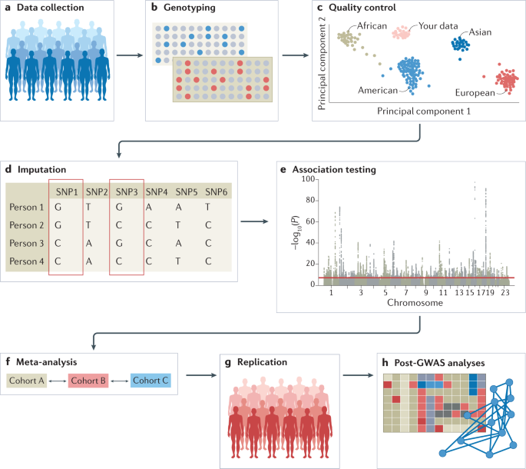
The GWAS analysis pipeline
(Affymetrix)
Uffelmann, E., Huang, Q.Q., Munung, N.S. et al. Genome-wide association studies. Nat Rev Methods Primers 1, 59 (2021). https://doi.org/10.1038/s43586-021-00056-9
Notes:
These are the basic steps of a GWAS analysis pipeline. Once you have completed the genotyping the first format of the data that you receive is lighting intensities and is what the genotyping machines actually measuring and more specifically two sets of intensity for every individual at every position. The format of the data can vary depending on the vendor specific file format such as CEL (Affymetrix) or IDAT (Illumina). Once you’ve got these intensities you want transform them into something usable which is the genotypes. This is a process known as calling and I give you an example of gencall and zcall calling algorithms. After this step you have a usable piece of data which contains your genotypes. There are many formats that you receive the files but the most popular one is PLINK which is mailnly used by Illuminas. However, you cannot run your association analysis yet as these data contain some errors leading to spurious associations. A thorough QC can help us identify samples and variants that should be removed prior to association analysis to minimize false-positive and false-negative associations. There are many software/languages that you use to identify outliers and low quality variants but the most commonly used ones are PLINK and R for visualizing the results. PLINK is a general toolbox that allows manipulation, association and other statistical analyses. Since it’s going to the one that we are going to use in our QC practical, a big part of this presentation explains how PLINK can be used but you will also have the opportunity to try this in the next practical. After that you proceed to the association analysis and examples of software are … and I am having a slide about these towards the end of this presentation.

Slide 6
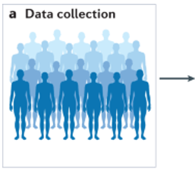





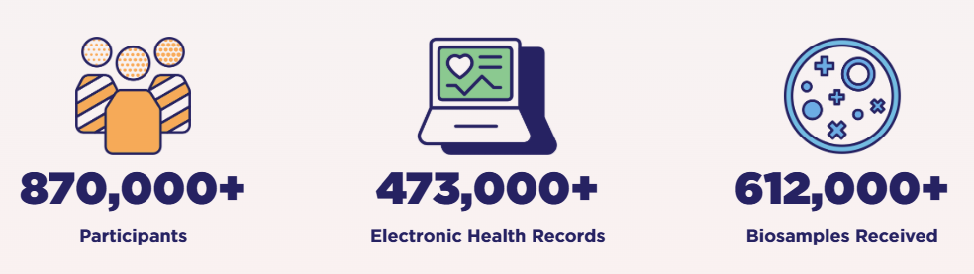
The GWAS analysis pipeline
Consortia & Biobanks
https://diagram-consortium.org/t2dggiabout.html
(Affymetrix)
https://www.genetics-osteoarthritis.com/

Slide 7
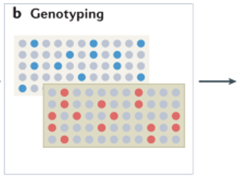
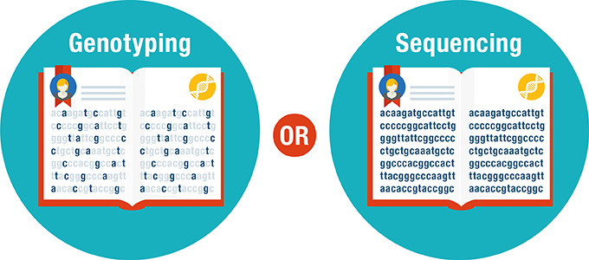
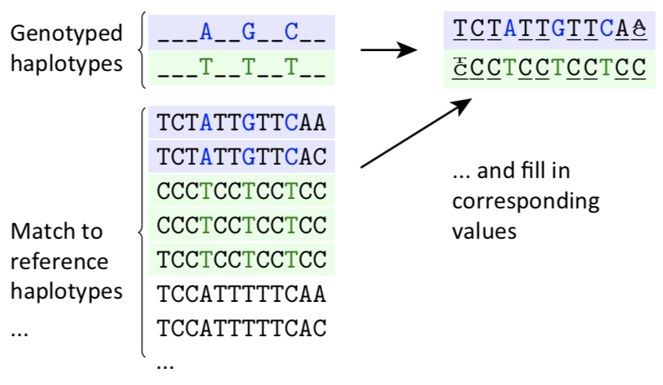
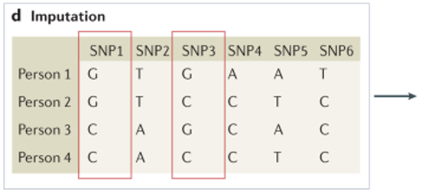
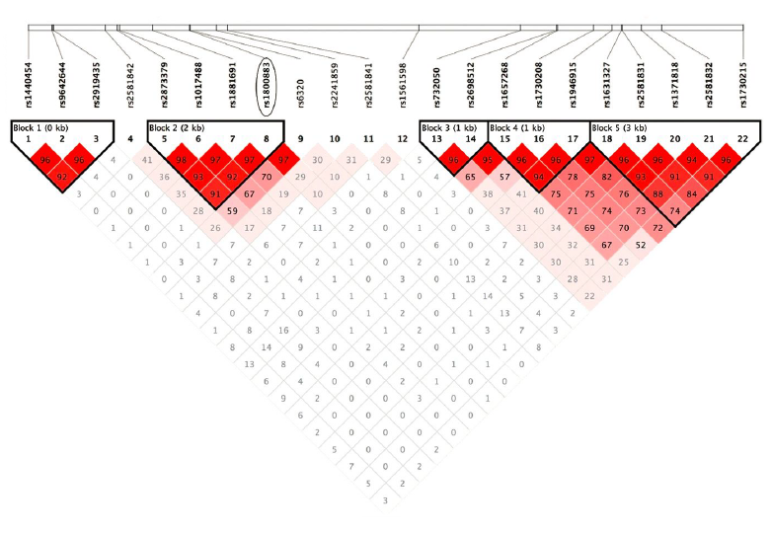
The GWAS analysis pipeline
(Affymetrix)

Slide 8
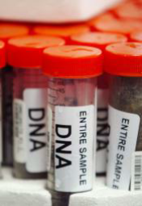

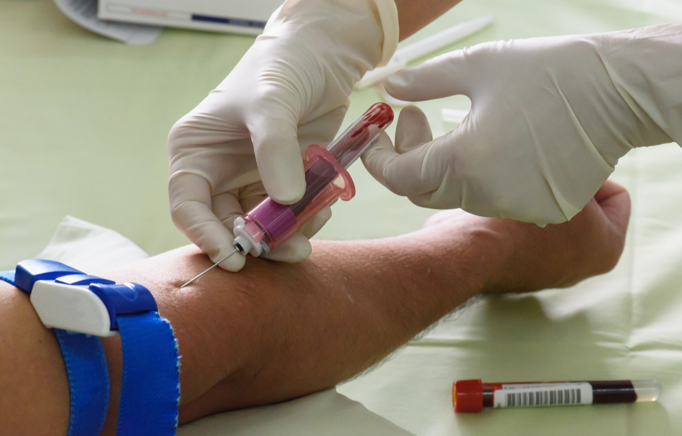
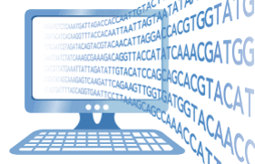
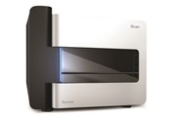
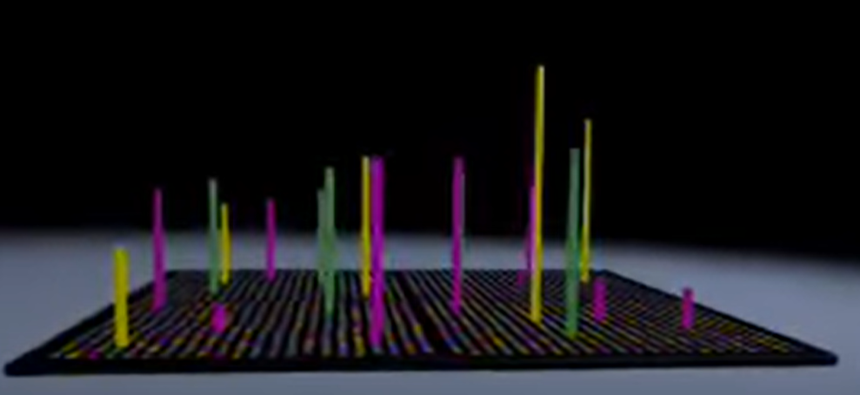
Did you say intensities?
Notes:
These are the basic steps of a GWAS analysis pipeline. Once you have completed the genotyping the first format of the data that you receive is lighting intensities and is what the genotyping machines actually measuring and more specifically two sets of intensity for every individual at every position. The format of the data can vary depending on the vendor specific file format such as CEL (Affymetrix) or IDAT (Illumina). Once you’ve got these intensities you want transform them into something usable which is the genotypes. This is a process known as calling and I give you an example of gencall and zcall calling algorithms. After this step you have a usable piece of data which contains your genotypes. There are many formats that you receive the files but the most popular one is PLINK which is mailnly used by Illuminas. However, you cannot run your association analysis yet as these data contain some errors leading to spurious associations. A thorough QC can help us identify samples and variants that should be removed prior to association analysis to minimize false-positive and false-negative associations. There are many software/languages that you use to identify outliers and low quality variants but the most commonly used ones are PLINK and R for visualizing the results. PLINK is a general toolbox that allows manipulation, association and other statistical analyses. Since it’s going to the one that we are going to use in our QC practical, a big part of this presentation explains how PLINK can be used but you will also have the opportunity to try this in the next practical. After that you proceed to the association analysis and examples of software are … and I am having a slide about these towards the end of this presentation.

Slide 9
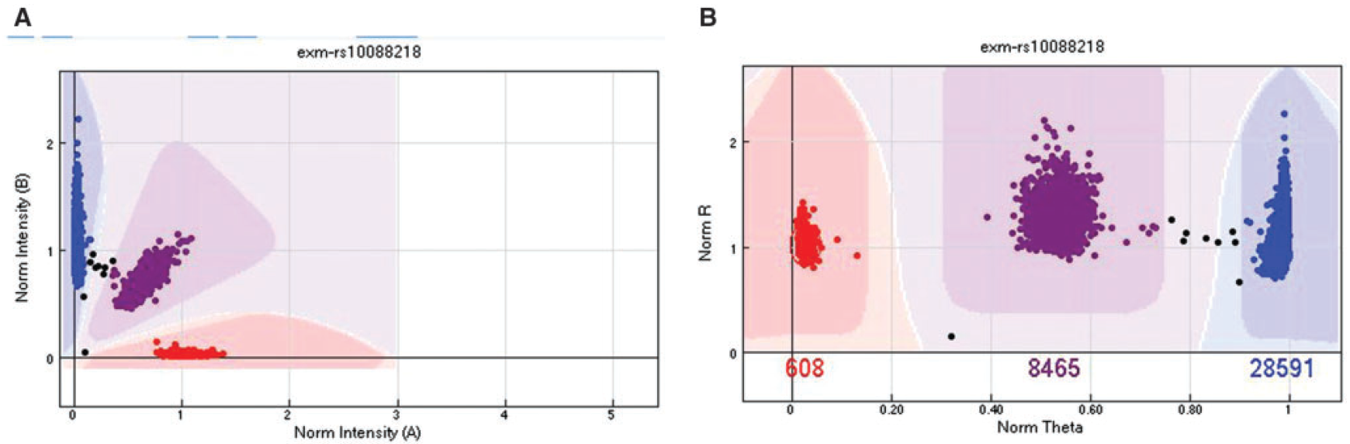
Intensities: the good …
Cartesian coordinates
Polar coordinates
Zhao et al., 2018
Notes:
GenomeStudio software is using GenCall algorithms for clustering, calling, and scoring genotypes
zCall: a rare variant caller for array-based genotyping
The cluster plot presented in Cartesian coordinates. The x-axis is the normalized intensity for allele A. The y-axis is the normalized intensity for allele B.
The same cluster plot presented in polar coordinates. The x-axis is the normalized h, which is computed as h ¼p2 arctanA1B. The y-axis is the normalized R, which is computed as R ¼A þB.
In both plots, the red cluster (Left in A and Right in B) denotes the AA genotype, the purple cluster (middle) denotes the AB genotype and the blue cluster (Left in A and Right in B) denotes the BB cluster. The samples in between clusters (black) were not assigned a genotype.

Slide 10
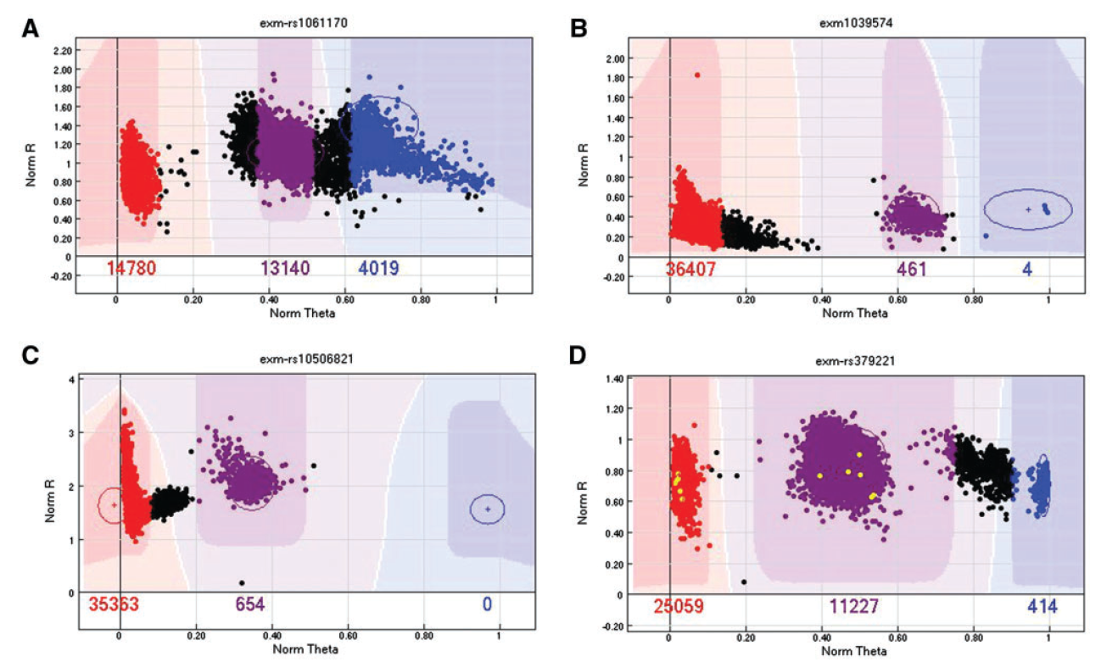
Intensities: the bad …
Zhao et al., 2018
Notes:
An example of a SNP with presumed AB and BB clusters closely connected. In this scenario, either remove the SNP (preferred) or remove the samples between the clusters.
An example of a SNP with a long tail in the AA cluster. We recommend removing the samples of the tail to be conservative.
An example of a SNP with a strange extension or tail in the AA cluster. The exact cause of this pattern is unknown. We recommend either removing the SNP or removing the samples in the extension.
An example of a SNP with four visible clusters that does not make biological sense. We recommend removing this SNP.

Slide 11
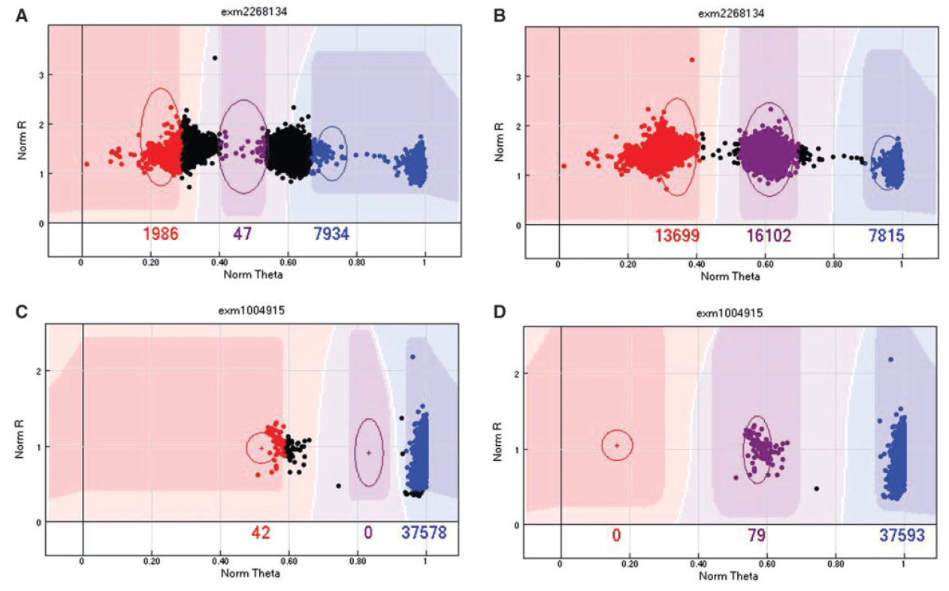
Intensities: the ugly …
Zhao et al., 2018
Notes:
An example of a SNP with low GenTrain score (0.42). (B) By manually realigning the cluster positions, the cluster becomes much clearer and the GenTrain score improves to 0.8. (C) An example of miss-cluster by the GenTrain algorithm, with a cluster separation score of 0.65. (D) The same SNP was re-clustered by manually realigning the cluster positions, and the cluster separation score increased to 1.
The most important QC parameter is the GenTrain score. The GenTrain score is computed from the GenTrain 2.0 clustering algorithm. It is a measurement of SNP calling quality, ranging from 0 to 1, with higher value meaning better quality. An example of a GenTrain score is given in Figure 4. The second most important QC parameter is the cluster separation score, which measures how well the AA, AB and BB clusters are separated. The cluster separation score also ranges from 0 to 1, with higher meaning better (more separation). An example of a cluster separation score is given in Figure 4. The third most important QC parameter is call frequency, which measures the percentage of samples with successful calls for that SNP. The call frequency also ranges from 0 to 1, with higher meaning more samples have successful calls for this SNP. These three scores are often positively correlated, but they also identify unique scenarios to which only one of the three measures may be sensitive. Therefore, to determine whether manual re-clustering is needed, it is best to sort the SNPs by each of the three QC parameters, from small to large, and go through the SNPs with the lowest scores on any of the three measures.

Slide 12
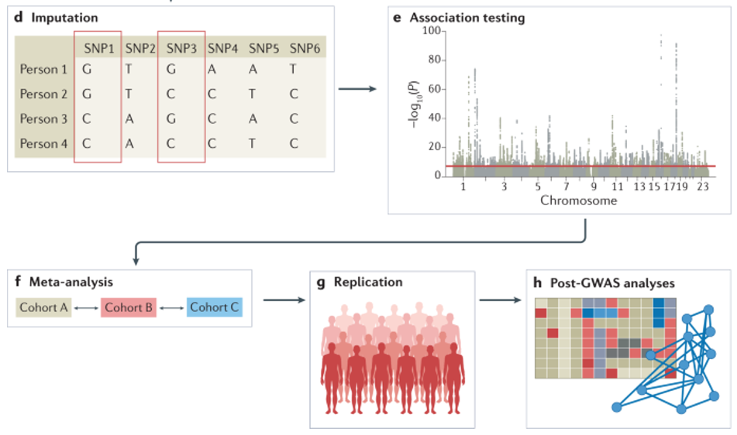
The GWAS analysis pipeline
(Affymetrix)

Slide 13
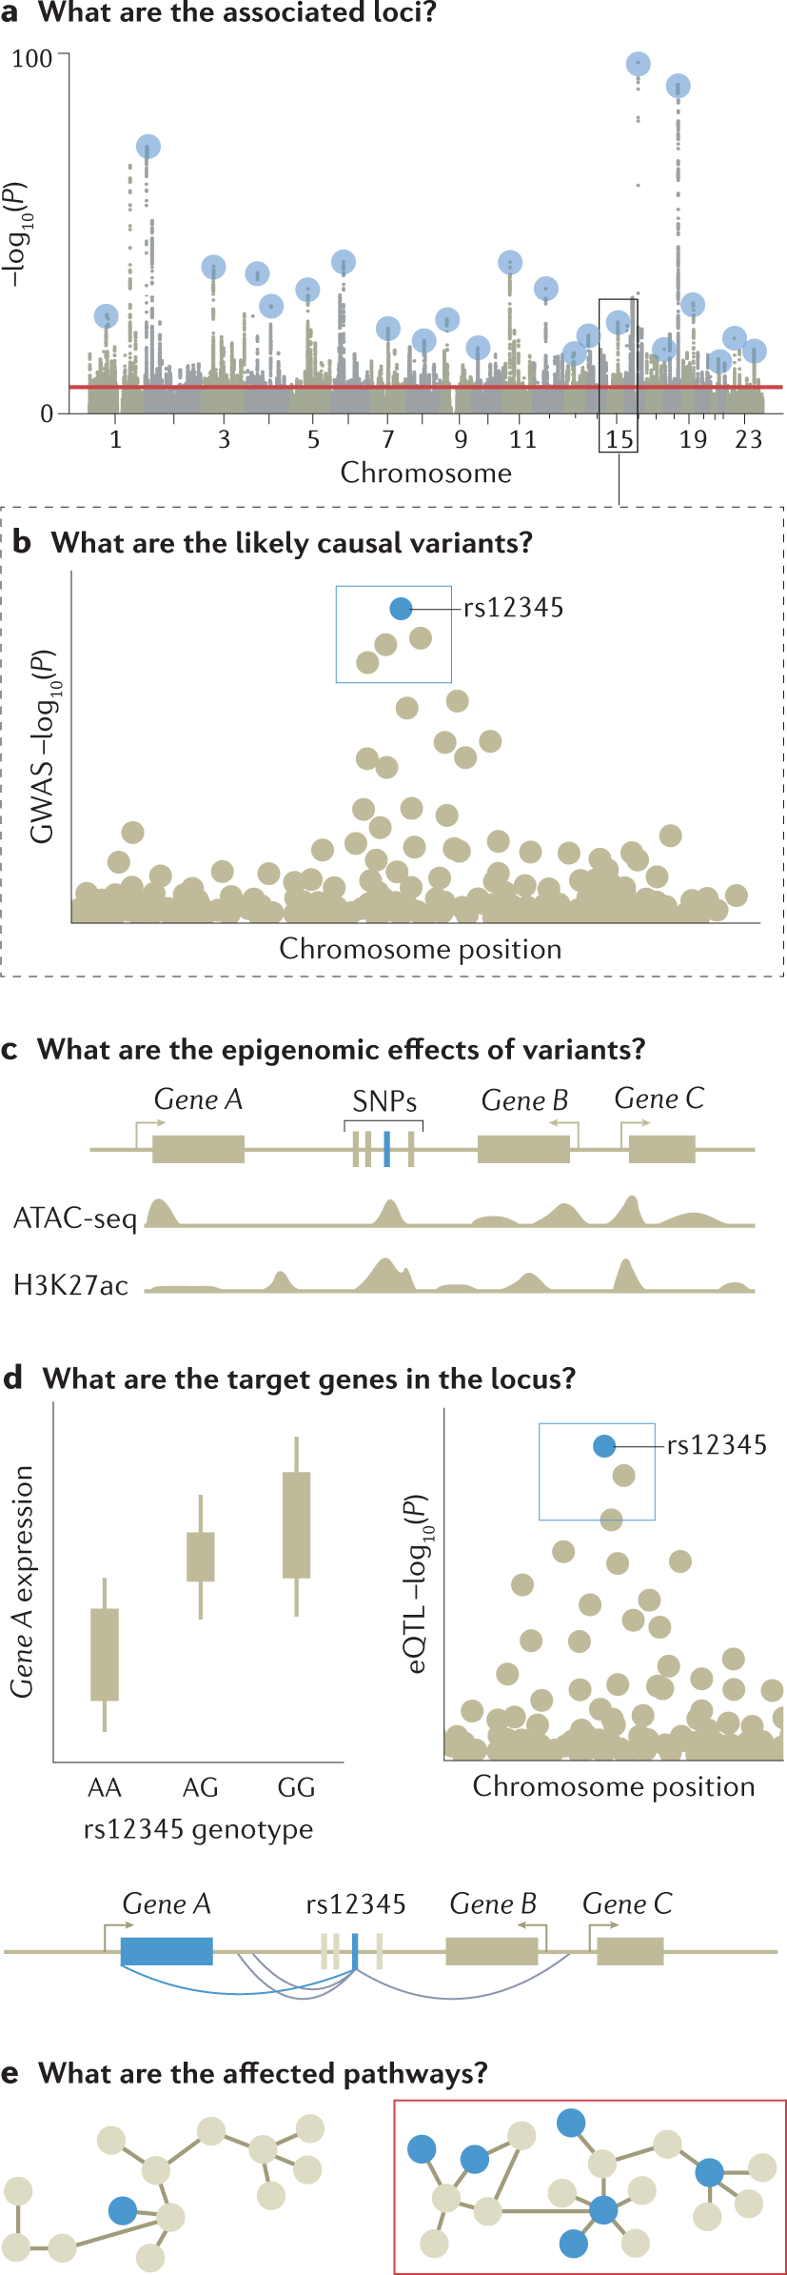
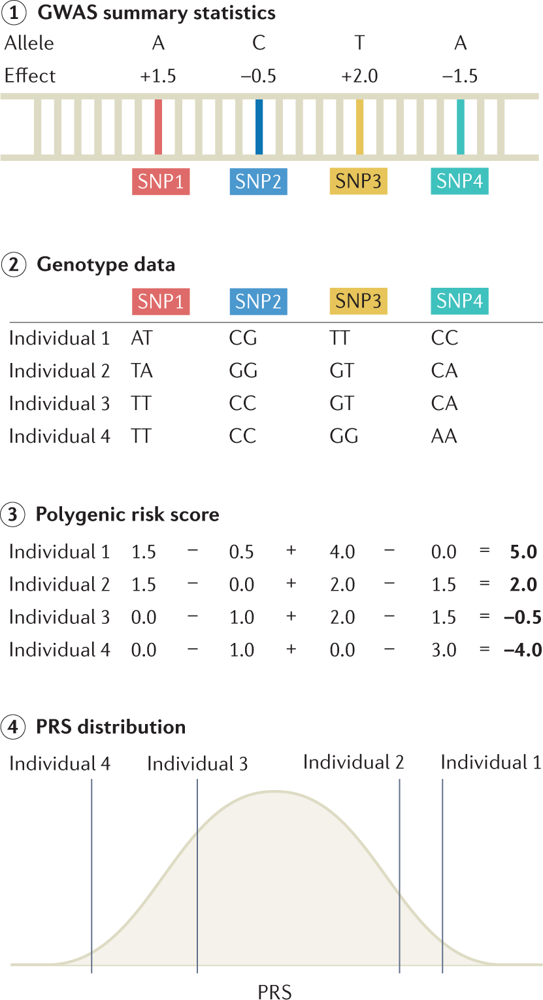
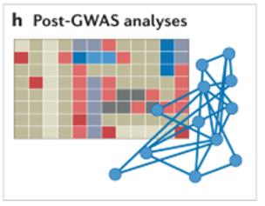
The GWAS analysis pipeline
(Affymetrix)
Uffelmann, E., Huang, Q.Q., Munung, N.S. et al. Genome-wide association studies. Nat Rev Methods Primers 1, 59 (2021). https://doi.org/10.1038/s43586-021-00056-9
Notes:
a | Genome-wide association studies (GWAS) are conducted to identify associated variants, often visualized as a Manhattan plot to show their genomic positions and strength of association. b | To prioritize likely causal variants, statistical fine-mapping is applied to identify a set of variants that are likely to include the causal variant (blue box) as well as the most likely causal variant (rs12345; blue dot). Massively parallel reporter assays can be used to measure whether alleles differ in their ability to drive gene expression or other molecular activity for each variant (not shown). c | Functional annotations of the genome can be integrated with GWAS data to identify epigenetic mechanisms that may be perturbed by the causal variant, including enhancers, promoters or other functional elements. Additional approaches include mapping molecular quantitative trait loci (molQTL) or in vitro assays (not shown). d | Target gene for a GWAS locus can be prioritized by mapping expression quantitative trait loci (eQTLs) (left) and their co-localization (right) to identify loci where the causal variant from GWAS is also a causal variant affecting gene expression. For GWAS variants in enhancers, high-throughput chromosome conformation capture (Hi-C) data and maps of enhancer target genes can be used together with simple prioritization by distance to identify genes affected by the causal variant (below). e | To identify pathways whose perturbation may mediate the trait in question (red box), one can analyse the enrichment of multiple GWAS-implicated genes in predefined pathways. Additional approaches include trans-eQTL mapping and CRISPR perturbation of GWAS loci/genes followed by cellular phenotyping (not shown). For these analyses, the context of a relevant tissue, cell type and cell state needs to be carefully considered and analysed. ATAC-seq, assay for transposase-accessible chromatin using sequencing; H3K27Ac, histone H3 acetylated at K27; SNP, single-nucleotide polymorphism.

Slide 14
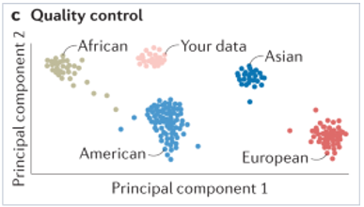
The GWAS analysis pipeline
(Affymetrix)

Slide 15
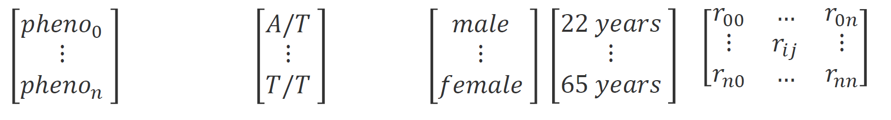
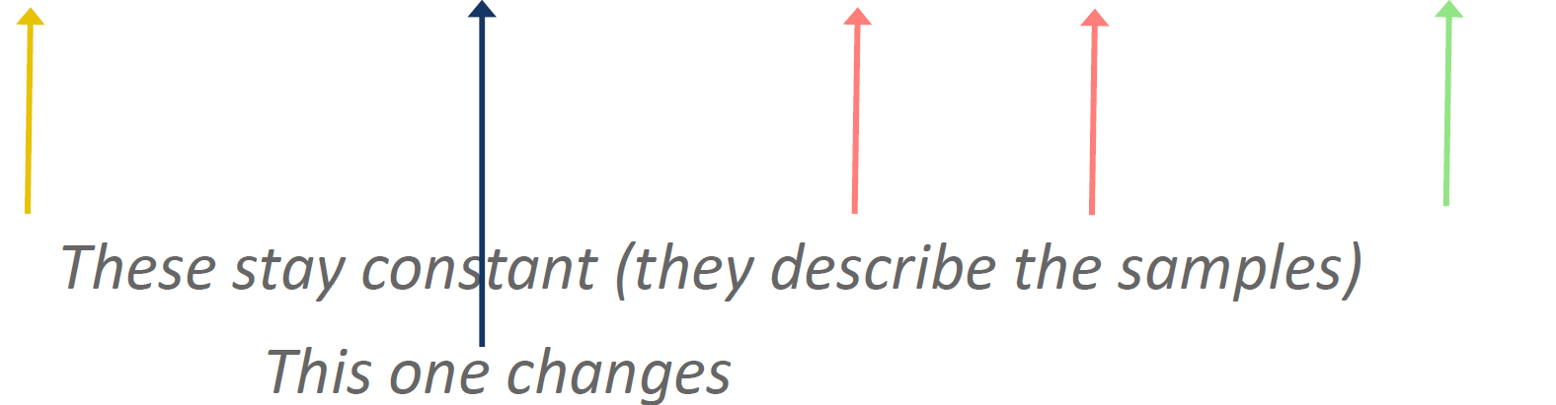
Genotyping data storage
Which data types do we need?
phenotype ~
𝜷×
genotype +
covariates +
structure +
ε

Slide 16
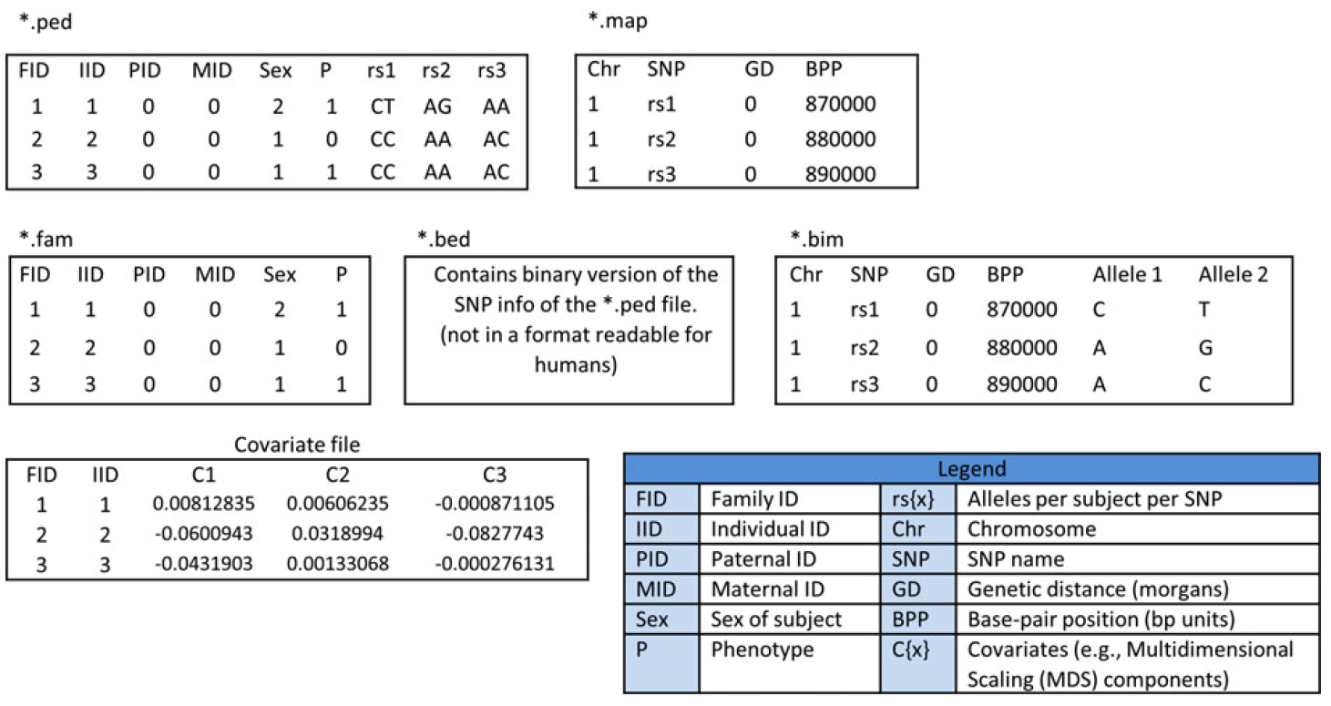
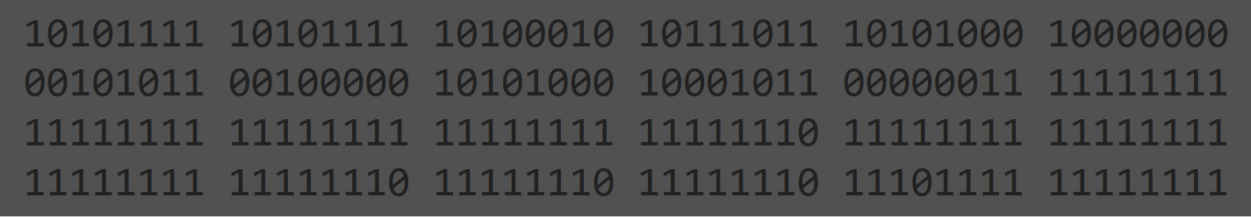
Genotyping data storage: PLINK
Can either be text‐format files or binary files.
Marees et al., 2017

Slide 17
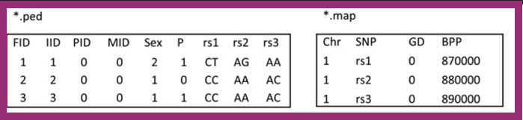
Genotyping data storage: PLINK
ped(igree) file has 6+2n, providing:
Family ID
Individual ID
Paternal ID (0 if father not in dataset)
Maternal ID (0 if mother not in dataset)
Sex (1=Male, 2=Female, 0 or -9=missing)
Phenotype (here 2 or 1, corresponding to case and control)
2 alleles for each SNP (0 = missing)
map(ing) file has 4 columns, providing:
Chromosome
SNP Name
Genetic distance (in morgans)
Base-pair position (bp unit)

Slide 18
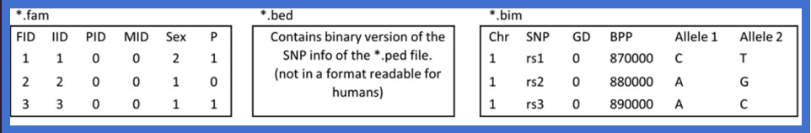
Genotyping data storage: PLINK
fam(ily) ﬁle consists of the ﬁrst six columns of ped ﬁle
The bed (binary pedigree) ﬁle is a matrix of 0s, 1s, 2s or NAs stored in binary format.
PLINK uses the following two-bit coding of genotypes:
00 = A1/A1 (Homozygous non-reference)
01 = A1/A2 (Heterozygous)
11 = A2/A2 (Homozygous reference)
10 = 0/0 (Missing)
bim (binary mapping) file is the .map file plus two columns, providing the A1 and A2 alleles

Slide 19
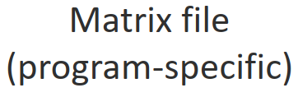
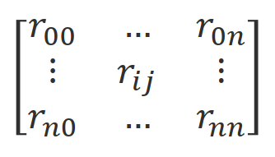
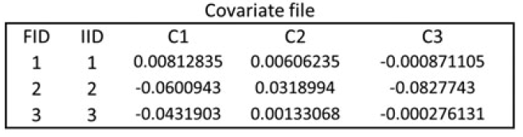
Genotyping data storage: PLINK
What is left?
Phenotype ﬁles have 2 + M columns: Family ID, Individual ID,
then value for each of M phenotypes
Marees et al., 2017

Slide 20
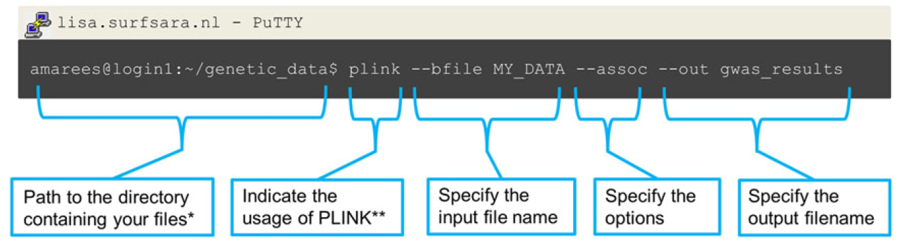
Genotyping data : PLINK common operations
https://www.cog-genomics.org/plink/1.9/index
https://www.cog-genomics.org/plink/2.0/index

Slide 21
Why Quality Control?

Slide 22
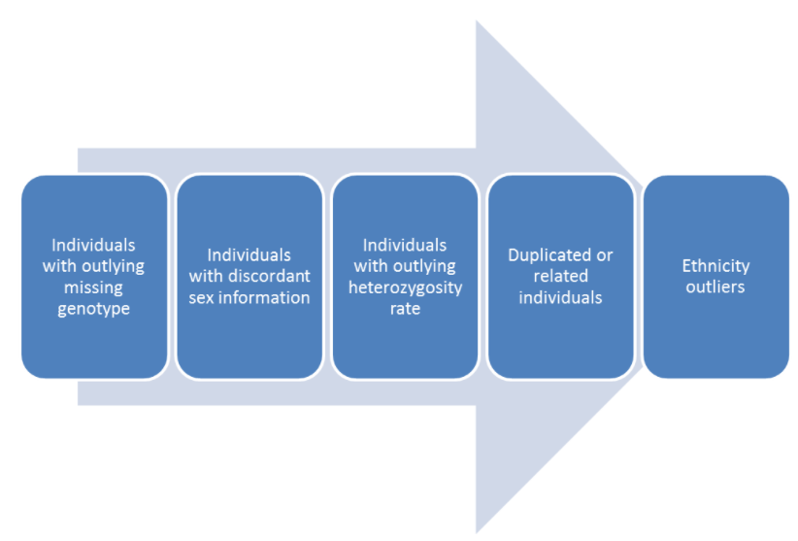
Why Quality Control?
The QC protocol of a GWAS is usually split into two broad categories.
“Sample QC”
“Variant QC”
Identification of variants with an excessive missing genotype
Identification of variants demonstrating a significant deviation from Hardy-Weinberg equilibrium (HWE)
Removal of all makers with a very low minor allele frequency
Removal of all makers with cluster separation score <0.4
Differential missingness (case/control studies)

Slide 23
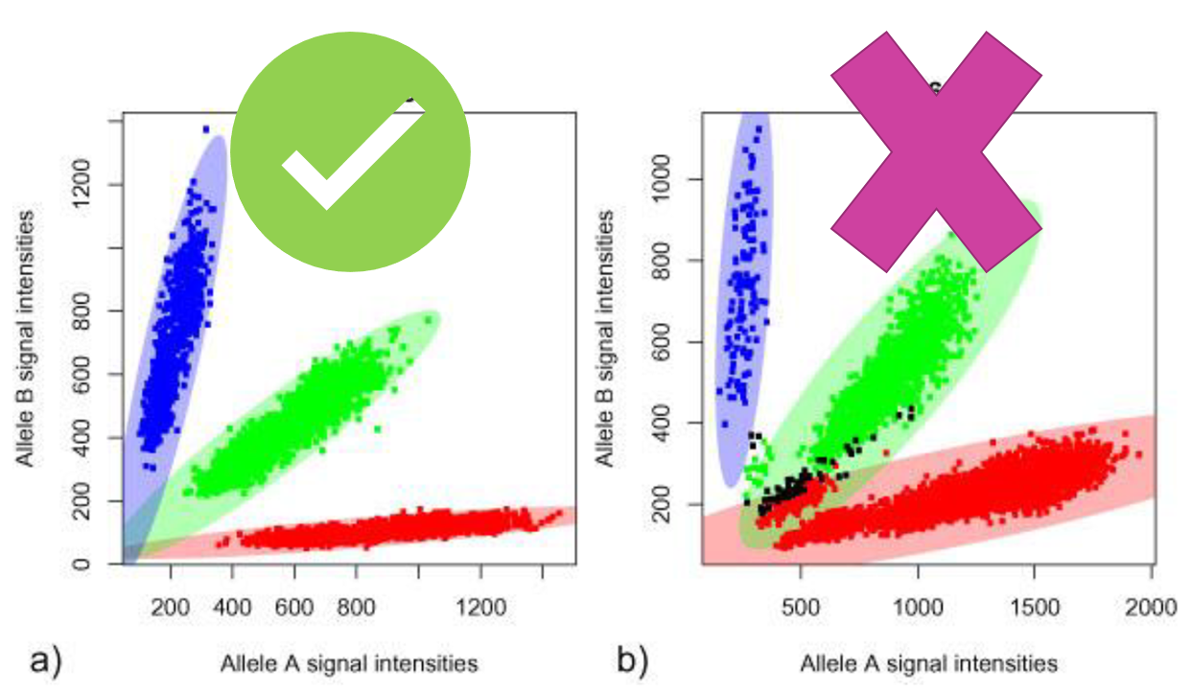
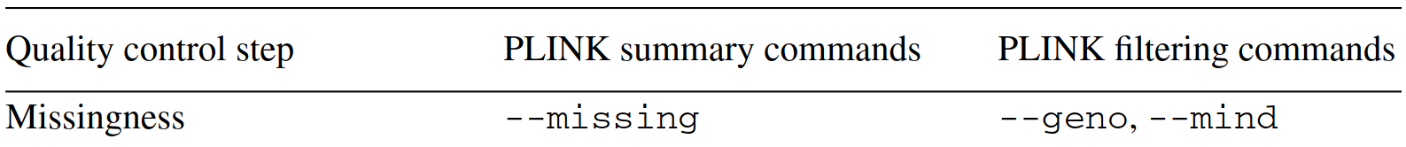
(A generalized) Quality Control process
Missingness
Per sample missingness
% missing for a sample across your variants
Per SNP missingness
% missing for a particular variant among your samples
Low genotyping call rate indicates issues with sample DNA (eg low concentration).

Slide 24
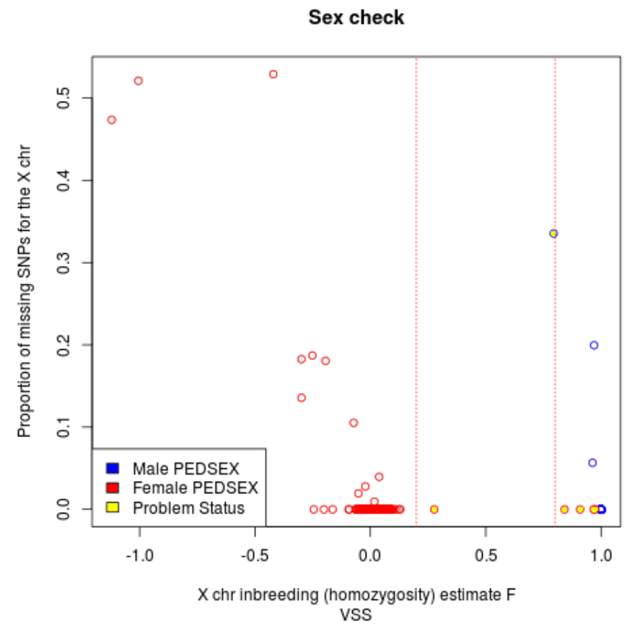
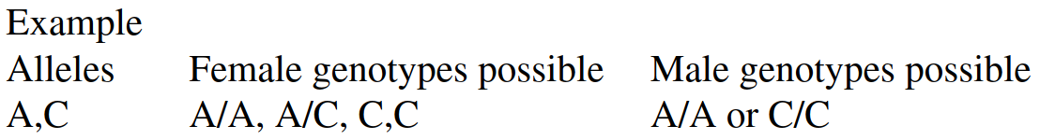
(A generalized) Quality Control process
Discordant Sex Check
Men have only one copy of the X chromosome
All X chromosome data is expected to be homozygous.
X chromosome homozygosity estimate for males (F statistic or inbreeding coefficient) is 1.
In Plink
Male (1) : XHE >0.80
Female (2) : XHE <0.20
No sex (0) : 0.20 <XHE <0.80

Slide 25
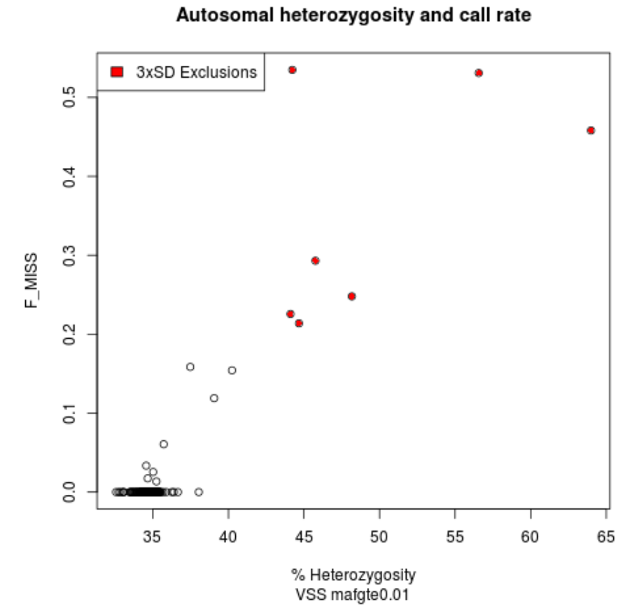
(A generalized) Quality Control process
Heterozygosity rate
The proportion of heterozygous genotypes (per sample)
Various ways of calculating the rate
PLINK: (<observed hom. count> - <expected count>) / (<total observations> - <expected count>))
--het (gives back and F estimate)
<custom scripts>
Excess heterozygosity -> Possible sample contamination
Less than expected heterozygosity –> Possibly inbreeding

Slide 26
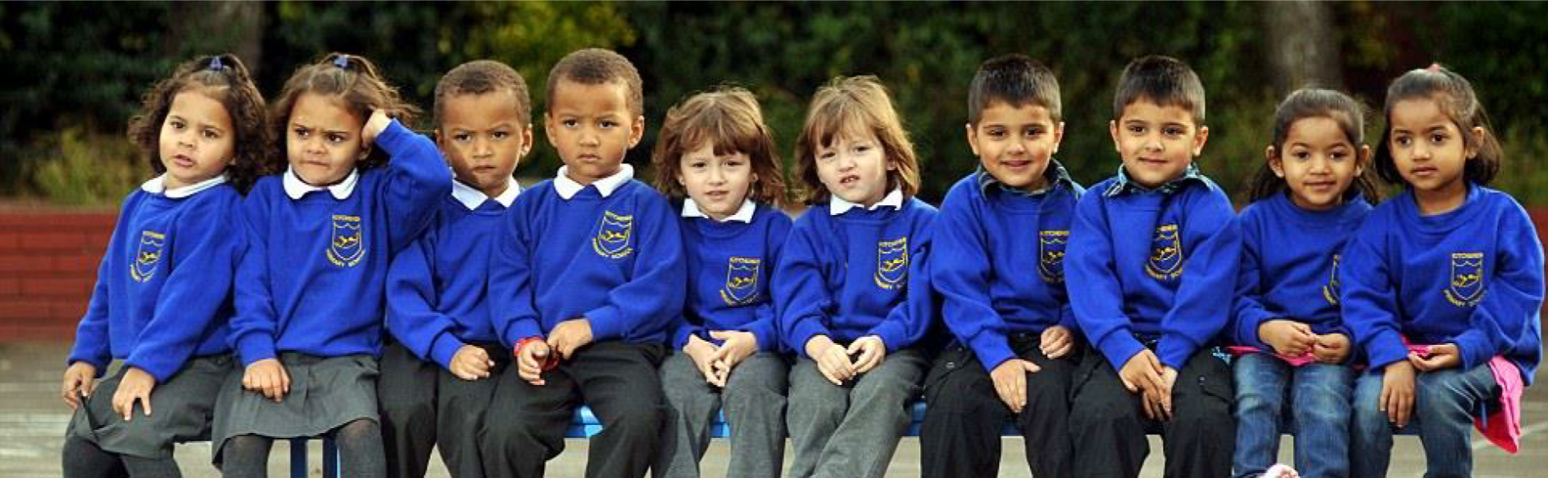
(A generalized) Quality Control process
Duplicated or related individuals
A basic assumption of GWAS: unrelated individuals
Either exclude or account for it
The presence can introduce a bias: genotypes in families to be over-represented

Slide 27
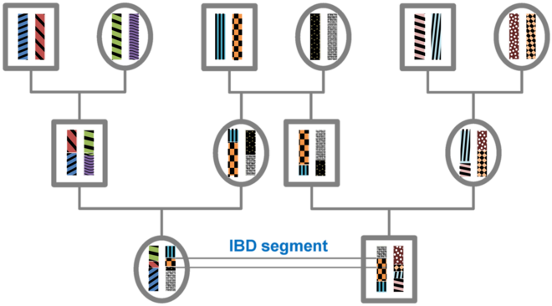
(A generalized) Quality Control process
Duplicated or related individuals
Calculated metrics:
Identity by state (IBS): A DNA segment is identical by state (IBS) in two or more individuals if they have identical nucleotide sequences in this segment.
Identity by Descent (IBD): An IBS segment is identical by descent (IBD) in two or more individuals if they have inherited it from a common ancestor without recombination, that is, the segment has the same ancestral origin in these individuals.
Wikipedia

Slide 28
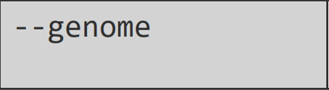

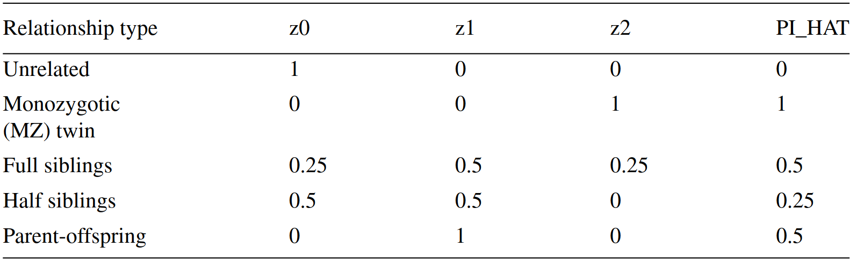
(A generalized) Quality Control process
Duplicated or related individuals
PLINK calculates identity by descent (IBD) of all sample
Approximates the percentage IBD overall, representing pairs as sharing, across all sites:
Zero alleles IBD (z0)
One allele IBD (z1)
Two alleles IBD (z2)
PI_HAT (the proportion IBD, deﬁned as P(IBD = 2) + 0.5*P(IBD = 1)).
Use an independent SNP set before running this command:
removing regions of extended Linkage Disequilibrium (LD)
and
2) pruning the remaining regions so that no pair of SNPs within a given window is correlated.
Slifer, 2018

Slide 29
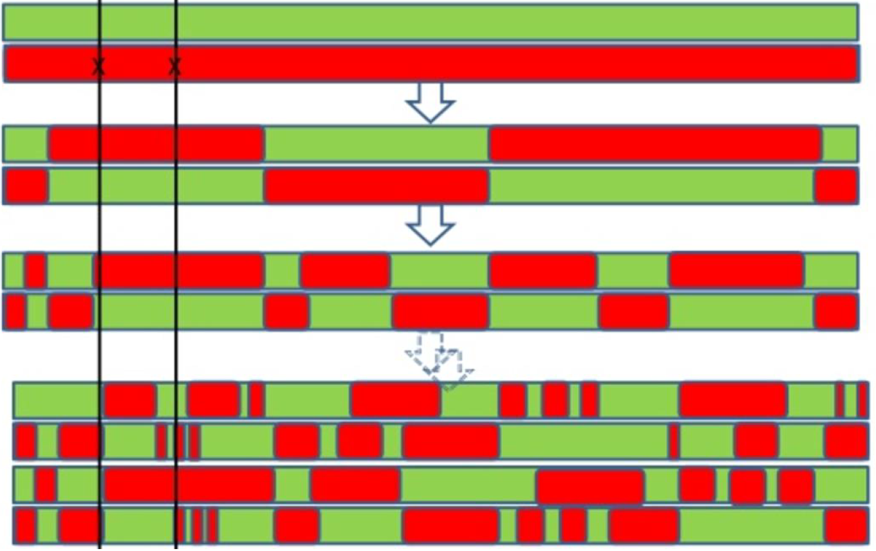
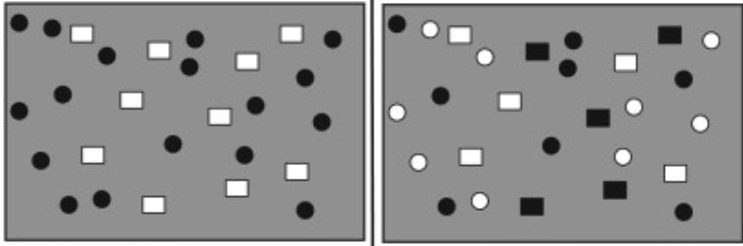
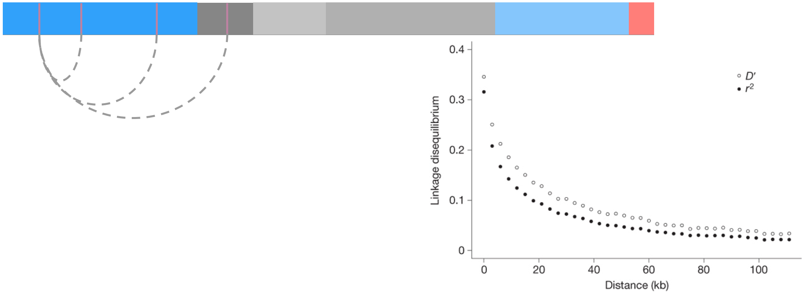
(A generalized) Quality Control process
Linkage disequilibrium (LD)
Is the non-random association of alleles at different loci in a given population.
In GWAS we (mainly) use correlation coefficient between pairs of loci, r²
r²=1 is perfect LD

Slide 30
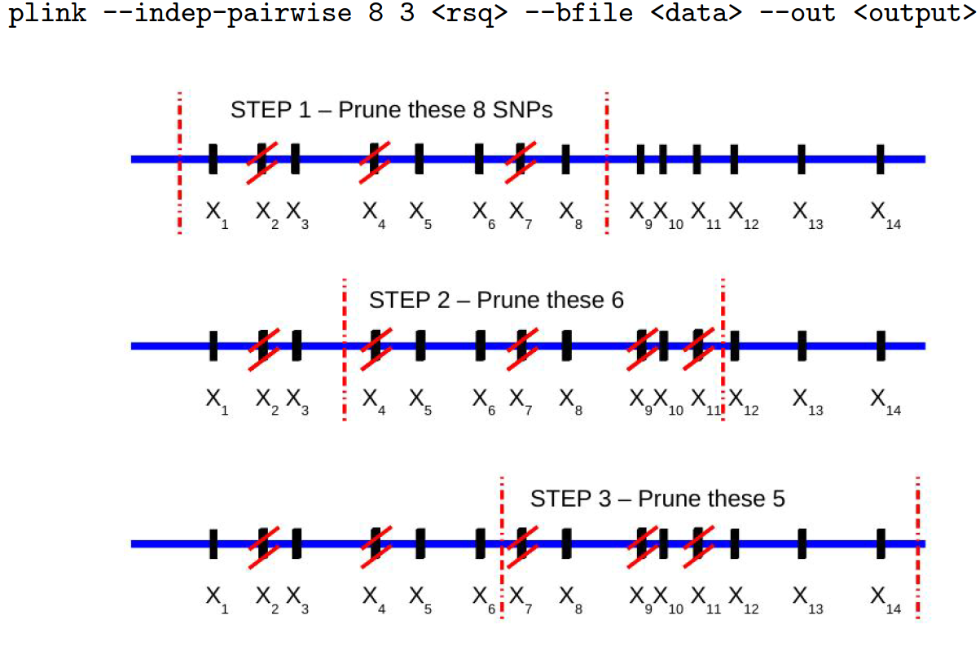
(A generalized) Quality Control process
PLINK: LD-based SNP prunning

Slide 31
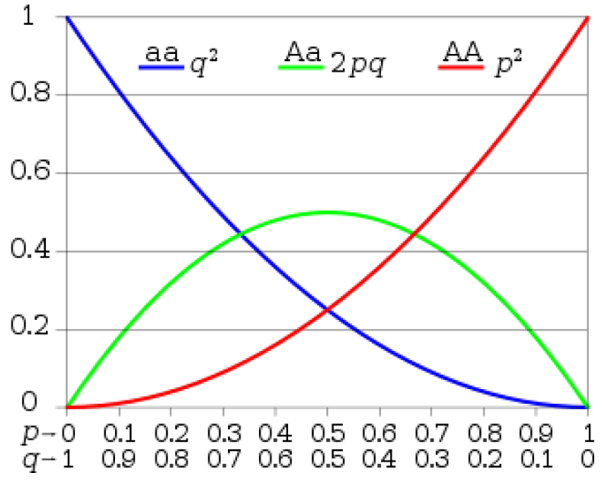
(A generalized) Quality Control process
The Hardy–Weinberg (dis)equilibrium (HWE) law:
The genotype and the allele frequencies are constant over generations.
Assumes:
An indefinitely large population
With no selection, no Mutation, no Migration ……
Significant deviations indicate genotyping errors
PLINK:
Less strict case threshold avoids discarding disease‐associated SNPs

Slide 32
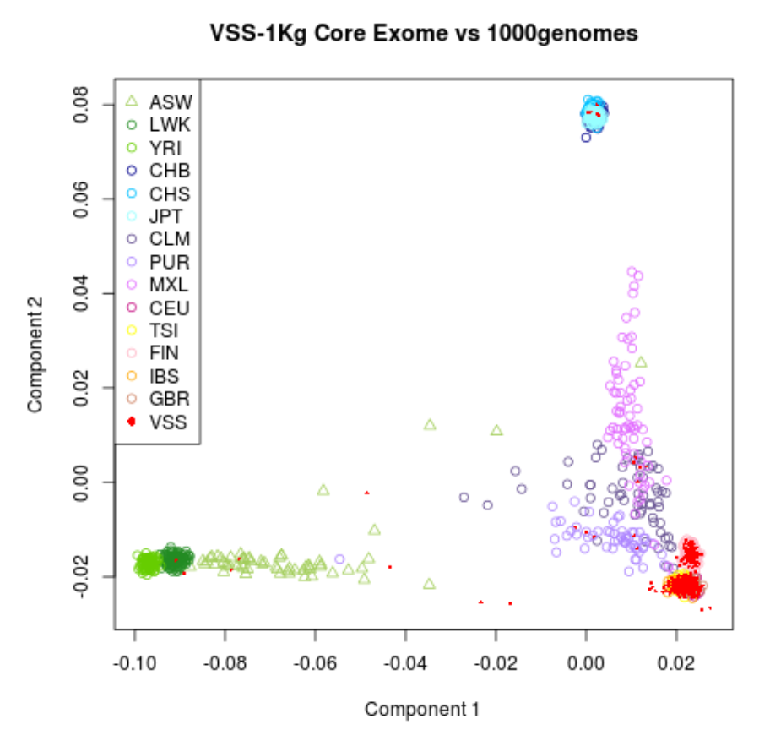
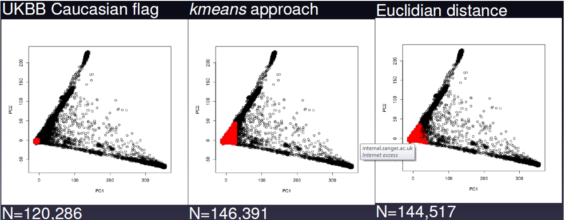
(A generalized) Quality Control process
Population structure
Occurs when samples have different genetic ancestries
Allele frequencies can differ between subpopulations and can lead to spurious associations due to differences in ancestry rather than true associations
PLINK: Merge with a population of known ethnic structure (e.g., HapMap/1KG data) and identify outliers through dimension reduction analyses such as Principal Component Analysis and/or MultiDimensional Scaling (MDS).

Slide 33

(A generalized) Quality Control process
Variant QC
It consists of (at least) four steps:
1.Identification of variants with an excessive missing genotype
2.Identification of variants demonstrating a significant deviation from Hardy-Weinberg equilibrium (HWE)
3.Removal of all makers with a very low minor allele frequency
4.Removal of all makers with cluster separation score

Slide 34



(A generalized) Quality Control process
Where to draw the line?

Slide 35

Genotyping data : PLINK common operations

Slide 36

Genotyping data : PLINK common operations

Slide 37
Genotyping data : PLINK common operations
What is the command for :
Excluding SNPs that are missing in a large proportion of the subjects (<0.90).
Excluding individuals who have high rates of genotype missingness (<0.85).
Keeping autosomal SNPs.
Extracting the top 20 principal components.
The association between SNPs and a binary/quantitative outcome.

