Slide 1
Google Colab

Slide 2

Google Colab
Colab notebooks allow you to combine executable code and text in a single document
Some technical stuff
Colab runs Python code by default. In this exercise, we will be using R.

Slide 3

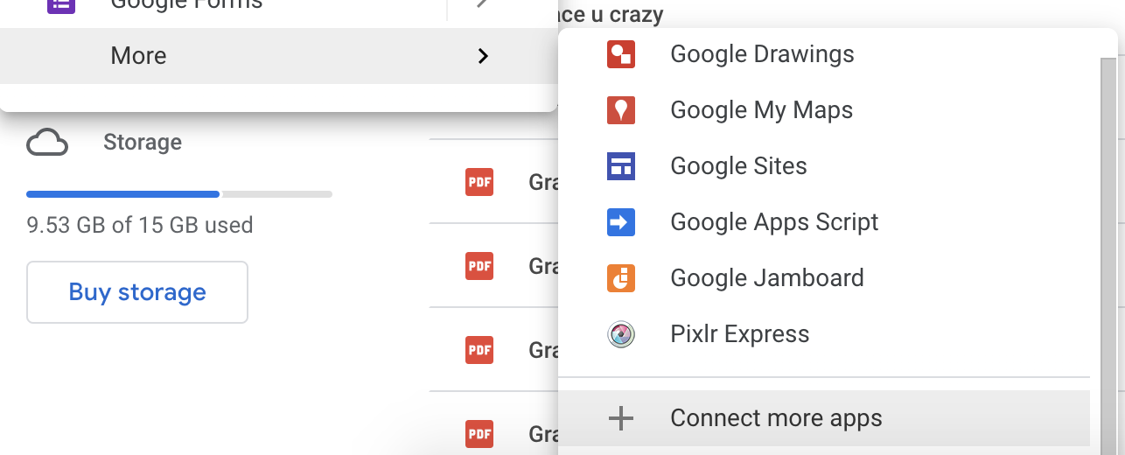
Installation instructions
Go to drive.google.com
Click on the +New button on the top left of the page
Navigate to More > Connect more apps
Search for ‘Colaboratory’, click and install

Slide 4
Installation instructions
5. Go to the link to notebook. The notebook should open in Colab automatically. If it doesn’t, please let us know.

Slide 5

How this is going to work
Most of the code has been provided, but please try to understand what the commands mean.
Ways to run code:
Click play button on the top left of each code cell
Windows: ctrl+enter
MacOS: cmd⌘+enter
When a command starts with ! it is a linux command written in bash (for managing directories and executing plink software).
When a shell starts with %%R the code follows is written in R

Slide 6
Things to note
Try not to refresh your notebooks
Run code cells sequentially
Answers are provided but try to do it on your own !

Slide 7
Thank you!

