Slide 1
Polygenic scores
Ana Luiza Arruda
Volos Summer School 2026

Slide 2
Agenda
Human genetics recap
GWAS recap
Complex traits
Polygenic scores

Slide 3
1
Human genetics recap

Slide 4
What is a gene?

Slide 5
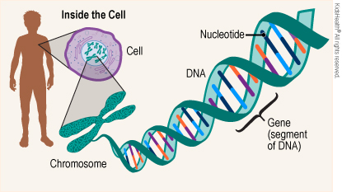
A gene is a sequence of nucleotides in DNA or RNA that encodes the synthesis of a gene product, either RNA or protein.
A genome region that includes all of the sequence elements necessary to encode a functional transcript and specifies a trait.

Slide 6
What is an allele?

Slide 7
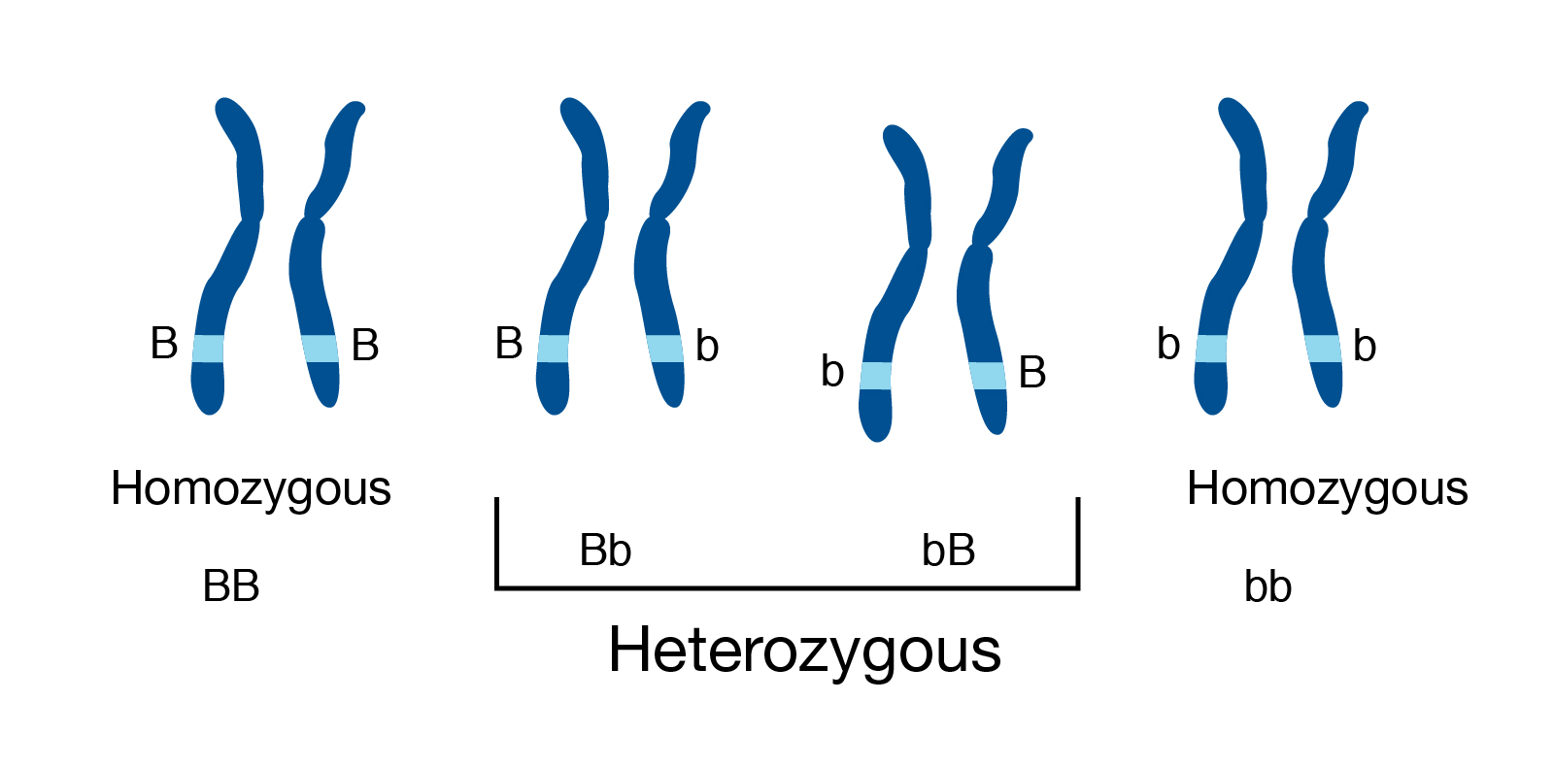
Allele: different forms of the same gene that determines an organism’s phenotype. It is represented by letters.
Humans are diploid organisms, which means that they have two alleles at each genetic position, or locus, with one allele inherited from each parent.
Allele b count
BB | bB | Bb | bb
0 | 1 | 1 | 2

Slide 8
What is a genotype?
What is a phenotype?

Slide 9
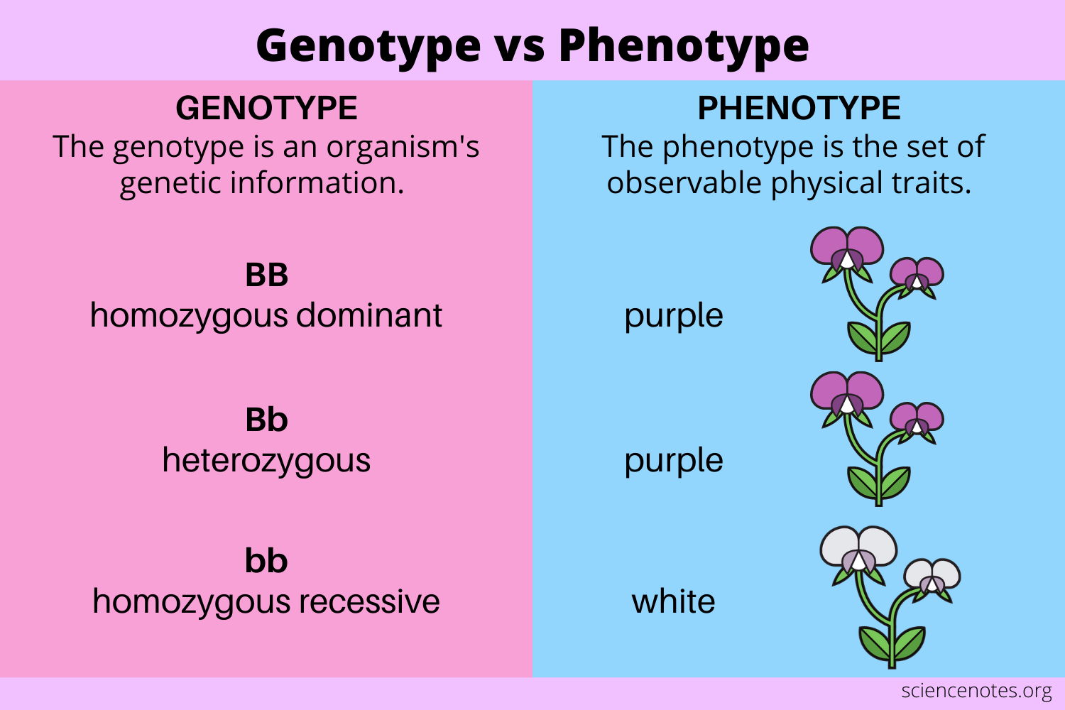
Notes:
Each pair of alleles represents the genotype of a specific gene.

Slide 10
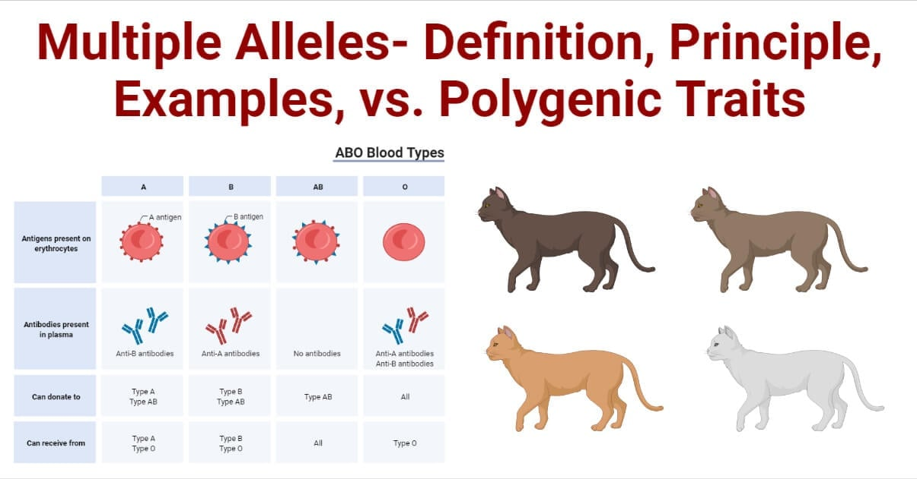
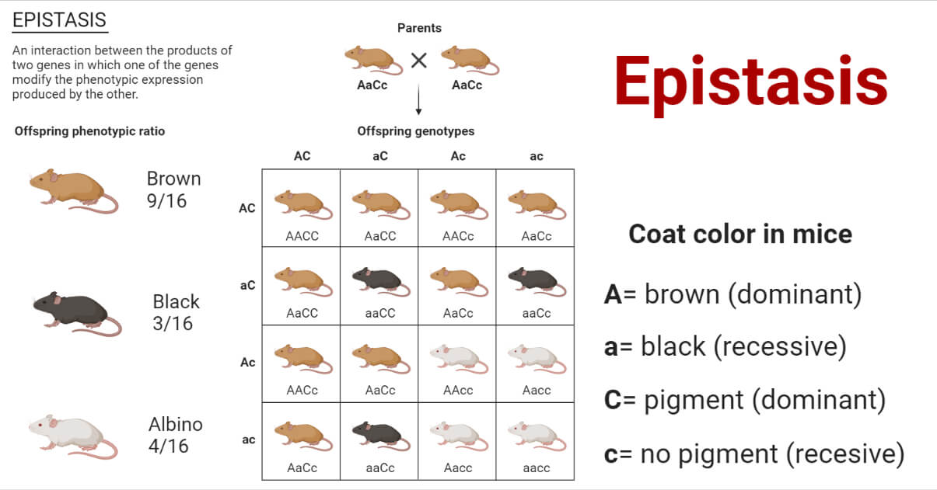
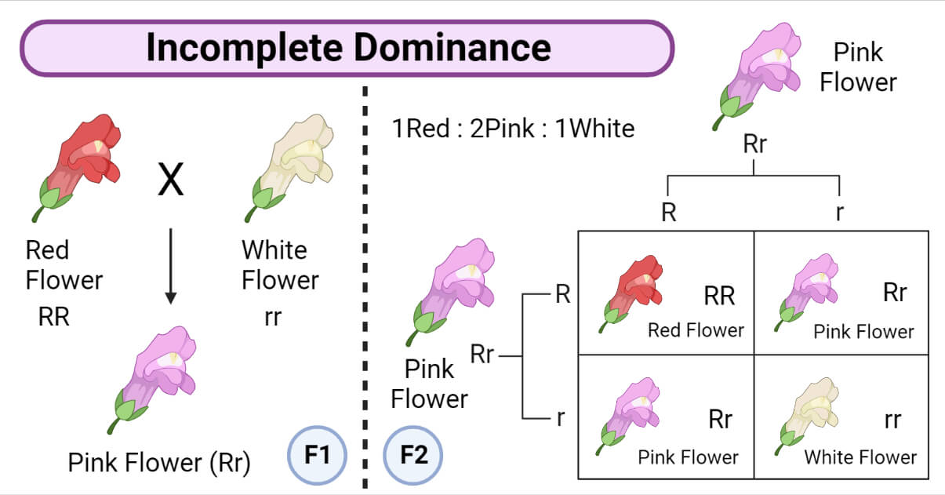
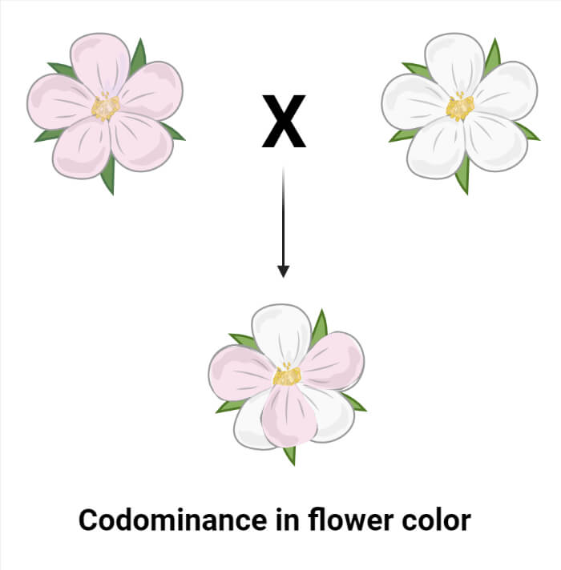
Deviation from Mendel’s Findings
Notes:
Epistasis means one gene can hide the effect of another gene. In this example, the c/c genotype prevents pigment production, so the mouse is albino no matter whether it carries the brown or black color genotype.
Two genes are involved:
Gene C/c = “Can the mouse make pigment at all?”: Determines whether pigment is actually deposited in the fur.
Gene A/a = “What color is the pigment?”: Determines whether the pigment is black or brown.
The C gene controls whether pigment is produced. If there is no pigment, the A gene cannot show its effect.
C_ means the mouse has at least one dominant C allele, so it can make pigment.
cc means the mouse has two recessive c alleles, so it cannot make pigment.
Even if the mouse has the genotype for brown or black, cc blocks pigment production, so the mouse becomes albino.
Epistasis deviates from Mendel’s laws as it involves the interaction of multiple genes and shows that the expression of one gene can modify the expression of another gene.

Slide 11
What is a SNP?
What is a risk/effect allele?

Slide 12
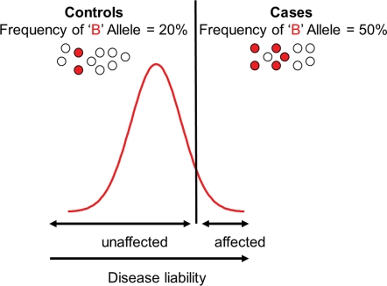
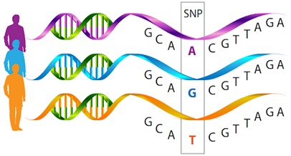
Single-nucleotide polymorphism
Notes:
A single-nucleotide polymorphism (varies across populations) is a substitution of a single nucleotide at a specific position in the genome, that is present in a sufficiently large fraction of the population (e.g. 1% or more). For example, at a specific base position in the human genome, the C nucleotide may appear in most individuals, but in a minority of individuals, the position is occupied by an A. This means that there is an SNP at this specific position, and the two possible nucleotide variations – C or A – are said to be the alleles for this specific position. SNPs pinpoint differences in our susceptibility to a wide range of diseases

Slide 13
2
Genetic association studies

Slide 14
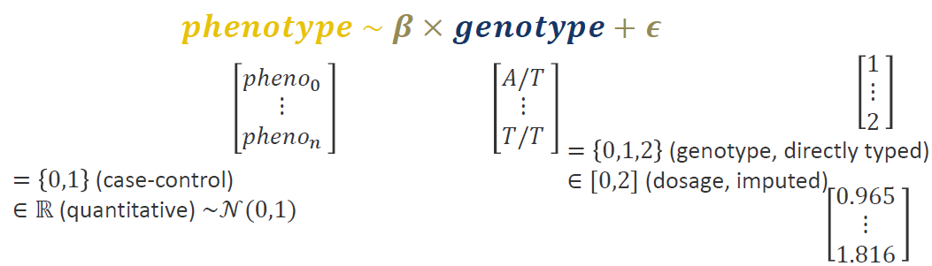
Modelling
Is there an association between the phenotype (disease or continuous trait) and the genotype?
Q1: What is the difference between directly typed and dosage genotypes?
Q2: What is the genome-wide significance threshold? Why?
Q3: What is the effect estimate for a binary trait? What is it for a continuous trait?
Notes:
Estimation of the effect of the variants: β or Odds Ratio (OR)
Goal: model the effect (beta) of genotype on phenotype
Disease: CaseXcontrol ={1,0}
Quantitative trait (e.g. height): std normally transformed (assumption of linear model)
Imputed data (expand to ungenotyped positions)) → ungenotyped positions → dosage = continuous measurements between 0 and 2
Directly typed genotype = {0,1,2}
Imputed data (not on chip) = [0,2] continuous measurements

Slide 15
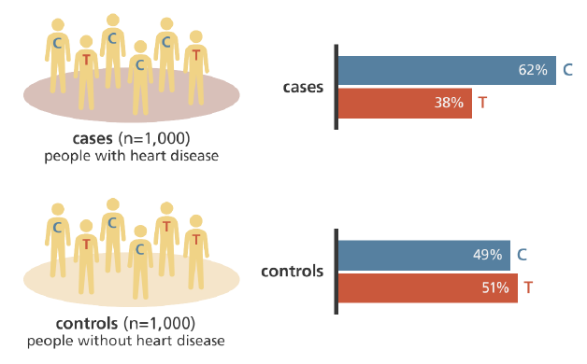
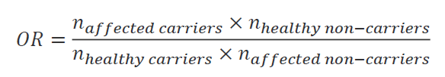
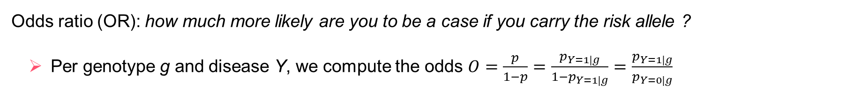
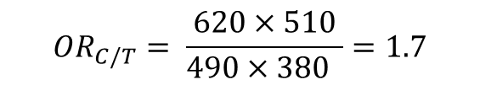
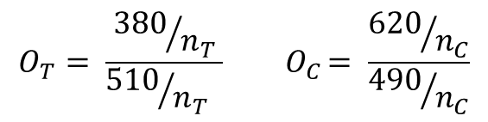
Case/control studies
Odds ratio (OR): how much more likely are you to be a case if you carry the risk allele ?
Per genotype g and disease Y, we compute the odds $O=\frac{p}{1−p}=\frac{p_{Y=1|g}}{1−p_{Y=1|g}}$ $=\frac{p_{Y=1|g}}{p_{Y=0|g}}$
 | Cases | Controls
T | 380 | 510
C | 620 | 490
$$O_{T}= \frac{{380}/{n_{T}}}{{510}/{n_{T}} }{ O}_{C}= \frac{{620}/{n_{C}}}{{490}/{n_{C}}}$$
$${OR}_{C/T}= \frac{620×510}{490×380 }=1.7$$
Notes:
Effect = OR = estimated effect
Odds for a genotype = probability of being a case if you have the genotype g/ prob of being control when having g
OR = ratio of the odds for 2 genotypes
Controls=0, cases =1 (e.g. heart disease)
1.7 times more likely to develop heart disease if you a carrying the risk allele C
Estimated effect: odds ratio (OR) + 95% CI
OR depends on allelic inheritance model (dominant X recessive X additive)

Slide 16
Case/control studies
OR = ratio of the odds of the two alleles
OR>1: the allele is ‘deleterious’
OR<1: the allele is ‘protective’
Statistical test: is the OR significantly different from 1?
Earlier: Fisher’s exact test or Chi-squared test
Nowadays + for imputed data: general linear model
Notes:
Test: is OR significantly different from 1?
Earlier: Fisher’s exact test or Chi-squared test
Nowadays + for imputed data: linear regression or GLM

Slide 17
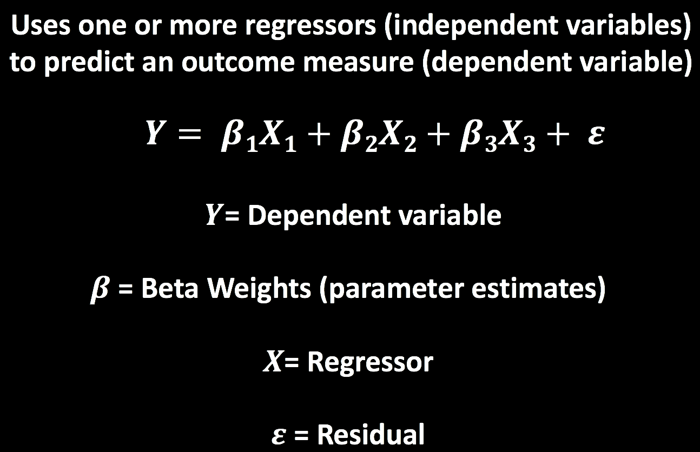
The General Linear Model (GLM)
For continuous traits (such as quantitative measures), we use a linear regression
For binary traits (such as diseases), we use a logistic regression
Notes:
Test: is OR significantly different from 1?
Earlier: Fisher’s exact test or Chi-squared test
Nowadays + for imputed data: linear regression or GLM

Slide 18
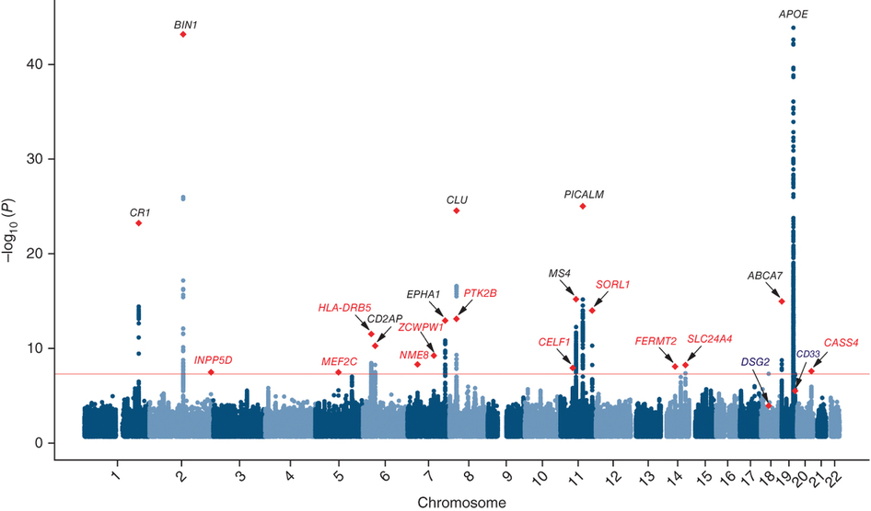
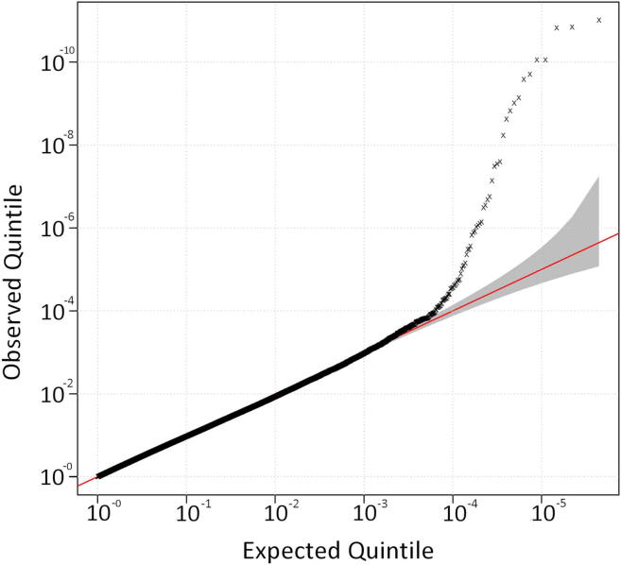
How to obtain GWAS results
Quality control (QC) of the data
Run model
Correct p-value for multiple testing (significance threshold = 5x10⁻⁸)
Visualize results (Manhattan plot)
Run sensitivity analyses
Notes:
Genome-wide significance threshold derived by Bonferroni correction
Peaks → variants in LD
QQ-plot → diagnose GWAS results
- Compare quantiles from your distribution and expected one (uniform)
- Check if p-values behave well (expected distribution = uniform, no or little signal which normally holds genome-wide)
Possible problems: no accounting for factors influencing your phenotype e.g. relatedness between samples or no ancestry correction (population structure)
Visual inspection + calculation of lambda (genomic inflation rate), lambda=1 is good
Inflation → false positives (type 1 error)

Slide 19
3
Complex traits

Slide 20
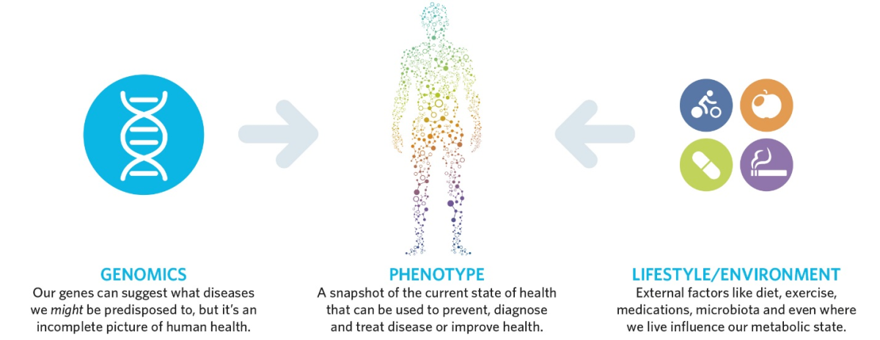
Complex traits
Interaction between (often many) genetic and environmental factors
Examples: body shape, type 2 diabetes, Alzheimer’s disease…
Complex diseases tend to be common in the population
→ Tool of choice = GWAS

Slide 21
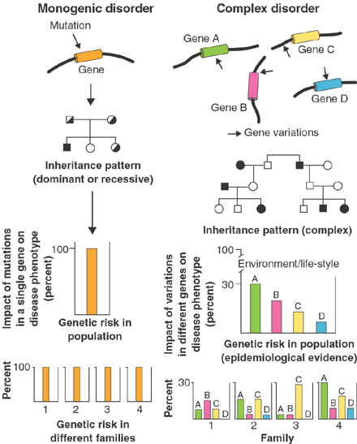
Monogenic disorder
vs
Complex traits
Peltonen & McKusick, Science, 2001
Notes:
Monogenic: single inheritance pattern mendelian fashion predictable, when mutation present produces the disease 100% of the time
Complex disorder: Multiple genes/factors, more frequent than monogenic disorders. Without clear inheritance pattern

Slide 22
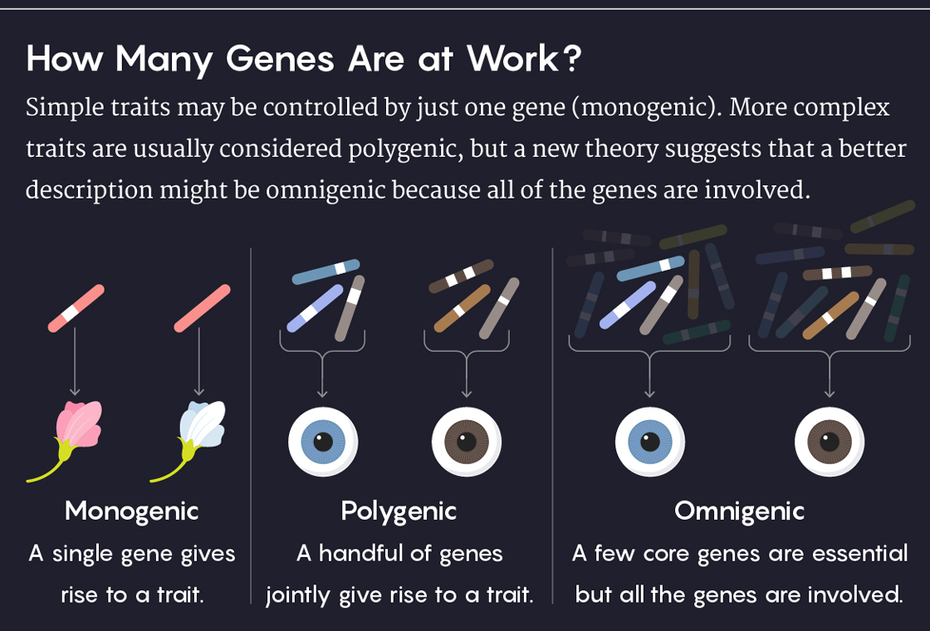
Notes:
One mutation is enough
Eye colour example: several genes interacting → we thought it was a monogenic trait, now: complex
Many gene influences a trait, some are core ones, some influence the trait indirectly

Slide 23
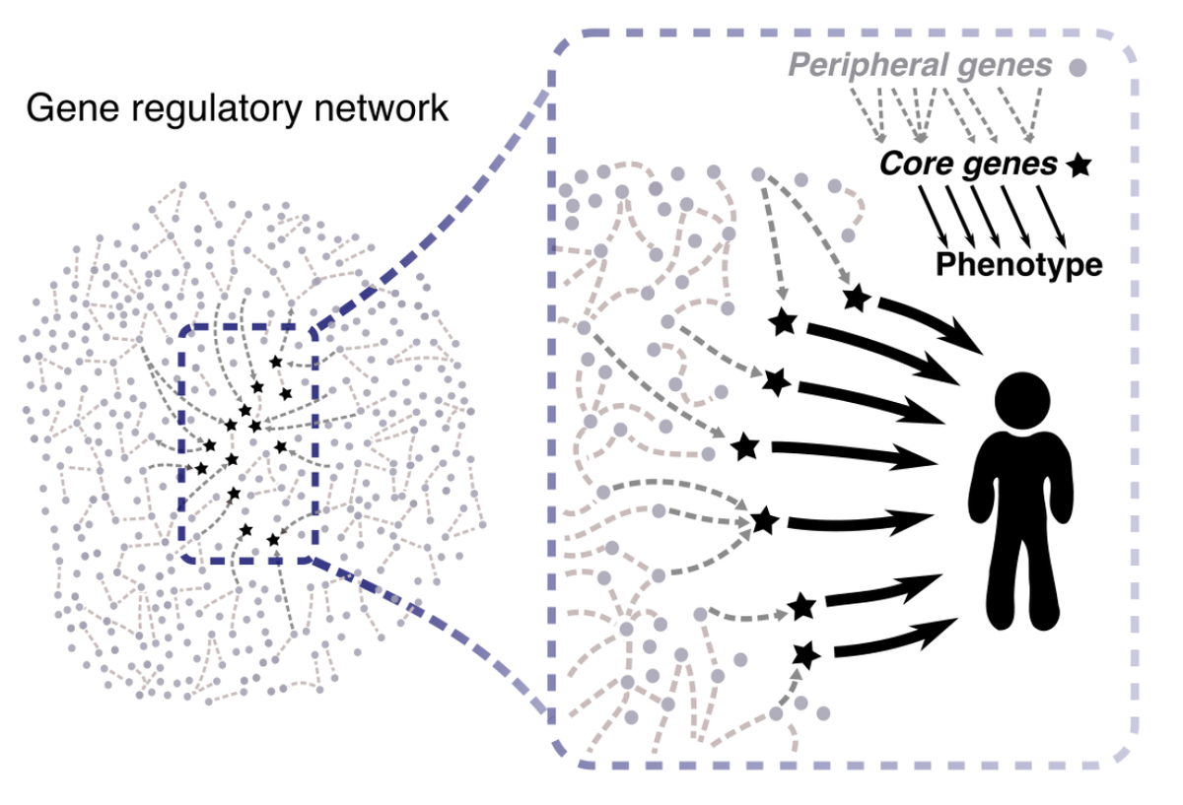
Omnigenic vs Polygenic model
Notes:
Omnigenic model = gene regulatory network (all genes influence a trait, some core genes though)
Extended network of interaction surrounding core genes including complex mechanisms that together determine the liability to contract a complex disease or that define a quantitative trait

Slide 24
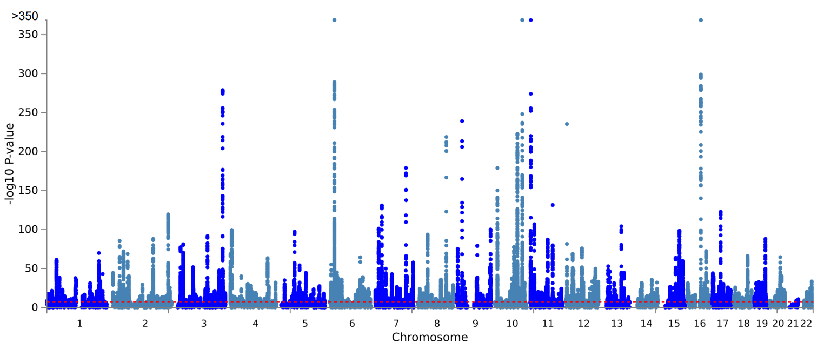
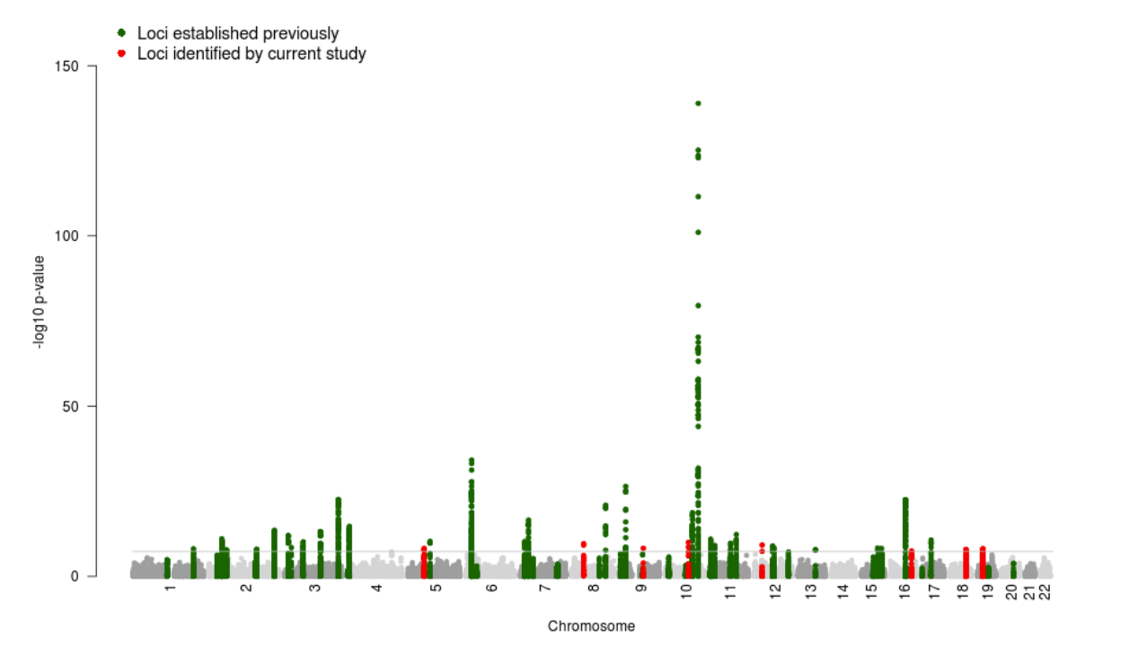
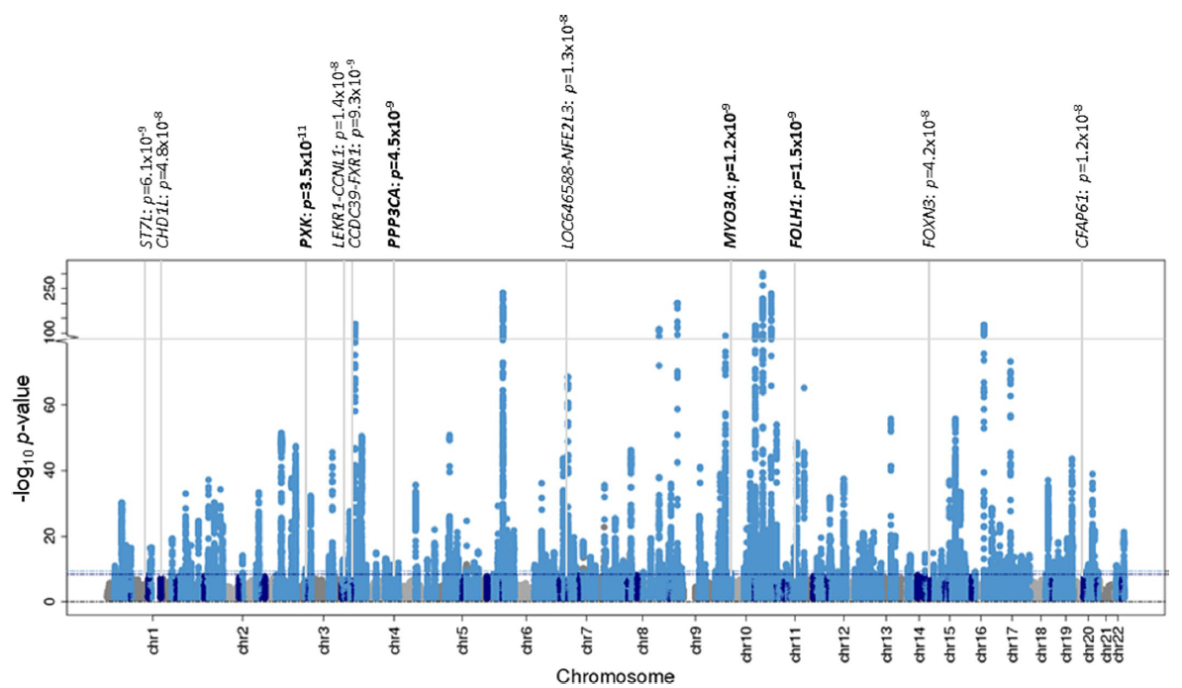
Type 2 diabetes GWAS
Current tool of choice to study complex traits
Suzuki,Hatzikotoulas,Southam et al. Nat. 2024
Number of cases = 428,452
Number of controls = 2,107,149
Type 2 diabetes GWAS Morris et al. Nat. Genet. 2012
Number of cases = 34,840
Number of controls = 114,981
Type 2 diabetes GWAS Mahajan et al. Nat. Genet. 2022
Number of cases = 180,834
Number of controls = 1,159,055
Notes:
More samples, more association → more rare variants (broader spectrum of allele frequencies)
More power to detect weaker associations
Many true negatives yet
GWAS variants: not causal alone → explain only a small fraction of the genetic risk
T2D 10 years apart

Slide 25

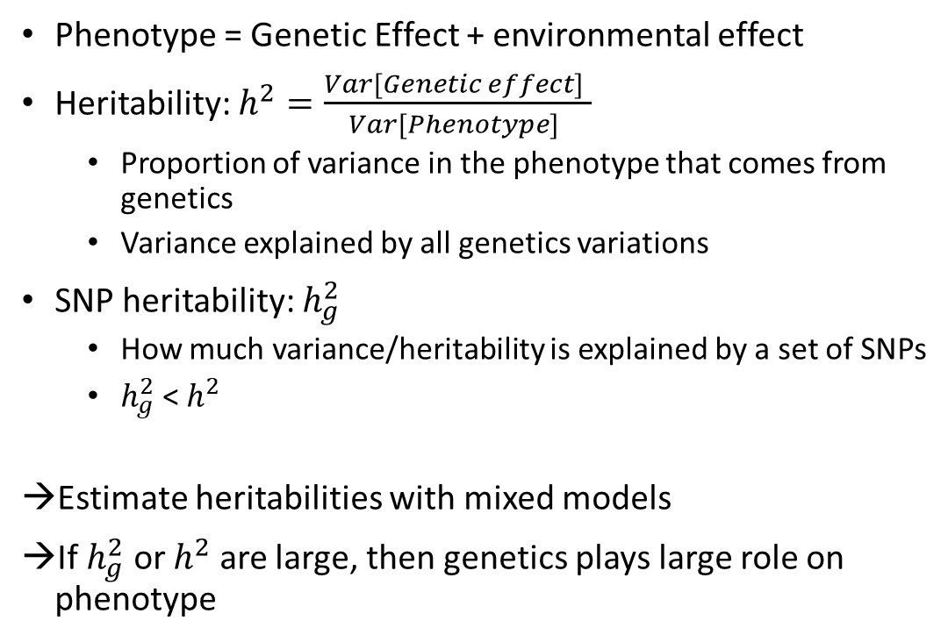
Heritability
Phenotype = Genetic Effect + environmental effect
Heritability: $h^{2}=\frac{Var[Genetic effect] }{Var[Phenotype] }$
Proportion of variance in the phenotype that comes from genetics
Variance explained by all genetics variations
SNP heritability: $h_{g}^{2}$
How much variance/heritability is explained by a set of SNPs
$h_{g}^{2}$ < $h^{2}$
Estimate heritabilities with mixed models
If $h_{g}^{2}$ or $h^{2}$ are large, then genetics plays large role on phenotype
Notes:
More sample size → rare variants (broader spectrum of allele frequencies) → PRS with rare variants not yet

Slide 26
3
Polygenic scores
3.1
Introduction

Slide 27
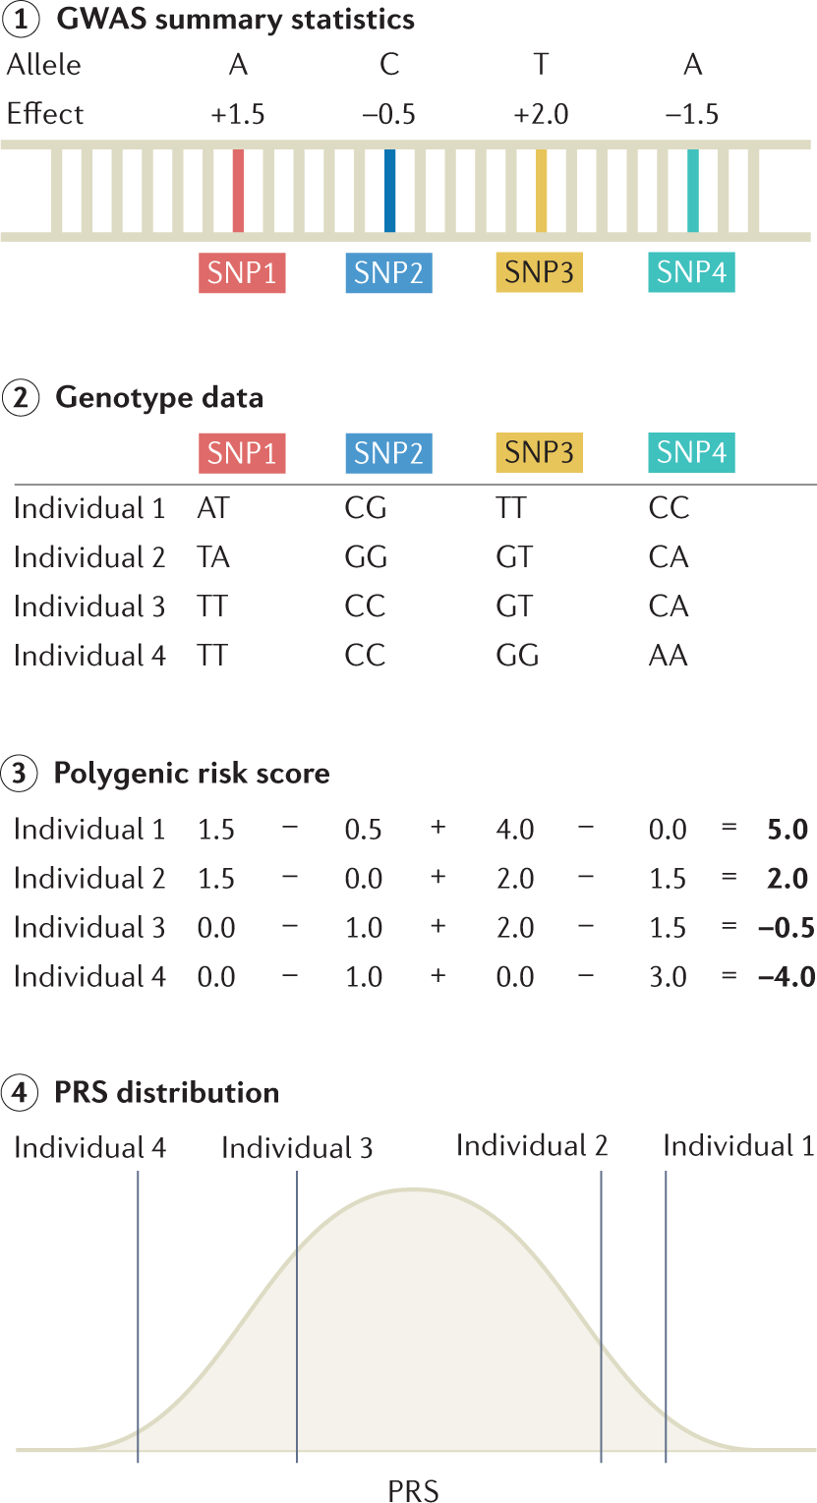
Polygenic scores (PGS)
Natural follow up for GWAS summary statistics:
One effect for each genetic variant (SNP)
Additive model → risk increases with each copy of the effect allele
→ Combine SNPs effects into a score
→ Predict quantitative traits (= polygenic score) or disease risk (= polygenic risk score)
Uffelmann, E., Huang, Q.Q., Munung, N.S. et al. Genome-wide association studies. Nat Rev Methods Primers 1, 59 (2021). https://doi.org/10.1038/s43586-021-00056-9
Notes:
Large GWAS: estimates of additive effects for each variant
Larger sample size for GWAS → increases predictive power of PGS
All SNPs have in principle non-zero weights (very small contribution)

Slide 28
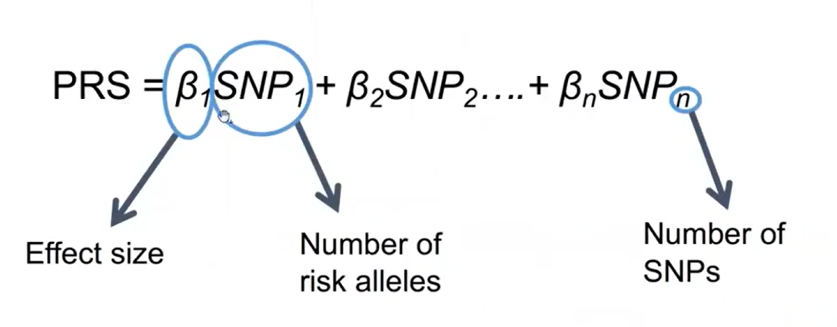
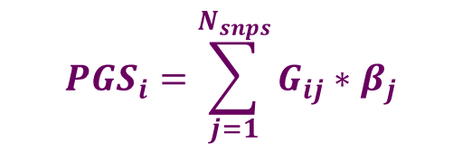
PGS: a weighted sum of the number of effect alleles
Polygenic score for individual i
Total number of SNPs included in PGS
$${PGS}_{i}=\sum_{j=1}^{N_{snps}}{G_{ij}∗β_{j}}$$
Effect of variant j on trait
Estimated in GWAS
Genotype at SNP j for individual i
Coded as 0, 1, 2 depending on the number of risk allele
Additive model
Sum of the number of risk alleles weighted by its effects
Notes:
Weighted sum of the number of risk alleles
Weighted = multiplied

Slide 29
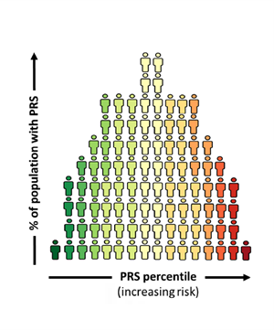

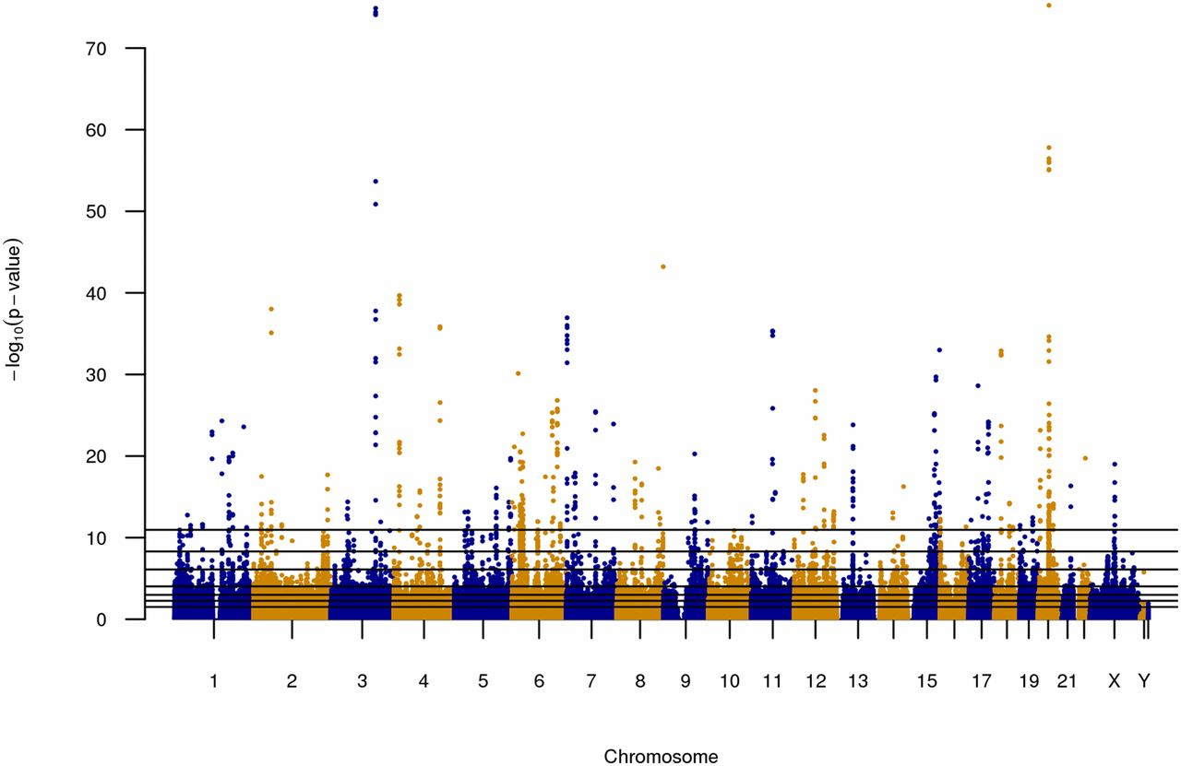

Polygenic scores: what kind of data do we need?
Scores of variants
Genetic data
Large GWAS
External cohort
Summary-level data
= BASE
Individual-level data
= TARGET
Notes:
Graphical explanation for the polygenic score pipeline:
Large GWAS weights X genetic data of external/independent cohort
Output: risk distribution of external cohort

Slide 30
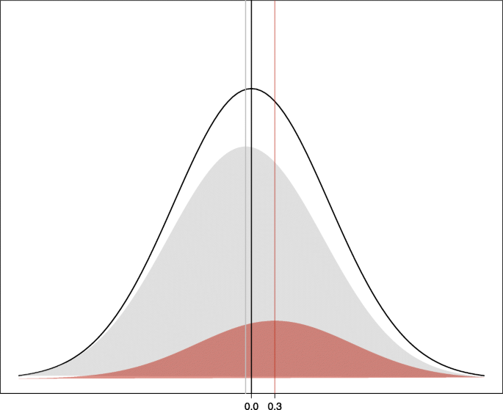
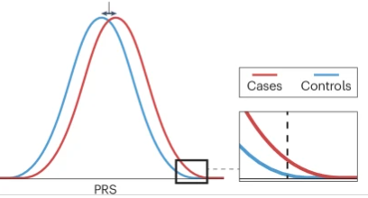
Polygenic risk score
Case/control study
Grey = controls
Red = cases
Overall mean = 0 (standardized)
Mean difference between cases and controls is directly proportional to the performance of the PGS
Kullo, I.J. Clinical use of polygenic risk scores: current status, barriers and future directions. Nat Rev Genet (2025). https://doi.org/10.1038/s41576-025-00900-8
Notes:
Log risk scores are normally distributed in the population
(sum of effect of many variants)
Mixture of two gaussian distribution (cases and controls) is std normal
Variance is an important determinant of risk stratification/ PRS performance
Cases (less samples) distribution is shifted to the right → amount of shift = population variance of PRS under log-linear model (assumes betas estimates are correct)
The larger the shift → the larger the discovery power of the PRS
Proportion of cases is enriched in the right end of the distribution

Slide 31
Predictive power of a PGS
Higher predictive power:
If trait has a high genetic heritability
If sample size used to estimate the GWAS effect sizes is large
For case-control studies: if the mean difference between the distributions of cases and controls is large (larger variance between populations)
Notes:
Log risk scores are normally distributed in the population
(sum of effect of many variants)
Mixture of two gaussian distribution (cases and controls) is std normal
Variance is an important determinant of risk stratification/ PRS performance
Cases (less samples) distribution is shifted to the right → amount of shift = population variance of PRS under log-linear model (assumes betas estimates are correct)
The larger the shift → the larger the discovery power of the PRS
Proportion of cases is enriched in the right end of the distribution

Slide 32
3
Polygenic scores
3.2
Construction

Slide 33
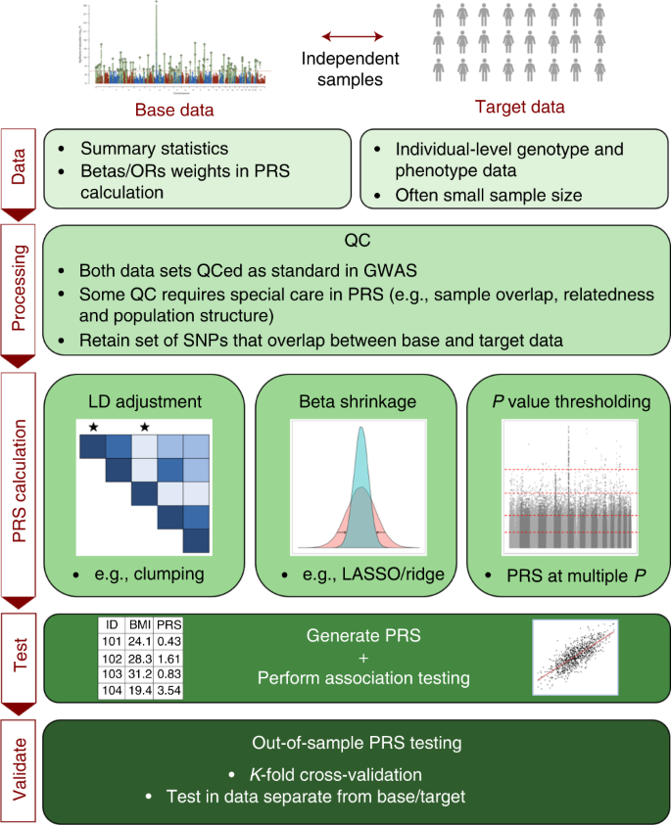
Choi et al. 2020

Slide 34
Input data
Sample used to estimate the weights for the PGS
Largest GWAS summary statistics
We need:
Effect sizes of the variants: betas/OR
Standard errors
P-values
Sample where we will apply the PGS
Individual level data (genotype data)
Often smaller sample size compared to the base data

Slide 35
Base and target data harmonization
Genome build matching: GRCh37 vs GRCh38
Effect allele alignment
No sample overlap between base and target data
Can lead to overfitting and inflated performance estimates
Need homogeneity between base and target samples
Hypothesis = samples underlie the same genetic architecture and environmental conditions
E.g. same population structure/genetic ancestry
Notes:
Apply the same QC as standard GWAS
Only SNPs in base AND target samples

Slide 36
PGS calculation
How to select the genetics variants to include in the PGS?

Slide 37
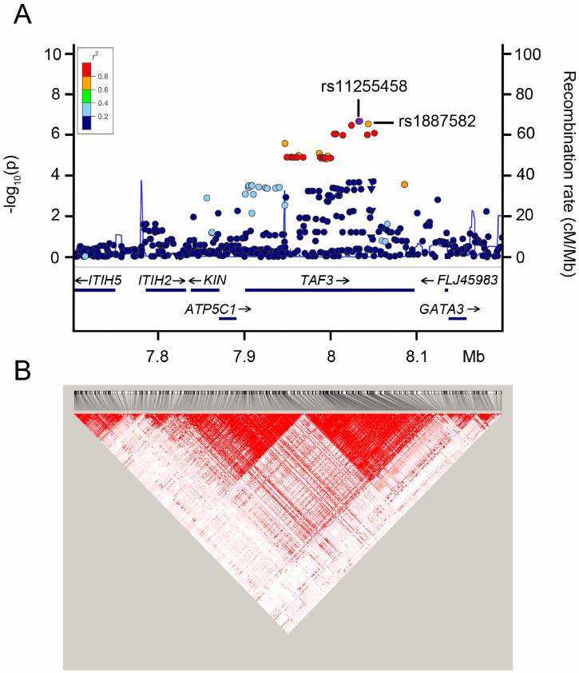
Selection of variants for PGS calculation
Historically: top associated variants
Challenging in omnigenic and polygenic models
Reduced predictive power
Solution: use all variants (omnigenic model)
Problem: linkage disequilibrium (LD)
What is LD?
Now: select independent variants (clumping, pruning)
One representative for each LD block
No overweighting of LD blocks
Notes:
non-random association of alleles at different loci resulting in inheritance of correlated blocks of variants (=haplotypes)
Mosaic of blocks in which variants are dependent of each other, distance based
Colors in regional association plot = LD
Problem: overrepresentation of blocks if taking all variants in LD into the score → signal inflation

Slide 38
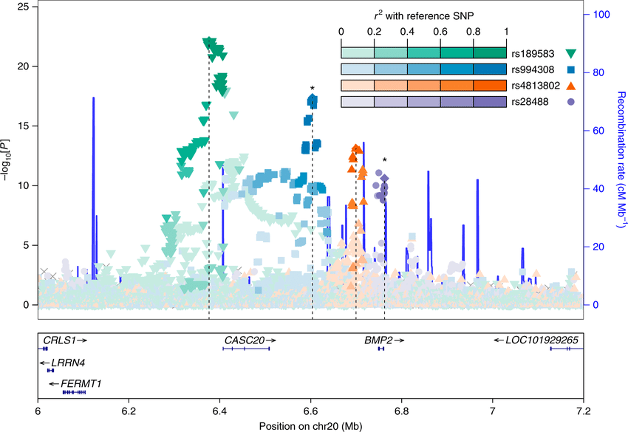
Clumping + Thresholding (C+T)
+
P-value aware LD pruning
Select SNPs with a p-value < threshold
Select top associated variant
Remove all variants in LD with this SNP
YES
Any other significant variant left in the block ?
NO
Set of pruned and significantly associated variants
How many SNPs do we get using the yellow or the red log(P) thresholds?
Notes:
Clumping = P-value aware LD pruning
3 variants in picture: green, blue, orange

Slide 39
Clumping + Thresholding (C+T)
How many SNPs do we get using the yellow or the red log(P) thresholds?
Notes:
Clumping = P-value aware LD pruning
3 variants in picture: green, blue, orange

Slide 40
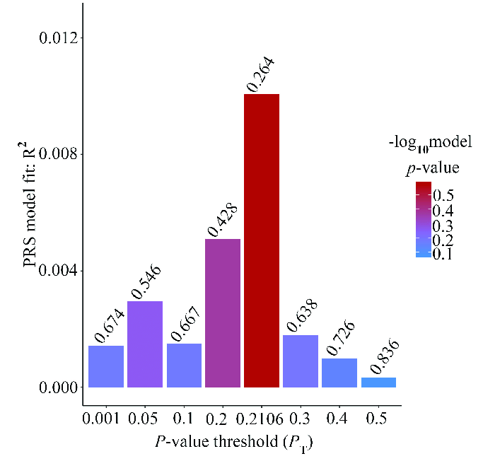
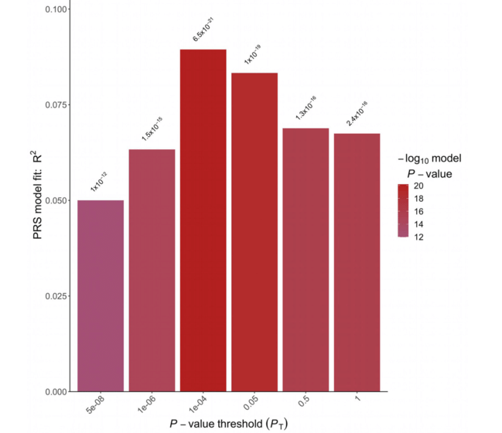
Clumping + Thresholding (C+T)
Which significance threshold to use to include variants?
Optimal threshold depends on the trait
More polygenicity → less stringent threshold
Unknown beforehand
Try multiple values with validation
Integrated into PGS calculation software, e.g. PRSice
Wang et al. Frontiers in Genetics, July 2019
Maj et al. Frontiers in Cardiovascular Medicine, Feb 2022
Notes:
P-value: trait not very polygenic → stringent threshold (e.g. even 5e-8)
More polygenic trait → less stringent threshold (e.g. 0.05)

Slide 41
Limitations of C+T
Potential removal of secondary signals
Based on the p-values but not on the effect sizes
The p-value is related to the power of the study
Can miss low-effect variants in small sample sizes
Ideal model = ‘whole-genome’ model
Account for LD
Sample size is still a limiting factors for improved methods
Notes:
Ideal model = ‘whole-genome’ model
Account for LD

Slide 42
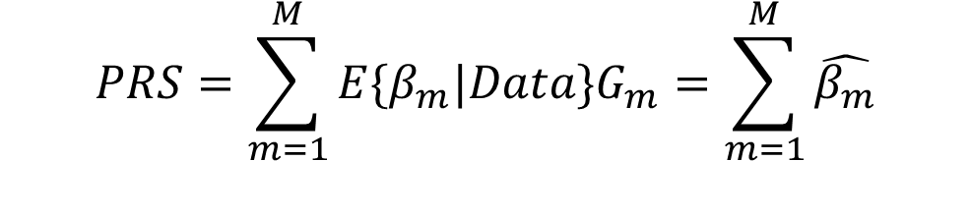
Bayesian sparse regression methods (beta shrinkage)
C+T: find subset of variants that best describe the trait of interest
Beta shrinkage methods: find optimal transformation of the vector of effect sizes from GWAS to best represent the trait
$$PRS=\sum_{m=1}^{M}{E\{β_{m}|Data\}G_{m}}=\sum_{m=1}^{M}{\hat{β_{m}}}$$
Notes:
C+T: find optimal set of variants to construct score
Bayesian sparse regression: find optimal transformation of the vector of effect sizes coming from GWAS to best represent the trait

Slide 43
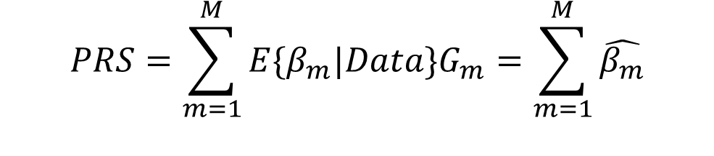
Bayesian sparse regression methods (beta shrinkage)
$$PRS=\sum_{m=1}^{M}{E\{β_{m}|Data\}G_{m}}=\sum_{m=1}^{M}{\hat{β_{m}}}$$
Models the distribution of shrunk/re-weighted effect sizes using:
prior that reflects the genetic architecture (e.g. all SNPs have non-zero weight)
genome-wide LD matrix to weigh down variants from the same LD block
→ Shrinkage method that produces scaled effect sizes genome-wide
Downsides: too many hyperparameters → harder to interpret
Notes:
Models the distribution of re-weighted effect sizes
E.g. weigh down variants in an LD block based on LD block size

Slide 44
Software to calculate PGS
Clumping + thresholding
plink --score
PRSice (Euesden et al, 2014)
PRSice2 (Choi et al, 2019)
Bayesian sparse regression method
LDpred (Vilhjalmsson et al,, 2015)
LDpred2 (Prive et al, 2020)
SBayesR (Ge et al, 2019)
PRS-CS (Zeng et al, 2017)

Slide 45
3
Polygenic scores
3.3
Application

Slide 46
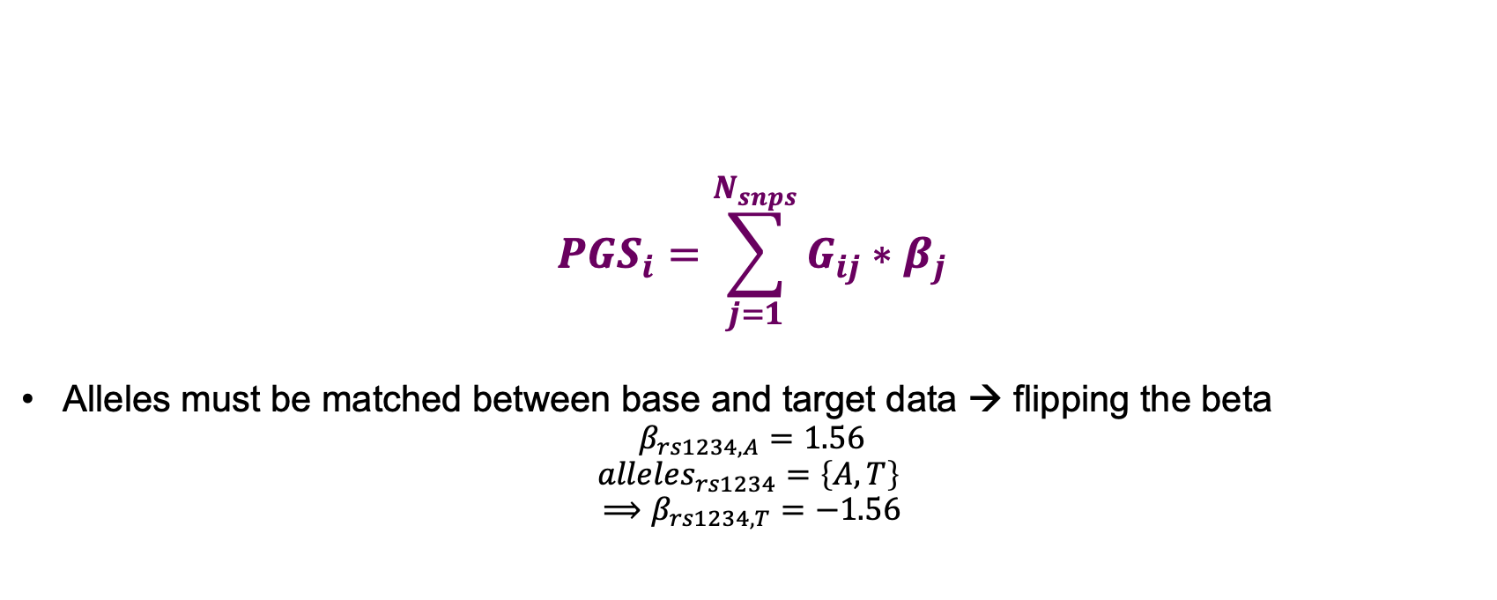
Applying PGS
$${PGS}_{i}=\sum_{j=1}^{N_{snps}}{G_{ij}∗β_{j}}$$
Alleles must be matched between base and target data → flipping the beta
$$β_{rs1234,A}=1.56$$
$$alleles_{rs1234}=\left\{A,T\right\}$$
$$⟹β_{rs1234,T}=−1.56$$
Notes:
Test predictive power of PGS
OR
Apply on real-world patients
Mismatched allele: multiply effect by -1

Slide 47
3
Polygenic scores
3.4
Validation and evaluation

Slide 48
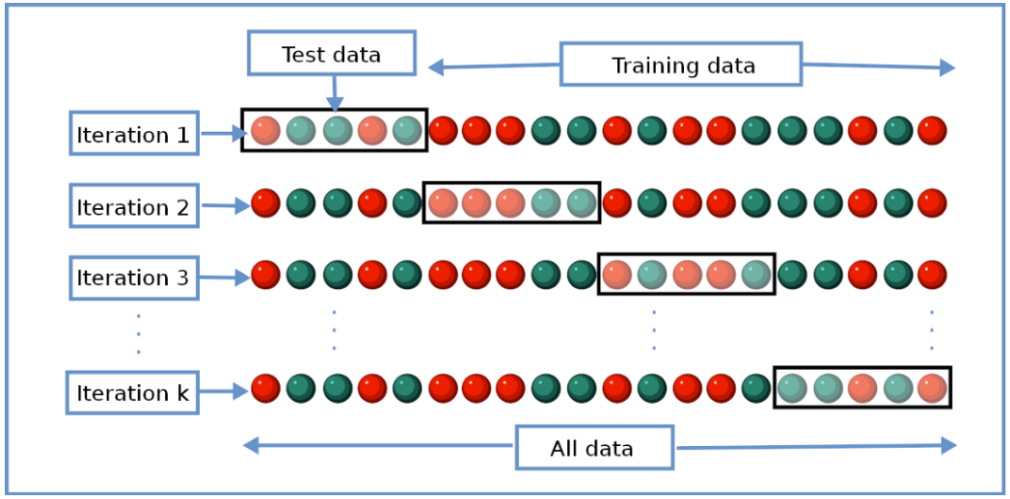
Validation of PGS
K-fold cross-validation
Alternative when no independent dataset is available
Divide the sample in training and validation data
Repeat multiple times, each using a different chunk of the data to train and validate

Slide 49
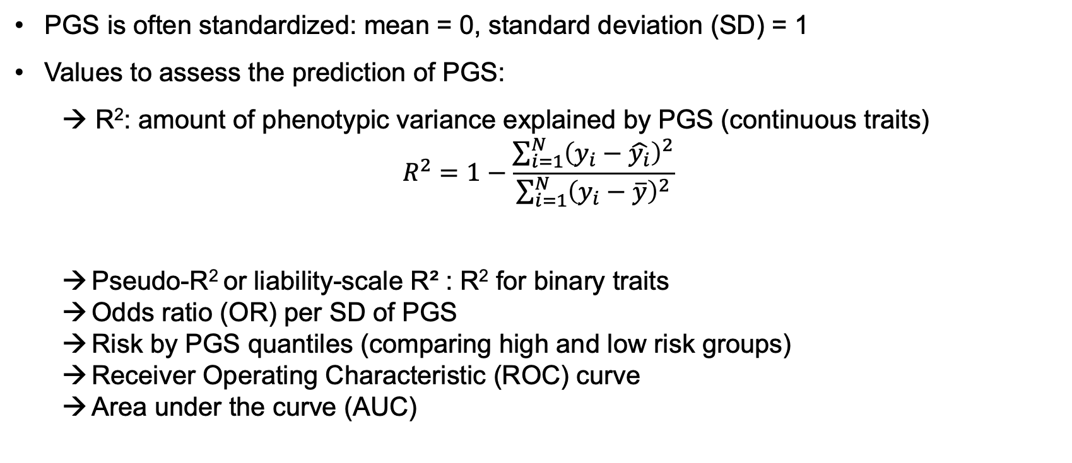
Validation of PGS - assessing the predictive power
PGS is often standardized: mean = 0, standard deviation (SD) = 1
Values to assess the prediction of PGS:
→ R²: amount of phenotypic variance explained by PGS (continuous traits)
$$R^{2}=1−\frac{\sum_{i=1}^{N}{{\left(y_{i}−\hat{y_{i}}\right)}^{2}}}{\sum_{i=1}^{N}{{\left(y_{i}−\overline{y}\right)}^{2}}}$$
Pseudo-R² or liability-scale R² : R² for binary traits
Odds ratio (OR) per SD of PGS
Risk by PGS quantiles (comparing high and low risk groups)
Receiver Operating Characteristic (ROC) curve
Area under the curve (AUC)
Variability in dependent variable not predicted by the model
Variability in dependent variable
Notes:
R2: goodness-of-fit measure
Numerator:
Denominator: how much y varies from its mean
→ proportion of the total variability unexplained by the model. Subtracting this ratio from one results in the proportion of the total variability explained by the model.
Pseudo R2:
https://onlinelibrary.wiley.com/doi/full/10.1002/gepi.21614
https://stats.oarc.ucla.edu/other/mult-pkg/faq/general/faq-what-are-pseudo-r-squareds/
https://shiny.cnsgenomics.com/abc/
ROC = the curve showing how sensitivity and specificity trade off.
AUC = the area under that curve, summarizing overall performance.
So, they’re related:
The AUC is the numerical summary of the ROC curve’s shape.
More SNPs with larger effects → larger AUC
The AUC can take values between 0.5 and 1.0, ranging from completely random, clinically useless predictions to perfect classification.

Slide 50
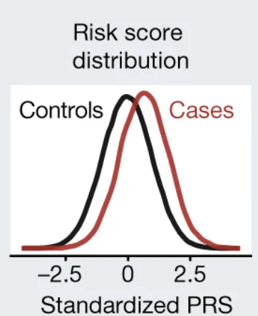
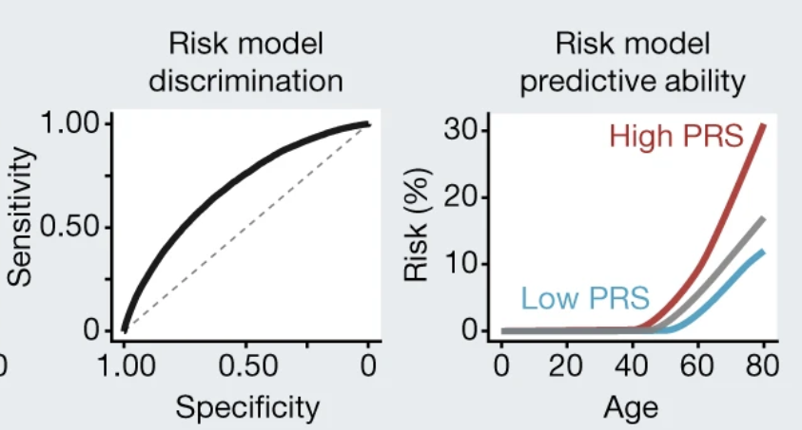
Validation of PGS - visualization
ROC curves: Measure of discrimination in disease prediction
Incidence plots: changes in OR in each quantile compared to the reference
Wand et al. Nat. 2021
Choi et al. Nat. prot. 2020
Notes:
ROC = the curve showing how sensitivity and specificity trade off.
AUC = the area under that curve, summarizing overall performance.
So, they’re related:
The AUC is the numerical summary of the ROC curve’s shape.

Slide 51
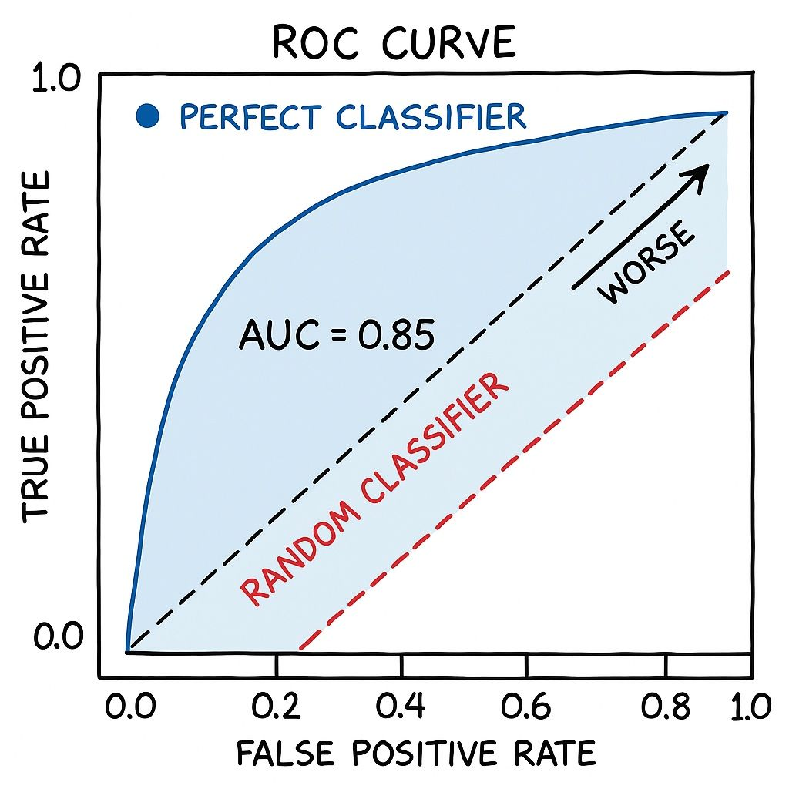
Validation of PGS – ROC curve and AUC
ROC curve = True Positive Rate against the False Positive Rate, shows the trade-off between sensitivity and specificity
AUC = probability that a randomly selected case has a higher predicted risk than a randomly selected control
AUC = 0.5: random prediction of cases and controls
AUC = 1.0: perfect discrimination between cases and controls
AUC can be modest but still identify a small group at substantially elevated risk
Notes:
ROC = the curve showing how sensitivity and specificity trade off.
AUC = the area under that curve, summarizing overall performance.
So, they’re related:
The AUC is the numerical summary of the ROC curve’s shape.

Slide 52
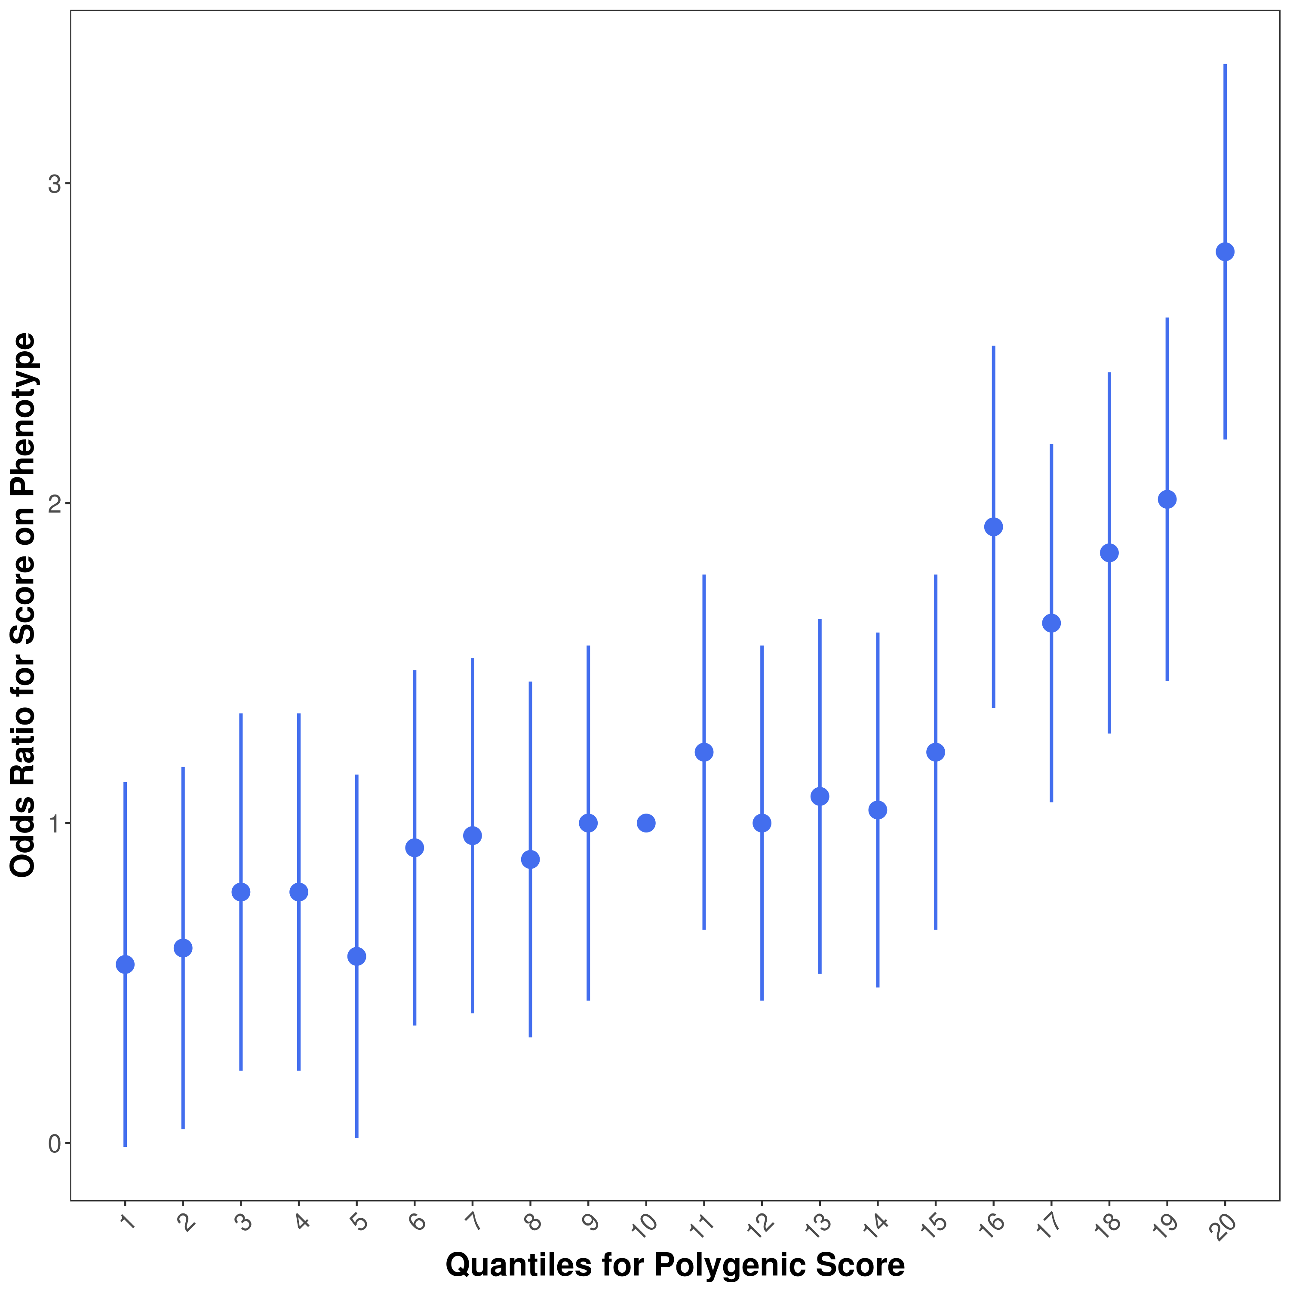
Validation of PGS – Quantile plots
Quantile plots: changes in OR in each quantile compared to the reference.
Notes:
ROC = the curve showing how sensitivity and specificity trade off.
AUC = the area under that curve, summarizing overall performance.
So, they’re related:
The AUC is the numerical summary of the ROC curve’s shape.

Slide 53
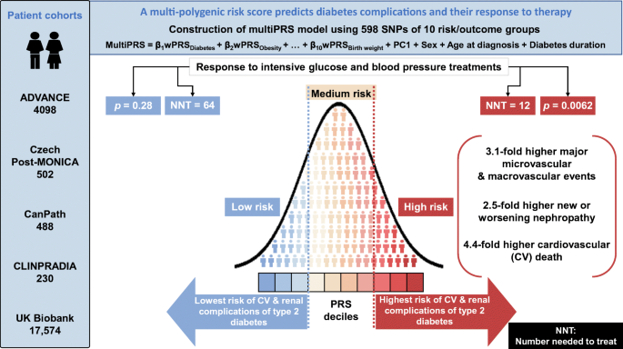
Clinical utility
However!
PGS cannot be regarded as standalone predictors of disease onset
PGS are one component in a multifactorial framework for risk stratification that should incorporate clinical variables, family history, lifestyle and environmental exposures and other omics data
The complex aetiology of complex traits requires integrative risk models that reflect both genetic predisposition and environmental context
MultiPRS model for type 2 diabetes (T2D)
→ Stratify T2D patients according to risk of complications
→ Identify early on T2D patients who would benefit the most from intensive therapy
Kullo, I.J. Clinical use of polygenic risk scores: current status, barriers and future directions. Nat Rev Genet (2025). https://doi.org/10.1038/s41576-025-00900-8
Tremblay, J., Haloui, M., Attaoua, R. et al. Polygenic risk scores predict diabetes complications and their response to intensive blood pressure and glucose control. Diabetologia 64, 2012–2025 (2021). https://doi.org/10.1007/s00125-021-05491-7
Notes:
Raw PGS gives relative genetic liability. For clinical use, it must usually be combined with age, sex, family history, clinical risk factors, disease incidence and ancestry-appropriate calibration to estimate absolute risk.
Clinical implementation still faces challenges including suboptimal precision, poor transferability across populations and limited familiarity among clinicians and patients.

Slide 54
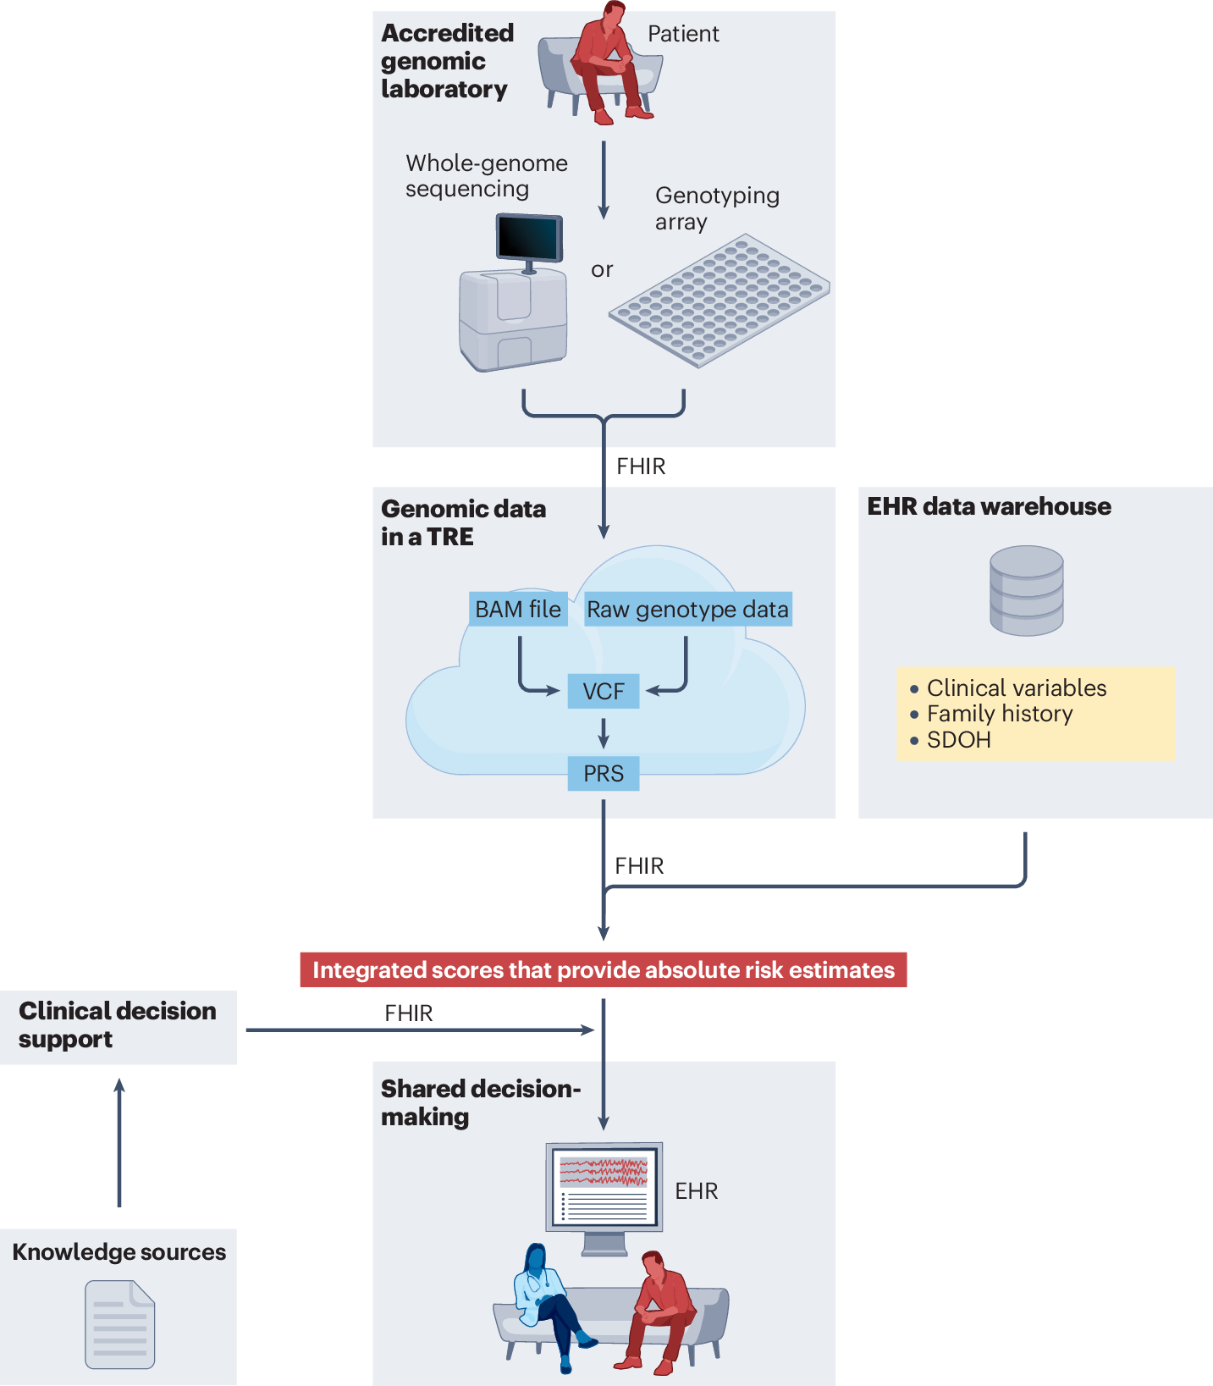
Clinical utility
Kullo, I.J. Clinical use of polygenic risk scores: current status, barriers and future directions. Nat Rev Genet (2025). https://doi.org/10.1038/s41576-025-00900-8
Notes:
Trusted research environment (TRE or ‘cloud’)
Integrated disease risk scores are calculated using PRSs plus clinical variables, family history and social determinants of health (SDOH) obtained from the electronic health record (EHR) data warehouse
Absolute risk estimates are made available to the clinician with linkage to a clinical decision support (CDS) tool and relevant knowledge sources
Fast Healthcare Interoperability Resources (FHIR) specifications facilitate the exchange of genomic data between different domains.

Slide 55
3
Polygenic scores
3.5
Limitations

Slide 56
Limitations of PGS
No environmental factors considered
Dependent on homogeneity in base (discovery) and testing (target) samples
Predictive power depends on sample size of base dataset
Low predictive power → limited clinical use
Low transferability when target data deviates from original GWAS cohort (e.g. different genetic ancestry)
Notes:
Low predictive power for human traits (because no environmental factors included)
Heritability of PRS: best PRS that could be created for the set of SNPs (no estimation and measurement error)
GWAS heritability: allow to estimate maximum potential for PRS associated with common variants
As sample sizes increase we approach the maximum

Slide 57
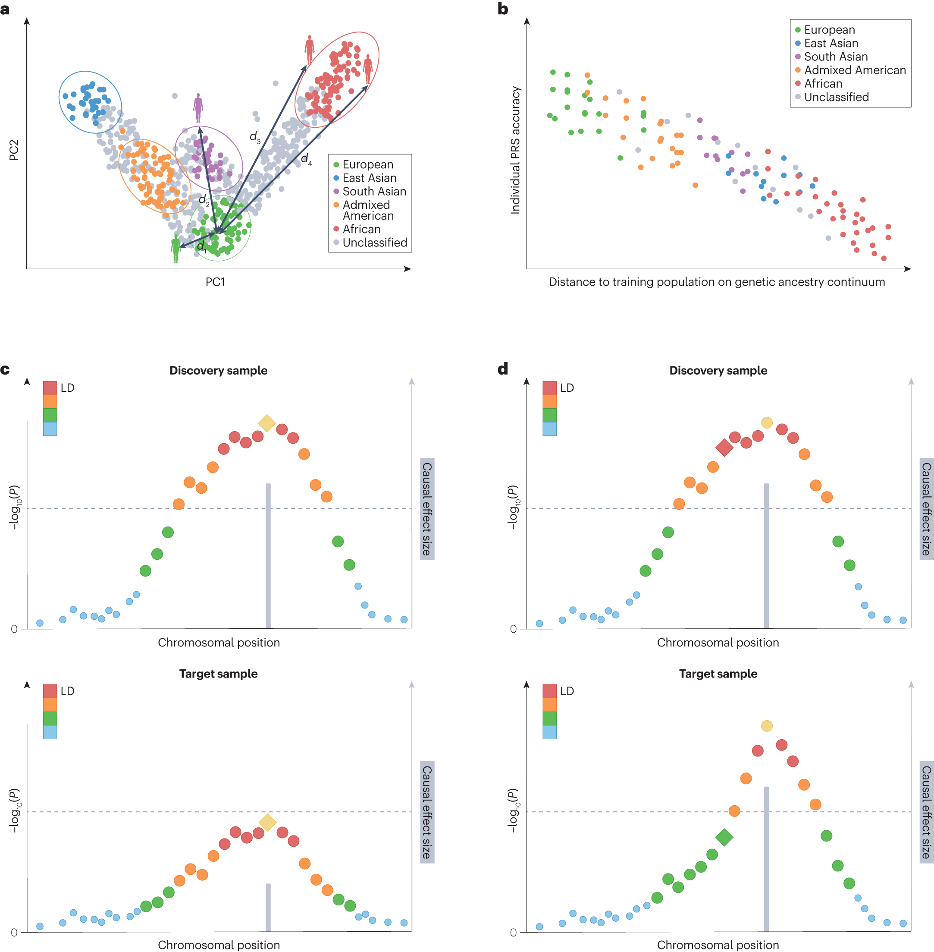
Genetic factors that can influence PGS performance
The accuracy of genomic prediction decreases as the genetic distance between the training and target populations increases
Genetic factors influencing PGS transferability across populations:
differences in genetic heritability
differences in causal allele(s)
allelic frequencies
allelic effect sizes
differences in LD patterns
Kachuri, L., Chatterjee, N., Hirbo, J. et al. Principles and methods for transferring polygenic risk scores across global populations. Nat Rev Genet 25, 8–25 (2024). https://doi.org/10.1038/s41576-023-00637-2

Slide 58


Trans-ancestry PGS: the European GWAS data bias
PGS mainly derived from European populations due to GWAS data availability
Poor transferability to non-European populations
Non-European PGS are limited due to small sample sizes
Trans-ancestry PGS = active area of research
→ Decrease health disparities
Duncan et al. Nat. Comm. 2019
Notes:
European derived PRS predict 2.0 fold less in East Asians
A simplified depiction of how human population genetics and evolutionary history underly differences in polygenic risk score (PRS) distributions across continental groups. Both neutral and non-neutral phenomena influence allele frequencies in such groups. The former includes genetic drift and gene flow facilitated by population migration, and the latter includes forces of natural selection¹⁷². a, After their origin in Africa around 300,000 years ago, anatomically modern humans were exposed to diverse environments, pathogens and nutrients, resulting in their genetic adaptation through natural selection. b, The subsequent migration(s) of humans out of Africa 50,000 years ago was characterized by a population bottleneck, which increased the effect of genetic drift, followed by explosive population growth and migration¹⁷³. Again, exposure to diverse environments, pathogens and nutrients led to the selection of certain genetic variants in different populations¹⁷². c, Differences in allele frequencies and linkage disequilibrium between populations that have been geographically and culturally separated lead to differences in genetic architecture and in the distribution of PRSs. Although causal variants (represented by larger dots within the PRS distributions) may be shared, the frequency and effect sizes differ between groups. This leads to variable transferability of a PRS that is based on data from one genetic ancestry group to other groups. d, To compare effect sizes across different PRSs, traits, cohorts or studies, when the raw score ranges differ, PRSs from different groups are standardized to a mean of zero and a standard deviation (s.d.) of 1.

Slide 59


Methods to improve PRS transferability across populations
Yang, S., Ye, X., Ji, X. et al. PGSFusion streamlines polygenic score construction and epidemiological applications in biobank-scale cohorts. Genome Med 17, 77 (2025). https://doi.org/10.1186/s13073-025-01505-w

Slide 60

Interplay between social, environmental and genetic determinants of health
PGS associations can be biased when genetic ancestry, environment and social determinants are correlated
This can happen because populations share both:
demographic history, which shapes allele frequencies and LD patterns
social history, which shapes exposures such as income, healthcare access and pollution
For instance, a PGS may seem associated with asthma, but part of the signal may reflect differences in:
air pollution exposure
housing conditions
smoking exposure
access to healthcare
neighbourhood or socioeconomic status
Kachuri, L., Chatterjee, N., Hirbo, J. et al. Principles and methods for transferring polygenic risk scores across global populations. Nat Rev Genet 25, 8–25 (2024). https://doi.org/10.1038/s41576-023-00637-2
Notes:
The important point is that ancestry is not only a genetic variable. Because of demographic and social history, ancestry can be correlated with environmental exposures and social determinants of health. For asthma, people with different ancestry backgrounds may also differ in average exposure to air pollution, housing quality, healthcare access or socioeconomic conditions. If we do not model these factors carefully, the PGS may capture part of these environmental differences. PCA adjustment helps correct genetic population structure, but it does not automatically solve confounding from social or environmental variables.

Slide 61

Considerations for the assessment of PRS clinical utility
Visual representation of the difference between risk prediction and risk stratification.
Model calibration = optimized to maximize the agreement between observed and estimated disease risk in one population (here Population A). The risks for Population B are systematically overestimated.
Cross-population calibration of the PGS distributions: important when selecting a single cut-off to identify individuals as high risk across samples with diverse ancestral backgrounds
Kachuri, L., Chatterjee, N., Hirbo, J. et al. Principles and methods for transferring polygenic risk scores across global populations. Nat Rev Genet 25, 8–25 (2024). https://doi.org/10.1038/s41576-023-00637-2

Slide 62
Current state-of-the-art of PGS
Equity across global populations
GWAS data generation from global populations needed
Novel statistical and computational methods needed to improve PGS transferability across populations
2) Integration of PGS in routine health care
Combine PGS with environmental established risk factors
Combine PGS with other data modalities, such as proteomics, metabolomics, imaging and longitudinal EHR data
The Polygenic Risk Methods in Diverse Populations (PRIMED) Consortium is developing methods and combining genomic and phenotypic information to improve the use of PGS in diverse populations for:
Disease risk prediction
Screening strategies for early interventions

