Slide 1
Get the Hint
Word-study tool for Finnish that provides users with infrequent hints-feedback
Maaike Los
Han Havinga
Tessa Bouws

Slide 2
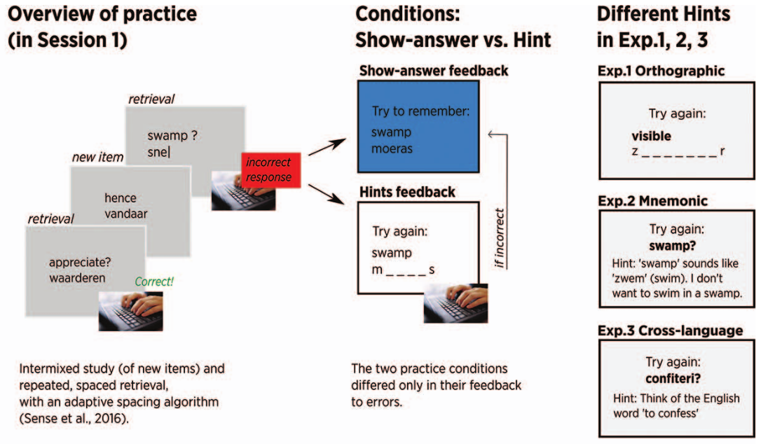
Reminder: Van den Broek et al. (2019)

Slide 3
The Idea
Van den Broek et al. (2019) found no significant difference during test performance between show-answer feedback and hints-feedback
A possible explanation is that students relied to much on the hints / recall prompts
How can we force or encourage students to rely less on hints during testing?

Slide 4
The Idea
Van den Broek et al. (2019) found no significant difference during test performance between show-answer feedback and hints-feedback
A possible explanation is that students relied to much on the hints / recall prompts
How can we force or encourage students to rely less on hints during testing?
We disencourage students to use the hints during practice

Slide 5
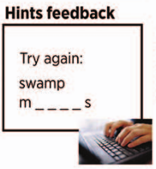
Basic Algorithm
Present the word-pairs in a spacing sequence based on the Slim Stampen algorithm
Give the students the option to buy a hint if they think they do not know the answer
Hints will be orthographic
Gamification by keeping scores:
Correct answer is rewarded with points, also after buying a hint
Buying a hint will cost points
No score, and no penalty, for wrong answers (to encourage students to try if they can remember the word without using the hint)

Slide 6
Model implementation
Participant buys hint ➔ count as an incorrect answer
Participant still does not know the answer ➔ count as another incorrect answer
Participant gives correct answer after hint ➔ count as correct answer with response time multiplied by 1.25

Slide 7
Game & Basic Algorithm
Type ‘1’ to buy a hint.
The game has levels
The higher the level, the higher the cost of a hint
Hints will never cost more than the reward for a correct answer
Second letter given in the hint is randomized
Notes:
Han
Type 1, we don’t use a button because the rest of the game all works with typing, so switching between typing and clicking might become annoying. Clicking is not used in the rest of the game for the sake of measuring reaction times.
The game has different levels. It is a way of making sure that hints become more expensive when you have more points, so buying a hint will still cost the player. If a hint would ever cost more than a correct answer would gain, there would be no point in buying a hint, as it would only make you lose points.
(next slide) The letters given in the hint are randomized to make the chance that people will make the associated between a hint a cue smaller.

Slide 8
Game & Basic Algorithm
Type ‘1’ to buy a hint.
The game has levels
The higher the level, the higher the cost of a hint
Hints will never cost more than the reward for a correct answer
Second letter given in the hint is randomized
Example
Lumi (snow) gets one of the following hints at random:
s n _ _
s _ o _
s _ _ w
Notes:
Han
(next slide) The letters given in the hint are randomized to make the chance that people will make the associated between a hint a cue smaller.

Slide 9
Demo
Notes:
Han
Normal trials:
Study and answer trials
Score bar, Total amount of points and Level
50 points right answer at level 1
Wrong answer:
Always see correct answer, whether in normal trial or after hint
Not lose any points
Buy Hint:
Message to buy hint, press 1
You will lose points
When you answer correctly, you gain points from correct answer
Level up/down:
A situation in which both levelling up and down occurs
Buying a hint -> lose points -> level down
Correct answer -> gain points -> level up
Unlikely to happen, need to buy a lot of hints

Slide 10
Experimental set-up
Short words are short Finnish words, long words are longer Finnish words
English translations are always short
Words randomly divided between conditions for each participant
9 participants
Counterbalanced (4 started with hint, 5 without)
Group 1
Group 2
12 short + 12 long words
With buying hints
12 short + 12 long words
Without hints
10 min.
12 short + 12 long words
Without hints
12 short + 12 long words
With buying hints
10 min.
TEST
24 short + 24 long words
Without hints
3 days later
Notes:
Han
Experimental set-up: We have two conditions, subject study 10 minutes in both. They test after 3 days.
We have Finnish word lists with long and short words -> definitions.
All English translations are short to make sure that hints have the same value (since they would have less value in very long words)
Words are randomly divided to make sure there is no bias from words that might be easier to learn
Counterbalanced to make sure that there is no bias because of what condition comes first.

Slide 11
Hypotheses
Main hypothesis: Better recall for words that were learned with hints than for words with show-answer feedback
Notes:
Main hypothesis: We expect the recall performance on the final test to be better for words that were practiced with orthographic hints feedback, than for words that were practiced with only show-answer feedback.

Slide 12
Hypotheses
Main hypothesis: Better recall for words that were learned with hints than for words with show-answer feedback
Better recall for short than for long words
Notes:
We think the short words might be to be easier to learn than the long words. So we expect a higher recall performance on the final test for the short words than for the long words.

Slide 13
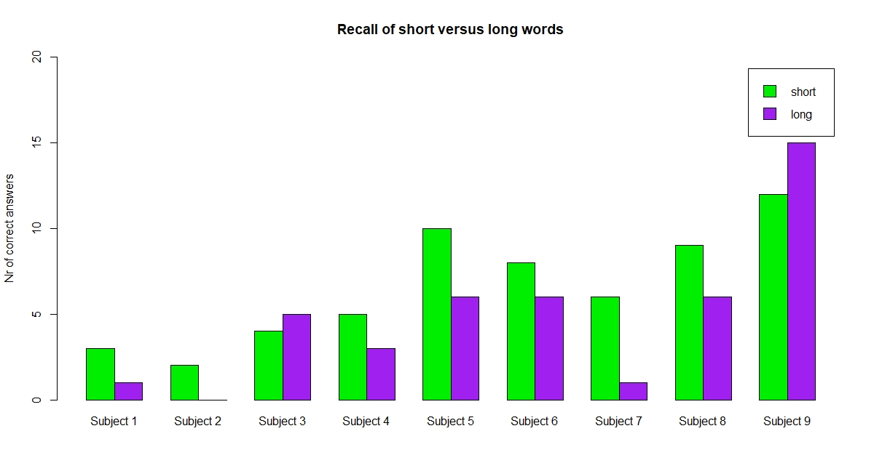
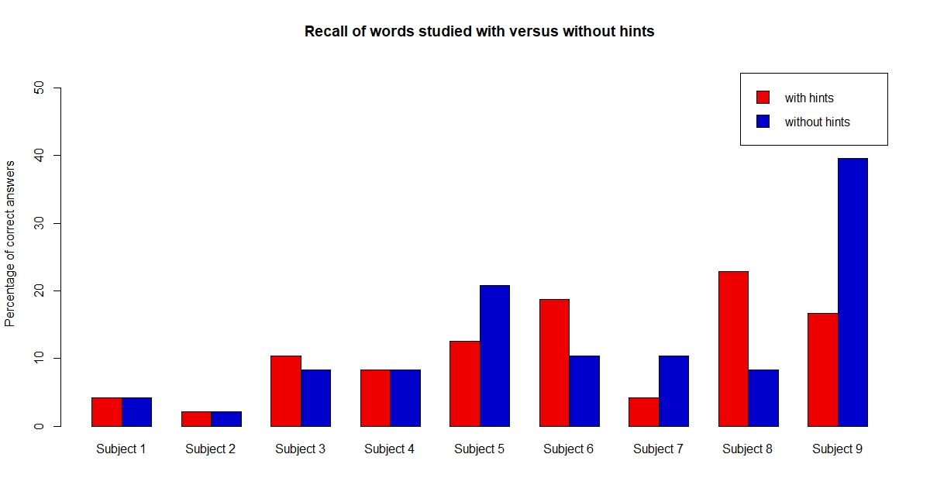
Results: studied with hints vs. without hints
Mean(hints): 11.11
Mean(no hints): 12.5
Results of paired t-test: p = 0.7051
Notes:
Results in percentages. Skip either this slide or the previous one.
Paired t-test
data: (nr_of_correct_hints/4.8 * 10) and (nr_of_correct_no_hints/4.8 * 10)
t = -0.39223, df = 8, p-value = 0.7051
alternative hypothesis: true difference in means is not equal to 0
95 percent confidence interval:
-9.554417 6.776639
sample estimates:
mean of the differences
-1.388889

Slide 14
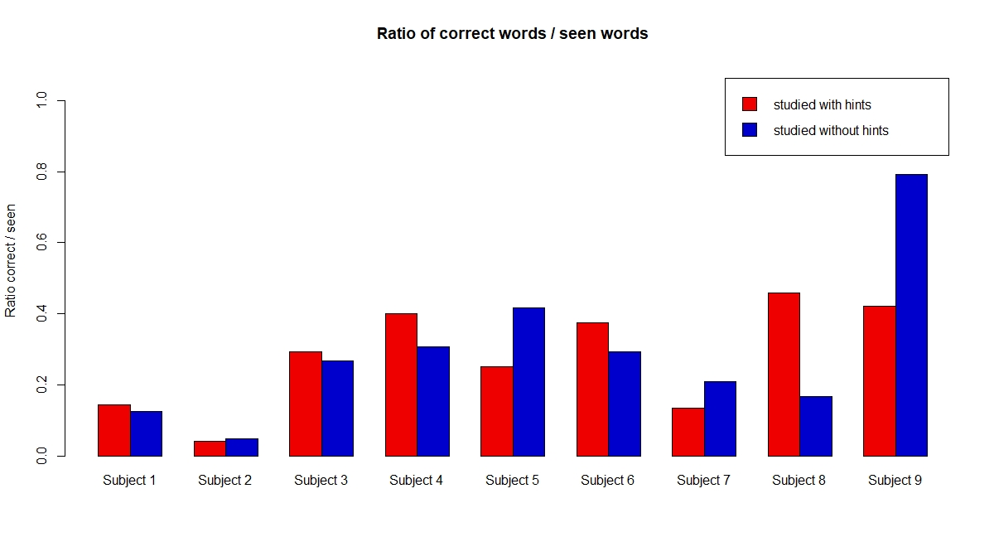
Results: ratio of (words correct)/(words seen) per condition
Mean(hints): 0.2796
Mean(no hints): 0.29160
Results of paired t-test: p = 0.8496
Notes:
Paired t-test
data: ratio_correct_vs_seen_hints and ratio_correct_vs_seen_no_hints
t = -0.19583, df = 8, p-value = 0.8496
alternative hypothesis: true difference in means is not equal to 0
95 percent confidence interval:
-0.1534038 0.1293887
sample estimates:
mean of the differences
-0.01200758

Slide 15
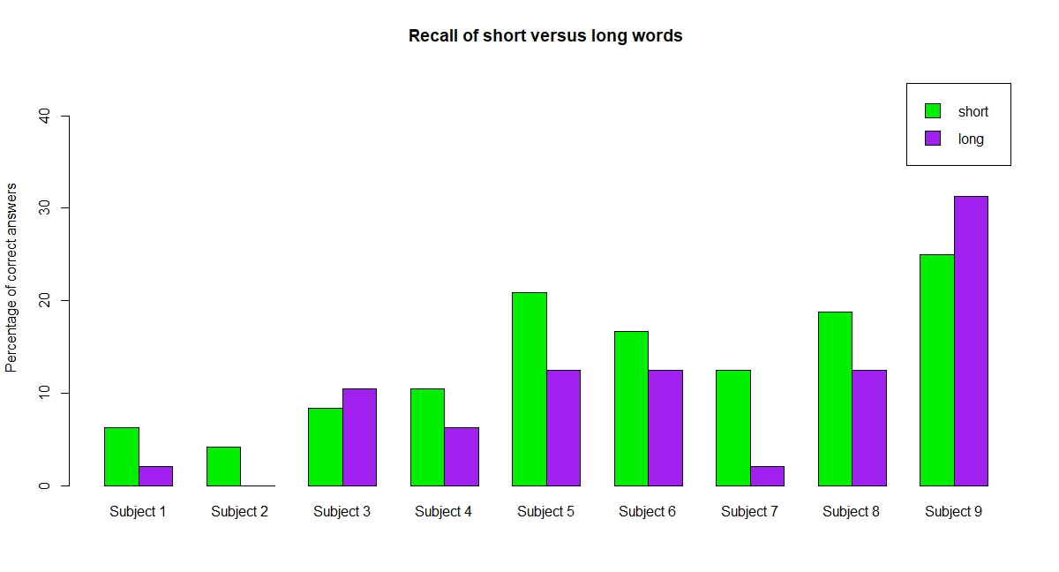
Results: short words vs. long words
Mean(short): 13.66
Mean(long): 9.95
Results of paired t-test: p = 0.06016
Notes:
Paired t-test
data: (nr_of_correct_short/4.8 * 10) and (nr_of_correct_long/4.8 * 10)
t = 2.1875, df = 8, p-value = 0.06016
alternative hypothesis: true difference in means is not equal to 0
95 percent confidence interval:
-0.2006866 7.6080940
sample estimates:
mean of the differences
3.703704

Slide 16
Summary of results
No significant results
The difference between performance on short/long words shows lowest p-value, may be significant in larger subject pool
No interaction between long/short and condition
Small sample (N=9)

Slide 17
Discussion
Number of participants
Low skilled participants (dyslexia)
Not necessary normal distribution (t-tests)
Implementation details
Some people don’t buy hints

Slide 18
Thank you for your attention :)

