Slide 1
Using CosmosDB Stored Procedure for Multiple-Clients Processing
Marvin Heng
www.techconnect.io Twitter: @hmheng

Slide 2
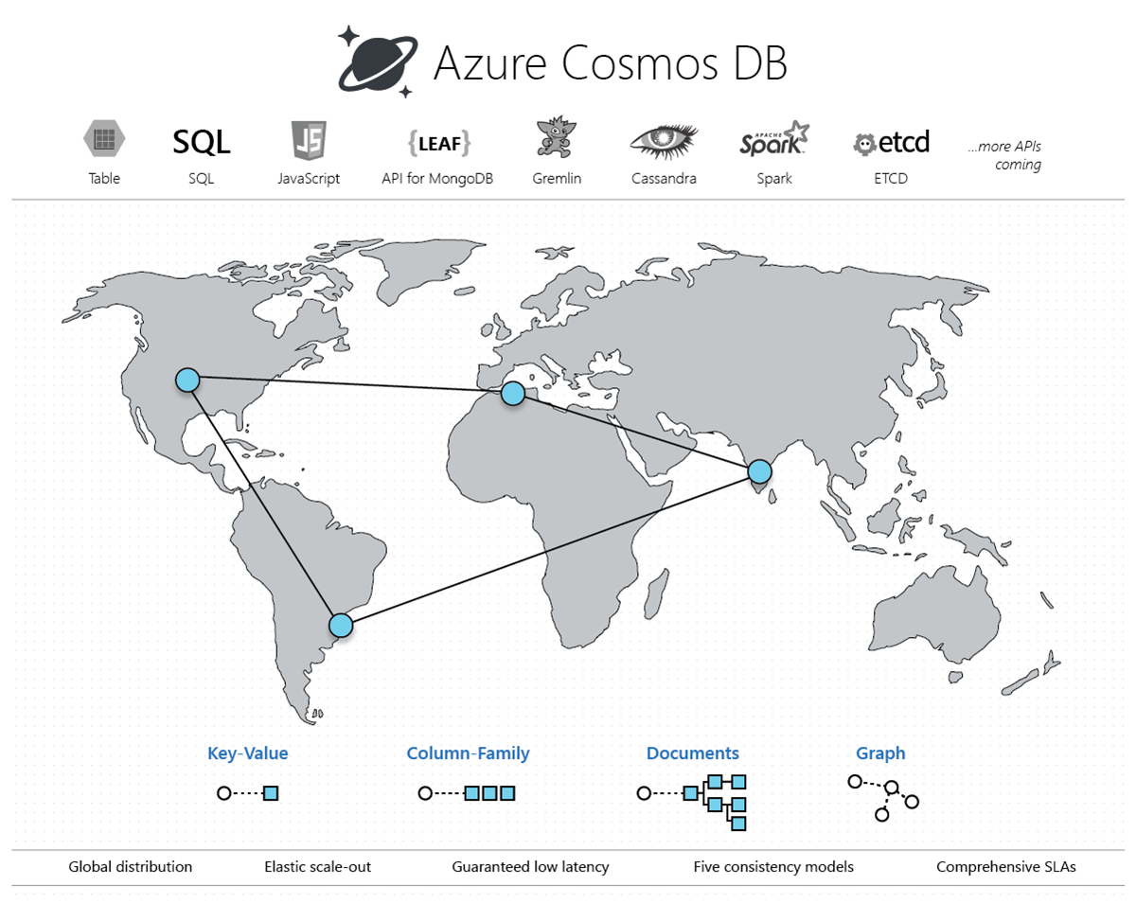

Slide 3

CosmosDB
Stored Procedure
Client 1
Client 2
https://github.com/hmheng/CosmosDBSPDemo

Slide 4
Git Repo
https://github.com/hmheng/CosmosDBSPDemo

Slide 5
Using CosmosDB Stored Procedure for Multiple-Clients Processing
Marvin Heng
www.techconnect.io Twitter: @hmheng

Slide 6

We appreciate your feedback!
https://bit.ly/2Xp20Vy

