Slide 1
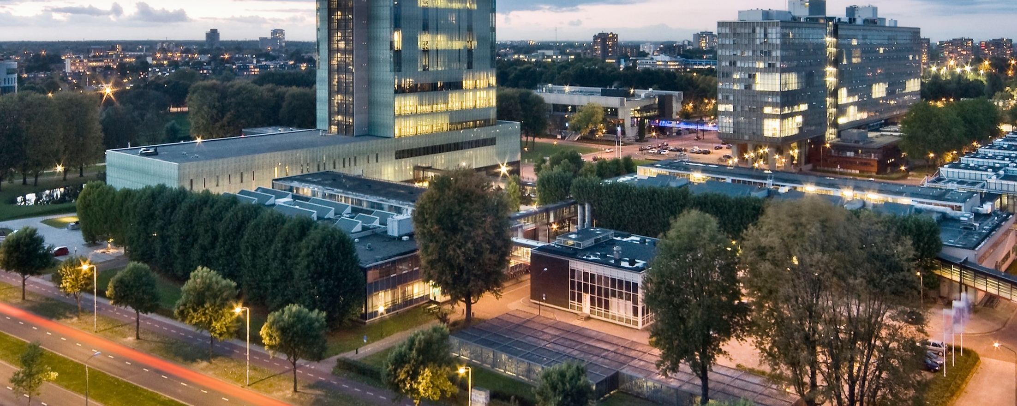
Designing the national HPC and public cloud-based solutions for the data-driven animal behavior detection
Progress Update
Jan 16, 2024
Oct 17, 2023

Slide 2
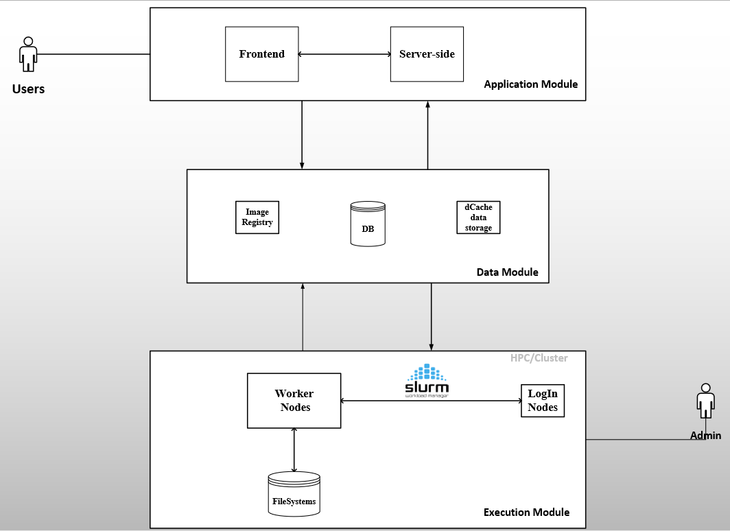
Progress Update
Image Registry: To store container images
DB: To store task information
(token) and users
Data storage (dCache): To store
Input data (datasets) and model results
HPC* filesystem (scratch):
To temporarily store data for fast I/O
operations
HPC: High performance computing

Slide 3








Progress Update
Users
Frontend
(HTML, JS, CSS, React)
Server-side
Firestore
WebApp
CouchDB
PiCaClient
Login Node
admin
Container Registry
Worker nodes
Cluster
Backend

Slide 4

Backend: Containerize FairMOT Model
Preparation
Libraries and dependencies
Extract input fields
Data Preparation
Definition file
Image
Verification
Error
Store in Repo
Run via
PiCas
Run via
UI

Slide 5
Pilot-Job frameworks
Radical-Job (formerly Big-Job)
Falkon (Fast and Light-weight tasK executiON framework)
DIRAC
DIANE (Distributed Analysis Environment)
PanDA (Production and Distributed Analysis)

Slide 6

Documentation
Tasks | Status
Chapter 1-4 (Introduction, Problem analysis, stakeholder analysis, Requirements)
Chapter 5-8 (Investigating pilot-job frameworks, design and architecture, Verification and validation, Conclusion and result) | In progress
Pilot-Job frameworks
Radical-Job (formerly Big-Job)
Falkon (Fast and Light-weight tasK executiON framework)
DIRAC
DIANE (Distributed Analysis Environment)
PanDA (Production and Distributed Analysis)

Slide 7
Defense and
Closure
Prepare for defense
Submit report to TEC
Presentation and defense
Project Booklet
Clearance (TU/e card, return laptop,
monitor, back up email)
FairMOT Containerization
WebApp Integration
Jan 8 -12 | 15-19 | 22-26 | 29-02 | Feb 05-09 | 12-16 | 19-23 | 26-01 | Mar 04-08 | 11-15 | 18-22 | 25-29
Send report
to TEC
Demo: Running a model via Martijn’s webAPP
Verification and validation
Presentation
and defense

Slide 8
Defense and
Closure
Prepare for defense
Submit report to TEC
Presentation and defense
Project Booklet
Clearance (TU/e card, return laptop,
monitor, back up email)
Report writing
Review (by sup.)
and revise
Send for
review
Jan 8 -12 | 15-19 | 22-26 | 29-02 | Feb 05-09 | 12-16 | 19-23 | 26-01 | Mar 04-08 | 11-15 | 18-22 | 25-29
Thesis outline
(updated and detailed)
Review
by Judith
Send report
to TEC
Review Thesis
Presentation
and defense

Slide 9
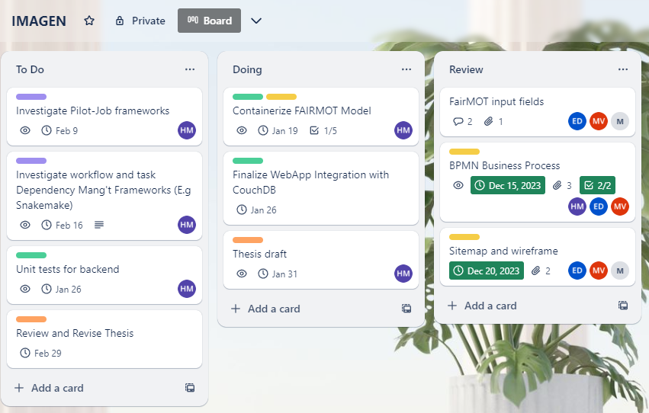
Project Plan

