Slide 1

Designing the national HPC and public cloud-based solutions for the data-driven animal behavior detection
Discussion with surf
Nov 28, 2023
Oct 17, 2023

Slide 2
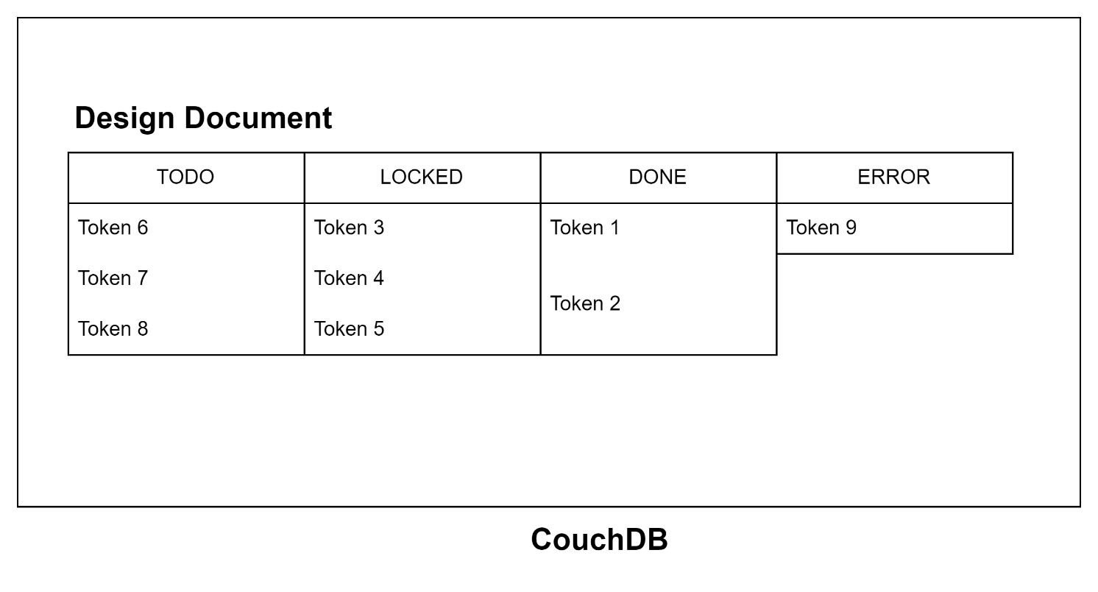
Progress Update: Jobs with no priority (default)
PilotJob
(PiCas Client)
Fetch Tokens
Push Tokens
UI

Slide 3
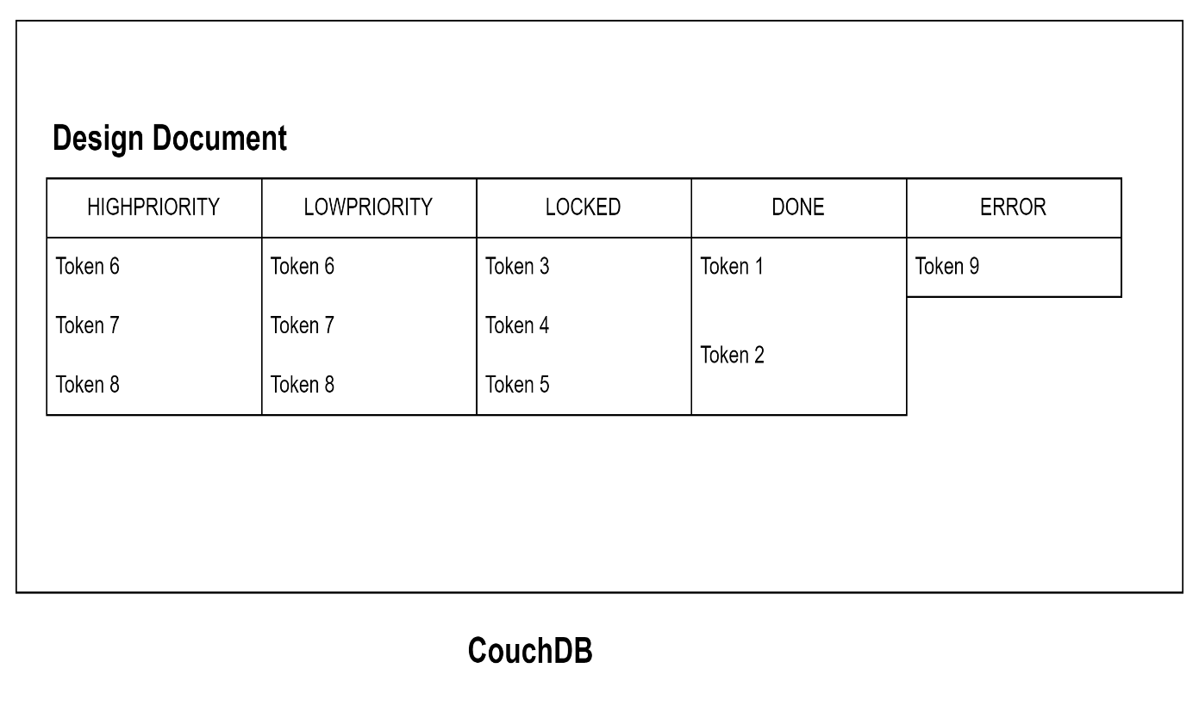
Progress Update: Jobs with priority
PilotJob
(PiCas Client)
Fetch Tokens
Priority == 1
Priority == 0
Push Tokens
UI

Slide 4
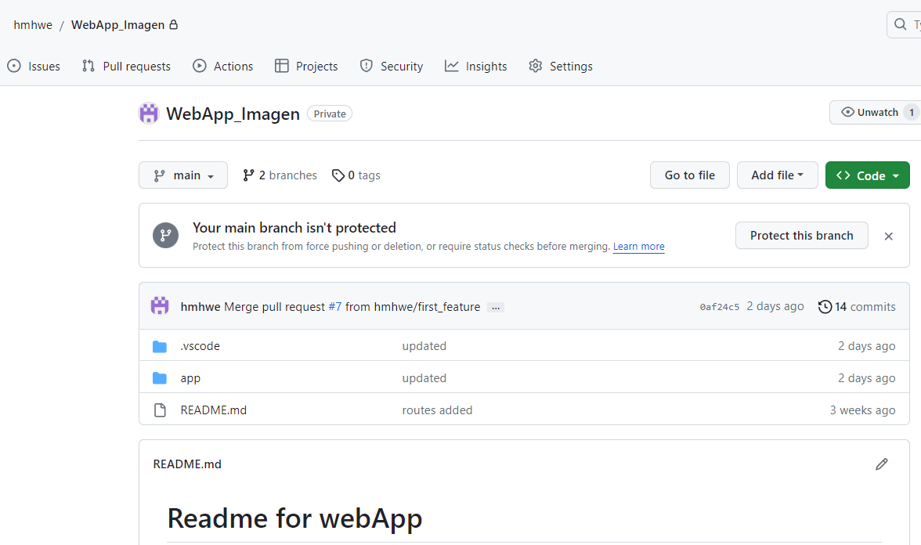
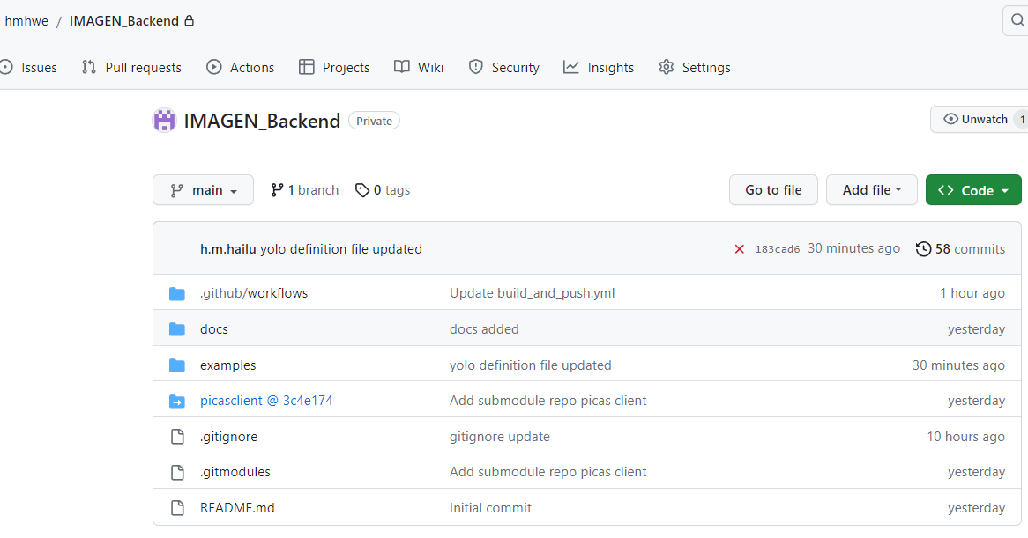
Progress Update: GitHub Repos for Backend and WebApp
Weekly slides

Slide 5
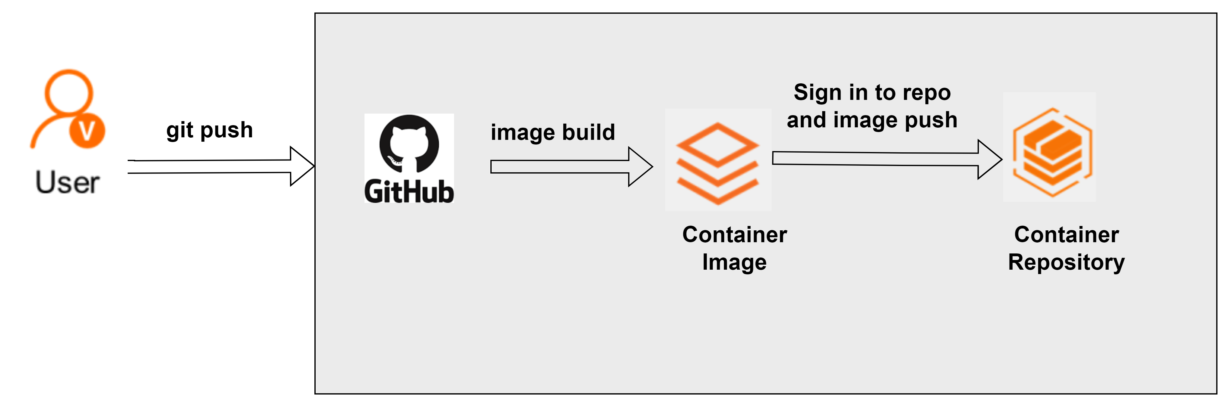
Progress Update: CI/CD using GitHub actions
GitHub Action
Rapid feedback
Improved quality
Fast deployment
Better collaboration

Slide 6

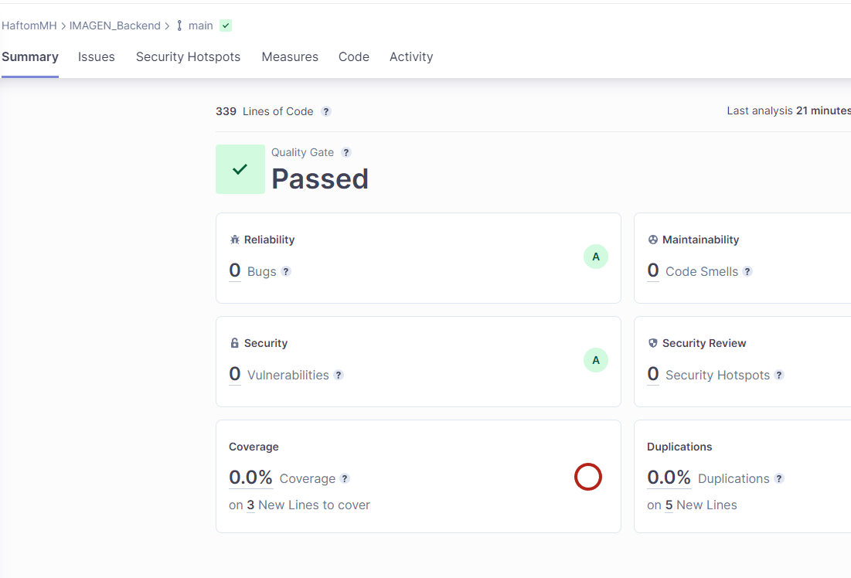

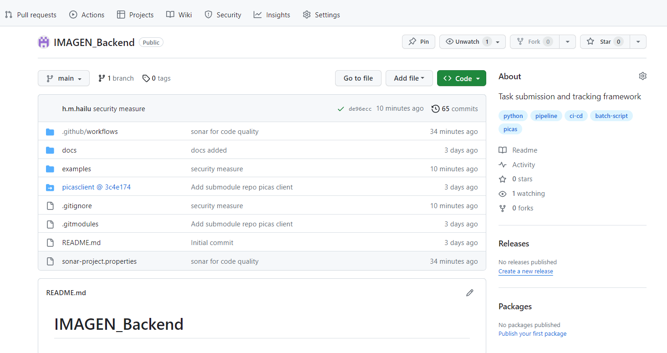

Progress Update: SonarQube for Security and code quality
Push
Pull

Slide 7
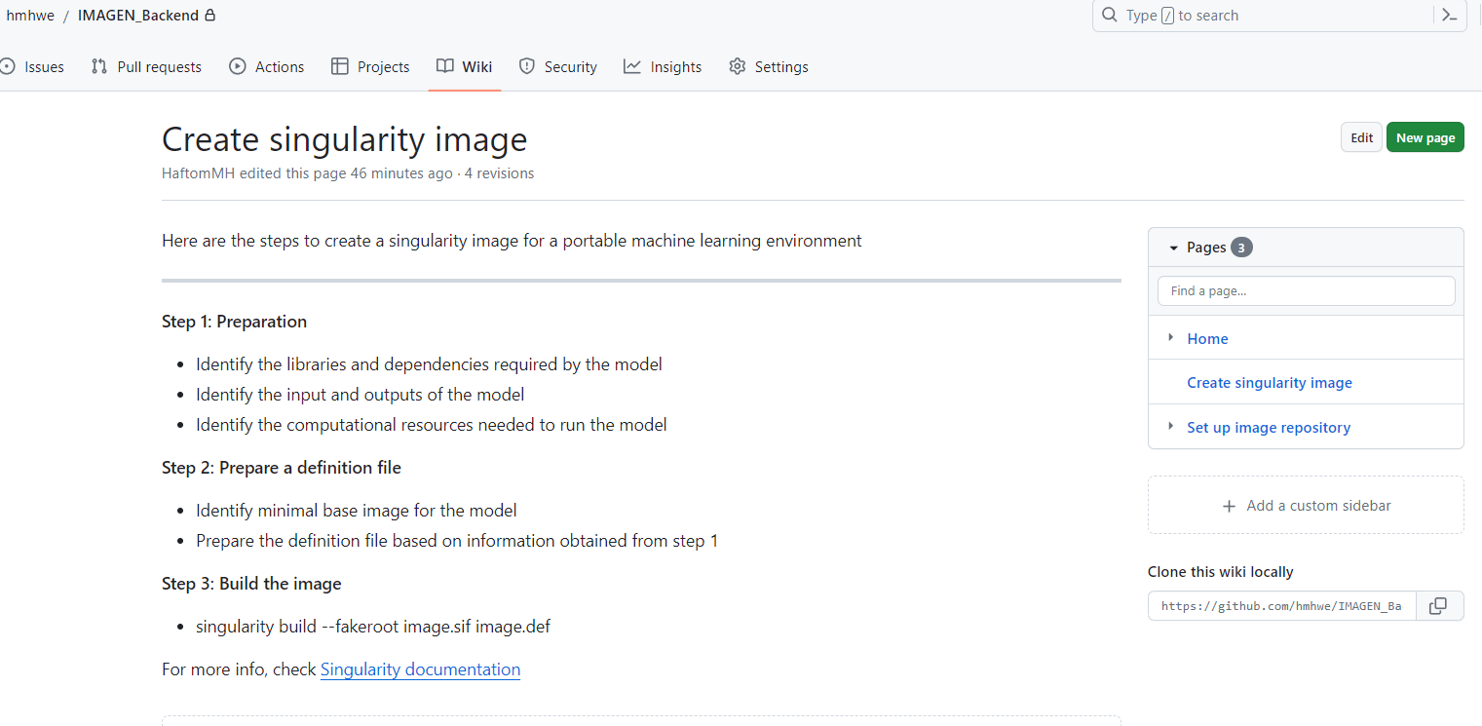
Progress Update: Wiki

Slide 8
Plan for this week
Meeting with stakeholders

Slide 9
Reminder
No GPU resource on spider
Send me your GitHub usernames

