Slide 1
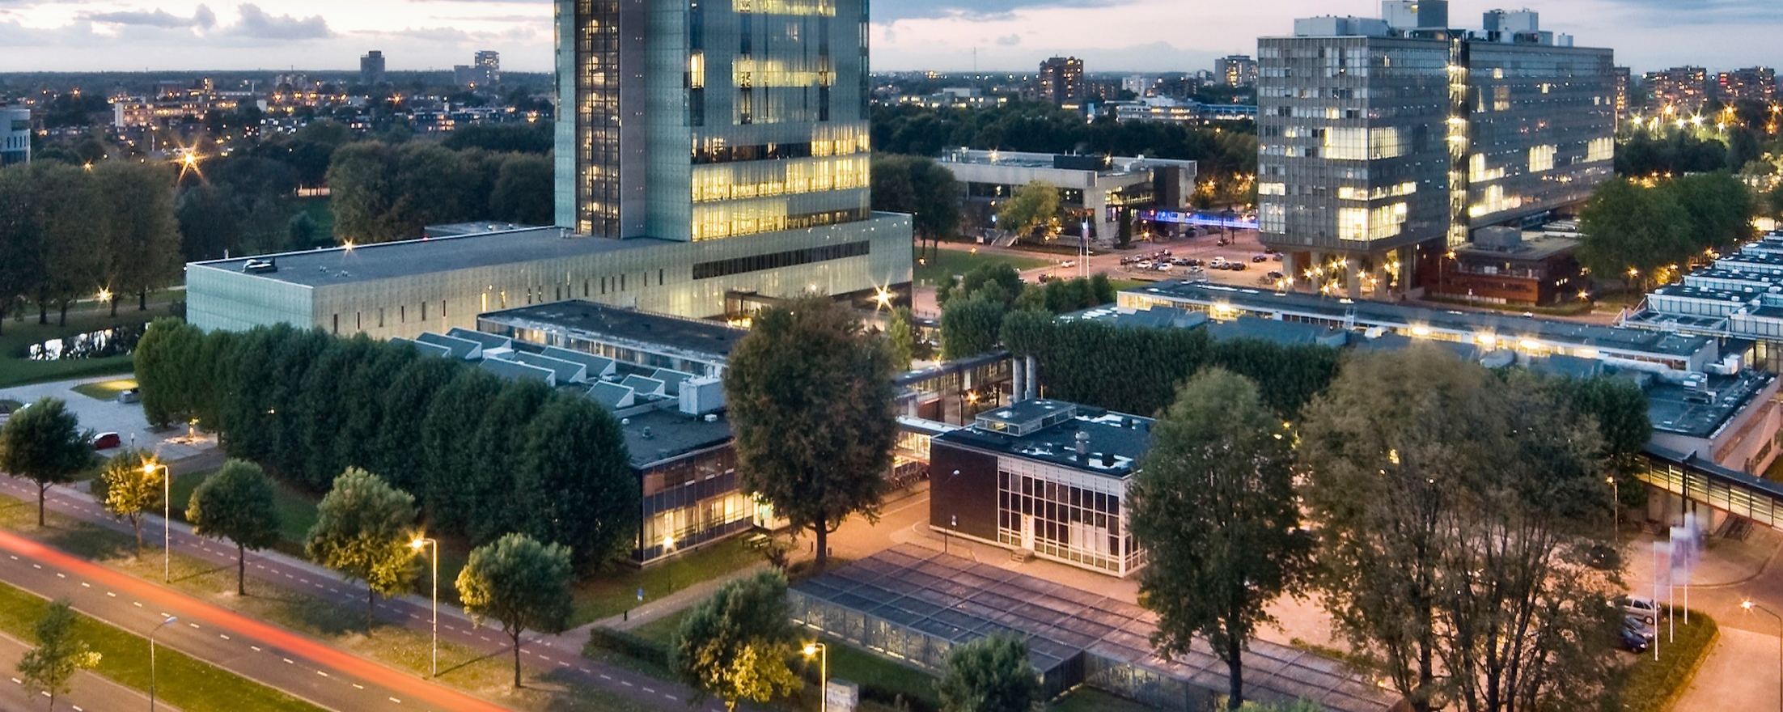
Designing the national HPC and public cloud-based solutions for the data-driven animal behavior detection
Haftom Hailu
Discussion with Surf
Nov 17, 2023
Oct 17, 2023

Slide 2
Tasks
DL models (Yolov5)
Yolov5
(.py)
Input data
Training result
Parameters
Epoch
Learning rate
….
….
Video synchronization
Synchronization
(.py)
Input video
Updated video
Testcase number

Slide 3
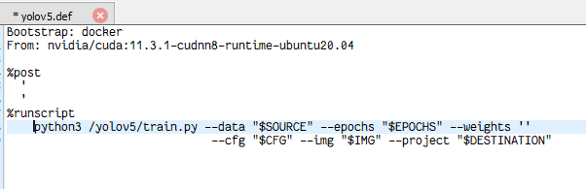
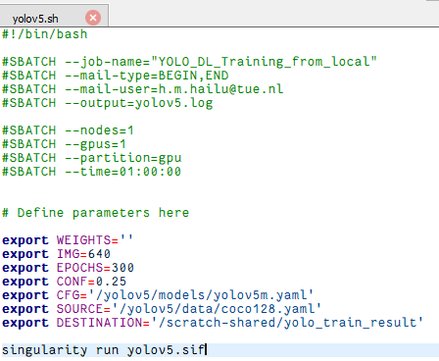
Task
(.py)
Definition file(.def)
Singularity Image Format (.sif)
Batch
(.sh)
singularity build….

Slide 4
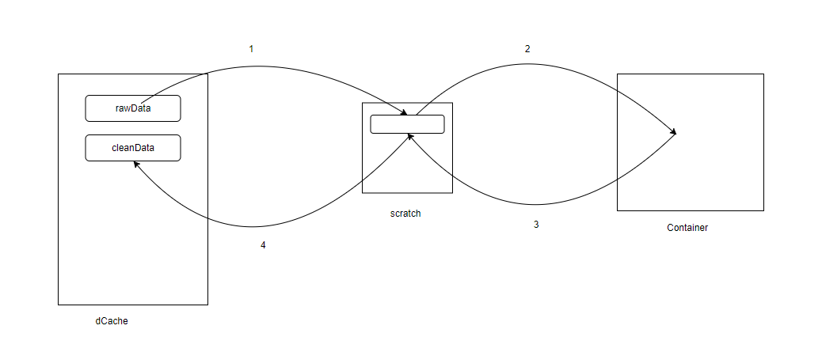
Pipeline

Slide 5
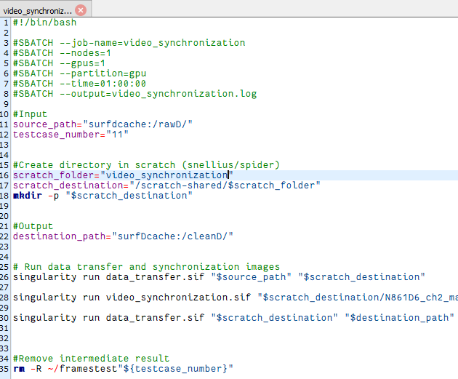
Pipeline

Slide 6
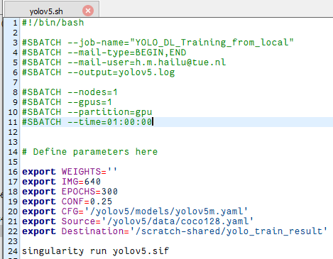
DL(Yolovs) – Token creation
Input parameters
Token structure
lock: timestamp in seconds, integer
done: timestamp in seconds, integer
Task_type: string
hostname: string
input: dictionary
{ WEIGHTS: “”
IMG: “”
CFG: “”
EPOCHS: “”
}
output: dictionary

Slide 7
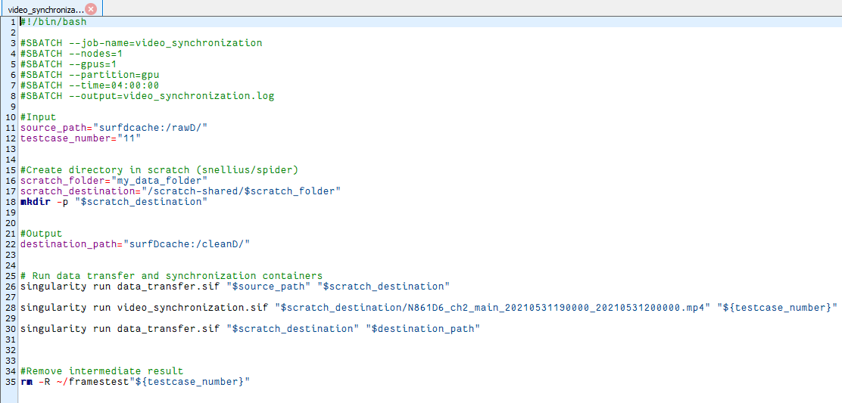
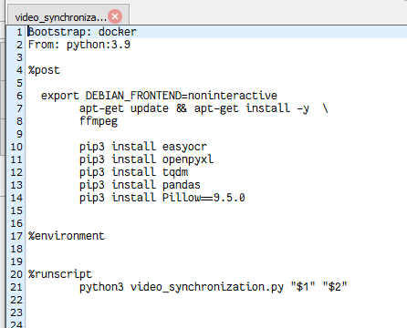
Data synchronization
Definition file
Job script

