Slide 1
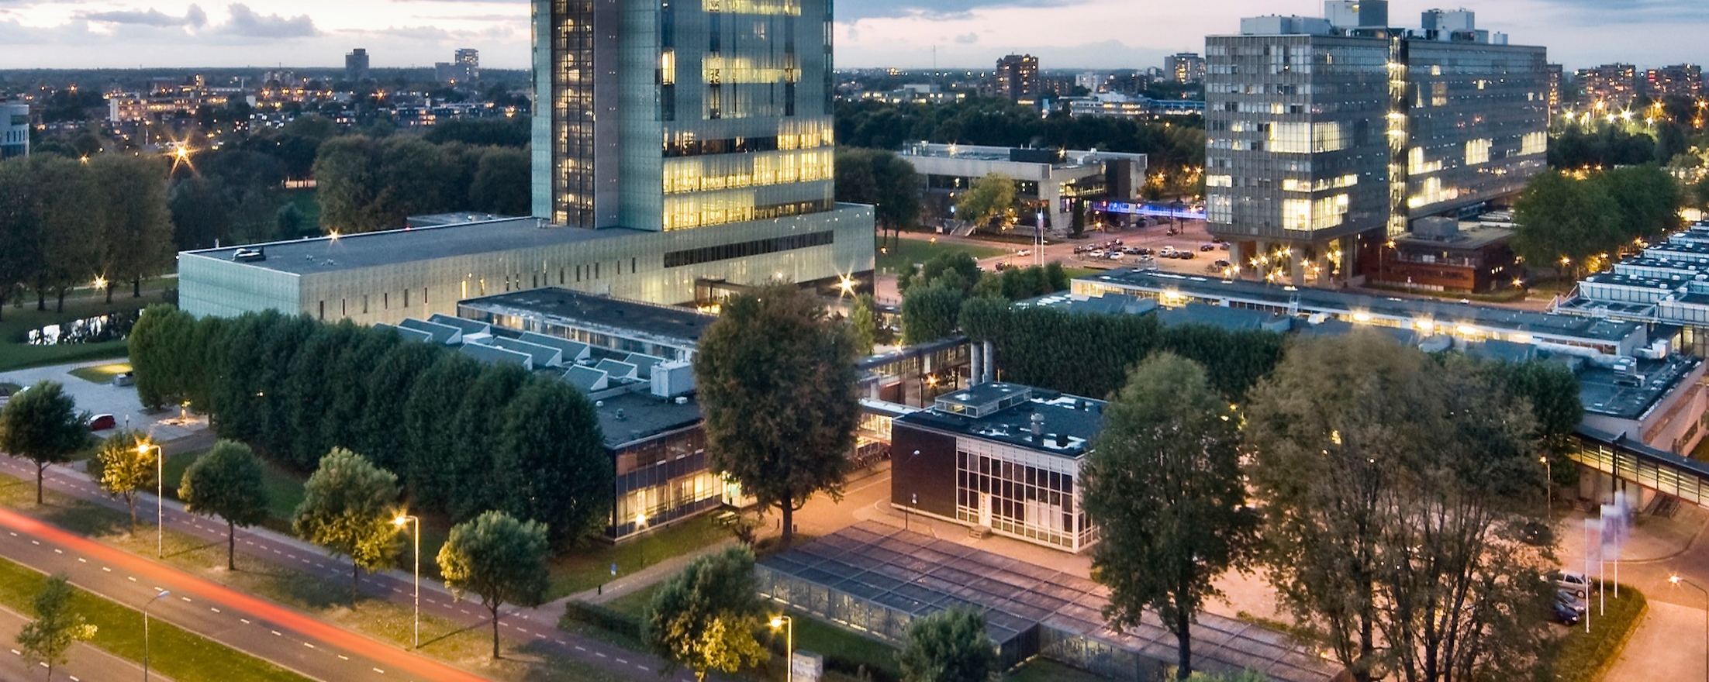
Designing the national HPC and public cloud-based solutions for the data-driven animal behavior detection
Haftom Hailu
Discussion with surf
Oct 24
Oct 17, 2023

Slide 2



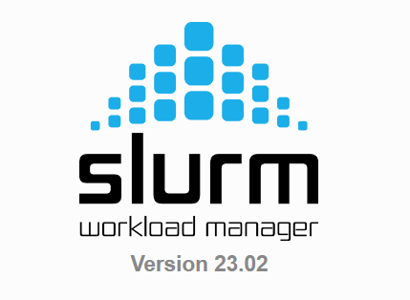

Progress update
{
"_id": "token_1",
"task_type": "YOLOv5",
"lock": 0,
"done": 0,
"gpu": "0",
"CONF": 0.25,
"WEIGHTS": "",
"EPOCHS": 10,
"IMG": 640, }
#!/bin/bash
…….. ……..
Pull and
run image
run python pilot1.py
pilot_gpu.sh
yoloToken.txt
pushToken ….
Fetch & process
token
sbatch ….
Login Node
CouchDB
Compute nodes
#!/bin/bash
…….. ……..
{
"_id": "token_1",
"task_type": "Synchronization",
"lock": 0,
"done": 0,
"gpu": "0",
"TestcastNumber": 12,
}
run python pilot2.py
pilot_cpu.sh
synchronization.txt
Users
(CV, researchers…)
HPC environment
(Admin)

Slide 3
Progress update
Yolov5.sh
Run yolov5.sif
pilot_Gpu.sh
pilotJob1.py
Data_Cleaning.sh
Run dataTransfer.sif
Run videoSynchr.sif
Run dataTransfer.sif

