Slide 1

Designing the national HPC and public cloud-based solutions for the data-driven animal behavior detection
Haftom Hailu
Discussion and question session with surfsara
Sep 25, 2023

Slide 2
Pilot job workflow

Slide 3


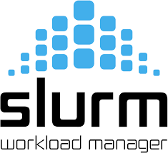
Pilot job workflow
1. User uploads tokens to DB
CouchDB
User
4. User retrieves results from DB
3. Retrieve and update DB
2. User submits a job
Worker nodes

Slide 4
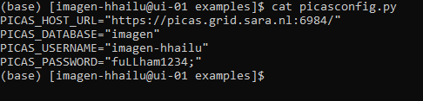
Configure picas
Push tokens
Submit pilot job
Output
configure picascongig.py

Slide 5
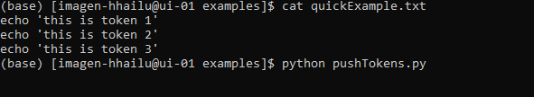
Configure picas
Push tokens
Submit pilot job
Output
First, create tokens
Push tokens using pushTokens.py

Slide 6
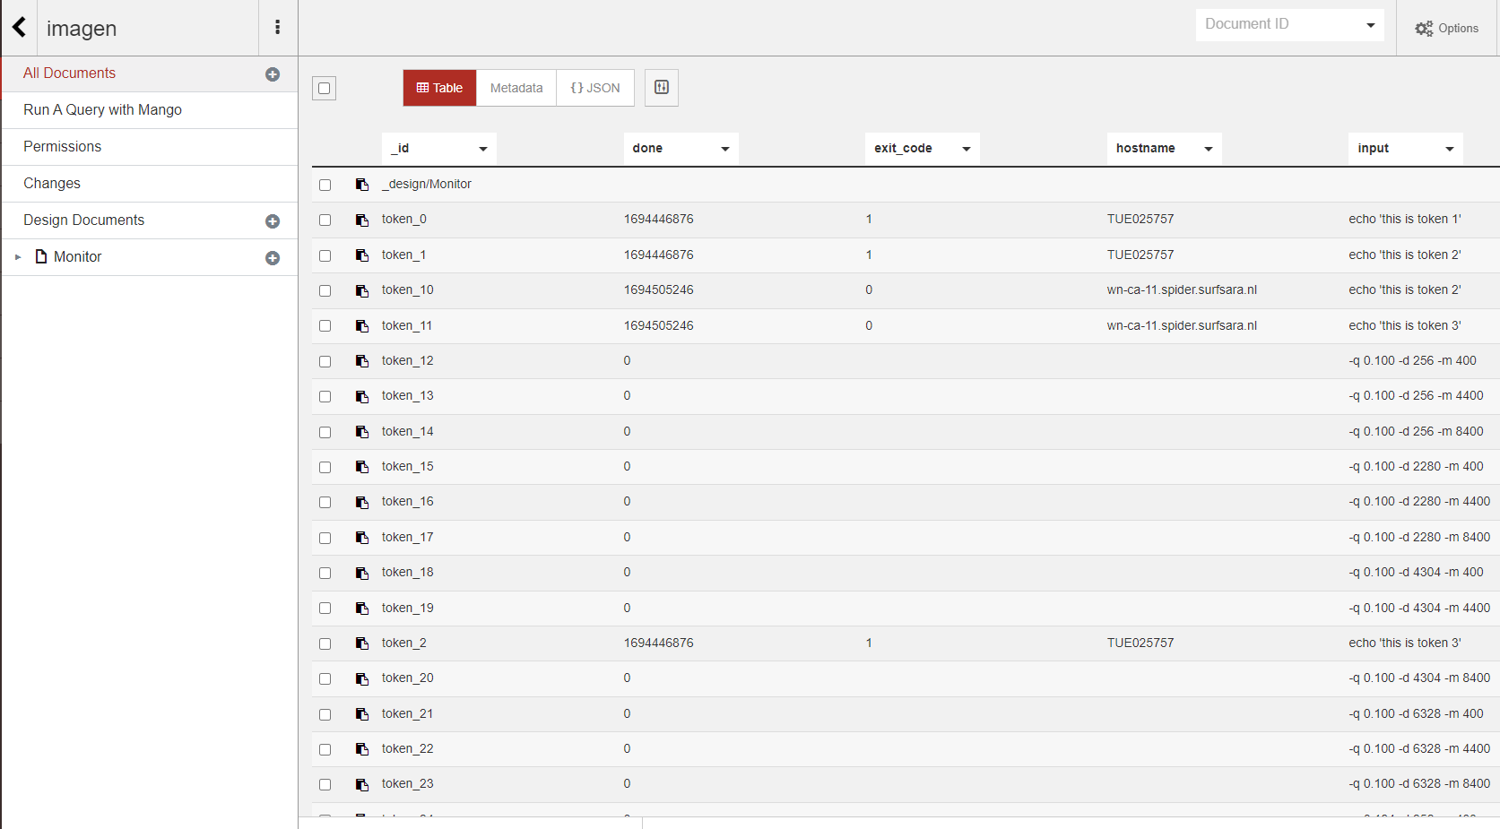
Configure picas
Push tokens
Submit pilot job
Output
Push tokens using pushTokens.py
CouchDB

Slide 7

Configure picas
Push tokens
Submit pilot job
Output
The pilot job has the following responsibilities
Todo
Lock
Done

Slide 8
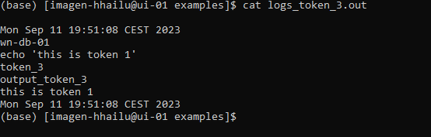
Configure picas
Push tokens
Submit pilot job
Output
Check outputs and logs

Slide 9
Token lifecycle
id
lock | 13453
done | 0
hostname | “”
Scrub_count | 0
id
lock | 13453
done | 12543
hostname | “”
Scrub_count | 0
Done
done
Todo
Lock
lock
scrub
id
lock | 0
done | 0
hostname | “”
Scrub_count | 0
scrub
id
lock | 13453
done | 0
hostname | “”
Scrub_count | 1

Slide 10
Questions
Why do we need pilot frameworks such as PiCas?
In what scenario do we use PiCas?
What benefits do we get?
How does it reduce the overhead in job submission?
Do we need to submit pilot job and tokens for each task?
Can we reuse tokens?
How to identify which token to use?
What happen when a pilot job failed?

Slide 11


Working with Supercomputers
ssh
Job
Submission
User
Login Node
Batch System
Shared Filesystem
Compute Nodes

Slide 12
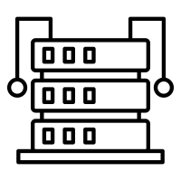
Supercomputers
Login Node(s)
Compute Nodes
Compile programs
Editing and
transferring files
Multicore nodes
Large memories
High-speed
interconnections
Batch System
Filesystem
Resource allocation
Job queueing
Accounting
Parallel FS
Efficient I/O
Node local disks

