Slide 1
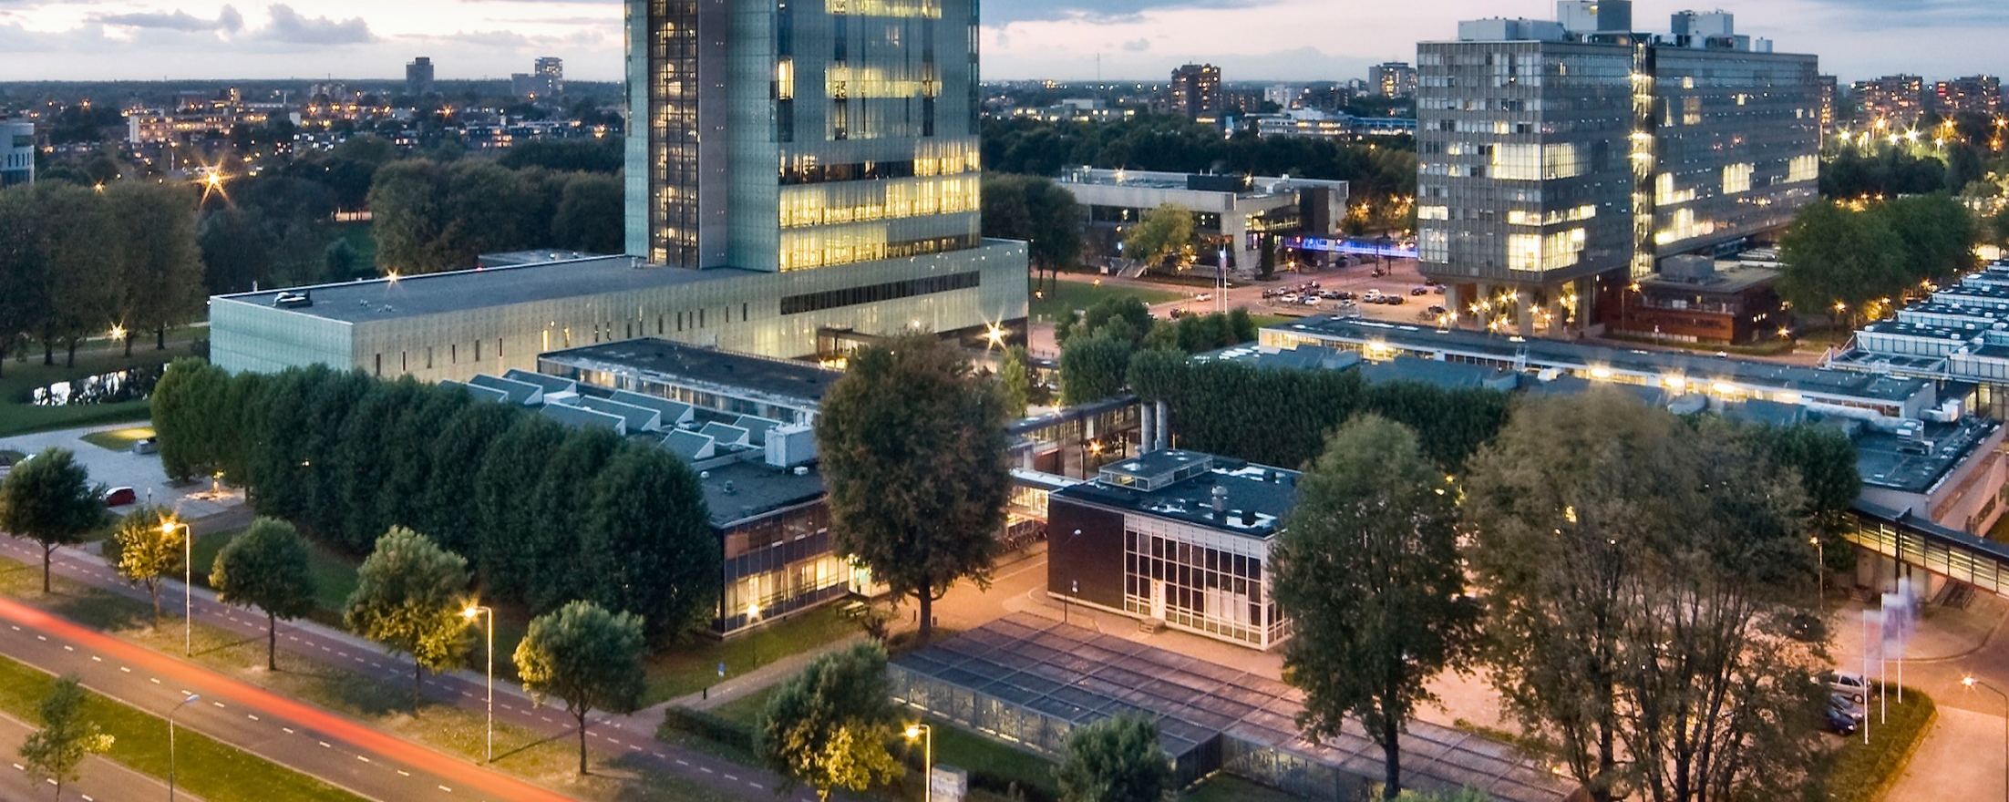
Designing the national HPC and public cloud-based solutions for the data-driven animal behavior detection
Discussion with surf
Nov 7, 2023
Oct 17, 2023

Slide 2
Progress Update
Doc attachment is working
GitHub Repo (Slides, codes,..)
Computation requirement

Slide 3
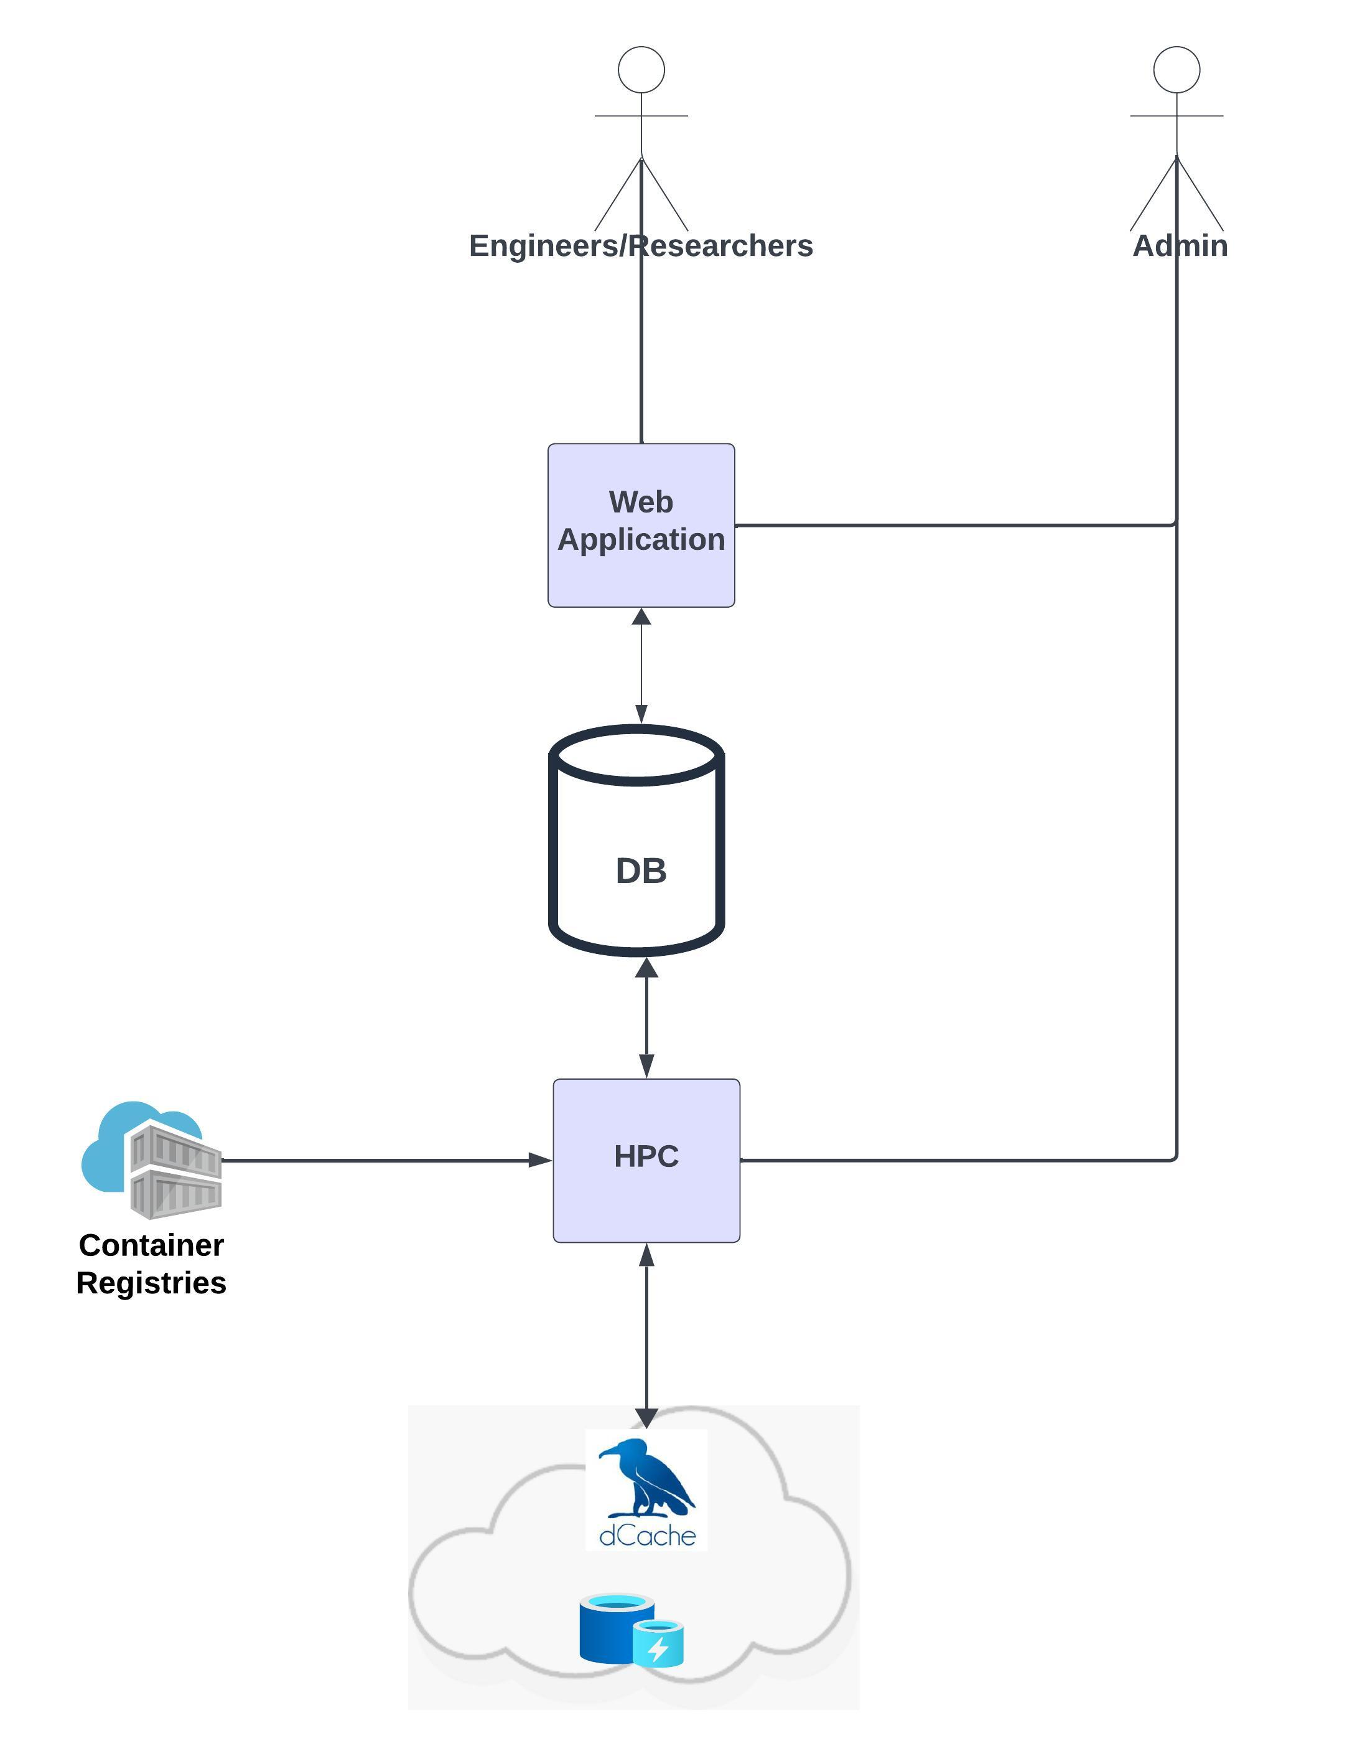
Progress Update: Context Diagram

Slide 4
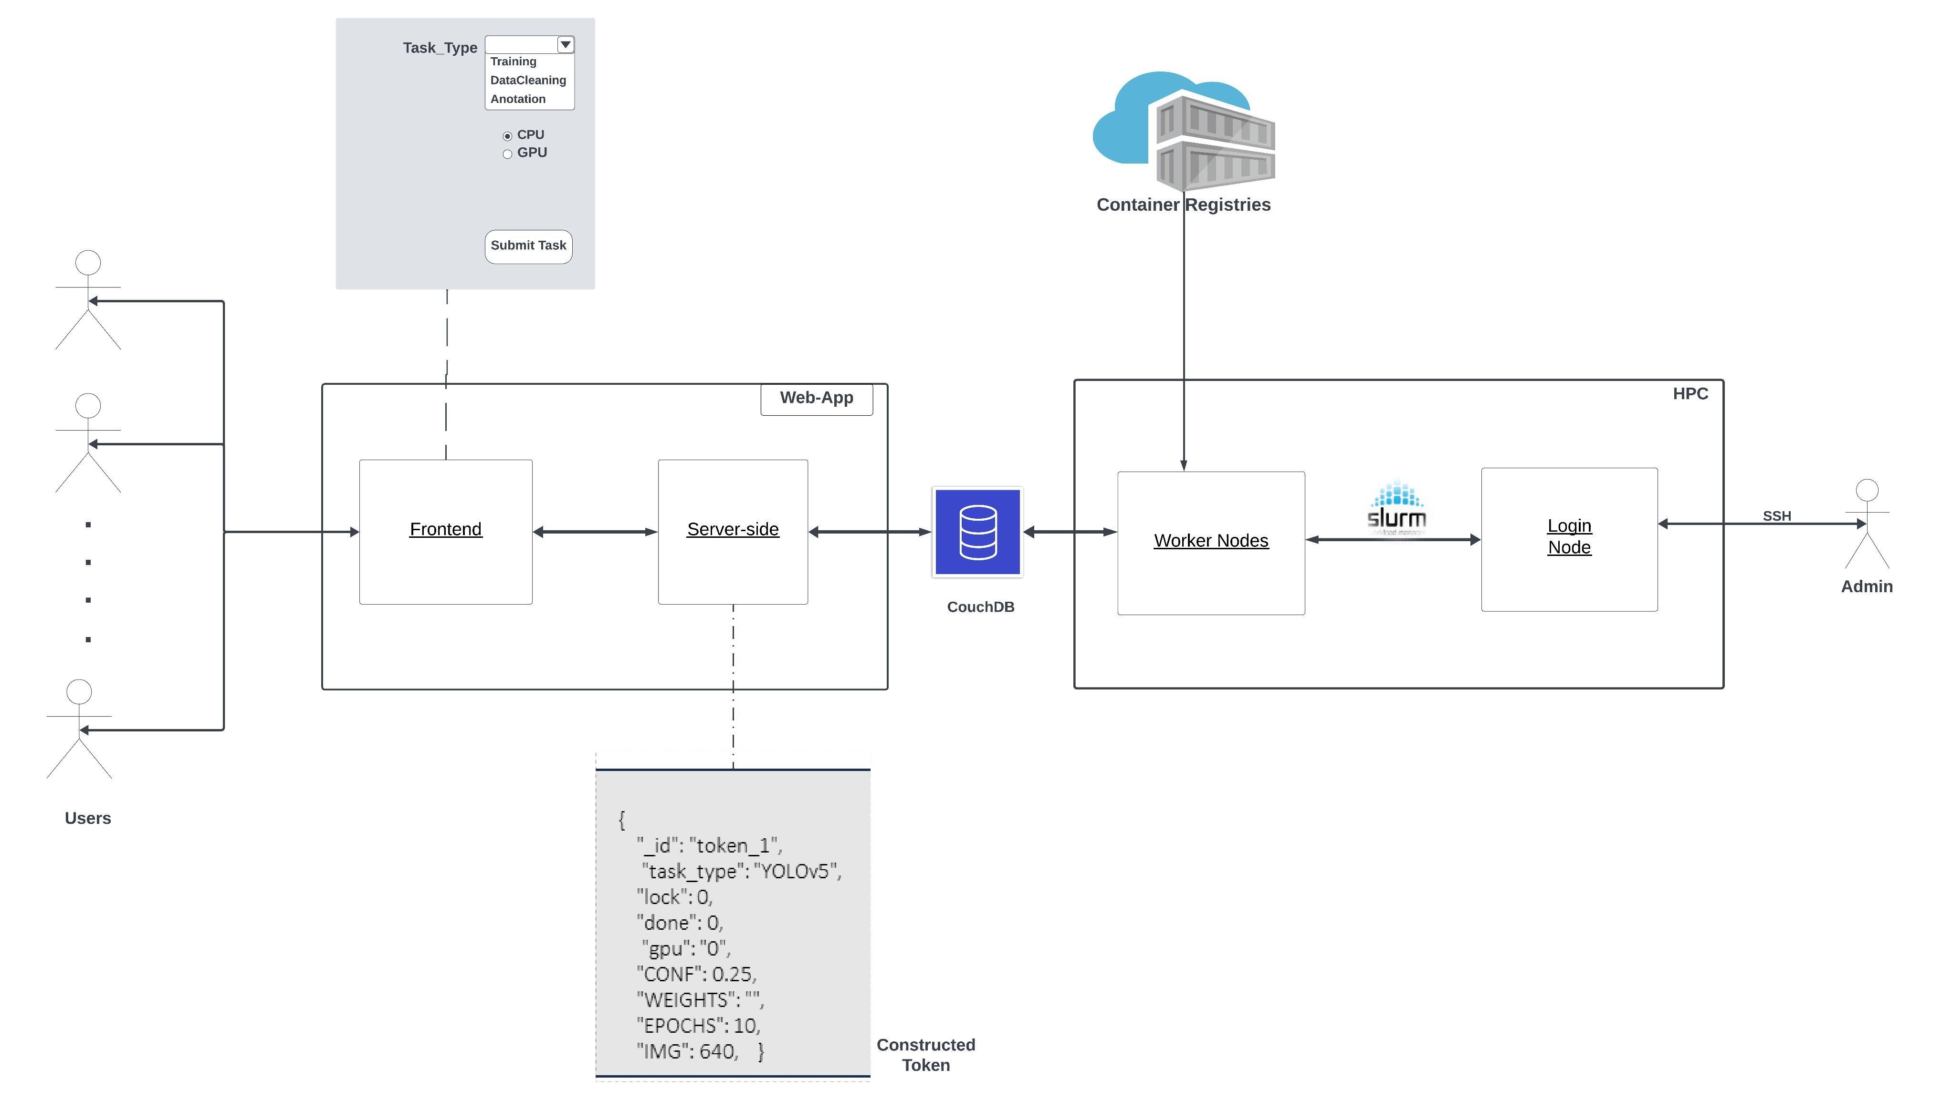
Progress Update

Slide 5




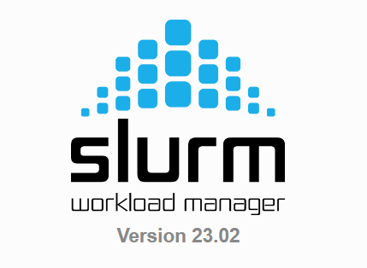




Progress Update
Users
Frontend
(HTML, JS, CSS…)
Server-side
( Flask)
MySQL
(optional)
Web app
CouchDB
Login Node
admin
Container Repo
Worker nodes
HPC Environment

Slide 6
Creating views in CouchDB
How does picas client know which design document to use?

Slide 7
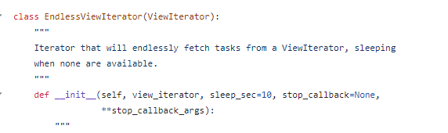
Creating views in CouchDB
Creating views ( for jobs with no priority)
Done
TODO
Done>0 && Exit_code == 0
Lock == 0 && done== 0
views
todo
Lock > && Done== 0
locked
Locked
Lock > 0 && done ==0
Done > 0 && Exit_code != 0
Done
Lock > 0 && done > 0 && exit_code ==0
Error
Error
Lock > 0 && done > 0 && exit_code !=0 >
Overview

Slide 8
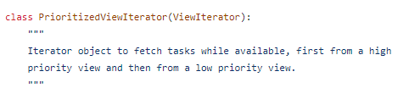
Creating views in CouchDB
Creating views ( for jobs with priority)
Done
High priority
highPriority
Lock == 0 && done== 0 && priority == 1
Done>0 && Exit_code == 0
Lock > && Done== 0
Low priority
locked
views
Lock == 0 && done== 0 && priority == 0
Lock > && Done== 0
Done > 0 && Exit_code != 0
Locked
Lock > 0 && done ==0
lowPriority
Error
Done
Lock > 0 && done > 0 && exit_code ==0
Error
Lock > 0 && done > 0 && exit_code !=0 >

