Slide 1

Designing the national HPC and public cloud-based solutions for the data-driven animal behavior detection
Discussion with surf
Nov 21, 2023
Oct 17, 2023

Slide 2
Update
WebApp development
How does picas client know which design document to use?
Blockers
None
Plan for next week
Automate(partly) pilot job submission - scrontab
Meeting with users of the system

Slide 3




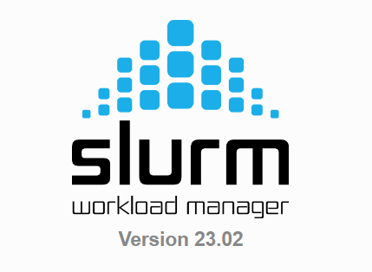




Users
Frontend
(HTML, JS, CSS…)
Server-side
( Flask)
MySQL
(optional)
Web app
CouchDB
Login Node
admin
Container Repo
Worker nodes
Cluster

