Slide 1
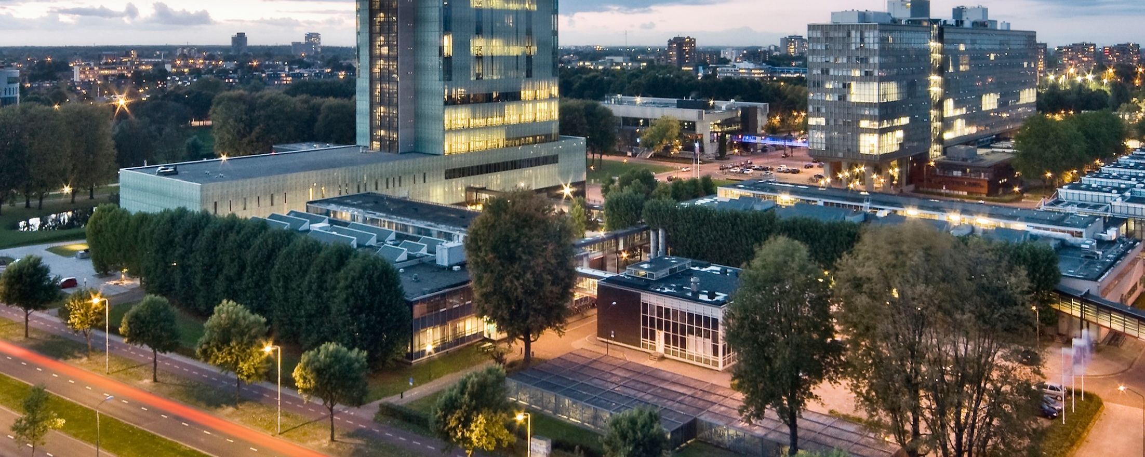
Designing the national HPC and public cloud-based solutions for the data-driven animal behavior detection
Discussion with surf
Dec 05, 2023
Oct 17, 2023

Slide 2
Progress update
Meeting with stakeholders
Models and data
Computational resources
UI

Slide 3
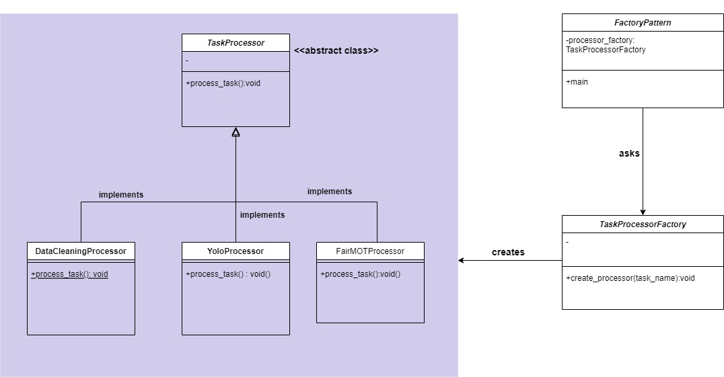
Progress update: Task Process
Implementation: On GitHub - IMAGEN_Backend/picas_client/pilotJob2.py

Slide 4



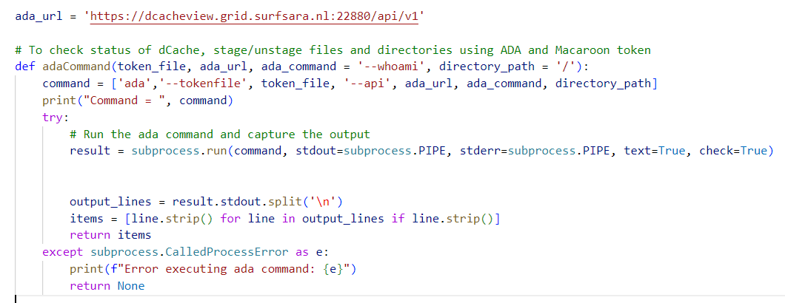
Progress update: Access to files and dir in dCache using ada and macaroon
ada
Implementation: On GitHub - IMAGEN_Backend/picas_client/scripts/data_archival.py

Slide 5
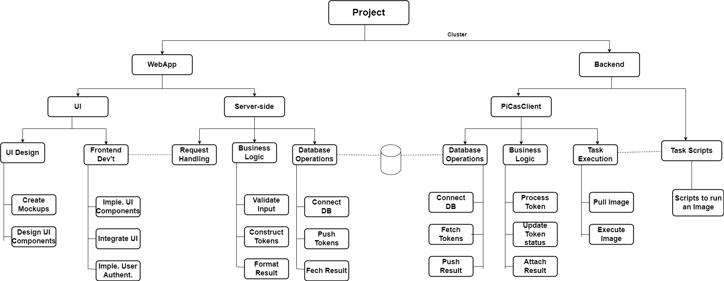
Progress update: Work breakdown structure (WBS)

Slide 6
Progress update: Work breakdown structure (WBS)

Slide 7
Progress update: Use cases
The following are the remaining tasks from WebApp and Backend
WebApp
Input data validation
User authentication (user roles)
Fetch result for specific task (depends on stakeholder needs)
File explorer to select files and dir from dCache using ada and macaroon
Backend
Prepare singularity images for tasks (models from Computer vision group)
Prepare different pilot jobs(depends on stakeholder needs)
Automate pilot job submission

Slide 8
Plan for next week
WebApp
Input data validation
User authentication (user roles)
Backend
Prepare singularity images for tasks (models from Computer vision group)

Slide 9
Project Plan and Milestones (Initial)
Milestone 1: Compatibility and shareability
Deliverable:
Demo: Run Data transfer, data cleaning, or Yolo images from repo
Short report (Guideline)
Deadline: Sep 29
Milestone 2: PiCas integration
Deliverables:
Demo: Run data cleaning or DL training(Yolo) tasks using PiCas
Deadline: Nov 30
Milestone 3: Web-application
Deliverable:
User interface (Front-end)
Server-side integration with CouchDB
Demo: How to submit and track tasks via UI
Deadline: Jan 30
Milestone 1
Milestone 2:
Prototype 1.0
Milestone 3:
Prototype 2.0
Initial draft
Second draft
Final presentation
July
August
September
October
November
December
January
February
March

Slide 10
Project Plan and Milestones (updated)
Milestone 1: Compatibility and shareability
Deliverable:
Prepare images for models (models of computer vision group)
Short report (Guideline)
Deadline: Jan 8
Milestone 2: PiCas integration
Deliverables:
Prepare different pilot jobs according to user needs
Automate (partly) pilot job submission
Deadline: Jan 30
Milestone 3: Web-application
Deliverable:
Complete remaining tasks
Deadline: Feb 15
Defense and
final presentation
Milestone 2
Milestone 3
Initial draft(thesis)
Milestone 1
Second draft(thesis)
October
November
December
January
February
March

Slide 11
Reminder
No GPU resource on spider
Send me your GitHub usernames

